Slide 1

InDepth Knockout Validation
Module 2: Basic Validation
Derik Whittaker
http://bit.ly/DerikWhittaker
derik@graudo.com
@DerikWhittaker
Notes:
Hello and welcome to Module 2 of InDepth Knockout Validation, I am your host Derik Whittaker.
This module kicks off our training of how to use the Knockout Validation library. We will go from 0 to 60 in learning how to use the basics of Knockout validation. The focus of this module will be 2 things, first learning how to set up our binding context in order to leverage the validation library. The 2nd will be how to use many of the validators which are built into the library.

Slide 2
Agenda
Validating your first observable
Using Required Validator
Working with Built In Validators
Using Min/Max Validators
Using Equal/Not Equal Validators
Using Min/Max Length Validators
Using Pattern (aka Regular Expression) Validator
Notes:
This module is going to be broken into 2 parts. The first part we will cover the basics needed to get knockout validation up and running and the 2nd part will cover many of the build in validators.
learn how to setup our binding context to hook into the validation library. We will also learn how to setup validation on our first observable. The validation rule we will be using will be the ‘required’ validator. The Required validator does exactly as the name implies, it will require that the bound observable is populated with some data
IN our first demo will
[show animation]
Now that we understand how to use the required validator we might as well spend some time taking a look at how to use some of the other built in validators. The next validators we will learn to use will be the min and max validators. These will ensure that our bound observable is not below or above the rule value.
[show animation]
The next 2 validators we will learn to use will be the equals and not equals validators. These can be used to ensure that our observable value is either equal to or not equal to our rule value.
[show animation]
The 3rd set of validators we will explore will be the min and max length validators. These 2 validators are used to ensure that a string value does not dip below a specified minimum length or exceed a maximum length
[show animation]
The last validator we will explore is the pattern validator. This validator leverages the power of regular expressions and can be used to perform pattern match validation on an observable.

Slide 4
Agenda
Creating Custom Validation Rules
Creating global or shared rules
Creating inline or anonymous rules
Validating Computed Observables
Performing Conditional Validations
Using HTML5 Validation Attributes
Notes:
Anytime we are working with a validation library we are going to run into the scenario when the built in validators simply do not meet our needs. When this occurs you will know you are using a quality validation library when you can easily inject your own rules into the library and go about your business.
Knockout validation will easily support you creating your own validation rules. IN fact this is supported in 2 different ways. You can either create and register a global rule, which means it can be used over and over. You also have the ability to create a simply inline rule, these rules are not globally registered and are not easily reusable.

Slide 5
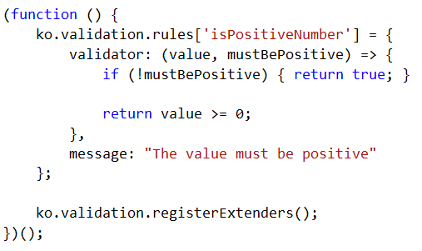
Custom Validators: Global Rule
Coding
Creating the Custom Rule
Notes:
[show animation]
First thing to point out when creating a custom validation rule is that you want to create this rule in a self executing function. The reason for this is that you need to register this rule within knockout validation and you want to do at prior to the HTML Dom being loaded and this will allow for this.
[show animation]
The next item to point out is how we are registering our rule within the library. We are going to call ko.validation.rules and add a new item to the collection. Because this is an array you need to make sure that the name you give your rule is unique or you will override an existing rule.
[show animation]
Once you have the rule registered you need to define the validator component of the rule, the part which actually performs the checking logic and the message part of the rule.
When setting up the validator you will have 2 parameters passed in.
[show animation]
The first parameter will be the value you will be checking, this is your bound value from your observable
[show animation]
The 2nd parameter will be the value you provided when you implemented your rule on your observable. In our case it will be a flag specifying if the value must be positive or not
[show animation]
One you have your rule setup it is time to implement the internal logic which does the rule comparison. In our case we are simply going to check to see if the provided value is greater than or equal to 0
[show animation]
Finally, once our validator is all setup we need to call ko.validation.registerExtenders. This will add our newly created rule to the knockout validation library so it can be used.

Slide 6
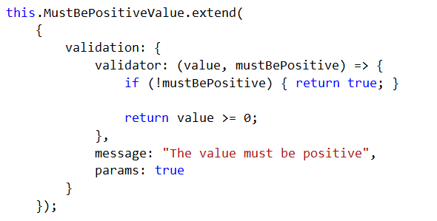
Custom Validators: Inline Rule
Coding
Creating the Inline Rule
Notes:
I mentioned that there were 2 ways in which you can create custom validation rules for knockout. The first is by creating and registering reusable rules the 2nd is by creating the rule inline. We have already seen how to create the reusable rule so lets learn about the inline rules.
If you look at code on the screen here you can see I have changed our isPositiveNumber rule and made it an inline rule.
[show animation]
When creating inline rule the first thing to understand is we going to use to be extending the observable.
[show animation]
Inside our extend call we are going to create anonymous object called validation, this validation object is going to house our validation implement logic and is almost exactly the same code as our reusable rules.
[show animation]
Inside our validation object we need to create 1 method and 2 properties as seen on screen. Our method will be for the validator logic and the properties are to house our message and our base comparison value.
[show animation]
The last thing we need to do is implement our validator, which in our case is the exact same syntax as before.

Slide 9
Summary
Validate our first observable
Used Required Validator
Learned to use the Built in Validators
Used Min/Max Validators
Used Equal/Not Equal Validators
Used Min/Max Length Validators
Used Pattern (aka Regular Expression) Validator
Notes:
This module was dedicated to providing you with enough knowledge to allow you to get up and running w/ the basics on how to use the Knockout validation library.
[show animation]
We started off by learning the basics. This included learning how to setup our bindings to allow for the knockout validation to work with our knockout bindings as well as learning how to use the required validator.
[show animation]
Once we understood how to use the required validator we moved on to learn about some of the other built in validators. The next validators we will learned to use was the min and max validators. These validators can be used to ensure that our observable is not above or below some predetermined value.
[show animation]
The next 2 validators we will learned to use were the equals and not equals validators. We learned these validators could be used to ensure that our observable value is either equal to or not equal to our rule value.
[show animation]
The 3rd set of validators we will explored was min and max length validators. These 2 validators can be used to ensure that a string value does not dip below a specified minimum length or exceed a maximum length
[show animation]
Finally we wrapped up the module by leaning how to use the pattern validator. We learned that this validator leverages the power of regular expressions and can be used to perform pattern match validation on an observable.

