Slide 1

InDepth Knockout Validation
Module 3: Advanced Validation
Derik Whittaker
http://bit.ly/DerikWhittaker
derik@graudo.com
@DerikWhittaker
Notes:
Hello and welcome to Module 3 of InDepth Knockout Validation, I am your host Derik Whittaker.
In this module we are going to shift focus from learning how to use some of the basic built in validation abilities of the framework and learn how to extend the framework to meet our custom needs.

Slide 2
Agenda
Creating Custom Validation Rules
Validating Computed Observables
Performing Conditional Validations
Using HTML5 Validation Attributes
Notes:
This module is going to be separated into 4 pieces.
First we will learn how to create our own custom validator. Having the ability to create a custom validator is critical as the basic built in ones will simply not satisfy all business needs. When learning to create our custom validators we will learn how to create global rules, these are rules which can be applied to any observable as well as inline rules. Inline rules are only available to their attached observable cannot be reused.
Once we understand how to create our own custom rule we will move on to learn how to perform validations against a computed observable. Computed observables are a bit different than standard observables because they are not attached to input fields. This means 2 things for us. 1st we must reference another observable inside our validator in order to get the validator to evaluate as data changes and 2nd if we want to display an error message to our user we will have to manually add our markup to displa the message.
We will next learn how to perform conditional validation of an observable. Having the ability to only have a validator fire based on some other value is very important because when building Line of business applications there are going to be caes that we only care about validation when a given piece of data is updated.
Finally we will end the module by learning how to perform validation by using the HTML 5 validation attributes. Using these attributes means we do not need to manually wire up the logic in our view model, but it does come w/ a cost which s that this solution will not work across all browsers or in all cases.

Slide 4
Agenda
Creating Custom Validation Rules
Creating global or shared rules
Creating inline or anonymous rules
Validating Computed Observables
Performing Conditional Validations
Using HTML5 Validation Attributes
Notes:
Anytime we are working with a validation library we are going to run into the scenario when the built in validators simply do not meet our needs. When this occurs you will know you are using a quality validation library when you can easily inject your own rules into the library and go about your business.
Knockout validation will easily support you creating your own validation rules. IN fact this is supported in 2 different ways. You can either create and register a global rule, which means it can be used over and over. You also have the ability to create a simply inline rule, these rules are not globally registered and are not easily reusable.

Slide 5
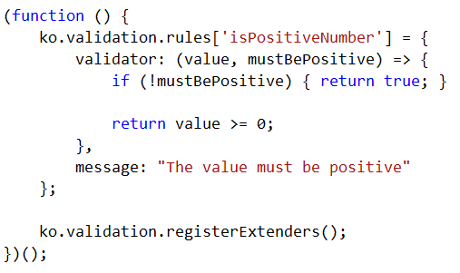
Custom Validators: Global Rule
Coding
Creating the Custom Rule
Notes:
First thing to point out when creating a custom validation rule is that you want to create this rule in a self executing function. The reason for this is that you need to register this rule within knockout validation and you want to do at prior to the HTML Dom being loaded and this will allow for this.
[show animation]
The next item to point out is how we are registering our rule within the library. We are going to call ko.validation.rules and add a new item to the collection. Because this is an array you need to make sure that the name you give your rule is unique or you will override an existing rule.
[show animation]
Once you have the rule registered you need to define the validator component of the rule, the part which actually performs the checking logic and the message part of the rule.
When setting up the validator you will have 2 parameters passed in.
[show animation]
The first parameter will be the value you will be checking, this is the value provided at runtime from your observable
The 2nd parameter will be the value you provided when you implemented your rule on your observable. In our case it will be a flag specifying if the value must be positive or not
[show animation]
One you have your rule setup it is time to implement the internal logic which does the rule comparison. In our case we are simply going to check to see if the provided value is greater than or equal to 0
[show animation]
Finally, once our validator is all setup we need to call ko.validation.registerExtenders. This will add our newly created rule to the knockout validation library so it can be used.

Slide 6
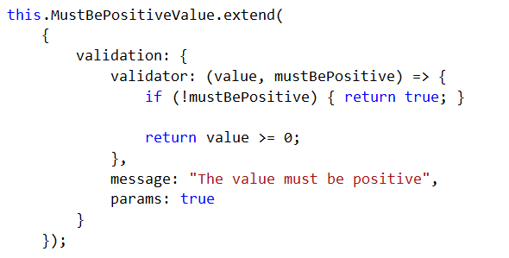
Custom Validators: Inline Rule
Coding
Creating the Inline Rule
Notes:
I mentioned that there were 2 ways in which you can create custom validation rules for knockout. The first is by creating and registering reusable rules the 2nd is by creating the rule inline. We have already seen how to create the reusable rule so lets learn about the inline rules.
If you look at code on the screen here you can see I have changed our isPositiveNumber rule and made it an inline rule.
[show animation]
When creating inline rule the first thing to understand is we going to use to be extending the observable.
[show animation]
Inside our extend call we are going to create anonymous object called validation, this validation object is going to house our validation implement logic and is almost exactly the same code as our reusable rules.
[show animation]
Inside our validation object we need to create 1 method and 2 properties as seen on screen. Our method will be for the validator logic and the properties are to house our message and our base comparison value.
[show animation]
The last thing we need to do is implement our validator, which in our case is the exact same syntax as before.

Slide 8
Agenda
Creating Custom Validation Rules
Creating global or shared rules
Creating inline or anonymous rules
Validating Computed Observables
Create the required validator
Register and Attach to the Computed
Performing Conditional Validations
Using HTML5 Validation Attributes
Notes:
One of the great features which Knockout provides is the ability to have computed observables. These observables allow us to monitor other observables and have their logic re-executed each time a monitored observable is updated. Because these computed values may be contain business logic it only makes sense that we should be able to validate that their value is correct and of course we can when using the knockout validation library.
Setting up the ability to validated a computed is really not much different than validating an observable with one small difference. Because computed fields are not bound to HTML input elements we are going to have to do a bit of additional work to get our error message to displayed to our user.

Slide 9

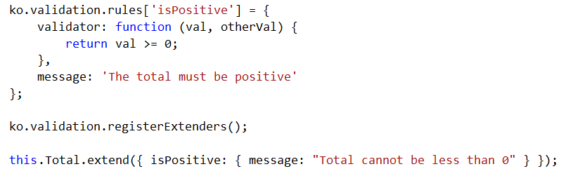
Validating Computed Observables
Coding
Creating the Computed Observable
Setup the Validation
Typical Custom Validator
Notes:
On the screen you should see logic which looks very failure to you, this is the typical setup for a computed observable.
[show animation]
Pay attention that inside my computed I am monitoring both the Value 1 and Value 2 observables, this means that each time either of these are updated my computed will be re-evaluated and a value returned. This also means that each time either value is updated my validation logic will be evaluated.
[show animation]
Once we have our computed setup we now want to define our validation rule
[show animation]
This validation rule follows the same pattern as we have seen before when creating custom rules, which is great as it means computed observables can use the same validators as non-computed observables
[show animation]
Because we created this custom validator we do need to ensure we register the rule w/in knockout validation so it can be used
[show animation]
Last thing we need to do is wire this validator to our computed. We will use the standard extends syntax to accomplish this, so again there is nothing different between computed observables and observables

Slide 11
Agenda
Creating Custom Validation Rules
Creating global or shared rules
Creating inline or anonymous rules
Validating Computed Observables
Create the required validator
Register and Attach to the Computed
Performing Conditional Validations
Using HTML5 Validation Attributes
Notes:
Having the ability to validate an observable is great, but there will be cases when you only want to validate the observable under certain conditions. When using the knockout validation library this is easily supported by using the OnlyIf parameter in our validatores.
The onlyIf parameter will allow you to provide a method to be evaluated in order to determine if the validator should be used. If the results of this method is true the validator will be applied and if it is false it will not be applied

Slide 12
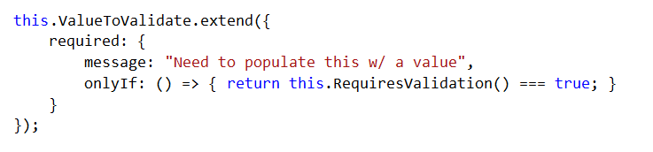
Conditional Validation
Coding
Implementing the Validator
Typical validator
syntax
Notes:
Adding the ability to make a validator conditional means we need to start off w/ our typical validator binding logic as seen here
[show animation]
The next thing we need to do is add the onlyIf parameter. This is the parameter needed in order to make a validator conditional. I will warn you that for this to work make sure you have the casing of the parameter correct otherwise it will nt work and no errors will be provided.
[show animation]
Once we have our onlyIf parameter declared we need to create some method which performs an evaluation and returns either true or false. The resulting value from this method will be used to determine if the validator will be used or not. It is important to note that you will want to reference another observable in your method in order to have this expression evaluated when other values are updated.

Slide 14
Agenda
Creating Custom Validation Rules
Creating global or shared rules
Creating inline or anonymous rules
Validating Computed Observables
Create the required validator
Register and Attach to the Computed
Performing Conditional Validations
Using HTML5 Validation Attributes
Notes:
To this point all the validators we have used have either been created by us or have been one of the built in validators. All of our validators have also been manually wired to our observables inside our view model.
Although this is the preferred because it will work across all browsers, the knockout validation library does offer the ability to use HTML 5 validation attributes. Right now I would consider the use of HTML 5 attributes as experimental because not all browsers support them as well as the fact that for this course I am using a non-mainline version of knockout validation. I am using the non-mainline version because the pull request to support HTML5 attributes has not been accepted at the time of this recording

Slide 15
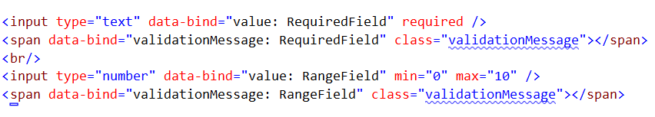
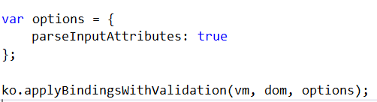
HTML 5 Validation
Coding
Implementing HTML 5 Validators
Configuring Knockout Validation
Enables the HTML 5 validation
Notes:
In all our other examples we have needed to use the view model in order to wire up our validators. When using the HTML5 validators this need goes away, all our logic will be here inside our markup on the screen.
[show animation]
The first thing we need to do is add the needed HTML5 attributes to each input we want to validate. In our example I am using the Required validator for one field and the min/max validators for another field.
[show animation]
Once we have our attributes added we need to make sure we add our span elements. We have to manually add these elements because the validation library will not inject them at runtime when using the HTML5 attributes.
[show animation]
Once we have our markup complete we do need to make one small change to our knockout validation configuration.
[show animation]
We need to specify to the library that we want to parse the input attributes as this is not enabled by default.
Once we have our configuration complete we are done w/ out setup.

Slide 17
Summary
Created Custom Validation Rules
Created both Global and Inline rules
Validated Computed Observables
Created our rule and attached it.
Performed Conditional Validation
Leaned to use the OnlyIf parameter
Learned to use the HTML 5 Attributes
Learned how to configure and implement
Notes:
This module was dedicated to showing you some of the advanced sides to knockout validation.
[show animation]
We started off by learning how to create custom rules which can be used to validate an observable. We learned how we can create global rules which can be reused by any observable as well as how to create inline rules which are not able to be shared.
[show animation]
We then moved on to learn how we can validate that a computed observable is producing a correct value. We learned the validating a computed observable is not too different from a normal observable with the exception that we have to manually provide the markup for the error message to be displayed
[show animation]
After this we moved on to learn how we can use the OnlyIf parameter on a validator to perform conditional validation. Conditional validation is powerful as it allows you to have your data validated based on dynamic business needs w/ little effort.
[show animation]
Finally we ended this module by learning how to leverage the built in HTML 5 validation attributes to perform our validation. Although this method is simple, we learned that it is not fully ready for primetime as not all browser support these attributes as well as the fact that the validation library is not quite complete when it comes to html5 validation.

