Slide 1
Presenters: Alexander Gaskins and Nikola Ciric
Buck-Boost Converter

Slide 2
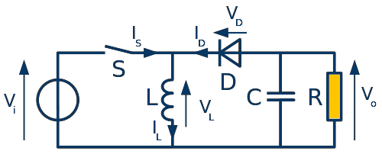
What is a Buck-Boost Converter?
Used for DC-DC conversion
Can provide step-up or step-down in voltage magnitude

Slide 3
The Objective
Case I:
Design a functional buck converter
Case II:
Implement a boost converter
Final:
Optimize both outputs

Slide 4
Emphasis on PID Tuning
Proportional
Depends only on the difference between the set point and the process variable
This difference is referred to as the Error term
Proportional gain determines the ratio of output response to the error signal
Integral
Sums the error term over time
Even small error magnitudes to slowly increase the integral component
Drive the steady state error to zero to prevent integral response from continuously increasing over time
Derivative
Causes the output to decrease if the process variable is increasing rapidly
Proportional to the rate of change of the process variable
Feedback noise can cause the derivative response to make the system unstable

Slide 5
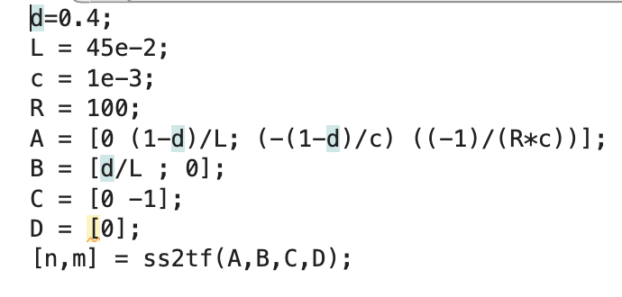
MatLab Code:

Slide 6
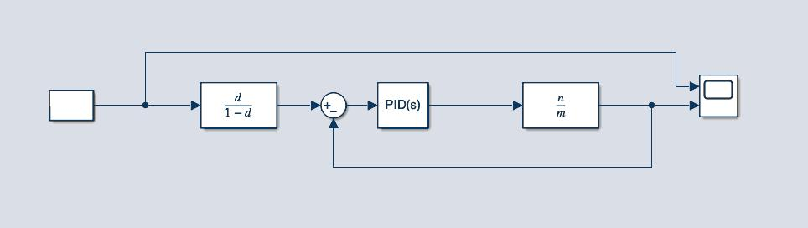
Problems Faced
Attempted to estimate using a transfer function, but to no avail, as the system is nonlinear
Struggled to optimize Case I and II using the same PID values

Slide 7
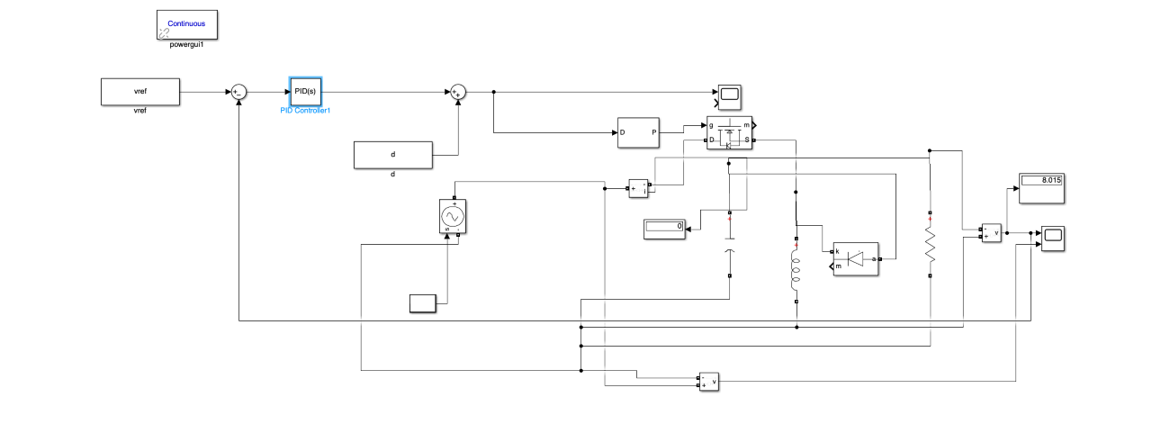
Simulink Model

Slide 8
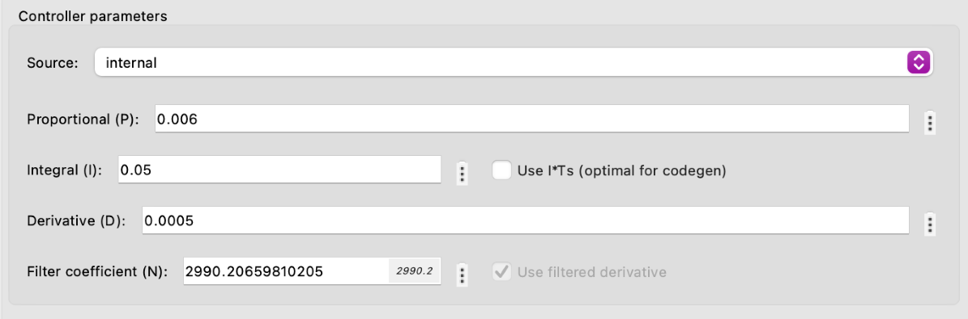
The following PID inputs produced the best results:
Values acquired through a tedious trial and error process

Slide 9
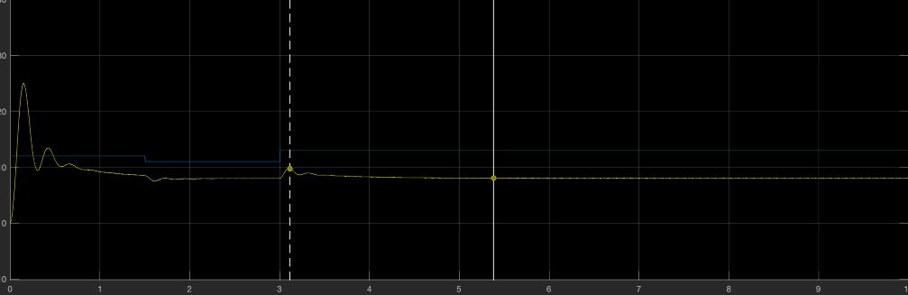
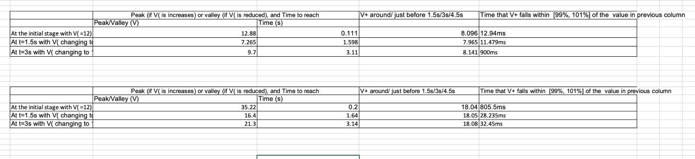
Buck Optimization

Slide 10
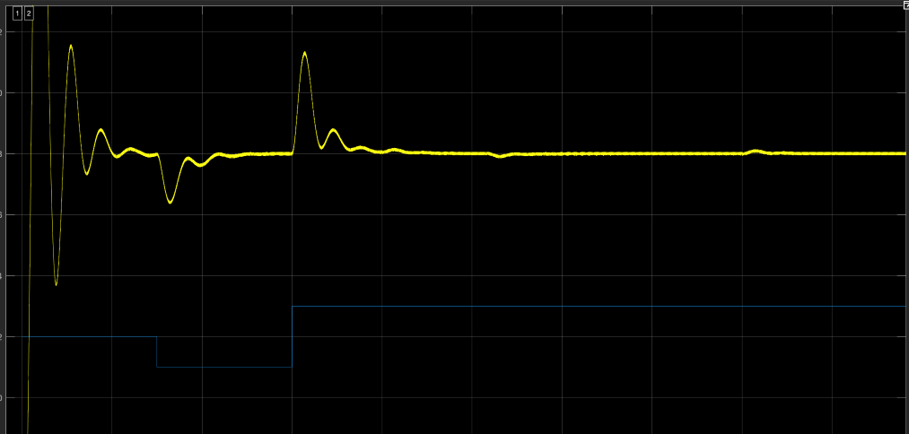
Boost Optimization

Slide 11

The Verdict
Smaller PID values allow for a reduction in overshooting in both cases
Boost converter required much smaller Integral and Derivative values to improve asymptotic stagnation
Increasing and decreasing Integral and Derivative values made a greater difference than Proportionality

Slide 12
Thank You
Questions?

