Slide 1
Software System Modeling & Design
by Junhui Liu
School of Software
Yunnan University

Slide 2
Bibliography
Applying UML and Patterns: An Introduction to Object-Oriented Analysis and Design and the Unified Process (3nd Edition)
  Craig Larman
UML面向对象建模与设计（第2版）
  James Rumbaugh, Michael Blaha
  人民邮电出版社

Slide 3


参考书籍
●
●
参考书籍
1. 重点大学计算机专业系列教材
《UML与软件建模》
徐宝文等 编著
清华大学出版社
2006.1
2.《面向对象技术UML教程》
王少峰编著
清华大学出版社

Slide 4
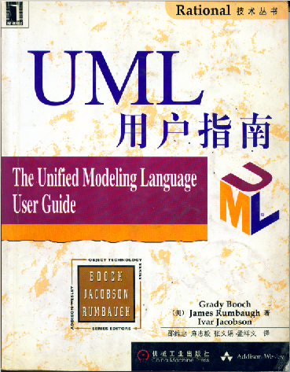

●
●
参考书籍
参考书籍
3.《UML用户指南》
Booch, Rumbaugh, Jacobson著
邵维忠等译
机械工业出版社
4.《Rational Rose 2003教程》
刘敏莺等编著
冶金工业出版社

Slide 5
Schedule
Introduction UML, OOAD, RUP.
UML core elements, UML core diagrams, UML core models.
Business Modeling, System Modeling, Analysis and design modeling, Implementation modeling
Thinking in practice
Notes:
在实践中思考

Slide 6
Accomplishment Evaluation
Teaching methods
  Lectures, class discussion, group reports, practice
Examinations
  Midterm: Examination
  Final: Examination
Score
  10%,20%(mid-term),70%(final exam)

Slide 7
Contact Me
QQ: 49873077
Email: HanksLau@foxmail.com
Interview: Science Hall 301

