Slide 1
Principles of Visual Modeling

Slide 2
Objectives
Describe the importance of visual modeling and the role of Model Driven Architecture.
Define the four principles of visual modeling.
Explain what the Unified Modeling Language (UML) represents.
Define the type of process that best relates to the UML.
Notes:
Introduce the objectives for this module.

Slide 3

Where Are We?
What is modeling?
Four principles of visual modeling
The UML
Process and visual modeling
Notes:
Explore the student’s knowledge of modeling.

Slide 4
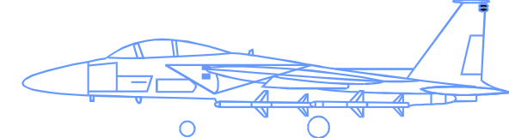
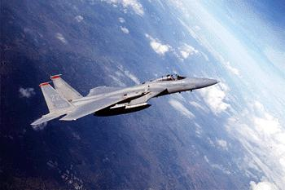
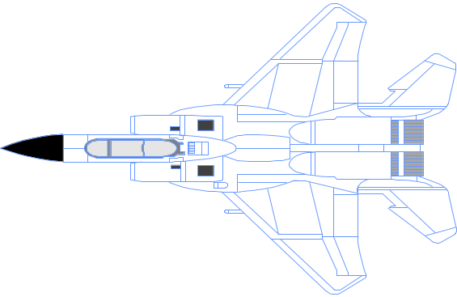

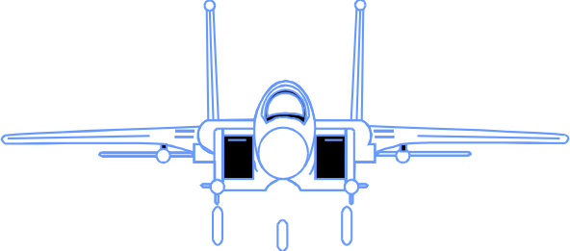
What Is a Model?
A model is a simplification of reality.
Notes:
Define what is meant by the term “model.”

Slide 5
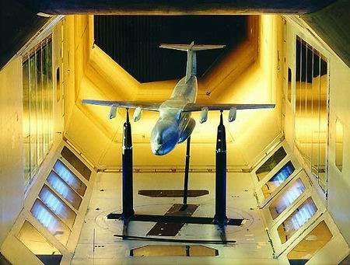
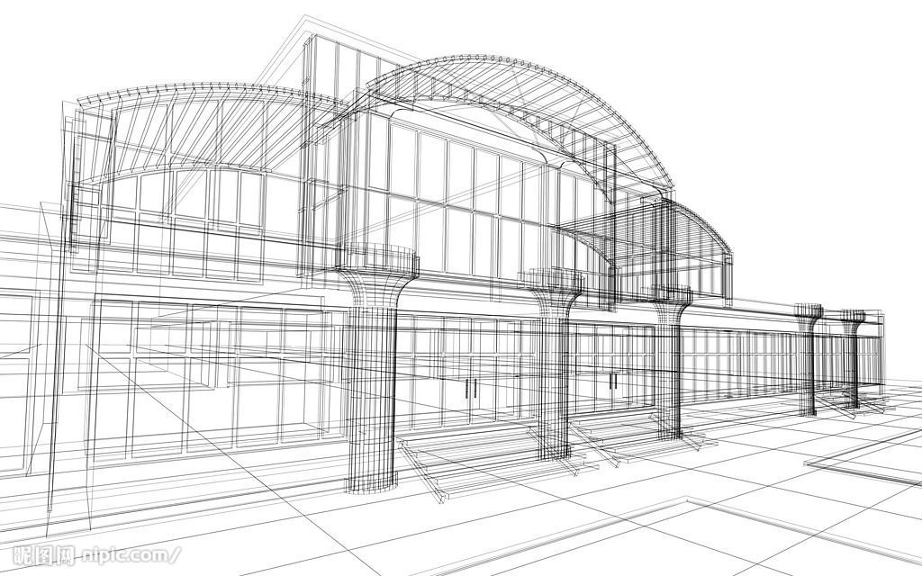
The core values ​​of the model
Model Assisted Analysis and Design
Model for a low price and can be tested
Model omitted specific function but details

Slide 6
Why Model?
Modeling achieves four aims:
  Helps you to visualize a system as you want it to be.
  Permits you to specify the structure or behavior of a system.
  Gives you a template that guides you in constructing a system.
  Documents the decisions you have made.
You build models of complex systems because you cannot comprehend such a system in its entirety.
You build models to better understand the system you are developing.
Notes:
Sell the students on the value of visual modeling.
Clarify that you are discussing formal modeling, not modeling written on a white board or on the back of a napkin at lunch.

Slide 7
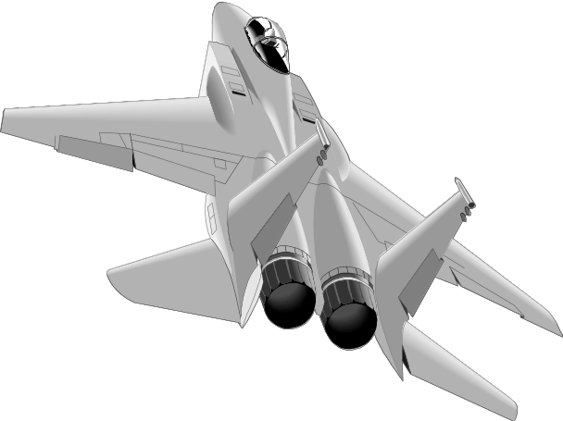

The Importance of Modeling
Less Important
More Important
Paper Airplane
Fighter Jet
Notes:
Emphasize that complex projects outside of the software industry require models.
It’s inconceivable that a defense contractor would build an airplane as complex as a fighter jet without modeling the airplane first. Why? Because unlike building paper airplanes, the cost of failure is significant.
As a general rule, modeling becomes more important as the complexity and expense rises.

Slide 8
Software Teams Often Do Not Model
Many software teams build applications approaching the problem like they were building paper airplanes
  Start coding from project requirements
  Work longer hours and create more code
  Lacks any planned architecture
  Doomed to failure
Modeling is a common thread to successful projects
Notes:
Point out that a major problem with software development is that we often fail to model complex systems before construction.
Software engineering is an engineering discipline.
Why is it that so many of our projects don’t use models like other engineering disciplines such as electrical, civil, and so on?
Would anyone work in a high rise that was put together without the benefit of a well thought- out design?
Would you drive an automobile that had not been modeled first?
Ask the class why they think that software teams don’t always model.
Note these ideas and address them through the course.

Slide 9
Where Are We?
What is modeling?
Four principles of visual modeling
The UML
Process and visual modeling
Notes:
Transition to the next subject.

Slide 10
Four Principles of Modeling
The model you create influences how the problem is attacked.
Every model may be expressed at different levels of precision.
The best models are connected to reality.
No single model is sufficient.
Notes:
Demonstrate that there are guiding principles for visual modeling. It is not chaotic activity.
The four modeling principles are described in detail on the next four slides.
See the “UML User Guide” for a more detailed discussion on these four principles.

Slide 11
Principle 1: The Choice of Model is Important
The models you create profoundly influence how a problem is attacked and how a solution is shaped.
  In software, the models you choose greatly affect your world view.
  Each world view leads to a different kind of system.
Process Model
Deployment Model
Design Model
Notes:
Remind students that each model should reflect the problem that they are trying to solve.
The model of a system comprises many different views of that system.
Refer students to the “Architectural Blueprints -The 4+1 View of Software Architecture” by Phillipe Kruchten. You can find the white paper at http://www-306.ibm.com/software/rational/info/literature/design.jsp.
Discuss the views later in this module.
Supplement this slide with the following example. To build a home, you would use different models to resolve structural and electrical problems.

Slide 12
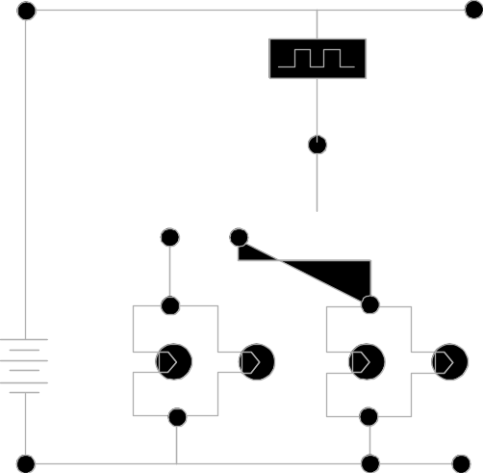
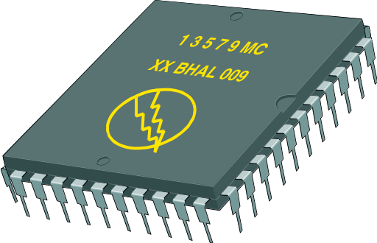
Principle 2: Levels of Precision May Differ
Every model may be expressed at different levels of precision.
  The best kinds of models let you choose your degree of detail, depending on:
    Who is viewing the model.
    Why they need to view it.
View for Customers
View for Designers
Notes:
Remember, there are many different ways to view a model of a solution.
Again, point out that there is no one mega-model that displays everything about a system.
Additional examples from building a home may include examples that the homebuyer may be interested only in the elevation and the floor plan.
Obviously, the construction foreman is going to need a more detailed view of the home.

Slide 13
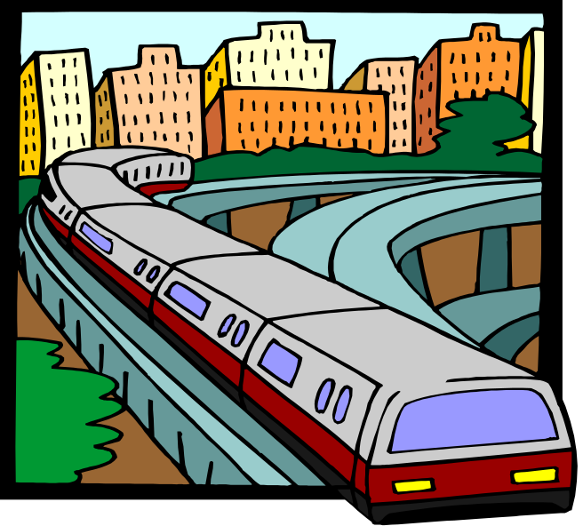
Principle 3: The Best Models Are Connected to Reality
All models simplify reality.
A good model reflects potentially fatal characteristics.
Notes:
A model should accurately reflect the real world.

Slide 14
Principle 4: No Single Model Is Sufficient
No single model is sufficient. Every non-trivial system is best approached through a small set of nearly independent models.
  Create models that can be built and studied separately, but are still interrelated.
Logical View
Implementation View
Analysts/Designers
Programmers
Structure
Software management
Use-Case View
End-user
Functionality
Process View
Deployment View
System engineering
System integrators
System topology, delivery,
installation, communication
Performance, scalability, throughput
Notes:
Many interrelated models are needed to accurately describe a system.
Introduce the 4+1 views of architecture first.
It’s important that they understand from the beginning that the models created/read represent a specific view of the system.

Slide 15
Where Are We?
What is modeling?
Four principles of visual modeling
The UML
Process and visual modeling

Slide 16

What Is the UML?
The UML is a language for
    Visualizing
    Specifying
    Constructing
    Documenting
the artifacts of a software-intensive system.
Notes:
Introduce the UML. Remember many of your students have no idea what the UML really is.
The next four slides explain how the UML is a language for visualizing, specifying, constructing and documenting.

Slide 17
Unified Modeling Language (UML)
Standard OOA&D modeling notation
Uses model-driven approach
  Enables creation of graphical models of the system requirements and system design
Components include
  Class diagrams
  Use Case diagrams
  Sequence diagrams
  State charts
  …

Slide 18
Visual Modeling with the Unified Modeling Language
Static Diagrams
Class
Diagrams
Use-Case
Diagrams
Sequence
Diagrams
Object
Diagrams
Communication
Diagrams
Component
Diagrams
Models
Dynamic Diagrams
State Machine
Diagrams
Deployment
Diagrams
Activity
Diagrams
Notes:
The UML provides a graphical language for representing models but provides little or no guidance on when and how to use these diagrams. This is an area in which the RUP helps. It describes the kinds of project artifacts needed, including diagrams, and puts them in the context of an overall project plan.

Slide 19
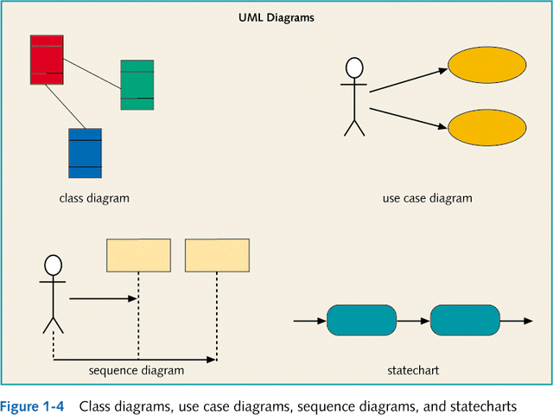

Slide 20
The UML Is a Language for Visualizing
Communicating conceptual models to others is prone to error unless everyone involved speaks the same language.
There are things about a software system you can’t understand unless you build models.
An explicit model facilitates communication.
Notes:
Stress how the UML is designed to promote communication using pictures rather than text.
Using the UML allows the “light bulb” to go on in the minds of many people. Rather than trying to interpret a textual description of a system design, the UML offers a graphical representation of that same description.
In this case, a picture is truly worth a thousand words.

Slide 21
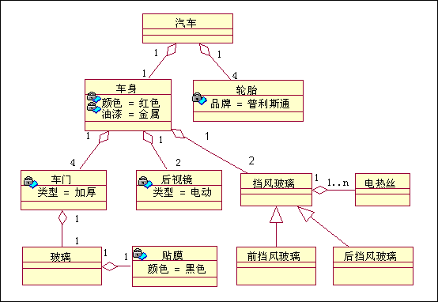
UML description of the car

Slide 22
The UML Is a Language for Specifying
The UML builds models that are precise, unambiguous, and complete.
Notes:
The UML can be used to specify detailed or general models.
Anyone who has worked on a project where miscommunication occurred appreciates this feature of the UML.
The UML allows the modeler to specify their intentions in a clear, unmistakable manner.

Slide 23
The UML Is a Language for Constructing
UML models can be directly connected to a variety of programming languages.
  Maps to Java, C++, Visual Basic, and so on
  Tables in a RDBMS or persistent store in an OODBMS
  Permits forward engineering
  Permits reverse engineering
Notes:
The UML was designed with forward and reverse engineering in mind.
Rational has partners who provide round-trip engineering for other languages.

Slide 24
The UML Is a Language for Documenting
The UML addresses documentation of system architecture, requirements, tests, project planning, and release management.
Use Case Diagram
Deployment Diagram
- À©µµ¿ì 95 : Å¬¶óÀÌ¾ðÆ®
ºÐ»ê È¯°æÀÇ ÇÏµå¿þ¾î¹× ³×Æ®¿÷À¸·ÎÀÇ Á¤º¸ ½Ã½ºÅÛ ¿¬°á ¸ðµ¨
- À©µµ¿ì NT: ÀÀ¿ë¼­¹ö
- À¯´Ð½º ¸Ó½Å: ÀÀ¿ë ¼­¹ö ¹× µ¥ÀÌÅ¸ ¼­¹ö, Åë½Å ¼­¹ö
- IBM ¸ÞÀÎÇÁ·¹ÀÓ: µ¥ÀÌÅ¸ ¼­¹ö, Åë½Å ¼­¹ö
Use Case 1
Window95
Windows95
Windows95
¹®¼­°ü¸®
Å¬¶óÀÌ¾ðÆ®.EXE
Windows
¹®¼­°ü¸® ¾ÖÇÃ¸´
Actor A
Use Case 2
Actor B
NT
Solaris
¹®¼­°ü¸® ¿£Áø.EXE
Alpha
Windows
ÀÀ¿ë¼­¹ö.EXE
UNIX
Use Case 3
NT
IBM
Mainframe
µ¥ÀÌÅ¸º£ÀÌ½º¼­¹ö
mainWnd
fileMgr :
document :
gFile
repository
FileMgr
DocumentList
Document
user
FileMgr
Document
add( )
name : int
fetchDoc( )
delete( )
docid : int
Æ¯Á¤¹®¼­¿¡ ´ëÇÑ º¸±â¸¦
1: Doc view request ( )
sortByName( )
get( )
numField : int
read() fill the
»ç¿ëÀÚ°¡ ¿äÃ»ÇÑ´Ù.
open( )
code..
2: fetchDoc( )
close( )
FileList
fList
read( )
sortFileList( )
3: create ( )
add( )
create( )
fillDocument( )
delete( )
1
4: create ( )
5: readDoc ( )
1
È­ÀÏ°ü¸®ÀÚ´Â ÀÐ¾î¿Â
6: fillDocument ( )
¹®¼­ÀÇ Á¤º¸¸¦ ÇØ´ç ¹®¼­
°´Ã¼¿¡ ¼³Á¤À» ¿äÃ»ÇÑ´Ù.
7: readFile ( )
Repository
rep
File
8: fillFile ( )
(from Persistence)
read( )
GrpFile
È­¸é °´Ã¼´Â ÀÐ¾îµéÀÎ
9: sortByName ( )
name : char * = 0
°´Ã¼µé¿¡ ´ëÇØ ÀÌ¸§º°·Î
º¸¿©ÁØ´Ù.
Á¤·ÄÀ» ½ÃÄÑ È­¸é¿¡
readDoc( )
read( )
readFile( )
open( )
create( )
fillFile( )
Sequence Diagram
Class Diagram
Notes:
UML diagrams should be treated as formal project artifacts.
Each diagram created by a project team should be treated as an artifact.
The UML can help alleviate some of the paper crunch that many software teams experience.

Slide 25

History of the UML
UML 2.0
(2004)
UML 1.5
(March, ‘03)
UML
Partners’
Expertise
UML 1.1
(Sept. ‘97)
UML 1.0
(Jan. ‘97)
UML 0.9
(June ‘96)
and
UML 0.91
(Oct. ‘96)
Public
Feedback
Unified Method 0.8
(OOPSLA ’95)
Booch ’93
OMT - 2
OOSE
Other
Methods
Booch ‘91
OMT - 1

Slide 26
Where Are We?
What is modeling?
Four principles of visual modeling
The UML
Process and visual modeling

Slide 27


A Language Is Not Enough to Build a System
Team
-
Based
Development
Modeling
Unified
Language
Process
Notes:
Emphasize here that the UML was not designed to stand alone, a process is also needed.
This slide establishes the need for more than the UML.
Some students may think that, if they know the UML, they’re done. They don’t need a process.
Establish that the UML, while a good and necessary first step, is not enough.
Just knowing the UML would be analogous to learning English by using a dictionary. Sure, all the words are there, but you still need to understand how the English language is structured before one can effectively speak.

Slide 28
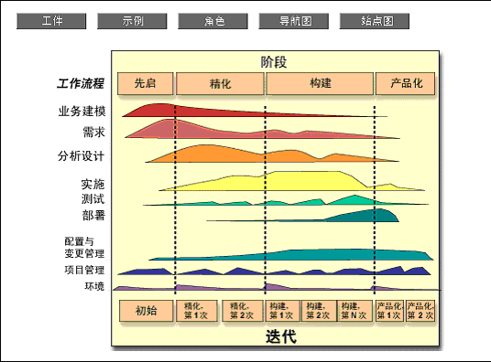
RUP

Slide 29
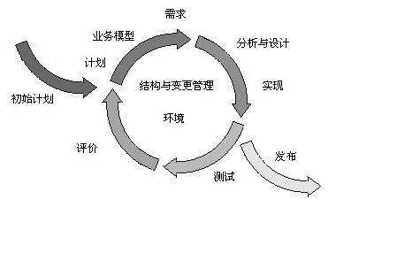
Spiral ascending development

Slide 30
What Type of Process Most Benefits the UML?
The UML is largely process independent. A process fully benefits from the UML when the process is:
  Use-case driven
  Architecture centric
  Iterative and incremental
Notes:
UML designers had a specific type of process in mind when the UML was first built.

Slide 31
A Use-Case Driven Process
Use cases defined for a system are the basis for the entire development process.
Benefits of use cases:
  Concise, simple, and understandable by a wide range of stakeholders.
  Help synchronize the content of different models.
Check Balance
Customer
Withdraw Money
Notes:
Use cases are the cornerstone of the type of process that works best with UML. UML diagrams can be used to model a use case.
Use cases are defined later in the course.

Slide 32
An Architecture-Centric Process
A system’s architecture is used as a primary artifact for conceptualizing, constructing, managing, and evolving the system under development.
Benefits:
  Intellectual control over a project to manage its complexity and to maintain system integrity.
  Effective basis for large-scale reuse.
  A basis for project management.
  Assistance in component-based development.
Notes:
Architecture should drive the design rather than the other way around. UML diagrams allow you to reflect this.
The “DEV475 Mastering Object-Oriented Analysis and Design with UML 2.0” course explores this topic in detail.

Slide 33
An Iterative and Incremental Process
Critical risks are resolved before making large investments.
Initial iterations enable early user feedback.
Testing and integration are continuous.
Objective milestones focus on the short term.
Progress is measured by assessing implementations.
Partial implementations can be deployed.
Notes:
Design the system in small digestible pieces. UML diagrams can enable one to design in an iterative fashion.
Developing iteratively means developing in small pieces that we call use-case realizations.

Slide 34
Iterative Development
Iteration 1
Iteration 2
Iteration 3
R
R
R
D
D
D
C
C
C
I
I
I
T
T
T
T I M E
Earliest iterations address greatest risks.
Each iteration produces an executable release, an additional increment of the system.
Each iteration includes integration and test.
Notes:
Define iterative development for the students. It is not necessary to go into great detail at this time. The Mastering Object-Oriented Analysis and Design with UML class discusses this topic.
In the iterative approach, the waterfall is applied to a single increment of the system at a time. Each iteration produces an executable.
Verify that the waterfall concept is understood by the students.

Slide 35

Review
What is a model?
What are the four principles of modeling? Describe each one.
What is the UML? Describe each of its four benefits.
What process characteristics best fit the UML? Describe each characteristic.
What is an iteration?
Notes:
Check to see if the students comprehended the material.
A. A model is a simplification of reality.
B. The three viewpoints of MDA are: (1) CIM – focus is on environment and requirements; (2) PIM – focus is on system operation, independent of the platform; (3) PSM – focus is on detailed usage on specific platform.
C. The four principles of modeling are: (1) The models you create profoundly influence how a problem is attacked and how a solution is shaped; (2) Every model may be expressed at different levels of precision; (3) The best models are connected to reality; (4) No single model is sufficient.
D. The UML is a language for visualizing, specifying, constructing, and documenting the artifacts of a software-intensive system.
E. The UML is largely process independent but consider a process that is: use-case driven, architecture-centric, and iterative and incremental.
F. An iteration encompasses the development activities that lead to a product release - a stable, executable versions of product, together with any other peripheral elements necessary to use this release.

