Slide 1
Use-case Model: Writing Requirements In Context

Slide 2
Main Points
Use-Case Modeling
Actors
Use Case
Relationship
Steps to write a use case
Three main types of use cases
Case Study

Slide 3
What Is a Use-Case Model?
A model that describes a system’s functional requirements in terms of use cases
A model of the system’s intended functionality (use cases) and its environment (actors)
View Report Card
Register for Courses
Student
Login
Notes:
Use this slide to begin a discussion regarding actors and use cases.
You might describe a Use-Case Model as a menu. The person can place themselves in a role (actor) and see the options available to them on this system.
A Use-Case Model does not imply the order that use cases will execute.
Disclaimer: Login is a controversial use case. The goal of this course is not to determine when/how/why one should use the Login use case, it is part of the OOAD curriculum so that instructors can have a short use case to demonstrate exercises. It is only here for instructional purposes.

Slide 4
Use Case Diagrams
The UML provides use case diagram notation to illustrate the names of use cases, actors, and the relationships between them

Slide 5
Major Concepts in Use-Case Modeling
An actor represents anything that interacts with the system.
A use case is a sequence of actions a system performs that yields an observable result of value to a particular actor.
Actor
Use Case
Notes:
This is a good place to remind students that in UML 2, actors are usually named and to put the name of the use case in the icon when space permits.

Slide 6
Use Case Diagram (a Library System)
Reserve book
Browse
Borrow copy of book
Book Borrower
Browser
Return copy of book
Extend loan
Update Catalog
Borrow Journal
Librarian
Journal Borrower
Return Journal

Slide 7
Main Points
Use-Case Modeling
Actors
Use Case
Relationship
Steps to write a use case
Three main types of use cases
Case Study

Slide 8
Actors
An actor is anything with behavior, including the system under discussion itself when it calls upon the services of other systems.
Primary and supporting actors will appear in the action steps of the use case text.
Actors are not only roles played by people, but organizations, software, and machines.

Slide 9
Type of Actors
Primary actor has user goals fulfilled through using services of the system.
For example, the cashier.
Supporting actor provides a service (for example, information) to the system. Often a computer system, but could be an organization or person.
For example, the automated payment authorization service
Offstage actor has an interest in the behavior of the use case, but is not primary or supporting
For example, a government tax agency.

Slide 10


Actor Stereotype
Business Actor
Business Worker

Slide 11
Identifying Actors
When developing a use case model, identify the different roles played by the potential human users of the system
People play different roles at different times
E.g. A person can play the role of book borrower, librarian, browser or journal borrower at different times
Any person who interacts with the system will be represented by at least one actor in use case model
Typical Actors:
Roles that people play
Computer systems
Electrical or mechanical devices

Slide 12
Actor Stakeholder User Role

Slide 13
Main Points
Use-Case Modeling
Actors
Use Case
Relationship
Steps to write a use case
Three main types of use cases
Case Study

Slide 14
What is use case?
Use Cases are to discover and record functional requirements.
A use case captures a contract between the stakeholders of a system about its behavior.
The use case describes the system’s behavior under various conditions as it responds to a request from one of the stakeholders, called the primary actor.
A Use Case is a collection of related success and failure scenarios that describe actors using a system to fulfill (or support) a goal.
A scenario is a specific sequence of actions and interactions between actors and the system under discussion.

Slide 15
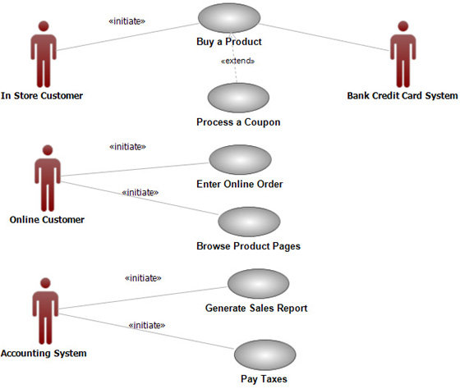
Use case = “Story”
Writing use cases—stories of using a system—is an excellent technique to understand and describe requirements.

Slide 16
Use Cases and Functional Requirements
Use cases are requirements (not all requirements).
Primarily they are functional requirements that indicate what the system will do. Use cases define a promise or contract of how a system will behave.
Use cases provide a structured way to help with requirements capture
Identify the actors
Find out what actors need from the system
Find out any other interactions the actors expect to have with the system

Slide 17
Use Cases
Use cases document system behavior from point of view of the user

Slide 18
Goals and Brief Format Use Cases
Customers and end users have goals (needs/requirements) and want computer systems to help meet them. The goals are primarily the starting point of finding out use case
Brief format Use cases are a mechanism to help keep it simple and understandable for all stakeholders.
Informally, they are stories of using a system to meet goals.
Here is an example brief format use case:
Process Sale: A customer arrives at a checkout with items to purchase. The cashier uses the POS system to record each purchased item. The system presents a running total and line-item details. The customer enters payment information, which the system validates and records. The system updates inventory. The customer receives a receipt from the system and then leaves with the items.

Slide 19
Use Case
The name of a Use Case should be the main goal of the Use Case.
Use cases are fundamentally a text form, although they can be written using graphic form.
In UML use-case diagrams, a use case is rendered as an ellipse.
Process Loan

Slide 20
UC Names
Every use case must have a name that distinguishes it from other use cases.
Rules of naming Use Case:
Verb + Noun
Place Order
Validate User

Slide 21
Business Use Case
Business use cases are less commonly written. If done, they are created in the Business Modeling discipline as part of a large-scale business process reengineering effort, or to help understand the context of a new system in the business.
Business use case describes a sequence of actions of a business as a whole to fulfill a goal of a business actor (an actor in the business environment, such as a customer or supplier).
For example, in a restaurant, one business use case is
Serve a Meal.

Slide 22
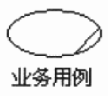
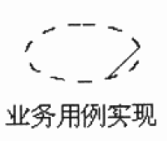
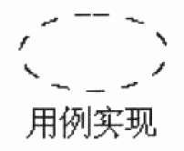
Use Case Stereotype
Business use case
Business use case realization
Use case realization

Slide 23
UC Characteristics
用例是相对独立的；
用例的执行结果对参与者来说是可观测的和有意义的；

Slide 24
UC Characteristics
这件事必须由一个参与者发起。不存在没有参与者的用例，用例不应该自动启动，也不应该主动启动另一个用例；
用例必然是以动宾短语形式出现的；

Slide 25
UC Characteristics
一个用例就是一个需求单元，分析单元，设计单元，开发单元，测试单元，甚至部署单元；

Slide 26
How to Find Use Cases
1. Choose the system boundary. Is it just a software application, the hardware and application as a unit, that plus a person using it, or an entire organization?
2. Identify the primary actors. Those that have user goals fulfilled through using services of the system.
3. For each, identify their user goals. Raise them to the highest user goal level that satisfies the EBP guideline.
4. Define use cases that satisfy user goals; name them according to their goal. Usually, user goal-level use cases will be one-to-one with user goals, but there is at least one exception, as will be examined.

Slide 27
Identifying Use Cases
Actor-Based Approach:
Identify actors related to a system or organization
Then, for each actor, identify the process they initiate or participate in
Event-Based Approach:
Identify external events that a system must respond to
Relate events to actors and use cases
Yet Another approach:
Express business processes in terms of specific scenarios, then generalize

Slide 28
Identifying Use Cases
发现用例的一般原则：
与用户交互
假设自己是参与者, 与系统进行交互
确定用例和确定参与者不能截然分开
Jacobson提供的一些原则:
参与者的主要任务是什么?
参与者需要了解系统的什么信息? 需要修改系统的什么信息?
参与者是否需要把系统外部的变化通知系统?
参与者是否希望系统把异常情况通知自己?

Slide 29
Use-Case Specifications
Name
Brief description
Flow of Events
Relationships
Activity diagrams
Use-Case diagrams
Special requirements
Pre-conditions
Post-conditions
Other diagrams
Use-Case Model
Actors
Use Cases
...
Use-Case Specifications
Notes:
The flow of events is understood by the customer.
The flow of events describes how and when the use case starts and ends, when the use case interacts with the actors, and what information is exchanged between an actor and the use case.
The flow of events does not describe user interface details.
A Use-Case Specification contains all textual information for a use case.

Slide 30
Main Points
Use-Case Modeling
Actors
Use Case
Relationship
Steps to write a use case
Three main types of use cases
Case Study

Slide 31
UML: Include Relationship
A include relationship from use case A to use case B indicates that A will also include the behavior as specified by B
similar behavior across use cases is identified after the use cases are specified
POST
Buy Items
<<include>>
<<include>>
<<include>>
Pay By Credit
Pay By Cash
Pay By Check
Customer
Cashier

Slide 32
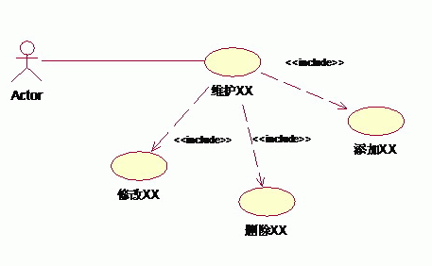
Another Example

Slide 33
UML: Extend Relationship
sometimes use cases are complex because they have many steps
Used when a second use case story follows the story of a prior use case
Extending a use case is, effectively, an alternate course of base use case
Introduce an extending use case whenever logic for an alternate course of action is at a complexity level similar to that of your basic course of action

Slide 34
(Continue)
An extends relationship from use case A to use case B indicates that an instance of B may include (subject to specific conditions) the behavior specified by A

Slide 35
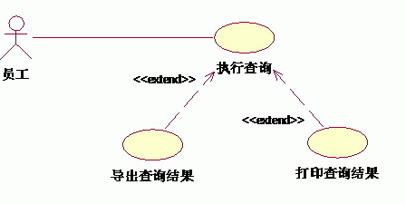
Another Example

Slide 36
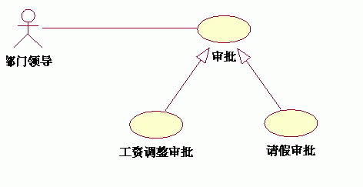
UML: Generalization Relationship

Slide 37
The distinction of the three relationships
三者对用例关系的优化侧重点是不同的：
泛化侧重表示子用例间的互斥性；
包含侧重表示被包含用例对Actor提供服务的间接性；
扩展侧重表示扩展用例的触发不定性；
泛化与包含用例属于无条件发生的用例，而扩展属于有条件发生的用例。进一步，用例的存在是为Actor提供服务，但用例提供服务的方式可分为间接和直接两种，依据于此，泛化中的子用例提供的是直接服务，而包含中的被包含用例提供的是间接服务。同样，扩展用例提供的也是直接服务，但扩展用例的发生是有条件的。

Slide 38
关系类型 | 说明 | 表示符号
关联 | actor与use case之间
泛化 | actor之间或use case之间
包含 | use case之间
扩展 | use case之间

Slide 39
Main Points
Use-Case Modeling
Actors
Use Case
Relationship
Steps to write a use case
Three main types of use cases
Case Study

Slide 40
Steps to write a use case (Important)
Step 1: Find the boundaries of the system (Context diagram, In/out list).
Step 2: Brainstorm and list the primary actors. (Actor List)
Step 3: Brainstorm and list the primary actors' goals against the system. (Actor-Goal List)
Step 4: Write the outermost summary level use cases covering all the above.
Step 5: Reconsider & revise the strategic use cases. Add, subtract, merge goals.
Step 6: Pick a use case to expand or write a narrative to get acquainted with the material.

Slide 41
Steps to write a use case (Continue)
Step 7: Fill in the stakeholders, interests, preconditions and guarantees. Double check them.
Step 8: Write the main success scenario. Check it against the interests and the guarantees.
Step 9: Brainstorm and list possible failure conditions and alternate success conditions.
Step 10: Write how the actors and system should behave in each extension.
Step 11: Break out any sub use case that needs its own space.
Step 12: Start from the top and readjust the use cases. Add, subtract, merge. Double check for completeness, readability, failure conditions.

Slide 42
Use Case Traps
Too many use cases
Highly complex use cases
GUI-containing use cases
Data definitions or algorithms in use cases
Use cases users don’t understand
New business processes

Slide 43
The difference between UC and functions
功能性观点，说明事物可利用的价值
用例观点，是使用者的观点，说明事物对于使用者的意义，以及使用者可以怎么使用它，得到什么样的利益。

Slide 44
Main Points
Use-Case Modeling
Actors
Use Case
Relationship
Steps to write a use case
Three main types of use cases
Case Study

Slide 45
Three main types of use cases
Business use case diagram
使用业务主角和业务用例展现业务建模的结果。
Conception use case diagram
用于展现从业务用例中经过分析分解出来的关键概念用例，并表示概念用例和业务用例之间的关系。一般来说这些关系有扩展、包含和精化。
System use case diagram
展现系统范围，将对业务用例进行分析以后得到的系统用例展现出来，系统用例视图即是系统的开发范围。

Slide 46
Business use case diagram

Slide 47
Conception use case diagram

Slide 48
System use case diagram

Slide 49
Main Points
Use-Case Modeling
Actors
Use Case
Relationship
Steps to write a use case
Three main types of use cases
Case Study

Slide 50
Case Study: Library Management System
确定系统涉及的总体信息
图书馆管理系统是对书籍的借阅及读者信息进行统一管理的系统，具体包括：
借阅者的借书、还书、书籍预订；
图书馆管理员的书籍借出处理、书籍归还处理、预订信息处理；
系统管理员的系统维护，包括增加书目、删除或更新书目、增加书籍、减少书籍、增加读者账户信息、删除或更新读者账户信息、书籍信息查询、读者信息查询等。

Slide 51
Case Study: Library Management System
确定系统的参与者
确定参与者首先需要分析系统所涉及的问题领域，明确系统运行的主要任务：分析使用该系统主要功能的是哪些人，谁需要该系统的支持以完成其工作，还有系统的管理者与维护者。或更新读者账户信息、书籍信息查询、读者信息查询等。

Slide 52
Case Study: Library Management System
确定系统的参与者
⑴ 作为一个图书馆管理系统，首先需要读者（借阅者）的参与，读者可以登录系统查询所需要的书籍，查到所需书籍后可以考虑预订，当然最重要的是借书、还书操作。
⑵ 对于系统来说，读者发起的借书、还书等操作最终还需要图书馆管理员来处理，他们还可以负责图书的预订和预订取消。
⑶ 对于图书馆管理系统来说，系统的维护操作也是相当重要的，维护操作主要包括增加书目、删除或更新书目、增加书籍、减少书籍等操作。
由以上分析可以得出，系统的参与者主要有3类：读者（也可称为借阅者）、图书馆管理员、图书馆管理系统维护者。

Slide 53
Case Study: Library Management System
确定系统用例
⑴ 用例是系统参与者与系统在交互过程中所需要完成的事务，一个完整的需求分析，要求必须找出所有的用例。
⑵ 识别用例最好的方法就是从分析系统的参与者开始，考虑每个参与者是如何使用系统的。
⑶ 由于系统存在借阅者、图书馆管理员、系统维护人员3个参与者，所以在识别用例的过程中，可以将系统分为3个用例图分别考虑。
⑷ 根据参与者之间的关系也可以将系统的用例图合为一张，这样画出的用例图略显复杂，为简单起见，我们将系统的用例图分为3个分别介绍。

Slide 54
Case Study: Library Management System
确定系统用例
⑴ 借阅者请求服务的用例
① 登录系统；
② 查询自己的借阅信息；
③ 查询书籍信息；
④ 预订书籍；
⑤ 借阅书籍；
⑥ 归还书籍。

Slide 55
Case Study: Library Management System
确定系统用例
⑵ 图书馆管理员处理借书、还书等的用例
① 处理书籍借阅；
② 处理书籍归还；
③ 删除预订信息。

Slide 56
Case Study: Library Management System
确定系统用例
⑶ 系统管理员进行系统维护的用例
① 查询借阅者信息；
② 查询书籍信息；
③ 增加书目；
④ 删除或更新书目；
⑤ 增加书籍；
⑥ 删除书籍；
⑦ 添加借阅者账户；
⑧ 删除或更新借阅者账户。

Slide 57
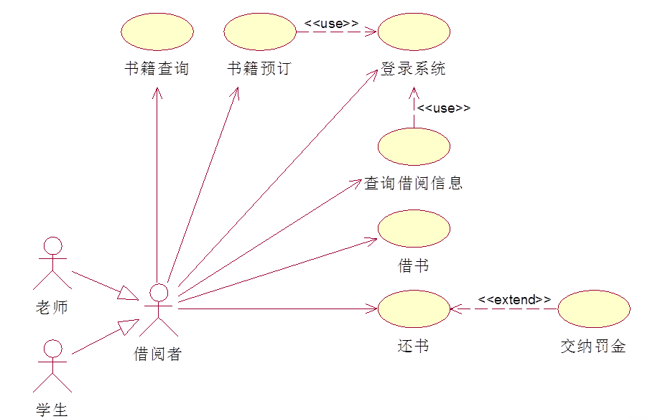
Case Study: Library Management System
图书馆管理系统中的用例图
⑴ 借阅者请求服务的用例图

Slide 58
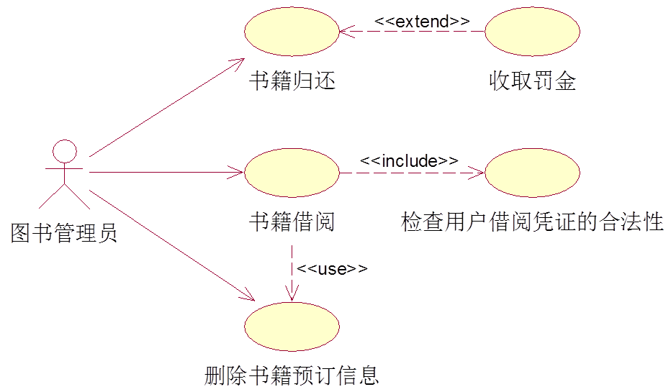
Case Study: Library Management System
图书馆管理系统中的用例图
⑵ 图书馆管理员处理借书、还书等的用例图

Slide 59
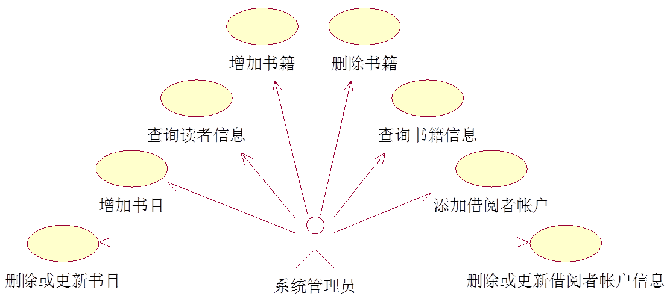
Case Study: Library Management System
图书馆管理系统中的用例图
⑶ 系统管理员进行系统维护的用例图

Slide 60
Practice：Online shopping system
以在线购物(Online Shopping) 进行领域分析构系统用例图；
在线购物通过会员机制维护客户，客户登录系统，分类浏览商品信息，选择多个目标商品形成订单，最后选择配送方式，并通过银行在线支付完成交易；
同时满足游客，会员，管理员的应用；

Slide 61
Homework
目标：构建一个语音邮箱系统
问题描述：
语音邮箱系统中,可以为每个系统用户(邮箱主人)分配一个语音邮箱号码.
进行留言时, 拨打语音邮箱系统的主号码, 在听到提示音”请输入邮箱号”后,输入要语音邮箱号,听到主人设定的问候语后,进行留言然后挂断电话.
邮箱主人拨打语音邮箱系统的主号码,在听到提示音”请输入邮箱号”后,输入要语音邮箱号,听到主人设定的问候语后, 输入密码+#进行邮箱管理. 此时系统提供三种服务:1.接收信息; 2.更改问候语; 3.更改密码.其中接收留言包括收听新留言、存储留言、删除留言等。

