Slide 1
On-Campus Accommodation Office
San Francisco Bay University
Data Modeling and Implementation Techniques
Natnael Haile - 20007
Prachi Sethi - 19963
Instructor - Pragati Dharmale
Date - 9 December 2023

Slide 2
Introduction
Efficient management of student accommodation is crucial to creating a productive learning environment.
The On-Campus Accommodation Office oversees housing logistics, student and administrative operations.
This paper focuses on a comprehensive database designed for the office's accommodation management needs.

Slide 3
Introduction
The database facilitates information flow, enhances decision-making, and streamlines housing management.
Staff details, financial transactions, leases, student records, and accommodation options require a automated system.
A relational database schema is proposed to address the diverse aspects of student accommodation on campus.

Slide 4
Inefficiencies in Student Accommodation Management
Difficulty tracking student housing
Lack of system to manage leases, invoices, and maintenance
Need to accommodate more students efficiently

Slide 5
Introducing the On-Campus Accommodation Management System
Key features of the system
Comprehensive data management
Streamlined administrative tasks
Enhanced data accuracy and integrity

Slide 6
Assumptions
All students are enrolled to the minimum required credit hours.
All students, staff members, and advisors have valid phone numbers, email addresses, and addresses.
All students have at least one next-of-kin person registered.
Students who have been in the accommodation for a year will have their renewal status changed to false.
All students must have a major and a minor course they are enrolled in.

Slide 7
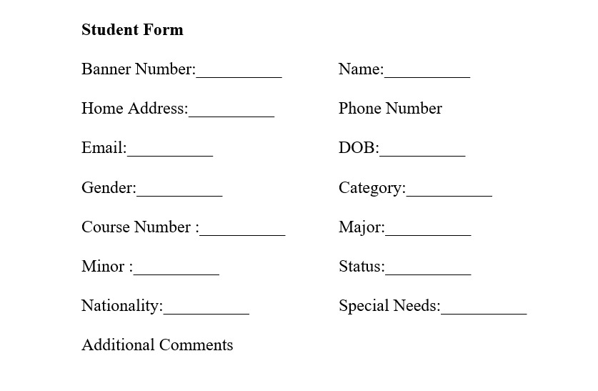
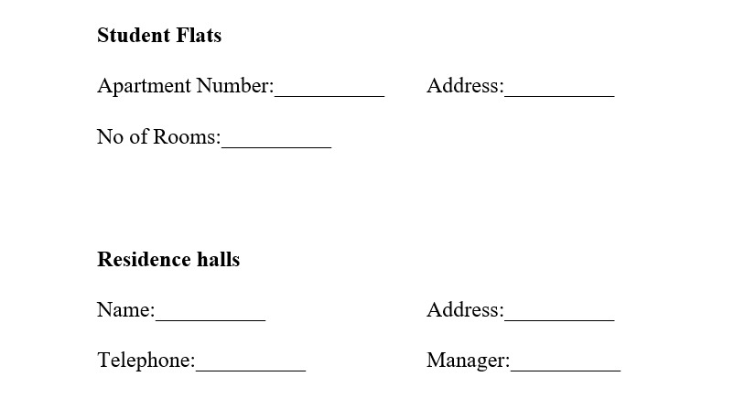
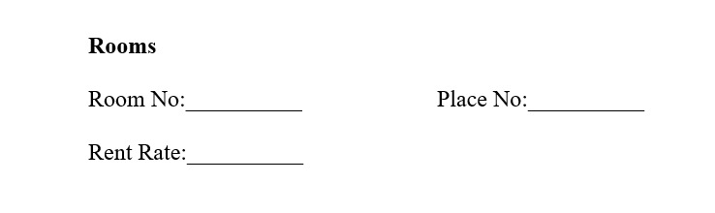
Sample form designs

Slide 8
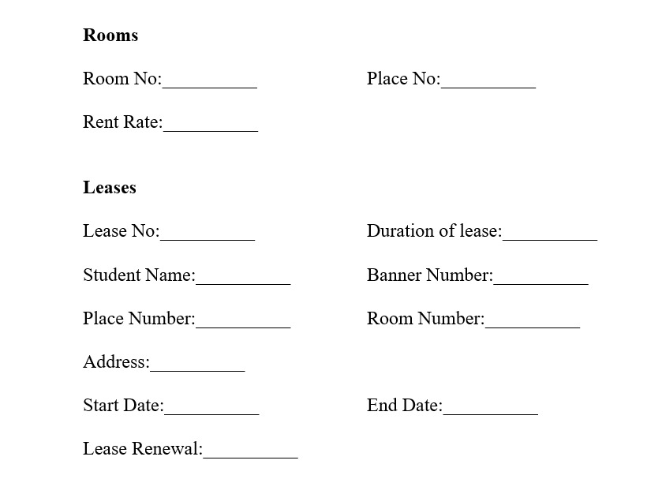
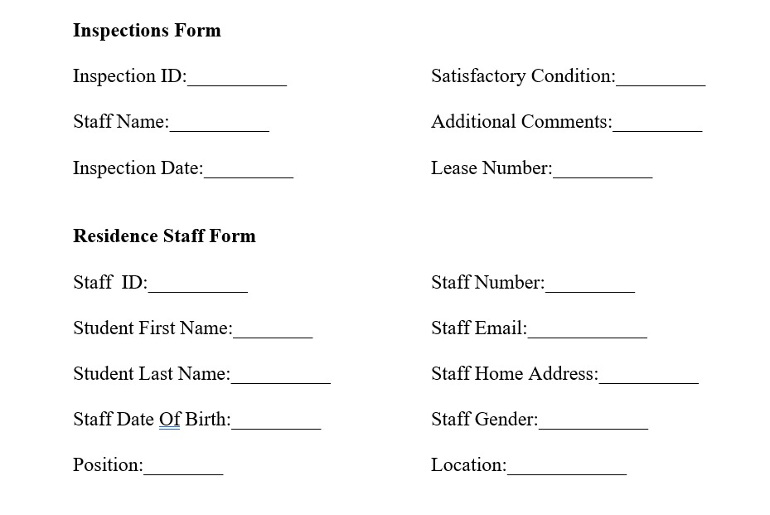
Sample form designs

Slide 9
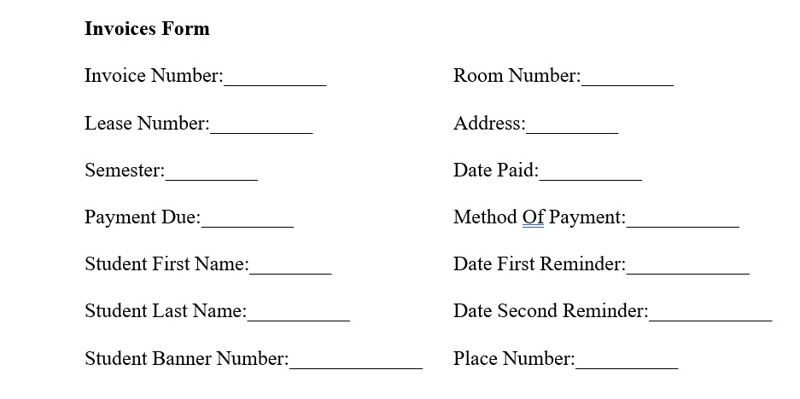
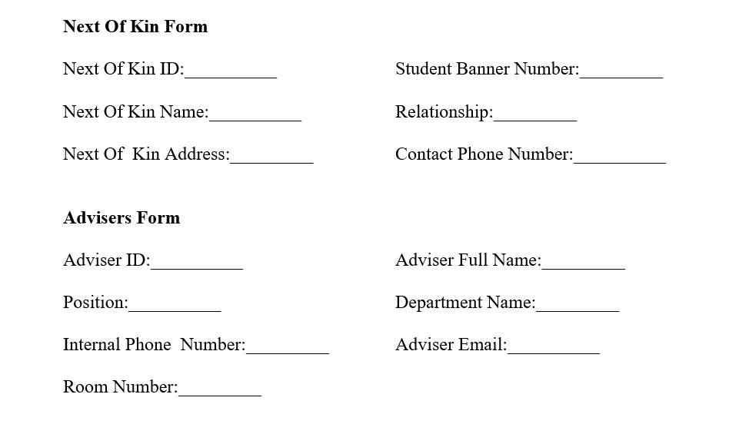
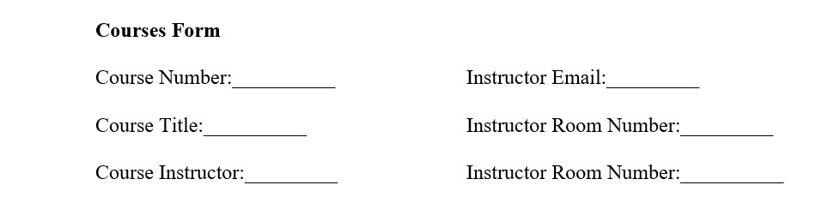
Sample form designs

Slide 10
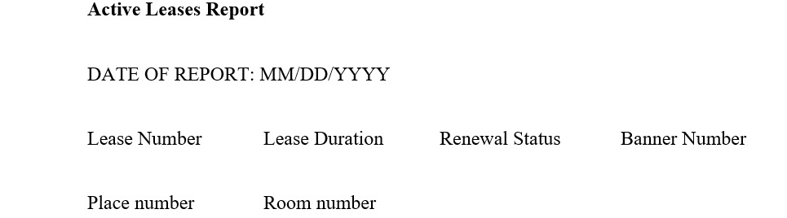
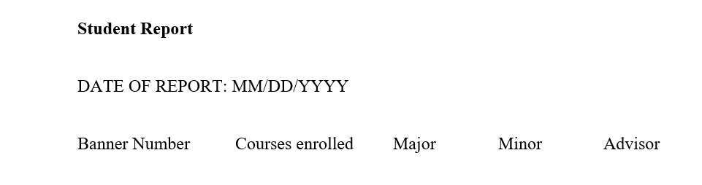
Sample report formats

Slide 11
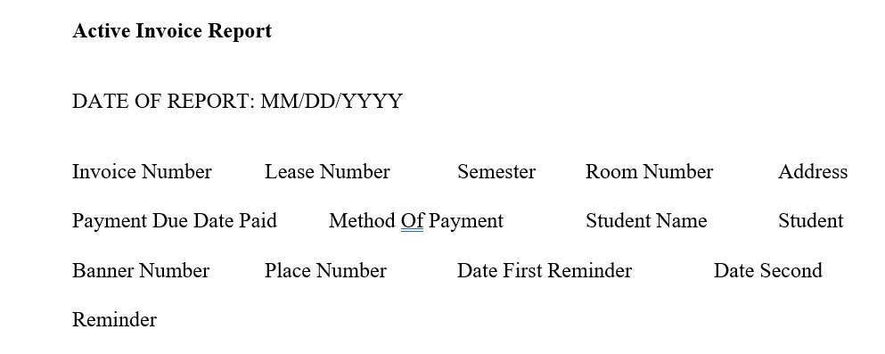
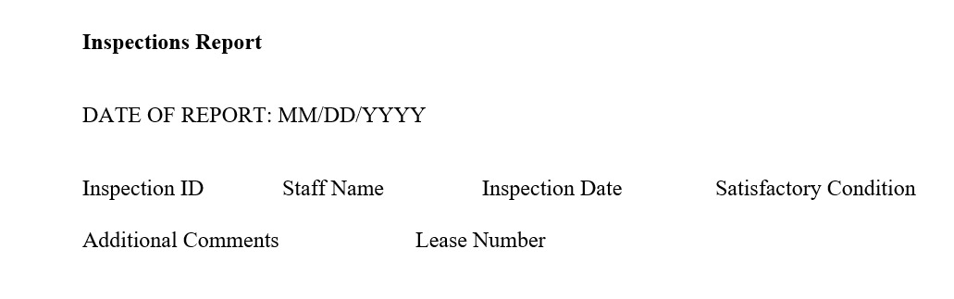
Sample report formats

Slide 12
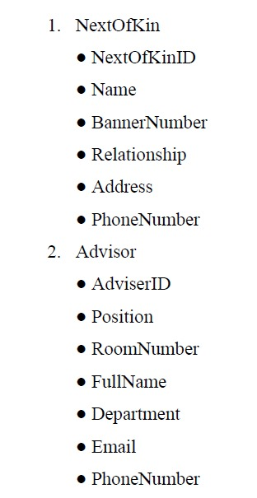
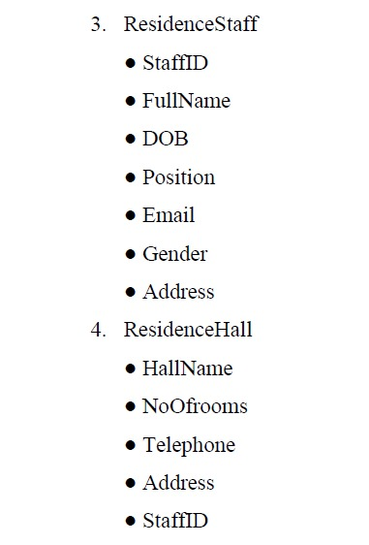
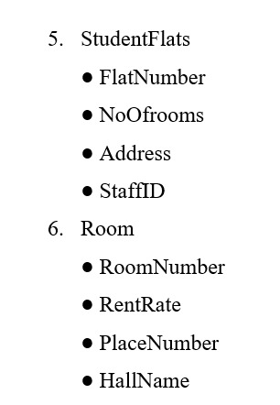
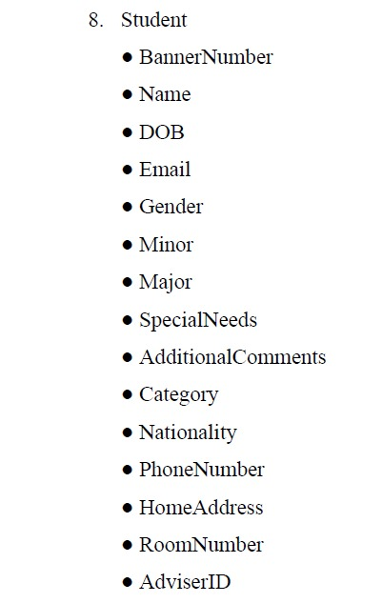
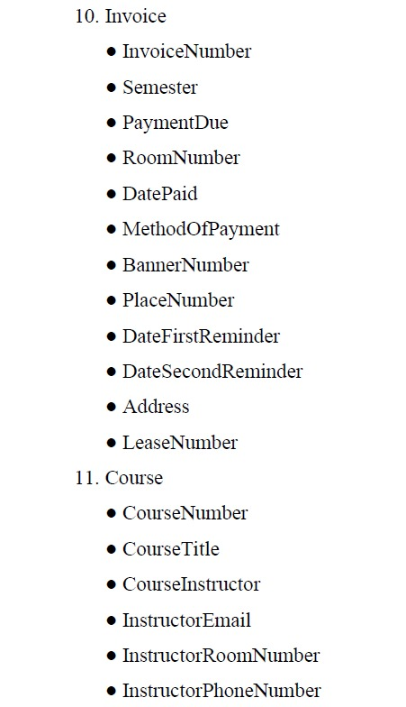
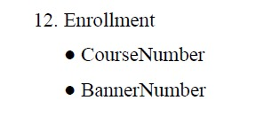
Data Dictionary

Slide 13
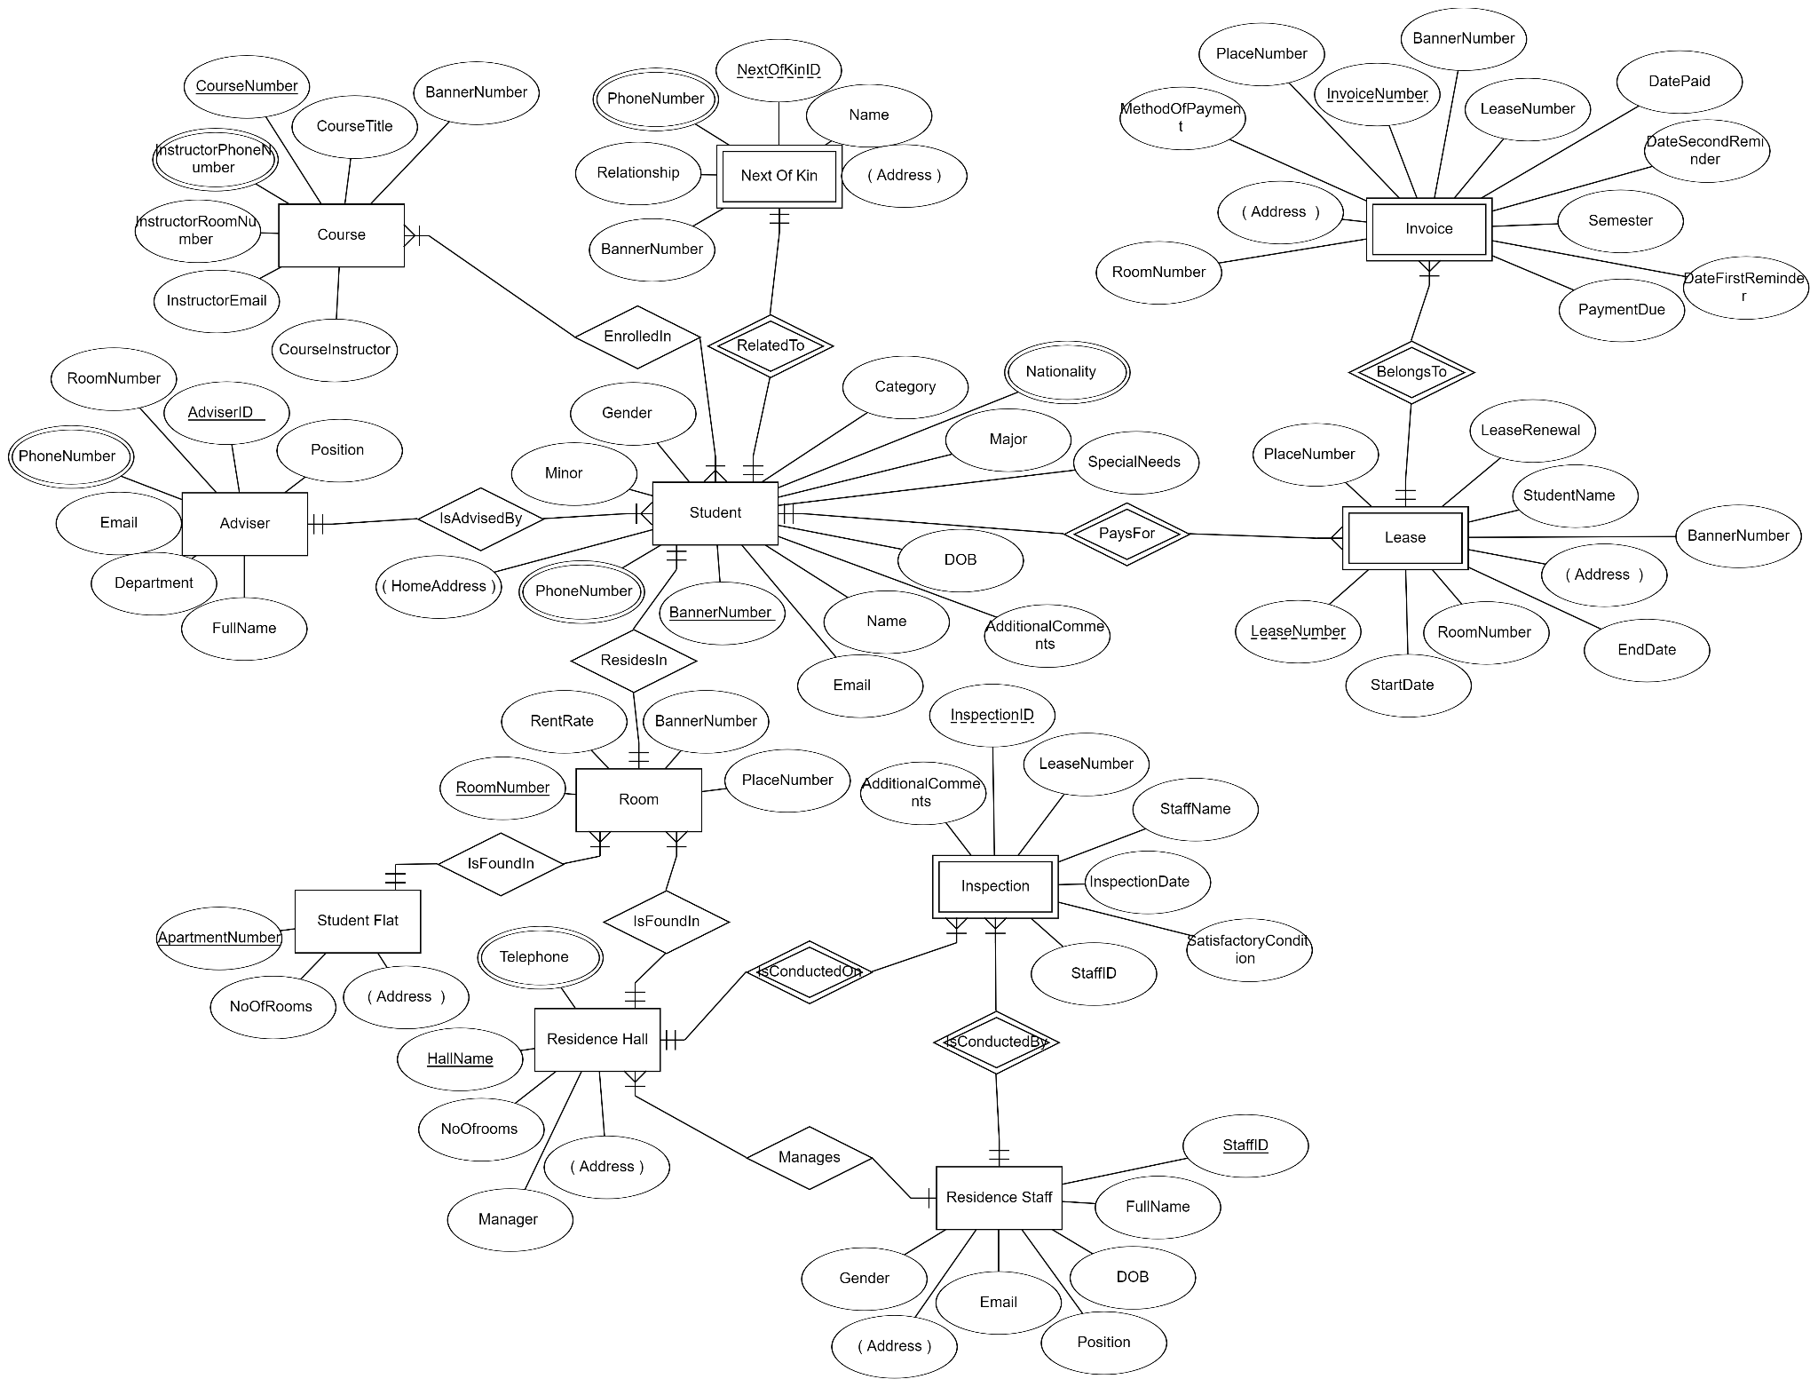
Building a Robust Data Model (initial data model)

Slide 14
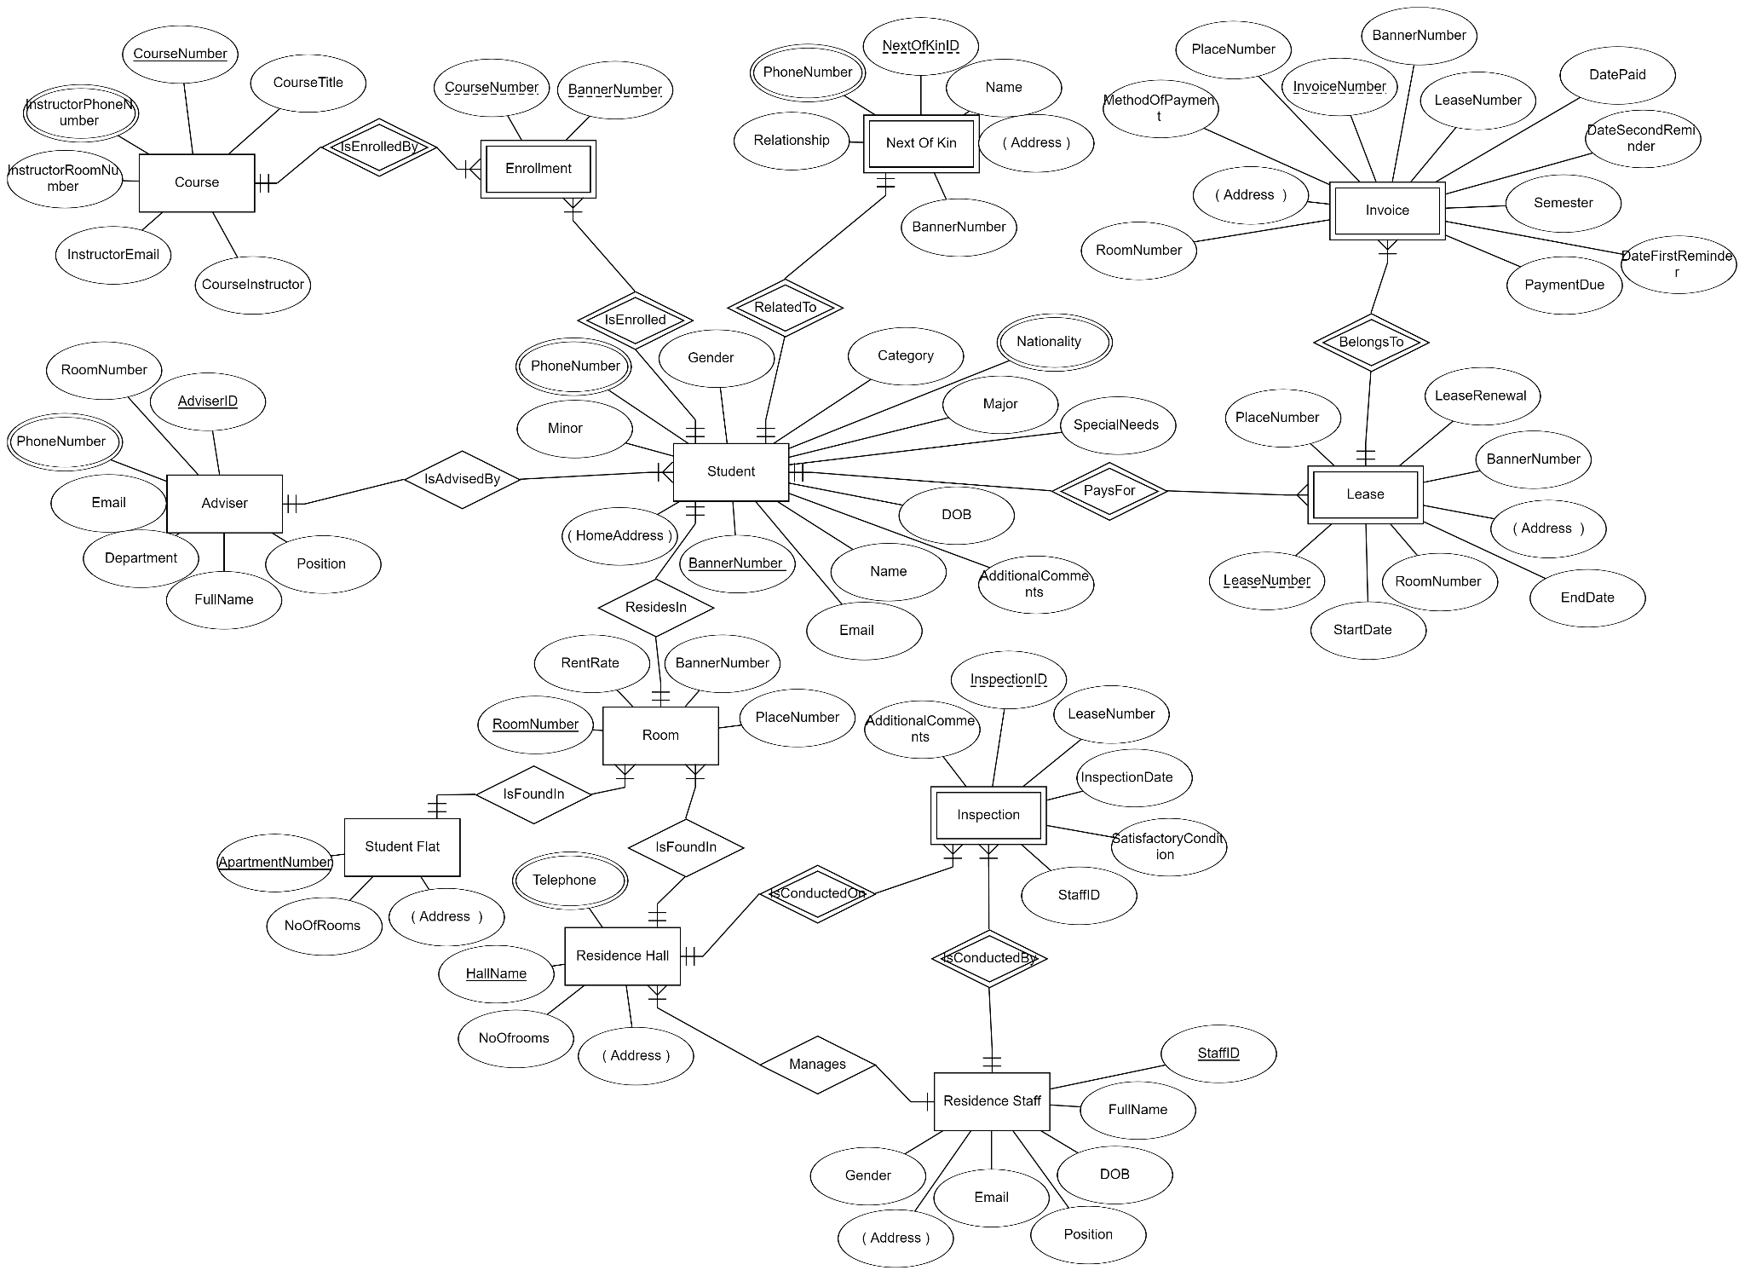
Building a Robust Data Model ( data model after normalization)

Slide 15
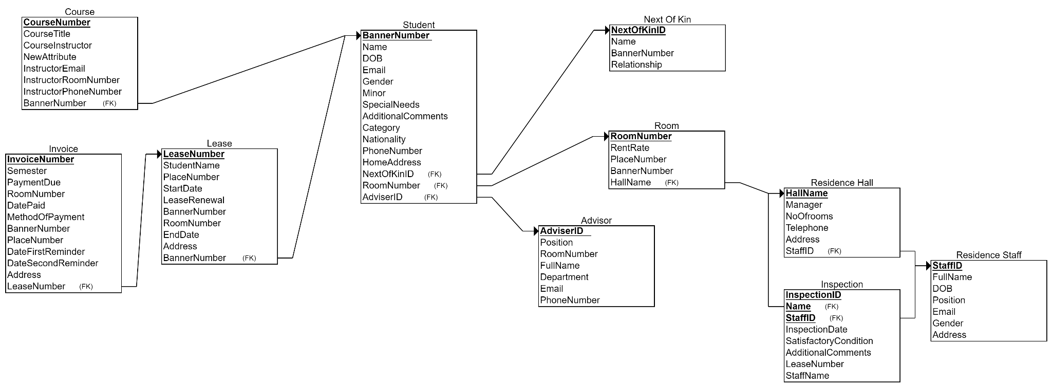
Relational Schema

Slide 16
Snapshots of the implementation

Slide 17
Sample Queries
CREATE TABLE Student
(
BannerNumber CHAR(6) NOT NULL,
Name VARCHAR(100),
DOB DATE,
Email VARCHAR(50),
Gender VARCHAR(6),
Minor VARCHAR(25),
Major VARCHAR(25),
SpecialNeeds VARCHAR(255),
AdditionalComments VARCHAR(255),
Category VARCHAR(25),
Nationality VARCHAR(50),
PhoneNumber VARCHAR(20),
HomeAddress VARCHAR(100),
RoomNumber CHAR(6) NOT NULL,
AdviserID CHAR(6) NOT NULL,
PRIMARY KEY (BannerNumber),
FOREIGN KEY (RoomNumber) REFERENCES Room(RoomNumber),
FOREIGN KEY (AdviserID) REFERENCES Advisor(AdviserID)
);
INSERT INTO Student (BannerNumber, Name, DOB, Email, Gender, Minor, Major, SpecialNeeds, AdditionalComments, Category, Nationality, PhoneNumber, HomeAddress, RoomNumber, AdviserID) VALUES
(11111, 'Liam Turner', '2000-07-12', 'liam@example.com', 'Male', 'Physics', 'Math', NULL, 'Enjoys stargazing', 'Undergraduate', 'USA', '555-8888', '101 Cedar St', 'A101', 104),

Slide 18
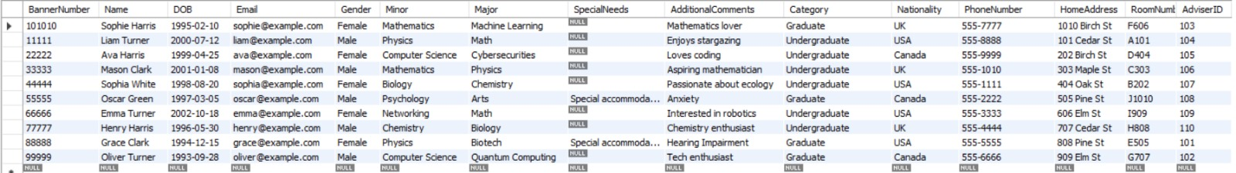
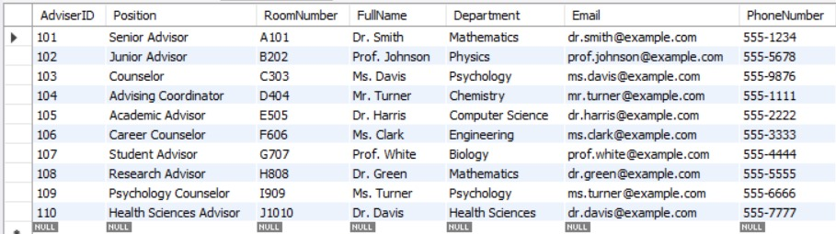
Database Snapshots
Student Table
Advisor Table

Slide 19
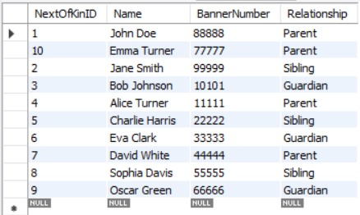
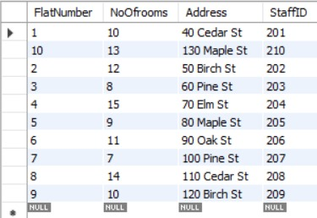
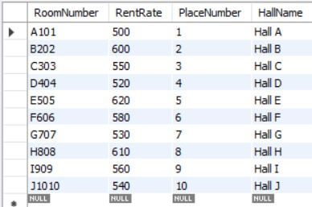
Database Snapshots
NextOfKin Table
StudentFlats Table
Room Table

Slide 20
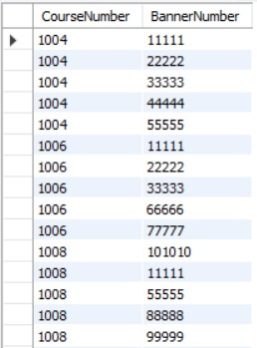
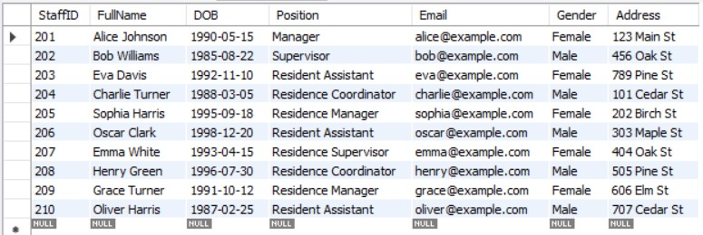
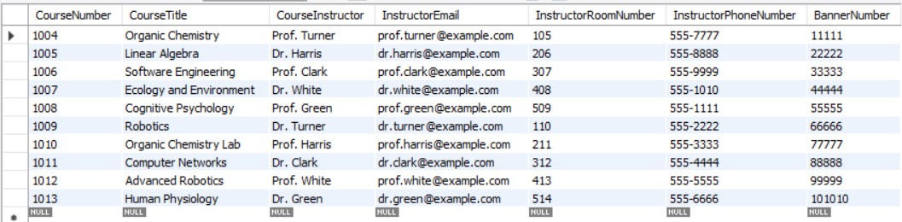
Database Snapshots
Enrollment Table
ResidenceStaff Table
Course Table

Slide 21
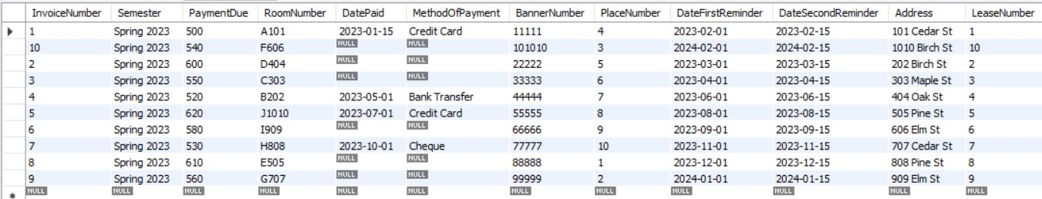
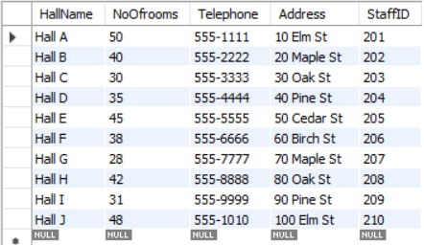
Database Snapshots
Invoice Table
ResidenceHall Table

Slide 22
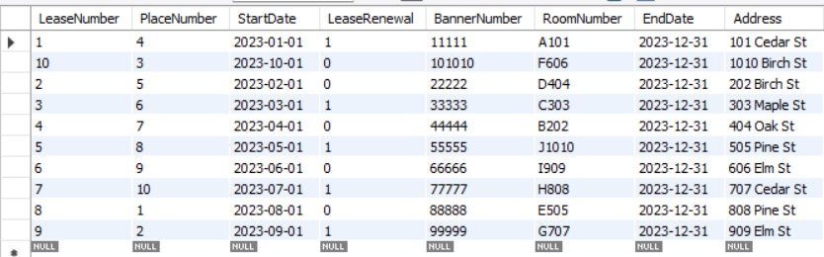
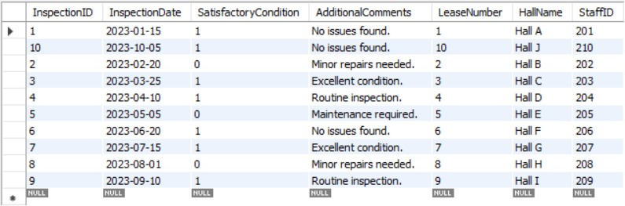
Database Snapshots
Lease Table
Inspection Table

Slide 23
Enhancing the existing database
Introducing Normalization

Slide 24
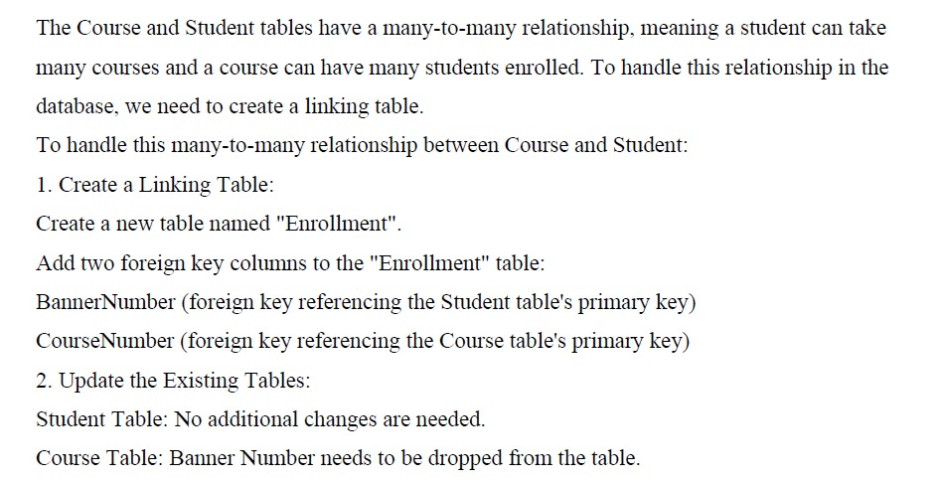

Slide 25
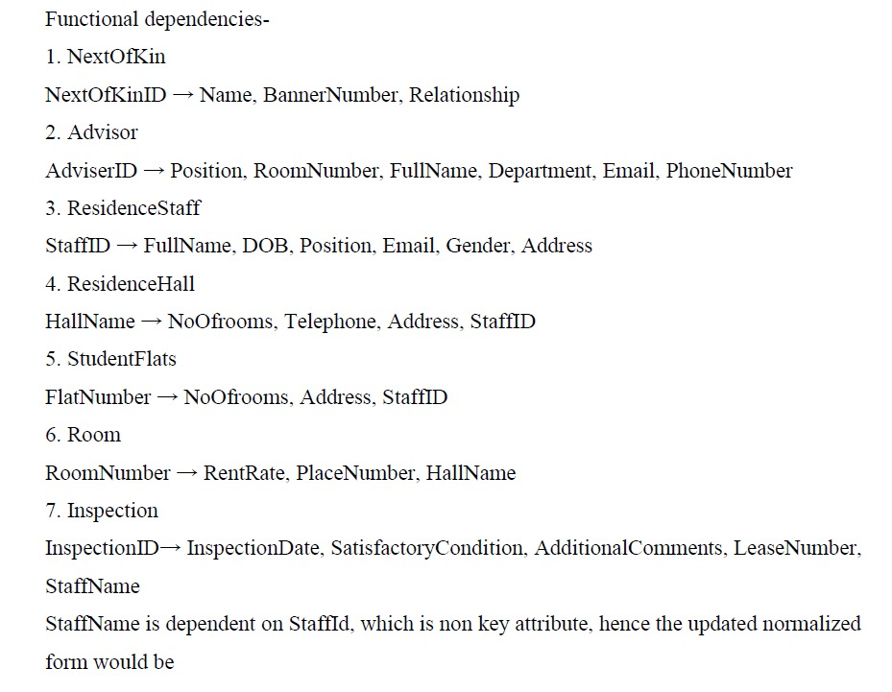

Slide 26
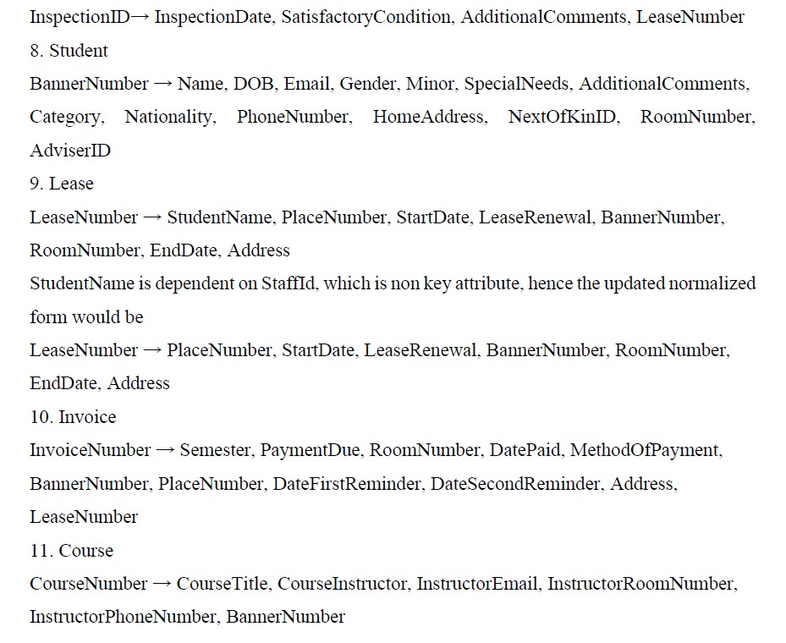

Slide 27
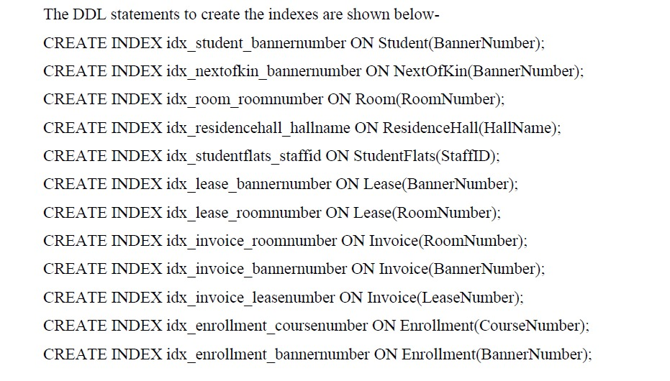
Indexing

Slide 28
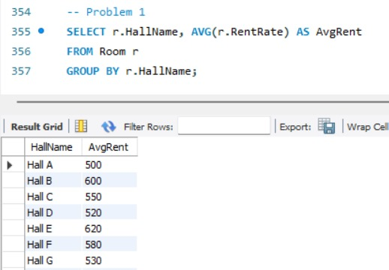
Non-routine requests
a)Calculate the average rent for rooms in each residence hall. The query for this request is as follows:

Slide 29
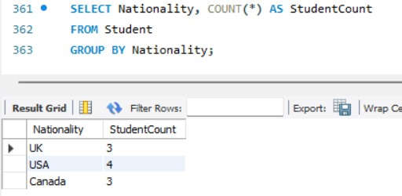
Non-routine requests
b) Count the number of students from each nationality.

Slide 30
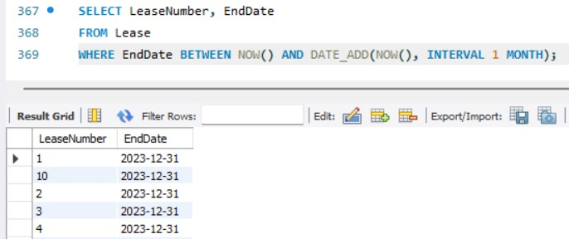
Non-routine requests
c) Identify leases that are ending within the next month.

Slide 31
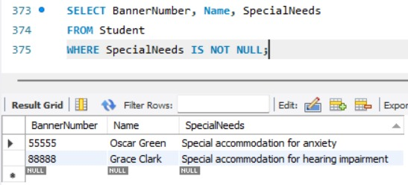
Non-routine requests
d) List students with any specified special needs or accommodations.

Slide 32
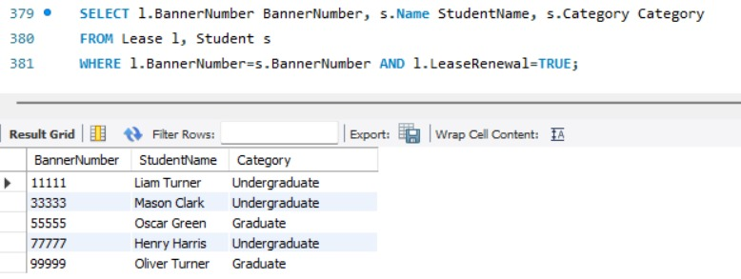
Non-routine requests
e) Display the students whose lease has been renewed.

Slide 33
Facilitating Day-to-Day Activities
Data entry, update, and deletion
Student data management
Lease agreement management
Invoice generation and tracking
Accommodation information management
Inspection reporting

Slide 34
Solving Key Challenges
Ensuring data integrity and accuracy
Efficient lease tracking
Streamlining invoice management
Facilitating inspection monitoring

Slide 35
Expanding Functionality and Adapting to Future Needs
Automated reminder systems for lease renewals
Advanced analytics for predicting accommodation demand
Detailed housing availability information

Slide 36
Challenges Faced
Data Integration: Combining data from disparate sources with different formats and standards.
Meeting Deadlines: Balancing multiple tasks and delivering the project on time within budget.
Scope Creep: Managing changes to the project requirements and keeping them aligned with the original goals.

Slide 37
Career skills obtained
Communication Skills: Communicating project progress, challenges, and solutions clearly.
Project Management Skills: Planning, organizing, and executing a project while adhering to deadlines and budgets.
Analytical Skills: Analyzing data to identify patterns and trends and draw meaningful conclusions.

Slide 38
Career skills obtained
Technical Skills: Proficiency in designing and creating a full-fledged database using MySQL.
Problem-Solving: Identifying and solving complex problems related to data management and system development.

Slide 39
Conclusion
Enhanced Efficiency: Streamlined administrative tasks, improved data accuracy, and increased efficiency in managing student accommodation.
Improved Decision-Making: Access to real-time data and insights to support informed decision-making about housing availability and student needs.

Slide 40
Q&A

Slide 41
Thank You !

