Slide 1
TABLE OF CONTENTS.
3.5
3.6
3.7
3.8
3.9
ROLE ACTIVITY DIAGRAMS
ROLE INTERACTION DIAGRAMS
GANTT CHARTS
04
COLORED PETRI-NETS
WORKFLOW TECHNIQUES
ACTIVITY

Slide 2
ROLE ACTIVITY DIAGRAMS
<p> Lesson 3.5 </p>

Slide 3
ROLE ACTIVITY DIAGRAMS.
<p> Based in the article “Business Process Modelling Techniques with Examples” by Nishadha (2020), Roles are abstract notations of behavior describing a desired behavior within the organization. They are often organizational functions. They also include software systems, customers and suppliers. </p>

Slide 4
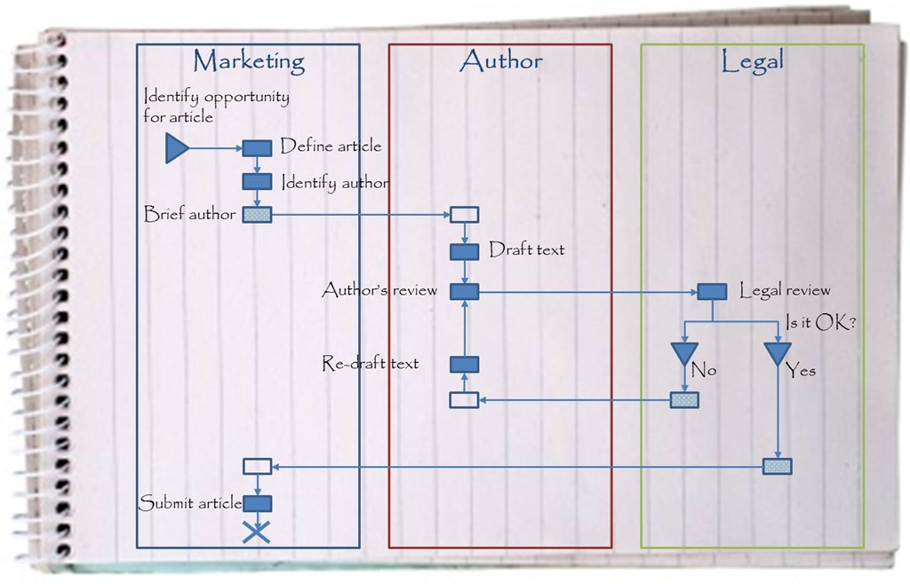

Slide 5
ROLE INTERACTION DIAGRAMS
<p> Lesson 3.6 </p>

Slide 6
ROLE INTERACTION DIAGRAMS.
<p> Based in the article “Business Process Modelling Techniques with Examples” by Nishadha (2020), Activities are connected to roles in a type of matrix. Activities are shown vertically on the left axis and the roles are shown horizontally at the top. Text and symbols are used together in order to represent the process.</p>

Slide 7
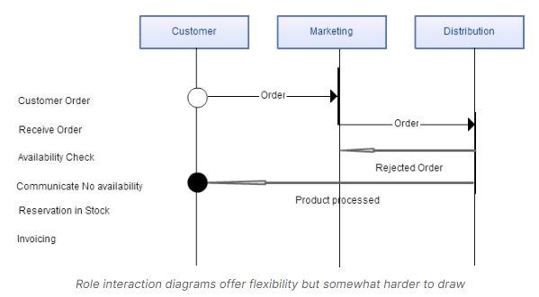

Slide 8
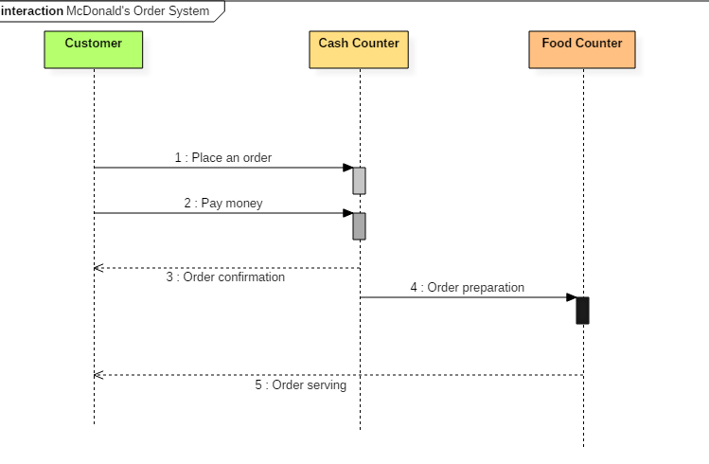

Slide 9
GANTT CHARTS
<p> Lesson 3.7 </p>

Slide 10
GANTT CHARTS.
<p> Based in the article “Business Process Modelling Techniques with Examples” by Nishadha (2020), Gantt charts relate a list of activities to a time scale.
A Gantt chart is a matrix that lists on the vertical axis all the tasks or activities to be performed in a process. </p>

Slide 11
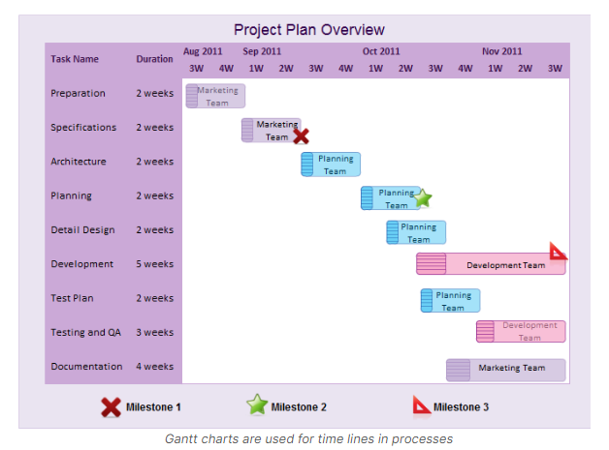

Slide 12
COLORED PETRI-NETS
<p> Lesson 3.8 </p>

Slide 13
COLORED PETRI-NETS.
<p> Based in the article “Business Process Modelling Techniques with Examples” by Nishadha (2020), Colored Petri nets are a graphical oriented language for design, specification, simulation and verification of systems. </p>

Slide 14
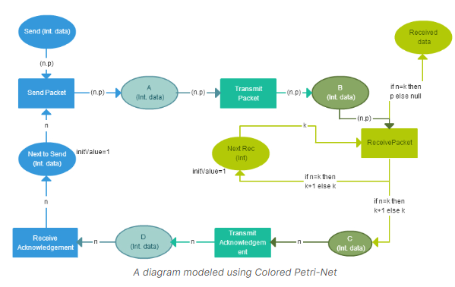

Slide 15
WORKFLOW TECHNIQUES
<p> Lesson 3.9 </p>

Slide 16
WORKFLOW TECHNIQUES.
<p> Based in the article “Business Process Modelling Techniques with Examples” by Nishadha (2020), Workflow is a flow of tasks between computer applications or people in an organization.
The work flow is more than a technique to model a process. It is a method to analyze and improve a process, including its modeling. </p>

Slide 17
