Slide 1

Fraud Detection Production Deployment
API Implementation Technical Guide
Roynel Cura

Slide 2

CONTENT
01
02
Environment Setup & Dependencies
API Architecture Design
03
Deployment & Monitoring

Slide 3

01
Environment Setup & Dependencies

Slide 4

Matching Production Environment
Ensuring production systems mirror development environments prevents model drift and maintains prediction accuracy across the deployment pipeline.
01
Environment Consistency Requirements
Implementing containerization with Docker or environment managers like Conda ensures consistent library versions and system dependencies across all deployment stages.
02
Dependency Management Strategies
Maintaining configuration files that document exact package versions and system specifications enables reproducible environments for consistent model performance.
03
Version Control for Environments

Slide 5



Required Libraries Installation
Core Python Libraries
API Framework Installation
Essential packages including pandas for data manipulation, numpy for numerical operations, and joblib for model persistence must be installed in the production environment.
FastAPI or Flask must be installed to create the API endpoints that will serve the model predictions to client applications.
01
02
03
Model Framework Dependencies
XGBoost and scikit-learn libraries are required for loading and operating the serialized fraud detection model in the production environment.

Slide 6
Model Serialization
2
1
3
Format Selection
Saving Model State
Choosing appropriate serialization formats like PKL, ONNX, or SavedModel based on deployment requirements and cross-platform compatibility needs.
Version Control
Preserving trained model parameters using pickle or joblib to maintain the exact state for consistent predictions in production environments.
Implementing systematic versioning for serialized models to track changes, enable rollbacks, and maintain audit trails throughout the model lifecycle.

Slide 7
02
API Architecture Design

Slide 8


JSON Input Structure
Required Transaction Features
The API expects specific transaction features including amount, category, timestamp, gender, and other fraud-indicating variables in standardized JSON format.
Payload Structure Example
A sample JSON structure showing proper formatting with all required fields, data types, and acceptable value ranges for API processing.
Validation Requirements
JSON inputs must pass validation checks for data completeness, type correctness, and range constraints before preprocessing and model evaluation.

Slide 9


Preprocessing Pipeline Integration
1
2
3
Feature Encoding Implementation
Data Scaling Procedures
Pipeline Serialization Strategy
Categorical variables must be transformed into numerical representations using the same encoding scheme from the training phase to maintain consistency.
Numerical features require standardization using saved scaling parameters to ensure model inputs match the distribution used during training.
The preprocessing workflow should be saved as a serialized object alongside the model to ensure identical transformation sequences for all production data.

Slide 10
Response Format
01
02
03
The API returns standardized JSON responses containing fraud probability score, prediction confidence, and model version for transaction tracking.
Comprehensive error codes and messages for missing features, validation failures, and processing errors ensure robust client-side troubleshooting.
The system guarantees responses within 200ms under normal load conditions, with degraded service notifications during high traffic periods.
JSON Response Structure
Error Handling Protocol
Response Time Guarantees

Slide 11
03
Deployment & Monitoring

Slide 12
Containerization Strategy
01
Docker Container Implementation
03
Microservice Architecture
Package the fraud detection model, dependencies, and API code into a Docker container for consistent deployment across environments.
Design the containerized application as a standalone microservice with defined API endpoints for fraud detection requests and responses.
02
Orchestration with Kubernetes
Implement Kubernetes for managing container deployment, scaling, and load balancing to ensure high availability of the fraud detection service.

Slide 13
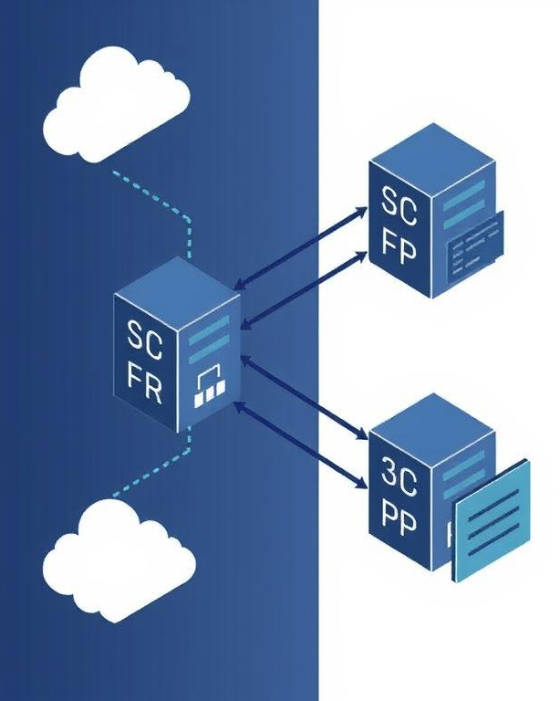
Scaling Considerations
Horizontal Scaling
Distributing model inference across multiple servers to handle increased request volume, ensuring consistent response times during peak loads.
Vertical Scaling
Upgrading hardware resources for the model deployment server, including CPU, RAM and storage to improve processing capacity for complex transactions.
Load Balancing Strategy
Implementing algorithms to distribute incoming fraud detection requests evenly across multiple server instances, preventing bottlenecks and service degradation.

Slide 14




Performance Metrics Tracking
Real-time Model Monitoring
Logging and Alerting System
Continuous tracking of model performance in production using metrics like precision, recall, and F1-score to detect performance degradation over time.
Comprehensive logging infrastructure that captures prediction details and triggers alerts when performance metrics fall below predetermined thresholds.
Threshold Optimization
Regular calibration of decision thresholds based on business requirements, balancing false positives against missed fraud cases.

Slide 15

Thanks！

