Slide 1
Bibliotheks-verwaltung
RM
Reisinger & Mitsch

Slide 2
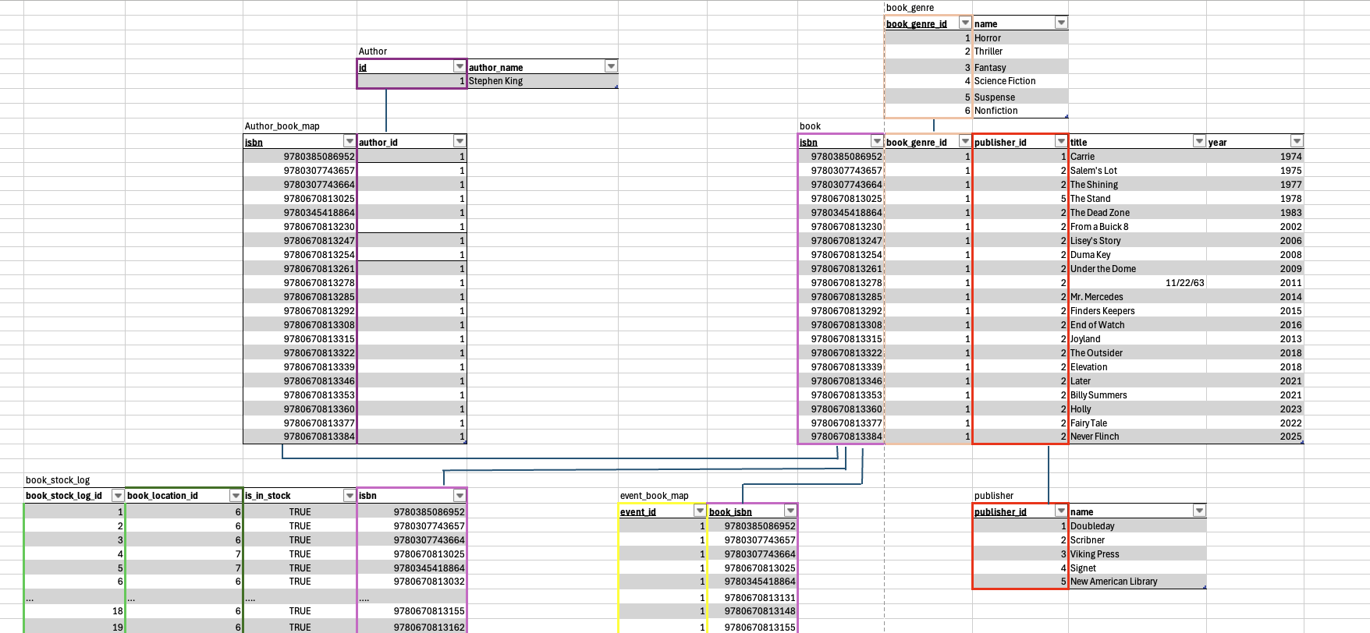
 |  | book_location
 | book_location_id | book_location_floor_id | book_location_shelf_id
 | 6 | 1 | 1
 | 7 | 1 | 2
 | 8 | 1 | 3
 | 9 | 2 | 1
 | 10 | 2 | 2
 | 11 | 2 | 3
 |  | book_location_floor
 | book_location_floor_id | number |  |  | book_location_shelf
 | 1 | 1 |  | book_location_shelf_id | number
 | 2 | 0 |  | 1 | 1
 | 3 | 2 |  | 2 | 2
 | 4 | 3 |  | 3 | 3

Slide 3
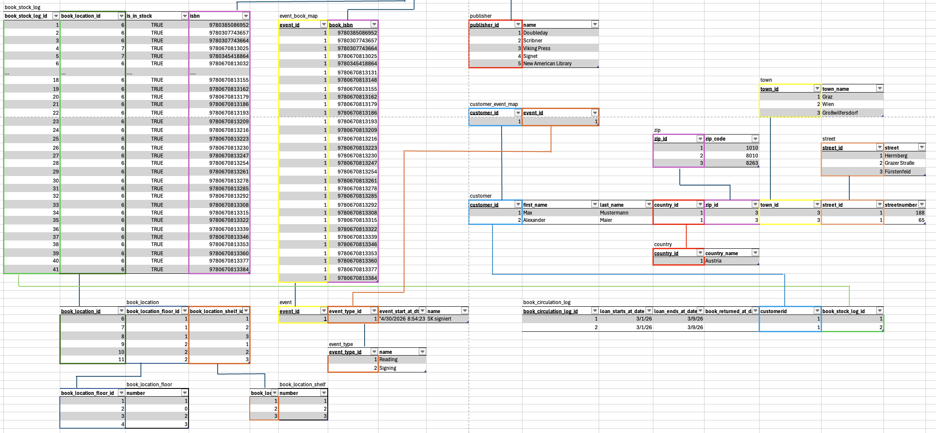

Slide 4
