Slide 1

A Puff of Steem:
Security Analysis of Decentralized Content Curation
Aggelos Kiayias
Benjamin Livshits
Andrés Monteoliva Mosteiro
Orfeas Stefanos Thyfronitis Litos
Tokenomics 6/5/2019

Slide 2
Content curation
The process of ranking and/or removing posts in a forum/social network, with the aim of promoting quality content

Slide 3
Manual content curation
Pros
    Trivial algorithm
Cons
    Subjective, error-prone
    Does not scale
    Moderator trusted

Slide 4

Crowdsourced content curation
Pros
    All opinions count - objectivity
    Scales well
Cons
    Ranking algorithm complicated
    Website admin trusted

Slide 5
Decentralized content curation
Pros
    All opinions count - objectivity
    Scales well
    Blockchain - No trust needed
Cons
    Ranking algorithm not good enough yet
    Sybil attacks harder to avoid

Slide 6

Steemit
Social media platform
1.26M accounts
Lives on Steem blockchain
Uses decentralized content curation

Slide 7
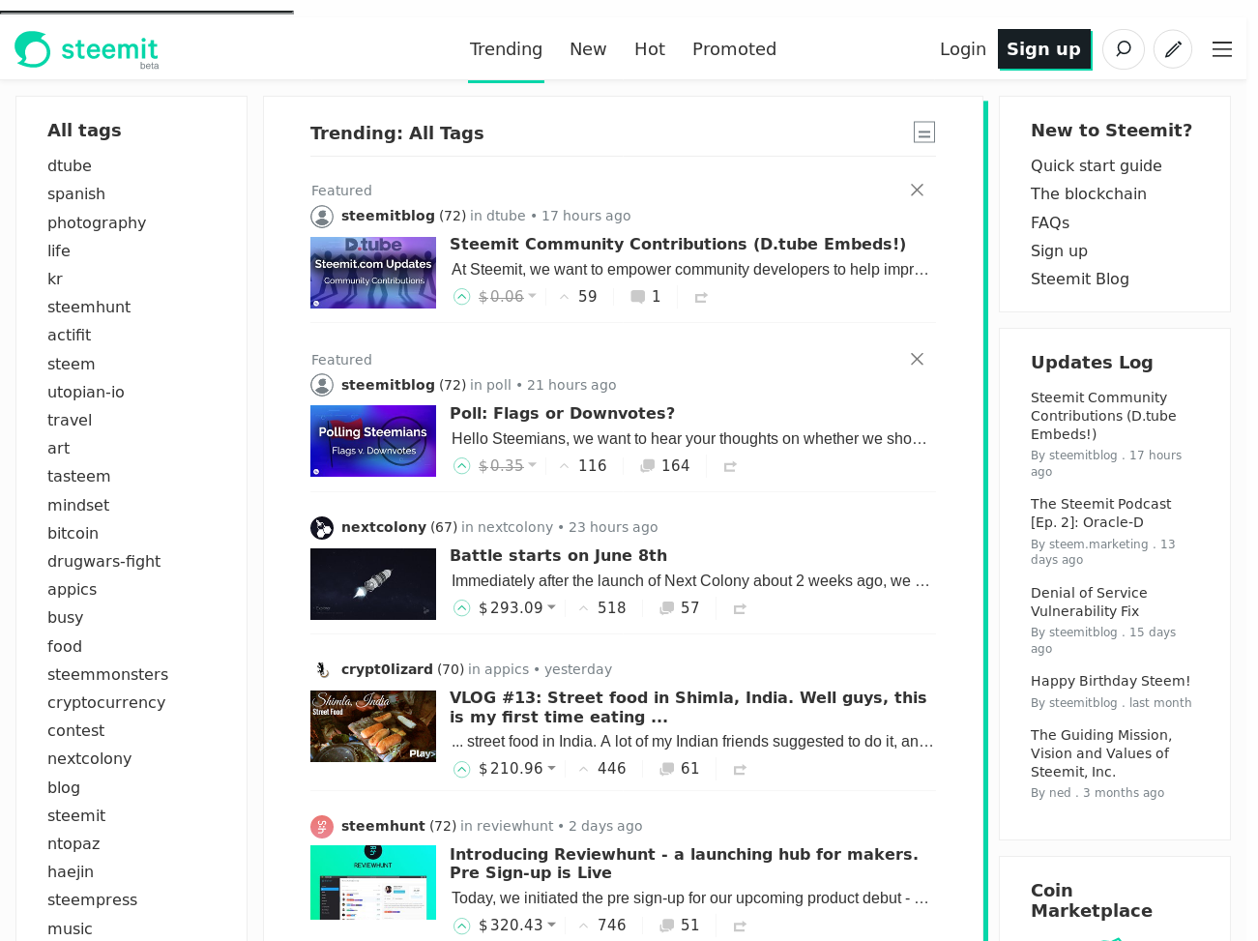

Slide 8
Our contributions
Abstract Post Voting System
Concrete PVS for Steemit
Metric for curation quality
Characterization of cases that Steemit ranks posts well:
    #posts > 70 → quality may be 0
Simulation
    Only honest players
    Mixed honest-selfish players

Slide 9
Posts
Ideal post list
-ideal post list
Each post has a likability vector
List of posts, ordered by most liked
List of posts, the first are ordered ideally

Slide 10
Abstract Post Voting System

Slide 11
Abstract Post Voting System
init()
aux(user)
handleVote(ballot)
vote(list, aux)

Slide 12
Abstract Post Voting System
init()
aux(user)
handleVote(ballot)
2) read
3) posts
4) vote
vote(list, aux)
1) activate

Slide 13
-convergence metric
For honest players,
for activations per player,
for any post list with posts,
holds a -ideal list at the end

Slide 14
Steemit Post Voting System
init(parms): initialize state (duh)
aux(user): send parameters & current round
handleVote(ballot):
    count vote, weighted by money and Voting Power
    Update Voting Power
vote(list, aux): choose best post of top attSpan, votes with weight = likability. Spreads votes to maximize Voting Power

Slide 15
Main theorem
If some players have differing funds:
    Steemit PVS does not 1-converge
If all players have the same funds:
    If there are up to 70 posts:
        Steemit PVS fully converges
    If there are more than 70 posts:
        Steemit PVS does not 1-converge

Slide 16
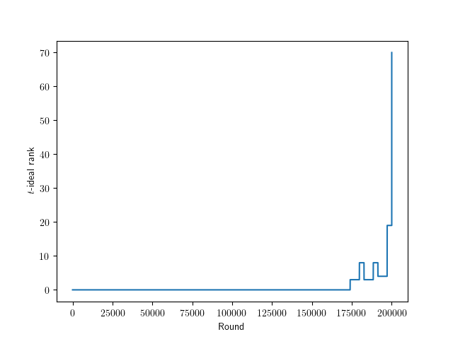
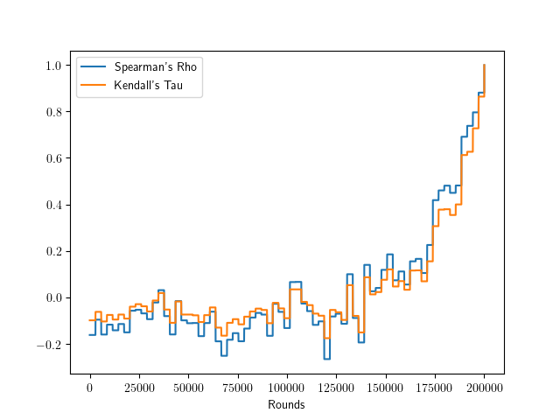
Simulation
All honest, few posts

Slide 17
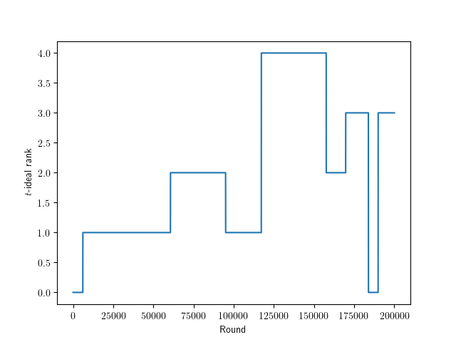
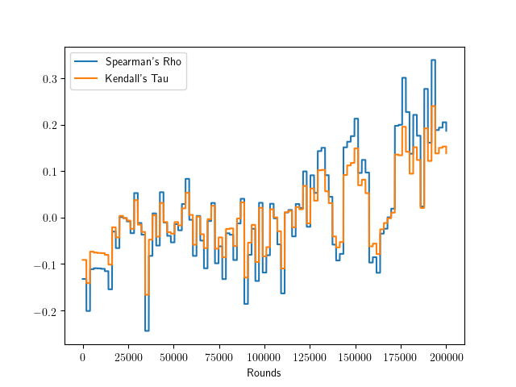
Simulation
All honest, many posts

Slide 18
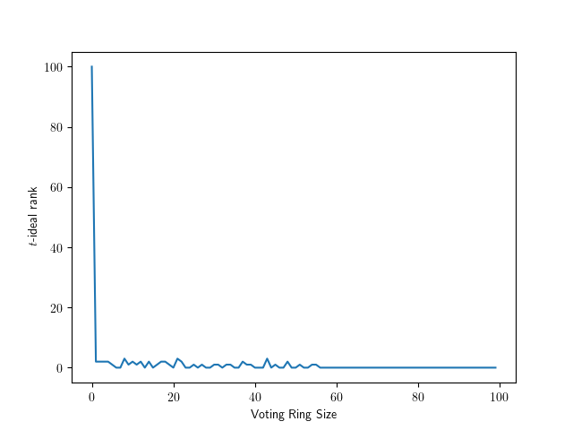
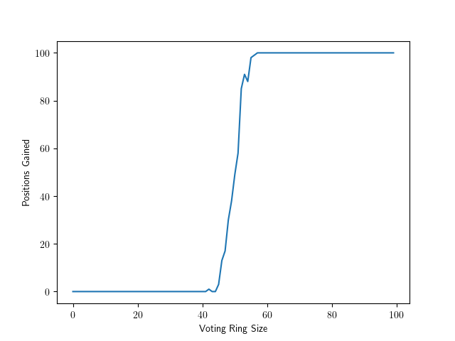
Simulation
Mixed honest-selfish

Slide 19
Conclusions
Steemit curates well in limited cases
More research into decentralized content curation needed

Slide 20
Future work
Analysis of other selfish strategies
Game-theoretic analysis
Dynamic post addition

Slide 21
Future work
Analysis of other selfish strategies
Game-theoretic analysis
Dynamic post addition
Thank you!
Questions?

