Slide 1

UNIT TWO
Friendship
Sept. 2007

Slide 2

Unit Two
Warming-up:
Input: sharing sayings + poems + songs + essays about friendship
II. Text A

Slide 3
Some sayings about friends/ friendship:
1. No man is an island. (by John Donne)
2. A friend is a second self.
3. Friendship is a single soul dwelling in two bodies. (by Aristotle )
4. No road is long with good company.
5. People are judged by the company they keep.
6. Be slow in choosing a friend, slower in changing. (by Benjamin Franklin)
7. Old wine to drink, old friends to trust, and old authors to read. (by Bacon)
8. A hedge (树篱) between keeps friendship green. 君子之交淡如水。
9. Familiarity breeds contempt.

Slide 4
Friendship
by Helen Foster Snow
Friendship is no common weed
That grows along the way.
It’s highly cultivated
And watered day by day.
……

Slide 5
G7
Auld Lang Syne (old long since)
Robert Burns
Should auld acquaintance be forgot,
And never brought to mind?
Should auld acquaintance be forgot
And days of auld lang syne?
And days of auld lang syne, my dear,
We'll take a cup of kindness yet,
For auld lang syne.
怎能忘记旧日朋友 心中怎能不怀想
旧日朋友岂能相忘 友谊地久天长
友谊万岁，朋友，友谊万岁
举杯痛饮 同声歌颂友谊地久天长

Slide 6
Friends, Good Friends --- and Such Good Friends
by Judith Viorst
Finish reading the passage in 5’, and then define …
5 categories of friends: convenience friends, special-interest friends, historical friends, crossroads friends, cross-generation friends
Define them：classification + characteristics
eg. Convenience friends are friends who we turn to for help, who provide us with convenience, and with who we maintain our public face and emotional distance.

Slide 7
Best friends, I still believe, totally love and support and trust each other, and tell each other the secrets of their souls, and run --- no questions asked --- to help each other, and tell harsh truths to each other when they must be told ….

Slide 8
The Gift of A Friend
Q. What would you compare a friend to ?

Slide 9
A friend is one of the nicest things you can have, and one of the best things you can be;
A friend is the one who will always be beside you, through all the laughter and tears;
A friend is the one you can always open up to;
A friend is a hand that is always holding yours, no matter where you are, no matter how close or far apart you may be;
A friend is someone who is always there and always cares;
A friend is a feeling of forever in the heart;
A friend is the one door that is always open;
A friend is the one to whom you can give your key.
A friend is a sanctuary (庇护所).
A friend is a smile.

Slide 10
Classroom activity: sharing poems
1. Compose a short poem (4-6 lines) of your own about your ideas of a true friend; (2-3’)
2. Share your poem within your groups; (4’)
3. Choose the best or the most interesting/ creative one to read to the class.

Slide 11
Questions for discussion:
1. What is friendship?
2. What do you think of a “fair-weather friend” ?
3. What factors are vital in establishing a true friendship?
4. What do you think may lead to the termination of a friendship?

Slide 12

Text A
All the Cabbie Had Was a Letter
Foster Furcolo

Slide 13


G R _ Scanning
Skimming
Skim Text A and decide which of the following statements is the theme. And why?
1. One should keep in touch with his friends.
2. Never delay expressing your true feelings to a friend.
3. A true friend will stand by you forever.
4. Late is better than never.
Never delay expressing your true feelings to a friend.

Slide 14
Text organization (P36)
1. Discuss
① How does the story begin?
② How did the two start the conversation?
③ What was the conversation centered on?
④ What do you think the author has learned from the cab driver’s story?

Slide 15
2. Organization:
The story is developed around “A letter”
Part I: Author and driver talk about the letter
(Para 1-20)
Part II Author reads the letter
(Para 21-35)
Part III Author writes a letter
(Para 35)

Slide 16
Reading skills:
Guess the meanings of the underlined parts in the sentences:
1. We used to call each other “Old Friend”, but I’m not much of a hand at writing. That’s why there isn’t much correspondence between us.
2. We should all keep in touch with old friends. But things come up and we just don’t seem to find the time.
3. It’s polite to ask the driver “Is your cab available?” before you get into the cab.

Slide 17
available: adj. (things) able to be used, had, reached or (sb) visited（东西等）可得到的；可用的；可买到的；（人）有暇的，可接见/客的
Eg. “Is your cab available?” (Para 2)
Tickets are available free of charge at the Students’ Union.
1. 钢琴考试已经考完了， 但成绩要等到两周后才能出来。
2. 这种新款iPhone 11现在没货。不过，一有货我们就会通知你的。
3. Mary已经名花有主了。你不要再打她的主意了/ 你还是省省吧。

Slide 18
1. The piano test is over, but the result won’t be (made) available until two weeks later.
2. This new iPhone 11 is not available right now. But we’ll let you know as soon as it becomes available/ is commercially available.
3. Mary is not available. She’s already got a boy friend. So save your trouble/ pains.

Slide 19
Part One (paras.1-20)
From a conversation with the cab driver the author learned how much he regretted failing to keep up correspondence with his old friend Ed.
available, estimate, keep up correspondence, on sb’s mind, not much of a, way (Para 8: … we go way back), kind of
might/ may (just) as well do …,
should have done
as if,
I take it that …
More A than B

Slide 20
Then, estimating (Para 5) that he was 60 or 70, I guessed: “ From a child …?”
Estimate: vt. form a judgment about (a quantity or value of sth) 估计
n. a judgment of the nature, value or amount, etc. of sth. 估计；估价
e.g. It is difficult to estimate the possible results in advance.
My estimate of his abilities was wrong.

Slide 21
estimate something at (a certain amount) :
Organizers estimated the crowd at 50,000.
译：据估计，比尔的个人财富高达368，000，000美元。
Bill’s personal riches were estimated at $368 million.
--- overestimate高估 / underestimate低估 overestimate vt. to think something is better, more important etc than it really is
Eg. 1. He tends to overestimate his own abilities.
2. The importance of training in health and safety cannot be overestimated (=is extremely important).

Slide 22
Come to think of it, it might/ may (just) as well have been a family.(Para 6)
might/ may (just) as well + do sth不妨；还是……为好
≠ may well do sth 满会/可能/可以，完全有可能
Eg. His appearance has changed so much that you may well not recognize him.

Slide 23
I’m not much of a hand at writing. (Para 6) I’m not good at writing.
not much of a: not a good … 不太好的
e.g. Some people may think that doing housework for others is not much of a career.
We haven’t had much of a summer / a National Day holiday this year.

Slide 24
I don’t think any of us keep up our correspondence too well. (Para 7): n.
1) the act of writing, receiving or sending letters (不可加s，但可加a，often followed by with + n. ) 通信（联系）
e.g. She kept up a fifty-year correspondence with Mary.
2) the letters that sb. receives or sends (used as an UN) 信件
e.g. Mary really never mentions her step-mother in her correspondence.

Slide 25
correspond (with sb; to/ with sth)v.通信；一致
Exchange letters with sb; To be the same as or match sth
Eg. He ~s with me regularly.
His actions do not ~ with his words.
His expenses do not ~ to his income.
correspondence: n.
Eg. personal/ private ~
The editor welcomes ~ from readers on any subject.

Slide 26
But I take it (that) he’s someone …… (Para 7) The sentence pattern “I take it (that)” is used to say you expect someone will do something, know something etc..我期望；我认为
e.g. 1. I take it (that) you’ve heard about the speech contest to be continued next Sunday.
2. I take it that most of you have adapted to college life here.

Slide 27
We were kids together, so we go way back. (Para 8)
Way: adv. (usu. put before prep./ adv.) by a large amount, very far 大量，很远
Eg. way ahead of sth/ sb
way above/ over/ beyond sth/ sb
way back (in …): a long time ago
Eg. Our friendship started way back in our childhood.
We all have a friend who knew us when it was maybe way back in the second grade ...

Slide 28
sort of/ kind of (Para 12 )
(infml) a little bit, in some way (used to modify v./ adj.) 有点儿；有几分
e.g. She wasn’t beautiful. But she was kind of cute.
She kind of hoped to be invited.
I sort of like him, but I don't know why.

Slide 29
It’s no fun losing/ to lose any friend…(Para 15)
It’s not enjoyable to lose a friend.
be no fun/ not be any fun: not be enjoyable
e.g. It’s no fun living by yourself.
It's no fun/ not much fun having classes on Saturdays.

Slide 30
on one’s mind (Para 16)
in one’s thoughts; of concern to one (if something is on your mind, you are worried or concerned about it and think about it a lot) 惦念；使人担心 ；有心事
e.g. Work is very much on her mind at the moment.
You seem quiet today. Do you have something on your mind?
(to one's mind; in one's mind)

Slide 31
more A than B / less B than A (Para 16)
与其说是B还不如说是A
Eg. more often than not
more brave than wise
His position is more in name than in reality.
I was more annoyed than worried when they didn’t show up.

Slide 32
come up (Para 17)
1) happen, occur, esp. unexpectedly 意想不到地发生，出现
e.g. “Sorry, I am late — something came up at home.”
2) be mentioned or discussed 被提到；被讨论
e.g. The issue of safety came up twice during the meeting.
A number of interesting points came up at today’s meeting.

Slide 33
Part Two (paras.21-35)
Reading the letter by himself, the author learned more about the lifelong friendship between the driver and Old Ed.

Slide 34
Halloween: (Para 21)
How much do you know about Halloween?
Eg. When to celebrate?
What to do?
Witches, Pumpkin, Jack-o-lantern, trick or treat etc.

Slide 35
Halloween (万圣节前夕)
annually celebrated on the night of October 31, when people once believed that ghosts could be seen. Now in Britain and America, it is a time when children have parties, dress up as witches, make lanterns out of pumpkins from which the inside has been removed, and play “trick or treat”.

Slide 36


Slide 37


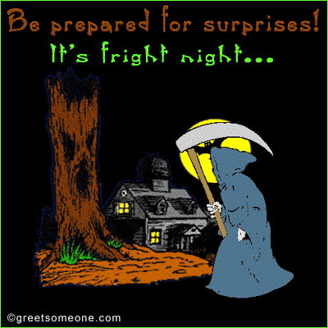
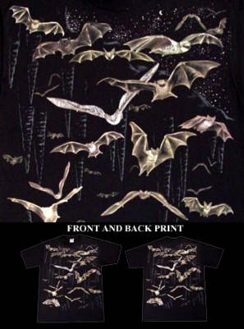
Create Images of witches, brooms and Bats

Slide 38
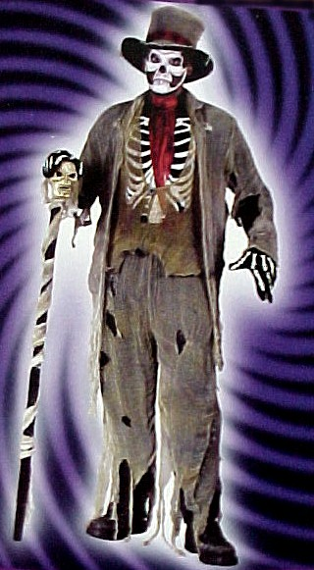
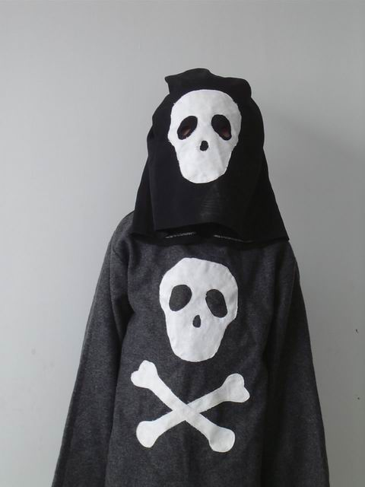
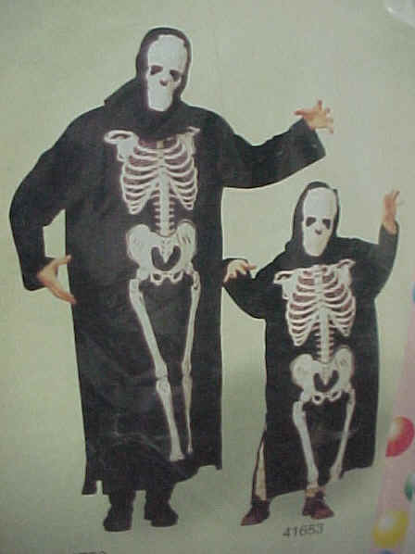
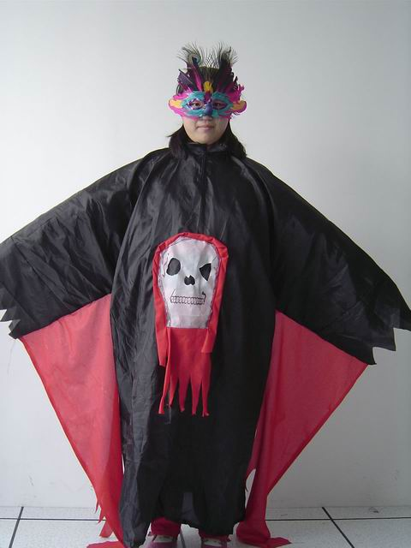
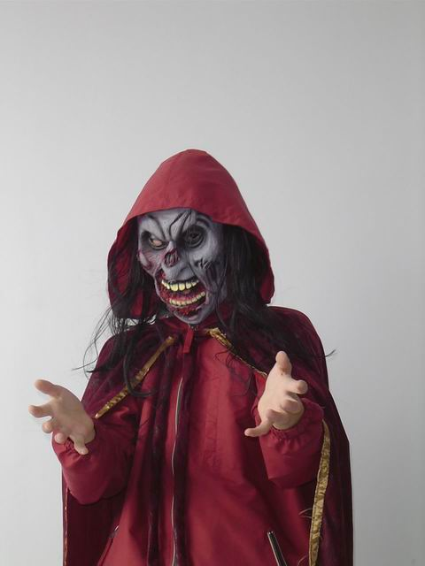
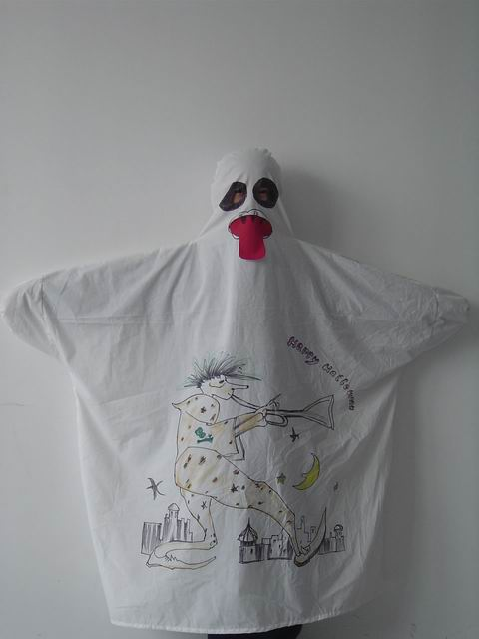

Wear Masks (戴面具)——usu. pretend to be witches, ghosts, skeletons, vampires (吸血鬼), etc.

Slide 39
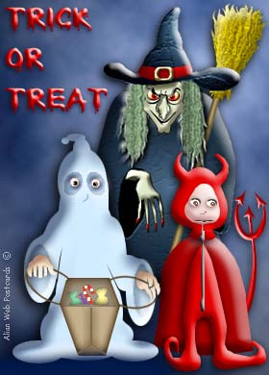
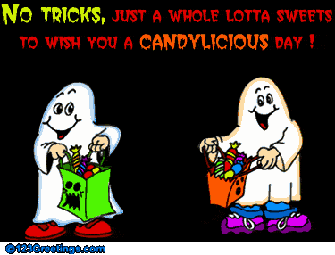
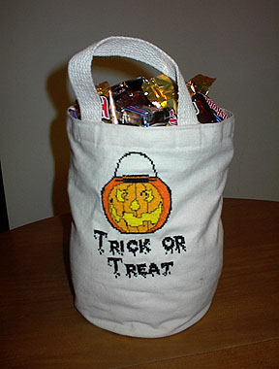

Trick or Treat（不给糖果就捣蛋）

Slide 40
Part 2 (Para 21-35)
Q1. What was/ were mentioned in the letter?
Q2. What did the two think were very important to maintain a friendship?

Slide 41
Part 2 (Para 21-35)
Q1. What was/ were mentioned in the letter?
Greeting
Good times: references to things such as Halloween, being kept after school etc.
Sad moments: not many left
Things done when single:
hang out
Things done after being married:
Friendship meaning an awful lot
Etc.
Q2. What did the two think were very important to maintain a friendship?

Slide 42
I’ve been meaning to do …(Para 21)
Mean: 1) intend to do but usually fail to 意欲
Eg. I’m feeling very guilty; I’ve been meaning to call my parents for days, but still haven’t got around to it.
2) be of value or importance to sb
Eg. Her son means the whole world to her. 她儿子就是她的一切。
Money/ Your friendship/ She means nothing/ everything/ an awful lot/ a great deal to me.

Slide 43
It had references to things … (Para 21)
refer to sth/ sb :
1) mention or speak about sth/ sb 提到，说起
Eg. refer to sb as a great guy
译：我们都知道玛丽说的是谁。
We all know who Mary is referring to.
译：这事已过去了，别再提了。
The matter is over, so don’t refer to it again.
2) look at sth or ask sb for information 查阅；征询
Eg. refer to your dictionary/ notes
refer to TV for the latest information

Slide 44
reference (Para 21) : n.
1) the act of talking about sb./sth., or mentioning them (usu. followed by prep. to) 提到；谈到
e.g. His recent book makes references to the political events of those days .
She made no/ passing reference to her husband. …只字不提 / 一语带过
2) the act of looking at sth. for information 参考；查阅
e.g. reference book 工具书
Put the directory near the phone for easy reference. … 方便查找。
part two

Slide 45
hang out (Para 28)
(infml; used mainly in AmE) (infml) spend a lot of time in a place 常去某处, 泡在某处
e.g. 1. I often hung out in coffee bars while I was unemployed.
2. She knew all the clubs where her husband usually hung out.

Slide 46

hang on : (hung, hung)
1) (to sth) : to keep hold of sth. 紧紧抓住
2) To continue waiting 继续等待
3) ( sth) :to depend on sth 决定于，有赖于（无被动语态）
Eg. 1) Hang on (to the strap): the bus is about to start.
2) I’m afraid the (telephone) line is engaged; would you like to hang on?
3) The future of the company hangs on the outcome of this meeting.

Slide 47
hang up (on sb): 挂断(某人)电话
hang about : (infml) wait or stay near a place, not doing very much (在某处附近)等待, 逗留, 闲荡, 徘徊 (= hang around)
hang out: (infml) spend a lot of time in a place 常去某处, 泡在某处
hang together: 团结一致，同心协力
Examples
I was so angry that I hung up on her.
I hung about the station for an hour but he didn’t come.
They normally hang out in the pub.
We must indeed all hang together.

Slide 48
awful (Para 29)
adj. (infml; used to add force) very great; very bad or unpleasant 非常的；极度的；糟糕的；可怕的
e.g. We had awful weather.
The smell was absolutely awful.
*an awful lot: a very large amount / number
e.g. There were an awful lot of people just standing around.
---awfully: adv.

Slide 49
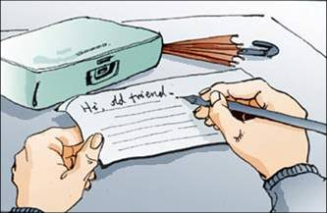
Part Three (Para. 36)
The driver’s experience urged the author to reach for his pen.
Q1: What lesson did the writer learn from the cabbie?
Q2: What word(s) should be stressed?
Why?

Slide 50
Try to find English equivalents in the text.
In-class translation work (6~8 minutes):
1. 完全沉浸于 2. 不着急
3. 保持通信往来 4. 不大擅长
5. 点头称是 6. 从小学一直到高中
7. 老街坊 8. 保持联系
9. 老同学聚会 10. 坐进后座
11. 对于某人意味深远
12. 常泡在图书馆里
Notes:
Be completely lost in
I’m in no hurry
Keep up our correspondence
I’m not much a hand at
Get one’s attention
All the way through high school
Old neighborhood
Keep in touch
A class reunion
Settle in the back seat
Time goes by.
Hang out on the same corner
Nod in agreement
In distance

Slide 51
1. be completely lost in sth
2. in no hurry
3. keep up correspondence with sb
4. not much of a hand at sth
5. nod in agreement
6. all the way through grade and high school
7. the old neighborhood
8. keep in touch/ contact with sb
9. a class reunion
10. settle into the back seat
11. mean an awful lot to sb
12. hang out in the library

Slide 52
Questions for thinking:
Friendship：
1. Why is friendship important?
2. How to maintain a friendship in the Cyber Age?
(Text 2 in Experiment Book)

Slide 53
Language:
1. subjunctive mood (虚拟语态)
2. basic differences between formal and informal English

Slide 54
Written English vs Spoken English:
Compare the following pairs:
1. Go on reading your letter.
Go ahead and finish your letter.
2. I’m not used to writing letters.
I’m not much of a hand at writing.
3. We have been friends since our childhood. So our friendship has a long history.
We were kids together, so we go way back.
4. For one reason or another you lose touch even though you never forget.
You kind of lose touch even though you never forget.
5. It’s painful to lose any friend.
It’s no fun to lose any friend.

Slide 55
In spoken English, sentences tend to be short and simple. Some sentences are incomplete. Choice of words is simple, colloquial, and informal, and even includes slang （俚语）.
More examples: “(Is the letter) From a child or maybe a grandchild?”
(You) Went to school together?
“Time.”
“(I have) Enjoyed talking with you.”

Slide 56
Some techniques employed to keep the conversation going:
1. The narrator expresses his agreement to show the cabbie what a sympathetic listener he is.
e.g. — “Letters from home always mean a lot. At least they do with me because I’m on the road so much.”
— “I don’t think any of us keep up our correspondence too well. I know I don’t.”

Slide 57
— “Well, we should all keep in touch with old friends more than we do. But things come up and we just don’t seem to find the time.”
— “You know, when it says here that there aren’t many of us left, that’s absolutely right.”
— “I know I’d like to receive a letter like that from my oldest friend.”

Slide 58
2. The narrator asks questions directly to get more information out of the cabbie.
e.g.
— “Did you two work at the same place?”
— “I thought your friend’s name was Ed. Why did he sign it Tom?”

Slide 59
3. Sometimes, he asks questions by making guesses about the past or predictions about the future.
e.g. — “From a child or maybe a grand child?”
— “You said ‘was’. Does that mean —?”
— “Went to school together?”
— “I take it he’s someone you’ve known quite a while?”
— “You must have spent a lot of time together.”
— “That must have made you feel good, didn’t it?”

Slide 60

Writing strategy on P52:
How to write a personal letter
Key points:
A. The heading (usu. date)
B. The salutation
C. The body
D. The complimentary close
E. The signature
Sept. 2007

Slide 61
B. personal letter writing:
10/20/2015 or
Oct. 20,2015
(Inside address X)
Dear Mary,
How are you? ……..
…………………………………………………..
………………………………………………….
Best wishes,/ Love,/
Keep me updated,/
Catch up next time etc.
Yours, …

Slide 62
Key to Ex (Unit 2)
Voc.
I. 1. 1) absolutely 2) available
3) every now and then
4) urged/ are urging (invest … in sth)
5) destination (as …, so… 正如…., 也…)
6) mostly 7) hangs out
8) right away 9) reunion
10) or something 11) estimate
12) going ahead (with sth)

Slide 63
2. 1) It seemed that his failure in the examination was still on his mind.
2) He was completely choked up by the sight of his team losing in the final minutes of the game.
3) She was so lost in study that she forgot to have dinner.
4) Something has come up and I’m afraid I won’t be able to accomplish the project on time.
5) The cost of equipping the new hospital was estimated at $2 million.

Slide 64
3. 1) were postponed, the awful, is estimated
2) reference, not available, am kind of
3) not much of a teacher, skips, go ahead
II. Collocation
1. to 2. for 3. at 4. from
5. in 6. to; on 7. on 8. with
III. Usage
1. more or less 2. kind/ sort of
3. Something 4. kind/ sort of
5. more or less 6. or something

Slide 65
Cloze
1.
1) choked up 2) awful 3) practically
4) neighborhood 5) correspondence
6) available 7) destination 8) reunion
9) Mostly 10) postponing 11) absolutely
2.
1) how 2) savings 3) embarrassment
4) phone 5) interrupted 6) touch
7) envelope 8) signed 9) message
10) needed

Slide 66
II. Translation
1. 1) Half an hour had gone by, but the last bus hadn’t come yet. We had to walk home.
2) Mary looks as if she is very worried about the Chinese exam because she hasn’t learnt the texts by heart.
3) Since the basketball match has been postponed, we might as well visit the museum.
4) He stayed in Australia with his parents all the way through World War Two.
5) Since I graduated from Nanjing University in 1985, I have kind of lost touch with my classmates.

Slide 67
Translation 2
It is not easy to keep in touch with friends when they are far away. This is certainly true in my case.
It has been a couple of years since I left my old neighborhood and all the friends I had there. I’ve been meaning to write to them but something comes up and I just don’t seem to find the time. Now I have kind of lost touch with them. They are always on my mind, however, and I think I will certainly make an effort to keep up correspondence with them in future.

Slide 68
Homework:
1. Review what has been discussed in Unit 2.
2. Do the following exercises.
3. Finish reading Text B; Texts 1+2.
4. Preview Unit 4
The American Dream

Slide 69
Thank you!

