Slide 1
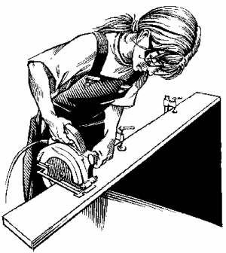

Unit 6
Women, Half the Sky

Slide 2
Female-related words
feminism n. 女性主义、女权主义
feminist n. 女性/ 权主义者
feminine a. 有女性气质的，适于女子的
femininity n. 女人风度，阴柔；（总称）妇女
tomboy n. 假小子, 野丫头
•

Slide 3
Male-related words:
(male) chauvinism/ masculinism n.
沙文主义、 大男子主义，
（sexism (尤指对女性的)性别歧视、偏见）
male chauvinist/ sexist n. 男权主义者/ 性别歧视者
masculine adj. 男子汉的，阳刚的
masculinity n. 男子气概，阳刚之气
sissy n. 女孩气的男孩; 怯懦的男孩

Slide 4
Feminism: Past and Present
Feminist movement:
reproductive rights (生殖权)，maternity leave (产假)，equal pay, women’s suffrage (参政权、选举权);
domestic violence (家庭暴力)，sexual harassment (性骚扰) etc.
1st wave (1900s): women’s suffrage (Virginia Woolf 弗吉尼亚•伍尔芙)
2nd wave (1960s-1980s): laws and culture (Simone de Beauvoir 西蒙•德•波伏娃)
3rd wave (1990s - ): greater achievements

Slide 5
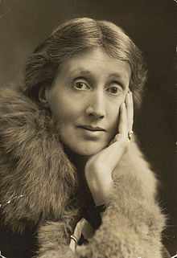

Virginia Woolf (1882-1941 伍尔夫/ 芙 an English writer of short stories, essayist, publisher, a pioneer in the use of “stream of consciousness”<意识流>) (P167)
& A Room of One’s Own
“Women are simultaneously victims of themselves as well as victims of men and are upholders of society by acting as mirrors of men.”

Slide 6

Simone de Beauvoir (1908-1986 西蒙·德·波伏娃 or 西蒙·波娃 a French writer, existentialist philosopher, feminist) (P167)
& The Second Sex
Jan 9, 1908 Paris
Philosophical interests: Existentialism （存在主义）, Feminism, etc.
Mate: Sartre (萨特1905-1980) (unmarried couple)
Ideas: (The Second Sex) (1949)
“One is not born, but rather becomes, a woman.” (P167)
Notes:
Never marry, never set up a joint household with Sartre, no children
Advanced academic degree,

Slide 7
Girls are expected:
to cry and need comforting;
to keep clean;
to play with dolls;
to stay at home;
to pick flowers;
to look after babies;
to be appearance-conscious ;
to be tender;
to be affectionate;
to keep out of trouble;
not to use bad language;
not to fight.

Slide 8
Boys are expected:
to get dirty;
to swear;
to fight;
to wrestle (摔跤);
to play with guns;
to play out;
to climb trees;
to play cowboys;
to win aggressively;
to be tough;
to be ambitious;
not to be crybabies.
Oh, well, boys will be boys.
from Violence by Colin Ward

Slide 9
Qs for discussion:
1. What are these words mainly about?
2. Can you imagine a world without men?
Stereotype n./ v. 公式化/模式化/老一套的看法/观念/形象，刻板模式
Stereotypical adj.
Cultural/ traditional cues + Social expectations:
(cue: sth that serves as a signal for sb to do sth 暗示，提示)

Slide 10
I Want A Wife
by Judy Syfers
Q1. What is the stereotypical image of a wife?
Q2. What do “a wife’s duties” include?
Q3. Do you think the author really means what is said in the article? Why/ Why not?
Q4. What do you think the author wants to say?

Slide 11
. Briefly comment on the following:
1. (G1+2) “Because I am a woman, I must make unusual efforts to succeed. If I fail, no one will say, ‘She doesn't have what it takes.’ They will say, ‘Women don't have what it takes.’ "
Clare Boothe Luce
2.(G3+4) “The emotional, sexual, and psychological stereotyping of females begins when the doctor says, ‘It’s a girl.’ ” Shirley Chisholm (雪莉•奇泽姆)
3.(G5+6) “Women are simultaneously victims of themselves as well as victims of men and are upholders of society by acting as mirrors of men.” Virginia Woolf
4.(G7+8)“One is not born, but rather becomes a woman.” Simone de Beauvoir

Slide 12

Text A
A Woman Can Learn Anything a Man Can

Slide 13

Outline: P165
Finish skimming the passage in 5 minutes.
Ex. 1
Parts
Para(s).
Main Ideas
1
1~5
The author describes how she stumbled into engineering.
2
6~9
The author writes about how she has overcome obstacles, including the prejudice (偏见) against women, on her way to success.

Slide 14
Parts
Para(s).
Main Ideas
3
10~11
The author draws the conclusion that women can do anything men can as long as they believe in themselves.

Slide 15
stumble into sth: (Para 6) become involved in sth by chance; step into sth accidentally
无意间涉足某事,偶然步入,误打误撞
Eg. stumble into business/ acting
As young people stumble into society, they often face confusion and illusion.
Much of what I stumbled into by following my curiosity and intuition turned out to be priceless later on. --- Steve Jobs

Slide 16
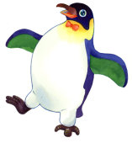
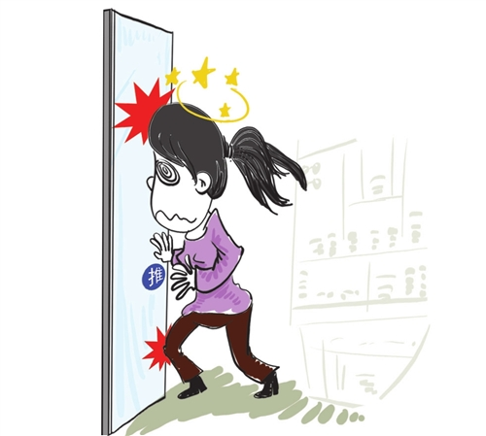
Stumble:
If you stumble, you walk unsteadily or hit your foot against sth while you are walking or running and nearly fall over. 跌跌撞撞；绊了一下
有一天她太累了，结果撞到玻璃门上了。
One day she was so exhausted that she stumbled into the glass door.

Slide 17
Part One: (Para 1-5)
The author describes how she stumbled into engineering.
Q1. Why does the author say that some people may find it ironic that she grew up to be an engineer?
Q2. Why did the author sign up for the summer program?

Slide 18
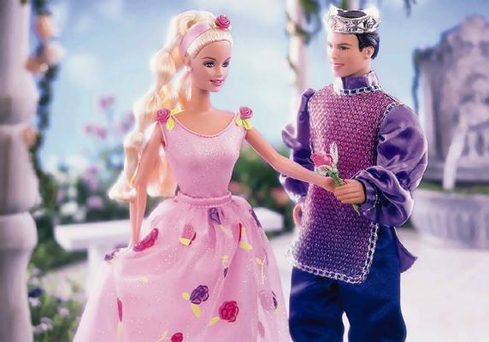


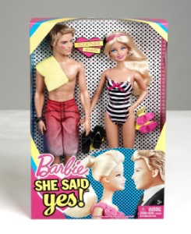
My Little Ponies + Barbie and Ken dolls

Slide 19
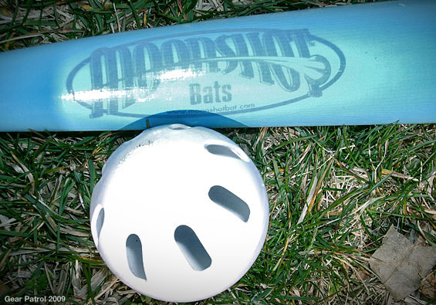

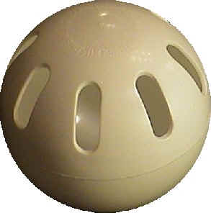

Slide 20
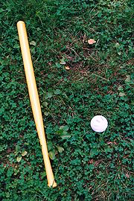
Wiffle-ball set
Wiffle ball (空心棒球游戏) is a variation of the sport of baseball designed for indoor or outdoor play in confined areas. The game is played using a perforated (有孔的), light-weight, rubbery plastic ball and a long, plastic (typically yellow) bat.

Slide 21
Convert: (Para 2)
v (~ sth from … to/ into …) change the nature, form, purpose, function, or system of something; change one’s religion （使）转变/换/化；皈依
Conversion n.
Convertible adj. ~ into / to sth 可改变/ 转换/兑换的

Slide 22
Eg. 1. convert wind to/ into electricity；convert dollars into pounds/ Reminbi
2. They converted the study into a nursery when the baby was born.
3. convert sb (from Buddhism) to Christianity

Slide 23
Para 3:
1. Topic Sentence?
2. subjunctive mood:
1) I couldn’t/ can’t have distinguished …..
我那时不可能辨别…
2) … Because honestly, the mechanic could have shown me an electric can opener…
因为说实话，（如果我把车开过去修理,) 他会给我一把电动开罐器 …
3) … and I wouldn’t have known any better.
… 我也不会知道他是在骗我…
… and (if he had shown me … and said to me …,) I wouldn’t have known any better.

Slide 24
distinguish:
recognize the difference between two; be a characteristic that makes two different from each other; be able to see or hear sth; do sth to make oneself stand out (eg. ~ oneself as sth) 区/ 分别； 使…有别于, 具…特色；看清, 辨出；使出众
Eg. distinguish (between) A and B;
distinguish A from B
One twin distinguished from the other by the scar on his cheek.
Zhang Yi-mou has already distinguished himself as a director. …. 享有盛名。
distinguished adj. 著名的，卓越的
distinguishable adj. 能被辨认出的

Slide 25
not know/ understand the first thing about sth/ sb (Para 3)
对 … 一无所知/一窍不通
Eg. Sorry, I don’t know the first thing about stocks.

Slide 26
not know any better: (Para 3)
(sb) to do sth bad or stupid because they haven’t been told that it is wrong 因无知而做错事/傻事
Eg. ______ (无知的孩子们) may think these animals are pretty cute and start playing with them.
Children who don’t know any better
Para 3:
I wouldn’t have known any better
(if the mechanic had shown me an electric can opener….)
…我也不会知道他是在骗我…(我也会就范/ 干傻事)

Slide 27
know better than that/ than to do sth…
If someone knows better than that or than to do something, they are sensible enough not to do sth or to know it is wrong to do sth. 明白事理（不至于做…），不至于糊涂到…
Eg. 1. She knew better than to argue with her boss.
2. You left your kid at home unattended? I thought you’d know better.
译：她还不至于糊涂到要跟她老板理论。
… 我还以为你不至于这么糊涂呢。

Slide 28

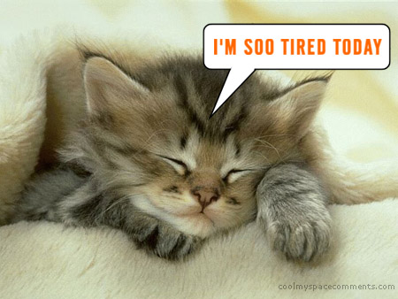
crave: vt./ vi. have a strong desire for sth.
The tired old man craved for a rest.
All the men present are not hesitant to give her the admiration she craves (for).

Slide 29



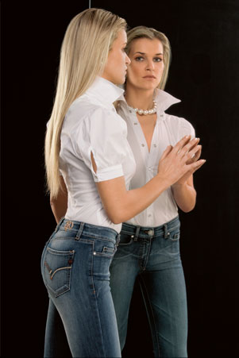

decent
1)
proper; socially acceptable 得体的,像样的
We must provide decent housing for the poor.
The hospital has no decent equipment.
第一次见面时得体的衣着会给人留下好印象。
A decent dressing at first meeting will leave a good impression.
That one isn’t decent. You should wear an evening dress, not a pair of jeans.

Slide 30
decent
2）satisfactory; quite good 相当好的
A decent job, an affectionate wife and several lovely kids are all that a man dreams of and strives for.

Slide 31
PART TWO (Para 6-9)
The author writes about how she has overcome obstacles, including the prejudice against women, on the way to success.

Slide 32
I can’t help shuddering when I hear about the studies that show that women are at a disadvantage when it comes to math: (Para 6)
at a disadvantage: 使处于不利地位
The lack of public transport has put this city at a disadvantage.
When it comes to (doing) sth: 当说/提/谈/讲到….
当说到赚钱时，没人能比得过盖茨。
When it comes to earning money, no one can beat Bill Gates.

Slide 33
Most people think that when you are good at something, it comes easily to you. (Para 7)
come easily/ naturally to sb: (of an activity, a skill, etc.) to be easy, natural, etc. for sb to do （活动，技能等）对某人而言轻而易举
Eg. Math and science don’t come easily to most people. (Para 11)

Slide 34
Just because a subject is difficult to learn, it doesn’t mean you are not good at it. (Para 7) →
Just because a subject is difficult to learn doesn’t mean you are not good at it.
Q. What does a difficult subject mean to the author?
grit your teeth (gritted)
grit: vt. grit one’s teeth 鼓起勇气，下定决心
n. 毅力，勇气

Slide 35
I was lucky enough to have a teacher who didn’t take my bad grades as a judgment of my abilities, but simply as an indication that I should study more. (Para 8)
值得庆幸的是我有一位老师，他没有根据我的低分来衡量我的能力，而是认为低分只表示我应下更大功夫。

Slide 36
Panic: (Para 9) n./ vt./ vi. (panicking, panicked) an overwhelming feeling of fear and anxiety
I got into a panic / panicked when I found the door was locked.
panic sb (into doing sth): 使某人仓皇行事
The thought of flying fills me with panic.

Slide 37
Para 9:
1. Cultural cues: ?
2. No man is an island. No woman is, either. ?
3. What is the faulty premise?
4. What does the author want to say?

Slide 38
Para 9:
Cultural cues implied? Effect of cultural cues?
1. I had moments of panic … when I worried that the estrogen (雌激素) in my body was preventing me from understanding thermodynamics.
2. I didn’t want to choose between my femininity and a good career.
3. I reminded myself that those studies that say math comes naturally to men are based on a faulty premise, that is, you can judge a person’s abilities separate from the cultural cues she has received ever since her infancy.

Slide 39
Part 3: (Para 10-11)
The author draws the conclusion that women can do anything men can as long as they believe in their own abilities.

Slide 40

limit: vt./ n. (Para 10) 限制/ 度 (to a certain amount/ number)；n. 极限，限量 （on sth）
Eg. 1. push/ stretch/ test sb/ sth to the limit 推/拉/考查 (sb/sth) 达到限度
2. His arrogance/ rudeness knew no limits/ bounds. 极其傲慢/无礼。
3. The sky is the limit.
4. The doctor limited the patient to one cigarette a day.
5. Please limit your short play to 10 minutes.
6. Strict limits have been set on levels of pollution. 对污染程度已经作了严格限制。
off limits (to sb) = out of bounds (to sb) <BrE>
禁止某人入内

Slide 41
Deny v. (Para 10)
say that (sth.) is not true 否认
Deny (doing) sth; Deny that ….
.
2) refuse to give sb. sth, or prevent sb. from having 拒绝给予
deny sth (to sb); deny sb sth
Eg. 1. She was angry at being denied the opportunity to see the boss.
2. 他太娇惯孩子了，对孩子简直就是百依百顺。
He was too kind to his boy, so much so that he denied him nothing.
There is no denying (the fact ) that… 无可否认…

Slide 42
Para 10:
Q1. To what are we so quick to limit ourselves?
Q2. The author’s suggestion?

Slide 43
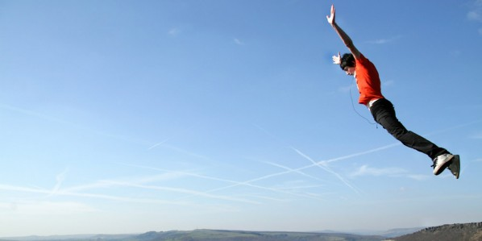
leap: (Para 11)
n. a light movement upwards or forwards
跳，跃
That’s one small step for a man, one giant leap for mankind.
2) v. jump vigorously; move quickly
(leapt, leapt) or (leaped, leaped)
My heart leapt for joy at the news.
Look before you leap.

Slide 44
D R _ word _ leap _2
Collocation：
by/ in leaps and bounds
非常快地;飞跃地，突飞猛进
a leap in the dark
冒险举动，瞎闯
to leap at a chance to do …
立刻抓住机会
Para 11: … and that takes a leap of faith.
大胆一试的精神

Slide 45
Para 11:
What does the author encourage people to do?

Slide 46
Key to Ex.
Vocabulary:
I. 1. 1) cultural/ culture 2) indication
3) miniature 4) ironic
5) stumbled into 6) decent
7) buzzing 8) abnormal
9) mechanical 10) Shuddering
11) implied 12) leap
(take a leap in the dark)

Slide 47
2. 1) … convert RMB into US dollars in the foreign exchange office at the airport
2) … didn’t know the first thing about cooking as she looked puzzled as to how to cook rice with the rice cooker
3) … their faulty equipment the team had accomplished some very useful work
4) … allowing me to work flexible hours as long as I work eight hours a day
5) …couldn’t help thinking the book must be quite fascinating
(can’t help doing sth = can’t help but do sth 忍不住，禁不住，不禁；未能避免、阻止)

Slide 48
3. 1) will not panic/ will not feel panicky
will be at a disadvantage
2) hybrid, transmissions
3) crave, One indication, to distinguish
II. Synonyms in Context:
1. also 2. as well
3. too 4. also
5. too 6. too
7. also 8. Also

Slide 49
III. Usage:
1. I’ve had enough
2. When I was old enough to work and earn money
3. can’t get enough sleep at night
4. has so far collected enough of them
5. have strong enough arms
6. have just enough money to live on

Slide 50
Cloze 1:
1) stumbled into
2) not know the first thing about
3) mechanical 4) when it comes to
5) hybrid 6) gritted her teeth
7) premise
8) at a disadvantage
no more A than B (同样都不…)
9) panic 10) cultural
11) flexible 12) imply

Slide 51
Cloze 1:
8) at a disadvantage
Girls, she argues, are no more at a disadvantage in this respect than boys. (Nonetheless, she still had moments of panic …)
no more A than B (同样都不…)
女生像男生一样，同样都不是处于劣势。
Eg. 1. He is no more able to read Spanish than I am.
他和我都不懂西班牙文。
2. The Web is no more dangerous than anything else in the world. In fact, the Web, in itself, is fairly harmless.

Slide 52
Cloze 2:
1) chair 2) force (in full force: )
3) secrets 4) painstaking
5) recognized 6) steered
7) essentially 8) observations 9) women
10) tutor 11) inspired 12) unless
Q. What is the last paragraph mainly about?

Slide 53
Translation 1:
1. He is a man of few words, but when it comes to playing computer games, he is far too clever for his classmates.
2. Children who don’t know any better may think these animals are pretty cute and start playing with them.
3. There is no way to obtain a loan, so to buy the new equipment, I’ll just have to grit my teeth and sell my hybrid car.
4. The hunter would not have fired the shots if he had not seen a herd of elephants coming towards his campsite.
5. I find it ironic that Tom has a selective memory --- he doesn’t seem to remember painful experiences in the past, particularly those of his own doing.

Slide 54
Translation 2:
Nancy Hopkins is a biology professor at MIT. She craves knowledge and works hard. However, as a scientist, she could not help noticing all kinds of indications of gender inequality on campus. Men and women professors did the same work, but when it came to promotion, the administrators were rather selective. It was ironic that after so much cultural progress women were still at a disadvantage in institutions of higher education. When her request for more lab space was refused, she knew she had to fight. So she gritted her teeth and complained to the President. The fight ended in victory and Nancy was converted into a gender-equity advocate.

Slide 55
Homework:
1. Review Text A + Vocabulary.
2. Do the following exercises, especially Cloze 2.
3. Finish reading Text B + Texts 1+2, U6, in Experiment B2.
4. Proceed with your Short Play scripts.
5. Preview U4.
6. Prepare a 6~8-minute presentation about the major influence of the Internet on human life (G3) and language (G6). Share next time.

