Slide 1


Unit 7

Slide 2
Importance of Animals:
1. Human beings
2. Language
3. Culture

Slide 3
Phrases about animals
Please fill in the blanks
as brave as ____
as busy as ____
as slow as___
as hungry as ____
5. as proud as ____
6. as strong as ____
7. as tall as ____
8. as blind as___
a lion
a peacock
a bee
a horse
a snail
a giraffe
a wolf
a bat

Slide 4
Culture:
Animal sign;
Star sign

Slide 5











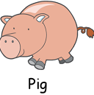
Animal Signs (Chinese Zodiac生肖)

Slide 6
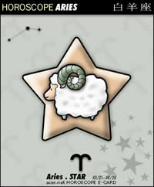


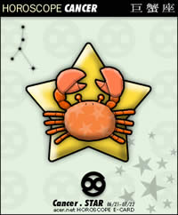








Horoscope（占星术）
Aries白羊
Taurus金牛
Gemini双子
Cancer巨蟹
Leo狮子
Virgo处女
Libra天秤
Scorpio天蝎
Sagittarius射手
Capricorn摩羯
Aquarius水瓶
Pisces双鱼

Slide 7
The 10 most intelligent animals:
1. Man
2. the chimp: better memory than man; 98% similar genes to Man’s
3. the dolphin: even more creative when realizing that it will be rewarded if it can perform new tricks
4. the elephant: able to comfort family members and offer help; able to recognize herself in the mirror
5. the octopus (章鱼): eg. Paul could predict the result of competition …

Slide 8
6. the crow (乌鸦): clever and deft at making tools
7. the squirrel: good at deceiving
8. the dog: man’s best friend, one of the most versatile animals
9. the cat: strong adaptability
10. the pig: loving cleanliness

Slide 9
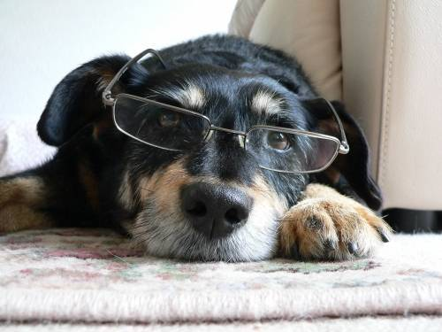
Unit 7 Text A
What Animals Really Think?

Slide 10
Text Organization (P186)
The text is a piece of expository writing. The purpose of exposition is to explain.
Now, skim the passage for 5 minutes and then figure out:
1. What does the author Eugene Linden want to express/ explain?
2. How does the author illustrate his point of view?
3. How many parts are there in the passage?

Slide 11
Text Organization (P186)
Exposition:.
1. three parts
2. the author’s point of view:
3. ways of illustrating his point of view:

Slide 12
The passage can be divided into three parts.
Part I ( para.1-2, an introduction)
Part II ( para.3-12, supporting facts grouped under three subheadings)
Part III ( para.13, the conclusion)

Slide 13
Sentences serving as a switch in the context:
Part One: 1. Do animals really have thoughts?... If … , … do their best thinking when it serves their own purposes, not when scientists ask them to. (Para 1)
2. And so I started talking to vets, …. …. a new window on animal intelligence: the kind of mental feats animals perform when dealing with captivity and the dominant species on the planet --- humans. (Para 2)

Slide 14
Part Two: supporting facts
Main ideas?
1. Let’s Make a Deal. (Para 3-6)
2. Tale of a Whale. (Para 7-10)
Why would an animal want to cooperate with a human? …. in their own interest to do so. … I don’t think it goes far enough. (Para 7)
3. Primate Shell Game. (Para 11-12)
Sometimes evidence of intelligence can be seen in attempts to deceive. (Para 11)
Para Three: Conclusion --- Some animals far more intelligent than imagined (Para 13)

Slide 15
Part Two: Main ideas?
Three aspects of animal intelligence:
1. Ability to negotiate,
2. Ability to assess a situation and act accordingly,
3. Ability to deceive.

Slide 16
Part I (para.1-2, an introduction)
Some animals demonstrate intelligence when dealing with captivity and dominant human beings.

Slide 17
Part II(para.3-12, supporting facts grouped under three subheadings)
Subheadings Main Ideas
Let’s make a deal
  Some animals are so intelligent that they know how to bargain with people. (trade A for B; negotiate )
Tale of a Whale
  Animals like whales can judge/ assess a situation and act accordingly. (size up, cooperate)
Primate Shell Game
  Animals sometimes can be tricky. (deceive sb into/ out of doing sth)
Main Ideas

Slide 18
Part III (para.13, the conclusion)
Some animals are far more intelligent than imagined.

Slide 19
Part I (para.1-2, an introduction)
Some animals demonstrate intelligence when dealing with captivity and dominant human beings.

Slide 20

Para 1: intelligence:
1) ability to learn and understand 智力，理解力
e.g. I.Q.=intelligence quotient
2) 情报
e.g. intelligence department
CIA= the Central Intelligence Agency

Slide 21
Controversy (Para 1) n. (~ over/ about sth)
public discussion or argument about sth which many people disagree with 争议
  E.g. Human cloning has long been the subject/ issue of much ~.
  克隆人类一直是一个颇有争议的题目.
controversial adj.
  E.g.
a highly ~ subject (figure, speech)

Slide 22
Do animals really have thoughts, what we call consciousness? (Para 1)
Do animals really have thoughts that we call consciousness?
在本句中what 等于the thing that，与 thoughts是同位语(apposition)。

Slide 23
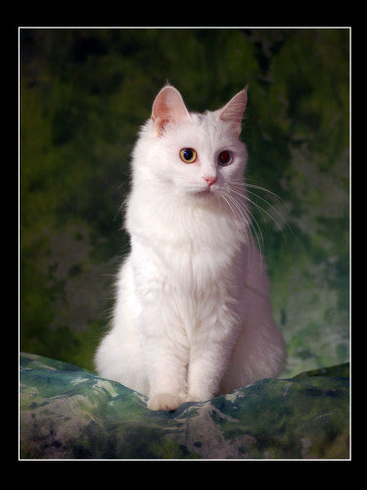
Wondering whether there might be better ways to explore animal intelligence than experiments designed to teach human signs. I realized … (Para 1):
In the 1960s and 1970s, some scientists tried to teach intelligent animals to communicate with humans by means of sign language.
Q1. What’s wrong with those experiments?
Q2. What is AI according to the author?

Slide 24
… if animals can think, they will probably do their best thinking when it serves their own purpose, not when scientists ask them to.: (Para 1) 如果动物能思维，那么它们会在自身确有需要的时候，而不是在科学家让它们思维的时候作出最佳思维。
serve one’s purpose= serve one’s needs (= be useful or helpful for a particular purpose)有用,有利; 满足…的需要
Q. What is animal intelligence in the author’s opinion?

Slide 25
Para 2 : Comprehension Questions
1. Why did the author talk to people like vets, animal researchers and zoo keepers?
2.What does the author think of the stories they told him?
---Most do not study animal intelligence, but they encounter it, and the lack of it, every day.

Slide 26
reveal
vt. to make known 揭示，显示，透露
*reveal + sth (to sb)
* reveal + that-clause
Eg. A recent survey reveals that a growing number of children in cities are overweight.
Notes:
This deeds reveal that he is an honest person.

Slide 27
convince vt. succeed in making sb believe sth 说服，使相信
* convince sb of sth
* convince sb +that-clause
使某人相信…
e.g. We finally convinced John of our innocence.
I’ve been trying to convince the students that English is learned not taught.
Sb. is convinced that…
Notes:
We are convinced that she id doing her best at fulfilling this task.

Slide 28
feat (Para 2)
(= successful completion of sth needing skill, strength or courage)技艺,业绩,功绩 (着重强调在脑力或体力方面完成某事物的艰巨性)
e.g. The new bridge is a feat of engineering.
这座新桥梁堪称工程上的伟绩.
The backward dive from such a great height is quite a feat.
从这样的高度背跳入水真不容易.

Slide 29
dominant ：(Para 2)
adj. stronger, more important, more powerful, or more noticeable than other people or things 突出的，占支配地位的，显著的，首要的
e.g. a dominant personality 霸道的性格
play a dominant role 起着举足轻重的作用

Slide 30
Dominate
vt. control over sth/sb 支配，控制
e.g. dominate one’s desire 支配某人的欲望
dominate the conversation 在谈话中占上风
译：因特网支配了我们的生活，进而产生了所谓的“网络经济学”。
The Internet has dominated our lives and thus brought about the so-called web-economics.

Slide 31
Part II (para.3-12): supporting facts
Let’s Make a Deal: negotiate, bargainer, trade … for ..
Tale of a Whale: assess, size up
Primate Shell Game: deceive

Slide 32
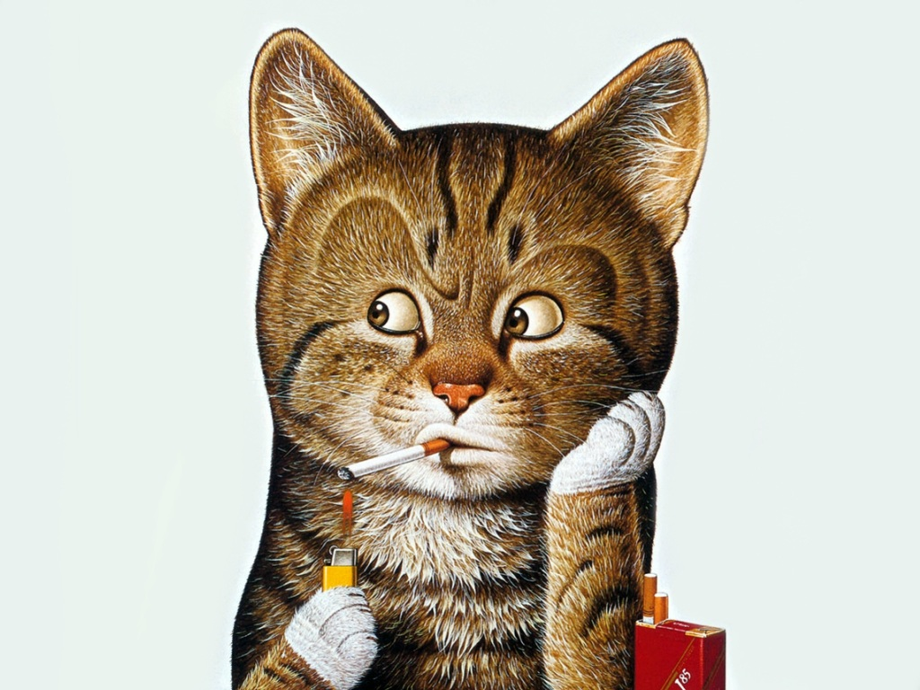
Let’s Make a Deal!!!

Slide 33
make/do a deal
reach an agreement, esp. in business, on certain terms for buying or doing sth 达成协议
e.g. 1. Japan has to make a deal with America on rice imports.
2. The workers have done a deal with the management on overtime.
工人已与管理方就加班达成了协议。

Slide 34
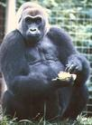
Section 1 Skimming and Scanning : Let’s Make a Deal
Filling in the blanks with the information about the animals mentioned in this part and figure out the author’s purpose
Broke the key chain
(1) Colo: ___________________
Author’s Purpose:___________________________________________
Animals know how to negotiate with people.

Slide 35
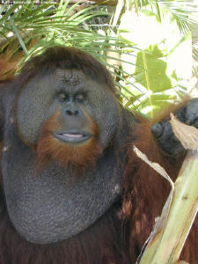
(2) Chantek:
① _______________
②__________
Expanded the money supply by breaking plastic chips in two
Found pieces of tin foil (锡箔) and tried to make copies of metal chips
Author’s purpose: __________________________________
Animals can even handle money

Slide 36
* Arriving on the scene, Jendry offered Colo some peanuts, only to be met with a blank stare. (Para 3)
*arrive on the scene : arrive at the place where sth happened
only to do sth (=used to introduce an unexpected result, esp. sth that causes surprise or disappointment)结果却…; 不料…(尤指出乎意料的结果，使人惊讶,失望等的事)

Slide 37
e.g. He spent ages negotiating for a pay rise, only to resign from his job soon after he’d received it.
他花了很长时间与老板商讨加薪,结果给他加了薪,他却辞职了.
Trans: 他终于鼓足勇气约那个女孩共进午餐时，结果发现那女孩有很多男朋友。
He finally squared himself and asked the girl to lunch together, only to discover that she had an awful lot of boyfriends.
Notes:
He finally decided to invite the girl to dinner, only to find that she had many boyfriends.

Slide 38
Negotiate (Para 3)
v. discuss in order to come to an agreement 协商，谈判
negotiate with sb 与…协商/谈
negotiate for sth 为…协商/谈判
negotiate to do sth 协商干…
negotiate on/over sth 就…而协商/谈判
negotiation: n.
Notes:
Franklin helped negotiate a peace treaty with Great Britain.

Slide 39
* raise the stakes/ lose one’s stakes (Para 3) : 加大筹码/输掉赌金
stakes (pl): sth that you risk losing, esp. money, when you try to predict the result of a race, or when you are involved in an activity 赌注
(pull up stakes: 离乡背井；搬家，迁址
stake --- a wooden or metal post pointed at one end and pushed into the ground to support sth or mark a place 标桩，篱笆桩 )

Slide 40
maintain (Para 3): 1. continue to have 保持，维持
Eg. maintain silence/an increase/ one’s health
2. keep a machine/building in good condition by looking after it 保养
eg: maintain a house/ a car
3. strongly express your belief that sth is true 坚持，主张 (=insist)
maintain +that-clause 坚持认为…
Notes:
I maintain that it is unreliable to fall in love with sb at the first sight.

Slide 41
relieve (Para 4)
vt. remove or reduce an unpleasant feeling, such as pain, anxiety, stress etc. ；make a problem less serious 减轻（痛苦，负担等），解除，缓和
Eg. relieve sth: relieve anxiety/ guilt/ unemployment
* relieve sb of sth
Taking a part-time job would relieve you of the financial burden.
* relieved adj.释然的，放松的
* relief n. 减轻，缓解，救济

Slide 42
Why give her the whole thing if I can get a bit of pineapple for each piece? (Para 4)
Why should I give her the whole thing if I can get a bit of pineapple for each piece?
  Why + do sth
  Why not do sth

Slide 43
Phrase Translation (para. 5-6)
1. trade A for B 用A交换B
(exchange A for B)
2. undertake a study 进行一项研究
3. figure out 理解
4. extend far beyond sth 远远超越
5. switch to sth 转向…
6. virtuous habits 好习惯

Slide 44
Extend: (Para 5) vt./ vi.
1. (make sth) stretch or reach sth else (使)伸展，延伸
Eg. ~ one’s hands/ body
The plain ~s as far as the eye can see.平原一望无际。
2. make sth longer/ larger/ wider 使伸长，扩大，扩展
eg. ~ a garden/ a road
The express-train service has been ~ed to many cities.
3. make sth last longer 使延长，展期
eg. ~ a deadline/ visa
They ~ed their visit another day.

Slide 45
expand (Para 5): vt./ vi.
1. increase in volume, esp. when heated 膨胀
Eg. Metals ~ when they are heated.
2. increase in size, volume, number, importance; grow larger 扩大，增加，增强
e.g. Student numbers are ~ing rapidly.
One’s vocabulary ~s mainly through reading.
expand one’s interest 拓宽某人的兴趣
expand/ broaden one’s mental horizon / one’s mind 开阔眼界
Reading/ Travel ~s one’s mind.
Mary ~ed her article into a book. 把一篇文章扩写成一本书。

Slide 46
switch .v. (Para 5 )
change or shift 转换，转变
搭配：
switch sth to sth 转换到另一事物
switch from sth to sth else
Let’s switch the conversation to another topic.
让我们把谈话转换话题。
He used to play tennis, but now he’s switched to golf.

Slide 47
envy v./ n. (Para )
wish that you had a quality or possession that another person has, 羡慕，嫉妒
搭配：
envy sb/ sth
envy sb sth
envy sb for sth
envy sb doing
eg. Everyone envies his good luck.
译：没人会嫉妒你的高薪水因为是你该得到的。
No one will envy you for your high salary for you deserve it.
envious adj.

Slide 48
Section 2: Tale of a Whale
Key words:
assess a situation and act accordingly;
cooperate

Slide 49
* be in one’s interest(s) to do sth (Para 7) :
be helpful for sb to do sth 做…对某人
有好处
e.g. It is in your interest to put your point of view first.
Raising the food price is not in public interest. 提高食品价格对公众不利。

Slide 50
Comprehension question:
---This is true, but I don’t think it goes far enough. (Para 7) 我觉得这一解释尚不充分。
Q. Why doesn’t the author think it goes far enough?
* go far enough: (usu. in questions and negative sentences) achieve much success 达到目的
The new legislation is welcome but does not go far enough. … 但力度还不够大。

Slide 51
Go far: (of people) be very successful in the future；(of sth) help very much 有远大前程；帮助很大，很有成效
Eg. 1. She is very talented, patient, and above all, industrious. So all of us believe that she should go far.
…. 会很有出息。
2. The financial help they got didn’t go far towards solving the problem.

Slide 52
Assess （Para 8）
(1) (= calculate the value or cost of sth)对…进行估价
* assess sth at + price
Trans:这套房子估价80万元。
(2) (= make judgment about a person or situation after thinking carefully about it)评价，评定
e.g. : assess a situation
Trans:考试不是评价学生能力的唯一方法
Notes:
The house is assessed at 800.000 yuan.
Examination is not the only way to assess students’ ability.

Slide 53
thrive (Para 9) vi. (throve, thriven; thrived, thrived)
vi. develop well and be successful 繁荣，兴旺 thrive on sth
eg: America is a nation thriving on challenges.
thriving (adj.) (=healthy, happy, successful, or strong )
e.g. thriving economy/ business/ market

Slide 54
emerge (=appear)出现;显露
e.g. new ideas/ situations emerge
有了新想法/新形势
emergence n.
emergency n. (Para 9) (=an unexpected situation that must be dealt with immediately)紧急情况
e.g. emergency landing/ room/ meeting/ repairs etc.
deal with emergencies

Slide 55
size sb/sth up (Para 10)
(= look at or consider a person or situation and make a judgment about them)估计，判断
e.g. size up the possibilities for action
He sized me up when my father introduced me.
我父亲介绍我时，他打量着我。

Slide 56
Release (Para 10)
1) let sb go free 释放，放出
* release sb/sth from
e.g. be released from prison
They were released from personal responsibility after the decision had been made.

Slide 57
2) let news or official information be known and printed 公布，发表
译: 根据官方的数据显示，目前有一小部分大学生存在心理问题。
According to the data released by the government, a minority of the college students have psychological problems.
The data released by the government reveal that a minority of college students have psychological problems.

Slide 58
Section 3：Primate Shell Game

Slide 59
Phrase Translation (para. 11)
尝试干…
be in attempts/ an attempt to do sth
不是 B 而是 A
A instead of B
正视某人
look sb in the eye(s)/ look sb in the face
伸出
hold out
离开,走开
move off

Slide 60
deceive (Para 11)
(vt) (= make sb believe sth that is not true in order to get what you want)欺骗
eg: deceive yourself 自欺欺人
* deceive sb into doing sth 欺骗某人干…
* deceive sb out of doing sth 欺骗某人不要干…
e.g. He was deceived into lending a large sum of money to his untrustworthy cousin.
deception n.

Slide 61
Part 3: Some animals are far more intelligent than imagined. (Para 13)
Survive: vt./ vi. continue to live, esp. after coming close to death); live longer than 死里逃生,大难不死;比活得长
* survive sth/ sb
译: 1. 他是空难中唯一的幸存者.
He is the only one who survived (in) the air crash.
2. 她比儿子还多活了10年。
She survived her son by 10 years.
* survival (n.) 幸存
e.g. hopes of survival 生还的希望
the survival of the fittest 适者生存

Slide 62
* wipe out (Para 13):
get rid of or destroy completely 消灭(干净)
e.g. The enemy wiped out the whole nation.
Whole villages were wiped out in the flood.

Slide 63
Para 13:
1. … then we can’t compare with pea-brained sea turtles, which were here long before us and survived the disaster that wiped out the dinosaurs. (Para 13)
那么我们根本无法与大脑只有豌豆大小的海龟相提并论。它们早在人类出现之前便已存在，并经历了使恐龙灭绝的重大灾难而幸存下来。
What does the author imply by saying that?

Slide 64
2. …it is comforting to realize that other species besides our own can stand back and assess the world around them, even if their horizons are more limited than ours. (Para 13)
Q1. Why is it comforting?
Q2. What can you infer about human beings?
Q3. What is the significance of animal intelligence research? --- G5

Slide 65

译
尽管如此,想到除了我们人类,尚还有其他物种,即便它们的视野比我们狭小,但它们却能退后一步,清醒地审视周围的世界,不由地让人感到宽慰.

Slide 66
Presentation time
G5: The significance of AI research

Slide 67
* Animal Rights:
1. The many ways man uses animals are listed as follows:
1) for sports and entertainment
2) for food
3) for pets
4) for various products
5) for work
6) for experiment
Etc.
2. The advocacy of animal rights (animal welfare ) began in England in the 18th century.
3. In 1824, the 1st national animal welfare organization was created in England --- the SPCA (the Society for the Prevention of Cruelty to Animals (防止虐待动物协会).

Slide 68
Legally Blonde (律政俏佳人)

Slide 69
The Dog
He is your friend, your partner, your defender, your dog.
You are his life, his love, his leader.
He will be yours, faithful and true, to the last beat of his heart.
You owe it to him to be worthy of such devotion.

Slide 70
A Night In A Cage
Running free, in the wild
In their homes, enjoying the freedom
Is all an animal really needs.
To be on their own and to be free
Just like a human.
Put in a cage like living under fascism.
What if a human spent a night in a cage?
Away from their family and all that they love
Stuck in a small space without anything
Unlike the freedom of their home.
Imagine that every day of your life
Like an animal in captivity.
By: Michelle Krapf

Slide 71
Key to Ex (Unit 7, B1)
Vocabulary I 1
1) go (very) far 2) has expanded
3) In the interest(s) of 4) only to
5) encountered 6) has cooperated
7) assessed 8) (had) switched
9) horizons 10) gaze
11) disaster 12) wiped out

Slide 72
Voc 2
1) There used to be a long/ long-running controversy over whether the book should be published or not.
2) Kate felt relieved after her first meeting with Tom had gone smoothly.
3) Something suddenly went wrong with my computer when I was in the middle of writing the essay.
4) It’s obvious that our company is still maintaining its position as market leader in software.
5) She is determined not to give in until they give her a pay rise.

Slide 73
Voc 3
1) have undertaken, original, to explore
2) evidence convinced, underneath, extending to
3) to negotiate, encounter, to figure out, explore

Slide 74
II. Confusable words:
1. firstly
2. first, first
3. At first I thought the house was empty; then I heard ….
4. First/ Firstly ….; then …
5. first
6. First
7. at first
8. first

Slide 75
III. Usage
1. animal intelligence whose
2. zoo keeper where
3. eye contact through what
4. money supply of what
5. killer whale what kind
6. baby whale how old
7. family member of what
8. sea turtle where/ what kind

Slide 76
Cloze 1
1. emergency 2. evidence 3. original
4. sizing up 5. negotiates 6. reveal
7. make a deal 8. dominant
9. in their interest(s) 10. deceiving
11. controversy 12. judgment 13. explore
Cloze 2
1. protect 2. However 3. type
4. situation 5. sights 6. together
7. rang 8. associate 9. without
10. environment

Slide 77
Translation 1
1. A local business undertook the project but went bankrupt before it was completed.
2. Let’s make a deal --- you wash my car, and I’ll let you use it tonight.
3. We got to the village which we thought ___ (一定是毁灭了) in the severe earthquake, ___ (不料却发现) slightly damaged.
must have been wiped out； only to find it
4. My garden is dry and shady. ___ (很少有植物能茁壮生长) in that condition.
Few plants thrive
5. Mystery still surrounds the exact truth behind the film star’s death/ the exact circumstances of the film star’s death.

Slide 78
Translation 2: U7,B1
When I was young, I used to visit the zoo in my hometown. There what attracted me most was a couple of tigers, especially the male. They were kept in a huge iron cage at first, but later were released from it and put in a place called Tiger Hill. Twenty years later, I revisited the zoo and was relieved to find that the Tiger Hill was still there, but greatly extended. Moving around now were six tigers, old and young, instead of two!

Slide 79
Mid-term: ( Nov. 14, W11 )
Part I Listening (1’ X 25 = 25 marks)
Section A: 7/8 short conversations
Section B: 2 passages
Section C: Spot dictation (10 blanks; read twice)
Part II Vocabulary a & structure (0.5’ X 20 = 10 marks)
Part III Collocation (1’ X 10 = 10 marks)
Part IV Reading (2’ X 10 + 1.5’ X 10 = 35 marks)
(Section A: 2 passages;
Section B: 1 passage + 10 statements)
Part V Cloze (1’ X 20 = 20 marks)
Paragraphs taken from any Text A passage (要求用课文的原词填空)

Slide 80
Mid-term: Suggestion:
1. Familiarize yourselves with Text A as much as possible + review the exercises. (尽量熟悉1、2、4、6、7单元的Text A，对对付最后一项Cloze将很有帮助。)
2. Learn by heart Band-4 vocabulary (with more focus on collocations).
3. Pay attention to the contexts while taking the exam.
4. Budget your time sensibly.

Slide 81
Homework:
1. Review Text A, U7 and learn by heart all Band-4 vocabulary.
2. Discuss Qs based on your understanding of Part 3:
Q1. Why is it comforting?
Q2. What can you infer about human beings?
Q3. What is the significance of animal intelligence research?
3. Do the following exercises.
4. Go on to read Text B + Texts 1+2, U7, Experiment B1 for general ideas and important details.
5. Prepare for the Mid-term examination (Oct. 30)
(No Reading Class next Tuesday.)

