Slide 1
Sept. 12, 2019
Things to be covered today:
1. Recap (on …)
critical, independent, liberal; idiomatic
higher education, liberal education (通识教育)
Chinese, English
2. Discuss Unit 1

Slide 2
Education is the kindling of a flame, not the filling of a vessel.
--- Socrates
liberal education(通识教育)：
本科教育的核心，是通识，是培养学生批判性独立思考的能力，并为终身学习打下基础。 --- The Work of the University (by Richard Levin)

Slide 3
1. You go to a great school not so much for knowledge as for arts or habits; for the art of expression, for the art of entering quickly into another person's thoughts, for the habit of regarding minute points of accuracy, for the art of working out what is possible in a given time; for taste, … for mental courage, and mental soberness.“
2. Among the skills a liberal education fosters is the ability to think about the good of the nation as a whole, not just that of one's local group, and to see one's own nation, in turn, as part of a complicated world order.

Slide 4
3. 一个学生在大学毕业时，首先他要具备三个能力：
ability to learn;
ability to criticize and create;
ability to articulate.
(表述的能力)

Slide 5
Major differences between E & C:
1) collocation (搭配不同):
2) part of speech (词性偏爱不同): verbs preferable in C while n./ adj./ adv./ prep. etc. preferable in E 如：It’s a must for you to be punctual.
3) length of sentences (英文长句较多, esp. in formal writing):
4) word order/ sequence (语序不同):
5) active/ passive voices (英文被动语态偏多): It’s reported/ said/ believed/ estimated/ understood/ proved … that …. ; You’re requested to make a speech at the conference.
6) sentences without subjects more in C (中文无主句偏多):

Slide 6
General Translation Rules:
1) follow respective idiomatic ways of expressing (地道的表达方式)
2) understand + express/ translate
3) translate with the above differences (eg. word collation, part of speech, voice, word order, length of sentences, etc.) in mind
4) choice of words (词的选择，措词) ：
词有广义/狭义(agriculture / farming);
强弱(indignation / anger);
褒贬(slender/ slim/ skinny, plump/ stout/ overweight/ obese/ fat, advocate / preach, publicize or popularize/ propagate <propaganda n. 宣传> );
语体色彩(farewell / good-bye) 等之分。
5) add/ omit accordingly

Slide 7
Eg.
A. Word collocation:
eg. wear a hearing aid/ long hair/ perfume or makeup/ a heavy beard
Have a cyber romance/ a cup of tea/ a cigarette
Make tea/ furniture/ progress
B. Passive voice in English; active in Chinese ( in many cases):
Eg. It is reported/ believed/ said/ well
known that ….

Slide 8
C. Part of speech
Eg. 1. However, the most important thing for me about best friends is the knowledge that I am never alone.
2. Away she skimmed over the lawn, up the path, up the steps, across the veranda, and into the porch.
3. Be generous with your praise. Even if your praise is a little bit ahead of reality, remember that expectations are often the parents of dreams fulfilled.
… 让我知道/明白….
她蹦着跳着跑了, 越过草坪, 跑上小径, 跨上台阶, 穿过凉台, 进了门廊.
不要吝啬…梦想的实现往往孕育于期待中.

Slide 9
D. Sentence Structures ( difference in word order and clause order between E and C):
1. It’s a great feeling to think that you are a small part of the reason that a kid decided to give school another try instead of dropping out.
2. The shop assistants think nothing of bicycling down the street in their lunch hour to take a piece of cheese to an old man who sent his order by word of mouth with a friend who happened to be passing.

Slide 10
Approaching College English
Language vs. Culture
Q: How do you understand language learning?
English/ Language learning: learning the entire way of life of a society
1) language: voc. (denotation, connotation; bilingual dictionary), structure, grammar, paragraph, passage etc. ( more idiomatic 地道)
(大学英语课程不会以词汇+语法讲解为主！！！)
2) beyond the language: culture (more appropriate 适切 ) --- the focus

Slide 11
Eg. 地道,适切,词意误用等例子：
1. He only said a few sentences. He made us very disappointed.
2. We are difficult to adapt to the new life here.
3.Prof. Lee, you’d better tell us more about American culture.
4. Traffic here is very crowded/ convenient.
5. White Elephant
6. I’ve learned a lot of knowledge.

Slide 12
Teaching arrangements
With 4 periods per week, this course is scheduled for one semester of 16 weeks (W3 – 18), covering 10 units (Units 1,2,4,6, and 7 in B1 + B2). (Supplementary reading: Text B in B1+2; Extensive Reading B1+2 《实验教程B1+2》) Each week is to be devoted to one unit. W10: Mid-term (after finishing Book 1; Oct. 30 ) + Movie time

Slide 13
W17: Play Showtime
W18: Oral Test
W19: Final

Slide 14
Assessment
Your course grade will be based on the following:
Final: 50%
Course work: 50% (made up of the following:

Slide 15
1. Mid-term: 10% （based on B1）
2. Short play (10 min): 10% (based on any of the 16 units, Text A/ B in B1+2；Extensive Reading B1+2) (groups of 5-8 students) (typed scripts to be handed in in W16)
3. Oral test: 10% (group discussion<3-4 students; 1-2 questions for each student; based on any of the 10 discussed topics covered in the 4 books )
4. Written work, attendance, participation in activities, etc. 5% (absent for more than 3 times --- no points to be earned)
5. Listening: 15% (from L & S Class)

Slide 16
Requirements:
1. Keep extensive reading every day, at least 1 hour, of anything in English.
2. Memorize: Voc. study: part of speech, meaning (denotation, connotation → choice of words), collocation, example etc. + pieces of good writing → idiomatic ways of expressing (eg.) + grammar (eg.虚拟)
3. Be regularly present and actively participate and complete all work, written and oral.
4. Get a bilingual dictionary.
5. Work in groups more
【6. Recommended resources: The Economist 《经济学人》； 魏剑峰 --- 英文悦读】

Slide 17
Unit One
Growing Up

Slide 18
Q1. What is “growing up” ?
Q2. What would you compare “growing up” to?
Q3. Who and what do you think may influence one’s growing up?
an experiment, a journey full of discoveries/ firsts, an adventure etc.
education, environment, travelling, friends, parents, teachers, mass media etc.

Slide 19
About growing up:
1. Growing up/ Youth is wholly experimental.
---Robert Louis Stevenson
P11
2. There’s no manual for growing up.
3. Learn to grow up by trial and error.

Slide 20
Text A
Writing for Myself
By Russell Baker

Slide 21
Russell Baker
US journalist, author, humorist (also known as Mark Twain of today);
A columnist for the "NY Times”;
A Pulitzer Prize winner of 1982, for his autobiography Growing Up.
His books also include The Good Times and Looking Back

Slide 22
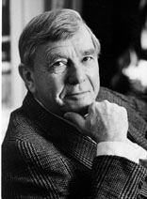

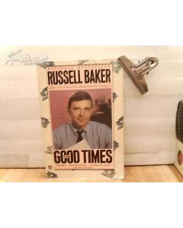



Slide 23
Writing for Myself
Reading skills:
1. Top-down: from general (title, subtitle, opening/ closing paragraphs → general ideas, opinions, style etc.) to specific
2. Bottom-up:
3. Mixture of the above:

Slide 24
Finish skimming the passage in 5 minutes, and then figure out:
1) words/ phrases used to express
① the author’s negative feeling about English
② about Mr. Fleagle
③ the author’s positive feeling about his writing of eating Spaghetti.
④ draw your conclusion based on the author’s choice of words
2) how the ideas are developed and organized (+ P9)
3) the main ideas

Slide 25
Words used to express：
① the author’s negative feeling about English:
bored, dull, difficult, hated, long, lifeless, agony, tedious, cheerless etc.

Slide 26
② about Mr. Fleagle:
dullness, inability to inspire, formal, rigid, hopelessly out of date, excessively prim, wore primly severe eyeglasses, (wavy hair) primly cut and primly combed, wore prim suits with neckties set primly against the collar buttons, a primly pointed jaw, a primly straight nose, a prim manner of speaking (that was) so correct, so gentlemanly, a comic antique etc. (“prim” used 9 times in Para 2)
费利格尔先生在学生中以说话干巴和激励学生无术而出名。据说他拘谨刻板，完全落后于时代，古板之极。他戴着古板而毫无装饰的眼镜，微微卷曲的头发剪得笔齐，梳得纹丝不乱。他身着古板套装，白衬衣领扣外的领带打得一丝不苟。他长着古板的尖下巴，古板的直鼻粱，说起话来一本正经，字斟句酌，彬彬有礼，活脱脱一个滑稽的老古董。

Slide 27
③ the author’s positive feeling about his writing of eating Spaghetti：
an extraordinary sequence of mental images, vivid memories came flooding back, the good humor … reawoke in my mind, the laughing arguments, the warmth and good feeling of it, for my own joy, relive the pleasure of that evening, listening attentively, laughed, with open-hearted enjoyment, pure delight, the happiest moment, happiness etc.

Slide 28
To produce a piece of good and vivid writing, what conclusion can you draw from the choice of words used in this passage?
1).The choice of words in agreement with the purpose of writing (eg. Formal/ informal, negative/ positive etc.);
2).The repetition of words, though in different forms, to emphasize;
3).The use of synonyms to avoid repetition; to add variety to writing

Slide 29
Text organization (P9) :
Clues:
1. choice of words (eg. Negative in Para 1-2; positive in Para 3-9)
2. time expressions used in the passage (a change in the development of ideas in Para 3 implied through “late in the year”)
3. things talked about (Para 3-5: new experience with E, love for E kind of aroused )

Slide 30
Text Organization (P9)
Parts | Para. | Main Ideas
Part 1 | 1~2 | Baker was bored by everything associated with English courses, including essay writing.
Part 2 | 3~5 | Baker found himself attracted by one particular topic and wrote about it for his own joy.
Part 3 | 6~7 | The experience of writing the essay helped him discover his talent for writing and realize what he wished to do in life.

Slide 31
Part One (para. 1-2):
Russell was bored by everything associated with English courses, including essay writing.

Slide 32
The idea of becoming a writer had come to me off and on since my childhood in Belleville, but it wasn’t until my third year in high school that the possibility took hold. (Para 1)
Ever since I was a child in Belleville, I had thought of becoming a writer from time to time, but I didn’t make up my mind until I was in the eleventh grade (Para 11).

Slide 33
…it was(n’t) until…that…
直到…才…
not … until… （主句V非延续）
Until… （主句V延续）
译：人们直到生病了才知道健康的可贵。
People don’t realize the importance/ value of health until they lose it.
Or: It is not until people lose health that they realize its importance/ value.

Slide 34
take hold (of sb): (an idea, habit, feeling etc.) to become very strong, to begin to have complete control over sb/ sth(观念, 想法,习惯, 情感等)开始生根/ 强大; 变得根深蒂固
Eg. 1. Old habits die hard. So I advise him to get rid of his bad habit before it takes hold.
2.This idea that Ivory Soap can float in water has taken hold of many Americans .
3. 译：当他意识到自己将失明时，恐慌害怕得不得了。
Panic/ Fear took hold of him when he realized that he would lose sight for ever.

Slide 35
assign, anticipate:
When our class was assigned to Mr. Fleagle for third-year English I anticipated another cheerless year in that most tedious of subjects. (Para 2)
When it was decided that Mr. Fleagle would teach us English during my third year in high school, I expected the English course to be as boring as before.

Slide 36
assign: vt. give sb some work or responsibility, or sth they can use
( ~ sth to sb , ~ (sb) sth ，~ sb to do sth)
分配/布置(工作);指定/派（某人）做；分配(某物供享用)
Eg. 1. Mr. Smith ~ed each child a different task.
2. The entire floor has been ~ed to the International School. 整层楼都分给了….
3. Mr. Lee ~ed me to help Mary with her studies .
assignment: n. 分派的工作/任务；作业

Slide 37
(usu. followed by n. or doing or that-clause)
anticipate:
expect; see what might happen and take action to prepare for it 期望;预见/料（并为之作准备）
Eg. We anticipate moving to the new building early next year.
译：________ (预料到) that the demand for electricity will be high in the next few months, they have decided to increase its production.
(Key: Anticipating)
anticipation n.

Slide 38
Homework (after Moon Festival)
1. Review what has been discussed today + finish Parts 2+3, Text A + study the vocabulary.
2. Finish reading Text B; Texts 1+2 in Experiments (B1), and work out how these three are related to the unit topic.
3. Prepare a 3~5-minute presentation about: (PPT preferable)
1) Pulitzer Prize (G1)
2) Elementary + secondary education in UK & USA (G8).

Slide 39
Part Two (Paras. 3-5):
Baker found himself attracted by one particular topic and wrote about it for his own joy.

Slide 40
I prepared for an unfruitful year with Mr. Fleagle and for a long time was not disappointed. (But) Late in the year ….(Para 3)
I expected that things wouldn’t improve with Mr. Fleagle as our English teacher, and for a long time I was right in my expectations.
( “not disappointed” --- a touch of humor.)

Slide 41
None was quite so simple-minded as “What I Did on My Summer Vacation,” but most seemed to be almost as dull. (Para 3)
像“暑假二三事”那样傻呼呼的题目倒是一个没有，但绝大多数都一样乏味。

Slide 42
I finally faced up to the unwelcome task…. (Para 3)
finally: 1) usu. used to introduce the last one in a series of things or events;
2) at last
Cf. finally, at last （最后终于）
first(ly), at first （起初，当初）

Slide 43
2. face up to sth:
be brave enough to accept or deal with (a problem or difficulty) 勇敢地面对
People in the world have to face up to the threat of terrorist attacks.

Slide 44
The art of eating spaghetti:
Italian-style thin noodle, served with sauce(调味酱)；
Put a fork into a plate of spaghetti；
Turn the fork several times so that spaghetti will wind around the fork；
Place the fork into your mouth；
Do not suck(吸，咂，啜).

Slide 45
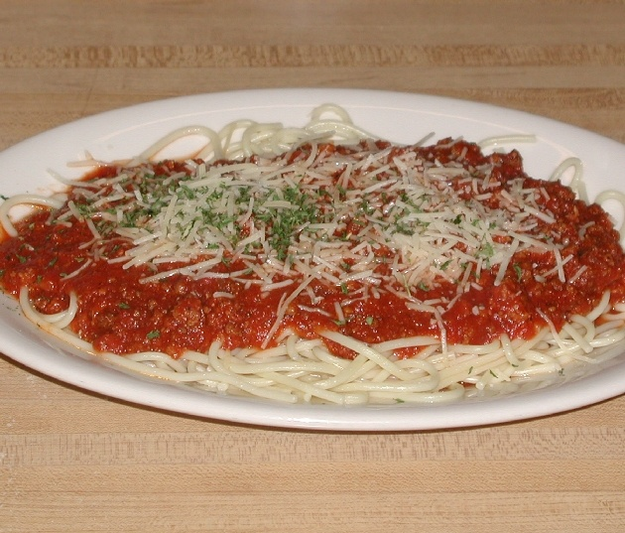
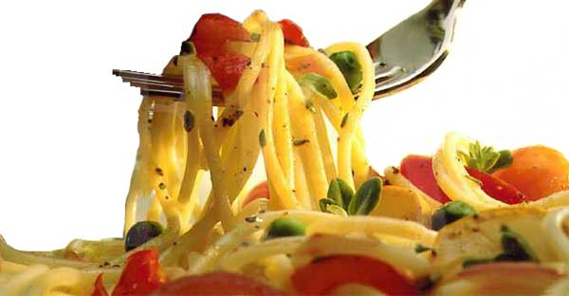

Wow! Spaghetti!!!

Slide 46
This title produced an extraordinary sequence of mental images. Vivid memories came flooding back of a night in Belleville when all of us were seated around the supper table. (Para 4)
Sequence:一系列，一连串(a sequence of); 顺序
Eg. That novel was written in historical sequence. 历史顺序
in/ out of sequence: 按顺序/ 不按或没有顺序
image, imagine

Slide 47
sequence:
1. A set of events, ideas, actions, numbers, etc. with a particular order
Eg. a sequence of 一系列，一连串
A sequence of bad harvests forced some countries to ask for foreign aid.
2. the order that events, actions etc. happen in
Eg. That novel was written in historical sequence. 历史顺序
in/ out of sequence: 按顺序/ 不按或没有顺序

Slide 48
recall (Para 4) : vi. / vt. ; n.
vi. / vt. (fml) (~ sth/ doing/ that) remember 回忆/想起…
Eg. I don’t recall ever meeting her.
She recalled that she had to see the doctor again that afternoon.
2. make sb think of sth 使人想起/想到，勾起
Eg. The picture recalls the happy days I spent with my grandma.
3. ask for sth to be returned because …召回

Slide 49
Part Three (Paras. 6-9):
The experience of writing the essay helped him discover his talent for writing and realize what he wished to do in life.

Slide 50
Compose (Para 6): vt.
(fml) to combine together to form a whole 组成 … be composed of 由…组成/构成
2. write or create (music, poetry, letters etc.)
作曲；撰写
Eg. The president’s speech is really brilliant. Do you think it was composed by himself or by someone else? composition n. 作文

Slide 51
I was preparing myself for a command to report to Mr. Fleagle immediately after school for discipline…: (Para 6)
I expected that Mr. Fleagle would order me to see him soon after school for the purpose of punishing me…
Discipline：n. 1) the practice of training people to obey rules and punishing them if they do not 训练，训导；纪律，风纪
2) The ability to control one’s behavior 自制力，遵守纪律
3) A subject taught , esp. in a university (尤指大学的)学科，科目

Slide 52
In the eleventh grade, at the eleventh hour as it were, I had discovered a calling. (Para 9)
可谓是在最后的时刻，我找到了一个我今生想做的事。
In my eleventh grade, and as one might say at the last possible moment, I had found something I wished to take up as a career.
the eleventh grade: the third year in high school
calling: (fml) a profession/ career

Slide 53
Para 9:
Q for discussion
According to the passage, what is the very essence of the essay?

Slide 54
Ex: Key to Ex.
Voc. I.
1. 1) respectable 2) agony
3) put… down 4) sequence
5) hold back 6) distribute
7) off and on 8) vivid
9) associate 10) finally
11) turn in 12) tackle

Slide 55
2. 1) George has been assigned to the newspaper’s Paris office.
2) The man’s story was so extraordinary that I didn’t know whether to believe him or not.
3) She had a clear image of how she would look in 20 years’ time.
4) When the officer gave the command the soldiers opened fire.
5) As long as people keep buying bikes, we’ll keep turning them out.

Slide 56
Key to Ex. Voc.
3. part of speech, collocation, grammar
1) reputation, rigid, to inspire
2) and tedious, What’s more, out-of-date ideas (out of date: adj. 一般做表语)
3) compose, career, avoid showing, his congratulations, hardly hold back

Slide 57
Key to Ex. II. Synonyms in context
1. composed 2. severe
3. agony 4. extraordinary
5. recall 6. command
7. was violating 8. anticipate
III. Collocation: adj. + prep.
1. at 2. for 3. of 4. with 5. as
6. about 7. to 8. in, in 9. from
10. on/upon

Slide 58
Cloze 1: a letter to Aunt Pat
1) hold back 2) tedious
3) scanned 4) recall
5) vivid 6) off and on
7) turn in/ out 8) career
Key to Cloze 2
1. last 2. surprise 3. pulled
4. blowing 5. dressed 6. scene
7. extraordinary 8. image
9. turn 10. excitement

Slide 59
Key to translation1 （P17）
1. As it was a formal dinner party, I wore formal dress, as Mother told me to.
2. His girlfriend advised him to get out of/ get rid of his bad habit of smoking before it took hold.
3. Anticipating that the demand for electricity will be high during the next few months, they have decided to increase its production.
4. It’s said that Bill has been fired for continually violating the company’s safety rules. / Bill is said to have been fired for …..
5. It’s reported that the government has taken proper measures to avoid the possibility of a sever water shortage./ The local government is reported to have taken proper measures to avoid …

Slide 60
Key to Translation 2 (P18)
Susan lost her legs because of/ in a car accident. For a time, she didn’t know how to face up to the fact that she would never (be able to) walk again.
One day, while scanning (through) books, a true story caught her eye/ she was attracted by a true story. It gave a vivid description of how a disabled girl became a writer. Greatly inspired, Susan made up her mind to read as much as she could, and what’s more, she wanted to write stories about her own childhood. Susan began to feel that she, too, would finally be able to lead a useful life.

Slide 61
Some recommended websites:
1. www.putclub.com
2. www.voanews.com
3. www.english-at-home.com
4. www.esl-lab.com
5. www.englishtown.com
6. www.englishbaby.com
7. www.parlo.com
8. www.peakenglish.com

Slide 62
Thank You!

