Slide 1

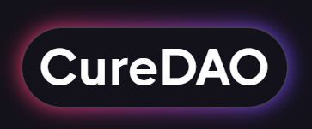

A Community-Owned
Platform for
Decentralized Clinical Research
Notes:
Lowering friction between data sources, digital health businesses, and patients to improve health outcomes faster, cheaper and better.
trust enabler - patients trust sharing their data, researchers trust integrity of data, digital health trusts effectiveness

Slide 2
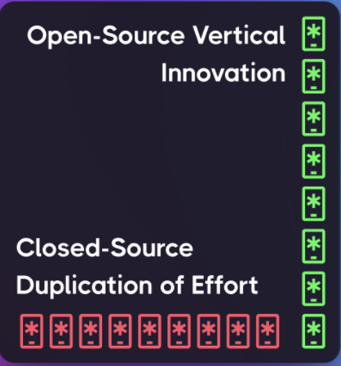
Existing digital health and digital health platforms are closed-source and privately owned.
A closed platform lacks the reward system and trust needed to incentivize these data sources to integrate with it.
Additionally, an individual company would never have the money required to keep up with the exponential rate of development required to implement the integrations.
The reason WordPress powers most of the internet and has 59,000 plugins is that it has an open-source core that developers can trust and rely upon.
As a result, its core SaaS offering generates $1.7B in annual revenue and the entire ecosystem generates $689B in annual revenue.
This is why enabling ease of developer integration with the CureDAO core platform and plugin marketplace is our core focus.

Slide 3
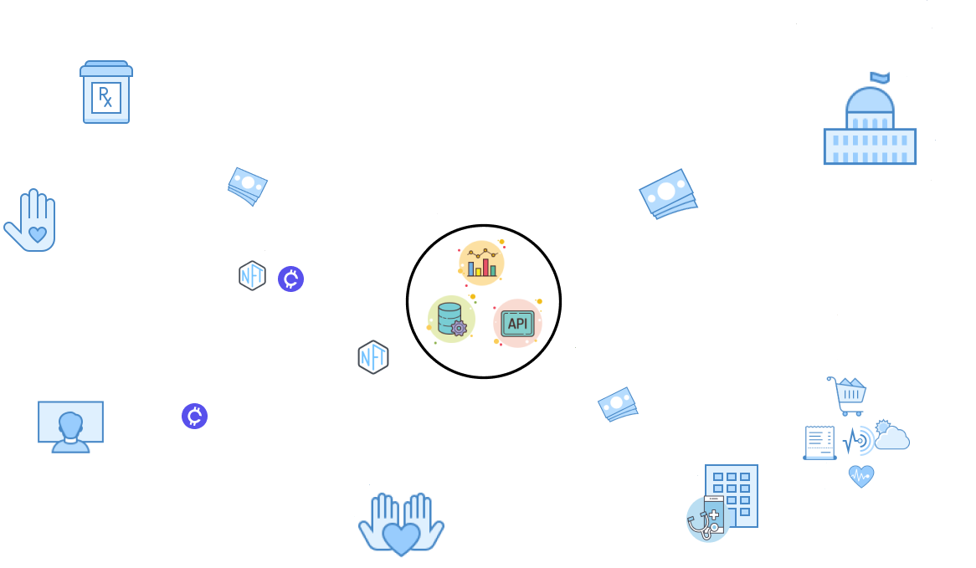
Notes:
E: supplementary deck. Instead of this, try to answer: 1) WHY NOW? (my answer: tools are here and look at our traction with the DAO)
2) WHAT'S THE COMPETITION

Slide 4
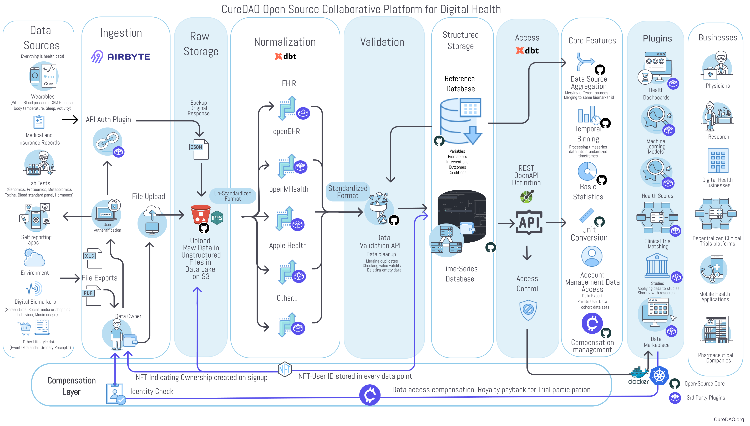
https://www.figma.com/file/pS3zfchd1JmV10GgFDsmck/curadao-platform-diagrams?node-id=348%3A3460

Slide 5
Thanks for paying attention!
Don’t hesitate to let us know if you have any questions or brutal criticisms!
Email: super-important@curedao.org

