Slide 1
Chapter 4: CPU and Von Neumann Architecture

Slide 2
Introduction to the CPU and the Von Neumann Model
The CPU (Central Processing Unit): The "brain" of the computer. It performs all calculations and executes program instructions. It is a complex integrated circuit containing billions of transistors.
The Von Neumann Model: A design architecture where both program instructions and data are stored in the same main memory.
This is the basis for most modern computers, allowing for flexible program execution.
It enables the CPU to fetch both instructions and data from a single memory location.
A key consequence: The "Von Neumann bottleneck," which is the limited data transfer rate between the CPU and memory.

Slide 3
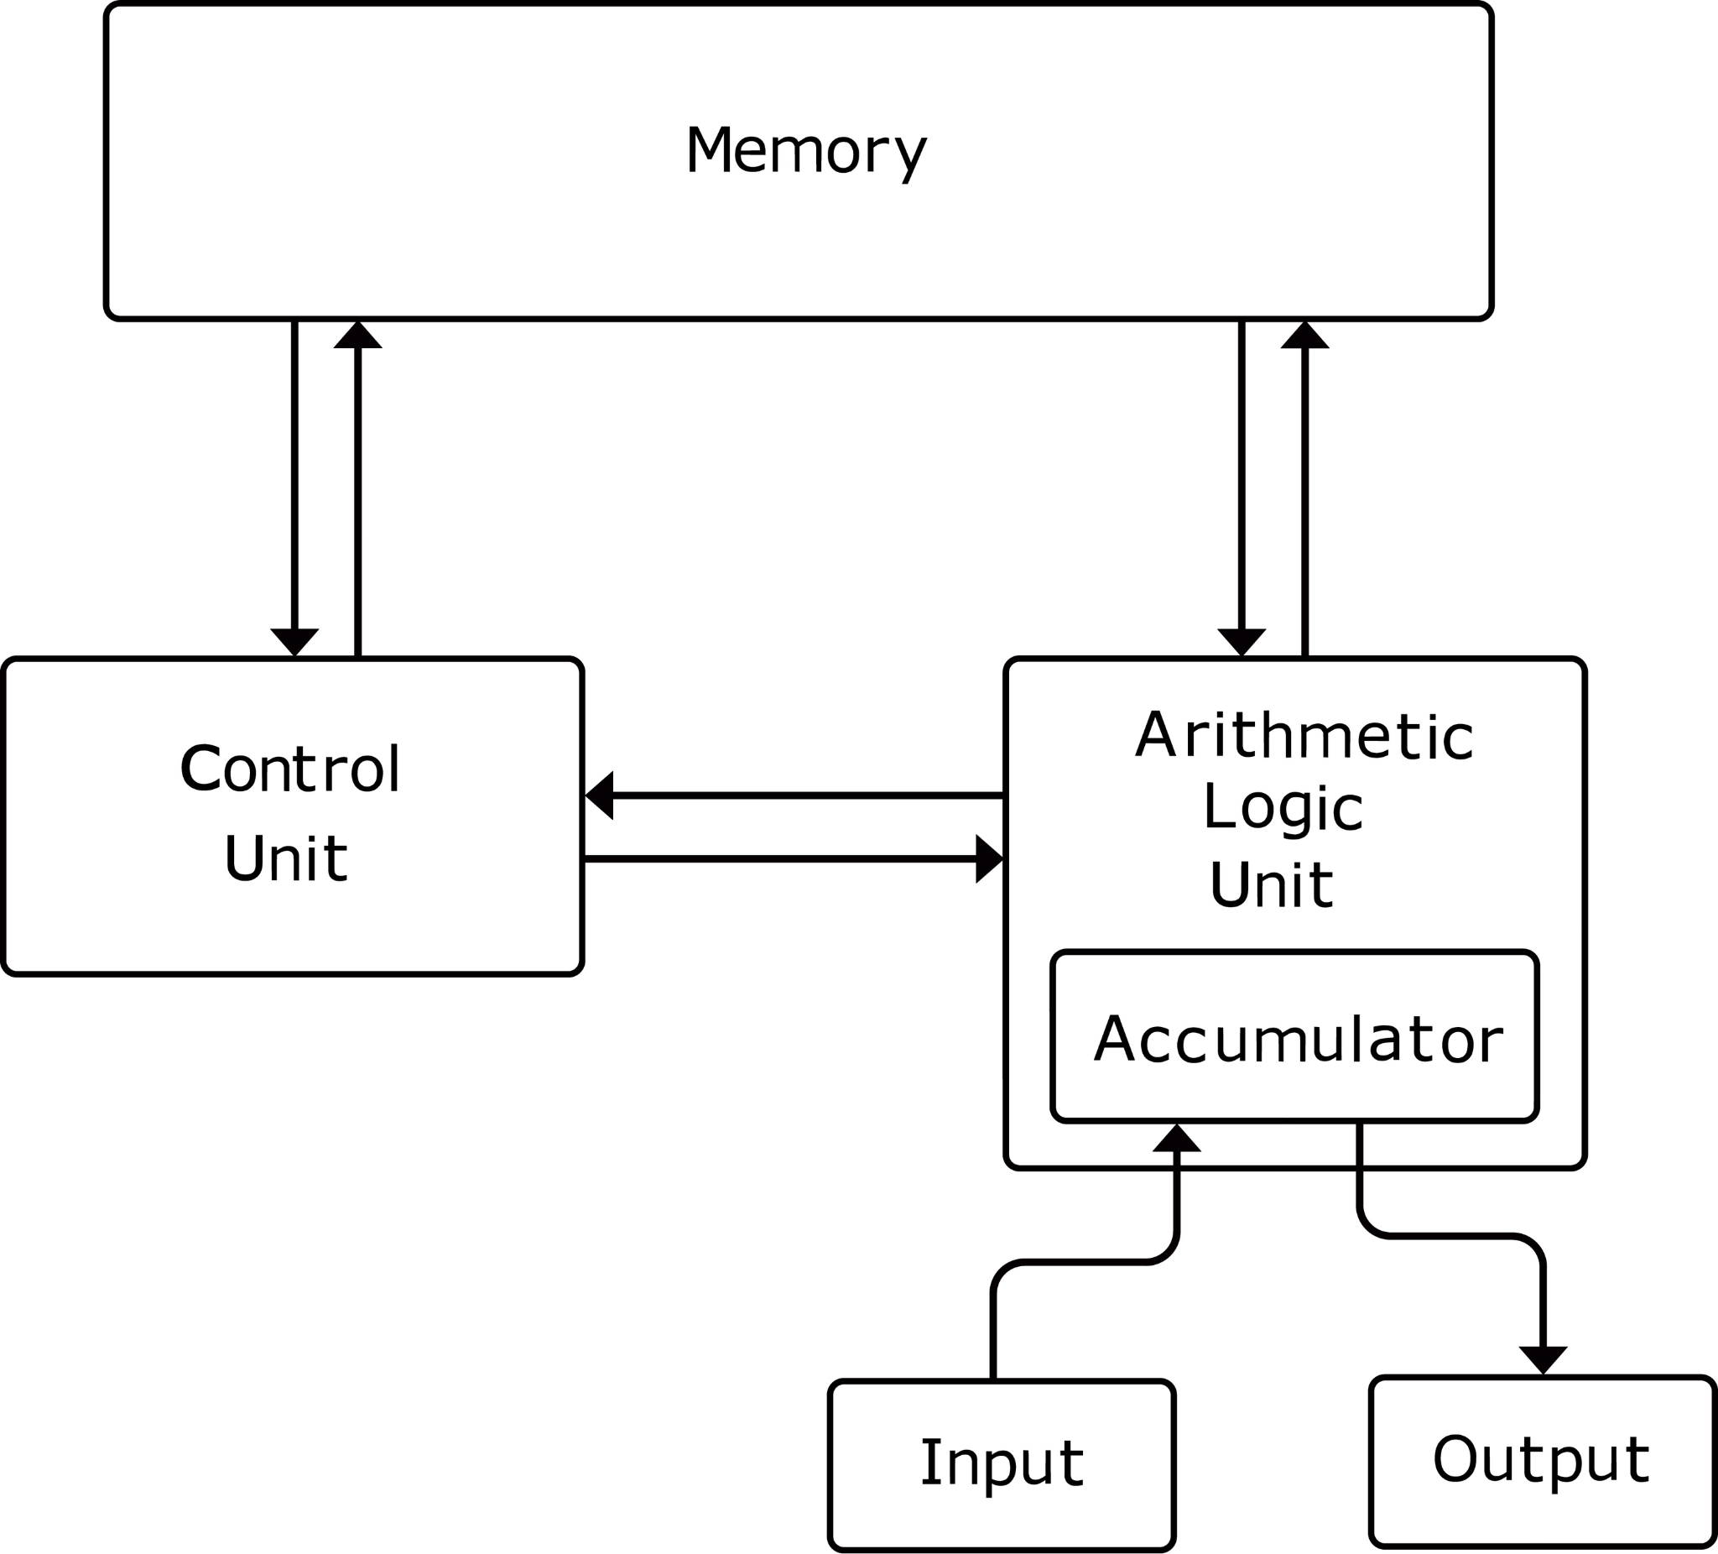
Introduction to the CPU and the Von Neumann Model

Slide 4
Introduction to the CPU and the Von Neumann Model
Evolution of Architecture: CISC vs. RISC
CISC (Complex Instruction Set Computing): Architectures (like early Intel x86) with a large number of complex instructions. A single instruction can perform multiple low-level operations (e.g., a single instruction to load data from memory and perform a calculation).
RISC (Reduced Instruction Set Computing): Architectures (like ARM) with a small, highly optimized set of simple instructions. Complex tasks are broken down into multiple simpler instructions. This simplifies the hardware and can lead to faster execution.

Slide 5
The Fetch-Execute Cycle - Part 1
What is it? The fundamental process by which a CPU retrieves an instruction from memory and then carries it out. It is the heart of CPU operation.
It's a continuous, repeating cycle: The CPU constantly performs this cycle as long as the computer is running.
Example: When you open an application, the CPU repeatedly executes instructions from the application's code by following this cycle.

Slide 6
The Fetch-Execute Cycle - Part 2
The four main steps:
Fetch: The CPU retrieves the next instruction from main memory.
  The address of the next instruction is held in the Program Counter (PC).
  This address is copied to the Memory Address Register (MAR).
  The instruction at that memory location is fetched and loaded into the Memory Data Register (MDR).
Decode: The CPU interprets the instruction to understand what operation to perform.
  The instruction from the MDR is copied to the Current Instruction Register (CIR).
  The Control Unit (CU) decodes the instruction, breaking it down into an Opcode (the action) and an Operand (the data to act on).
Execute: The CPU carries out the operation.
  This step is performed by the ALU (Arithmetic Logic Unit) for calculations or the Control Unit for data movement.
  Examples: A mathematical calculation like 4+2, a logical comparison like X>Y, or moving data from one register to another.
Store (Write Back): The result of the execution is written back to a register or main memory.
  The result is temporarily stored in an accumulator register and then moved to a more permanent location.

Slide 7
Key CPU Components
ALU (Arithmetic Logic Unit): The core computational component.
Arithmetic Operations: Addition, subtraction, multiplication, division.
Logical Operations: AND, OR, NOT, XOR.
Comparison Operations: Is equal to Y? Is X greater than Y?
Control Unit (CU): The manager of the CPU.
Fetches instructions from memory.
Decodes instructions.
Controls the flow of data between the CPU's components.
Generates the control signals to coordinate all actions.

Slide 8
Key CPU Components
Registers: Small, high-speed memory locations directly within the CPU.
They are the fastest form of memory available, much faster than RAM.
Used to temporarily hold data and instructions while the CPU is actively processing them.

Slide 9
Registers - High-Speed Storage
Registers are physically located on the CPU chip itself.
They are used to hold:
  Operands for the ALU (e.g., the two numbers to be added).
  The result of a calculation.
  Memory addresses.
  The current instruction being executed.

Slide 10
General vs. Special-Purpose Registers
General-Purpose Registers (GPRs): Can be used for any temporary data storage during program execution. They are flexible and programmer-accessible.
  Examples: In x86 architecture, EAX (Accumulator), EBX (Base), ECX (Counter), and EDX (Data) are common GPRs. They can hold data or addresses.
Special-Purpose Registers (SPRs): Have a specific, defined function and are essential for the fetch-execute cycle. They are not typically used by programmers for general data storage.

Slide 11
Buses
Buses: A set of parallel wires or electronic pathways that connect the different components of a computer. Think of them as the highway system of the motherboard.
Data Bus: Carries the actual data between the CPU, memory, and I/O devices. It is bidirectional, meaning data can travel in both directions.
Control Bus: Carries control signals from the Control Unit to other components (e.g., signals to read or write data, interrupt signals, clock signals).
Address Bus: Carries the memory addresses of data or instructions to be accessed. It is unidirectional (from the CPU to memory or devices). The number of wires determines the maximum memory a system can address.

Slide 12
Essential Special-Purpose Registers (Part 1)
MAR (Memory Address Register): Holds the memory address of the instruction or data that is about to be accessed.
  Analogy: When a librarian goes to get a book, the MAR is the "shelf number" they write down.
MDR (Memory Data Register): Holds the data or instruction that has been fetched from or is about to be written to memory.
  Analogy: The MDR is the "book itself" that the librarian carries to or from the shelf.

Slide 13
Essential Special-Purpose Registers (Part 2)
PC (Program Counter): Contains the memory address of the next instruction to be fetched.
  After an instruction is fetched, the PC is automatically incremented to point to the next instruction in the sequence.
CIR (Current Instruction Register): A temporary store for the instruction that has just been fetched from memory and is about to be decoded by the Control Unit.

Slide 14
Motherboard Layout Basics
The Motherboard: The main circuit board of a computer. All components plug into it, forming a connected system.
Key Components on the Motherboard:
  CPU Socket: The physical connector for the CPU.
  RAM Slots: Connectors for the main system memory (RAM).
  Expansion Slots (e.g., PCIe): For adding extra components like graphics cards, network cards, or SSDs.
  Chipset: A set of integrated circuits that manage the flow of data between the CPU and other components. It acts as a central hub.
  BIOS/UEFI Chip: Stores the firmware that controls basic hardware functions and initiates the boot process.

Slide 15
Instruction Set Formats
Instruction Set: The complete set of commands or instructions that a specific CPU can understand and execute. Each CPU family has its own unique instruction set.
Formats: Instructions are formatted in binary code. A typical format includes:
  Opcode (Operation Code): Specifies the action to be performed (e.g., ADD, SUB, JUMP, LOAD).
  Operand(s): The data or memory addresses that the instruction will operate on. An instruction can have zero, one, or more operands.

Slide 16
Example Instruction Formats
Zero-address: Operates on data from a stack. The operands are implicitly on top of the stack. Example: ADD (Pops the top two items from the stack, adds them, and pushes the result back on the stack).
One-address: Uses an accumulator register. Example: ADD X (adds the value at memory address X to the accumulator).
Two-address: Specifies two operands. The result is stored in one of the operand locations. Example: MOV AX, BX (moves the value from register BX to AX).
Three-address: Specifies two source operands and a destination operand. Example: ADD R1, R2, R3 (adds the values in registers R2 and R3, then stores the result in register R1).

Slide 17
Example Execution Walkthrough - Step 1
Task: Execute the instruction LOAD 100 (load the value at memory address 100 into a register).
Fetch:
  The PC holds the address of the LOAD 100 instruction. Let's say it's at address 500.
  The address 500 is copied from the PC to the MAR.
  The Control Unit sends a "read" signal to memory.
  The instruction at address 500 (LOAD 100) is fetched and moved from main memory to the MDR.
  The PC is incremented to 501, pointing to the next instruction.

Slide 18
Example Execution Walkthrough - Step 2 & 3
2. Decode:
The content of the MDR (LOAD 100) is moved to the CIR.
The Control Unit decodes the instruction. It identifies the Opcode as LOAD and the Operand as the memory address 100.
3. Execute:
The Control Unit sends the operand address 100 to the MAR.
A "read" signal is sent to memory.
The value stored at memory address 100 is moved from memory to the MDR.
This value from the MDR is then moved into a general-purpose register, like the Accumulator, completing the operation.

