Slide 1
PK DTS / PROCESS FLOW
PROCESS FLOW SERIES
PK DOCUMENT TRACKING SYSTEM
FIVE PARTS
01
Meet the sample users and their roles
Process Flow
02
Learn the three document types
One request, from sign-in to final approval
03
Follow one softcopy request from start to finish
Learn what softcopy, hardcopy and external documents are, follow one request through every step with sample users, then see every scenario and approval route.
04
See every scenario of each document type
05
See every request type and its approval route
WHAT YOU WILL SEE
Sign in
Follow the route
Check the result
Start as the requester.
Each approver acts in turn.
See the status and outcome.
PK DTS / PROCESS FLOW / 11 NOVEMBER 2026
1 / 41
Notes:
Introduce the deck: it follows one softcopy request and then shows every request route.

Slide 2


PK DTS / PROCESS FLOW
PART 1 / SAMPLE USERS
Meet the sample users
Five sample accounts play the roles used in every route. Your own people and routes come from Workflow Builder.
REQUESTER
NOTED BY LEADER
PLANT MANAGER
DOCUMENT CONTROL
READS ONLY
Sam Staff
Alex Staff
Morgan Manager
Casey Controller
Avery Auditor
Staff
Staff / Sam's leader
Plant Manager
Document Control Officer
Internal Auditor
Signs in, creates the request, saves the draft and submits it.
First reviewer ("Noted By"). Also confirms assignment requests as Sam's leader.
Second reviewer. In document requests, this approval locks the attached file.
Final reviewer. Approval creates or updates the document.
Reads documents, history and the audit trail. Does not approve requests.
HOW TO READ THIS PRESENTATION
Every person signs in with their own account and sees only what their role allows.
Only the person or role assigned to the current approval step can decide it. Administrator status gives no bypass.
The default document route is: Requester, Requester's leader, Plant Manager, Document Control Officer.
Other request types use Plant Manager, Document Control Officer, then a final confirmation by the requester or the requester's leader.
PK DTS / PROCESS FLOW / 11 NOVEMBER 2026
2 / 41
Notes:
Sample users come from the documentation demonstration site. They are synthetic.

Slide 3
PK DTS / PROCESS FLOW
PART 2 / DOCUMENT TYPES
Three kinds of document, three different jobs
Each register answers a different question. Pick the register that matches what you need.
Softcopy
Hardcopy
External
TEMPLATE REPOSITORY
LOCATION TRACKER
SCANNED BACKUP REPOSITORY
In one line
The repository of approved softcopy templates.
A tracker of where each physical document is kept.
A repository of scanned outside documents, kept only as backup.
What it stores
The approved electronic file, its document number and its revisions.
No file. Only the record: place, Current Holder and optional retention dates.
Attached scans and files (up to 20 per record) with a category and description.
Sample documents
Incident Report Form Template, Inspection Checklist Template
Sample Inspection Record in Records Cabinet A
Supplier Quality Certificate, Signed Delivery Receipt
How it is used
Staff open the approved template and use it to prepare their own document.
Staff look up where the paper is and who holds it, then go and get it.
Kept as a backup copy of a document that came from outside. Not a template.
How it gets in
An approved request, or a direct save by a controller.
Registered directly. Moving the paper needs an approved transfer.
An approved request, or a direct save by a controller.
PK DTS / PROCESS FLOW / 11 NOVEMBER 2026
3 / 41
Notes:
Softcopy is the template repository. Hardcopy only tracks where the paper is. External keeps scanned outside documents as backup.

Slide 4
PK DTS / PROCESS FLOW
PART 2 / DOCUMENT TYPES
Softcopy documents
The repository of approved softcopy templates.
SAMPLE DOCUMENTS (ILLUSTRATIVE)
TEMPLATE REPOSITORY
Incident Report Form Template
DOCX
WHAT IT IS
FT-001 / Forms and Templates / Revision 00
A softcopy document is a template. Once a request is approved and completed, the approved electronic file is stored here as the controlled template. This register is the repository of all softcopy templates that staff can use.
Inspection Checklist Template
XLSX
FT-002 / Forms and Templates / Revision 00
WHAT IT HOLDS
Leave Application Form Template
An electronic file: PDF, DOCX, XLSX, TXT, PNG or JPG, up to 15 MB.
DOCX
FT-003 / HR Forms / Revision 00
A document number from its category, for example FT-002.
Revisions: the number stays and the revision moves from 00 to 01.
Sample Quality Procedure
PDF
A read-only lock on the file once the locking approval is given.
QP-001 / Quality Procedures / Revision 00
SCENARIOS COVERED IN PART 4 (6)
Create a template by request
Revise a template by request
Create or revise directly
1
Approval route / 6 steps
2
Approval route / 6 steps
3
Direct action, no route / 6 steps
Request temporary access
Request an assignment
Dispose of a template
4
Approval route / 6 steps
5
Approval route / 6 steps
6
Direct action, no route / 6 steps
PK DTS / PROCESS FLOW / 11 NOVEMBER 2026
4 / 41
Notes:
Softcopy documents: A softcopy document is a template. Once a request is approved and completed, the approved electronic file is stored here as the controlled template. This register is the repository of all softcopy templates that staff can use.

Slide 5
PK DTS / PROCESS FLOW
PART 2 / DOCUMENT TYPES
Hardcopy documents
Tracking only: where each physical document is kept and who holds it.
SAMPLE DOCUMENTS (ILLUSTRATIVE)
LOCATION TRACKER
Sample Inspection Record
PAPER
WHAT IT IS
Sample Office > Records Section > Records Cabinet A
Sequence 1 / Holder: Casey Controller
A hardcopy record is only a tracking entry. It does not store a file. It shows where the physical (paper) document is placed or stored in the workplace and who holds it, so anyone permitted can locate the paper quickly.
Sample Dispatch Record
PAPER
Sample Office > Records Section > Records Cabinet A
Sequence 1 / Holder: Casey Controller
WHAT IT HOLDS
Sample Incoming Record
The title of the paper document.
PAPER
Sample Office > Records Section > Records Cabinet B
Sequence 2 / Holder: Alex Staff
Its place (Area, Specific, optional Asset, Location) and its own Sequence, which many documents may share.
The Current Holder who is responsible for the paper.
Signed Contract Binder
PAPER
Optional retention dates that remind you when to review it.
Sample Office > Records Section > Records Cabinet B
Sequence 2 / Holder: Casey Controller
SCENARIOS COVERED IN PART 4 (6)
Register a hardcopy
Locate and check retention
Transfer to a new place
1
Direct action, no route / 6 steps
2
Direct action, no route / 6 steps
3
Approval route / 8 steps
Request temporary access
Request an assignment
Request disposal
4
Approval route / 6 steps
5
Approval route / 6 steps
6
Approval route / 6 steps
PK DTS / PROCESS FLOW / 11 NOVEMBER 2026
5 / 41
Notes:
Hardcopy documents: A hardcopy record is only a tracking entry. It does not store a file. It shows where the physical (paper) document is placed or stored in the workplace and who holds it, so anyone permitted can locate the paper quickly.

Slide 6
PK DTS / PROCESS FLOW
PART 2 / DOCUMENT TYPES
External documents
A repository of scanned outside documents, kept only as backup.
SAMPLE DOCUMENTS (ILLUSTRATIVE)
SCANNED BACKUP REPOSITORY
Supplier Quality Certificate
PDF
WHAT IT IS
Supplier References / 2 scanned files / Revision 00
An external document came from outside the organization, for example from a supplier, a customer or an authority. Its scanned copy is attached here just for backup. It is a repository of attachments: not a template, and not a location tracker.
Signed Delivery Receipt
JPG
Supplier References / 1 scanned file / Revision 00
WHAT IT HOLDS
Government Permit Copy
Up to 20 attached files per record: PDF, images or scans, up to 15 MB each.
PDF
Regulatory Permits / 3 scanned pages / Revision 00
An External Category, for example Supplier References.
A description of up to 2,000 characters.
Customer Purchase Order
PDF
Revisions that replace the attachments. No retention dates.
Customer Orders / 1 file / Revision 00
SCENARIOS COVERED IN PART 4 (4)
Register by request
Revise by request
Register or revise directly
1
Approval route / 6 steps
2
Approval route / 6 steps
3
Direct action, no route / 6 steps
Request disposal
4
Approval route / 6 steps
PK DTS / PROCESS FLOW / 11 NOVEMBER 2026
6 / 41
Notes:
External documents: An external document came from outside the organization, for example from a supplier, a customer or an authority. Its scanned copy is attached here just for backup. It is a repository of attachments: not a template, and not a location tracker.

Slide 7
PK DTS / PROCESS FLOW
PART 2 / DOCUMENT TYPES
What you can do with each type
Not every action exists for every type. Part 4 shows each action that applies, step by step.
Action
Softcopy
Hardcopy
External
Create by request
Yes
No. Register directly
Yes
Revise by request
Yes
No. Edit directly
Yes
Direct save by a controller
Yes. Approve Directly
Yes. Register or Edit
Yes. Save Directly
Hardcopy transfer
Not applicable
Yes. Request, Dispatch, Accept
Not applicable
Temporary access
Yes
Yes
Not applicable
Assignment
Yes. Softcopy assignee
Yes. Current Holder
Not applicable
Disposal request
No. Direct only
Yes
Yes
Direct disposal
Yes
Yes
Yes
Hardcopy has no create or revise request: register or edit it directly, and use a Hardcopy Transfer Request to move the paper. Softcopy disposal is direct only.
PK DTS / PROCESS FLOW / 11 NOVEMBER 2026
7 / 41
Notes:
Which actions exist for each document type.

Slide 8
PK DTS / PROCESS FLOW
PART 3 / ONE REQUEST START TO FINISH
The journey at a glance
A softcopy creation request: eight stations in order. The status shows where the request stands after each one.
1
2
3
4
Sign in
Start a request
Save a draft
Submit
Sam Staff
Sam Staff
Sam Staff
Sam Staff
Sam signs in with their own account.
My Requests, Softcopy Request, New Request.
Complete the form, attach the file, Save Draft.
Check View Details, then Submit and Confirm.
REQUEST STATUS
REQUEST STATUS
REQUEST STATUS
REQUEST STATUS
No request yet
No request yet
Draft
Submitted
5
6
7
8
Noted By
Plant Manager review
Final review
Result
Alex Staff
Morgan Manager
Casey Controller
Sam Staff
Alex reviews and approves.
Morgan approves. The file is locked.
Casey approves.
Active document and file at revision 00.
REQUEST STATUS
REQUEST STATUS
REQUEST STATUS
REQUEST STATUS
Submitted
Submitted / file locked
Completed
Completed
If an approver returns the request it goes back one step (or to Sam at the first step). A rejection ends the route.
PK DTS / PROCESS FLOW / 11 NOVEMBER 2026
8 / 41
Notes:
Walk the eight stations left to right, then continue on the second row.

Slide 9
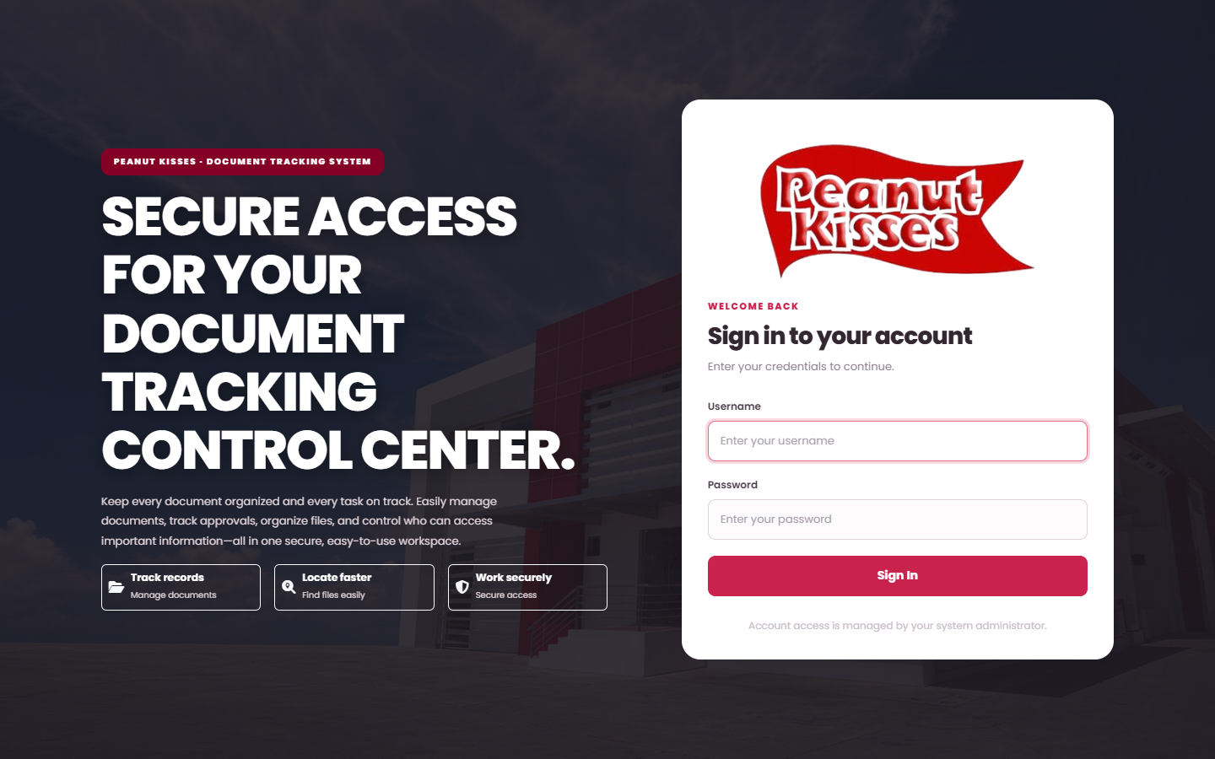
PK DTS / PROCESS FLOW
PART 3 / ONE REQUEST START TO FINISH
Station 1: sign in as the requester
Sam Staff starts with their own account.
Sam Staff / Staff
REQUEST STATUS
No request yet
Acts in this station
Sign in using your own account.
FOLLOW THESE STEPS
1
Open PK DTS in the browser.
2
Enter Sam's Username and Password.
A
B
C
3
Select Sign In. Replace a temporary password first if asked.
A Username
B Password
C Sign In
The Overview page opens with totals and recent activity.
4
AFTER THIS
KEEP IN MIND
Sam is signed in as a Staff requester. The menus show only what the Staff role may use.
Each person uses their own account. If a menu or action is missing, the role does not have that permission.
PK DTS / PROCESS FLOW / 11 NOVEMBER 2026
9 / 41
Notes:
Station 1: sign in as the requester: Open PK DTS in the browser. Enter Sam's Username and Password. Select Sign In. Replace a temporary password first if asked. The Overview page opens with totals and recent activity.

Slide 10
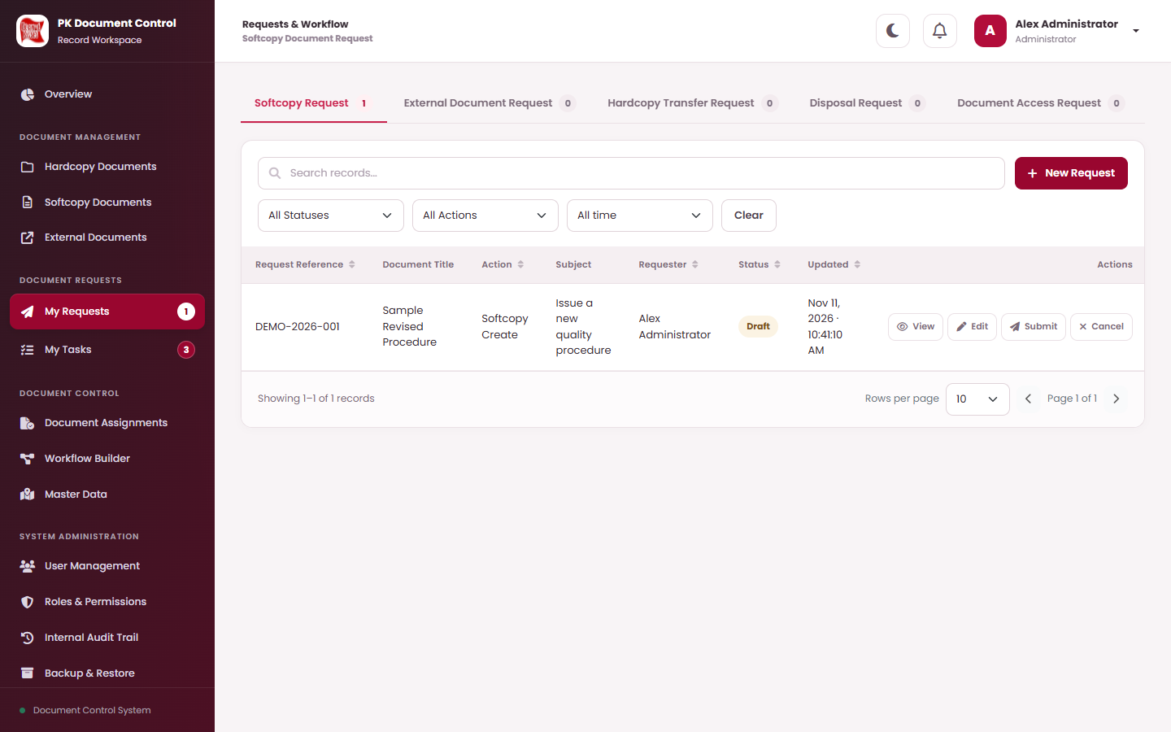
PK DTS / PROCESS FLOW
PART 3 / ONE REQUEST START TO FINISH
Station 2: start a new request
Sam opens My Requests and chooses the Softcopy Request tab.
Sam Staff / Staff
REQUEST STATUS
No request yet
Acts in this station
My Requests lists your requests. Select New Request to start another.
FOLLOW THESE STEPS
1
Under Document Requests, open My Requests.
A
2
Choose the Softcopy Request tab.
3
Select New Request.
A New Request
The request form opens.
4
AFTER THIS
KEEP IN MIND
A blank New Request form is ready. Nothing is saved until Sam selects Save Draft.
Saving a draft does not change any document, holder, access or status. Only Submit sends it for approval.
PK DTS / PROCESS FLOW / 11 NOVEMBER 2026
10 / 41
Notes:
Station 2: start a new request: Under Document Requests, open My Requests. Choose the Softcopy Request tab. Select New Request. The request form opens.

Slide 11
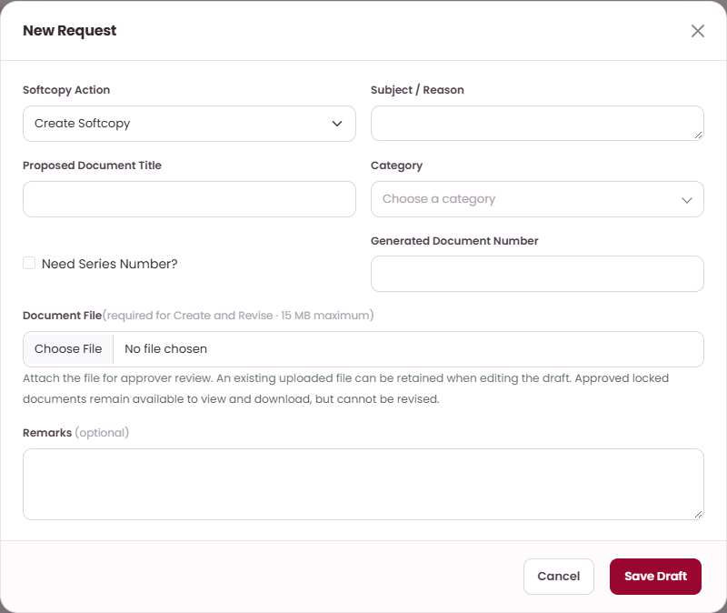
PK DTS / PROCESS FLOW
PART 3 / ONE REQUEST START TO FINISH
Station 3: complete the form and save a draft
Sam describes the document and attaches the file.
Sam Staff / Staff
REQUEST STATUS
Draft
Acts in this station
Prepare a softcopy create request.
FOLLOW THESE STEPS
1
Choose Create Softcopy as the action.
A
B
2
Enter Subject / Reason and Proposed Document Title, then choose Category.
3
Check Generated Document Number. Attach the Document File (up to 15 MB).
C
A Action
B Document title
C Save
Add optional Remarks. Select Save Draft and Confirm.
4
AFTER THIS
KEEP IN MIND
The request is saved as a Draft with its own reference. Only Sam can edit it.
The final document number is assigned at final approval and may differ from the preview.
PK DTS / PROCESS FLOW / 11 NOVEMBER 2026
11 / 41
Notes:
Station 3: complete the form and save a draft: Choose Create Softcopy as the action. Enter Subject / Reason and Proposed Document Title, then choose Category. Check Generated Document Number. Attach the Document File (up to 15 MB). Add optional Remarks. Select Save Draft and Confirm.

Slide 12
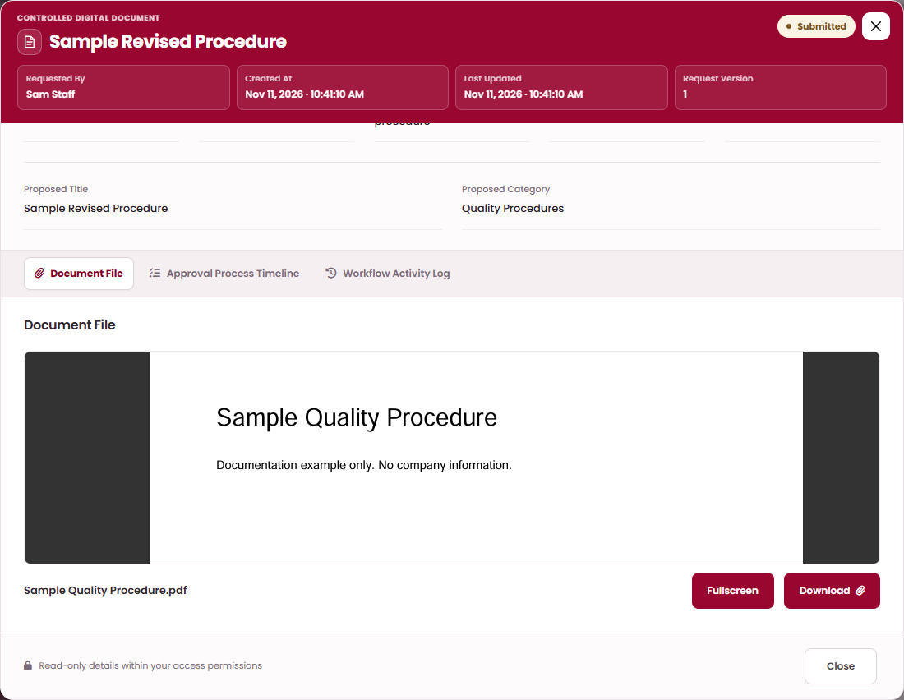
PK DTS / PROCESS FLOW
PART 3 / ONE REQUEST START TO FINISH
Station 4: check the draft and submit
Sam previews the proposal and sends it into the approval route.
Sam Staff / Staff
REQUEST STATUS
Draft > Submitted
Acts in this station
View Details shows the proposal. The Document File tab previews the attachment.
FOLLOW THESE STEPS
1
In My Requests, select View on the draft.
A
2
Open the Document File tab and check the preview. Use Fullscreen to enlarge it.
B
C
3
Close View Details. Select Submit, then Continue and Confirm.
A Document File
B Fullscreen
C Download
The status changes to Submitted and the first approver is notified.
4
AFTER THIS
KEEP IN MIND
The request is Submitted. Sam can no longer edit or cancel it, but can follow it in My Requests.
The route is fixed at submission. If the request is returned and resubmitted, it keeps the original route.
PK DTS / PROCESS FLOW / 11 NOVEMBER 2026
12 / 41
Notes:
Station 4: check the draft and submit: In My Requests, select View on the draft. Open the Document File tab and check the preview. Use Fullscreen to enlarge it. Close View Details. Select Submit, then Continue and Confirm. The status changes to Submitted and the first approver is notified.

Slide 13
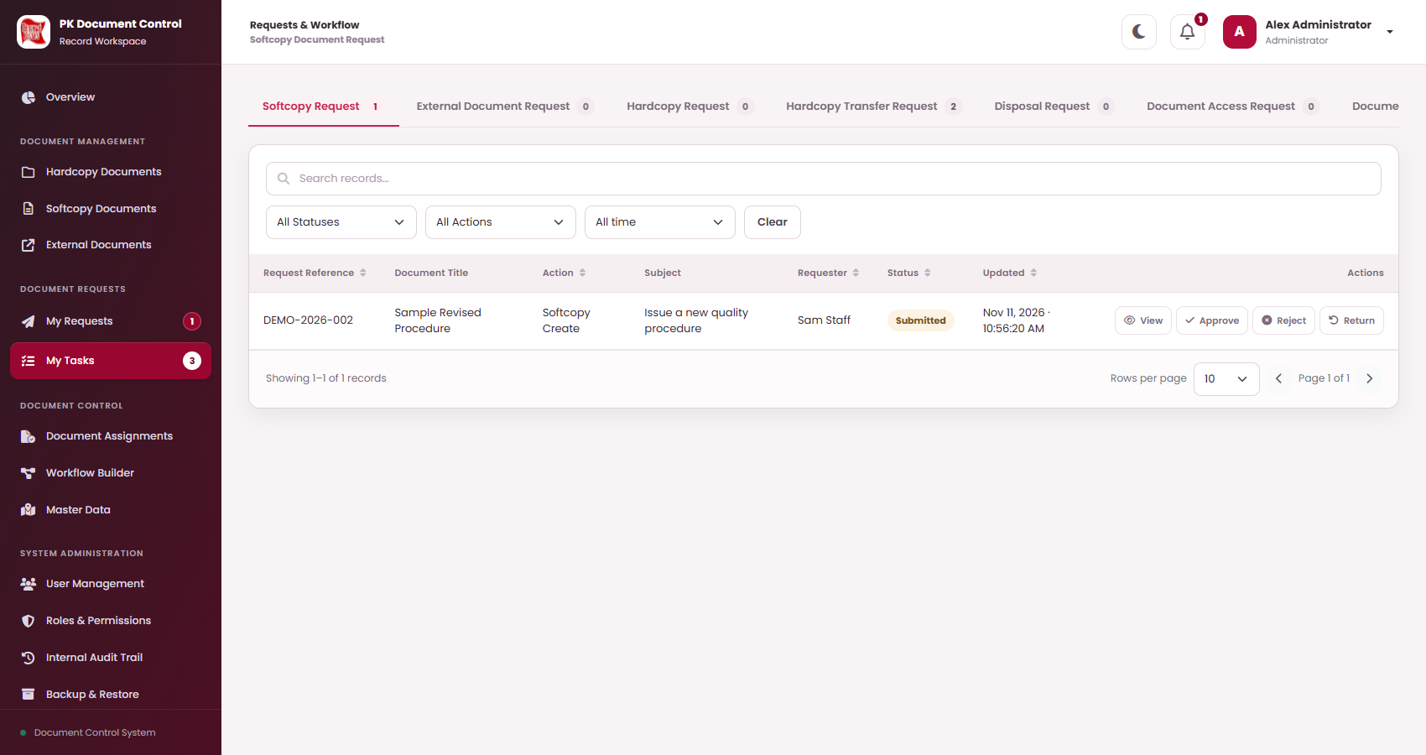
PK DTS / PROCESS FLOW
PART 3 / ONE REQUEST START TO FINISH
Station 5: the requester's leader reviews (Noted By)
Alex sees the task in My Tasks and decides.
Alex Staff / Staff, Sam's leader (Noted By)
REQUEST STATUS
Submitted
Acts in this station
My Tasks shows the request assigned to Alex. Each row offers View, Approve, Reject and Return.
FOLLOW THESE STEPS
1
Open My Tasks and the Softcopy Request tab. A badge counts waiting tasks.
A
B
C
Select View. Check the proposal, the file preview and the timeline.
2
3
Choose Approve, Return or Reject. Add an optional remark.
A Approve
B Reject
C Return
Select Continue and Confirm.
4
AFTER THIS
KEEP IN MIND
Alex's approval moves the request to the Plant Manager. The status stays Submitted.
Only the assigned user or role can decide. A Return sends the request back to Sam to correct and resubmit.
PK DTS / PROCESS FLOW / 11 NOVEMBER 2026
13 / 41
Notes:
Station 5: the requester's leader reviews (Noted By): Open My Tasks and the Softcopy Request tab. A badge counts waiting tasks. Select View. Check the proposal, the file preview and the timeline. Choose Approve, Return or Reject. Add an optional remark. Select Continue and Confirm.

Slide 14
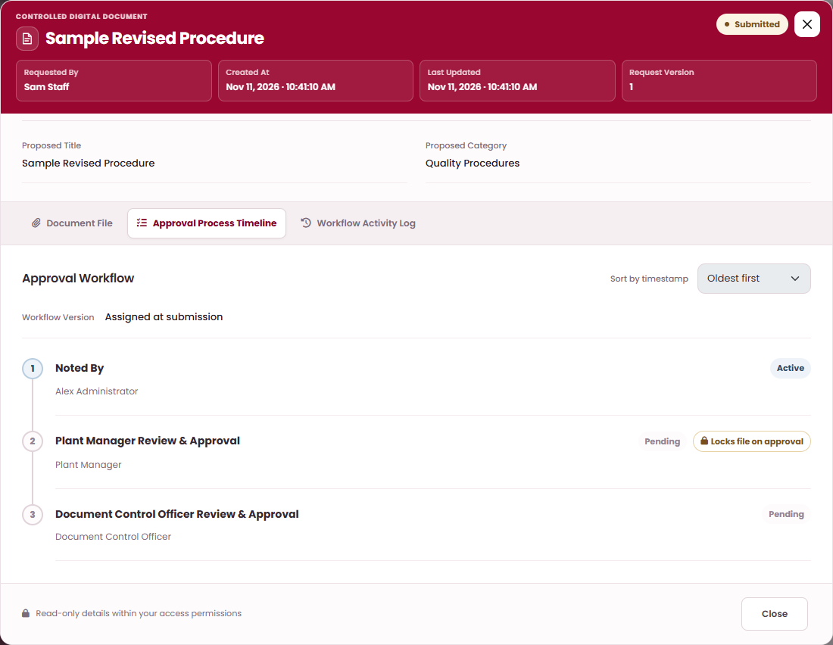
PK DTS / PROCESS FLOW
PART 3 / ONE REQUEST START TO FINISH
Station 6: the Plant Manager approves and the file locks
Morgan reviews next. In this route, this approval locks the attachment.
Morgan Manager / Plant Manager
REQUEST STATUS
Submitted, file locked
Acts in this station
The Approval Process Timeline shows each step. A badge marks the step that locks the file.
FOLLOW THESE STEPS
1
Morgan opens My Tasks, then View on the request.
A
2
Open Approval Process Timeline. The step shows Locks file on approval.
B
3
Choose Approve, add a remark and Confirm.
A Approval Process Timeline
B Locks file on approval badge
The step shows Locked. The next reviewer is notified.
4
AFTER THIS
KEEP IN MIND
The attached file is locked as read-only. It can still be previewed; downloads are limited to roles with lock access.
A Return here goes back to Alex, the requester's leader. The status stays Submitted.
PK DTS / PROCESS FLOW / 11 NOVEMBER 2026
14 / 41
Notes:
Station 6: the Plant Manager approves and the file locks: Morgan opens My Tasks, then View on the request. Open Approval Process Timeline. The step shows Locks file on approval. Choose Approve, add a remark and Confirm. The step shows Locked. The next reviewer is notified.

Slide 15
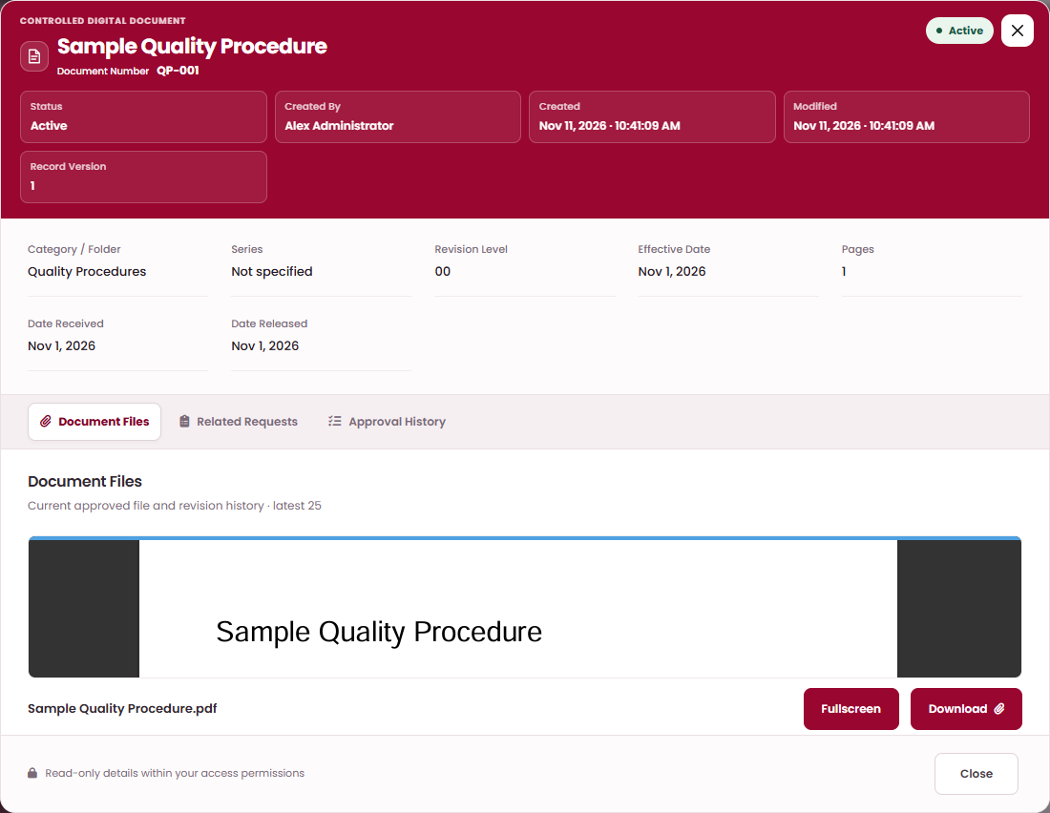
PK DTS / PROCESS FLOW
PART 3 / ONE REQUEST START TO FINISH
Station 7: Document Control gives the final approval
Casey approves. The system applies the change.
Casey Controller / Document Control Officer
REQUEST STATUS
Completed
Acts in this station
The new Active document opens with its approved file on the Document Files tab.
FOLLOW THESE STEPS
1
Casey opens My Tasks, then View on the request.
2
Check the proposal, approval history and file preview.
3
Choose Approve and Confirm.
A
B
A Fullscreen
B Download
The Active record and file are created at revision 00.
4
AFTER THIS
KEEP IN MIND
The request is Completed. The document appears in Softcopy Documents with its number and file.
Sam can check the Workflow Activity Log for every decision, remark and time. A rejection would have closed the request.
PK DTS / PROCESS FLOW / 11 NOVEMBER 2026
15 / 41
Notes:
Station 7: Document Control gives the final approval: Casey opens My Tasks, then View on the request. Check the proposal, approval history and file preview. Choose Approve and Confirm. The Active record and file are created at revision 00.

Slide 16

PK DTS / PROCESS FLOW
PART 4 / SOFTCOPY SCENARIO 1 OF 6
Softcopy scenario 1: create a template by request
Sam asks for a new softcopy template. Three reviewers approve it and the system publishes it.
SAMPLE DOCUMENT
ACTION
CATEGORY
NUMBER PREVIEW
FILE
Visitor Log Template
Create Softcopy
Forms and Templates
FT-004
visitor-log.docx, 1 page
1
2
3
Prepare the request
Submit
Noted By
Sam Staff
Sam Staff
Alex Staff
In My Requests, Softcopy Request, New Request: choose Create Softcopy, enter the title, pick Category and attach the template file.
Sam checks View Details, then selects Save Draft, Submit and Confirm. The route is fixed.
Alex, Sam's leader, reads the proposal and previews the file in My Tasks, then approves.
Draft
Submitted
Submitted
4
5
6
Plant Manager review
Final review
Template published
Morgan Manager
Casey Controller
PK DTS
Morgan approves. In this route, this approval locks the attached file as read-only.
Casey approves. As the last step, this applies the request.
Creates the Active document at revision 00 with its final number and the approved file.
Submitted, file locked
Submitted
Completed
RESULT
IF A REVIEWER RETURNS OR REJECTS
KEEP IN MIND
A new softcopy template exists in Softcopy Documents. Anyone with access can open the approved file and use it.
Return goes back one step (to Sam at the first step) and the route is kept. Reject ends the route as Rejected: nothing is applied and it cannot be resubmitted.
The final number is assigned at approval and may differ from the preview. Screen-by-screen steps are in Part 3.
PK DTS / PROCESS FLOW / 11 NOVEMBER 2026
16 / 41
Notes:
Softcopy scenario 1: create a template by request: 1. Prepare the request - In My Requests, Softcopy Request, New Request: choose Create Softcopy, enter the title, pick Category and attach the template file. 2. Submit - Sam checks View Details, then selects Save Draft, Submit and Confirm. The route is fixed. 3. Noted By - Alex, Sam's leader, reads the proposal and previews the file in My Tasks, then approves. 4. Plant Manager review - Morgan approves. In this route, this approval locks the attached file as read-only. 5. Final review - Casey approves. As the last step, this applies the request. 6. Template published - Creates the Active document at revision 00 with its final number and the approved file.

Slide 17
PK DTS / PROCESS FLOW
PART 4 / SOFTCOPY SCENARIO 2 OF 6
Softcopy scenario 2: revise a template by request
Sam proposes a replacement file for an Active template. The document number is kept.
SAMPLE DOCUMENT
ACTION
DOCUMENT
PROPOSED
FILE
Inspection Checklist Template
Revise Softcopy
FT-002, revision 00
Revision 01
inspection-checklist-v2.xlsx
1
2
3
Prepare the revision
Submit
Noted By
Sam Staff
Sam Staff
Alex Staff
Choose Revise Softcopy, pick the existing document FT-002, give the reason and attach the replacement file.
Save Draft, review it, then Submit and Confirm. The current approved file stays in use meanwhile.
Alex reviews the reason and previews the proposed file, then approves.
Draft
Submitted
Submitted
4
5
6
Plant Manager review
Final review
Revision published
Morgan Manager
Casey Controller
PK DTS
Morgan approves. In this route, this approval locks the attached file as read-only.
Casey approves. As the last step, this applies the request.
Same number, revision 01. The new file becomes current; revision 00 stays in File History.
Submitted, file locked
Submitted
Completed
RESULT
IF A REVIEWER RETURNS OR REJECTS
KEEP IN MIND
FT-002 now opens the revision 01 file, so staff always use the latest approved template.
Return goes back one step (to Sam at the first step) and the route is kept. Reject ends the route as Rejected: nothing is applied and it cannot be resubmitted.
A proposed file is never the current file until final approval. Revision keeps the number, series and category.
PK DTS / PROCESS FLOW / 11 NOVEMBER 2026
17 / 41
Notes:
Softcopy scenario 2: revise a template by request: 1. Prepare the revision - Choose Revise Softcopy, pick the existing document FT-002, give the reason and attach the replacement file. 2. Submit - Save Draft, review it, then Submit and Confirm. The current approved file stays in use meanwhile. 3. Noted By - Alex reviews the reason and previews the proposed file, then approves. 4. Plant Manager review - Morgan approves. In this route, this approval locks the attached file as read-only. 5. Final review - Casey approves. As the last step, this applies the request. 6. Revision published - Same number, revision 01. The new file becomes current; revision 00 stays in File History.

Slide 18
PK DTS / PROCESS FLOW
PART 4 / SOFTCOPY SCENARIO 3 OF 6
Softcopy scenario 3: create or revise directly
An authorized controller applies the change at once. There is no approval route.
SAMPLE DOCUMENT
ACTION
WHO
ROUTE
FILE
Emergency Contact Form Template
Create Softcopy
Casey Controller
None, applies at once
DOCX, up to 15 MB
1
2
3
Open the register
Choose the action
Attach the file
Casey Controller
Casey Controller
Casey Controller
Open Softcopy Documents. Select Add New Softcopy Document, or Edit on an Active record.
Choose Create Softcopy or Revise Softcopy. Enter the reason and title, then the Category or the existing document.
Check Number of Pages. Attach Document File. Add Effective Date and Remarks if needed.
No request
Form open
Form complete
4
5
6
Approve Directly
Applied at once
Check the record
Casey Controller
PK DTS
Casey Controller
Select Approve Directly, then Confirm. No reviewer is involved.
Creates the Active document, or publishes the next revision with the replacement file.
Open View Details and the Document Files tab. The approved file and revision are shown.
Confirmed
Active
Verified
RESULT
WHEN TO USE IT
KEEP IN MIND
The template is available immediately in Softcopy Documents.
Direct save is for controller maintenance. Staff who need an approval use a request instead.
Direct actions need permission. A blank direct Effective Date uses the approval date.
PK DTS / PROCESS FLOW / 11 NOVEMBER 2026
18 / 41
Notes:
Softcopy scenario 3: create or revise directly: 1. Open the register - Open Softcopy Documents. Select Add New Softcopy Document, or Edit on an Active record. 2. Choose the action - Choose Create Softcopy or Revise Softcopy. Enter the reason and title, then the Category or the existing document. 3. Attach the file - Check Number of Pages. Attach Document File. Add Effective Date and Remarks if needed. 4. Approve Directly - Select Approve Directly, then Confirm. No reviewer is involved. 5. Applied at once - Creates the Active document, or publishes the next revision with the replacement file. 6. Check the record - Open View Details and the Document Files tab. The approved file and revision are shown.

Slide 19
PK DTS / PROCESS FLOW
PART 4 / SOFTCOPY SCENARIO 4 OF 6
Softcopy scenario 4: request temporary access
Sam asks to open a softcopy for a limited time. Sam gives the final confirmation.
SAMPLE DOCUMENT
REQUEST
DOCUMENT
EXPIRY
ROUTE
Inspection Checklist Template
Document Access Request
FT-002 (Softcopy)
20 Nov 2026
Manager, Control, Sam
1
2
3
Ask for access
Submit
Plant Manager review
Sam Staff
Sam Staff
Morgan Manager
In My Requests, Document Access Request, New Request: select the softcopy and an expiry date after today.
Save Draft, then Submit and Confirm.
Morgan reviews and approves.
Draft
Submitted
Submitted
4
5
6
Document control review
Final confirmation
Access granted
Casey Controller
Sam Staff
PK DTS
Casey reviews and approves.
Sam gives Requester Confirmation in My Tasks. This is the last step of the route.
Sam gets access to the document until the end of the expiry day, unless revoked sooner.
Submitted
Submitted
Completed
RESULT
IF A REVIEWER RETURNS OR REJECTS
KEEP IN MIND
Sam can open the softcopy until 20 November 2026. For a renewal, submit another request.
Return goes back one step (to Sam at the first step) and the route is kept. Reject ends the route as Rejected: nothing is applied and it cannot be resubmitted.
The expiry must still be valid at final approval. The access is for the requester only.
PK DTS / PROCESS FLOW / 11 NOVEMBER 2026
19 / 41
Notes:
Softcopy scenario 4: request temporary access: 1. Ask for access - In My Requests, Document Access Request, New Request: select the softcopy and an expiry date after today. 2. Submit - Save Draft, then Submit and Confirm. 3. Plant Manager review - Morgan reviews and approves. 4. Document control review - Casey reviews and approves. 5. Final confirmation - Sam gives Requester Confirmation in My Tasks. This is the last step of the route. 6. Access granted - Sam gets access to the document until the end of the expiry day, unless revoked sooner.

Slide 20
PK DTS / PROCESS FLOW
PART 4 / SOFTCOPY SCENARIO 5 OF 6
Softcopy scenario 5: request an assignment
Sam asks to be assigned a softcopy. Sam's leader gives the final approval.
SAMPLE DOCUMENT
REQUEST
DOCUMENT
SAM BECOMES
ROUTE
Inspection Checklist Template
Document Assignment Request
FT-002 (Softcopy)
Softcopy assignee
Manager, Control, leader
1
2
3
Ask to be assigned
Submit
Plant Manager review
Sam Staff
Sam Staff
Morgan Manager
In My Requests, Document Assignment Request, New Request: select the softcopy and save the draft.
Select Submit and Confirm.
Morgan reviews and approves.
Draft
Submitted
Submitted
4
5
6
Document control review
Final approval
Assignee recorded
Casey Controller
Alex Staff
PK DTS
Casey reviews and approves.
Alex, as Sam's leader, gives the final approval.
Sam is recorded as a Softcopy assignee. No separate temporary access grant is created.
Submitted
Submitted
Completed
RESULT
IF A REVIEWER RETURNS OR REJECTS
KEEP IN MIND
Sam is the softcopy assignee. Document and file permissions still apply.
Return goes back one step (to Sam at the first step) and the route is kept. Reject ends the route as Rejected: nothing is applied and it cannot be resubmitted.
A controller can also assign directly in Document Assignments: one document, or every softcopy in a category (up to 2,000).
PK DTS / PROCESS FLOW / 11 NOVEMBER 2026
20 / 41
Notes:
Softcopy scenario 5: request an assignment: 1. Ask to be assigned - In My Requests, Document Assignment Request, New Request: select the softcopy and save the draft. 2. Submit - Select Submit and Confirm. 3. Plant Manager review - Morgan reviews and approves. 4. Document control review - Casey reviews and approves. 5. Final approval - Alex, as Sam's leader, gives the final approval. 6. Assignee recorded - Sam is recorded as a Softcopy assignee. No separate temporary access grant is created.

Slide 21
PK DTS / PROCESS FLOW
PART 4 / SOFTCOPY SCENARIO 6 OF 6
Softcopy scenario 6: dispose of a template directly
Softcopy has no disposal request. An authorized controller disposes of it directly.
SAMPLE DOCUMENT
ACTION
METHOD
WHO
ROUTE
Leave Application Form Template
Dispose (direct)
Shred, Scratch or Other
Casey Controller
None
1
2
3
Find the document
Select Dispose
Give the method
Casey Controller
Casey Controller
Casey Controller
Open Softcopy Documents. Use Search or Folder to find FT-003.
Choose Dispose on the record. This needs the register direct permission and direct disposal permission.
Choose Shred, Scratch or Other. Describe Other when it is selected.
Active
Active
Active
4
5
6
Continue and Confirm
Marked Disposed
Follow the procedure
Casey Controller
PK DTS
Casey Controller
Review the details, select Continue and confirm the action.
Records the method and history. The document status becomes Disposed.
Carry out your organization's disposal procedure as well as recording the action.
Confirming
Disposed
Disposed
RESULT
WHY NO REQUEST
KEEP IN MIND
FT-003 is Disposed and no longer in normal use. Its history stays in the audit trail.
Approval-based Disposal Requests cover Hardcopy and External documents only.
Disposed status restricts document use. Recording the action does not destroy anything for you.
PK DTS / PROCESS FLOW / 11 NOVEMBER 2026
21 / 41
Notes:
Softcopy scenario 6: dispose of a template directly: 1. Find the document - Open Softcopy Documents. Use Search or Folder to find FT-003. 2. Select Dispose - Choose Dispose on the record. This needs the register direct permission and direct disposal permission. 3. Give the method - Choose Shred, Scratch or Other. Describe Other when it is selected. 4. Continue and Confirm - Review the details, select Continue and confirm the action. 5. Marked Disposed - Records the method and history. The document status becomes Disposed. 6. Follow the procedure - Carry out your organization's disposal procedure as well as recording the action.

Slide 22
PK DTS / PROCESS FLOW
PART 4 / HARDCOPY SCENARIO 1 OF 6
Hardcopy scenario 1: register a paper document
The record says where the paper is kept and who holds it. No file is attached.
SAMPLE DOCUMENT
ACTION
SEQUENCE
LOCATION
HOLDER
Sample Maintenance Record
Add New Hardcopy Document
2 (shared with others)
Records Cabinet A
Casey Controller
1
2
3
Open the register
Describe the paper
Holder and sequence
Administrator
Administrator
Administrator
Open Hardcopy Documents and select Add New Hardcopy Document.
Enter Document Title. Choose Area, Specific, optional Asset and the Location where the paper is kept.
Check Current Holder. Leave Sequence blank for the next number, or share one with other documents.
New record
Form open
Form open
4
5
6
Set retention
Save and confirm
Record saved
Administrator
Administrator
PK DTS
Turn on Track retention period. Enter Retention Start and Retention End.
Select Save Document and Confirm.
Checks the storage, holder and dates, then saves the active record and its history.
Form complete
Confirmed
Active
RESULT
EDITING LATER
KEEP IN MIND
The record shows where the paper is and who holds it. Search by title or browse the folders to find it.
The current holder with direct permission, or an Administrator, can Edit the title, storage and retention dates. To move the paper, use a transfer.
New hardcopy creation requests are unavailable: register directly. Several documents may share one Location or one Sequence.
PK DTS / PROCESS FLOW / 11 NOVEMBER 2026
22 / 41
Notes:
Hardcopy scenario 1: register a paper document: 1. Open the register - Open Hardcopy Documents and select Add New Hardcopy Document. 2. Describe the paper - Enter Document Title. Choose Area, Specific, optional Asset and the Location where the paper is kept. 3. Holder and sequence - Check Current Holder. Leave Sequence blank for the next number, or share one with other documents. 4. Set retention - Turn on Track retention period. Enter Retention Start and Retention End. 5. Save and confirm - Select Save Document and Confirm. 6. Record saved - Checks the storage, holder and dates, then saves the active record and its history.

Slide 23
PK DTS / PROCESS FLOW
PART 4 / HARDCOPY SCENARIO 2 OF 6
Hardcopy scenario 2: locate the paper and check retention
Find where the paper is, then review its retention date.
SAMPLE DOCUMENT
LOCATION
HOLDER
RETENTION END
DAYS LEFT
Sample Inspection Record
Records Cabinet A
Casey Controller
1 Jan 2027
51 on 11 Nov 2026
1
2
3
Find the record
Read the place
Go to the paper
Casey Controller
Casey Controller
Casey Controller
Open Hardcopy Documents. Use Folder or Search to find Sample Inspection Record.
Open View Details. Check Area, Specific, Asset, Location and Current Holder.
Walk to Records Cabinet A in the Records Section and take the paper from there.
Active
Active
Located
4
5
6
Retention counted
Filter by due date
Review the paper
PK DTS
Casey Controller
Casey Controller
Shows days remaining, Due today or an overdue message using Manila dates.
Filter by Due Today, Overdue, Due in the Next 7 Days or Due in 8-30 Days.
Decide whether to keep it, update it, transfer it or dispose of it.
Tracking
Tracking
Reviewed
RESULT
RETENTION NOTICE
KEEP IN MIND
The paper is found fast and no retention end date is missed.
A reminder appears for visible active hardcopies once the end date arrives. Dismissing it leaves the record unchanged.
Retention never disposes of a document automatically.
PK DTS / PROCESS FLOW / 11 NOVEMBER 2026
23 / 41
Notes:
Hardcopy scenario 2: locate the paper and check retention: 1. Find the record - Open Hardcopy Documents. Use Folder or Search to find Sample Inspection Record. 2. Read the place - Open View Details. Check Area, Specific, Asset, Location and Current Holder. 3. Go to the paper - Walk to Records Cabinet A in the Records Section and take the paper from there. 4. Retention counted - Shows days remaining, Due today or an overdue message using Manila dates. 5. Filter by due date - Filter by Due Today, Overdue, Due in the Next 7 Days or Due in 8-30 Days. 6. Review the paper - Decide whether to keep it, update it, transfer it or dispose of it.

Slide 24
PK DTS / PROCESS FLOW
PART 4 / HARDCOPY SCENARIO 3 OF 6
Hardcopy scenario 3: transfer the paper to a new place
Approval prepares the handoff. Dispatch and Accept finish it and update the record.
SAMPLE DOCUMENT
REQUEST
FROM
TO
RECEIVER
Sample Inspection Record
Hardcopy Transfer Request
Records Cabinet A
Records Cabinet B
Named receiving user
1
2
3
4
Prepare the transfer
Submit
Plant Manager review
Document control review
Sam Staff
Sam Staff
Morgan Manager
Casey Controller
Choose the hardcopy and check its holder and place. Pick the Receiving User and a different destination Location.
Save Draft, then Submit and Confirm.
Morgan reviews and approves.
Casey reviews and approves.
Draft
Submitted
Submitted
Submitted
5
6
7
8
Final confirmation
Dispatch
Accept
Holder and place updated
Sam Staff
Sam Staff
Receiving user
PK DTS
Sam gives Requester Confirmation in My Tasks. A For Transfer handoff is created.
Sam releases the paper, then selects Dispatch in Physical Transfer Handoffs.
After receiving the paper, the named receiver selects Accept and confirms.
Checks the handoff, makes the receiver the holder, updates the Location and completes the request.
Approved, For Transfer
In Transit
In Transit
Accepted, Completed
RESULT
IF IT GOES WRONG
KEEP IN MIND
The record shows Records Cabinet B and the new holder. The previous holder's personal hardcopy access grants are revoked.
Return goes back one step; Reject ends the route with no handoff. If the holder or destination changed, Accept is blocked: contact document control.
Holder and Location stay unchanged until Accept. Only the requester can Dispatch; only the named receiver can Accept.
PK DTS / PROCESS FLOW / 11 NOVEMBER 2026
24 / 41
Notes:
Hardcopy scenario 3: transfer the paper to a new place: 1. Prepare the transfer - Choose the hardcopy and check its holder and place. Pick the Receiving User and a different destination Location. 2. Submit - Save Draft, then Submit and Confirm. 3. Plant Manager review - Morgan reviews and approves. 4. Document control review - Casey reviews and approves. 5. Final confirmation - Sam gives Requester Confirmation in My Tasks. A For Transfer handoff is created. 6. Dispatch - Sam releases the paper, then selects Dispatch in Physical Transfer Handoffs. 7. Accept - After receiving the paper, the named receiver selects Accept and confirms. 8. Holder and place updated - Checks the handoff, makes the receiver the holder, updates the Location and completes the request.

Slide 25
PK DTS / PROCESS FLOW
PART 4 / HARDCOPY SCENARIO 4 OF 6
Hardcopy scenario 4: request temporary access
Sam asks to use a hardcopy record for a limited time. The paper does not move.
SAMPLE DOCUMENT
REQUEST
DOCUMENT
EXPIRY
ROUTE
Sample Incoming Record
Document Access Request
Sample Incoming Record
20 Nov 2026
Manager, Control, Sam
1
2
3
Ask for access
Submit
Plant Manager review
Sam Staff
Sam Staff
Morgan Manager
In My Requests, Document Access Request, New Request: select the hardcopy and an expiry date after today.
Save Draft, then Submit and Confirm.
Morgan reviews and approves.
Draft
Submitted
Submitted
4
5
6
Document control review
Final confirmation
Access granted
Casey Controller
Sam Staff
PK DTS
Casey reviews and approves.
Sam gives Requester Confirmation in My Tasks. This is the last step of the route.
Sam gets access to the record until the end of the expiry day, unless revoked sooner.
Submitted
Submitted
Completed
RESULT
IF A REVIEWER RETURNS OR REJECTS
KEEP IN MIND
Sam has temporary access to the hardcopy record until 20 November 2026.
Return goes back one step (to Sam at the first step) and the route is kept. Reject ends the route as Rejected: nothing is applied and it cannot be resubmitted.
Access does not change the holder or the Location. To move the paper, use a transfer.
PK DTS / PROCESS FLOW / 11 NOVEMBER 2026
25 / 41
Notes:
Hardcopy scenario 4: request temporary access: 1. Ask for access - In My Requests, Document Access Request, New Request: select the hardcopy and an expiry date after today. 2. Submit - Save Draft, then Submit and Confirm. 3. Plant Manager review - Morgan reviews and approves. 4. Document control review - Casey reviews and approves. 5. Final confirmation - Sam gives Requester Confirmation in My Tasks. This is the last step of the route. 6. Access granted - Sam gets access to the record until the end of the expiry day, unless revoked sooner.

Slide 26
PK DTS / PROCESS FLOW
PART 4 / HARDCOPY SCENARIO 5 OF 6
Hardcopy scenario 5: request an assignment
Sam asks to become the Current Holder. The paper stays where it is.
SAMPLE DOCUMENT
REQUEST
SAM BECOMES
LOCATION
ROUTE
Sample Incoming Record
Document Assignment Request
Current Holder
Stays Records Cabinet B
Manager, Control, leader
1
2
3
Ask to be assigned
Submit
Plant Manager review
Sam Staff
Sam Staff
Morgan Manager
In My Requests, Document Assignment Request, New Request: select the hardcopy and save the draft.
Select Submit and Confirm.
Morgan reviews and approves.
Draft
Submitted
Submitted
4
5
6
Document control review
Final approval
Holder recorded
Casey Controller
Alex Staff
PK DTS
Casey reviews and approves.
Alex, as Sam's leader, gives the final approval.
Sam becomes the Current Holder. The storage Location is kept. No Dispatch or Accept is used.
Submitted
Submitted
Completed
RESULT
IF A REVIEWER RETURNS OR REJECTS
KEEP IN MIND
Sam is the Current Holder of the hardcopy record. The storage Location is unchanged.
Return goes back one step (to Sam at the first step) and the route is kept. Reject ends the route as Rejected: nothing is applied and it cannot be resubmitted.
An active handoff blocks direct reassignment. A controller can also assign every hardcopy at a Location in bulk (up to 2,000).
PK DTS / PROCESS FLOW / 11 NOVEMBER 2026
26 / 41
Notes:
Hardcopy scenario 5: request an assignment: 1. Ask to be assigned - In My Requests, Document Assignment Request, New Request: select the hardcopy and save the draft. 2. Submit - Select Submit and Confirm. 3. Plant Manager review - Morgan reviews and approves. 4. Document control review - Casey reviews and approves. 5. Final approval - Alex, as Sam's leader, gives the final approval. 6. Holder recorded - Sam becomes the Current Holder. The storage Location is kept. No Dispatch or Accept is used.

Slide 27
PK DTS / PROCESS FLOW
PART 4 / HARDCOPY SCENARIO 6 OF 6
Hardcopy scenario 6: request disposal
Sam asks to dispose of a paper document. Sam gives the final confirmation.
SAMPLE DOCUMENT
REQUEST
TYPE
METHOD
ROUTE
Sample Dispatch Record
Disposal Request
Hardcopy
Shred
Manager, Control, Sam
1
2
3
Prepare the request
Submit
Plant Manager review
Sam Staff
Sam Staff
Morgan Manager
In My Requests, Disposal Request, New Request: choose Hardcopy, pick the active document and choose Shred, Scratch or Other.
Save Draft, review it, then Submit and Confirm.
Morgan reviews and approves.
Draft
Submitted
Submitted
4
5
6
Document control review
Final confirmation
Marked Disposed
Casey Controller
Sam Staff
PK DTS
Casey reviews and approves.
Sam gives Requester Confirmation in My Tasks. This is the last step of the route.
Marks the document Disposed and the request Completed. Clears the Location and revokes personal grants.
Submitted
Submitted
Completed
RESULT
IF A REVIEWER RETURNS OR REJECTS
KEEP IN MIND
The record is Disposed. Shred the paper following your organization's disposal procedure.
Return goes back one step (to Sam at the first step) and the route is kept. Reject ends the route as Rejected: nothing is applied and it cannot be resubmitted.
Other needs a description of up to 250 characters. A permitted direct Dispose keeps the place and grants.
PK DTS / PROCESS FLOW / 11 NOVEMBER 2026
27 / 41
Notes:
Hardcopy scenario 6: request disposal: 1. Prepare the request - In My Requests, Disposal Request, New Request: choose Hardcopy, pick the active document and choose Shred, Scratch or Other. 2. Submit - Save Draft, review it, then Submit and Confirm. 3. Plant Manager review - Morgan reviews and approves. 4. Document control review - Casey reviews and approves. 5. Final confirmation - Sam gives Requester Confirmation in My Tasks. This is the last step of the route. 6. Marked Disposed - Marks the document Disposed and the request Completed. Clears the Location and revokes personal grants.

Slide 28
PK DTS / PROCESS FLOW
PART 4 / EXTERNAL SCENARIO 1 OF 4
External scenario 1: register an outside document by request
Sam attaches the scanned copy of a document received from outside. Three reviewers approve it.
SAMPLE DOCUMENT
ACTION
CATEGORY
FILES
SOURCE
Fire Safety Inspection Certificate
Create (External Create Request)
Regulatory Permits
2 scanned PDFs
Local fire authority
1
2
3
Prepare and attach
Submit
Noted By
Sam Staff
Sam Staff
Alex Staff
Choose Create, enter the title, Category and Description. Attach up to 20 scanned files, 15 MB each.
Save Draft, review it, then Submit and Confirm.
Alex, Sam's leader, reads the proposal and previews the file in My Tasks, then approves.
Draft
Submitted
Submitted
4
5
6
Plant Manager review
Final review
Backup record created
Morgan Manager
Casey Controller
PK DTS
Morgan approves. The attachments are locked as read-only.
Casey approves. As the last step, this applies the request.
Creates the Active external record at revision 00 with the attached scans.
Submitted, file locked
Submitted
Completed
RESULT
IF A REVIEWER RETURNS OR REJECTS
KEEP IN MIND
The scanned copy is stored as a backup under its External Category.
Return goes back one step (to Sam at the first step) and the route is kept. Reject ends the route as Rejected: nothing is applied and it cannot be resubmitted.
External documents are backups of outside documents. They are not templates and have no retention dates.
PK DTS / PROCESS FLOW / 11 NOVEMBER 2026
28 / 41
Notes:
External scenario 1: register an outside document by request: 1. Prepare and attach - Choose Create, enter the title, Category and Description. Attach up to 20 scanned files, 15 MB each. 2. Submit - Save Draft, review it, then Submit and Confirm. 3. Noted By - Alex, Sam's leader, reads the proposal and previews the file in My Tasks, then approves. 4. Plant Manager review - Morgan approves. The attachments are locked as read-only. 5. Final review - Casey approves. As the last step, this applies the request. 6. Backup record created - Creates the Active external record at revision 00 with the attached scans.

Slide 29
PK DTS / PROCESS FLOW
PART 4 / EXTERNAL SCENARIO 2 OF 4
External scenario 2: revise an outside document by request
Sam proposes replacement scans for an Active external document, for example a renewed permit.
SAMPLE DOCUMENT
ACTION
CATEGORY
CHANGE
FILES
Government Permit Copy
Revise (External Revised Request)
Regulatory Permits
Renewed permit, revision 01
3 replacement scans
1
2
3
Prepare and attach
Submit
Noted By
Sam Staff
Sam Staff
Alex Staff
Choose Revise, pick the existing document, give the reason and attach the replacement scans.
Save Draft, review it, then Submit and Confirm.
Alex, Sam's leader, reads the proposal and previews the file in My Tasks, then approves.
Draft
Submitted
Submitted
4
5
6
Plant Manager review
Final review
Revision published
Morgan Manager
Casey Controller
PK DTS
Morgan approves. The proposed attachments are locked as read-only.
Casey approves. As the last step, this applies the request.
Publishes the next revision. The replacement attachments become current.
Submitted, file locked
Submitted
Completed
RESULT
IF A REVIEWER RETURNS OR REJECTS
KEEP IN MIND
The record opens the renewed scans. Earlier revision records are kept.
Return goes back one step (to Sam at the first step) and the route is kept. Reject ends the route as Rejected: nothing is applied and it cannot be resubmitted.
The proposed attachments are not current until final approval.
PK DTS / PROCESS FLOW / 11 NOVEMBER 2026
29 / 41
Notes:
External scenario 2: revise an outside document by request: 1. Prepare and attach - Choose Revise, pick the existing document, give the reason and attach the replacement scans. 2. Submit - Save Draft, review it, then Submit and Confirm. 3. Noted By - Alex, Sam's leader, reads the proposal and previews the file in My Tasks, then approves. 4. Plant Manager review - Morgan approves. The proposed attachments are locked as read-only. 5. Final review - Casey approves. As the last step, this applies the request. 6. Revision published - Publishes the next revision. The replacement attachments become current.

Slide 30
PK DTS / PROCESS FLOW
PART 4 / EXTERNAL SCENARIO 3 OF 4
External scenario 3: register or revise directly
An authorized controller records the outside document and its scans at once.
SAMPLE DOCUMENT
ACTION
CATEGORY
FILES
ROUTE
Supplier Price List
Add New External Document
Supplier References
1 scanned PDF
None, applies at once
1
2
3
Open the register
Describe it
Attach the scans
Casey Controller
Casey Controller
Casey Controller
Open External Documents. Select Add New External Document, or Edit on an active record.
Enter Document Title, choose Category and add a Description if needed.
Select Attach Files. Choose up to 20 files. For a revision these replace the current attachments.
No request
Form open
Form complete
4
5
6
Save Directly
Applied at once
Check the record
Casey Controller
PK DTS
Casey Controller
Select Save Directly and Confirm.
Creates the active record at revision 00, or publishes the next revision and its files.
Open View Details to see the files. Download is offered when you have permission.
Confirmed
Active
Verified
RESULT
WHEN TO USE IT
KEEP IN MIND
The backup record is available immediately in External Documents.
Direct save is for controller maintenance. Staff who need an approval use a request instead.
Revising or using a file needs the right permission and document access.
PK DTS / PROCESS FLOW / 11 NOVEMBER 2026
30 / 41
Notes:
External scenario 3: register or revise directly: 1. Open the register - Open External Documents. Select Add New External Document, or Edit on an active record. 2. Describe it - Enter Document Title, choose Category and add a Description if needed. 3. Attach the scans - Select Attach Files. Choose up to 20 files. For a revision these replace the current attachments. 4. Save Directly - Select Save Directly and Confirm. 5. Applied at once - Creates the active record at revision 00, or publishes the next revision and its files. 6. Check the record - Open View Details to see the files. Download is offered when you have permission.

Slide 31
PK DTS / PROCESS FLOW
PART 4 / EXTERNAL SCENARIO 4 OF 4
External scenario 4: request disposal
Sam asks to dispose of an external document. Sam gives the final confirmation.
SAMPLE DOCUMENT
REQUEST
TYPE
METHOD
ROUTE
Customer Purchase Order
Disposal Request
External
Other: superseded order
Manager, Control, Sam
1
2
3
Prepare the request
Submit
Plant Manager review
Sam Staff
Sam Staff
Morgan Manager
In My Requests, Disposal Request, New Request: choose External, pick the active document and the method.
Save Draft, review it, then Submit and Confirm.
Morgan reviews and approves.
Draft
Submitted
Submitted
4
5
6
Document control review
Final confirmation
Marked Disposed
Casey Controller
Sam Staff
PK DTS
Casey reviews and approves.
Sam gives Requester Confirmation in My Tasks. This is the last step of the route.
Marks the record Disposed and the request Completed. Stored files and revision records are kept.
Submitted
Submitted
Completed
RESULT
IF A REVIEWER RETURNS OR REJECTS
KEEP IN MIND
The record is Disposed. Normal download is stopped; the stored files remain as backup records.
Return goes back one step (to Sam at the first step) and the route is kept. Reject ends the route as Rejected: nothing is applied and it cannot be resubmitted.
Disposal Requests cover Hardcopy and External only. Direct Dispose needs both direct permissions.
PK DTS / PROCESS FLOW / 11 NOVEMBER 2026
31 / 41
Notes:
External scenario 4: request disposal: 1. Prepare the request - In My Requests, Disposal Request, New Request: choose External, pick the active document and the method. 2. Submit - Save Draft, review it, then Submit and Confirm. 3. Plant Manager review - Morgan reviews and approves. 4. Document control review - Casey reviews and approves. 5. Final confirmation - Sam gives Requester Confirmation in My Tasks. This is the last step of the route. 6. Marked Disposed - Marks the record Disposed and the request Completed. Stored files and revision records are kept.

Slide 32
PK DTS / PROCESS FLOW
PART 5 / EVERY REQUEST TYPE
Every request on one page
Default routes with the sample users. All eight request types pass three approvals before the result is applied.
Request
Requester
Approval 1
Approval 2
Approval 3
When the last approver approves
Softcopy creation
Sam Staff
Alex Staff
Morgan Manager
Casey Controller
Create the Active record and file at revision 00. Status: Completed.
Requester
Requester's leader
Plant Manager
Document Control Officer
Softcopy revision
Sam Staff
Alex Staff
Morgan Manager
Casey Controller
Publish the next revision and replacement file. Status: Completed.
Requester
Requester's leader
Plant Manager
Document Control Officer
External document creation
Sam Staff
Alex Staff
Morgan Manager
Casey Controller
Create the Active record and file at revision 00. Status: Completed.
Requester
Requester's leader
Plant Manager
Document Control Officer
External document revision
Sam Staff
Alex Staff
Morgan Manager
Casey Controller
Publish the next revision and replacement file. Status: Completed.
Requester
Requester's leader
Plant Manager
Document Control Officer
Hardcopy transfer
Sam Staff
Morgan Manager
Casey Controller
Sam Staff
Status: Approved; handoff: For Transfer. Then Dispatch and Accept.
Requester
Plant Manager
Document Control Officer
Requester account
Document access
Sam Staff
Morgan Manager
Casey Controller
Sam Staff
Grant access through the approved expiry. Status: Completed.
Requester
Plant Manager
Document Control Officer
Requester account
Document assignment
Sam Staff
Morgan Manager
Casey Controller
Alex Staff
Assign the softcopy or hardcopy to the requester. Status: Completed.
Requester
Plant Manager
Document Control Officer
Requester's leader
Disposal
Sam Staff
Morgan Manager
Casey Controller
Sam Staff
Mark the document Disposed and record it. Request status: Completed.
Requester
Plant Manager
Document Control Officer
Requester account
PK DTS / PROCESS FLOW / 11 NOVEMBER 2026
32 / 41
Notes:
Each row is one request type; the names are the sample users.

Slide 33
PK DTS / PROCESS FLOW
PART 5 / REQUEST 1 OF 8
Softcopy creation request
Sam asks for a new controlled document. Three reviewers approve it in turn.
Sam Staff
1
Alex Staff
2
Morgan Manager
3
Casey Controller
4
Staff
Staff, Sam's leader (Noted By)
Plant Manager
Document Control Officer
Prepare the proposal and Submit.
Noted By
Plant Manager Review & Approval
Document Control Officer Review & Approval
Draft, then Submitted
Submitted
Submitted, file locked
Completed
WHEN THE LAST APPROVER APPROVES
Create the Active record and file at revision 00. Status: Completed.
Approve
Return
Reject
Alex (Requester's leader) approves
Alex (Requester's leader) returns
Any assigned operator rejects
Plant Manager reviews next.
Requester corrects and resubmits. Status: Returned until resubmission.
Status: Rejected. The approval route ends.
Morgan (Plant Manager) approves
Morgan (Plant Manager) returns
Proposed change
Document Control Officer reviews next.
Requester's leader reviews again. Status stays Submitted.
Not applied. No new document is created.
Casey (Document Control Officer) approves
Casey (Document Control Officer) returns
Requester checks the result
Create the Active record and file at revision 00. Status: Completed.
Plant Manager reviews again. Status stays Submitted.
Read the decision and remarks. This request cannot be resubmitted.
This sample uses the supplied default. Check your Approval Process Timeline. Resubmission keeps the original route. Only the assigned user or role can decide; Administrator status gives no bypass.
PK DTS / PROCESS FLOW / 11 NOVEMBER 2026
33 / 41
Notes:
Softcopy creation: Sam asks for a new controlled document. Three reviewers approve it in turn.

Slide 34
PK DTS / PROCESS FLOW
PART 5 / REQUEST 2 OF 8
Softcopy revision request
Sam proposes a replacement file for an Active document. The document number is kept.
Sam Staff
1
Alex Staff
2
Morgan Manager
3
Casey Controller
4
Staff
Staff, Sam's leader (Noted By)
Plant Manager
Document Control Officer
Prepare the revision request and Submit.
Noted By
Plant Manager Review & Approval
Document Control Officer Review & Approval
Draft, then Submitted
Submitted
Submitted, file locked
Completed
WHEN THE LAST APPROVER APPROVES
Publish the next revision and replacement file. Status: Completed.
Approve
Return
Reject
Alex (Requester's leader) approves
Alex (Requester's leader) returns
Any assigned operator rejects
Plant Manager reviews next.
Requester corrects and resubmits. Status: Returned until resubmission.
Status: Rejected. The approval route ends.
Morgan (Plant Manager) approves
Morgan (Plant Manager) returns
Proposed change
Document Control Officer reviews next.
Requester's leader reviews again. Status stays Submitted.
Not applied. The current approved file and revision stay unchanged.
Casey (Document Control Officer) approves
Casey (Document Control Officer) returns
Requester checks the result
Publish the next revision and replacement file. Status: Completed.
Plant Manager reviews again. Status stays Submitted.
Read the decision and remarks. This request cannot be resubmitted.
This sample uses the supplied default. Check your Approval Process Timeline. Resubmission keeps the original route. Revision keeps the document number, category and series. The approved replacement becomes the current file.
PK DTS / PROCESS FLOW / 11 NOVEMBER 2026
34 / 41
Notes:
Softcopy revision: Sam proposes a replacement file for an Active document. The document number is kept.

Slide 35
PK DTS / PROCESS FLOW
PART 5 / REQUEST 3 OF 8
External document creation request
Sam registers a document received from outside the organization.
Sam Staff
1
Alex Staff
2
Morgan Manager
3
Casey Controller
4
Staff
Staff, Sam's leader (Noted By)
Plant Manager
Document Control Officer
Prepare the external creation request and Submit.
Noted By
Plant Manager Review & Approval
Document Control Officer Review & Approval
Draft, then Submitted
Submitted
Submitted, file locked
Completed
WHEN THE LAST APPROVER APPROVES
Create the Active record and file at revision 00. Status: Completed.
Approve
Return
Reject
Alex (Requester's leader) approves
Alex (Requester's leader) returns
Any assigned operator rejects
Plant Manager reviews next.
Requester corrects and resubmits. Status: Returned until resubmission.
Status: Rejected. The approval route ends.
Morgan (Plant Manager) approves
Morgan (Plant Manager) returns
Proposed change
Document Control Officer reviews next.
Requester's leader reviews again. Status stays Submitted.
Not applied. No new external document is created.
Casey (Document Control Officer) approves
Casey (Document Control Officer) returns
Requester checks the result
Create the Active record and file at revision 00. Status: Completed.
Plant Manager reviews again. Status stays Submitted.
Read the decision and remarks. This request cannot be resubmitted.
This sample uses the supplied default. Check your Approval Process Timeline. Resubmission keeps the original route. External Documents uses its own categories. The attached file becomes the current file after final approval.
PK DTS / PROCESS FLOW / 11 NOVEMBER 2026
35 / 41
Notes:
External document creation: Sam registers a document received from outside the organization.

Slide 36
PK DTS / PROCESS FLOW
PART 5 / REQUEST 4 OF 8
External document revision request
Sam proposes replacement attachments for an Active external document.
Sam Staff
1
Alex Staff
2
Morgan Manager
3
Casey Controller
4
Staff
Staff, Sam's leader (Noted By)
Plant Manager
Document Control Officer
Prepare the external revision request and Submit.
Noted By
Plant Manager Approval
Document Control Officer
Draft, then Submitted
Submitted
Submitted, file locked
Completed
WHEN THE LAST APPROVER APPROVES
Publish the next revision and replacement file. Status: Completed.
Approve
Return
Reject
Alex (Requester's leader) approves
Alex (Requester's leader) returns
Any assigned operator rejects
Plant Manager reviews next.
Requester corrects and resubmits. Status: Returned until resubmission.
Status: Rejected. The approval route ends.
Morgan (Plant Manager) approves
Morgan (Plant Manager) returns
Proposed change
Document Control Officer reviews next.
Requester's leader reviews again. Status stays Submitted.
Not applied. The current external file and revision stay unchanged.
Casey (Document Control Officer) approves
Casey (Document Control Officer) returns
Requester checks the result
Publish the next revision and replacement file. Status: Completed.
Plant Manager reviews again. Status stays Submitted.
Read the decision and remarks. This request cannot be resubmitted.
This sample uses the supplied default. Check your Approval Process Timeline. Resubmission keeps the original route. The approved replacement becomes the current Download file. External Documents has no separate File History action.
PK DTS / PROCESS FLOW / 11 NOVEMBER 2026
36 / 41
Notes:
External document revision: Sam proposes replacement attachments for an Active external document.

Slide 37
PK DTS / PROCESS FLOW
PART 5 / REQUEST 5 OF 8
Hardcopy transfer request
Sam asks to move a paper document. Approval prepares the handoff; Dispatch and Accept finish it.
Sam Staff
1
Morgan Manager
2
Casey Controller
3
Sam Staff
4
Handoff
5
Staff
Plant Manager
Document Control Officer
Staff (Requester account)
Sam Staff and the named receiver
Prepare the transfer request and Submit.
Plant Manager Approval
Document Control Officer Approval
Requester Confirmation
Sam dispatches the document. The named receiver accepts it. Holder and location change after Accept.
Draft, then Submitted
Submitted
Submitted
Approved, For Transfer
In Transit, then Accepted
WHEN THE LAST APPROVER APPROVES
Status: Approved; handoff: For Transfer. Then Dispatch and Accept.
Approve
Return
Reject
Morgan (Plant Manager) approves
Morgan (Plant Manager) returns
Any assigned operator rejects
Document Control Officer reviews next.
Requester corrects and resubmits. Status: Returned until resubmission.
Status: Rejected. The approval route ends.
Casey (Document Control Officer) approves
Casey (Document Control Officer) returns
Proposed change
Requester reviews next.
Plant Manager reviews again. Status stays Submitted.
No handoff is created. The current holder and location stay unchanged.
Sam (Requester) approves
Sam (Requester) returns
Requester checks the result
Status: Approved; handoff: For Transfer. Then Dispatch and Accept.
Document Control Officer reviews again. Status stays Submitted.
Read the decision and remarks. This request cannot be resubmitted.
This sample uses the supplied default. Check your Approval Process Timeline. Resubmission keeps the original route. Only the requester can Dispatch; only the named receiver can Accept. Holder and location change after Accept.
PK DTS / PROCESS FLOW / 11 NOVEMBER 2026
37 / 41
Notes:
Hardcopy transfer: Sam asks to move a paper document. Approval prepares the handoff; Dispatch and Accept finish it.

Slide 38
PK DTS / PROCESS FLOW
PART 5 / REQUEST 6 OF 8
Document access request
Sam asks for temporary access to a document. Sam gives the final confirmation.
Sam Staff
1
Morgan Manager
2
Casey Controller
3
Sam Staff
4
Staff
Plant Manager
Document Control Officer
Staff (Requester account)
Prepare the access request and Submit.
Plant Manager Approval
Document Control Officer
Requester Confirmation
Draft, then Submitted
Submitted
Submitted
Completed
WHEN THE LAST APPROVER APPROVES
Grant access through the approved expiry. Status: Completed.
Approve
Return
Reject
Morgan (Plant Manager) approves
Morgan (Plant Manager) returns
Any assigned operator rejects
Document Control Officer reviews next.
Requester corrects and resubmits. Status: Returned until resubmission.
Status: Rejected. The approval route ends.
Casey (Document Control Officer) approves
Casey (Document Control Officer) returns
Proposed change
Requester reviews next.
Plant Manager reviews again. Status stays Submitted.
No new access is granted. Existing permissions stay unchanged.
Sam (Requester) approves
Sam (Requester) returns
Requester checks the result
Grant access through the approved expiry. Status: Completed.
Document Control Officer reviews again. Status stays Submitted.
Read the decision and remarks. This request cannot be resubmitted.
This sample uses the supplied default. Check your Approval Process Timeline. Resubmission keeps the original route. Access is for the requester. The expiry must still be valid at final approval; document holder and location stay unchanged.
PK DTS / PROCESS FLOW / 11 NOVEMBER 2026
38 / 41
Notes:
Document access: Sam asks for temporary access to a document. Sam gives the final confirmation.

Slide 39
PK DTS / PROCESS FLOW
PART 5 / REQUEST 7 OF 8
Document assignment request
Sam asks to be assigned a document. Sam's leader gives the final approval.
Sam Staff
1
Morgan Manager
2
Casey Controller
3
Alex Staff
4
Staff
Plant Manager
Document Control Officer
Staff, Sam's leader (Noted By)
Prepare the assignment request and Submit.
Plant Manager Approval
Document Control Officer
Requester Approval
Draft, then Submitted
Submitted
Submitted
Completed
WHEN THE LAST APPROVER APPROVES
Assign the softcopy or hardcopy to the requester. Status: Completed.
Approve
Return
Reject
Morgan (Plant Manager) approves
Morgan (Plant Manager) returns
Any assigned operator rejects
Document Control Officer reviews next.
Requester corrects and resubmits. Status: Returned until resubmission.
Status: Rejected. The approval route ends.
Casey (Document Control Officer) approves
Casey (Document Control Officer) returns
Proposed change
Requester's leader reviews next.
Plant Manager reviews again. Status stays Submitted.
No new assignment or hardcopy holder change is applied.
Alex (Requester's leader) approves
Alex (Requester's leader) returns
Requester checks the result
Assign the softcopy or hardcopy to the requester. Status: Completed.
Document Control Officer reviews again. Status stays Submitted.
Read the decision and remarks. This request cannot be resubmitted.
This sample uses the supplied default. Check your Approval Process Timeline. Resubmission keeps the original route. Softcopy assignment adds the requester as assignee. Hardcopy assignment changes the holder, keeps Location and records no physical handoff.
PK DTS / PROCESS FLOW / 11 NOVEMBER 2026
39 / 41
Notes:
Document assignment: Sam asks to be assigned a document. Sam's leader gives the final approval.

Slide 40
PK DTS / PROCESS FLOW
PART 5 / REQUEST 8 OF 8
Disposal request
Sam asks to dispose of a document. Sam gives the final confirmation.
Sam Staff
1
Morgan Manager
2
Casey Controller
3
Sam Staff
4
Staff
Plant Manager
Document Control Officer
Staff (Requester account)
Prepare the disposal request and Submit.
Plant Manager Approval
Document Control Officer
Requester Confirmation
Draft, then Submitted
Submitted
Submitted
Completed
WHEN THE LAST APPROVER APPROVES
Mark the document Disposed and record it. Request status: Completed.
Approve
Return
Reject
Morgan (Plant Manager) approves
Morgan (Plant Manager) returns
Any assigned operator rejects
Document Control Officer reviews next.
Requester corrects and resubmits. Status: Returned until resubmission.
Status: Rejected. The approval route ends.
Casey (Document Control Officer) approves
Casey (Document Control Officer) returns
Proposed change
Requester reviews next.
Plant Manager reviews again. Status stays Submitted.
No disposal is applied. The document stays unchanged.
Sam (Requester) approves
Sam (Requester) returns
Requester checks the result
Mark the document Disposed and record it. Request status: Completed.
Document Control Officer reviews again. Status stays Submitted.
Read the decision and remarks. This request cannot be resubmitted.
This sample uses the supplied default. Check your Approval Process Timeline. Resubmission keeps the original route. Disposal requests cover Hardcopy and External Documents. Hardcopy disposal clears Location; active document grants are revoked.
PK DTS / PROCESS FLOW / 11 NOVEMBER 2026
40 / 41
Notes:
Disposal: Sam asks to dispose of a document. Sam gives the final confirmation.

Slide 41
PK DTS / PROCESS FLOW
SUMMARY
Keep these four rules in mind
They apply to every request type and every sample user.
Status shows the stage
Only the assigned approver decides
Draft: only the requester can edit.
Submitted: in the approval route.
Returned: back to the requester.
Completed or Approved: applied.
Rejected: closed, cannot be resubmitted.
The current step names one person or role. Each reviewer chooses Approve, Return or Reject and may add a remark. Administrator status gives no bypass.
A return goes back one step
Approval can lock the file
At the first step it goes to the requester. At a later step it goes to the previous approver and the status stays Submitted. The original route is kept.
In softcopy and external requests, the approval at the document-locking step locks the attachment. A Locked badge marks that step in the timeline.
Check View Details at any time: Document File, Approval Process Timeline and Workflow Activity Log.
PK DTS / PROCESS FLOW / 11 NOVEMBER 2026
41 / 41
Notes:
Close with the four rules.

