Slide 1
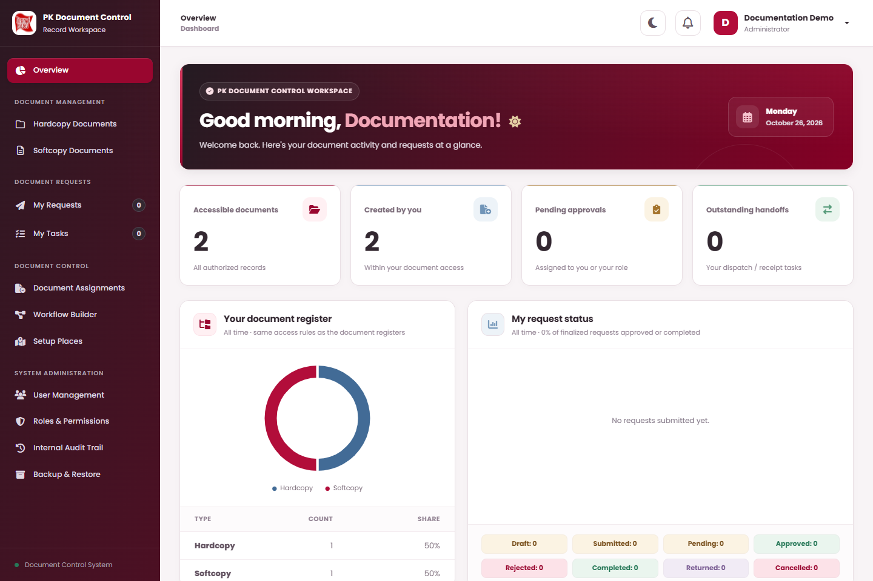
PROPOSED OPERATING PROCEDURES
PK Document
Control
PROPOSED USER GUIDE
Find controlled records. Prepare requests.
Review approvals. Complete physical handoffs.
Planned user procedures, screen illustrations,
and expected outcomes for nine request scenarios.
26 OCTOBER 2026 · PROPOSAL · REVISION 02
Notes:
This proposed guide sets out intended user procedures and expected outcomes. Screen illustrations use sample data.

Slide 2
HOW TO USE THIS GUIDE
Your route through the workspace
01
02
03
GET ORIENTED
REQUEST AND REVIEW
CONTROL AND ADMINISTER
Sign in and account security
Overview and navigation
Find records and inspect details
All nine request actions
Save Draft → Submit → decision
Return, reject, dispatch, and accept
Direct documents and assignments
Places, users, roles, and workflows
Audit events and recovery tools
These procedures describe intended operation. Letters match the screen markers; short arrows identify controls. Numbered steps describe actions. Available actions will depend on permissions and the active workflow step.
People, records, dates and transactions in the screen illustrations are sample data.
PK DOCUMENT CONTROL | USER GUIDE
PROPOSED OPERATING PROCEDURES · REVISION 02
02

Slide 3
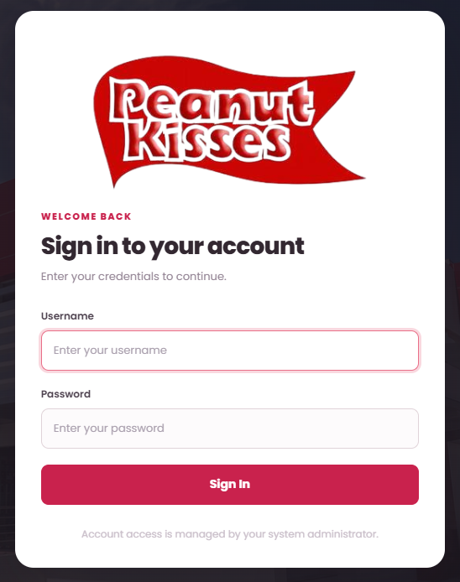
SYSTEM MODULES
System access and responsibilities
WHAT TO DO
ON THIS SCREEN
01
Open the address supplied by your
system administrator and use your
own account.
02
Hardcopy Documents tracks physical
records; Softcopy Documents
provides controlled electronic
records and files.
03
Use My Requests for approval
proposals and My Tasks for assigned
approvals or physical handoffs.
04
Document controllers and
administrators receive extra
management menus when
permitted.
A
Username
A
B
Password
B
05
Ask the administrator when a
needed menu, action, or record is
unavailable.
C
C
Sign In
Permissions and document access will determine
the menus, records, request actions, and file
buttons available to each user.
PK DOCUMENT CONTROL | USER GUIDE
PROPOSED OPERATING PROCEDURES · REVISION 02
03
Notes:
Planned procedure:
Open the address supplied by your system administrator and use your own account.
Hardcopy Documents tracks physical records; Softcopy Documents provides controlled electronic records and files.
Use My Requests for approval proposals and My Tasks for assigned approvals or physical handoffs.
Document controllers and administrators receive extra management menus when permitted.
Ask the administrator when a needed menu, action, or record is unavailable.
Operating notes:
Permissions and document access will determine the menus, records, request actions, and file buttons available to each user.
Ask your administrator when a needed menu or document is unavailable; do not use another person's account.
Document access will not automatically grant permission to edit, download, print, approve, or administer the system.

Slide 4
SYSTEM MODULES
Sign in and change your password
WHAT TO DO
ON THIS SCREEN
01
Enter Username and Password,
then select Sign In.
02
For a temporary password,
complete Current or temporary
password, New password, and
Confirm new password.
03
Choose more than 8 characters, up
to 72 bytes; select Set permanent
password.
04
Later, open your name → Change
Password, complete the fields, then
Update Password → Confirm.
A
Username
A
05
Open your name → Sign Out →
Confirm to finish your session.
B
Password
B
C
C
Sign In
If Invalid username or password appears, recheck
the credentials. After too many failed attempts,
wait before trying again or contact the
administrator.
PK DOCUMENT CONTROL | USER GUIDE
PROPOSED OPERATING PROCEDURES · REVISION 02
04
Notes:
Planned procedure:
Enter Username and Password, then select Sign In.
For a temporary password, complete Current or temporary password, New password, and Confirm new password.
Choose more than 8 characters, up to 72 bytes; select Set permanent password.
Later, open your name → Change Password, complete the fields, then Update Password → Confirm.
Open your name → Sign Out → Confirm to finish your session.
Operating notes:
If Invalid username or password appears, recheck the credentials. After too many failed attempts, wait before trying again or contact the administrator.
The proposed sign-in screen will use administrator-managed password resets. Contact an administrator for a new temporary password.
Your name and role will appear in the account menu, where Change Password will provide the self-service password action.

Slide 5
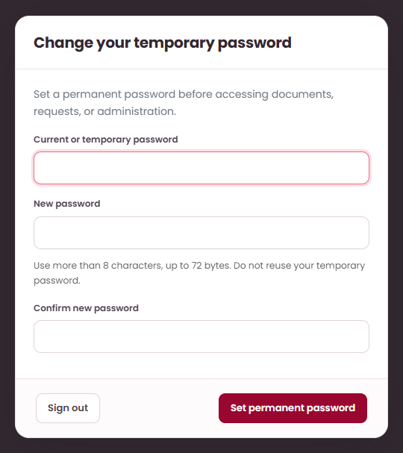
ACCOUNT ACCESS
Set your permanent password
WHAT TO DO
ON THIS SCREEN
01
For a new or reset account, enter
the Current or temporary
password.
02
Enter a New password with more
than 8 characters, up to 72 bytes.
03
Repeat it in Confirm new password,
then select Set permanent
password.
A
Enter temporary
password
A
B
Enter permanent
password
B
C
Confirm permanent
password
C
D
Set permanent
password
D
The system will require this step before allowing
access to the workspace.
PK DOCUMENT CONTROL | USER GUIDE
PROPOSED OPERATING PROCEDURES · REVISION 02
05
Notes:
Planned procedure:
For a new or reset account, enter the Current or temporary password.
Enter a New password with more than 8 characters, up to 72 bytes.
Repeat it in Confirm new password, then select Set permanent password.
Operating notes:
The system will require this step before allowing access to the workspace.

Slide 6
SYSTEM MODULES
Overview and main navigation
WHAT TO DO
ON THIS SCREEN
01
Select Overview for your
dashboard. On narrow screens, use
Toggle navigation to show the
sidebar.
A
Open physical
documents
A
02
Check Accessible documents and
Created by you for counts within
your document access.
Start and track
requests
B
03
Check Pending approvals and
Outstanding handoffs for work
assigned to you or your roles.
B
C
C
Review assigned
work
04
Read Your document register and
My request status to see document
and request distributions.
05
Use the left navigation for
documents, My Requests, My
Tasks, and permitted management
pages; use the bell for
Notifications.
Dashboard numbers will reflect the signed-in
user's authorized records and assigned work.
PK DOCUMENT CONTROL | USER GUIDE
PROPOSED OPERATING PROCEDURES · REVISION 02
06
Notes:
Planned procedure:
Select Overview for your dashboard. On narrow screens, use Toggle navigation to show the sidebar.
Check Accessible documents and Created by you for counts within your document access.
Check Pending approvals and Outstanding handoffs for work assigned to you or your roles.
Read Your document register and My request status to see document and request distributions.
Use the left navigation for documents, My Requests, My Tasks, and permitted management pages; use the bell for Notifications.
Operating notes:
Dashboard numbers will reflect the signed-in user's authorized records and assigned work.
Additional menus will appear only when the account has the corresponding permissions.

Slide 7
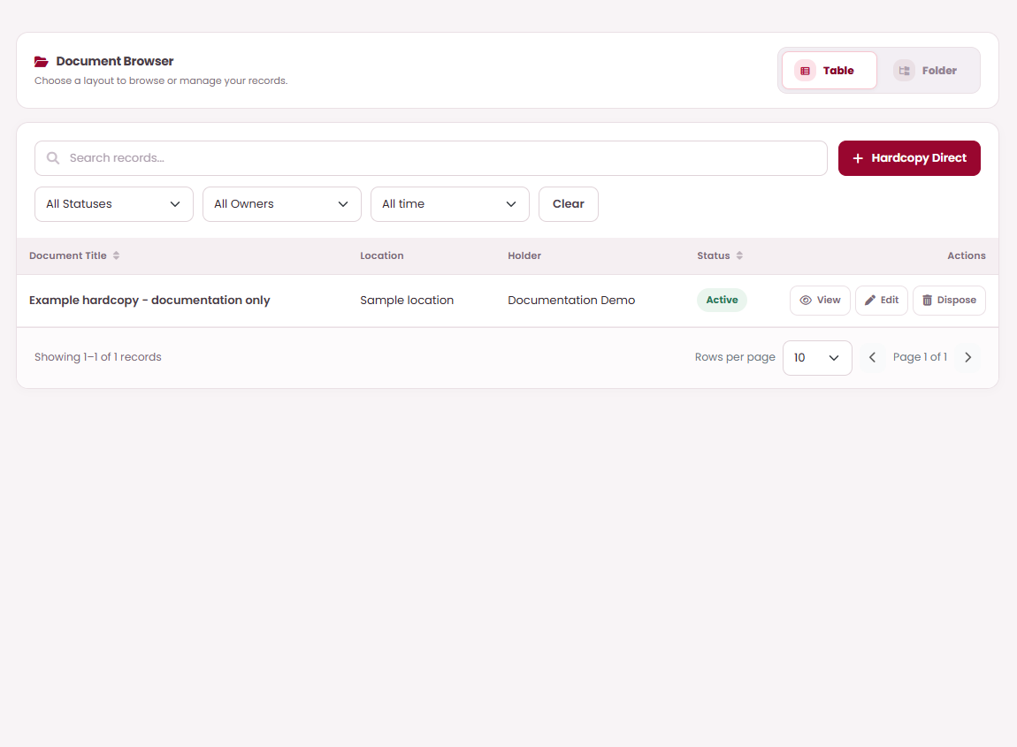
SYSTEM MODULES
Find and inspect document records
WHAT TO DO
ON THIS SCREEN
01
Open Hardcopy Documents or
Softcopy Documents and choose Table
or Folder.
02
Use Search records, status, owner, and
date filters. Select Clear to remove
filters.
A
Search by document
details
A
B
03
Expand hardcopy Area → Specific →
optional Asset → Location, or softcopy
category folders. Use breadcrumbs
and All Documents to change scope.
B
Authorized direct
entry
C
C
Open document
details
04
Open a document title or View action
for full details, related requests,
approval history, and applicable file or
transfer history.
05
Use Rows per page, page arrows, and
Recent / A–Z / Z–A ordering to browse
long lists.
The proposed hardcopy register will show
Document Title, Location, Holder, and Status. The
softcopy register will show Document Title,
Document Number, Category, and Status.
PK DOCUMENT CONTROL | USER GUIDE
PROPOSED OPERATING PROCEDURES · REVISION 02
07
Notes:
Planned procedure:
Open Hardcopy Documents or Softcopy Documents and choose Table or Folder.
Use Search records, status, owner, and date filters. Select Clear to remove filters.
Expand hardcopy Area → Specific → optional Asset → Location, or softcopy category folders. Use breadcrumbs and All Documents to change scope.
Open a document title or View action for full details, related requests, approval history, and applicable file or transfer history.
Use Rows per page, page arrows, and Recent / A–Z / Z–A ordering to browse long lists.
Operating notes:
The proposed hardcopy register will show Document Title, Location, Holder, and Status. The softcopy register will show Document Title, Document Number, Category, and Status.
Only authorized folders and records will be available. The status filters will include Active, Disposed, and Cancelled.

Slide 8
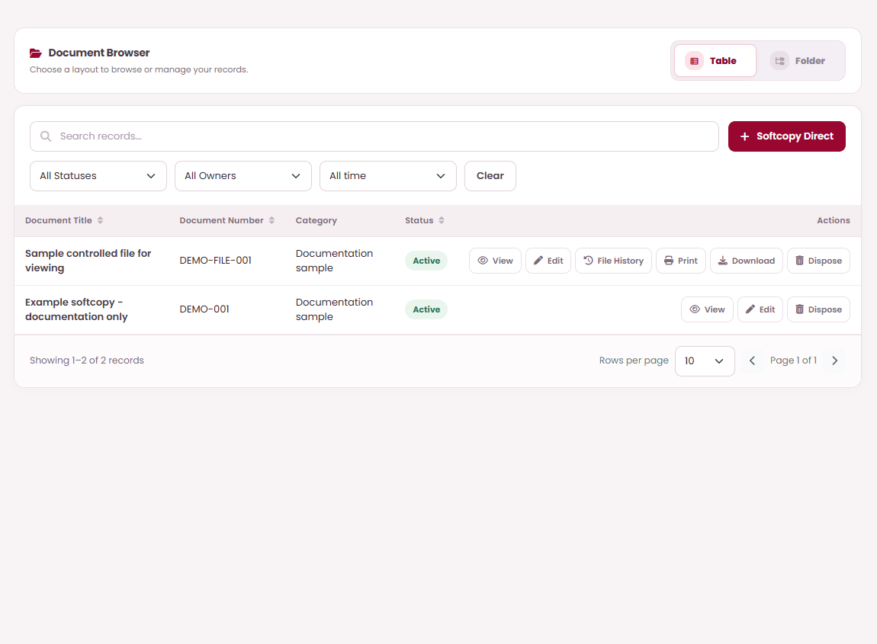
WORKED EXAMPLES
Open, download and print controlled files
WHAT TO DO
ON THIS SCREEN
01
Open Softcopy Documents and find
the permitted active record.
02
Select File History to inspect its
available revision files.
03
Select Download for an authorized
copy of the current approved file.
B
A
Open File History
04
Select Print to open the controlled
print preview.
A
C
B
Open print preview
C
Download approved
file
Available file actions depend on your permissions
and document access.
PK DOCUMENT CONTROL | USER GUIDE
PROPOSED OPERATING PROCEDURES · REVISION 02
08
Notes:
Planned procedure:
Open Softcopy Documents and find the permitted active record.
Select File History to inspect its available revision files.
Select Download for an authorized copy of the current approved file.
Select Print to open the controlled print preview.
Operating notes:
Available file actions depend on your permissions and document access.

Slide 9
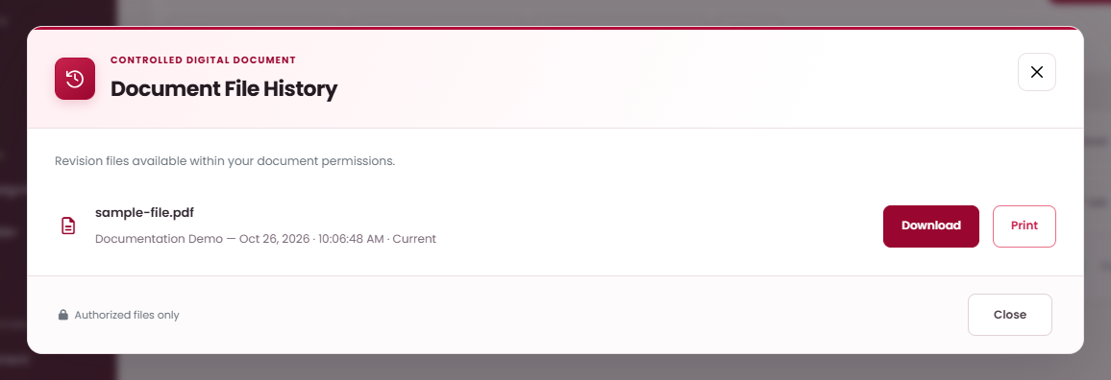
WORKED EXAMPLES
Inspect Document File History
WHAT TO DO
ON THIS SCREEN
01
Open File History on the intended
softcopy record.
02
Read the revision details and
identify the current file.
03
Use available Download or Print
actions for files within your access.
04
Select Close to return to the
document register.
A
Identify current
revision
A
B
C
B
Download revision
file
C
Print revision file
Historical revision metadata can remain after
retired file bytes are cleaned up.
PK DOCUMENT CONTROL | USER GUIDE
PROPOSED OPERATING PROCEDURES · REVISION 02
09
Notes:
Planned procedure:
Open File History on the intended softcopy record.
Read the revision details and identify the current file.
Use available Download or Print actions for files within your access.
Select Close to return to the document register.
Operating notes:
Historical revision metadata can remain after retired file bytes are cleaned up.

Slide 10
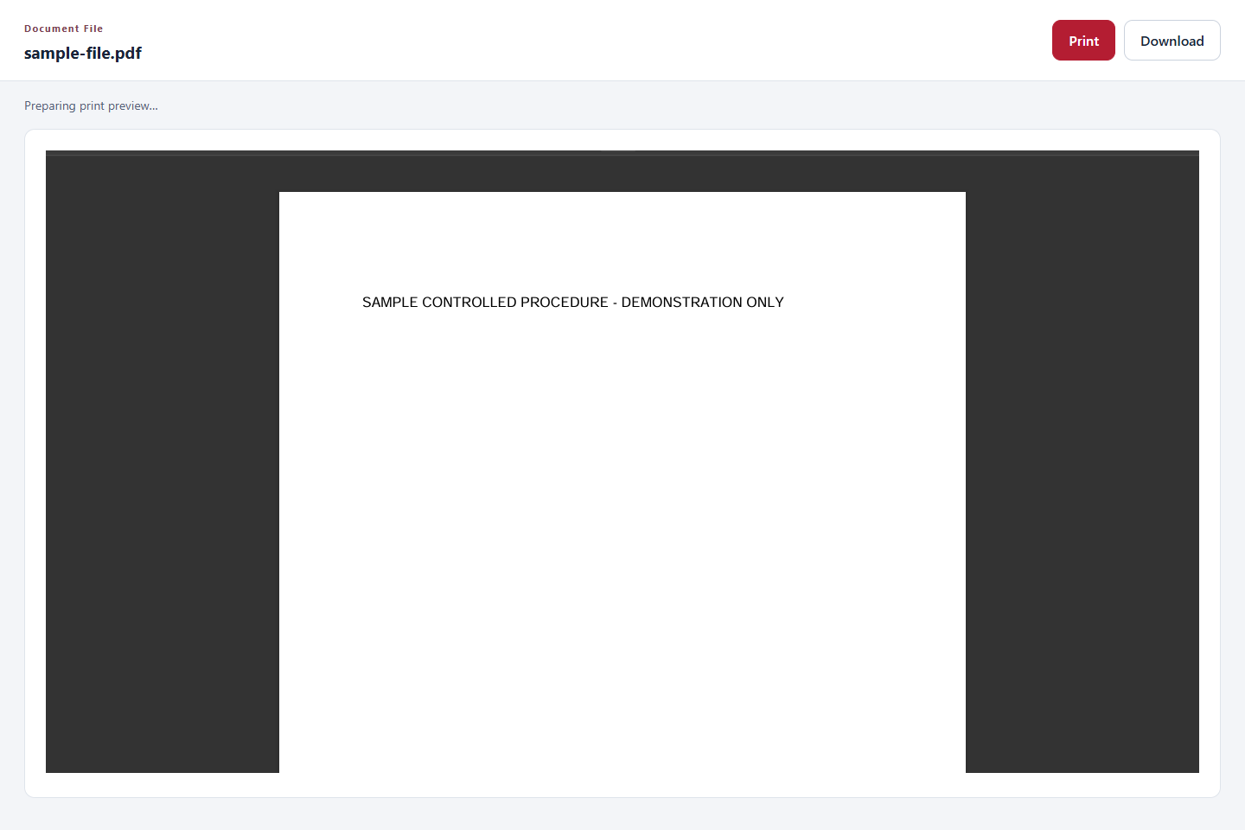
WORKED EXAMPLES
Use the controlled print preview
WHAT TO DO
ON THIS SCREEN
01
Open Print from the authorized
document file action.
A
Print this controlled
file
A
B
02
Wait for the PDF, image or text
preview to prepare.
B
Download the
approved file
03
Select Print when ready, then
complete your browser's print
dialog.
04
Use Download when you need a
permitted local copy.
C
Review the file
preview
C
Office files use the downloaded file and an
installed Office application for printing.
PK DOCUMENT CONTROL | USER GUIDE
PROPOSED OPERATING PROCEDURES · REVISION 02
10
Notes:
Planned procedure:
Open Print from the authorized document file action.
Wait for the PDF, image or text preview to prepare.
Select Print when ready, then complete your browser's print dialog.
Use Download when you need a permitted local copy.
Operating notes:
Office files use the downloaded file and an installed Office application for printing.

Slide 11
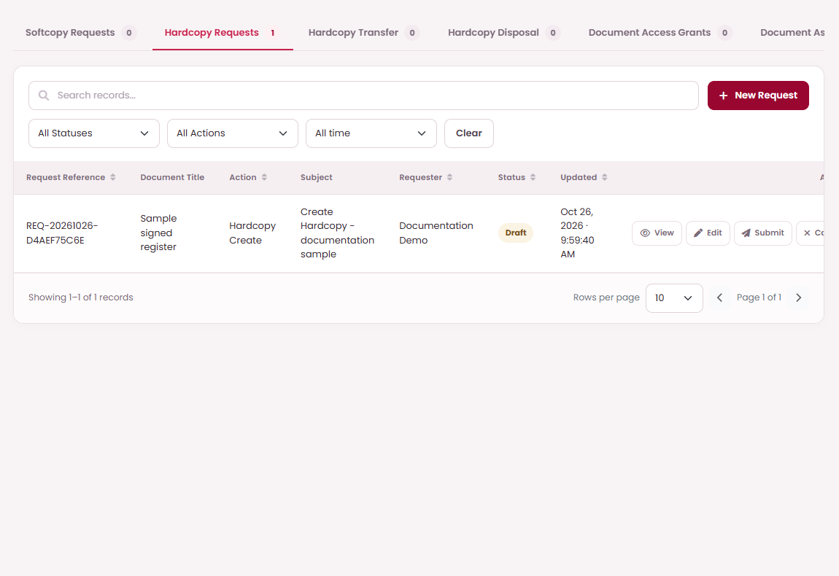
SYSTEM MODULES
Save, submit, and track requests
WHAT TO DO
ON THIS SCREEN
01
Choose the appropriate My Requests
tab and select New Request; complete
the action-specific fields.
02
Save Draft → Confirm records the
proposal. Open View to inspect
metadata, any attachment, and its
approval timeline.
B
03
Select Submit → Confirm when ready.
Submitted means the published
approval workflow has started.
A
View draft details
A
C
04
For a request Returned to you, read
the remarks, Edit, save, and Submit
again.
B
Edit before
submitting
05
Cancel an unwanted Draft. Delete is
permanent and is offered only for your
cancelled, never-submitted draft.
C
Submit for approval
Request filters will include Draft, Submitted,
Completed, Approved, Rejected, Returned, and
Cancelled. An Approved transfer will still require
the physical handoff steps.
PK DOCUMENT CONTROL | USER GUIDE
PROPOSED OPERATING PROCEDURES · REVISION 02
11
Notes:
Planned procedure:
Choose the appropriate My Requests tab and select New Request; complete the action-specific fields.
Save Draft → Confirm records the proposal. Open View to inspect metadata, any attachment, and its approval timeline.
Select Submit → Confirm when ready. Submitted means the published approval workflow has started.
For a request Returned to you, read the remarks, Edit, save, and Submit again.
Cancel an unwanted Draft. Delete is permanent and is offered only for your cancelled, never-submitted draft.
Operating notes:
Request filters will include Draft, Submitted, Completed, Approved, Rejected, Returned, and Cancelled. An Approved transfer will still require the physical handoff steps.
Only the requester will be able to edit their own draft or returned request. Submitted requests will remain protected from draft editing.
Submission will require a published workflow. Resubmitting a returned request will retain its original workflow version.

Slide 12
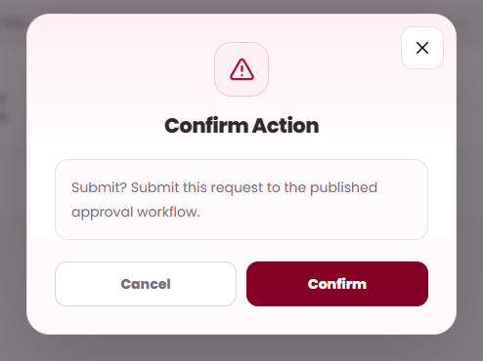
WORKED EXAMPLES
Submit a checked draft
WHAT TO DO
ON THIS SCREEN
01
Save Draft records your proposal
without starting approval.
02
Back in the request list, select
Submit for the intended draft.
03
Read the request confirmation and
select Confirm to start the approval
workflow.
04
Check the request becomes
Submitted, then inspect its
Approval Process Timeline.
A
Review the
submission
A
B
Confirm to start
approval
B
Submit uses the shared Confirm dialog; it does
not ask for an approval remark.
PK DOCUMENT CONTROL | USER GUIDE
PROPOSED OPERATING PROCEDURES · REVISION 02
12
Notes:
Planned procedure:
Save Draft records your proposal without starting approval.
Back in the request list, select Submit for the intended draft.
Read the request confirmation and select Confirm to start the approval workflow.
Check the request becomes Submitted, then inspect its Approval Process Timeline.
Operating notes:
Submit uses the shared Confirm dialog; it does not ask for an approval remark.

Slide 13
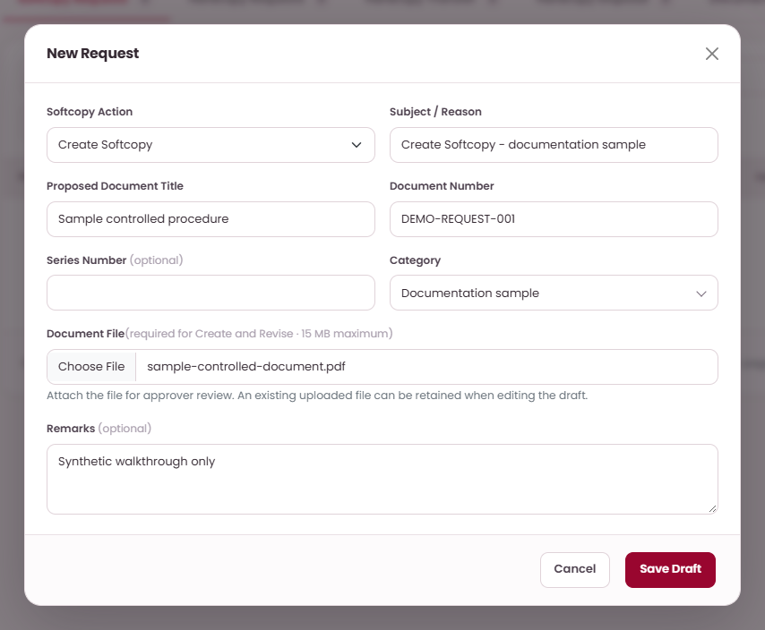
PLANNED REQUEST SCENARIOS · INPUT
Sample 01 · Create Softcopy
EXAMPLE DATA
ON THIS SCREEN
Subject / Reason: Create Softcopy -
documentation sample
Proposed Document Title: Sample controlled
procedure
A
Choose Create
Softcopy
A
B
Document Number: DEMO-REQUEST-001
WHAT TO DO
C
01
Open My Requests → Softcopy and
select New Request.
B
State the reason
02
Choose Create Softcopy and enter
Subject / Reason.
C
Enter the sample
title
03
Enter the proposed title, Document
Number, optional Series Number,
and Category.
04
Attach the Document File, add
Remarks if needed, and select Save
Draft.
Save Draft first. Submit only after checking the
document, fields and attachment.
PK DOCUMENT CONTROL | USER GUIDE
PROPOSED OPERATING PROCEDURES · REVISION 02
13
Notes:
Planned procedure:
Open My Requests → Softcopy and select New Request.
Choose Create Softcopy and enter Subject / Reason.
Enter the proposed title, Document Number, optional Series Number, and Category.
Attach the Document File, add Remarks if needed, and select Save Draft.
Operating notes:
Save Draft first. Submit only after checking the document, fields and attachment.

Slide 14
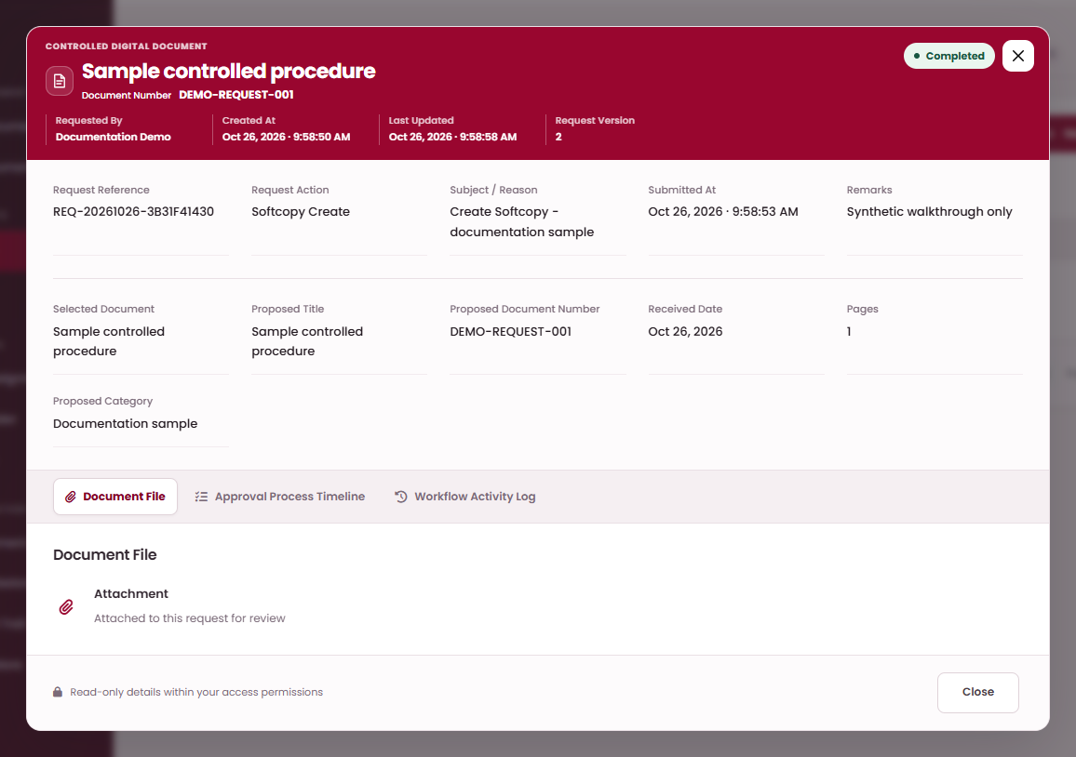
PLANNED REQUEST SCENARIOS · OUTCOME
Sample 01 · Create Softcopy — expected outcome
ON THIS SCREEN
EXPECTED: COMPLETED
WHAT TO DO
A
Completed request
A
01
Open the saved draft and verify the
selected document, fields, and
attachment where required.
02
Select Submit, read the shared
confirmation, and select Confirm.
The request enters its published
approval route.
03
The assigned approver opens My
Tasks, reviews the proposal, and
selects Approve → Confirm at each
required step.
B
Open approval
timeline
B
04
After final approval, the new
controlled softcopy will appear in
Softcopy Documents. Expected
status: Completed.
The illustration shows the expected state for this
sample scenario.
PK DOCUMENT CONTROL | USER GUIDE
PROPOSED OPERATING PROCEDURES · REVISION 02
14
Notes:
Planned procedure:
Open the saved draft and verify the selected document, fields, and attachment where required.
Select Submit, read the shared confirmation, and select Confirm. The request enters its published approval route.
The assigned approver opens My Tasks, reviews the proposal, and selects Approve → Confirm at each required step.
After final approval, the new controlled softcopy will appear in Softcopy Documents. Expected status: Completed.
Operating notes:
The illustration shows the expected state for this sample scenario.

Slide 15
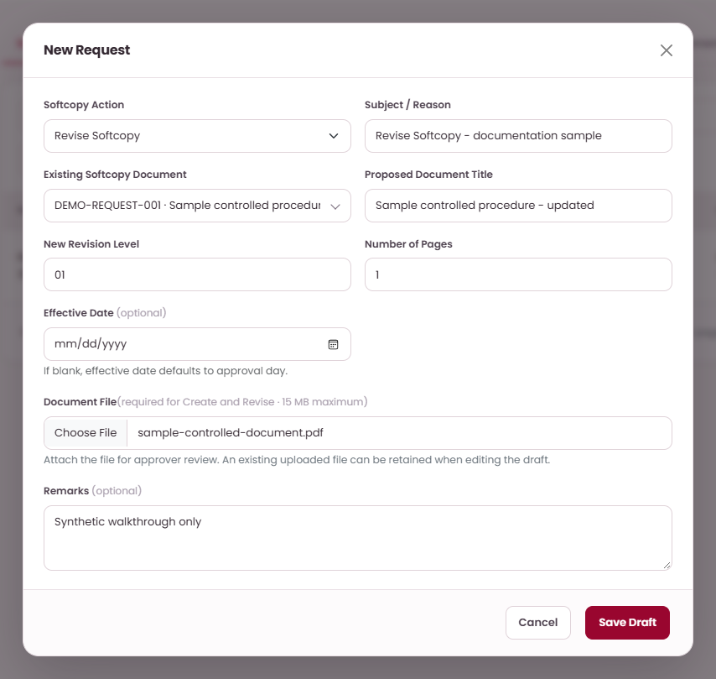
PLANNED REQUEST SCENARIOS · INPUT
Sample 02 · Revise Softcopy
EXAMPLE DATA
ON THIS SCREEN
Subject / Reason: Revise Softcopy -
documentation sample
Proposed Document Title: Sample controlled
procedure - updated
A
Choose Revise
Softcopy
A
B
New Revision Level: 01
C
D
WHAT TO DO
B
State the reason
01
Open My Requests → Softcopy and
select New Request.
02
Choose Revise Softcopy and select
the Existing Softcopy Document.
C
Select existing
document
03
Check the proposed title; enter
New Revision Level and Number of
Pages.
D
Enter the sample
title
04
Choose an optional Effective Date,
attach the revised file, then Save
Draft.
Save Draft first. Submit only after checking the
document, fields and attachment.
PK DOCUMENT CONTROL | USER GUIDE
PROPOSED OPERATING PROCEDURES · REVISION 02
15
Notes:
Planned procedure:
Open My Requests → Softcopy and select New Request.
Choose Revise Softcopy and select the Existing Softcopy Document.
Check the proposed title; enter New Revision Level and Number of Pages.
Choose an optional Effective Date, attach the revised file, then Save Draft.
Operating notes:
Save Draft first. Submit only after checking the document, fields and attachment.

Slide 16
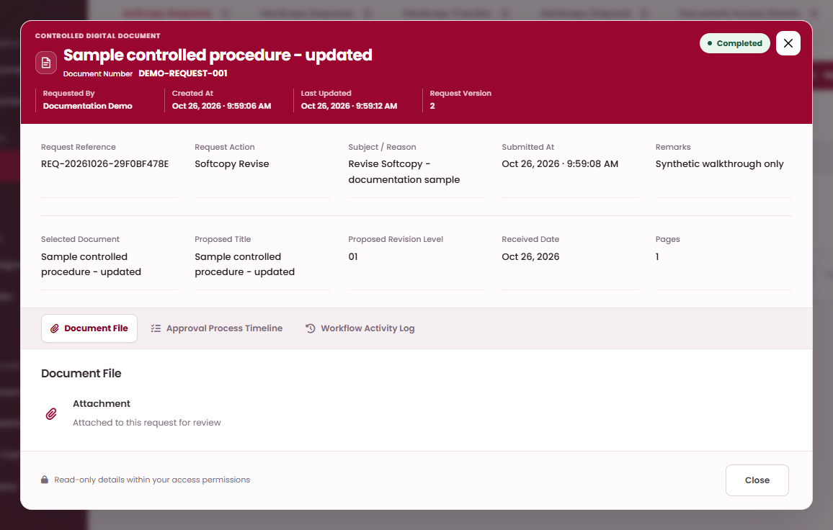
PLANNED REQUEST SCENARIOS · OUTCOME
Sample 02 · Revise Softcopy — expected outcome
ON THIS SCREEN
EXPECTED: COMPLETED
WHAT TO DO
A
Completed request
01
Open the saved draft and verify the
selected document, fields, and
attachment where required.
A
02
Select Submit, read the shared
confirmation, and select Confirm.
The request enters its published
approval route.
03
The assigned approver opens My
Tasks, reviews the proposal, and
selects Approve → Confirm at each
required step.
B
Open approval
timeline
B
04
The approved revision will become
the current controlled file; check
the revision and File History.
Expected status: Completed.
The illustration shows the expected state for this
sample scenario.
PK DOCUMENT CONTROL | USER GUIDE
PROPOSED OPERATING PROCEDURES · REVISION 02
16
Notes:
Planned procedure:
Open the saved draft and verify the selected document, fields, and attachment where required.
Select Submit, read the shared confirmation, and select Confirm. The request enters its published approval route.
The assigned approver opens My Tasks, reviews the proposal, and selects Approve → Confirm at each required step.
The approved revision will become the current controlled file; check the revision and File History. Expected status: Completed.
Operating notes:
The illustration shows the expected state for this sample scenario.

Slide 17
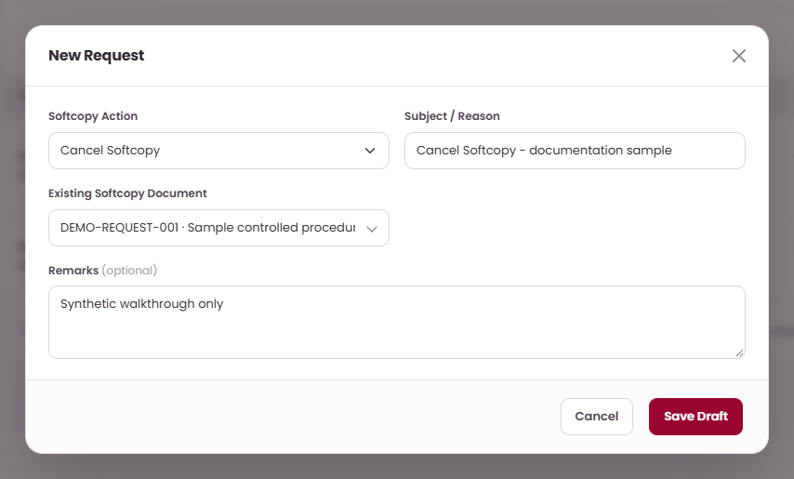
PLANNED REQUEST SCENARIOS · INPUT
Sample 03 · Cancel Softcopy
EXAMPLE DATA
ON THIS SCREEN
Subject / Reason: Cancel Softcopy -
documentation sample
Existing Softcopy Document: Sample controlled
procedure - updated
WHAT TO DO
01
Open My Requests → Softcopy and
select New Request.
A
Choose Cancel
Softcopy
A
B
02
Choose Cancel Softcopy and select
the Existing Softcopy Document.
B
State the reason
C
03
Enter Subject / Reason and any
Remarks explaining the
cancellation.
C
Select existing
document
04
Save Draft, check the selected
record, and submit the proposal.
Save Draft first. Submit only after checking the
document, fields and attachment.
PK DOCUMENT CONTROL | USER GUIDE
PROPOSED OPERATING PROCEDURES · REVISION 02
17
Notes:
Planned procedure:
Open My Requests → Softcopy and select New Request.
Choose Cancel Softcopy and select the Existing Softcopy Document.
Enter Subject / Reason and any Remarks explaining the cancellation.
Save Draft, check the selected record, and submit the proposal.
Operating notes:
Save Draft first. Submit only after checking the document, fields and attachment.

Slide 18
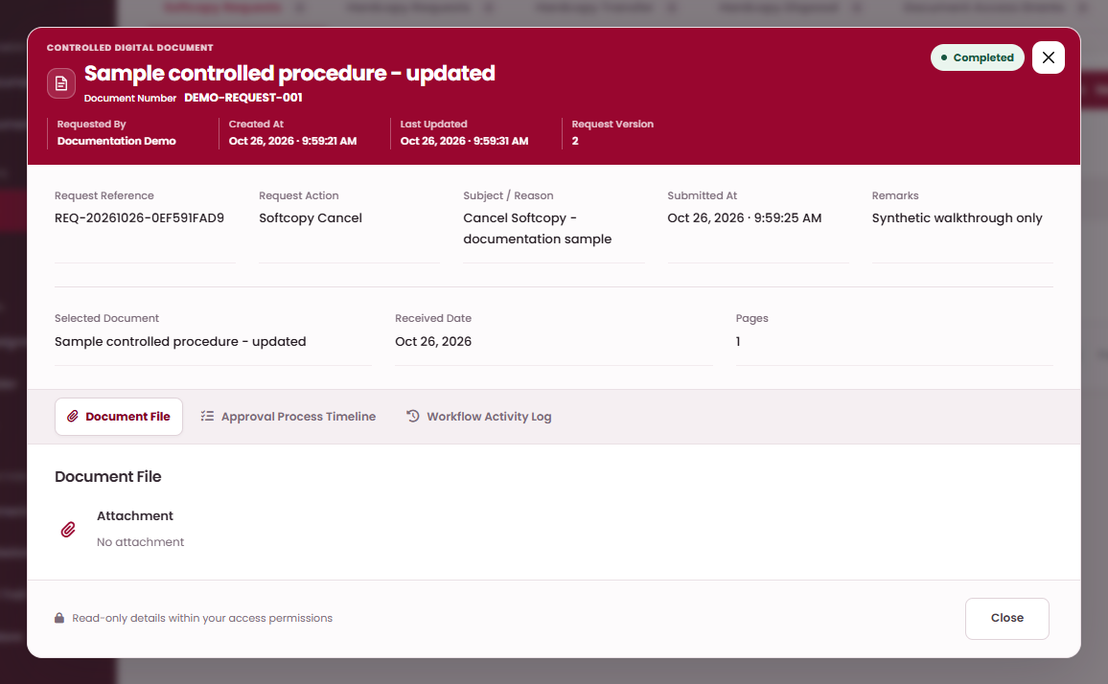
PLANNED REQUEST SCENARIOS · OUTCOME
Sample 03 · Cancel Softcopy — expected outcome
ON THIS SCREEN
EXPECTED: COMPLETED
WHAT TO DO
Completed request
01
Open the saved draft and verify the
selected document, fields, and
attachment where required.
A
A
02
Select Submit, read the shared
confirmation, and select Confirm.
The request enters its published
approval route.
03
The assigned approver opens My
Tasks, reviews the proposal, and
selects Approve → Confirm at each
required step.
B
Open approval
timeline
B
04
Final approval will cancel the
controlled softcopy; use the
Cancelled status filter to inspect it.
Expected status: Completed.
The illustration shows the expected state for this
sample scenario.
PK DOCUMENT CONTROL | USER GUIDE
PROPOSED OPERATING PROCEDURES · REVISION 02
18
Notes:
Planned procedure:
Open the saved draft and verify the selected document, fields, and attachment where required.
Select Submit, read the shared confirmation, and select Confirm. The request enters its published approval route.
The assigned approver opens My Tasks, reviews the proposal, and selects Approve → Confirm at each required step.
Final approval will cancel the controlled softcopy; use the Cancelled status filter to inspect it. Expected status: Completed.
Operating notes:
The illustration shows the expected state for this sample scenario.

Slide 19
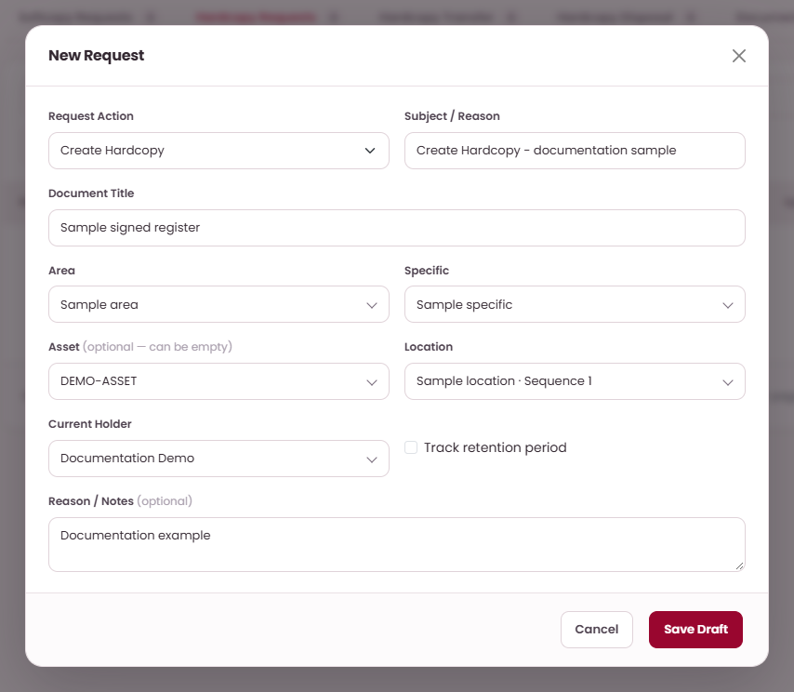
PLANNED REQUEST SCENARIOS · INPUT
Sample 04 · Create Hardcopy
EXAMPLE DATA
ON THIS SCREEN
Subject / Reason: Create Hardcopy -
documentation sample
Document Title: Sample signed register
A
Choose Create
Hardcopy
WHAT TO DO
A
B
01
Open My Requests → Hardcopy
and select New Request.
State the reason
C
B
02
Choose Create Hardcopy and enter
Subject / Reason and Document
Title.
C
Enter the sample
title
03
Select Area, Specific, optional
Asset, Location, and check Current
Holder.
04
Optionally enable retention
monitoring, then enter both Start
and End dates (End on/after Start).
Add notes and Save Draft.
Save Draft first. Submit only after checking the
document, fields and attachment.
PK DOCUMENT CONTROL | USER GUIDE
PROPOSED OPERATING PROCEDURES · REVISION 02
19
Notes:
Planned procedure:
Open My Requests → Hardcopy and select New Request.
Choose Create Hardcopy and enter Subject / Reason and Document Title.
Select Area, Specific, optional Asset, Location, and check Current Holder.
Optionally enable retention monitoring, then enter both Start and End dates (End on/after Start). Add notes and Save Draft.
Operating notes:
Save Draft first. Submit only after checking the document, fields and attachment.

Slide 20
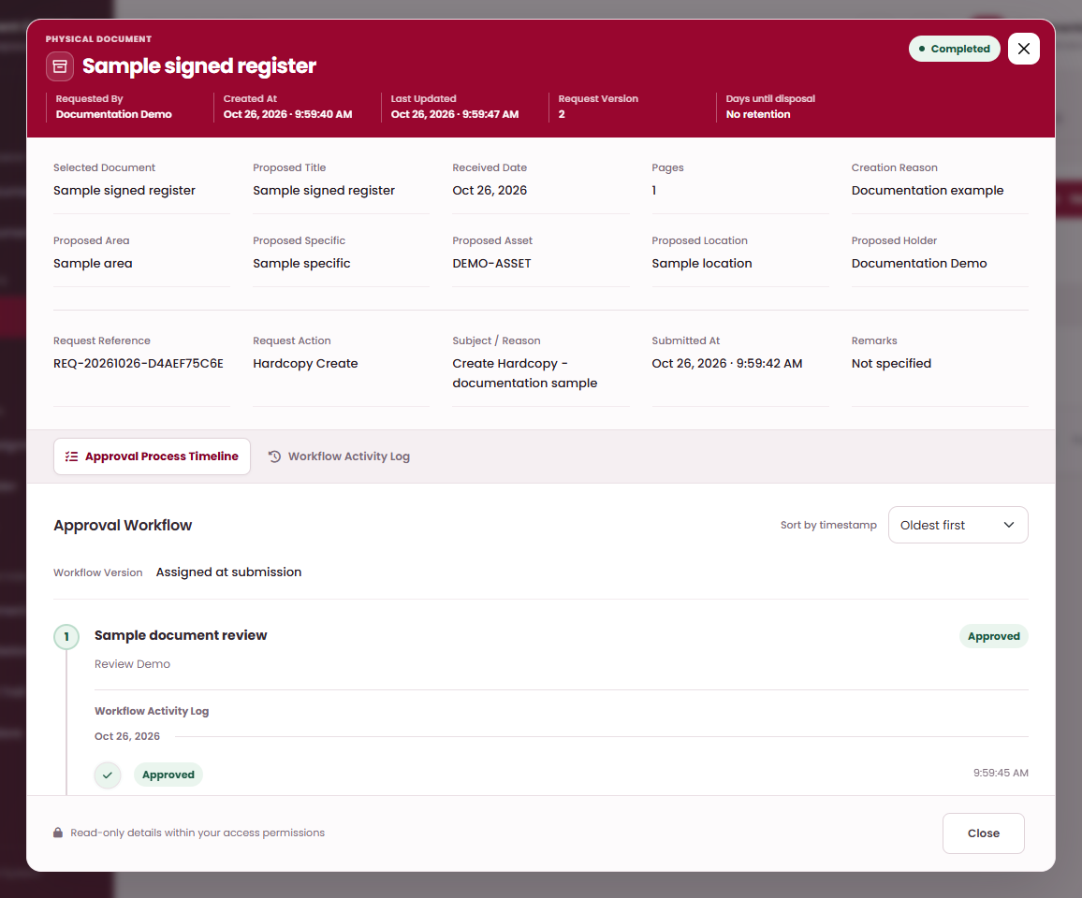
PLANNED REQUEST SCENARIOS · OUTCOME
Sample 04 · Create Hardcopy — expected outcome
ON THIS SCREEN
EXPECTED: COMPLETED
Completed request
A
WHAT TO DO
A
01
Open the saved draft and verify the
selected document, fields, and
attachment where required.
02
Select Submit, read the shared
confirmation, and select Confirm.
The request enters its published
approval route.
B
Open approval
timeline
B
03
The assigned approver opens My
Tasks, reviews the proposal, and
selects Approve → Confirm at each
required step.
04
The new hardcopy will appear with
its approved storage hierarchy and
holder. Expected status:
Completed.
The illustration shows the expected state for this
sample scenario.
PK DOCUMENT CONTROL | USER GUIDE
PROPOSED OPERATING PROCEDURES · REVISION 02
20
Notes:
Planned procedure:
Open the saved draft and verify the selected document, fields, and attachment where required.
Select Submit, read the shared confirmation, and select Confirm. The request enters its published approval route.
The assigned approver opens My Tasks, reviews the proposal, and selects Approve → Confirm at each required step.
The new hardcopy will appear with its approved storage hierarchy and holder. Expected status: Completed.
Operating notes:
The illustration shows the expected state for this sample scenario.

Slide 21
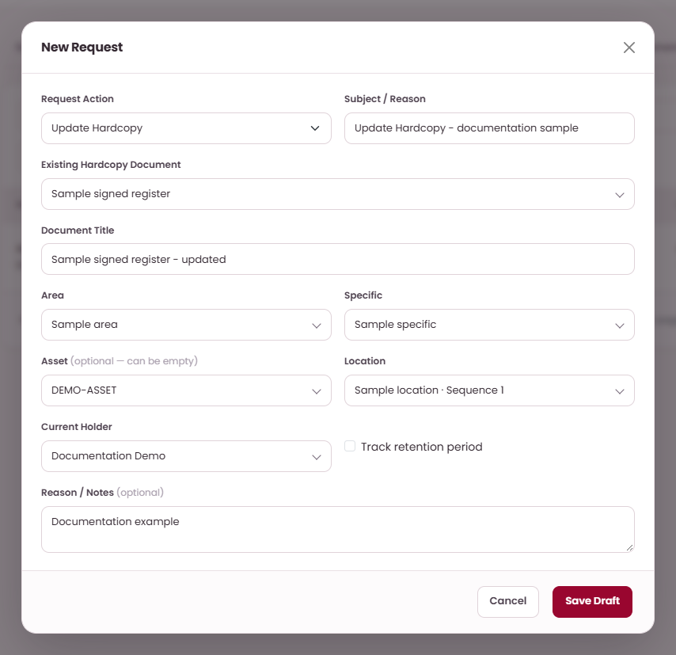
PLANNED REQUEST SCENARIOS · INPUT
Sample 05 · Update Hardcopy
EXAMPLE DATA
ON THIS SCREEN
Subject / Reason: Update Hardcopy -
documentation sample
Document Title: Sample signed register -
updated
A
Choose Update
Hardcopy
A
B
WHAT TO DO
C
01
Open My Requests → Hardcopy
and select New Request.
B
State the reason
D
02
Choose Update Hardcopy and
select the Existing Hardcopy
Document.
C
Select existing
document
03
Check Document Title, Area,
Specific, optional Asset, Location,
and Current Holder.
D
Enter the sample
title
04
Update the intended metadata or
retention information, then Save
Draft.
Save Draft first. Submit only after checking the
document, fields and attachment.
PK DOCUMENT CONTROL | USER GUIDE
PROPOSED OPERATING PROCEDURES · REVISION 02
21
Notes:
Planned procedure:
Open My Requests → Hardcopy and select New Request.
Choose Update Hardcopy and select the Existing Hardcopy Document.
Check Document Title, Area, Specific, optional Asset, Location, and Current Holder.
Update the intended metadata or retention information, then Save Draft.
Operating notes:
Save Draft first. Submit only after checking the document, fields and attachment.

Slide 22
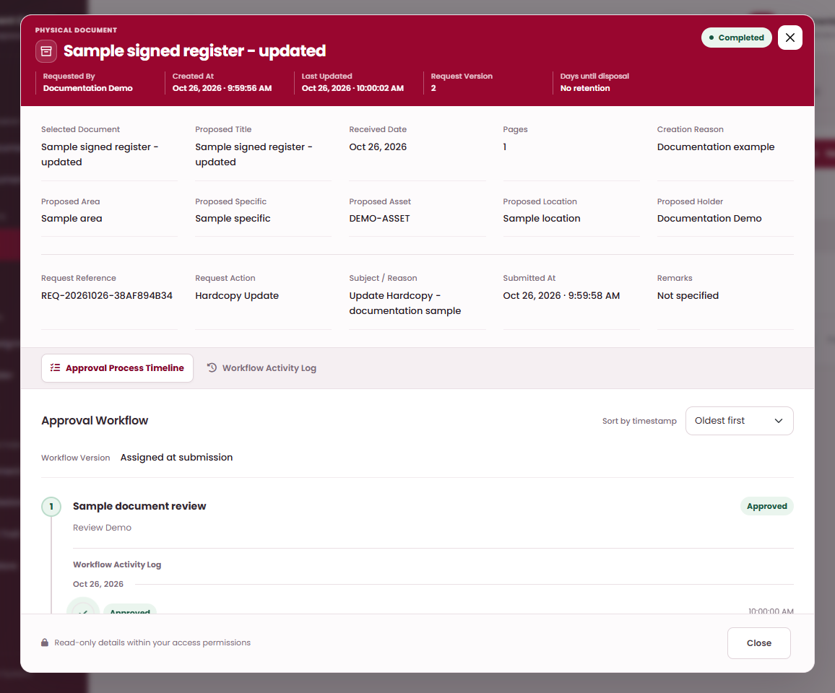
PLANNED REQUEST SCENARIOS · OUTCOME
Sample 05 · Update Hardcopy — expected outcome
ON THIS SCREEN
EXPECTED: COMPLETED
Completed request
A
WHAT TO DO
A
01
Open the saved draft and verify the
selected document, fields, and
attachment where required.
02
Select Submit, read the shared
confirmation, and select Confirm.
The request enters its published
approval route.
Open approval
timeline
03
The assigned approver opens My
Tasks, reviews the proposal, and
selects Approve → Confirm at each
required step.
B
B
04
Final approval will apply the
hardcopy metadata; inspect the
changed storage or retention fields.
Expected status: Completed.
The illustration shows the expected state for this
sample scenario.
PK DOCUMENT CONTROL | USER GUIDE
PROPOSED OPERATING PROCEDURES · REVISION 02
22
Notes:
Planned procedure:
Open the saved draft and verify the selected document, fields, and attachment where required.
Select Submit, read the shared confirmation, and select Confirm. The request enters its published approval route.
The assigned approver opens My Tasks, reviews the proposal, and selects Approve → Confirm at each required step.
Final approval will apply the hardcopy metadata; inspect the changed storage or retention fields. Expected status: Completed.
Operating notes:
The illustration shows the expected state for this sample scenario.

Slide 23
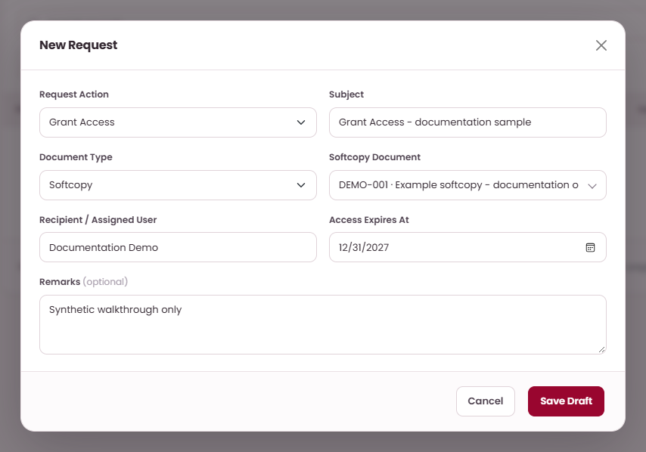
PLANNED REQUEST SCENARIOS · INPUT
Sample 06 · Grant Access
EXAMPLE DATA
ON THIS SCREEN
Access Expires At: 2027-12-31
Selected document: Example softcopy -
documentation only
Subject: Grant Access - documentation sample
WHAT TO DO
A
Choose Grant
Access
A
B
01
Open My Requests → Document
Access Grants and select New
Request.
B
State the reason
C
02
Enter Subject in the Document
Access Grant form.
C
Select existing
document
03
Choose Document Type, select the
document, and check your
read-only Recipient field.
04
Set Access Expires At after today,
allowing time for approval; add
optional Remarks, then Save Draft.
Save Draft first. Submit only after checking the
document, fields and attachment.
PK DOCUMENT CONTROL | USER GUIDE
PROPOSED OPERATING PROCEDURES · REVISION 02
23
Notes:
Planned procedure:
Open My Requests → Document Access Grants and select New Request.
Enter Subject in the Document Access Grant form.
Choose Document Type, select the document, and check your read-only Recipient field.
Set Access Expires At after today, allowing time for approval; add optional Remarks, then Save Draft.
Operating notes:
Save Draft first. Submit only after checking the document, fields and attachment.

Slide 24
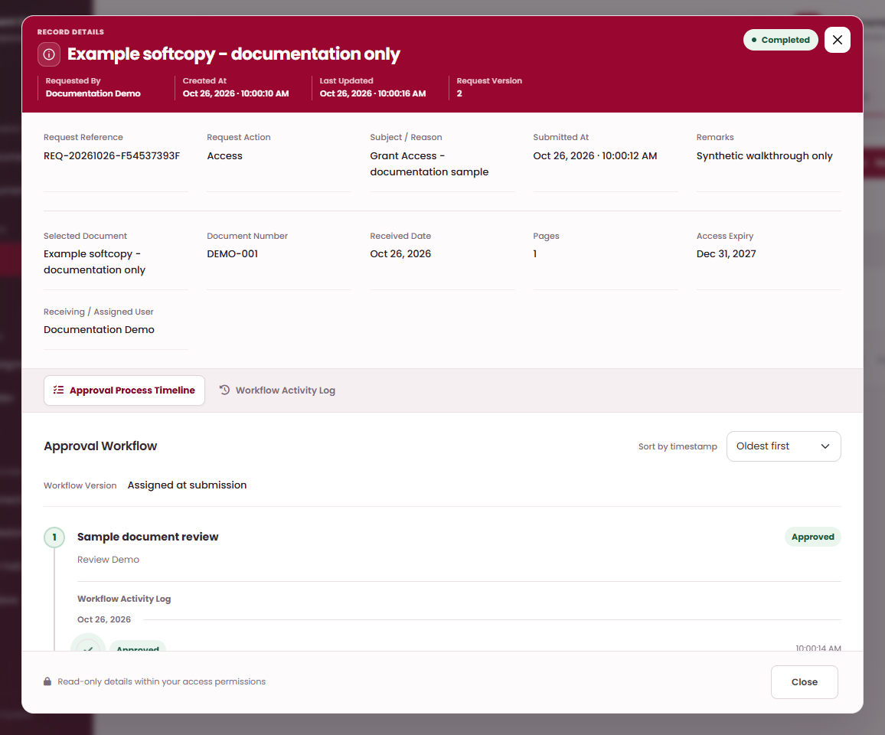
PLANNED REQUEST SCENARIOS · OUTCOME
Sample 06 · Grant Access — expected outcome
ON THIS SCREEN
EXPECTED: COMPLETED
Completed request
A
WHAT TO DO
A
01
Open the saved draft and verify the
selected document, fields, and
attachment where required.
02
Select Submit, read the shared
confirmation, and select Confirm.
The request enters its published
approval route.
Open approval
timeline
03
The assigned approver opens My
Tasks, reviews the proposal, and
selects Approve → Confirm at each
required step.
B
B
04
The approved grant will give the
signed-in recipient access to the
selected document until expiry.
Expected status: Completed.
The illustration shows the expected state for this
sample scenario.
PK DOCUMENT CONTROL | USER GUIDE
PROPOSED OPERATING PROCEDURES · REVISION 02
24
Notes:
Planned procedure:
Open the saved draft and verify the selected document, fields, and attachment where required.
Select Submit, read the shared confirmation, and select Confirm. The request enters its published approval route.
The assigned approver opens My Tasks, reviews the proposal, and selects Approve → Confirm at each required step.
The approved grant will give the signed-in recipient access to the selected document until expiry. Expected status: Completed.
Operating notes:
The illustration shows the expected state for this sample scenario.

Slide 25

PLANNED REQUEST SCENARIOS · INPUT
Sample 07 · Assign Document
EXAMPLE DATA
ON THIS SCREEN
Selected document: Example softcopy -
documentation only
Subject: Assign Document - documentation
sample
WHAT TO DO
A
Choose Assign
Document
A
B
01
Open My Requests → Document
Assignments and select New
Request.
B
State the reason
C
02
Choose Document Assignments
and enter Subject.
Select existing
document
03
Choose Document Type and select
the document to be assigned to
you.
C
04
Check your read-only Recipient /
Assigned User, add optional
Remarks, then Save Draft.
Save Draft first. Submit only after checking the
document, fields and attachment.
PK DOCUMENT CONTROL | USER GUIDE
PROPOSED OPERATING PROCEDURES · REVISION 02
25
Notes:
Planned procedure:
Open My Requests → Document Assignments and select New Request.
Choose Document Assignments and enter Subject.
Choose Document Type and select the document to be assigned to you.
Check your read-only Recipient / Assigned User, add optional Remarks, then Save Draft.
Operating notes:
Save Draft first. Submit only after checking the document, fields and attachment.

Slide 26

PLANNED REQUEST SCENARIOS · OUTCOME
Sample 07 · Assign Document — expected outcome
ON THIS SCREEN
EXPECTED: COMPLETED
Completed request
A
WHAT TO DO
A
01
Open the saved draft and verify the
selected document, fields, and
attachment where required.
02
Select Submit, read the shared
confirmation, and select Confirm.
The request enters its published
approval route.
B
Open approval
timeline
B
03
The assigned approver opens My
Tasks, reviews the proposal, and
selects Approve → Confirm at each
required step.
04
The approved assignment will apply
to the selected document and
signed-in recipient. Expected
status: Completed.
The illustration shows the expected state for this
sample scenario.
PK DOCUMENT CONTROL | USER GUIDE
PROPOSED OPERATING PROCEDURES · REVISION 02
26
Notes:
Planned procedure:
Open the saved draft and verify the selected document, fields, and attachment where required.
Select Submit, read the shared confirmation, and select Confirm. The request enters its published approval route.
The assigned approver opens My Tasks, reviews the proposal, and selects Approve → Confirm at each required step.
The approved assignment will apply to the selected document and signed-in recipient. Expected status: Completed.
Operating notes:
The illustration shows the expected state for this sample scenario.

Slide 27
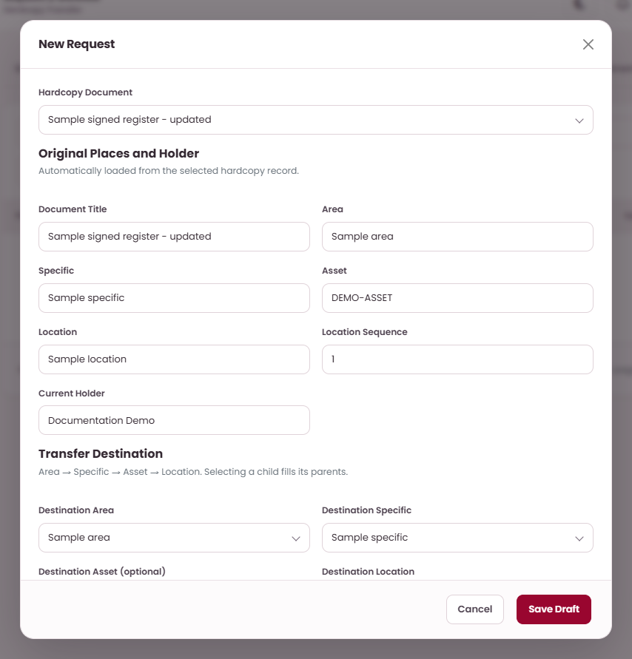
PLANNED REQUEST SCENARIOS · INPUT
Sample 08 · Transfer Hardcopy
EXAMPLE DATA
ON THIS SCREEN
Location: Sample receiving location
Hardcopy Document: Sample signed register -
updated
A
Select hardcopy
document
A
Receiving User: Receiver Demo
Request Subject: Transfer Hardcopy -
documentation sample
WHAT TO DO
01
Open My Requests → Hardcopy
Transfer and select New Request.
02
Select the Hardcopy Document and
check Original Places and Holder.
B
Check original
holder
B
03
Choose the destination hierarchy
and Receiving User; destination
must differ from the original.
C
Choose destination
area
C
D
04
Enter Request Subject and optional
Remarks, then Save Draft.
D
Choose destination
specific
Save Draft first. Submit only after checking the
document, fields and attachment.
PK DOCUMENT CONTROL | USER GUIDE
PROPOSED OPERATING PROCEDURES · REVISION 02
27
Notes:
Planned procedure:
Open My Requests → Hardcopy Transfer and select New Request.
Select the Hardcopy Document and check Original Places and Holder.
Choose the destination hierarchy and Receiving User; destination must differ from the original.
Enter Request Subject and optional Remarks, then Save Draft.
Operating notes:
Save Draft first. Submit only after checking the document, fields and attachment.

Slide 28
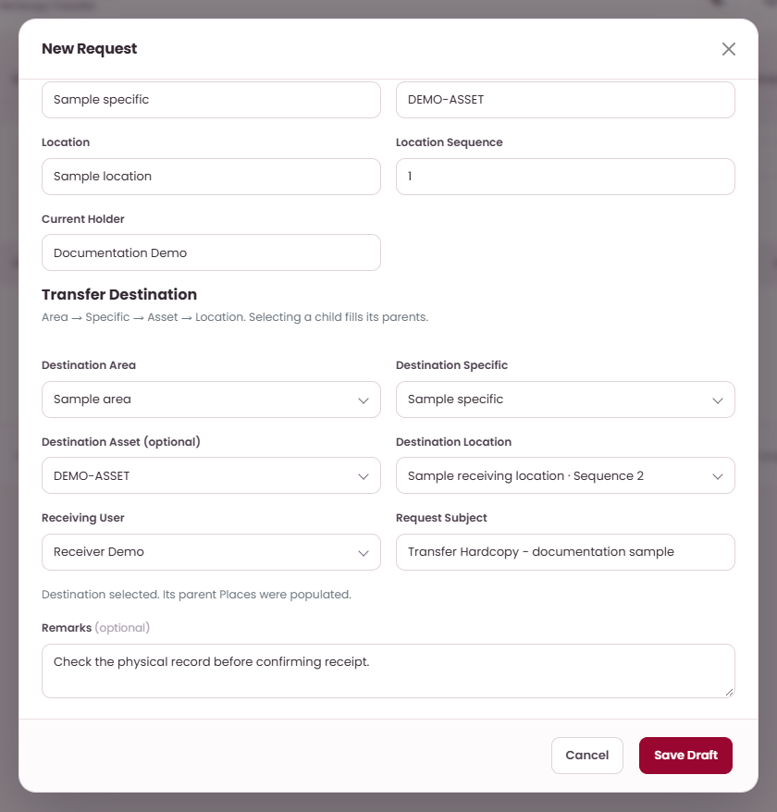
PLANNED REQUEST SCENARIOS · INPUT
Sample 08 · Transfer destination and recipient
WHAT TO DO
ON THIS SCREEN
01
Scroll down within the New
Request form to the destination
fields.
02
Select the destination hierarchy
and Receiving User; the destination
must differ from the original.
A
Choose Destination
Location
03
Enter Request Subject and any
Remarks, then select Save Draft.
B
Choose Receiving
User
A
C
Enter Request
Subject
B
C
D
Add optional
Remarks
D
E
E
Save Draft
Approval will authorize the handoff. Dispatch and
receipt will be recorded separately.
PK DOCUMENT CONTROL | USER GUIDE
PROPOSED OPERATING PROCEDURES · REVISION 02
28
Notes:
Planned procedure:
Scroll down within the New Request form to the destination fields.
Select the destination hierarchy and Receiving User; the destination must differ from the original.
Enter Request Subject and any Remarks, then select Save Draft.
Operating notes:
Approval will authorize the handoff. Dispatch and receipt will be recorded separately.

Slide 29
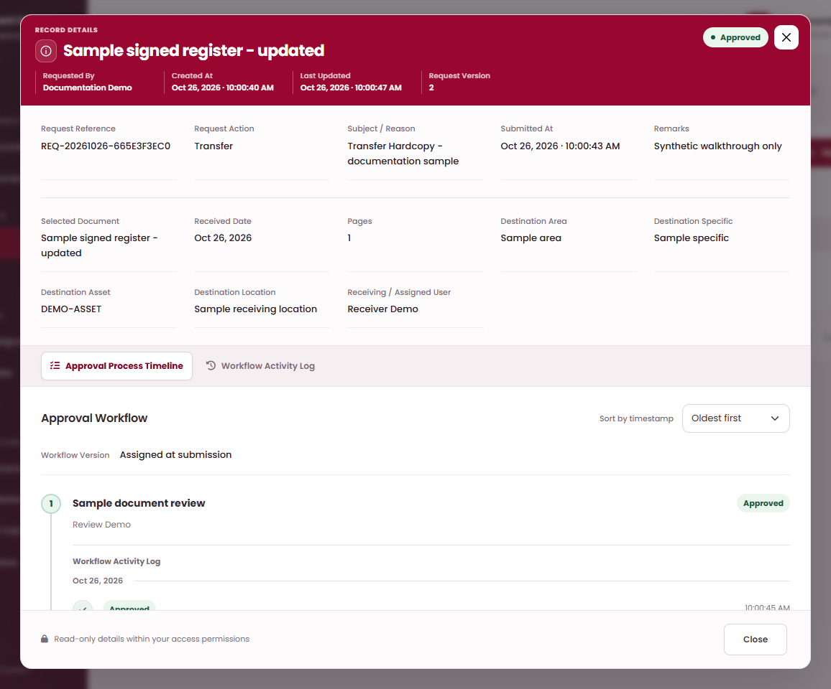
PLANNED REQUEST SCENARIOS · OUTCOME
Sample 08 · Transfer Hardcopy — expected outcome
ON THIS SCREEN
EXPECTED: APPROVED
Approved request
A
WHAT TO DO
A
01
Open the saved draft and verify the
selected document, fields, and
attachment where required.
02
Select Submit, read the shared
confirmation, and select Confirm.
The request enters its published
approval route.
Open approval
timeline
03
The assigned approver opens My
Tasks, reviews the proposal, and
selects Approve → Confirm at each
required step.
B
B
04
Approval will create the handoff
work. Complete Dispatch and
recipient Accept to record physical
receipt. Expected status: Approved.
The illustration shows the expected state for this
sample scenario.
PK DOCUMENT CONTROL | USER GUIDE
PROPOSED OPERATING PROCEDURES · REVISION 02
29
Notes:
Planned procedure:
Open the saved draft and verify the selected document, fields, and attachment where required.
Select Submit, read the shared confirmation, and select Confirm. The request enters its published approval route.
The assigned approver opens My Tasks, reviews the proposal, and selects Approve → Confirm at each required step.
Approval will create the handoff work. Complete Dispatch and recipient Accept to record physical receipt. Expected status: Approved.
Operating notes:
The illustration shows the expected state for this sample scenario.

Slide 30
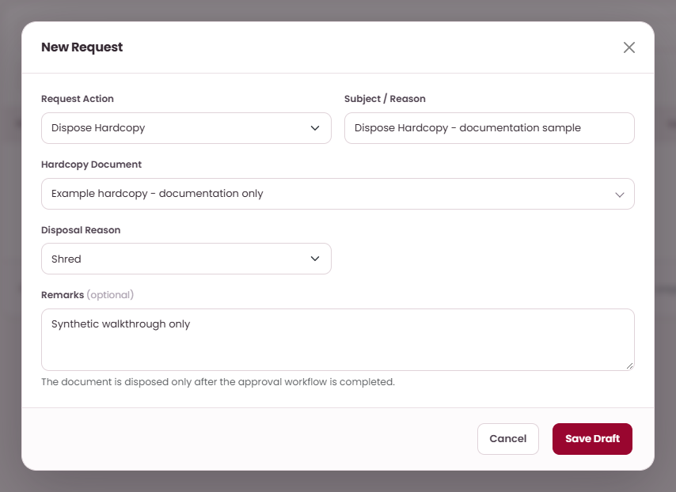
PLANNED REQUEST SCENARIOS · INPUT
Sample 09 · Dispose Hardcopy
EXAMPLE DATA
ON THIS SCREEN
Subject / Reason: Dispose Hardcopy -
documentation sample
Disposal Reason: Shred
Hardcopy Document: Example hardcopy -
documentation only
A
Choose Dispose
Hardcopy
A
B
WHAT TO DO
01
Open My Requests → Hardcopy
Disposal and select New Request.
B
State the reason
C
02
Choose Hardcopy Disposal, enter
Subject / Reason, and select the
document.
C
Select existing
document
03
Choose Disposal Reason: Shred,
Scratch, or Other. Complete Other
Reason if selected.
04
Add optional Remarks, Save Draft,
then review and submit the
proposal.
Save Draft first. Submit only after checking the
document, fields and attachment.
PK DOCUMENT CONTROL | USER GUIDE
PROPOSED OPERATING PROCEDURES · REVISION 02
30
Notes:
Planned procedure:
Open My Requests → Hardcopy Disposal and select New Request.
Choose Hardcopy Disposal, enter Subject / Reason, and select the document.
Choose Disposal Reason: Shred, Scratch, or Other. Complete Other Reason if selected.
Add optional Remarks, Save Draft, then review and submit the proposal.
Operating notes:
Save Draft first. Submit only after checking the document, fields and attachment.

Slide 31
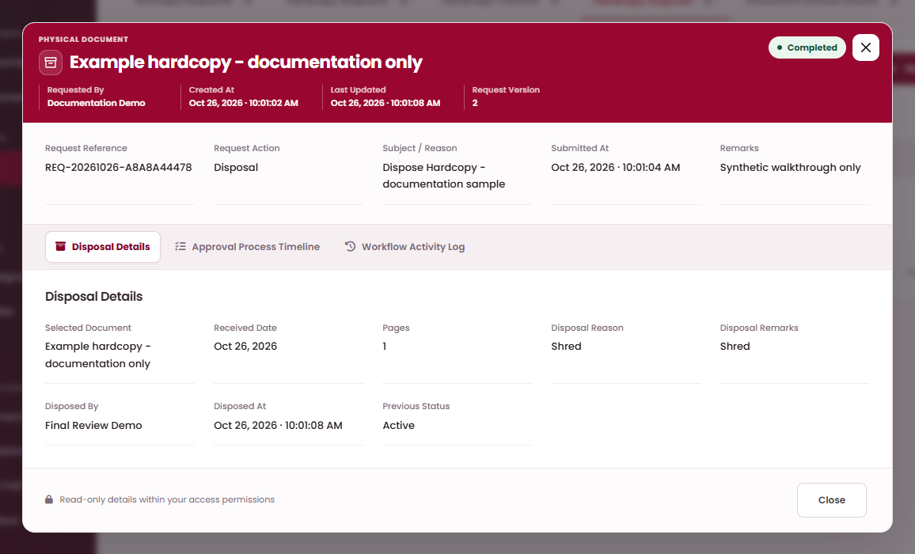
PLANNED REQUEST SCENARIOS · OUTCOME
Sample 09 · Dispose Hardcopy — expected outcome
ON THIS SCREEN
EXPECTED: COMPLETED
WHAT TO DO
01
Open the saved draft and verify the
selected document, fields, and
attachment where required.
A
Completed request
A
02
Select Submit, read the shared
confirmation, and select Confirm.
The request enters its published
approval route.
B
Open approval
timeline
B
03
The assigned approver opens My
Tasks, reviews the proposal, and
selects Approve → Confirm at each
required step.
04
The record will become Disposed;
inspect Disposal Details and the
selected reason in the register.
Expected status: Completed.
The illustration shows the expected state for this
sample scenario.
PK DOCUMENT CONTROL | USER GUIDE
PROPOSED OPERATING PROCEDURES · REVISION 02
31
Notes:
Planned procedure:
Open the saved draft and verify the selected document, fields, and attachment where required.
Select Submit, read the shared confirmation, and select Confirm. The request enters its published approval route.
The assigned approver opens My Tasks, reviews the proposal, and selects Approve → Confirm at each required step.
The record will become Disposed; inspect Disposal Details and the selected reason in the register. Expected status: Completed.
Operating notes:
The illustration shows the expected state for this sample scenario.

Slide 32
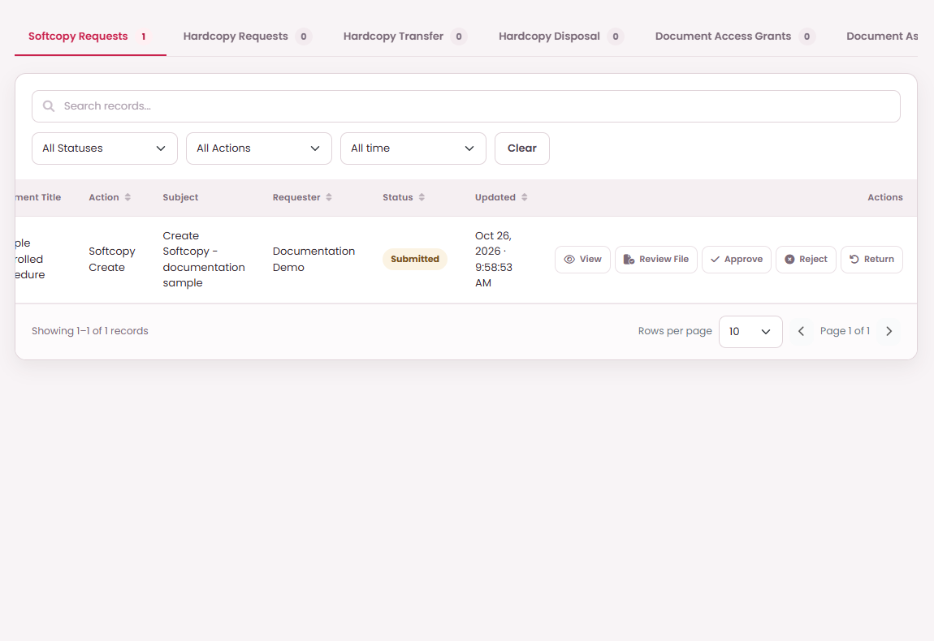
SYSTEM MODULES
Review and decide approval tasks
WHAT TO DO
ON THIS SCREEN
01
Open My Tasks, choose a category,
and open the assigned request's
View details.
02
Read the proposal, Approval
Process Timeline, and Workflow
Activity Log; use Review File for an
attached softcopy.
B
C
A
Read request details
A
D
03
Choose Approve → Confirm to
move the current step forward.
04
Choose Return or Reject, enter an
optional Remark, then Continue to
record the decision.
B
Approve this step
05
Inspect the updated timeline.
Return at step one sends to the
requester; later-step Return
reactivates the previous approver.
C
Reject this request
D
Return for
correction
Only the currently assigned approver, or an
authorized member of the assigned role, may
decide.
PK DOCUMENT CONTROL | USER GUIDE
PROPOSED OPERATING PROCEDURES · REVISION 02
32
Notes:
Planned procedure:
Open My Tasks, choose a category, and open the assigned request's View details.
Read the proposal, Approval Process Timeline, and Workflow Activity Log; use Review File for an attached softcopy.
Choose Approve → Confirm to move the current step forward.
Choose Return or Reject, enter an optional Remark, then Continue to record the decision.
Inspect the updated timeline. Return at step one sends to the requester; later-step Return reactivates the previous approver.
Operating notes:
Only the currently assigned approver, or an authorized member of the assigned role, may decide.
Return at the first approval step will send the request to its requester for correction. Return at a later step will reactivate the immediately previous approver.
Review File will open the proposal for inspection. Use the task's decision buttons to record approval.
Editing a review copy in Word, Excel, or WPS will not update the proposal attachment or controlled document. If an application link expires, refresh Review File to obtain a new link.

Slide 33
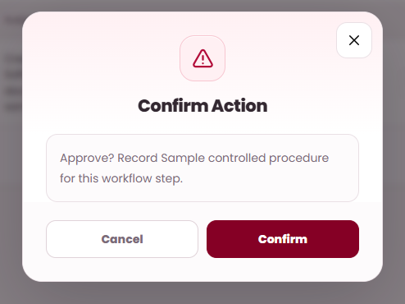
WORKED EXAMPLES
Approve the active workflow step
WHAT TO DO
ON THIS SCREEN
01
Open the assigned request in My
Tasks and inspect the proposal and
file.
02
Select Approve for the active task.
03
Read the shared confirmation and
select Confirm.
04
Check the next step or completed
result in the Approval Process
Timeline.
A
Check the approval
action
A
B
Confirm this step
approval
B
Approve uses Confirm directly. It does not open a
remark form.
PK DOCUMENT CONTROL | USER GUIDE
PROPOSED OPERATING PROCEDURES · REVISION 02
33
Notes:
Planned procedure:
Open the assigned request in My Tasks and inspect the proposal and file.
Select Approve for the active task.
Read the shared confirmation and select Confirm.
Check the next step or completed result in the Approval Process Timeline.
Operating notes:
Approve uses Confirm directly. It does not open a remark form.

Slide 34
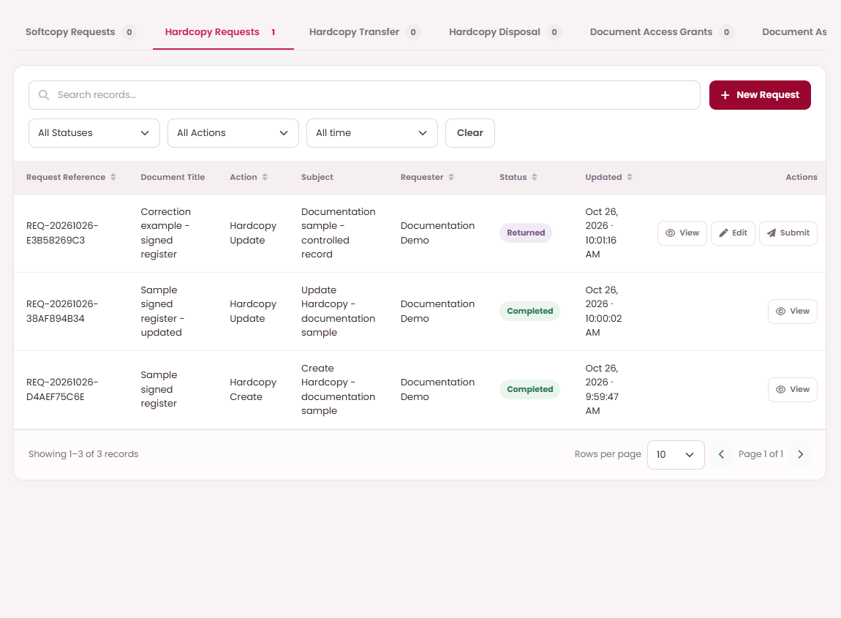
WORKED EXAMPLES
Return from the first approval step
WHAT TO DO
ON THIS SCREEN
01
At the first active step, select
Return.
02
Enter an optional Remark
explaining what needs attention.
03
Select Continue. This records the
Return decision.
A
Edit returned
request
A
B
04
The request becomes Returned to
its requester, who may edit, save,
and resubmit it.
B
Resubmit after
correction
Continue in the Return dialog is the confirmation;
no second Confirm dialog follows.
PK DOCUMENT CONTROL | USER GUIDE
PROPOSED OPERATING PROCEDURES · REVISION 02
34
Notes:
Planned procedure:
At the first active step, select Return.
Enter an optional Remark explaining what needs attention.
Select Continue. This records the Return decision.
The request becomes Returned to its requester, who may edit, save, and resubmit it.
Operating notes:
Continue in the Return dialog is the confirmation; no second Confirm dialog follows.

Slide 35
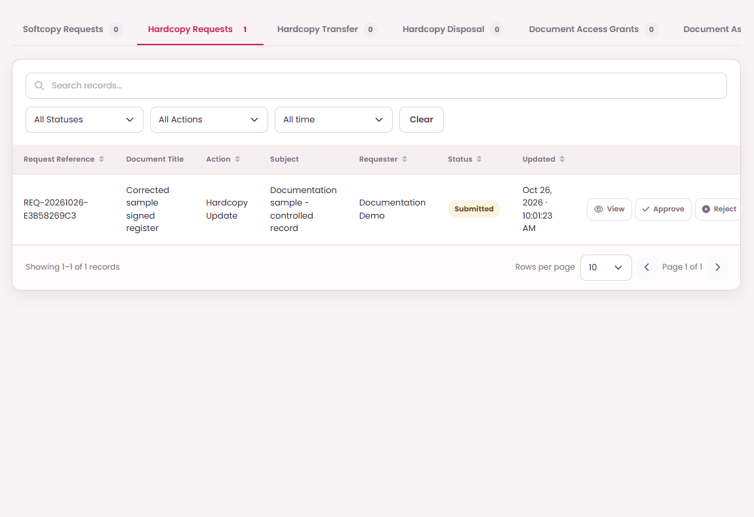
WORKED EXAMPLES
Return from a later approval step
WHAT TO DO
ON THIS SCREEN
01
Select Return when an earlier
review needs to be reconsidered.
02
Add an optional Remark and select
Continue.
03
The immediately previous approver
becomes active again.
View return history
04
After that approver approves again,
the request returns to the step that
returned it.
A
A
B
B
Reopened approval
step
A later-step Return keeps the request Submitted;
it does not send an editable draft to the
requester.
PK DOCUMENT CONTROL | USER GUIDE
PROPOSED OPERATING PROCEDURES · REVISION 02
35
Notes:
Planned procedure:
Select Return when an earlier review needs to be reconsidered.
Add an optional Remark and select Continue.
The immediately previous approver becomes active again.
After that approver approves again, the request returns to the step that returned it.
Operating notes:
A later-step Return keeps the request Submitted; it does not send an editable draft to the requester.

Slide 36
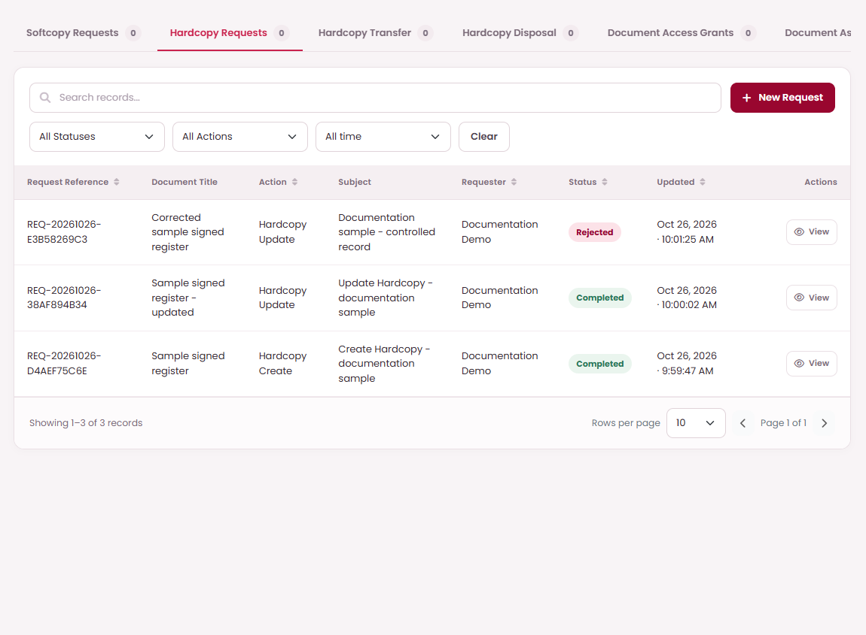
WORKED EXAMPLES
Reject a proposal
WHAT TO DO
ON THIS SCREEN
01
Review the proposal and choose
Reject when it should stop.
02
Enter an optional Remark that
explains the decision.
03
Select Continue to record the
rejection.
A
Rejected request
remains in history
A
04
Check Rejected in the request
status and read the decision in the
activity log.
Rejected proposals are not completed document
changes and are not editable returned drafts.
PK DOCUMENT CONTROL | USER GUIDE
PROPOSED OPERATING PROCEDURES · REVISION 02
36
Notes:
Planned procedure:
Review the proposal and choose Reject when it should stop.
Enter an optional Remark that explains the decision.
Select Continue to record the rejection.
Check Rejected in the request status and read the decision in the activity log.
Operating notes:
Rejected proposals are not completed document changes and are not editable returned drafts.

Slide 37
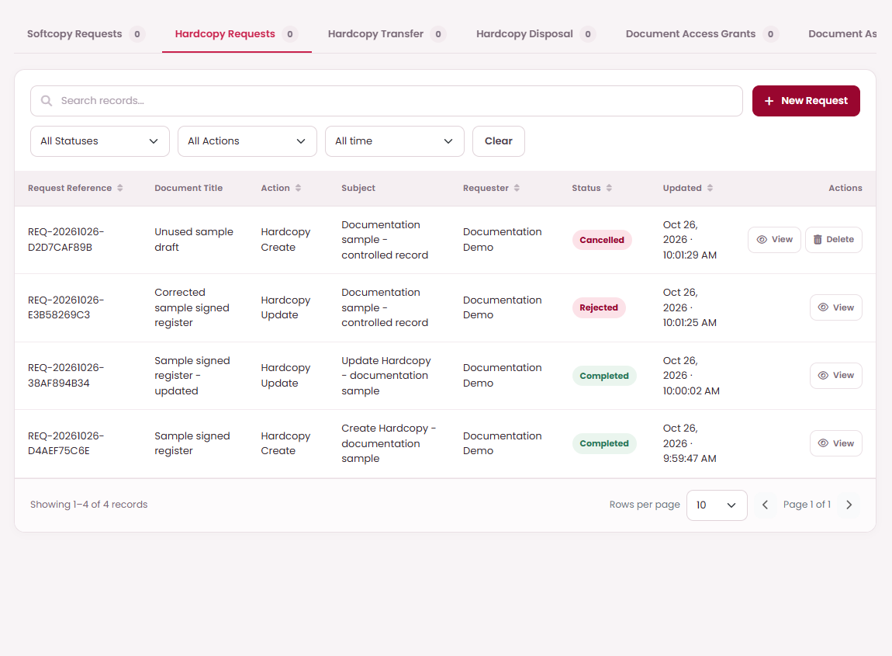
WORKED EXAMPLES
Cancel and, when eligible, remove a draft
WHAT TO DO
ON THIS SCREEN
01
Open your own Draft in My
Requests and select Cancel.
02
Confirm the cancellation and check
the Cancelled status.
03
If Delete is offered, check that this
is the draft you intend to remove
permanently.
A
Delete eligible
cancelled draft
A
04
Select Delete and confirm. Only
your cancelled, never-submitted
draft is eligible.
Permanent draft deletion cannot be undone. It is
not an operation on an approved document.
PK DOCUMENT CONTROL | USER GUIDE
PROPOSED OPERATING PROCEDURES · REVISION 02
37
Notes:
Planned procedure:
Open your own Draft in My Requests and select Cancel.
Confirm the cancellation and check the Cancelled status.
If Delete is offered, check that this is the draft you intend to remove permanently.
Select Delete and confirm. Only your cancelled, never-submitted draft is eligible.
Operating notes:
Permanent draft deletion cannot be undone. It is not an operation on an approved document.

Slide 38
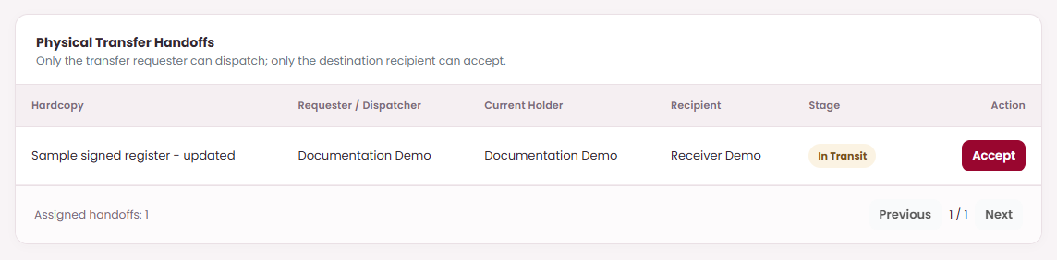
SYSTEM MODULES
Dispatch and accept the physical hardcopy
WHAT TO DO
ON THIS SCREEN
01
Open My Tasks → Hardcopy
Transfer and find Physical Transfer
Handoffs.
02
Check the document, requester,
current holder, recipient, and
stage.
03
The requester selects Dispatch at
physical release, then Confirm.
04
After physical receipt, the recipient
selects Accept for the In Transit
handoff, then Confirm.
A
Accept physical
handoff
A
05
Inspect the updated holder,
location, and Transfer History in
Hardcopy Documents.
Only the transfer requester can dispatch. Only the
destination recipient can accept.
PK DOCUMENT CONTROL | USER GUIDE
PROPOSED OPERATING PROCEDURES · REVISION 02
38
Notes:
Planned procedure:
Open My Tasks → Hardcopy Transfer and find Physical Transfer Handoffs.
Check the document, requester, current holder, recipient, and stage.
The requester selects Dispatch at physical release, then Confirm.
After physical receipt, the recipient selects Accept for the In Transit handoff, then Confirm.
Inspect the updated holder, location, and Transfer History in Hardcopy Documents.
Operating notes:
Only the transfer requester can dispatch. Only the destination recipient can accept.
Accept will confirm physical receipt and update custody and location. Record these actions when the physical handoff occurs.
Users may receive dispatch or receipt tasks even when they are not general workflow approvers.

Slide 39
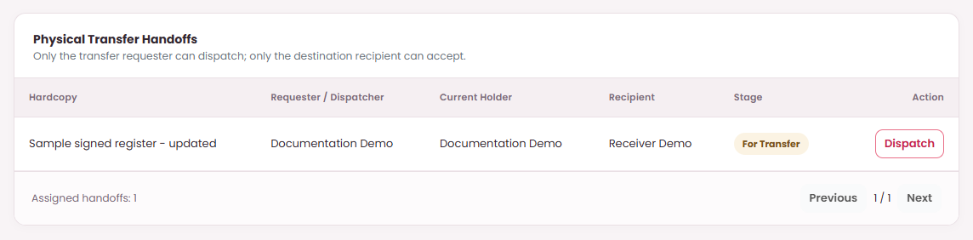
WORKED EXAMPLES
Record physical dispatch
WHAT TO DO
ON THIS SCREEN
01
After approval, open My Tasks →
Hardcopy Transfer.
02
The requester locates the intended
Physical Transfer Handoff.
03
Select Dispatch at physical release,
then select Confirm.
04
Check that the handoff awaits the
receiving user's acceptance.
A
Dispatch physical
handoff
A
Only the transfer requester can dispatch.
PK DOCUMENT CONTROL | USER GUIDE
PROPOSED OPERATING PROCEDURES · REVISION 02
39
Notes:
Planned procedure:
After approval, open My Tasks → Hardcopy Transfer.
The requester locates the intended Physical Transfer Handoff.
Select Dispatch at physical release, then select Confirm.
Check that the handoff awaits the receiving user's acceptance.
Operating notes:
Only the transfer requester can dispatch.

Slide 40
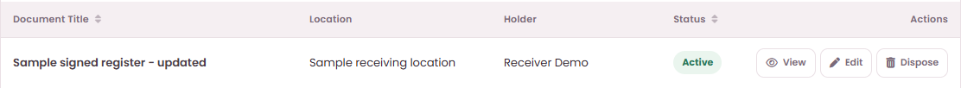
WORKED EXAMPLES
Verify the received hardcopy
WHAT TO DO
ON THIS SCREEN
01
The receiving user opens the
in-transit handoff.
02
After checking the physical record,
select Accept → Confirm.
03
Inspect the updated holder and
location in Hardcopy Documents.
04
Use Transfer History when
confirming the recorded handoff.
A
Verify receiving
location
A
B
B
Verify receiving
holder
The receiving user's acceptance completes
physical receipt and updates custody.
PK DOCUMENT CONTROL | USER GUIDE
PROPOSED OPERATING PROCEDURES · REVISION 02
40
Notes:
Planned procedure:
The receiving user opens the in-transit handoff.
After checking the physical record, select Accept → Confirm.
Inspect the updated holder and location in Hardcopy Documents.
Use Transfer History when confirming the recorded handoff.
Operating notes:
The receiving user's acceptance completes physical receipt and updates custody.

Slide 41
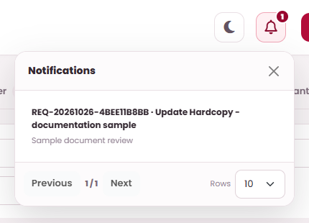
SYSTEM MODULES
Read notifications and approval reminders
WHAT TO DO
ON THIS SCREEN
01
Open the bell to read Notifications
and their Request Reference, title,
and approval label.
A
Open Notifications
A
02
Select an entry to mark that
notification read and open the
matching My Tasks list.
B
Close Notifications
B
03
Use Previous, Next, and Rows for
additional notification pages.
04
If Approval needed appears,
inspect its new-task links or select
Got it.
C
Open pending
approval task
C
05
Use My Tasks to record the actual
decision or handoff; reading a
notice does not approve it.
D
Choose rows per
page
D
Selecting an entry will acknowledge that
notification. Opening the panel alone will leave
unread entries unacknowledged.
PK DOCUMENT CONTROL | USER GUIDE
PROPOSED OPERATING PROCEDURES · REVISION 02
41
Notes:
Planned procedure:
Open the bell to read Notifications and their Request Reference, title, and approval label.
Select an entry to mark that notification read and open the matching My Tasks list.
Use Previous, Next, and Rows for additional notification pages.
If Approval needed appears, inspect its new-task links or select Got it.
Use My Tasks to record the actual decision or handoff; reading a notice does not approve it.
Operating notes:
Selecting an entry will acknowledge that notification. Opening the panel alone will leave unread entries unacknowledged.
Reading or dismissing a notification will not approve or reject its request.
No unread notifications means the inbox has no unread entries; continue to use My Tasks to check current assigned work.

Slide 42
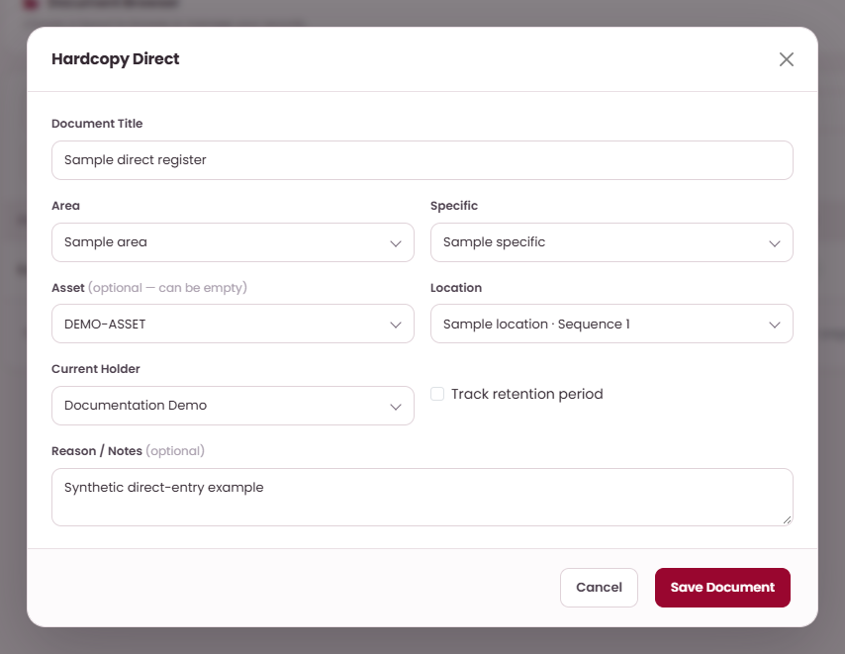
SYSTEM MODULES
Apply authorized direct document actions
WHAT TO DO
ON THIS SCREEN
01
Open the permitted document
register. Direct actions require the
corresponding direct permission.
02
For a hardcopy, select Hardcopy
Direct and complete title, storage
hierarchy, holder, and optional
retention or notes.
A
Enter the sample
title
A
03
Select Save Document → Confirm,
then inspect the saved record.
04
For a softcopy, choose Softcopy
Direct, select the action, and
complete the visible fields; Create
and Revise require a file.
B
Choose Current
Holder
B
05
Select Approve Directly → Confirm.
Edit an active record or use Dispose
with a disposal reason only when
those actions are permitted.
C
Save Document and
confirm
C
An authorized direct softcopy action will be
approved and applied immediately. Use My
Requests when approval through the workflow is
required.
PK DOCUMENT CONTROL | USER GUIDE
PROPOSED OPERATING PROCEDURES · REVISION 02
42
Notes:
Planned procedure:
Open the permitted document register. Direct actions require the corresponding direct permission.
For a hardcopy, select Hardcopy Direct and complete title, storage hierarchy, holder, and optional retention or notes.
Select Save Document → Confirm, then inspect the saved record.
For a softcopy, choose Softcopy Direct, select the action, and complete the visible fields; Create and Revise require a file.
Select Approve Directly → Confirm. Edit an active record or use Dispose with a disposal reason only when those actions are permitted.
Operating notes:
An authorized direct softcopy action will be approved and applied immediately. Use My Requests when approval through the workflow is required.
Edit and Dispose require an active record within the operator's permitted scope. Dispose also requires direct disposal permission.
The hardcopy holder will be fixed to an ordinary user's account; administrators will be able to select a holder.

Slide 43
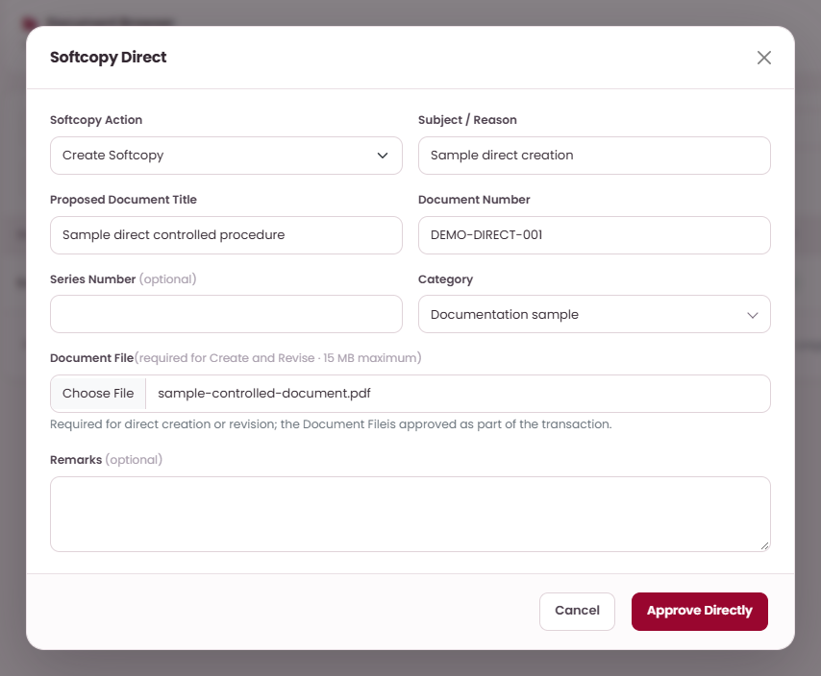
WORKED EXAMPLES
Apply a direct softcopy action
WHAT TO DO
ON THIS SCREEN
01
Open Softcopy Documents and
select Softcopy Direct.
02
Choose Create Softcopy, Revise
Softcopy, or Cancel Softcopy.
A
Create, Revise or
Cancel directly
A
03
Complete the action-specific fields
and attach a file for Create or
Revise.
Use a unique
document number
B
B
04
Select Approve Directly, then
Confirm. Inspect the resulting
record.
C
Attach the
controlled file
C
D
Approve Directly
and confirm
D
Direct actions require the appropriate permission
and apply the change immediately.
PK DOCUMENT CONTROL | USER GUIDE
PROPOSED OPERATING PROCEDURES · REVISION 02
43
Notes:
Planned procedure:
Open Softcopy Documents and select Softcopy Direct.
Choose Create Softcopy, Revise Softcopy, or Cancel Softcopy.
Complete the action-specific fields and attach a file for Create or Revise.
Select Approve Directly, then Confirm. Inspect the resulting record.
Operating notes:
Direct actions require the appropriate permission and apply the change immediately.

Slide 44
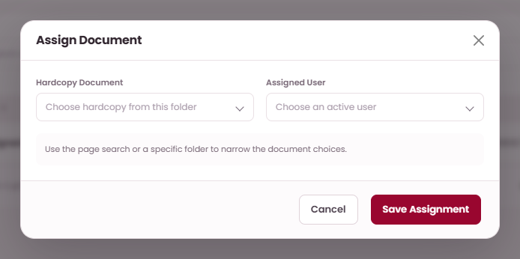
SYSTEM MODULES
Assign documents directly to users
WHAT TO DO
ON THIS SCREEN
01
Open Document Assignments and
choose Hardcopy / Places or Softcopy
/ Categories.
02
Select Assign Document, choose the
document and Assigned User, then
Save Assignment → Confirm.
03
Use Edit to select an Assigned User.
Hardcopy replaces Current Holder;
softcopy adds the selected user and
retains earlier assignees.
A
Choose document
A
B
04
For a bulk hardcopy assignment, select
Location and Assigned User, then
Assign All → Confirm. Complete active
transfers first.
B
Choose active user
C
05
For softcopies, select Category /
Subcategory and Assigned User, then
Assign All → Confirm; subcategories
are included.
C
Save Assignment
Hardcopy assignment will change Current Holder
immediately. Softcopy assignment will retain
earlier assignees. Assign All will be limited to
2,000 active records.
PK DOCUMENT CONTROL | USER GUIDE
PROPOSED OPERATING PROCEDURES · REVISION 02
44
Notes:
Planned procedure:
Open Document Assignments and choose Hardcopy / Places or Softcopy / Categories.
Select Assign Document, choose the document and Assigned User, then Save Assignment → Confirm.
Use Edit to select an Assigned User. Hardcopy replaces Current Holder; softcopy adds the selected user and retains earlier assignees.
For a bulk hardcopy assignment, select Location and Assigned User, then Assign All → Confirm. Complete active transfers first.
For softcopies, select Category / Subcategory and Assigned User, then Assign All → Confirm; subcategories are included.
Operating notes:
This page applies assignments directly and requires direct assignment permission. Approval-based assignment requests remain in My Requests → Document Assignments.
Read the selected location or category carefully before confirming Assign All, because it applies to multiple active records.
Hardcopy assignment will change Current Holder immediately without dispatch or receipt steps. Softcopy assignment will preserve earlier users' assignments when a different user is selected.
Complete active hardcopy handoffs before reassigning affected records. The system will block single and bulk hardcopy assignments while an affected record has an active transfer.
Assign All will support up to 2,000 active records in the selected location or category branch. Use individual assignments or a smaller category branch when the selection exceeds this limit.
Physical transfer requests have their own approval, dispatch, and acceptance flow.

Slide 45
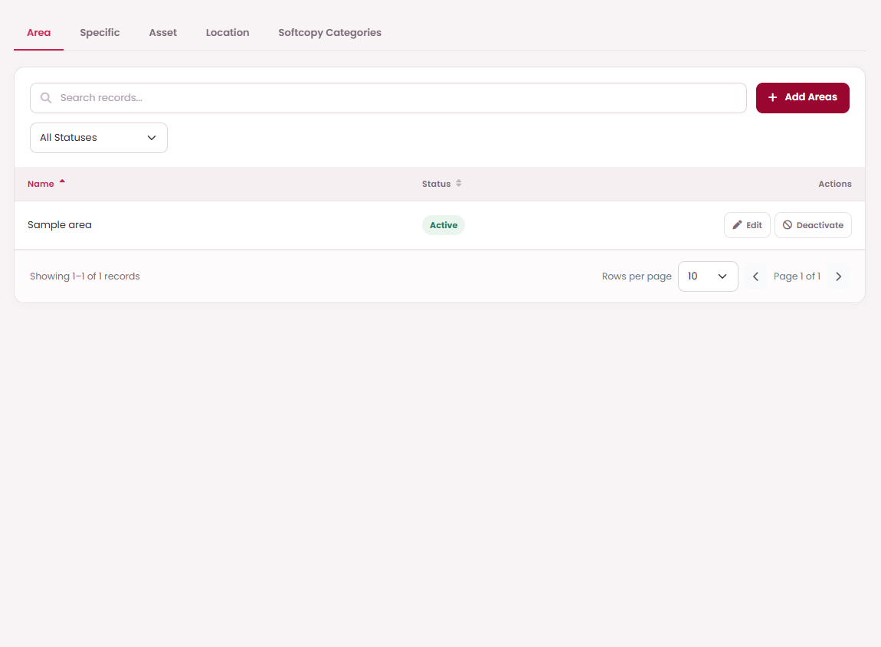
SYSTEM MODULES
Maintain places and softcopy categories
WHAT TO DO
ON THIS SCREEN
01
Open Setup Places and choose
Area, Specific, Asset, Location, or
Softcopy Categories.
A
Choose a setup tab
A
B
02
Use Add or Edit. Maintain Area →
Specific → optional Asset before
selecting Location.
B
Add reference
record
C
03
For Location, enter Location Name,
Area, Specific, optional Asset
Number, and optional Sequence or
Archive Date.
C
Edit reference
record
04
For Softcopy Categories, enter
Name, Folder, optional Description,
and Parent for a subcategory.
05
Check Active, then Save Record →
Confirm. Deactivate an unused
reference item to preserve its
historical links.
Only tabs and actions permitted for the signed-in
account will be shown.
PK DOCUMENT CONTROL | USER GUIDE
PROPOSED OPERATING PROCEDURES · REVISION 02
45
Notes:
Planned procedure:
Open Setup Places and choose Area, Specific, Asset, Location, or Softcopy Categories.
Use Add or Edit. Maintain Area → Specific → optional Asset before selecting Location.
For Location, enter Location Name, Area, Specific, optional Asset Number, and optional Sequence or Archive Date.
For Softcopy Categories, enter Name, Folder, optional Description, and Parent for a subcategory.
Check Active, then Save Record → Confirm. Deactivate an unused reference item to preserve its historical links.
Operating notes:
Only tabs and actions permitted for the signed-in account will be shown.
A Location can be saved without an Asset Number. Keep Area and Specific consistent when choosing children.
Deactivating reference data is different from disposing of a document record.

Slide 46
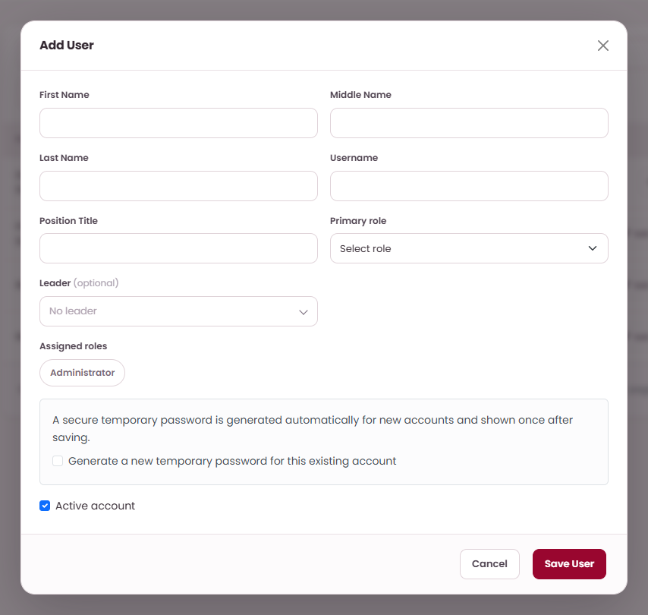
SYSTEM MODULES
Create and maintain user accounts
WHAT TO DO
ON THIS SCREEN
01
Open User Management and select
Add User or Edit an existing eligible
account.
02
Complete First Name, optional
Middle Name, Last Name,
Username, and Position Title.
A
Choose unique
username
A
03
Choose Primary role and Assigned
roles; select an optional Leader
when the workflow needs one.
B
B
Choose primary role
C
04
Check Active account, then Save
User → Confirm. New-account
credentials appear once; share
privately with the owner.
C
Choose optional
leader
D
05
Use Generate a new temporary
password for a reset, Deactivate to
disable an eligible account, or
Assigned Documents to inspect
assignments.
D
Choose assigned
roles
E
Save User
E
A temporary password will be displayed once
after saving. The user will be required to replace it
before accessing protected modules.
PK DOCUMENT CONTROL | USER GUIDE
PROPOSED OPERATING PROCEDURES · REVISION 02
46
Notes:
Planned procedure:
Open User Management and select Add User or Edit an existing eligible account.
Complete First Name, optional Middle Name, Last Name, Username, and Position Title.
Choose Primary role and Assigned roles; select an optional Leader when the workflow needs one.
Check Active account, then Save User → Confirm. New-account credentials appear once; share privately with the owner.
Use Generate a new temporary password for a reset, Deactivate to disable an eligible account, or Assigned Documents to inspect assignments.
Operating notes:
A temporary password will be displayed once after saving. The user will be required to replace it before accessing protected modules.
Leader will be optional in account data. An active leader will be required when a request's workflow uses Requester's leader.
Account permissions will restrict available actions. Users will not be able to deactivate themselves, and administrator accounts will receive additional protection.

Slide 47
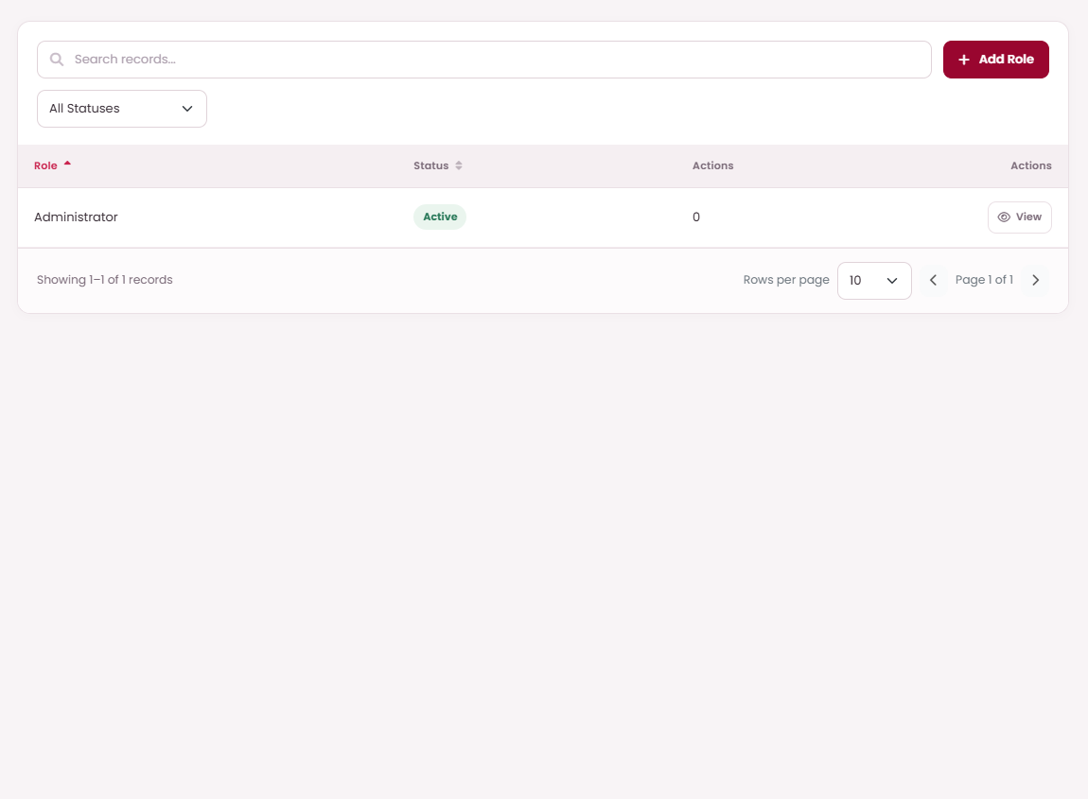
SYSTEM MODULES
Maintain roles and permissions
WHAT TO DO
ON THIS SCREEN
01
Open Roles & Permissions; search
or filter to find the role.
A
Add Role
A
02
Select Add Role or Edit and enter
Role Name; check Active role as
appropriate.
B
View role
permissions
B
03
Under Module Permissions, select
only the actions needed for this
role.
04
Select Save Role → Confirm, then
assign the role to users in User
Management.
05
Use Deactivate or permanent
Remove only when offered for an
unused role, and read the
confirmation carefully.
Permissions will control both visible menus and
individual actions such as direct changes,
requests, downloads, and printing.
PK DOCUMENT CONTROL | USER GUIDE
PROPOSED OPERATING PROCEDURES · REVISION 02
47
Notes:
Planned procedure:
Open Roles & Permissions; search or filter to find the role.
Select Add Role or Edit and enter Role Name; check Active role as appropriate.
Under Module Permissions, select only the actions needed for this role.
Select Save Role → Confirm, then assign the role to users in User Management.
Use Deactivate or permanent Remove only when offered for an unused role, and read the confirmation carefully.
Operating notes:
Permissions will control both visible menus and individual actions such as direct changes, requests, downloads, and printing.
Document access and the active workflow assignment will determine which records or tasks a user can act on.
Deactivation and permanent removal are separate actions; read the confirmation before continuing.

Slide 48
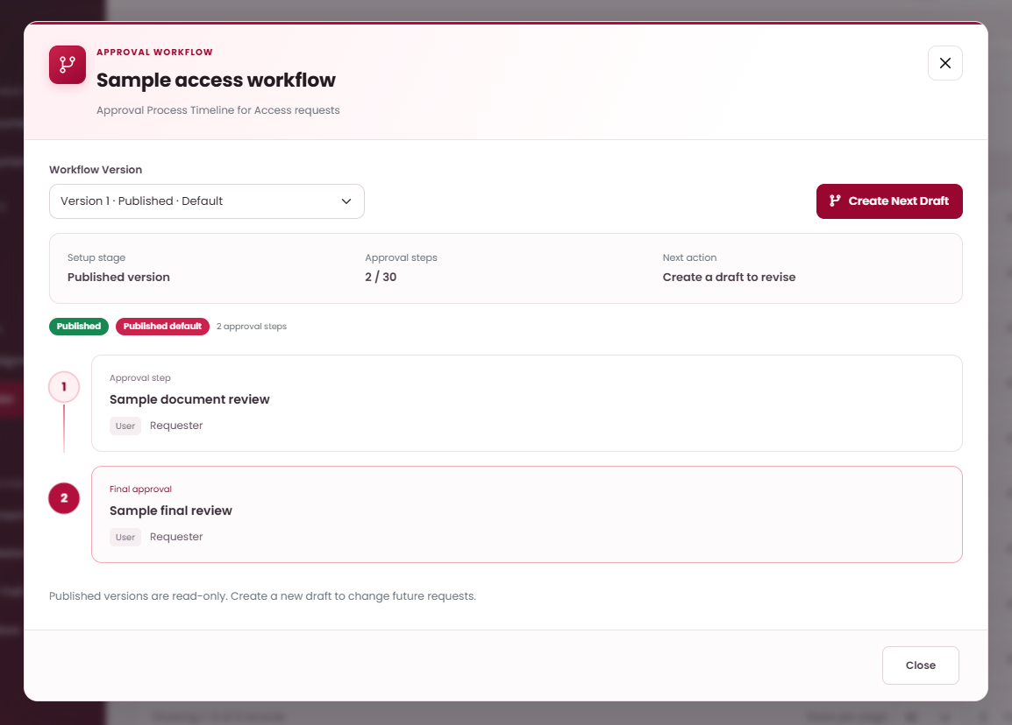
SYSTEM MODULES
Configure and publish approval workflows
WHAT TO DO
ON THIS SCREEN
01
Open Workflow Builder, find the
Request Type, and open Steps. Use
Workflow Version to inspect the
route.
02
Select Start First Draft or Create
Next Draft; published versions are
read-only.
A
Choose workflow
version
A
B
03
Add Approval Step, enter its name,
and select a role, specific user,
Requester's leader, or Requester
account; Save Step → Confirm.
B
Create Next Draft
C
D
C
Check published
default
04
Edit, move, or remove draft steps
until the order is correct, then
Validate & Publish → Confirm.
D
Review approval
step
05
Check the published default. Future
requests will use it; previously
submitted requests will retain their
original approval timeline.
A workflow will support up to 30 approval steps
and will require an approval route before
publication.
PK DOCUMENT CONTROL | USER GUIDE
PROPOSED OPERATING PROCEDURES · REVISION 02
48
Notes:
Planned procedure:
Open Workflow Builder, find the Request Type, and open Steps. Use Workflow Version to inspect the route.
Select Start First Draft or Create Next Draft; published versions are read-only.
Add Approval Step, enter its name, and select a role, specific user, Requester's leader, or Requester account; Save Step → Confirm.
Edit, move, or remove draft steps until the order is correct, then Validate & Publish → Confirm.
Check the published default. Future requests will use it; previously submitted requests will retain their original approval timeline.
Operating notes:
A workflow will support up to 30 approval steps and will require an approval route before publication.
The system will resolve Requester and Requester's leader at submission. Ensure the relevant accounts, roles, and leaders are active.
Publishing will set the route for future requests. Previously submitted requests, including returned requests that are resubmitted, will retain their original approval timeline.

Slide 49
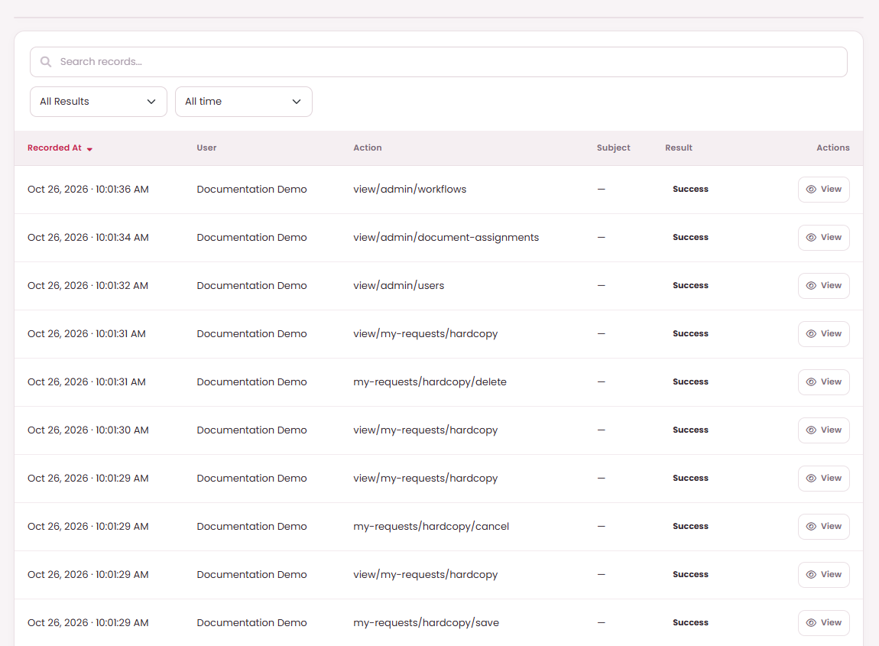
SYSTEM MODULES
Inspect the Internal Audit Trail
WHAT TO DO
ON THIS SCREEN
01
Open Internal Audit Trail and
search for the relevant user, action,
or subject.
A
Search audit events
A
02
Filter All Results, Success, or Failed
and choose the required date
period.
03
Read Recorded At, User, Action,
Subject, and Result.
04
Open View for Audit Event details,
including User ID and recorded
Details; select Close when finished.
05
For document-specific evidence,
also inspect its Approval History,
Related Requests, or Transfer
History.
The proposed audit page will provide read-only
inspection of events, without edit or delete
operations.
PK DOCUMENT CONTROL | USER GUIDE
PROPOSED OPERATING PROCEDURES · REVISION 02
49
Notes:
Planned procedure:
Open Internal Audit Trail and search for the relevant user, action, or subject.
Filter All Results, Success, or Failed and choose the required date period.
Read Recorded At, User, Action, Subject, and Result.
Open View for Audit Event details, including User ID and recorded Details; select Close when finished.
For document-specific evidence, also inspect its Approval History, Related Requests, or Transfer History.
Operating notes:
The proposed audit page will provide read-only inspection of events, without edit or delete operations.
If a warning is shown on the page, include it when reporting an investigation to the administrator.
The proposed navigation will provide Internal Audit Trail and Overview charts. The planned screens will not include a separate Reports menu or report-export control.

Slide 50
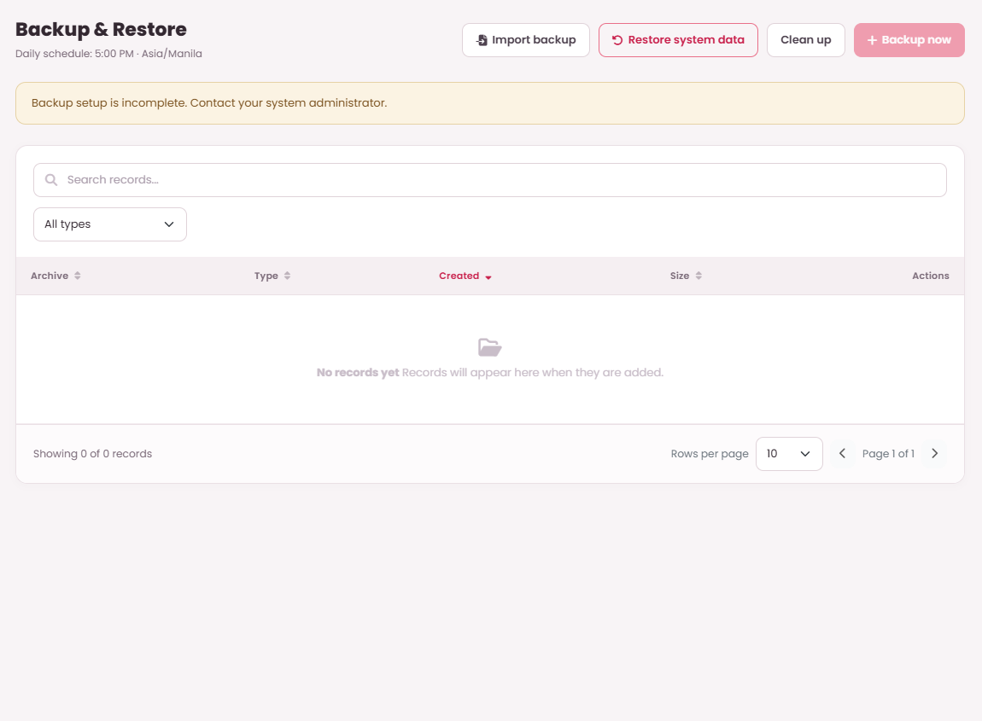
SYSTEM MODULES
Back up, import, and restore system data
WHAT TO DO
ON THIS SCREEN
B
C
01
Open Backup & Restore and check
readiness. The example shows incomplete
setup, disabled Backup now, and an
empty archive list.
A
Import backup
A
D
E
02
Have the administrator complete
configuration and readiness checks
before using backup or restore. The
planned daily schedule is 5:00 PM,
Asia/Manila.
B
Restore system data
C
Clean up archives
03
After setup, select Backup now then
Confirm. Check the resulting archive;
Download or Import backup will require a
ready setup and permission.
D
Backup now when
ready
04
To restore when ready, choose Backup to
restore, enter Your password and
RESTORE, then Restore selected backup
then Confirm. A recovery backup will be
created first.
E
Check backup
readiness
05
Use Clean up then Confirm for backup
and log archives older than three months.
Check archive dates after backup runs.
PK DOCUMENT CONTROL | USER GUIDE
PROPOSED OPERATING PROCEDURES · REVISION 02
50
Notes:
Planned procedure:
Open Backup & Restore and check readiness. The example shows incomplete setup, disabled Backup now, and an empty archive list.
Have the administrator complete configuration and readiness checks before using backup or restore. The planned daily schedule is 5:00 PM, Asia/Manila.
After setup, select Backup now then Confirm. Check the resulting archive; Download or Import backup will require a ready setup and permission.
To restore when ready, choose Backup to restore, enter Your password and RESTORE, then Restore selected backup then Confirm. A recovery backup will be created first.
Use Clean up then Confirm for backup and log archives older than three months. Check archive dates after backup runs.
Operating notes:
Backup and restore will require administrator configuration and readiness checks before use. The setup-incomplete example will illustrate this prerequisite; it will not represent a completed backup.
After setup, backup actions will require edit permission. Restoring will replace live records and private files and will create a recovery backup first. Follow the organization's recovery procedure.
The schedule will describe the intended run time. Check the resulting archive and recorded time after each run before treating that recovery point as available.

