Slide 1
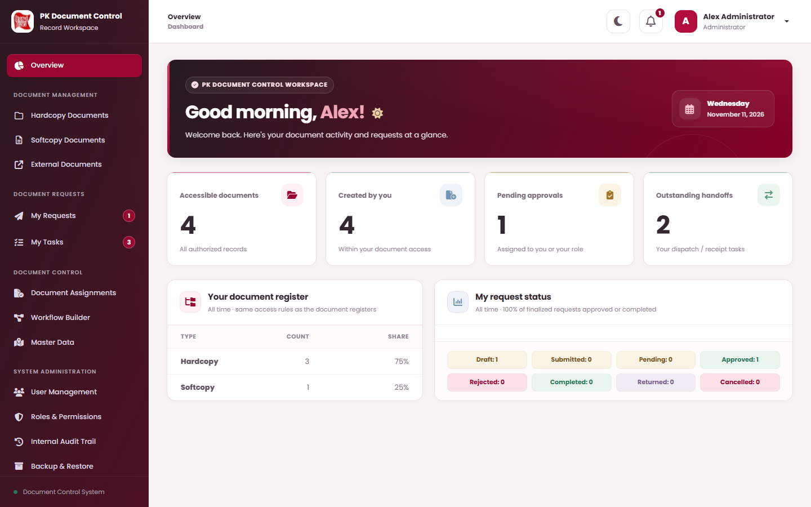
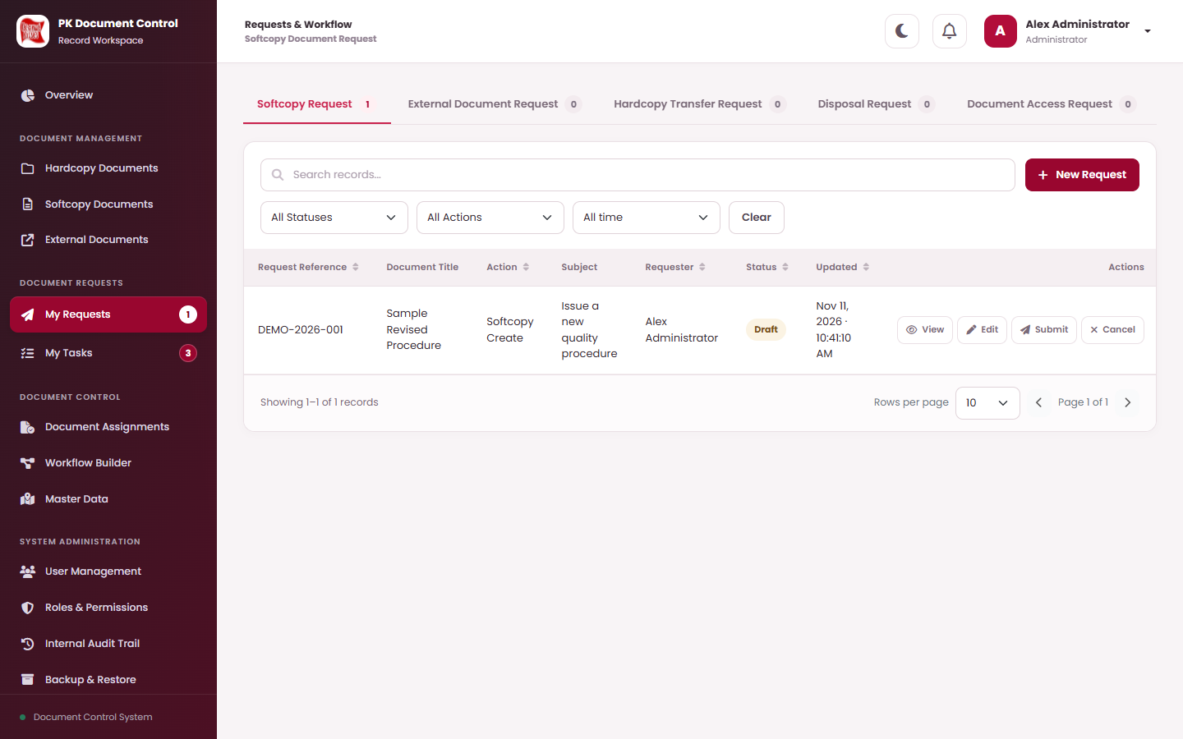
PEANUT KISSES · DOCUMENT TRACKING SYSTEM
Step-by-Step
User Guide
Every screen, every field and every next step — from signing in to approving, transferring and disposing of documents.
Requesters
Approvers
Document Control
Administrators
Matches the system as of 12 November 2026 · 165 slides

Slide 2
How to use this guide
START HERE
Each task starts with an overview, then one slide per step. Follow the numbers on the picture and in the list — they always match.
1
Task overview
2
Step slide
3
Numbered markers
Who can do it, what you need before you start, where to begin, the full list of steps (select one to jump) and the final result.
The progress dots (top right) show which step you are on. The title is the action you perform on this slide.
Red numbers on the screen picture or form match the numbered actions or field rows on the right.
4
Field table
5
Coloured boxes
6
WHO chip
Every field in the form: what to type or choose, and its rule — Required, Optional, Auto (filled by the system) or Button.
What happens next (green) · Keep in mind (amber) · Important (red) · Good to know (blue).
Bottom left of each slide: the role that performs that step. If you cannot see a menu or button, your role may not allow it.
Screen pictures use demonstration records. Your lists show your own documents, and your buttons depend on your role.

Slide 3
Who does what
START HERE
The five standard roles and the permissions they hold in the system today. An Administrator can change permissions or add roles.
What the role can do | Administrator | Document Control Officer | Plant Manager | Internal Auditor | Staff
View documents (hardcopy, softcopy, external) | ● | ● | ● | ● | ●
Submit requests (softcopy, external, transfer, access, assignment, disposal) | ● | ● | ● | — | ●
Direct add / edit / Approve Directly / Save Directly | ● | ● | — | — | —
Direct disposal and Document Assignments | ● | ● | — | — | —
Master Data (places, categories, subsidiaries) | ● | ● | — | view | —
Approve requests (as an assigned workflow step) | if assigned | ● | ● | — | as leader
Download files | ● | ● | ● | ● | ●
Download Locked Files · Hard Delete disposed documents | ● | if granted | — | — | —
Internal Audit Trail | ● | ● | — | ● | —
Users, Roles & Permissions, Workflow Builder, Backup & Restore | ● | — | — | — | —
Requester’s leader = the Leader on the requester’s account. Requester confirmation steps are done by the requester in My Tasks. Only the person or role assigned to the current step can decide.

Slide 4
Start with the tasks for your role
START HERE
Everyone
Requesters
Approvers
Document control & admin
1
Sign in for the first time · 9
1
Request a new softcopy · 71
1
Approve, return or reject a request · 111
1
Register a new hardcopy · 38
2
Find your way around · 13
2
Request a hardcopy transfer · 89
2
Upload the final softcopy file (Document Control) · 116
2
Create a softcopy directly · 51
3
Find a document · 26
3
Request access to a document · 96
3
Assign documents directly · 128
3
Know locked files · 119
4
Preview, enlarge and download a file · 33
4
Request a disposal · 104
4
Set up storage places · 139
4
Approval routes — who acts next · 120
5
Notifications and alerts · 21
5
Fix a returned request · 108
5
Add a user account · 147
6
Change an approval route · 154

Slide 5
Contents
FIND YOUR TASK
Select a task to jump to its overview. Every task lists its steps, and every step slide shows exactly what to click and type.
01 GETTING STARTED
Track hardcopy retention dates
47
Sign in for the first time
9
04 SOFTCOPY DOCUMENTS — DIRECT ACTIONS
Find your way around
13
Create a softcopy directly
51
Change your password and sign out
17
Use document and series numbers
56
Messages and confirmations you will see
20
Revise a softcopy directly
57
Notifications and alerts
21
Search, filter and page through lists
24
02 FIND AND OPEN DOCUMENTS
Find a document
26
Open a document’s details
30
Preview, enlarge and download a file
33
03 HARDCOPY DOCUMENTS
Register a new hardcopy
38
Edit a hardcopy record
43
Check who holds a hardcopy
46

Slide 6
Contents (continued)
FIND YOUR TASK
Select a task to jump to its overview. Every task lists its steps, and every step slide shows exactly what to click and type.
05 EXTERNAL DOCUMENTS — DIRECT ACTIONS
07 APPROVALS — REVIEWING AS AN APPROVER
Register an external document directly
62
Approve, return or reject a request
111
Revise an external document directly
65
Upload the final softcopy file (Document Control)
116
06 REQUESTS — ASKING FOR A CHANGE
Know locked files
119
Know the My Requests page
69
Approval routes — who acts next
120
Request a new softcopy
71
Request a softcopy revision
77
Request a new external document
81
Request an external document revision
85
Request a hardcopy transfer
89
Request access to a document
96
Request a document assignment
100
Request a disposal
104
Fix a returned request
108
Cancel or delete a draft
109

Slide 7
Contents (continued)
FIND YOUR TASK
Select a task to jump to its overview. Every task lists its steps, and every step slide shows exactly what to click and type.
08 DOCUMENT CONTROL ACTIONS
Statuses and terms
164
Assign documents directly
128
Dispose of a document directly
132
Permanently delete a disposed document
135
09 MASTER DATA — SETUP LISTS
Set up storage places
139
Set up categories and subsidiaries
143
10 SYSTEM ADMINISTRATION
Add a user account
147
Manage roles and permissions
151
Change an approval route
154
Review the audit trail
158
Back up and restore
159
11 HELP AND REFERENCE
Solve common problems
163

Slide 8
Getting started
01
IN THIS SECTION
Sign in for the first time
9
Find your way around
13
Change your password and sign out
17
Messages and confirmations you will see
20
Notifications and alerts
21
Sign in, learn the screens, and understand the messages PK DTS shows you. For everyone.
Search, filter and page through lists
24

Slide 9
Sign in for the first time
GETTING STARTED · TASK OVERVIEW
Your Administrator creates your account and gives you a username and a temporary password.
WHO CAN DO THIS
STEP BY STEP
Everyone with an account
1
Enter your username and password
slide 10
BEFORE YOU START
2
Replace your temporary password
slide 11
Your Username and temporary password from the Administrator.
The PK DTS address (link) used in your office.
3
Check that you are signed in
slide 12
✓
Result: You are signed in with your own permanent password and see the Overview page.
WHERE TO START
Open the PK DTS address in your browser. The Sign in to your account page appears.
WHO: Everyone with an account

Slide 10
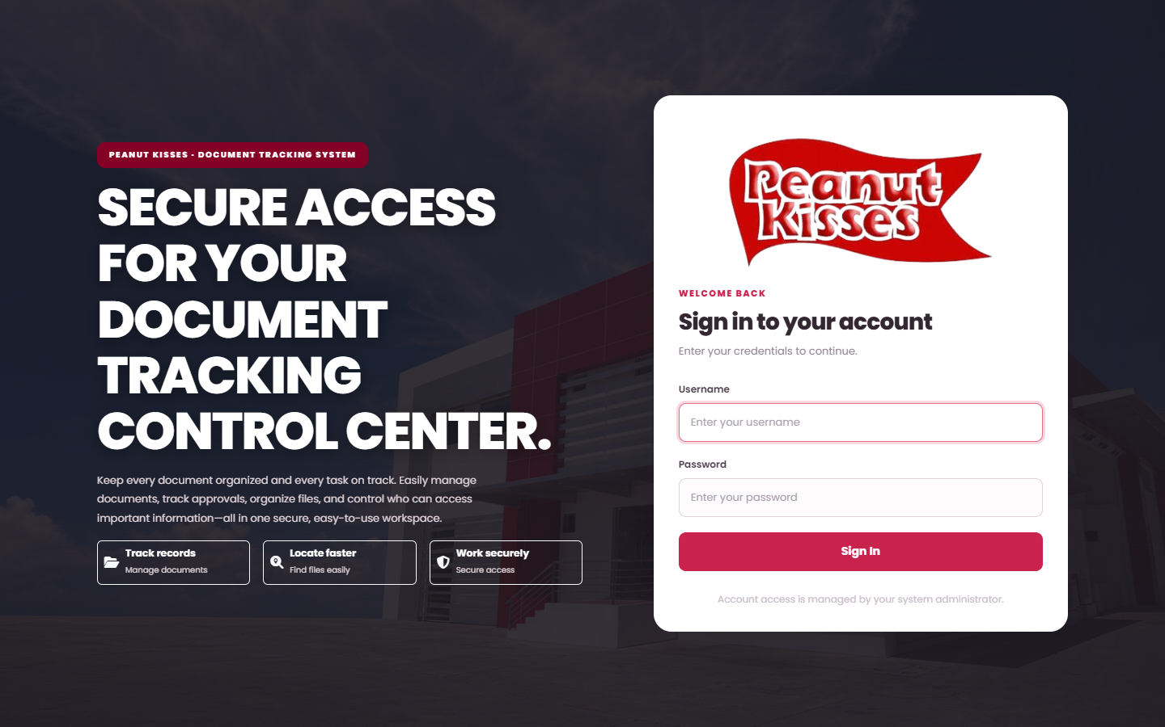
Enter your username and password
SIGN IN FOR THE FIRST TIME · STEP 1 OF 3
1
2
3
DO THIS
1
Type your Username (placeholder: “Enter your username”).
2
Type your Password. On your first sign-in this is the temporary password.
3
Select Sign In.
1
2
KEEP IN MIND
3
After several wrong passwords you must wait before trying again. Ask the Administrator if you forgot your password or your account is disabled.
WHAT HAPPENS NEXT
First sign-in, or after the Administrator resets your password: the Change your temporary password window opens (next step). Otherwise you go straight to Overview.
WHO: Everyone with an account

Slide 11
Replace your temporary password
SIGN IN FOR THE FIRST TIME · STEP 2 OF 3
1
2
3
Change your temporary password
×
This window cannot be skipped. Fill in all three fields, then select Set permanent password.
Set a permanent password before accessing documents, requests, or administration.
# | Field / button | What to enter or check | Rule
1 | Current or temporary password | The temporary password you just signed in with. | Required
2 | New password | Your own new password: at least 9 characters, up to 72 bytes. It must differ from the temporary one. | Required
3 | Confirm new password | Type the new password again, exactly the same. | Required
4 | Set permanent password | Saves the password. Sign out leaves without changing it. | Button
1
Current or temporary password
••••••••
2
New password
Use more than 8 characters, up to 72 bytes. Do not reuse your temporary password.
3
Confirm new password
Sign out
4
Set permanent password
WHAT HAPPENS NEXT
Your password is saved and the Overview page opens. Use the new password from now on.
WHO: Everyone with an account

Slide 12
Check that you are signed in
SIGN IN FOR THE FIRST TIME · STEP 3 OF 3
1
2
3
1
DO THIS
3
2
1
Your name and role appear at the top right.
2
The Overview page greets you and shows today’s date.
3
The menu on the left lists only the areas your role may use.
WHAT HAPPENS NEXT
You are ready to work. Continue with Find your way around to learn each part of the screen.
WHO: Everyone with an account

Slide 13
Find your way around
GETTING STARTED · TASK OVERVIEW
Every page has the same frame: the menu on the left, the top bar, and the work area.
WHO CAN DO THIS
STEP BY STEP
Everyone with an account
1
Read your Overview page
slide 14
BEFORE YOU START
2
Use the left menu
slide 15
You are signed in.
3
Use the top bar
slide 16
WHERE TO START
Select Overview in the left menu (or the PK Document Control logo).
✓
Result: You know which menu to open for each kind of work, and what the Overview numbers mean.
WHO: Everyone with an account

Slide 14
Read your Overview page
FIND YOUR WAY AROUND · STEP 1 OF 3
1
2
3
DO THIS
1
Four tiles: Accessible documents, Created by you, Pending approvals (assigned to you or your role) and Outstanding handoffs (your dispatch / receipt tasks).
1
2
Your document register shows how many Hardcopy and Softcopy documents you can access, and their share.
3
My request status counts your requests: Draft, Submitted, Pending, Approved, Rejected, Completed, Returned and Cancelled.
2
3
WHAT HAPPENS NEXT
A number under Pending approvals or Outstanding handoffs means work is waiting for you in My Tasks.
WHO: Everyone with an account

Slide 15
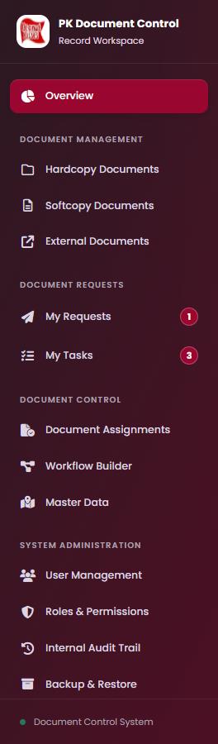
Use the left menu
FIND YOUR WAY AROUND · STEP 2 OF 3
1
2
3
DO THIS
1
1
Overview — your summary page.
2
2
Document Management — Hardcopy Documents, Softcopy Documents and External Documents: the registers where you find and manage records.
3
Document Requests — My Requests (badge = your Draft and Returned requests) and My Tasks (badge = work waiting for you).
3
4
Document Control — Document Assignments, Workflow Builder and Master Data (setup lists).
5
System Administration — User Management, Roles & Permissions, Internal Audit Trail and Backup & Restore.
4
5
KEEP IN MIND
You only see menus your role allows. If a menu or button you need is missing, ask the Administrator to check your role.
WHO: Everyone with an account

Slide 16
Use the top bar
FIND YOUR WAY AROUND · STEP 3 OF 3
1
2
3
1
2
3
4
1
Where you are
2
Dark mode
3
Notifications
4
Account menu
The section (e.g. Requests & Workflow) and the page name (e.g. Softcopy Document Request).
The moon button switches between light and dark colours. Your choice is remembered on this browser.
The bell. A red number shows unread notifications. Select it to open the list.
Your name and role. Select it for Change Password and Sign Out.
GOOD TO KNOW
Install App appears in the top bar when your browser can install PK DTS as an app. On a phone or narrow window, the ☰ button at the top left shows or hides the left menu.
WHO: Everyone with an account

Slide 17
Change your password and sign out
GETTING STARTED · TASK OVERVIEW
Change your password whenever you need to, and always sign out on a shared computer.
WHO CAN DO THIS
STEP BY STEP
Everyone with an account
1
Change your password
slide 18
BEFORE YOU START
2
Sign out when you finish
slide 19
Your current password.
✓
Result: Your new password is active, or you are signed out safely.
WHERE TO START
Select your name at the top right to open the account menu.
WHO: Everyone with an account

Slide 18
Change your password
CHANGE YOUR PASSWORD AND SIGN OUT · STEP 1 OF 2
1
2
Change Password
×
Select your name (top right) › Change Password. Fill in the window, select Update Password, then Confirm.
1
Current or temporary password
# | Field / button | What to enter or check | Rule
1 | Current or temporary password | Your password today. | Required
2 | New password | At least 9 characters, up to 72 bytes. | Required
3 | Confirm new password | Same new password again. | Required
4 | Update Password | Opens Confirm Action: “Change your account password?” Select Confirm. | Button
••••••••
2
New password
Use more than 8 characters, up to 72 bytes. Do not reuse your temporary password.
3
Confirm new password
Cancel
4
Update Password
KEEP IN MIND
If a message says the password is too long, shorten it (72-byte limit) and try again.
WHAT HAPPENS NEXT
Operation successful appears. Select Got it. Use the new password next time you sign in.
WHO: Everyone with an account

Slide 19
Sign out when you finish
CHANGE YOUR PASSWORD AND SIGN OUT · STEP 2 OF 2
1
2
Confirm Action
×
DO THIS
1
Select your name at the top right.
Sign out of your account?
2
Select Sign Out (shown in red at the bottom of the menu).
Cancel
1
Confirm
3
The confirmation asks “Sign out of your account?”. Select Confirm.
WHAT HAPPENS NEXT
You return to the Sign in to your account page. Nobody can use your account from this browser until you sign in again.
WHO: Everyone with an account

Slide 20
Every action asks first, then tells you the result
GETTING STARTED · REFERENCE
PK DTS never saves a change without your confirmation, and always shows the result in a window. Read it before selecting Got it.
1
Confirm Action
2
Working on it
3
Operation successful
Shows what is about to happen, e.g. “Save request draft?”.
Confirm = do it. Cancel = go back without saving.
“Please wait while we prepare the result of your action.” Do not close the page or select again while this shows.
The change is saved. Read the message, then select Got it and check the record or status.
4
Action could not be completed
5
Attention required
6
Dialogs with a remark or reason
Nothing was changed. The message says why (e.g. a missing field or an outdated record). Fix it and try again.
A warning that needs a decision or check before you continue.
Return, Reject, Dispose and the final-file upload open a window with fields. There, Continue is the confirmation — no second Confirm.
WHAT HAPPENS NEXT
If an error mentions that the record changed, someone else saved it first: close the window, refresh the page, check the latest details and repeat only what is still needed.
WHO: Everyone with an account

Slide 21
Notifications and alerts
GETTING STARTED · TASK OVERVIEW
PK DTS tells you when work is waiting. A notification only takes you to the work — it never approves or finishes anything.
WHO CAN DO THIS
STEP BY STEP
Everyone with an account
1
Open the notification bell
slide 22
BEFORE YOU START
2
Respond to pop-up alerts
slide 23
You are signed in.
✓
Result: You find the task that needs you and complete it in My Tasks.
WHERE TO START
The bell in the top bar, and pop-up windows after you sign in or open a page.
WHO: Everyone with an account

Slide 22
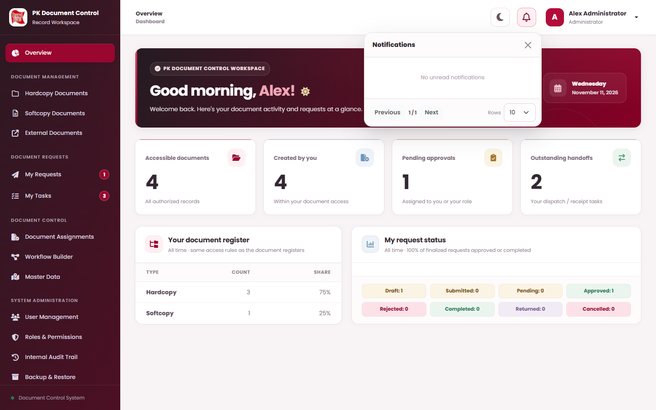
Open the notification bell
NOTIFICATIONS AND ALERTS · STEP 1 OF 2
1
2
1
DO THIS
2
1
A red number on the bell = unread notifications. Select the bell.
3
2
Select a notification to open its page (usually My Tasks). Opening it marks it as read.
3
Use Previous, Next and Rows (5, 10, 20 or 50) to browse.
KEEP IN MIND
“No unread notifications” means everything has been read — it does not mean all tasks are done. Check the My Tasks badge.
WHAT HAPPENS NEXT
Open the request in My Tasks and record your decision or handoff there.
WHO: Everyone with an account

Slide 23
Respond to pop-up alerts
NOTIFICATIONS AND ALERTS · STEP 2 OF 2
1
2
1
Approval needed
2
Retention period reached
“New tasks are waiting for your approval.” The window lists the tasks.
Select Got it to close it, then open My Tasks and decide each one.
Closing the window does not approve or reject anything.
“These active hardcopy records have reached their retention end date.”
Review the listed records. Select Got it to close.
The alert never disposes of a document — use a Disposal Request or Dispose if the document should go.
WHAT HAPPENS NEXT
For approvals continue with Approvals — reviewing as an approver. For retention continue with Track hardcopy retention dates.
WHO: Everyone with an account

Slide 24
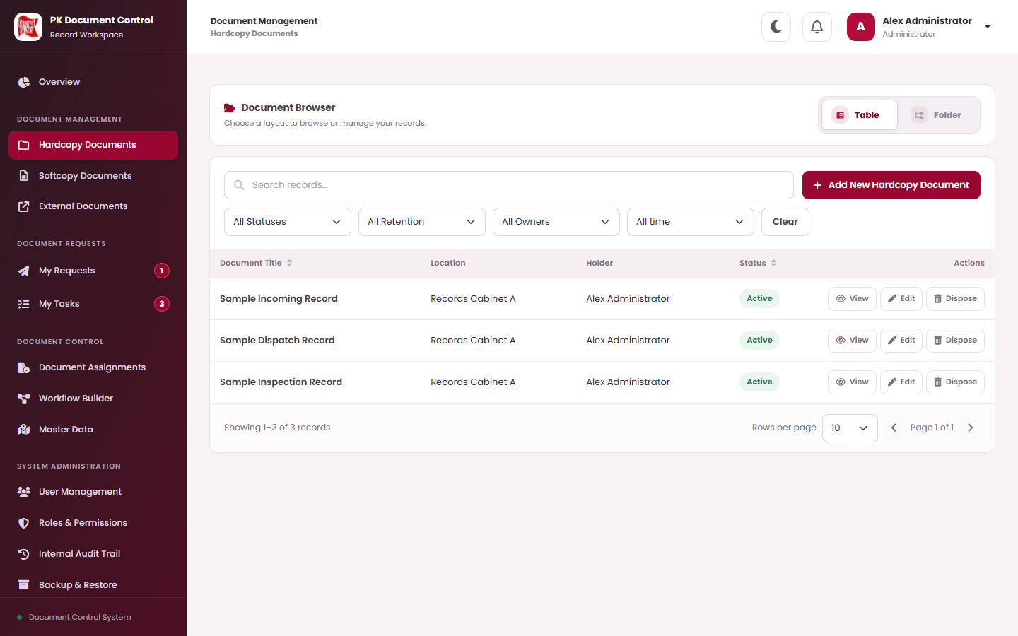
Search, filter and sort a list
GETTING STARTED · LISTS
DO THIS
1
Type in Search records... (title, reference, number…) and press Enter.
2
Choose filters, e.g. All Statuses, All Owners. Dates: All time, Today, This week, This month, This year or Custom range (Start date / End date). Lists refresh at once.
1
2
3
4
3
Select Clear to remove search and filters.
4
Select a column heading with ⇅ to sort; select again to reverse.
5
5
Choose Rows per page (10, 25, 50, 100) and use ‹ › to move between pages.
WHAT HAPPENS NEXT
Select View on a row (or the row itself) to open its details. Use Edit or other buttons only when they appear for you.
WHO: Everyone with an account

Slide 25
Find and open documents
02
IN THIS SECTION
Find a document
26
Open a document’s details
30
Preview, enlarge and download a file
33
Browse the three registers, open a document’s details, preview, enlarge and download its file.

Slide 26
Find a document
FIND AND OPEN DOCUMENTS · TASK OVERVIEW
Hardcopy = paper (tracked by holder and place) · Softcopy = controlled electronic file · External = scanned document from outside.
WHO CAN DO THIS
STEP BY STEP
Everyone with document access
1
Open the register and search
slide 27
BEFORE YOU START
2
What each register shows
slide 28
The document title, number or the place / category you expect it in.
3
Browse with the Folder view
slide 29
WHERE TO START
✓
Result: The document’s View Details window is open.
Left menu › Hardcopy Documents, Softcopy Documents or External Documents.
WHO: Everyone with document access

Slide 27
Open the register and search
FIND A DOCUMENT · STEP 1 OF 3
1
2
3
DO THIS
1
Open the register in the left menu.
2
1
2
Choose Table (rows) or Folder (folder tree). Your choice is kept while you work.
3
4
3
Type the title or number in Search records....
5
4
Narrow with the filters (next slide lists each register’s filters).
5
Select View on the row (or select the title).
WHAT HAPPENS NEXT
The View Details window opens. See Open a document’s details for what each part shows.
WHO: Everyone with document access

Slide 28
What each register shows
FIND A DOCUMENT · STEP 2 OF 3
1
2
3
Register | Columns in Table view | Filters | Buttons you may see on a row
Hardcopy Documents | Document Title, Sequence, Location, Holder, Status | All Statuses (Active, Disposed, Cancelled) · All Retention (Due Today, Overdue, Due in the Next 7 Days, Due in 8-30 Days) · All Owners · date | View · Edit · Dispose · Hard Delete (disposed only)
Softcopy Documents | Document Title, Document Number, Category, Status | All Statuses · All Categories · All Owners · date | View · Edit · File History · Download / Download Original / Download PDF · Dispose · Hard Delete
External Documents | Document Title, Document No., Subsidiary, Category, Status, Revision Level | All Statuses (Active, Disposed) · All Categories · All Owners · date | View · Download All · Edit · Dispose · Hard Delete
KEEP IN MIND
Buttons appear only when your role and the record allow them. Edit appears only for Active records you may change; a softcopy or external document with a locked file has no Edit.
WHO: Everyone with document access

Slide 29
Browse with the Folder view
FIND A DOCUMENT · STEP 3 OF 3
1
2
3
DO THIS
3
All Documents / ADMIN OFFICE / PM’S FILE ORGANIZER
1
Select Folder at the top of the register.
Recent · A–Z
4
⇊ Expand all
⇈ Collapse all
2
Open folders level by level. Hardcopy: Area › Specific › Asset › Location. Softcopy: folder categories › numbered categories. External: External Categories.
2
ADMIN OFFICE
Area
PM’S FILE ORGANIZER
Specific
3
The path above the list shows where you are. Select a part to go back up (All Documents = the top).
PK-PNK-00106945
Asset
4
Expand all / Collapse all opens or closes every folder. Sort with Recent or A–Z.
B
Location
Sample Dispatch Record
5
Browse this … filters the register to that folder. Select a document title to open its details.
Sample Incoming Record
6
Hardcopy Location with permission: + Add document here registers a hardcopy with the place filled in.
+ Add document here
6
Browse this location ›
5
PRODUCTION OFFICE
Area
KEEP IN MIND
Unfiled documents
No active folder
Unfiled documents holds records without an active folder. If nothing shows, use the All Documents link or clear the search filters.
WHO: Everyone with document access

Slide 30
Open a document’s details
FIND AND OPEN DOCUMENTS · TASK OVERVIEW
View Details is read-only. It shows everything you are allowed to see about one document.
WHO CAN DO THIS
STEP BY STEP
Everyone with document access
1
Read the details window
slide 31
BEFORE YOU START
2
What each tab shows
slide 32
Find the document first.
✓
Result: You have checked the document’s data, files and history.
WHERE TO START
Select View on the row, or select the document title.
WHO: Everyone with document access

Slide 31
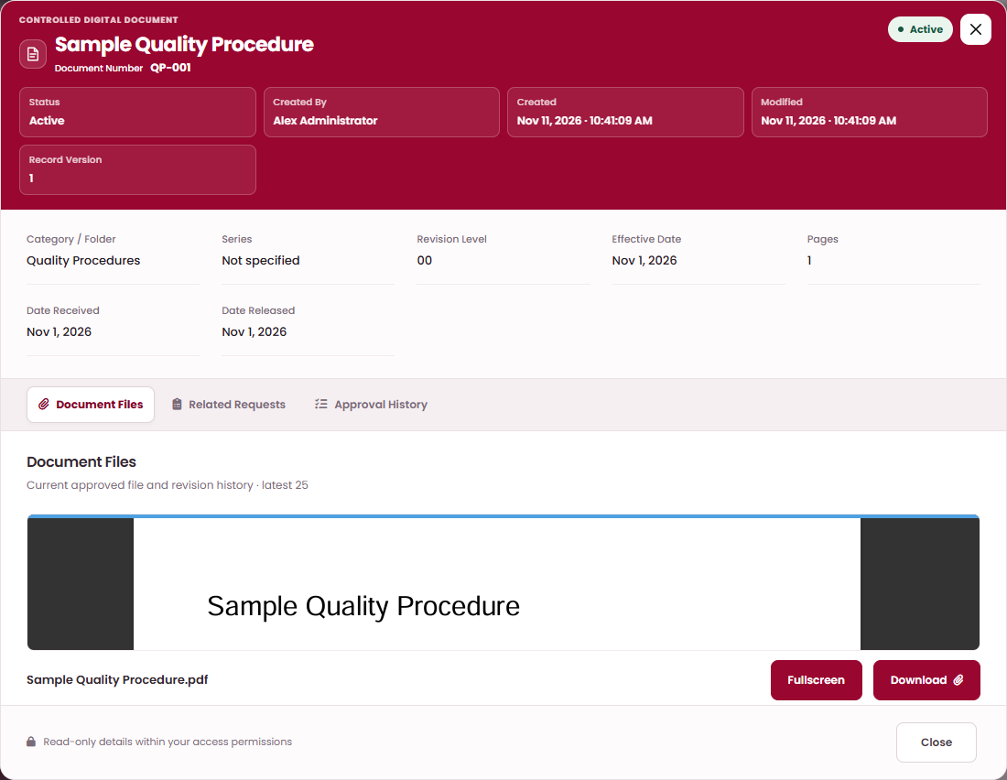
Read the details window
OPEN A DOCUMENT’S DETAILS · STEP 1 OF 2
1
2
1
DO THIS
1
The header shows the title, Document Number, status badge (e.g. Active) and Created By, Created, Modified and Record Version.
2
The fields below show the record’s data, e.g. Category / Folder, Series, Revision Level, Effective Date, Pages.
2
3
Select a tab to see files and history (next slide).
3
4
Select Close (or ×) when done.
WHAT HAPPENS NEXT
4
Nothing here can be changed. To change a document use Edit (direct) or a request in My Requests.
WHO: Everyone with document access

Slide 32
What each tab shows
OPEN A DOCUMENT’S DETAILS · STEP 2 OF 2
1
2
Tab | Appears for | What you find there
Overview | All documents | Main data: title, number, status, created / modified details.
Storage & Custody | Hardcopy | Area, Specific, Asset, Location, Sequence, Current Holder and Days until disposal (when retention is tracked).
Revision & Classification | Softcopy | Category / Folder, Series, Revision Level, Effective Date, Pages, Date Received / Released.
Document Files | Softcopy, External | Preview of the current approved file(s), Fullscreen and, when allowed, Download.
Disposal Details | Disposed documents | Disposal reason (Shred, Scratch, Other) and when / by whom.
Related Requests | All documents | Requests made for this document and their status.
Approval History | All documents | Approval decisions recorded for this document.
Transfer History | Hardcopy | Every physical handoff: from, to, dispatched and accepted.
WHO: Everyone with document access

Slide 33
Preview, enlarge and download a file
FIND AND OPEN DOCUMENTS · TASK OVERVIEW
Files open inside PK DTS. Word (.docx) and Excel (.xlsx) are shown as a PDF; the uploaded original is kept unchanged.
WHO CAN DO THIS
STEP BY STEP
Users with file permissions (View, Download)
1
Preview the current file
slide 34
BEFORE YOU START
2
Move around in Fullscreen
slide 35
Access to the document. Download needs the Files: Download permission.
3
See earlier versions in File History
slide 36
WHERE TO START
✓
Result: You have read the file on screen, or saved a copy you are allowed to download.
View Details › Document Files tab.
WHO: Users with file permissions (View, Download)

Slide 34
Preview the current file
PREVIEW, ENLARGE AND DOWNLOAD A FILE · STEP 1 OF 3
1
2
3
DO THIS
1
Open the Document Files tab.
2
The current file loads. Word / Excel need a few seconds the first time.
3
Select Fullscreen to enlarge it (next slide).
4
Select Download. Word / Excel: Download Original or Download PDF.
1
2
KEEP IN MIND
A locked file can be previewed but downloaded only with Download Locked Files. Superseded, disposed and cancelled files cannot be downloaded normally.
3
4
WHAT HAPPENS NEXT
External documents: View previews each attachment; Download All on the row saves them all.
WHO: Users with file permissions (View, Download)

Slide 35
Move around in Fullscreen
PREVIEW, ENLARGE AND DOWNLOAD A FILE · STEP 2 OF 3
1
2
3
Fullscreen shows the file page by page with no save or print toolbar. “Page X of Y” shows where you are.
Zoom
Move (pan)
Fit or actual size
Close
Scroll wheel or trackpad pinch zooms at the pointer.
Keys + and −.
Drag with the mouse or one finger.
Arrow keys, Page Up / Page Down.
Double-click: fit the page, or zoom in.
Key 0 = fit, key 1 = actual size.
Press Esc or use the close control to return to View Details.
WHAT HAPPENS NEXT
If the preview stays blank, close View Details and open it again. If it says “This file could not be shown here.”, ask document control to check the file.
WHO: Users with file permissions (View, Download)

Slide 36
See earlier versions in File History
PREVIEW, ENLARGE AND DOWNLOAD A FILE · STEP 3 OF 3
1
2
3
Document File History
×
DO THIS
1
On a softcopy row select File History. The newest file is marked Current; older ones Superseded.
Revision files available within your document permissions.
1
quality-procedure-r01-final.pdf
2
Each file shows who uploaded it, when, and its stage: Proposed, Locked proposed file or Final (Document Control), plus who locked it.
DCO name — 2026-11-12 · Current · Final (Document Control)
2
quality-procedure-r01.docx
Requester — 2026-11-10 · Superseded · Locked proposed file · Locked by Plant Manager
3
3
quality-procedure-r00.pdf
Download (or Preview if locked) appears only for the current file.
Requester — 2026-10-02 · Superseded · Final (Document Control)
4
Close
4
Select Close.
GOOD TO KNOW
External Documents have no File History button: open View to see current attachments.
WHO: Users with file permissions (View, Download)

Slide 37
Hardcopy documents
03
IN THIS SECTION
Register a new hardcopy
38
Edit a hardcopy record
43
Check who holds a hardcopy
46
Track hardcopy retention dates
47
Register paper documents, keep their storage place and holder correct, and watch retention dates.

Slide 38
Register a new hardcopy
HARDCOPY DOCUMENTS · TASK OVERVIEW
Hardcopies are registered directly in the register. There is no request for creating a hardcopy.
WHO CAN DO THIS
STEP BY STEP
Administrator, or a role with Hardcopy: Direct
1
Open the Add form
slide 39
BEFORE YOU START
2
Enter the title and storage place
slide 40
The document title and where it is stored (Area › Specific › optional Asset › Location).
The storage places must already exist in Master Data.
3
Set the holder, retention and notes
slide 41
4
Confirm and check the new record
slide 42
WHERE TO START
Result: An Active hardcopy record with its holder, storage place and sequence.
Hardcopy Documents › Add New Hardcopy Document, or Folder view › a Location › Add document here.
✓
WHO: Administrator, or a role with Hardcopy: Direct

Slide 39
Open the Add form
REGISTER A NEW HARDCOPY · STEP 1 OF 4
1
2
3
4
DO THIS
1
Open Hardcopy Documents in the left menu.
1
2
Select Add New Hardcopy Document.
2
★
Shortcut: in Folder view open a Location and select + Add document here. Area, Specific, Asset and Location are filled in for you.
WHAT HAPPENS NEXT
The Add New Hardcopy Document window opens (next step).
WHO: Administrator, or a role with Hardcopy: Direct

Slide 40
Enter the title and storage place
REGISTER A NEW HARDCOPY · STEP 2 OF 4
1
2
3
4
Add New Hardcopy Document
×
Fill in the fields top to bottom. Each list only offers choices that belong to the one above it.
1
Document Title
# | Field / button | What to enter or check | Rule
1 | Document Title | The name of the paper document (up to 255 characters). | Required
2 | Sequence | Leave blank for the next number, or type a number (1–1,000,000). Several documents may share one Sequence. | Optional
3 | Area | Choose the area, e.g. ADMIN OFFICE. You can type to search. | Required
4 | Specific | Choose the cabinet / organizer inside that Area. | Required
5 | Asset | Choose the Asset Number, or keep “No asset / not assigned”. | Optional
6 | Location | Choose the exact place, e.g. Location B. Choosing a Location fills in its parents. | Required
Enter the hardcopy document title
2
Sequence (next number if empty)
3
Area
e.g. 1
ADMIN OFFICE
▾
4
Specific
5
Asset (optional — can be empty)
PM'S FILE ORGANIZER
▾
No asset / not assigned
▾
6
Location
Current Holder
B
▾
Your name
▾
Track retention period
Retention Start (optional)
Retention End (optional)
mm/dd/yyyy
▦
mm/dd/yyyy
▦
Reason / Notes (optional)
Optional document notes
Cancel
Save Document
WHO: Administrator, or a role with Hardcopy: Direct

Slide 41
Set the holder, retention and notes
REGISTER A NEW HARDCOPY · STEP 3 OF 4
1
2
3
4
Add New Hardcopy Document
×
Complete the lower part of the same window, then select Save Document.
Document Title
# | Field / button | What to enter or check | Rule
1 | Current Holder | Administrator: choose any active user. Other users: your own name, filled in and locked. | Required
2 | Track retention period | Tick only if this document has a keep-until date to watch. | Optional
3 | Retention Start | First day of the retention period. | If tracked
4 | Retention End | Last day. Must be on or after Retention Start. | If tracked
5 | Reason / Notes | Any note about this document. Saved only now, at registration. | Optional
6 | Save Document | Opens the confirmation (next step). | Button
Enter the hardcopy document title
Sequence (next number if empty)
Area
e.g. 1
ADMIN OFFICE
▾
Specific
Asset (optional — can be empty)
PM'S FILE ORGANIZER
▾
No asset / not assigned
▾
Location
1
Current Holder
B
▾
Your name
▾
2
✓
Track retention period
3
Retention Start (optional)
4
Retention End (optional)
mm/dd/yyyy
▦
mm/dd/yyyy
▦
5
Reason / Notes (optional)
Optional document notes
Cancel
6
Save Document
WHO: Administrator, or a role with Hardcopy: Direct

Slide 42
Confirm and check the new record
REGISTER A NEW HARDCOPY · STEP 4 OF 4
1
2
3
4
Confirm Action
×
DO THIS
1
Read the question Save document metadata? and select Confirm.
Save document metadata?
2
Wait for Operation successful, then select Got it.
Cancel
1
Confirm
3
Find the new row (Status Active). Select View and check Storage & Custody.
▼ then
Operation successful
×
The document was saved.
2
Got it
KEEP IN MIND
A hardcopy has no file attached — PK DTS tracks only where it is and who holds it.
WHAT HAPPENS NEXT
The record is live immediately. To move the paper to another person or place later, use a Hardcopy Transfer Request.
WHO: Administrator, or a role with Hardcopy: Direct

Slide 43
Edit a hardcopy record
HARDCOPY DOCUMENTS · TASK OVERVIEW
Correct the title, storage place or retention dates of an Active hardcopy.
WHO CAN DO THIS
STEP BY STEP
Administrator, or the current holder with Hardcopy: Direct
1
Select Edit on the record
slide 44
2
Change the details and save
slide 45
BEFORE YOU START
The record must be Active and you must be allowed to change it.
Result: The corrected details are saved immediately.
✓
WHERE TO START
Hardcopy Documents › the record’s Edit button.
WHO: Administrator, or the current holder with Hardcopy: Direct

Slide 44
Select Edit on the record
EDIT A HARDCOPY RECORD · STEP 1 OF 2
1
2
DO THIS
1
Search for the record.
2
Select Edit on its row. No Edit button means the record is not Active or you may not change it.
1
2
WHAT HAPPENS NEXT
The Edit Record window opens with the current values filled in.
WHO: Administrator, or the current holder with Hardcopy: Direct

Slide 45
Change the details and save
EDIT A HARDCOPY RECORD · STEP 2 OF 2
1
2
Edit Record
×
Change only what is wrong, then select Save Document › Confirm.
1
# | Field / button | What to enter or check | Rule
1 | Document Title | Correct the title if needed. | Required
2 | Area › Specific › Asset › Location | Correct the recorded storage place. Choose from the top down. | Required
3 | Retention fields | Turn tracking on/off or correct the dates. | Optional
4 | Save Document | Confirm “Save document metadata?”. | Button
Document Title
Enter the hardcopy document title
Sequence (next number if empty)
2
Area
e.g. 1
ADMIN OFFICE
▾
2
Specific
2
Asset (optional — can be empty)
PM'S FILE ORGANIZER
▾
No asset / not assigned
▾
2
Location
Current Holder
B
▾
Your name
▾
3
Track retention period
3
Retention Start (optional)
3
Retention End (optional)
mm/dd/yyyy
▦
mm/dd/yyyy
▦
KEEP IN MIND
Reason / Notes (optional)
Changes to Reason / Notes are not saved during Edit. If the paper is physically handed to someone else, use a Hardcopy Transfer Request instead of editing the holder.
Optional document notes
Cancel
4
Save Document
WHAT HAPPENS NEXT
Operation successful › Got it. Open View to check the saved changes.
WHO: Administrator, or the current holder with Hardcopy: Direct

Slide 46
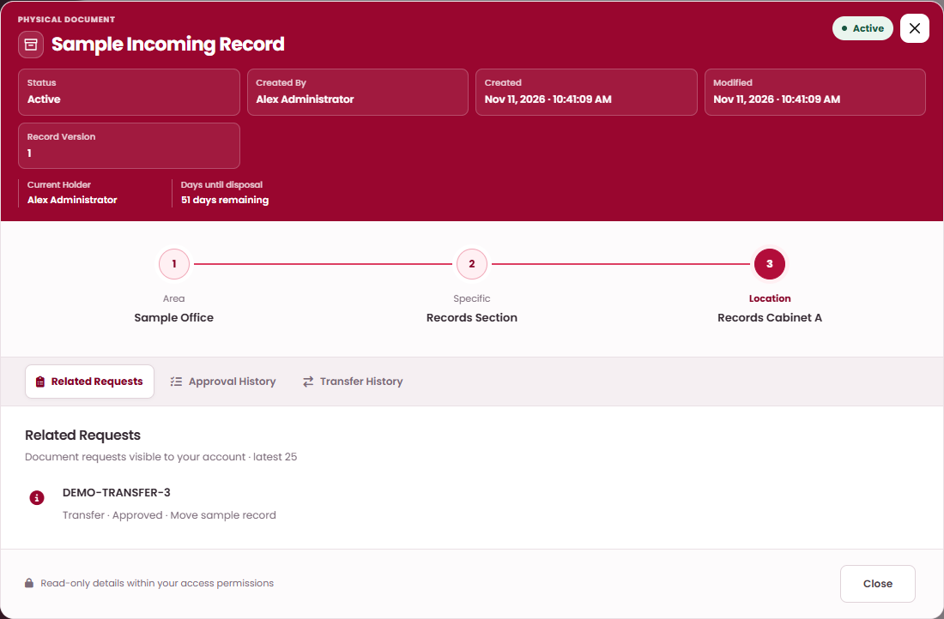
Check who holds a hardcopy and where it is
HARDCOPY DOCUMENTS
DO THIS
1
Open the record’s View. Current Holder is the person responsible for the paper now.
2
Days until disposal counts down to Retention End (only when retention is tracked).
1
2
3
Open Transfer History to see every handoff, and Related Requests for open requests.
3
KEEP IN MIND
An approved transfer does not change the holder. The holder and place change only when the receiving user selects Accept.
WHAT HAPPENS NEXT
Before collecting or releasing the paper, confirm the holder and that no transfer is still in progress.
WHO: Hardcopy users and document controllers

Slide 47
Track hardcopy retention dates
HARDCOPY DOCUMENTS · TASK OVERVIEW
Retention tracking reminds you when a paper document’s keep-until date arrives. It never disposes of anything by itself.
WHO CAN DO THIS
STEP BY STEP
Hardcopy holders and document controllers
1
Turn on retention tracking
slide 48
BEFORE YOU START
2
Find documents that are due
slide 49
Permission to add or edit the hardcopy.
✓
Result: You see which hardcopies are due and act on them.
WHERE TO START
Add or Edit window › Track retention period; then the All Retention filter.
WHO: Hardcopy holders and document controllers

Slide 48
Turn on retention tracking
TRACK HARDCOPY RETENTION DATES · STEP 1 OF 2
1
2
Edit Record
×
DO THIS
1
In Add or Edit, tick Track retention period.
Document Title
Enter the hardcopy document title
2
Enter Retention Start and Retention End (end on or after start).
Sequence (next number if empty)
Area
e.g. 1
ADMIN OFFICE
▾
3
Select Save Document › Confirm.
Specific
Asset (optional — can be empty)
PM'S FILE ORGANIZER
▾
No asset / not assigned
▾
Location
Current Holder
B
▾
Your name
▾
1
✓
Track retention period
2
Retention Start (optional)
2
Retention End (optional)
mm/dd/yyyy
▦
mm/dd/yyyy
▦
Reason / Notes (optional)
Optional document notes
Cancel
3
Save Document
WHAT HAPPENS NEXT
View Details now shows Days until disposal. Dates follow Manila time.
WHO: Hardcopy holders and document controllers

Slide 49
Find documents that are due
TRACK HARDCOPY RETENTION DATES · STEP 2 OF 2
1
2
DO THIS
1
Open the All Retention filter and choose Due Today, Overdue, Due in the Next 7 Days or Due in 8-30 Days.
2
Open View on each record and decide what to do.
1
3
When the Retention period reached pop-up appears, review its list and select Got it.
2
WHAT HAPPENS NEXT
To dispose of a due document: submit a Disposal Request, or (with permission) use Dispose directly. To keep it longer, Edit the Retention End date.
WHO: Hardcopy holders and document controllers

Slide 50
Softcopy documents — direct actions
04
IN THIS SECTION
Create a softcopy directly
51
Use document and series numbers
56
Revise a softcopy directly
57
Create or revise a controlled electronic document immediately, without an approval request. For document controllers.

Slide 51
Create a softcopy directly
SOFTCOPY DOCUMENTS — DIRECT ACTIONS · TASK OVERVIEW
“Approve Directly” creates the Active document at once. Use a Softcopy Request instead when approval is needed.
WHO CAN DO THIS
STEP BY STEP
Document Control Officer or Administrator (Softcopy: Direct)
1
Open the Add form
slide 52
2
Describe the document and choose its category
slide 53
BEFORE YOU START
The final file (PDF, TXT, PNG, JPG/JPEG, DOCX or XLSX, up to 15 MB).
A Document Number Pattern category in Master Data.
3
Set the revision, date and file
slide 54
4
Confirm and check the result
slide 55
WHERE TO START
✓
Result: An Active softcopy with its final document number, revision level and approved file.
Softcopy Documents › Add New Softcopy Document.
WHO: Document Control Officer or Administrator (Softcopy: Direct)

Slide 52
Open the Add form
CREATE A SOFTCOPY DIRECTLY · STEP 1 OF 4
1
2
3
4
Softcopy Documents
›
Add New Softcopy Document
DO THIS
1
Open Softcopy Documents in the left menu.
2
Select Add New Softcopy Document (top right of the list).
Add New Softcopy Document
×
3
Check that Softcopy Action shows Create Softcopy.
1
Softcopy Action
Subject / Reason
Create Softcopy
▾
Proposed Document Title
Category
Production Process Monitoring
▾
Need Series Number?
Generated Document Number
PPM-001
Revision Level
Effective Date (optional)
00
mm/dd/yyyy
▦
Document File (required for Create and Revise · 15 MB maximum)
Choose File
No file chosen
Remarks (optional)
Cancel
Approve Directly
WHAT HAPPENS NEXT
Fill in the form (next step).
WHO: Document Control Officer or Administrator (Softcopy: Direct)

Slide 53
Describe the document and choose its category
CREATE A SOFTCOPY DIRECTLY · STEP 2 OF 4
1
2
3
4
Add New Softcopy Document
×
Complete the upper half of the form.
1
2
# | Field / button | What to enter or check | Rule
1 | Softcopy Action | Create Softcopy. | Required
2 | Subject / Reason | Why the document is being issued (up to 255 characters). | Required
3 | Proposed Document Title | The official title. | Required
4 | Category | A numbering category, e.g. Production Process Monitoring (PPM-001). Folders are not listed. | Required
5 | Need Series Number? | Leave unticked for a new number. Tick only to add a series to an existing number — see Use document and series numbers. | Optional
6 | Generated Document Number | Preview of the next number for the category. The final number is assigned when you approve. | Auto
Softcopy Action
Subject / Reason
Create Softcopy
▾
3
Proposed Document Title
4
Category
Production Process Monitoring
▾
5
Need Series Number?
6
Generated Document Number
PPM-001
Revision Level
Effective Date (optional)
00
mm/dd/yyyy
▦
Document File (required for Create and Revise · 15 MB maximum)
Choose File
No file chosen
Remarks (optional)
Cancel
Approve Directly
WHO: Document Control Officer or Administrator (Softcopy: Direct)

Slide 54
Set the revision, date and file
CREATE A SOFTCOPY DIRECTLY · STEP 3 OF 4
1
2
3
4
Add New Softcopy Document
×
Complete the lower half, then select Approve Directly.
# | Field / button | What to enter or check | Rule
1 | Revision Level | Starts at 00 for a new document. Change only if your procedure says so. | Required
2 | Effective Date | Date the document takes effect. Blank = the approval day. | Optional
3 | Document File | Choose the file: PDF, TXT, PNG, JPG/JPEG, DOCX or XLSX, 15 MB maximum. | Required
4 | Remarks | Any comment for the record. | Optional
5 | Approve Directly | Opens the confirmation (next step). | Button
Softcopy Action
Subject / Reason
Create Softcopy
▾
Proposed Document Title
Category
Production Process Monitoring
▾
Need Series Number?
Generated Document Number
PPM-001
1
Revision Level
2
Effective Date (optional)
00
mm/dd/yyyy
▦
3
Document File (required for Create and Revise · 15 MB maximum)
Choose File
No file chosen
4
Remarks (optional)
Cancel
5
Approve Directly
WHO: Document Control Officer or Administrator (Softcopy: Direct)

Slide 55
Confirm and check the result
CREATE A SOFTCOPY DIRECTLY · STEP 4 OF 4
1
2
3
4
Confirm Action
×
DO THIS
1
Read Approve and apply this softcopy action directly? and select Confirm.
Approve and apply this softcopy action directly?
Cancel
1
Confirm
2
Wait for Operation successful › Got it.
3
Find the new document (Status Active). Open View › Document Files to check the file.
▼ then
Operation successful
×
The softcopy action was approved and applied.
2
Got it
WHAT HAPPENS NEXT
The document and its file are current immediately, with the final document number. Staff can now find it, request access to it, or request a revision.
WHO: Document Control Officer or Administrator (Softcopy: Direct)

Slide 56
Add a series to an existing document number
SOFTCOPY DOCUMENTS · NUMBERING
Add New Softcopy Document
×
Use this when a new document must share an existing Document No. and be told apart by a series.
Softcopy Action
Subject / Reason
# | Field / button | What to enter or check | Rule
1 | Need Series Number? | Tick it. The number fields below appear. | Optional
2 | Document Number | Choose the existing Document No. to share. | Required
3 | Series No. Code Pattern (first-time setup) | Only the first time for this Document No., e.g. 001 or SER-001. Later series continue automatically. | First time
4 | Original Document Series No. | The series the existing original receives at final approval (the number before yours). | Auto
5 | Series Number | Filled with the next series. Edit only to use a different one. | Auto
Create Softcopy
▾
Proposed Document Title
Category
Production Process Monitoring
▾
1
✓
Need Series Number?
2
Document Number
PPM-001
▾
3
Series No. Code Pattern (first-time setup)
For example 001 or SER-001
4
Original Document Series No.
5
Series Number
000
001
Cancel
Approve Directly
GOOD TO KNOW
Example with pattern 001: the original becomes series 000, your new document 001, the next one 002. Revisions keep their series.
WHAT HAPPENS NEXT
Finish the form and approve (direct) or Save Draft (request). The numbers are final only after approval and may change before then.
WHO: Softcopy creators and requesters

Slide 57
Revise a softcopy directly
SOFTCOPY DOCUMENTS — DIRECT ACTIONS · TASK OVERVIEW
A direct revision replaces the current file at once and raises the revision level. The number, series and category stay the same.
WHO CAN DO THIS
STEP BY STEP
Document Control Officer or Administrator (Softcopy: Direct)
1
Select Edit on the document
slide 58
2
Enter the revision details
slide 59
BEFORE YOU START
The replacement file.
The document must be Active and its file not locked.
3
Attach the replacement file and approve
slide 60
✓
Result: The replacement file is current; the old one is kept as Superseded in File History.
WHERE TO START
Softcopy Documents › the document’s Edit button.
WHO: Document Control Officer or Administrator (Softcopy: Direct)

Slide 58
Select Edit on the document
REVISE A SOFTCOPY DIRECTLY · STEP 1 OF 3
1
2
3
Softcopy Documents
›
Search the document
›
Edit
DO THIS
1
Open Softcopy Documents and search for the document.
×
2
Select Edit on its row.
Edit Record
3
The window opens with Revise Softcopy and the Existing Softcopy Document already chosen.
1
Softcopy Action
Subject / Reason
Revise Softcopy
▾
Revision: Sample Quality Procedure
2
Existing Softcopy Document
Series No.
PPM-001 · Sample Quality Procedure
▾
Proposed Document Title
Revision Level
Sample Quality Procedure
01
Number of Pages
Effective Date (optional)
1
mm/dd/yyyy
▦
KEEP IN MIND
Document File (required for Create and Revise · 15 MB maximum)
No Edit button? The document is not Active, or its file is locked (read-only). Locked documents cannot be revised.
Choose File
No file chosen
Remarks (optional)
Cancel
Approve Directly
WHAT HAPPENS NEXT
Fill in the revision details (next step).
WHO: Document Control Officer or Administrator (Softcopy: Direct)

Slide 59
Enter the revision details
REVISE A SOFTCOPY DIRECTLY · STEP 2 OF 3
1
2
3
Edit Record
×
Check the pre-filled values and complete the rest.
3
# | Field / button | What to enter or check | Rule
1 | Series No. | Correct the series only if it is wrong. | Optional
2 | Revision Level | The new level, e.g. 01 after 00. | Required
3 | Subject / Reason | Pre-filled “Revision: <title>”. Describe what changed. | Required
4 | Proposed Document Title | Keep or correct the title. | Required
5 | Number of Pages | Total pages of the new file (1 or more). | Required
Softcopy Action
Subject / Reason
Revise Softcopy
▾
Revision: Sample Quality Procedure
Existing Softcopy Document
1
Series No.
PPM-001 · Sample Quality Procedure
▾
4
Proposed Document Title
2
Revision Level
Sample Quality Procedure
01
5
Number of Pages
Effective Date (optional)
1
mm/dd/yyyy
▦
Document File (required for Create and Revise · 15 MB maximum)
Choose File
No file chosen
Remarks (optional)
Cancel
Approve Directly
WHO: Document Control Officer or Administrator (Softcopy: Direct)

Slide 60
Attach the replacement file and approve
REVISE A SOFTCOPY DIRECTLY · STEP 3 OF 3
1
2
3
Edit Record
×
Attach the new file, then select Approve Directly › Confirm.
# | Field / button | What to enter or check | Rule
1 | Effective Date | Blank = the approval day. | Optional
2 | Document File | The replacement file (same types, 15 MB maximum). | Required
3 | Remarks | Any comment. | Optional
4 | Approve Directly | Confirm “Approve and apply this softcopy action directly?”. | Button
Softcopy Action
Subject / Reason
Revise Softcopy
▾
Revision: Sample Quality Procedure
Existing Softcopy Document
Series No.
PPM-001 · Sample Quality Procedure
▾
Proposed Document Title
Revision Level
Sample Quality Procedure
01
Number of Pages
1
Effective Date (optional)
1
mm/dd/yyyy
▦
2
Document File (required for Create and Revise · 15 MB maximum)
Choose File
No file chosen
3
Remarks (optional)
Cancel
4
Approve Directly
WHAT HAPPENS NEXT
Operation successful. Open View › Document Files to check the new file, and File History to see the previous one marked Superseded.
WHO: Document Control Officer or Administrator (Softcopy: Direct)

Slide 61
External documents — direct actions
05
IN THIS SECTION
Register an external document directly
62
Revise an external document directly
65
Register or revise scanned documents received from outside the company. For document controllers.

Slide 62
Register an external document directly
EXTERNAL DOCUMENTS — DIRECT ACTIONS · TASK OVERVIEW
External documents are stored as a backup copy of what you received. They have their own categories and no retention dates.
WHO CAN DO THIS
STEP BY STEP
Document Control Officer or Administrator (External Documents: Direct)
1
Fill in the Direct External form
slide 63
2
Check the new record
slide 64
BEFORE YOU START
The scanned files: up to 20 PDF or image files, 15 MB each.
Result: An Active external document at revision 00 with its attachments.
✓
WHERE TO START
External Documents › Add New External Document.
WHO: Document Control Officer or Administrator (External Documents: Direct)

Slide 63
Fill in the Direct External form
REGISTER AN EXTERNAL DOCUMENT DIRECTLY · STEP 1 OF 2
1
2
Direct External
×
Open External Documents › Add New External Document, complete the window, then select Save Directly.
1
Document Title
# | Field / button | What to enter or check | Rule
1 | Document Title | The title as written on the received document. | Required
2 | Document No. | The sender’s document number, if any (up to 150 characters). | Optional
3 | Subsidiary | The company / subsidiary it belongs to (from Subsidiary Setup). | Optional
4 | Category | An External Category. Default: Uncategorized. | Required
5 | Description | Short description of the content. | Optional
6 | Attach File | Select up to 20 PDF or image files, 15 MB each. | Required
7 | Save Directly | Opens the confirmation. | Button
2
Document No. (optional)
3
Subsidiary (optional)
Select a subsidiary
▾
4
Category
Uncategorized
▾
5
Description
6
Attach File (up to 20 files, 15 MB each)
Choose File
No file chosen
Cancel
7
Save Directly
WHAT HAPPENS NEXT
Select Confirm › Got it. Find the new row and open View to check the attachments.
WHO: Document Control Officer or Administrator (External Documents: Direct)

Slide 64
Check the new record
REGISTER AN EXTERNAL DOCUMENT DIRECTLY · STEP 2 OF 2
1
2
External Documents
›
Search
›
View
DO THIS
1
Find the row and select View. Check Subsidiary, Category, Status Active and Revision Level 00.
Document Details
×
2
Under Current Attachments preview each file; use Fullscreen to read closely.
1
Subsidiary
1
Category
—
Uncategorized
3
Use Download, or Download All on the row, to save copies when allowed.
1
Status
1
Revision Level
Active
00
2
Current Attachments
supplier-certificate-p1.pdf · supplier-certificate-p2.jpg
Each attachment: preview, Fullscreen and (when allowed) Download.
Close
WHAT HAPPENS NEXT
The document is Active at revision 00. Later changes need at least one replacement attachment.
WHO: Document Control Officer or Administrator (External Documents: Direct)

Slide 65
Revise an external document directly
EXTERNAL DOCUMENTS — DIRECT ACTIONS · TASK OVERVIEW
Saving a direct revision replaces the current attachments and raises the revision level automatically.
WHO CAN DO THIS
STEP BY STEP
Document Control Officer or Administrator (External Documents: Direct)
1
Select Edit on the document
slide 66
2
Edit the details and attach the replacement
slide 67
BEFORE YOU START
At least one replacement file.
The document must be Active with no locked file.
Result: The new attachments are current; the revision level increases (00 › 01).
✓
WHERE TO START
External Documents › Edit on the row.
WHO: Document Control Officer or Administrator (External Documents: Direct)

Slide 66
Select Edit on the document
REVISE AN EXTERNAL DOCUMENT DIRECTLY · STEP 1 OF 2
1
2
External Documents
›
Search the document
›
Edit
DO THIS
1
Open External Documents and search for the document (Status Active).
×
2
Select Edit on its row. The Direct External window opens with the current values.
Direct External
1
Document Title
Document No. (optional)
Subsidiary (optional)
Select a subsidiary
▾
Category
Uncategorized
▾
Description
KEEP IN MIND
No Edit button: the document is not Active, has a locked file, or you lack External Documents: Direct.
Attach File (up to 20 files, 15 MB each)
Choose File
No file chosen
Cancel
Save Directly
WHAT HAPPENS NEXT
Change the details and attach the replacement (next step).
WHO: Document Control Officer or Administrator (External Documents: Direct)

Slide 67
Edit the details and attach the replacement
REVISE AN EXTERNAL DOCUMENT DIRECTLY · STEP 2 OF 2
1
2
Direct External
×
Select Edit on the row. Check the details, attach the new files, then Save Directly › Confirm.
1
Document Title
# | Field / button | What to enter or check | Rule
1 | Title, Document No., Subsidiary, Category, Description | Pre-filled with the current values. Correct any that changed. | Check
2 | Attach File | At least one replacement PDF or image (up to 20, 15 MB each). | Required
3 | Save Directly | Confirm the action. | Button
1
Document No. (optional)
1
Subsidiary (optional)
Select a subsidiary
▾
1
Category
Uncategorized
▾
1
Description
2
Attach File (up to 20 files, 15 MB each)
Choose File
No file chosen
3
KEEP IN MIND
Cancel
Save Directly
No Edit button: the document is not Active, has a locked file, or you lack External Documents: Direct.
WHAT HAPPENS NEXT
Operation successful. Open View to check the new attachments and revision level.
WHO: Document Control Officer or Administrator (External Documents: Direct)

Slide 68
Requests — asking for a change
06
IN THIS SECTION
Know the My Requests page
69
Request a new softcopy
71
Request a softcopy revision
77
Request a new external document
81
Request an external document revision
85
Request a hardcopy transfer
89
Request access to a document
96
Your point of view as a requester: prepare a request, save it as a draft, submit it, follow it, and fix it if it comes back.
Request a document assignment
100
Request a disposal
104
Fix a returned request
108
Cancel or delete a draft
109

Slide 69
Your requests in one place
REQUESTS · ORIENTATION
DO THIS
1
1
Tabs: Softcopy Request, External Document Request, Hardcopy Transfer Request, Disposal Request, Document Access Request, Document Assignment Request. The number = your Draft + Returned requests.
2
3
2
New Request starts a request of the open tab.
4
5
3
Filter by status, action and date.
4
Status: Draft, “Awaiting <approver>” while in progress, Approved, Completed, Returned, Rejected or Cancelled.
5
Row buttons: View, Edit, Submit, Cancel, Delete — shown only when allowed.
WHO: Requester — Staff, Plant Manager, Document Control Officer or Administrator

Slide 70
How every request moves
REQUESTS · ORIENTATION
Draft
In progress
Completed
Rejected
You Save Draft. Edit freely. Nothing changes yet.
Submit
Shown as Awaiting <approver>. Each step decides in turn. You cannot edit.
Last OK
The change is applied. (Transfers: Approved until Accept.)
Closed by an approver. Nothing changes. Cannot be resubmitted.
Return
Reject (any step)
Cancel
Returned
GOOD TO KNOW
Edit › Submit
Sent back at step 1. Edit, then Submit again (same route).
A Return at a later step goes to the previous approver, not to you; your request stays in progress. Track every step on the Approval Process Timeline.
Cancelled
Deleted
KEEP IN MIND
Draft cancelled with Cancel.
Delete removes a never-submitted cancelled draft.
Approvers see the same request in My Tasks with the status Pending your approval: <step>.
WHO: Requester — Staff, Plant Manager, Document Control Officer or Administrator

Slide 71
Request a new softcopy
REQUESTS — ASKING FOR A CHANGE · TASK OVERVIEW
Ask for a new controlled document. It becomes Active only after every approver agrees.
WHO CAN DO THIS
STEP BY STEP
Requester — Staff, Plant Manager, Document Control Officer or Administrator
1
Open Softcopy Request and start a New Request
slide 72
2
Fill in the softcopy request
slide 73
BEFORE YOU START
The proposed file (PDF, TXT, PNG, JPG/JPEG, DOCX, XLSX, max 15 MB).
Your account should have a Leader — the first approver.
3
Save the draft and check the file
slide 74
4
Submit the request for approval
slide 75
5
Follow its progress
slide 76
WHERE TO START
My Requests › Softcopy Request tab › New Request.
✓
Result: An Active softcopy (revision 00) using the final file uploaded by Document Control.
WHO: Requester — Staff, Plant Manager, Document Control Officer or Administrator

Slide 72
Open Softcopy Request and start a New Request
REQUEST A NEW SOFTCOPY · STEP 1 OF 5
1
2
3
4
5
DO THIS
2
1
Select My Requests in the left menu.
3
2
Select the Softcopy Request tab.
3
Select New Request.
1
WHAT HAPPENS NEXT
The New Request window opens (next step).
WHO: Requester — Staff, Plant Manager, Document Control Officer or Administrator

Slide 73
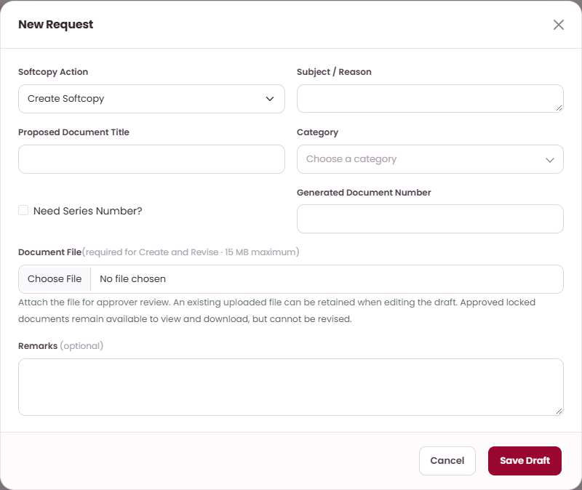
Fill in the softcopy request
REQUEST A NEW SOFTCOPY · STEP 2 OF 5
1
2
3
4
5
# | Field / button | What to enter or check | Rule
1 | Softcopy Action | Create Softcopy. | Required
2 | Subject / Reason | Why the document is needed (up to 255 characters). | Required
3 | Proposed Document Title | The title you propose. | Required
4 | Category | The numbering category, e.g. Quality Control (FS&Q-QC-001). | Required
5 | Need Series Number? | Tick only to share an existing number with a new series (see Numbering slide). | Optional
6 | Generated Document Number | Preview only. The final number is set at final approval and may differ. | Auto
7 | Document File | Your proposed file. Can be added while editing the draft, but is required to Submit. | Required
8 | Remarks | Anything approvers should know. | Optional
9 | Save Draft | Saves the request as a Draft (next step). | Button
1
2
3
4
6
5
7
8
9
WHO: Requester — Staff, Plant Manager, Document Control Officer or Administrator

Slide 74
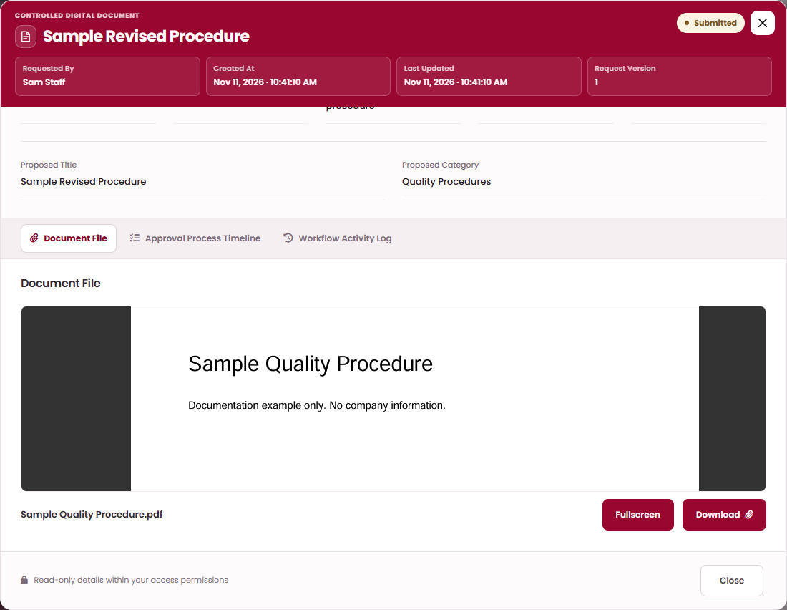
Save the draft and check the file
REQUEST A NEW SOFTCOPY · STEP 3 OF 5
1
2
3
4
5
DO THIS
1
Select Save Draft. Confirm “Save request draft?” › Confirm › Got it. The request is listed with status Draft. Nothing has changed in the register yet.
2
Select View on your draft and open the Document File tab to preview what approvers will see.
2
3
Use Fullscreen to check every page.
3
KEEP IN MIND
The Document File preview is available only to you and the approver who currently holds the task.
WHO: Requester — Staff, Plant Manager, Document Control Officer or Administrator

Slide 75
Submit the request for approval
REQUEST A NEW SOFTCOPY · STEP 4 OF 5
1
2
3
4
5
DO THIS
1
Optional check: select View and read your draft (and its file on the Document File tab).
2
Need a change? Select Edit, correct it, Save Draft › Confirm.
1
2
3
3
Select Submit. The confirmation reads “Submit? Submit this request to the published approval workflow.” Select Confirm.
WHAT HAPPENS NEXT
Status becomes Awaiting Requester’s leader. You can no longer Edit or Cancel it. Your leader gets a task in My Tasks.
WHO: Requester — Staff, Plant Manager, Document Control Officer or Administrator

Slide 76
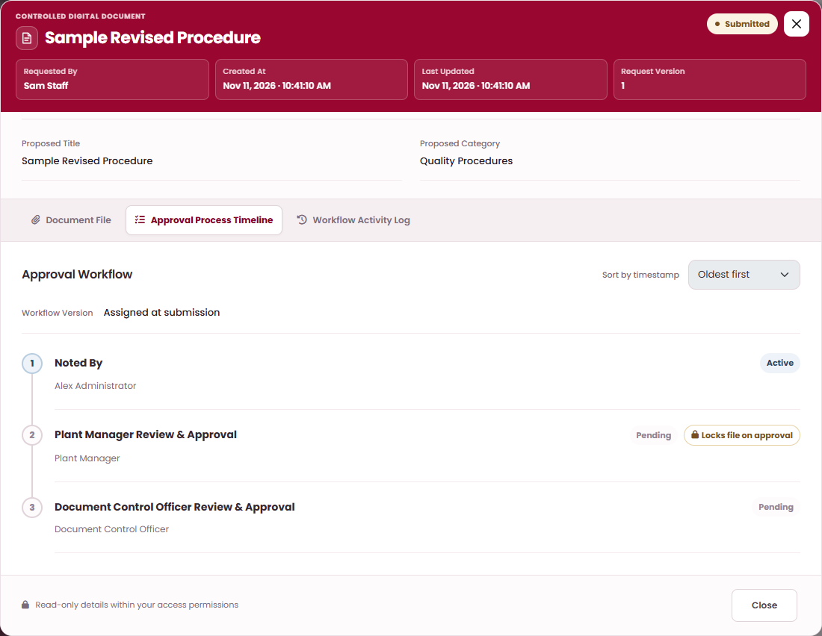
Follow its progress
REQUEST A NEW SOFTCOPY · STEP 5 OF 5
1
2
3
4
5
DO THIS
1
Open View › Approval Process Timeline.
2
Each step shows its approver and status: Active = waiting now, Pending = later, Approved.
1
4
3
Locks file on approval: when the Plant Manager approves, your file becomes read-only (Locked).
4
Workflow Activity Log lists every decision with names, dates and remarks.
2
3
WHAT HAPPENS NEXT
Route: Noted By (your leader) › Plant Manager › Document Control Officer, who uploads the final controlled file. Then the request is Completed and the document is Active.
WHO: Requester — Staff, Plant Manager, Document Control Officer or Administrator

Slide 77
Request a softcopy revision
REQUESTS — ASKING FOR A CHANGE · TASK OVERVIEW
Propose a new version of an existing Active softcopy. The current version stays in force until final approval.
WHO CAN DO THIS
STEP BY STEP
Requester with access to the document
1
Open Softcopy Request and start a New Request
slide 78
BEFORE YOU START
2
Fill in the revision request
slide 79
The replacement file.
The document must not be Locked - read-only.
3
Check, then submit the revision
slide 80
WHERE TO START
✓
Result: The approved file becomes current and the revision level increases. Number, series and category stay.
My Requests › Softcopy Request › New Request › Revise Softcopy.
WHO: Requester with access to the document

Slide 78
Open Softcopy Request and start a New Request
REQUEST A SOFTCOPY REVISION · STEP 1 OF 3
1
2
3
DO THIS
2
1
Select My Requests in the left menu.
3
2
Select the Softcopy Request tab.
3
Select New Request.
1
WHAT HAPPENS NEXT
In the window choose Softcopy Action › Revise Softcopy (next step).
WHO: Requester with access to the document

Slide 79
Fill in the revision request
REQUEST A SOFTCOPY REVISION · STEP 2 OF 3
1
2
3
New Request
×
Open the Softcopy Request tab › New Request and choose Revise Softcopy.
1
Softcopy Action
2
Subject / Reason
# | Field / button | What to enter or check | Rule
1 | Softcopy Action | Revise Softcopy. | Required
2 | Subject / Reason | What changes and why. | Required
3 | Existing Softcopy Document | Choose “Number · Title”. Items marked (Locked - read-only) cannot be chosen. | Required
4 | Proposed Document Title | Keep or change the title. | Required
5 | Number of Pages | Pages in the new file. | Required
6 | Document File | The replacement file. | Required
7 | Remarks | Notes for approvers. | Optional
8 | Save Draft | Then Confirm. | Button
Revise Softcopy
▾
3
Existing Softcopy Document
PPM-001 · Sample Quality Procedure
▾
4
Proposed Document Title
5
Number of Pages
Sample Quality Procedure
1
6
Document File (required for Create and Revise · 15 MB maximum)
Choose File
No file chosen
7
Remarks (optional)
Cancel
8
Save Draft
WHO: Requester with access to the document

Slide 80
Check, then submit the revision
REQUEST A SOFTCOPY REVISION · STEP 3 OF 3
1
2
3
DO THIS
1
Optional check: select View and read your draft (and its file on the Document File tab).
2
Need a change? Select Edit, correct it, Save Draft › Confirm.
1
2
3
3
Select Submit. The confirmation reads “Submit? Submit this request to the published approval workflow.” Select Confirm.
WHAT HAPPENS NEXT
Same route as a new softcopy: leader › Plant Manager (locks your file) › Document Control Officer (uploads the final file). At completion the new revision is current; the old file becomes Superseded.
WHO: Requester with access to the document

Slide 81
Request a new external document
REQUESTS — ASKING FOR A CHANGE · TASK OVERVIEW
Ask document control to register a document you received from outside.
WHO CAN DO THIS
STEP BY STEP
Requester — Staff, Plant Manager, Document Control Officer or Administrator
1
Open External Document Request and start a New Request
slide 82
2
Fill in the external document request
slide 83
BEFORE YOU START
The scanned files: up to 20 PDF or image files, 15 MB each.
3
Save, check the attachments and submit
slide 84
✓
Result: An Active external document at revision 00 with your attachments.
WHERE TO START
My Requests › External Document Request › New Request.
WHO: Requester — Staff, Plant Manager, Document Control Officer or Administrator

Slide 82
Open External Document Request and start a New Request
REQUEST A NEW EXTERNAL DOCUMENT · STEP 1 OF 3
1
2
3
DO THIS
2
1
Select My Requests in the left menu.
3
2
Select the External Document Request tab.
3
Select New Request.
1
WHAT HAPPENS NEXT
The New Request window opens (next step).
WHO: Requester — Staff, Plant Manager, Document Control Officer or Administrator

Slide 83
Fill in the external document request
REQUEST A NEW EXTERNAL DOCUMENT · STEP 2 OF 3
1
2
3
New Request
×
# | Field / button | What to enter or check | Rule
1 | External Document Action | External Create Request. | Required
2 | Subject / Reason | Why it should be registered. | Required
3 | Document Title | Title on the received document. | Required
4 | Document No. | Sender’s number, if any. | Optional
5 | Subsidiary | Company it belongs to. | Optional
6 | External Category | Default Uncategorized. | Required
7 | Description | Short description. | Optional
8 | Attach Files | Up to 20 PDF/image files, 15 MB each. Required to Submit. | Required
9 | Remarks | Notes for approvers. | Optional
10 | Save Draft | Then Confirm. | Button
1
External Document Action
2
Subject / Reason
External Create Request
▾
3
Document Title
4
Document No. (optional)
5
Subsidiary (optional)
6
External Category
Select a subsidiary
▾
Uncategorized
▾
7
Description
8
Attach Files (up to 20 files, 15 MB each)
Choose File
No file chosen
9
Remarks (optional)
Cancel
10
Save Draft
WHO: Requester — Staff, Plant Manager, Document Control Officer or Administrator

Slide 84
Save, check the attachments and submit
REQUEST A NEW EXTERNAL DOCUMENT · STEP 3 OF 3
1
2
3
DO THIS
1
Optional check: select View and read your draft (and its file on the Document File tab).
2
Need a change? Select Edit, correct it, Save Draft › Confirm.
1
2
3
3
Select Submit. The confirmation reads “Submit? Submit this request to the published approval workflow.” Select Confirm.
WHAT HAPPENS NEXT
Route: Plant Manager Review & Approval (locks the attachment) › Document Control Officer Review & Approval. Then Completed and the document is Active at revision 00.
WHO: Requester — Staff, Plant Manager, Document Control Officer or Administrator

Slide 85
Request an external document revision
REQUESTS — ASKING FOR A CHANGE · TASK OVERVIEW
Propose replacement attachments or corrected details for an Active external document.
WHO CAN DO THIS
STEP BY STEP
Requester with access to the document
1
Open External Document Request and start a New Request
slide 86
BEFORE YOU START
2
Fill in the external revision request
slide 87
At least one replacement file.
3
Check the attachments and submit
slide 88
WHERE TO START
My Requests › External Document Request › New Request › External Revised Request.
✓
Result: The approved attachments become current and the revision level increases.
WHO: Requester with access to the document

Slide 86
Open External Document Request and start a New Request
REQUEST AN EXTERNAL DOCUMENT REVISION · STEP 1 OF 3
1
2
3
DO THIS
2
1
Select My Requests in the left menu.
3
2
Select the External Document Request tab.
3
Select New Request.
1
WHAT HAPPENS NEXT
In the window choose External Revised Request (next step).
WHO: Requester with access to the document

Slide 87
Fill in the external revision request
REQUEST AN EXTERNAL DOCUMENT REVISION · STEP 2 OF 3
1
2
3
New Request
×
# | Field / button | What to enter or check | Rule
1 | External Document Action | External Revised Request. | Required
2 | Subject / Reason | What changes and why. | Required
3 | Existing External Document | Choose “Title · Revision NN”. Locked items cannot be chosen. | Required
4 | Title, Document No., Subsidiary, Category, Description | Filled from the current record. Correct what changed. | Check
5 | Attach Files | At least one replacement file. When editing a draft, new files are added to the ones kept. | Required
6 | Remarks | Notes for approvers. | Optional
7 | Save Draft | Then Confirm. | Button
1
External Document Action
2
Subject / Reason
External Revised Request
▾
3
Existing External Document
Supplier Certificate · Revision 00
▾
4
Document Title
4
Document No. (optional)
4
Subsidiary (optional)
4
External Category
Select a subsidiary
▾
Uncategorized
▾
4
Description
5
Attach Files (up to 20 files, 15 MB each)
Choose File
No file chosen
6
Remarks (optional)
7
WHAT HAPPENS NEXT
Cancel
Save Draft
Saved as Draft. Check it, then submit (next step).
WHO: Requester with access to the document

Slide 88
Check the attachments and submit
REQUEST AN EXTERNAL DOCUMENT REVISION · STEP 3 OF 3
1
2
3
DO THIS
1
Optional check: select View and read your draft (and its file on the Document File tab).
2
Need a change? Select Edit, correct it, Save Draft › Confirm.
1
2
3
3
Select Submit. The confirmation reads “Submit? Submit this request to the published approval workflow.” Select Confirm.
WHAT HAPPENS NEXT
Route: Plant Manager Review & Approval (locks the attachments) › Document Control Officer Review & Approval. Then Completed: the new attachments are current and the revision increases.
WHO: Requester with access to the document

Slide 89
Request a hardcopy transfer
REQUESTS — ASKING FOR A CHANGE · TASK OVERVIEW
Move a paper document to another person and place with approval. The handoff is recorded in two steps: Dispatch, then Accept.
WHO CAN DO THIS
STEP BY STEP
Requester (Transfer: Request permission)
1
Open Hardcopy Transfer Request and start a New Request
slide 90
BEFORE YOU START
2
Choose the hardcopy and check where it is now
slide 91
The hardcopy, the receiving person, and the destination place.
3
Choose the destination and the receiver
slide 92
WHERE TO START
4
Submit, then confirm it yourself
slide 93
My Requests › Hardcopy Transfer Request › New Request.
5
Dispatch the document (requester)
slide 94
6
Accept the document (receiving user)
slide 95
✓
Result: The receiver accepts it; holder and location are updated and the request is Completed.
WHO: Requester (Transfer: Request permission)

Slide 90
Open Hardcopy Transfer Request and start a New Request
REQUEST A HARDCOPY TRANSFER · STEP 1 OF 6
1
2
3
4
5
6
DO THIS
2
1
Select My Requests in the left menu.
3
2
Select the Hardcopy Transfer Request tab.
3
Select New Request.
1
WHAT HAPPENS NEXT
The New Request window opens (next step).
WHO: Requester (Transfer: Request permission)

Slide 91
Choose the hardcopy and check where it is now
REQUEST A HARDCOPY TRANSFER · STEP 2 OF 6
1
2
3
4
5
6
New Request
×
Select New Request on the Hardcopy Transfer Request tab.
1
# | Field / button | What to enter or check | Rule
1 | Hardcopy Document | Choose the paper document to move. | Required
2 | Original Places and Holder | Title, Area, Specific, Asset, Sequence, Location and Current Holder fill in automatically. Check they are right. | Auto
Hardcopy Document
Sample Dispatch Record
▾
2
Original Places and Holder
Automatically loaded from the selected hardcopy record.
Document Title
Area
Sample Dispatch Record
ADMIN OFFICE
Specific
Asset
PM'S FILE ORGANIZER
Sequence
Location
3
B
Current Holder
Current holder name
Cancel
Save Draft
KEEP IN MIND
You do not have to be the holder to request a transfer. If the details look wrong, stop and tell document control.
WHO: Requester (Transfer: Request permission)

Slide 92
Choose the destination and the receiver
REQUEST A HARDCOPY TRANSFER · STEP 3 OF 6
1
2
3
4
5
6
New Request (continued)
×
# | Field / button | What to enter or check | Rule
1 | Destination Area | Where the paper goes. | Required
2 | Destination Specific | Cabinet / organizer in that Area. | Required
3 | Destination Asset | Asset Number, if used. | Optional
4 | Destination Location | Exact place. Must differ from the current Location. | Required
5 | Receiving User | The person who will receive and Accept it. | Required
6 | Request Subject | Short reason, e.g. “Move to QA for audit”. | Required
7 | Save Draft | Then Confirm. The request is saved as Draft. | Button
Transfer Destination
Area → Specific → Asset → Location. Selecting a child fills its parents.
1
Destination Area
2
Destination Specific
All Area
▾
All Specific
▾
3
Destination Asset (optional)
4
Destination Location
No asset / not assigned
▾
Choose a location
▾
5
Receiving User
6
Request Subject
Select receiving user
▾
Destination must differ from the original location.
Remarks (optional)
Cancel
7
Save Draft
WHAT HAPPENS NEXT
Check the draft, then submit it (next step).
WHO: Requester (Transfer: Request permission)

Slide 93
Submit, then confirm it yourself
REQUEST A HARDCOPY TRANSFER · STEP 4 OF 6
1
2
3
4
5
6
DO THIS
1
Optional check: select View and read your draft (and its file on the Document File tab).
2
Need a change? Select Edit, correct it, Save Draft › Confirm.
1
2
3
3
Select Submit. The confirmation reads “Submit? Submit this request to the published approval workflow.” Select Confirm.
WHAT HAPPENS NEXT
Route: Plant Manager Approval › Document Control Officer Approval › Requester Confirmation: you get a task in My Tasks — open it and select Approve. Then the request is Approved and the handoff is For Transfer.
WHO: Requester (Transfer: Request permission)

Slide 94
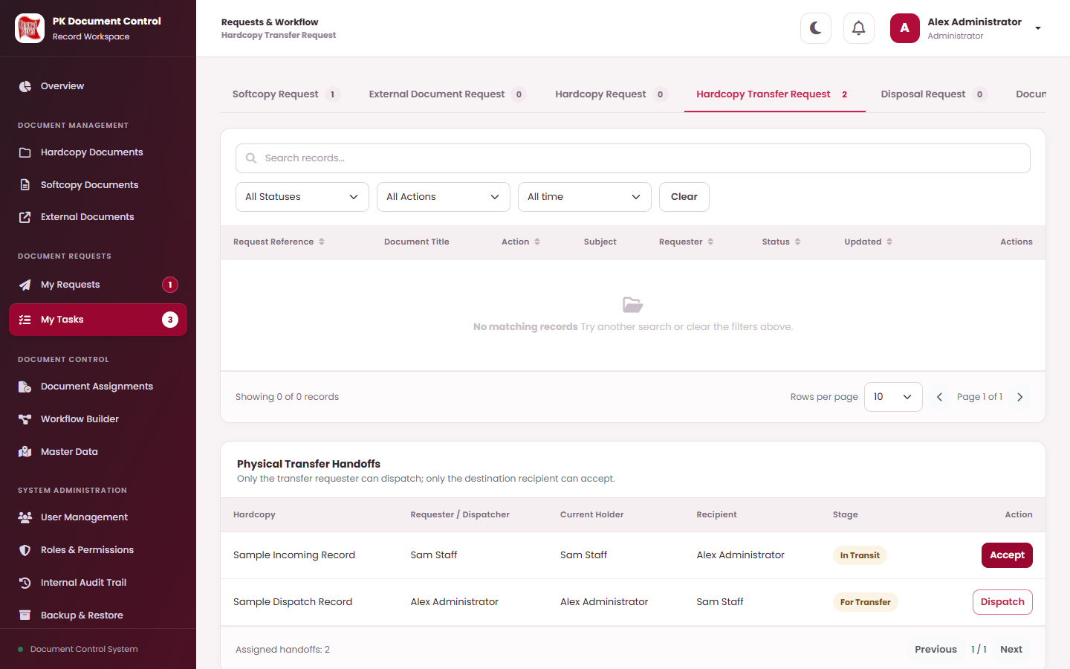
Dispatch the document (requester)
REQUEST A HARDCOPY TRANSFER · STEP 5 OF 6
1
2
3
4
5
6
DO THIS
2
1
Open My Tasks.
2
Select the Hardcopy Transfer Request tab.
3
Scroll to Physical Transfer Handoffs.
4
Find your document with stage For Transfer. Hand the paper over.
1
5
Select Dispatch › Confirm (“Confirm physical release of this document to the intended recipient.”).
3
KEEP IN MIND
5
Only the original requester can Dispatch. The holder and place do not change yet.
4
WHAT HAPPENS NEXT
The stage becomes In Transit. The receiving user can now Accept.
WHO: Requester (Transfer: Request permission)

Slide 95

Accept the document (receiving user)
REQUEST A HARDCOPY TRANSFER · STEP 6 OF 6
1
2
3
4
5
6
DO THIS
1
Receive the paper and check it is the right document.
2
Open My Tasks › Hardcopy Transfer Request › Physical Transfer Handoffs.
3
Find the row with stage In Transit.
1
4
Select Accept › Confirm (“Confirm physical receipt of the document and update its custodian and location.”).
2
KEEP IN MIND
Only the named receiving user can Accept. If the holder or destination changed meanwhile, contact document control.
3
4
WHAT HAPPENS NEXT
Handoff Accepted, request Completed. You are the Current Holder and the Location is the destination. The previous holder’s personal access to it ends.
WHO: Requester (Transfer: Request permission)

Slide 96
Request access to a document
REQUESTS — ASKING FOR A CHANGE · TASK OVERVIEW
Get temporary access for yourself to a Softcopy or Hardcopy you cannot see yet, until a date you choose.
WHO CAN DO THIS
STEP BY STEP
Requester (Access: Request permission)
1
Open Document Access Request and start a New Request
slide 97
BEFORE YOU START
2
Fill in the access request
slide 98
Which document, and until when you need it.
3
Submit the request for approval
slide 99
WHERE TO START
My Requests › Document Access Request › New Request.
✓
Result: You can open the document until the end of the approved expiry date.
WHO: Requester (Access: Request permission)

Slide 97
Open Document Access Request and start a New Request
REQUEST ACCESS TO A DOCUMENT · STEP 1 OF 3
1
2
3
DO THIS
2
1
Select My Requests in the left menu.
3
2
Select the Document Access Request tab.
3
Select New Request.
1
WHAT HAPPENS NEXT
The New Request window opens (next step).
WHO: Requester (Access: Request permission)

Slide 98
Fill in the access request
REQUEST ACCESS TO A DOCUMENT · STEP 2 OF 3
1
2
3
New Request
×
# | Field / button | What to enter or check | Rule
1 | Request Action | Grant Access. | Required
2 | Subject | Why you need access. | Required
3 | Document Type | Softcopy or Hardcopy. External documents are not covered. | Required
4 | Softcopy / Hardcopy Document | Choose the document. | Required
5 | Recipient / Assigned User | Always you — access is only for the requester. | Auto
6 | Access Expires At | A date after today. It must still be in the future at final approval. | Required
7 | Save Draft | Confirm, then Submit from the list. | Button
1
Request Action
2
Subject
Grant Access
▾
3
Document Type
4
Softcopy Document
Softcopy
▾
Not selected
▾
5
Recipient / Assigned User
6
Access Expires At
Your name
mm/dd/yyyy
▦
Remarks (optional)
Cancel
7
Save Draft
KEEP IN MIND
Download and print still need their own permissions. An unfinished access, assignment or transfer request of yours for the same document blocks a new one.
WHAT HAPPENS NEXT
Saved as Draft. Check it, then submit (next step).
WHO: Requester (Access: Request permission)

Slide 99
Submit the request for approval
REQUEST ACCESS TO A DOCUMENT · STEP 3 OF 3
1
2
3
DO THIS
1
Optional check: select View and read your draft (and its file on the Document File tab).
2
Need a change? Select Edit, correct it, Save Draft › Confirm.
1
2
3
3
Select Submit. The confirmation reads “Submit? Submit this request to the published approval workflow.” Select Confirm.
WHAT HAPPENS NEXT
Route: Plant Manager Approval › Document Control Officer › Requester Confirmation (approve it yourself in My Tasks). Then Completed: you can open the document through the expiry date. To extend, submit a new request.
WHO: Requester (Access: Request permission)

Slide 100
Request a document assignment
REQUESTS — ASKING FOR A CHANGE · TASK OVERVIEW
Ask to become the assignee of a Softcopy, or the Current Holder of a Hardcopy (without a physical handoff).
WHO CAN DO THIS
STEP BY STEP
Requester (Assignment: Request permission)
1
Open Document Assignment Request and start a New Request
slide 101
BEFORE YOU START
2
Fill in the assignment request
slide 102
Which document should be assigned to you.
3
Submit the request for approval
slide 103
WHERE TO START
My Requests › Document Assignment Request › New Request.
✓
Result: The document is assigned to you.
WHO: Requester (Assignment: Request permission)

Slide 101
Open Document Assignment Request and start a New Request
REQUEST A DOCUMENT ASSIGNMENT · STEP 1 OF 3
1
2
3
DO THIS
2
1
Select My Requests in the left menu.
3
2
Select the Document Assignment Request tab (the last tab — scroll the tab bar to the right on a small screen).
3
Select New Request.
1
WHAT HAPPENS NEXT
The New Request window opens (next step).
WHO: Requester (Assignment: Request permission)

Slide 102
Fill in the assignment request
REQUEST A DOCUMENT ASSIGNMENT · STEP 2 OF 3
1
2
3
New Request
×
# | Field / button | What to enter or check | Rule
1 | Request Action | Assign. | Required
2 | Subject | Why it should be assigned to you. | Required
3 | Document Type | Softcopy or Hardcopy. | Required
4 | Softcopy / Hardcopy Document | Choose the document. | Required
5 | Recipient / Assigned User | Always you. | Auto
6 | Save Draft | Confirm, then Submit from the list. | Button
1
Request Action
2
Subject
Assign
▾
3
Document Type
4
Hardcopy Document
Hardcopy
▾
Not selected
▾
5
Recipient / Assigned User
Your name
Remarks (optional)
Cancel
6
Save Draft
KEEP IN MIND
Hardcopy assignment changes the holder but keeps the Location and records no Dispatch / Accept. Use a transfer when the paper physically moves.
WHAT HAPPENS NEXT
Saved as Draft. Check it, then submit (next step).
WHO: Requester (Assignment: Request permission)

Slide 103
Submit the request for approval
REQUEST A DOCUMENT ASSIGNMENT · STEP 3 OF 3
1
2
3
DO THIS
1
Optional check: select View and read your draft (and its file on the Document File tab).
2
Need a change? Select Edit, correct it, Save Draft › Confirm.
1
2
3
3
Select Submit. The confirmation reads “Submit? Submit this request to the published approval workflow.” Select Confirm.
WHAT HAPPENS NEXT
Route: Plant Manager Approval › Document Control Officer › Requester Approval (your leader). Then Completed: softcopy — you are added as an assignee; hardcopy — you become Current Holder.
WHO: Requester (Assignment: Request permission)

Slide 104
Request a disposal
REQUESTS — ASKING FOR A CHANGE · TASK OVERVIEW
Ask for a Hardcopy or External Document to be disposed of. Softcopies are disposed directly by document control.
WHO CAN DO THIS
STEP BY STEP
Requester (Disposal: Request permission)
1
Open Disposal Request and start a New Request
slide 105
BEFORE YOU START
2
Fill in the disposal request
slide 106
The Active document and the disposal method (Shred, Scratch or Other).
3
Submit the request for approval
slide 107
WHERE TO START
✓
Result: The document is marked Disposed with the reason recorded.
My Requests › Disposal Request › New Request.
WHO: Requester (Disposal: Request permission)

Slide 105
Open Disposal Request and start a New Request
REQUEST A DISPOSAL · STEP 1 OF 3
1
2
3
DO THIS
2
1
Select My Requests in the left menu.
3
2
Select the Disposal Request tab.
3
Select New Request.
1
WHAT HAPPENS NEXT
The New Request window opens (next step).
WHO: Requester (Disposal: Request permission)

Slide 106
Fill in the disposal request
REQUEST A DISPOSAL · STEP 2 OF 3
1
2
3
New Request
×
# | Field / button | What to enter or check | Rule
1 | Request Action | Disposal Request. | Required
2 | Subject / Reason | Why it should be disposed of. | Required
3 | Document Type | Hardcopy or External Document. | Required
4 | Hardcopy / External Document | Choose the Active document. | Required
5 | Disposal Reason | Shred, Scratch or Other. | Required
6 | Other Reason | Only for Other: describe the method (up to 250 characters). | If Other
7 | Save Draft | Confirm, then Submit from the list. | Button
1
Request Action
2
Subject / Reason
Disposal Request
▾
3
Document Type
4
Hardcopy Document
Hardcopy
▾
Choose an active document
▾
5
Disposal Reason
6
Other Reason
Select disposal reason
▾
Enter disposal reason
Remarks (optional)
The document is disposed only after the approval workflow is completed.
Cancel
7
Save Draft
WHAT HAPPENS NEXT
Saved as Draft. Check it, then submit (next step).
WHO: Requester (Disposal: Request permission)

Slide 107
Submit the request for approval
REQUEST A DISPOSAL · STEP 3 OF 3
1
2
3
DO THIS
1
Optional check: select View and read your draft (and its file on the Document File tab).
2
Need a change? Select Edit, correct it, Save Draft › Confirm.
1
2
3
3
Select Submit. The confirmation reads “Submit? Submit this request to the published approval workflow.” Select Confirm.
WHAT HAPPENS NEXT
Route: Plant Manager Approval › Document Control Officer › Requester Confirmation (approve it yourself in My Tasks). Then Completed: the document is Disposed.
WHO: Requester (Disposal: Request permission)

Slide 108
Correct a Returned request and submit it again
REQUESTS · WHEN A REQUEST COMES BACK
DO THIS
1
Filter All Statuses › Returned (or look for the badge on My Requests).
2
Select View › Workflow Activity Log and read the approver’s remark.
1
3
Select Edit, make the corrections (e.g. a new file), Save Draft › Confirm.
2
3
4
4
Select Submit › Confirm.
KEEP IN MIND
A resubmitted request keeps its original approval route, even if the Administrator changed the route since.
WHAT HAPPENS NEXT
The request starts again at the first approval step. Rejected requests cannot be resubmitted — create a new one.
WHO: Requester — Staff, Plant Manager, Document Control Officer or Administrator

Slide 109
Cancel a draft, or delete a cancelled one
REQUESTS · HOUSEKEEPING
DO THIS
1
On a Draft, select Cancel. Confirm “Cancel this draft request.”. Status becomes Cancelled.
2
To remove it completely, select Delete on the Cancelled row and confirm “Delete this cancelled draft permanently? This cannot be undone.”
1
KEEP IN MIND
Delete appears only on your own cancelled drafts that were never submitted. A Submitted request cannot be cancelled or withdrawn — ask the current approver to Return or Reject it.
WHAT HAPPENS NEXT
A cancelled request stays in the list for reference until you delete it.
WHO: Requester — Staff, Plant Manager, Document Control Officer or Administrator

Slide 110
Approvals — reviewing as an approver
07
IN THIS SECTION
Approve, return or reject a request
111
Upload the final softcopy file (Document Control)
116
Know locked files
119
Approval routes — who acts next
120
Your point of view when a request is assigned to you or your role: review it, decide, and know what happens next.

Slide 111
Approve, return or reject a request
APPROVALS — REVIEWING AS AN APPROVER · TASK OVERVIEW
Only the person or role assigned to the current step can decide. Being an Administrator gives no bypass.
WHO CAN DO THIS
STEP BY STEP
Assigned approver (leader, Plant Manager, Document Control Officer or requester)
1
Find the task in My Tasks
slide 112
2
Review the request and its file
slide 113
BEFORE YOU START
A task in My Tasks (badge number, bell or “Approval needed” pop-up).
3
Approve
slide 114
4
Return or reject with a remark
slide 115
WHERE TO START
My Tasks › the request’s tab.
✓
Result: Your decision is recorded and the request moves to the next step, back, or closes.
WHO: Assigned approver (leader, Plant Manager, Document Control Officer or requester)

Slide 112
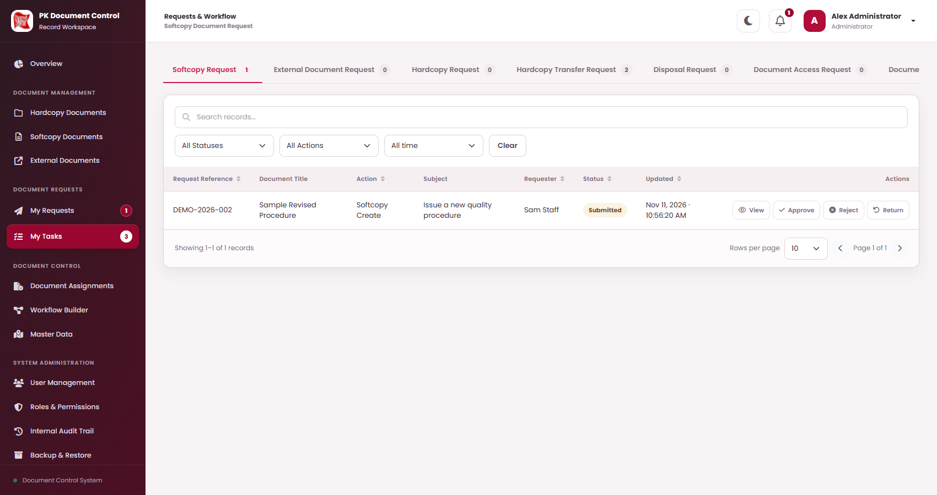
Find the task in My Tasks
APPROVE, RETURN OR REJECT A REQUEST · STEP 1 OF 4
1
2
3
4
DO THIS
2
1
Select My Tasks. The badge counts tasks waiting for you.
2
Choose the tab with a number: Softcopy, External Document, Hardcopy (older requests), Hardcopy Transfer, Disposal, Document Access or Document Assignment Request.
3
1
3
Status reads Pending your approval: <step name>. Select View.
WHAT HAPPENS NEXT
The request opens read-only. Review it fully before deciding (next step).
WHO: Assigned approver (leader, Plant Manager, Document Control Officer or requester)

Slide 113
Review the request and its file
APPROVE, RETURN OR REJECT A REQUEST · STEP 2 OF 4
1
2
3
4
1
DO THIS
1
Header: who requested it, when, request version and status.
2
Document File: preview the proposed file (softcopy / external). Use Fullscreen.
2
3
4
3
Approval Process Timeline: which steps are done and which are next.
4
Workflow Activity Log: earlier decisions and remarks.
GOOD TO KNOW
Other tabs show Request & Ownership (reference, action, subject, remarks) and the proposal: Proposed Classification & Revision, Proposed External Document, Proposed Storage & Custody or Disposal Details.
WHO: Assigned approver (leader, Plant Manager, Document Control Officer or requester)

Slide 114
Approve
APPROVE, RETURN OR REJECT A REQUEST · STEP 3 OF 4
1
2
3
4
DO THIS
1
Select Approve on the row.
2
The confirmation reads “Approve? Record <title> for this workflow step.” Select Confirm.
1
3
Read Operation successful › Got it.
KEEP IN MIND
Document Control Officer on a softcopy request: Approve opens Upload Final Document instead — see the next task.
WHAT HAPPENS NEXT
The next approver gets the task. After the last step the change is applied (document created, revised, transferred, granted, assigned or disposed).
WHO: Assigned approver (leader, Plant Manager, Document Control Officer or requester)

Slide 115
Return or reject with a remark
APPROVE, RETURN OR REJECT A REQUEST · STEP 4 OF 4
1
2
3
4
Return
×
Select Return (send back) or Reject (close) on the row. A window asks for a remark.
1
Record Sample Revised Procedure for this workflow step.
# | Field / button | What to enter or check | Rule
1 | Description | Confirms which request and step you are deciding. | Shown
2 | Remark | Explain what must be corrected or why you reject. Strongly recommended. | Optional
3 | Continue | Records the decision. This is the confirmation. | Button
2
Remark (optional)
e.g. Please attach the signed page 2.
Cancel
3
Continue
WHAT HAPPENS NEXT
Return at step 1 › back to the requester (Returned). Return at a later step › back to the previous approver (still in progress). Reject › closed as Rejected; nothing changes.
WHO: Assigned approver (leader, Plant Manager, Document Control Officer or requester)

Slide 116
Upload the final softcopy file (Document Control)
APPROVALS — REVIEWING AS AN APPROVER · TASK OVERVIEW
On softcopy create and revise requests, the Document Control Officer approves by uploading the final, edited controlled file.
WHO CAN DO THIS
STEP BY STEP
Document Control Officer at the final-file step
1
Select Approve on the softcopy request
slide 117
2
Download, edit and upload the final file
slide 118
BEFORE YOU START
The Plant Manager has approved (the requester’s file is now Locked).
Software to edit the file (e.g. Word or Excel).
Result: Request Completed; your uploaded file is the controlled document.
✓
WHERE TO START
My Tasks › Softcopy Request › Approve on the request.
WHO: Document Control Officer at the final-file step

Slide 117
Select Approve on the softcopy request
UPLOAD THE FINAL SOFTCOPY FILE (DOCUMENT CONTROL) · STEP 1 OF 2
1
2
DO THIS
2
1
Open My Tasks.
2
Select the Softcopy Request tab. Your step reads Pending your approval: Document Control Officer Review & Approval.
3
4
3
Select View and check the request and the locked file (Document File tab).
1
4
Select Approve.
WHAT HAPPENS NEXT
Instead of a simple confirmation, the Upload Final Document window opens (next step).
WHO: Document Control Officer at the final-file step

Slide 118
Download, edit and upload the final file
UPLOAD THE FINAL SOFTCOPY FILE (DOCUMENT CONTROL) · STEP 2 OF 2
1
2
Upload Final Document
×
In My Tasks select Approve on the softcopy request. The Upload Final Document window opens.
Step 1. Download the locked approved file and edit it.
# | Field / button | What to enter or check | Rule
1 | Download locked file | Saves the requester’s locked file. Open it and make your controlled edits (header, number, signatures…). | Step 1
2 | Final edited file | Choose your edited file: PDF, DOCX, XLSX, TXT, PNG, JPG/JPEG. | Required
3 | Result note | Your file becomes the final controlled document. | Shown
4 | Continue | Uploads the file and records your approval. | Button
1
⤓ Download locked file
Step 2. Upload your edited file. The requester’s proposed file is then removed.
2
Final edited file (required)
Choose File
No file chosen
3
Upload your edited version of the locked file. It becomes the final controlled document.
Cancel
4
Continue
GOOD TO KNOW
The requester’s locked file is not lost: it stays in File History as Superseded / “Locked proposed file”. If you Return or Reject instead, no final file is kept.
WHAT HAPPENS NEXT
If yours is the last step: request Completed, the document is Active (new) or revised, with your file as Final (Document Control).
WHO: Document Control Officer at the final-file step

Slide 119
What “Locked” means for a file
APPROVALS · REFERENCE
1
When it locks
2
What changes
3
Who can download
When the Document-locking approver approves — by default the Plant Manager step on softcopy and external create / revise requests.
The timeline shows Locks file on approval, then a Locked badge.
Excel, PDF and Word attachments become read-only: they cannot be replaced or deleted.
Everyone with file access can still preview them.
Only roles with Download Locked Files (Administrator by default; can be granted to e.g. Document Control Officer).
Others see Preview instead of Download.
4
Revising a locked document
5
Final file step
6
Audit
A document whose current file is locked has no Edit and shows (Locked - read-only) in revision lists.
The Document Control Officer downloads the locked file, edits it and uploads the final controlled file.
Every lock records who approved and when, in the Workflow Activity Log and the Internal Audit Trail.
WHO: Everyone working with softcopy and external files

Slide 120
Softcopy Request — Create Softcopy
APPROVAL ROUTES · CURRENT DEFAULT
Approval order published in Workflow Builder today. Check your request’s own timeline: routes can change.
START
STEP 1
STEP 2
STEP 3
RESULT
Submit
Noted By
Plant Manager Review & Approval
Document Control Officer Review & Approval
Done
›
›
›
›
You (requester)
Requester’s leader
Plant Manager
Document Control Officer
Completed: new Active softcopy, revision 00, with the final file.
Locks the file
Uploads final file
IF AN APPROVER CHOOSES APPROVE
IF AN APPROVER CHOOSES RETURN
IF AN APPROVER CHOOSES REJECT
Each approval sends the task to the next step. The Document Control Officer’s approval (with the final file) creates the Active document and assigns its final number.
At step 1 the request goes back to you as Returned: Edit it, then Submit again. At a later step it goes back to the previous approver; your status stays in progress.
The request closes as Rejected. Nothing is changed. It cannot be resubmitted; create a new request if still needed.
WHO: Requesters and approvers

Slide 121
Softcopy Request — Revise Softcopy
APPROVAL ROUTES · CURRENT DEFAULT
Same reviewers as creation. The current version stays in force until the last approval.
START
STEP 1
STEP 2
STEP 3
RESULT
Submit
Noted By
Plant Manager Review & Approval
Document Control Officer Review & Approval
Done
›
›
›
›
You (requester)
Requester’s leader
Plant Manager
Document Control Officer
Completed: next revision is current; old file Superseded.
Locks the file
Uploads final file
IF AN APPROVER CHOOSES APPROVE
IF AN APPROVER CHOOSES RETURN
IF AN APPROVER CHOOSES REJECT
The last approval publishes the next revision with the final file. Number, series and category stay the same.
At step 1 the request goes back to you as Returned: Edit it, then Submit again. At a later step it goes back to the previous approver; your status stays in progress.
The request closes as Rejected. Nothing is changed. It cannot be resubmitted; create a new request if still needed.
WHO: Requesters and approvers

Slide 122
External Document Request — Create and Revise
APPROVAL ROUTES · CURRENT DEFAULT
External Create Request and External Revised Request use the same two-step route.
START
STEP 1
STEP 2
RESULT
Submit
Plant Manager Review & Approval
Document Control Officer Review & Approval
Done
›
›
›
You (requester)
Plant Manager
Document Control Officer
Completed: external document registered (rev 00) or next revision current.
Locks the file
IF AN APPROVER CHOOSES APPROVE
IF AN APPROVER CHOOSES RETURN
IF AN APPROVER CHOOSES REJECT
Plant Manager approval locks the attachments; the Document Control Officer’s approval registers the document or publishes the revision.
At step 1 the request goes back to you as Returned: Edit it, then Submit again. At a later step it goes back to the previous approver; your status stays in progress.
The request closes as Rejected. Nothing is changed. It cannot be resubmitted; create a new request if still needed.
WHO: Requesters and approvers

Slide 123
Hardcopy Transfer Request
APPROVAL ROUTES · CURRENT DEFAULT
Approval is followed by two physical steps: the requester Dispatches, the receiving user Accepts.
START
STEP 1
STEP 2
STEP 3
RESULT
Submit
Plant Manager Approval
Document Control Officer Approval
Requester Confirmation
Done
›
›
›
›
You (requester)
Plant Manager
Document Control Officer
Requester account (you)
Approved › For Transfer › Dispatch › In Transit › Accept › Completed.
IF AN APPROVER CHOOSES APPROVE
IF AN APPROVER CHOOSES RETURN
IF AN APPROVER CHOOSES REJECT
After Requester Confirmation the request is Approved and a handoff For Transfer appears. Holder and place change only on Accept.
At step 1 the request goes back to you as Returned: Edit it, then Submit again. At a later step it goes back to the previous approver; your status stays in progress.
The request closes as Rejected. Nothing is changed. It cannot be resubmitted; create a new request if still needed.
WHO: Requesters and approvers

Slide 124
Document Access Request
APPROVAL ROUTES · CURRENT DEFAULT
Temporary access for the requester to one Softcopy or Hardcopy.
START
STEP 1
STEP 2
STEP 3
RESULT
Submit
Plant Manager Approval
Document Control Officer
Requester Confirmation
Done
›
›
›
›
You (requester)
Plant Manager
Document Control Officer
Requester account (you)
Completed: access until the end of the expiry date.
IF AN APPROVER CHOOSES APPROVE
IF AN APPROVER CHOOSES RETURN
IF AN APPROVER CHOOSES REJECT
The final approval grants access through the chosen expiry date (it must still be in the future). Holder and location do not change.
At step 1 the request goes back to you as Returned: Edit it, then Submit again. At a later step it goes back to the previous approver; your status stays in progress.
The request closes as Rejected. Nothing is changed. It cannot be resubmitted; create a new request if still needed.
WHO: Requesters and approvers

Slide 125
Document Assignment Request
APPROVAL ROUTES · CURRENT DEFAULT
Assigns a Softcopy or Hardcopy to the requester.
START
STEP 1
STEP 2
STEP 3
RESULT
Submit
Plant Manager Approval
Document Control Officer
Requester Approval
Done
›
›
›
›
You (requester)
Plant Manager
Document Control Officer
Requester’s leader
Completed: assigned to the requester.
IF AN APPROVER CHOOSES APPROVE
IF AN APPROVER CHOOSES RETURN
IF AN APPROVER CHOOSES REJECT
The leader’s approval completes it: softcopy — requester added as assignee; hardcopy — requester becomes Current Holder (Location unchanged, no handoff).
At step 1 the request goes back to you as Returned: Edit it, then Submit again. At a later step it goes back to the previous approver; your status stays in progress.
The request closes as Rejected. Nothing is changed. It cannot be resubmitted; create a new request if still needed.
WHO: Requesters and approvers

Slide 126
Disposal Request
APPROVAL ROUTES · CURRENT DEFAULT
For Hardcopy and External Documents. Softcopies use direct Dispose.
START
STEP 1
STEP 2
STEP 3
RESULT
Submit
Plant Manager Approval
Document Control Officer
Requester Confirmation
Done
›
›
›
›
You (requester)
Plant Manager
Document Control Officer
Requester account (you)
Completed: document Disposed and recorded.
IF AN APPROVER CHOOSES APPROVE
IF AN APPROVER CHOOSES RETURN
IF AN APPROVER CHOOSES REJECT
The final confirmation marks the document Disposed. Hardcopy: Location cleared, active access grants revoked. External: files kept but no normal download.
At step 1 the request goes back to you as Returned: Edit it, then Submit again. At a later step it goes back to the previous approver; your status stays in progress.
The request closes as Rejected. Nothing is changed. It cannot be resubmitted; create a new request if still needed.
WHO: Requesters and approvers

Slide 127
Document control actions
08
IN THIS SECTION
Assign documents directly
128
Dispose of a document directly
132
Permanently delete a disposed document
135
Assign documents to people and dispose of documents directly. For document controllers.

Slide 128
Assign documents directly
DOCUMENT CONTROL ACTIONS · TASK OVERVIEW
Assign one document, or every document in a Location or category, to a person — without a request.
WHO CAN DO THIS
STEP BY STEP
Document Control Officer or Administrator (Assignment: Direct)
1
Open Document Assignments
slide 129
2
Assign one document
slide 130
BEFORE YOU START
The active user who should receive the documents.
3
Assign a whole Location or category
slide 131
✓
Result: The chosen user holds (hardcopy) or is assigned (softcopy) the documents.
WHERE TO START
Left menu › Document Assignments.
WHO: Document Control Officer or Administrator (Assignment: Direct)

Slide 129
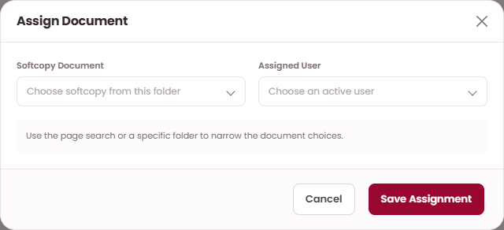
Open Document Assignments
ASSIGN DOCUMENTS DIRECTLY · STEP 1 OF 3
1
2
3
Document Assignments
›
Choose the tab
›
Assign Document
DO THIS
1
Open Document Assignments and choose the tab Hardcopy / Places or Softcopy / Categories.
2
2
Select Assign Document for one document, or use the Assign All panel for a whole Location / category.
3
The list shows Document, Assigned To and Updated. Filter with All Assigned Users.
WHAT HAPPENS NEXT
Continue with one document (next step) or a whole group (step 3).
WHO: Document Control Officer or Administrator (Assignment: Direct)

Slide 130
Assign one document
ASSIGN DOCUMENTS DIRECTLY · STEP 2 OF 3
1
2
3
Assign Document
×
Select Assign Document, fill in both fields, then Save Assignment › Confirm.
1
Hardcopy Document
# | Field / button | What to enter or check | Rule
1 | Hardcopy / Softcopy Document | The document to assign (softcopies show “Number · Title”). | Required
2 | Assigned User | An active user. | Required
3 | Save Assignment | Confirm the action. | Button
Choose hardcopy from this folder
▾
2
Assigned User
Choose an active user
▾
Use the page search or a specific folder to narrow the document choices.
Cancel
3
Save Assignment
KEEP IN MIND
Hardcopy: the user becomes Current Holder; Location stays; no Dispatch / Accept is recorded. Softcopy: the user is added; other assignees stay.
WHAT HAPPENS NEXT
Read the result message and check the row in the list.
WHO: Document Control Officer or Administrator (Assignment: Direct)

Slide 131
Assign a whole Location or category
ASSIGN DOCUMENTS DIRECTLY · STEP 3 OF 3
1
2
3
Assign All
×
Use the Assign All panel on the tab, then Confirm.
1
# | Field / button | What to enter or check | Rule
1 | Location / Category / Subcategory | Hardcopy: every Active hardcopy at that Location. Softcopy: every Active softcopy in the category and its subcategories. | Required
2 | Assigned User | An active user. | Required
3 | Assign All | Confirm. Up to 2,000 records at once. | Button
Location
Choose Location
▾
2
Assigned User
Choose active user
▾
Softcopy tab: Category / Subcategory + Assigned User.
3
Assign All
KEEP IN MIND
Hardcopies with a handoff For Transfer or In Transit cannot be reassigned until the transfer finishes.
WHO: Document Control Officer or Administrator (Assignment: Direct)

Slide 132
Dispose of a document directly
DOCUMENT CONTROL ACTIONS · TASK OVERVIEW
Mark a Hardcopy, Softcopy or External document as Disposed immediately, without a request.
WHO CAN DO THIS
STEP BY STEP
Document Control Officer or Administrator (register Direct + Disposal: Direct)
1
Select Dispose on the document
slide 133
2
Choose the reason and continue
slide 134
BEFORE YOU START
The document is Active and you may manage it.
Result: The document is Disposed and its disposal history is saved.
✓
WHERE TO START
The register › Dispose on the row.
WHO: Document Control Officer or Administrator (register Direct + Disposal: Direct)

Slide 133
Select Dispose on the document
DISPOSE OF A DOCUMENT DIRECTLY · STEP 1 OF 2
1
2
DO THIS
1
Open the register (Hardcopy, Softcopy or External Documents).
1
2
Search for the document and check it is the right one (Status Active).
2
3
Select Dispose on its row.
3
KEEP IN MIND
No Dispose button: the document is not Active, or your role lacks the register’s Direct permission or Disposal: Direct.
WHAT HAPPENS NEXT
The Dispose window opens (next step).
WHO: Document Control Officer or Administrator (register Direct + Disposal: Direct)

Slide 134
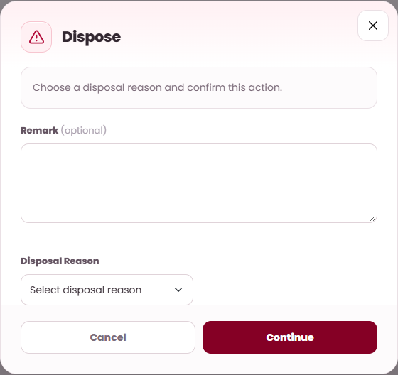
Choose the reason and continue
DISPOSE OF A DOCUMENT DIRECTLY · STEP 2 OF 2
1
2
Find the Active document and select Dispose on its row. The Dispose window opens.
1
# | Field / button | What to enter or check | Rule
1 | Message | “Choose a disposal reason and confirm this action.” | Shown
2 | Remark | Any note about the disposal. | Optional
3 | Disposal Reason | Shred, Scratch or Other. | Required
4 | Other Reason | Appears for Other: describe the method (up to 250 characters). | If Other
5 | Continue | Records the disposal. This is the confirmation. | Button
2
3
KEEP IN MIND
5
Follow your physical disposal procedure as well. Disposed softcopy and external files can no longer be downloaded normally.
WHAT HAPPENS NEXT
Status Disposed at once. Find it with All Statuses › Disposed; View › Disposal Details shows the record.
WHO: Document Control Officer or Administrator (register Direct + Disposal: Direct)

Slide 135
Permanently delete a disposed document
DOCUMENT CONTROL ACTIONS · TASK OVERVIEW
Hard Delete erases a disposed document, its files and related records for good. It cannot be undone.
WHO CAN DO THIS
STEP BY STEP
Administrator, or a role given Documents: Hard Delete
1
Find the disposed document
slide 136
2
Type DELETE and your password
slide 137
BEFORE YOU START
The document is already Disposed.
A recent backup (Backup & Restore › Backup now).
Your own password.
Result: The document no longer exists; the audit trail keeps a record that it was deleted.
✓
WHERE TO START
The register › All Statuses › Disposed › Hard Delete on the row.
WHO: Administrator, or a role given Documents: Hard Delete

Slide 136
Find the disposed document
PERMANENTLY DELETE A DISPOSED DOCUMENT · STEP 1 OF 2
1
2
DO THIS
1
Set All Statuses to Disposed.
2
Search for the document and open View to be sure it is the right one.
2
1
3
Use the row buttons: on a Disposed row you see Hard Delete (the example shows Active rows, which never have it). Select it.
3
IMPORTANT
Make a backup first: Backup & Restore › Backup now. A hard delete cannot be undone.
WHAT HAPPENS NEXT
The Hard Delete window asks for confirmation (next step).
WHO: Administrator, or a role given Documents: Hard Delete

Slide 137
Type DELETE and your password
PERMANENTLY DELETE A DISPOSED DOCUMENT · STEP 2 OF 2
1
2
Hard Delete
×
Filter Disposed, then select Hard Delete on the row.
1
# | Field / button | What to enter or check | Rule
1 | Warning | Read it. Make a backup first if you have not. | Shown
2 | Type DELETE to confirm | Type DELETE in capitals. | Required
3 | Your password | Your own sign-in password. | Required
4 | Continue | Deletes the document. | Button
This permanently deletes the disposed document, its files and related records. It cannot be undone.
This permanently erases the document, its files and records. Recommended: download a full backup first (Administration > Backups).
2
Type DELETE to confirm
3
Your password
Cancel
4
Continue
IMPORTANT
If DELETE or the password is wrong you see “Not deleted: type DELETE and enter your correct password.” and nothing is removed.
WHAT HAPPENS NEXT
“Document permanently deleted.” The record disappears from the register.
WHO: Administrator, or a role given Documents: Hard Delete

Slide 138
Master Data — setup lists
09
IN THIS SECTION
Set up storage places
139
Set up categories and subsidiaries
143
Maintain the storage places, categories and subsidiaries that every form offers. For document controllers and administrators.

Slide 139
Set up storage places
MASTER DATA — SETUP LISTS · TASK OVERVIEW
Hardcopies are stored by Area › Specific › optional Asset › Location. Create them in that order.
WHO CAN DO THIS
STEP BY STEP
Document Control Officer or Administrator (Areas, Specifics, Assets, Locations)
1
Add an Area, a Specific and an Asset
slide 140
2
Add a Location
slide 141
BEFORE YOU START
The names of your rooms, cabinets, asset numbers and exact places.
3
Correct or retire an entry
slide 142
✓
Result: The new places are offered in hardcopy and transfer forms.
WHERE TO START
Left menu › Master Data › tabs Area, Specific, Asset, Location.
WHO: Document Control Officer or Administrator (Areas, Specifics, Assets, Locations)

Slide 140
Add an Area, a Specific and an Asset
SET UP STORAGE PLACES · STEP 1 OF 3
1
2
3
On each tab select Add Areas, Add Specifics or Add Assets, fill in the window, keep Active ticked, then Save Record › Confirm “Save these changes?”.
1
Area
2
Specific
3
Asset
Name — e.g. ADMIN OFFICE, PRODUCTION OFFICE.
Active — ticked.
Name — e.g. PM’S FILE ORGANIZER.
Area Id — choose the Area it is in.
Active — ticked.
Asset Number — e.g. PK-PNK-00106945.
Specifics — tick every Specific this Asset Number is used under. One Asset Number is a single record, however many Specifics it is linked to.
WHAT HAPPENS NEXT
Then add the Locations inside them (next step).
WHO: Document Control Officer or Administrator (Areas, Specifics, Assets, Locations)

Slide 141
Add a Location
SET UP STORAGE PLACES · STEP 2 OF 3
1
2
3
Add Locations
×
On the Location tab select Add Locations.
# | Field / button | What to enter or check | Rule
1 | Location Name | e.g. “Location A” or a shelf code. | Required
2 | Area | Choose the Area. | Required
3 | Specific | Choose a Specific of that Area. | Required
4 | Asset Number | Can be empty: “No asset / not assigned”. | Optional
5 | Archive Date | Date the place is archived, if any. | Optional
6 | Save Record | Confirm “Save these changes?”. | Button
Location details
Name the Location and set its order within the selected Specific.
1
Location Name
e.g. Location A
2
Area
3
Specific
No area
▾
No specific
▾
4
Asset Number (optional — can be empty)
5
Archive Date (optional)
No asset / not assigned
▾
mm/dd/yyyy
▦
A Location can be saved without an Asset Number.
✓
Active
Cancel
6
Save Record
KEEP IN MIND
A Location has no Sequence: each hardcopy document has its own Sequence.
WHAT HAPPENS NEXT
The Location appears in hardcopy and transfer forms under its Area and Specific.
WHO: Document Control Officer or Administrator (Areas, Specifics, Assets, Locations)

Slide 142
Correct or retire an entry
SET UP STORAGE PLACES · STEP 3 OF 3
1
2
3
Master Data
›
Tab
›
Edit or Deactivate
DO THIS
1
Search or filter the tab (All Statuses: Active / Inactive; All Parent Folders for categories).
Deactivate
×
2
Select Edit, correct the entry, Save Record › Confirm.
Deactivate this reference item without deleting historical links.
3
Select Deactivate to stop offering it in new forms. Confirm “Deactivate this reference item without deleting historical links.”
Cancel
3
Confirm
KEEP IN MIND
Deactivation keeps past links. If a warning mentions linked records, resolve them first and try again.
WHAT HAPPENS NEXT
Inactive entries stay visible with the Inactive filter but are no longer offered in forms.
WHO: Document Control Officer or Administrator (Areas, Specifics, Assets, Locations)

Slide 143
Set up categories and subsidiaries
MASTER DATA — SETUP LISTS · TASK OVERVIEW
Softcopy categories also control document numbering. External categories and subsidiaries organise external documents.
WHO CAN DO THIS
STEP BY STEP
Document Control Officer or Administrator (Categories, External Categories, Subsidiaries)
1
Add a Softcopy Category
slide 144
2
Add External Categories and Subsidiaries
slide 145
BEFORE YOU START
Your numbering scheme, e.g. FS&Q-QC-001.
Result: New documents can use the categories and number correctly.
✓
WHERE TO START
Master Data › Softcopy Categories, External Categories, Subsidiary Setup.
WHO: Document Control Officer or Administrator (Categories, External Categories, Subsidiaries)

Slide 144
Add a Softcopy Category
SET UP CATEGORIES AND SUBSIDIARIES · STEP 1 OF 2
1
2
Add Softcopy Categories
×
# | Field / button | What to enter or check | Rule
1 | Name | Category name shown in forms. | Required
2 | Category Type | Document Number Pattern (documents get numbers) or Folder (only groups other categories). | Required
3 | Folder | Folder name used in Folder view. | Required
4 | Document No. Code Pattern | Pattern types only, e.g. PPM-001. The number after the last dash counts up: PPM-001 › PPM-002. | Pattern only
5 | Description | What belongs here. | Optional
6 | Parent Folder | A Folder category to nest under, or “No parent (root)”. | Optional
7 | Save Record | Confirm “Save these changes?”. | Button
1
Name
2
Category Type
Quality Control
Document Number Pattern
▾
3
Folder
4
Document No. Code Pattern
Quality Control
FS&Q-QC-001
5
Description
6
Parent Folder (optional)
Food Safety Quality (Folder)
▾
✓
Active
Cancel
7
Save Record
KEEP IN MIND
A category cannot be its own parent or sit inside one of its own subcategories. Series patterns are set per Document No. in the softcopy form, not here.
WHO: Document Control Officer or Administrator (Categories, External Categories, Subsidiaries)

Slide 145
Add External Categories and Subsidiaries
SET UP CATEGORIES AND SUBSIDIARIES · STEP 2 OF 2
1
2
1
External Categories › Add External Categories
2
Subsidiary Setup › Add Subsidiaries
Name — e.g. Memorandum.
Folder — folder name.
Description — optional.
Parent Id — optional parent category.
Active — ticked. Then Save Record › Confirm.
External categories have no number pattern.
Name — the subsidiary / company name.
Active — ticked. Then Save Record › Confirm.
Subsidiaries appear in the optional Subsidiary field of external document forms.
WHAT HAPPENS NEXT
New entries are offered immediately in External Documents forms and filters.
WHO: Document Control Officer or Administrator (Categories, External Categories, Subsidiaries)

Slide 146
System administration
10
IN THIS SECTION
Add a user account
147
Manage roles and permissions
151
Change an approval route
154
Review the audit trail
158
Back up and restore
159
Accounts, roles, approval routes, the audit trail and backups. For administrators.

Slide 147
Add a user account
SYSTEM ADMINISTRATION · TASK OVERVIEW
Every person needs their own account so the history shows who did what.
WHO CAN DO THIS
STEP BY STEP
Administrator (or a role given these permissions) (Users: Add)
1
Fill in the user details
slide 148
2
Hand over the temporary password
slide 149
BEFORE YOU START
Full name, username, position, role(s) and leader.
3
Reset a password, check documents or deactivate
slide 150
✓
Result: The person can sign in with a temporary password and must set their own.
WHERE TO START
Left menu › User Management › Add User.
WHO: Administrator (or a role given these permissions) (Users: Add)

Slide 148
Fill in the user details
ADD A USER ACCOUNT · STEP 1 OF 3
1
2
3
User
×
# | Field / button | What to enter or check | Rule
1 | First / Middle / Last Name | The person’s name as it should appear in history. | Required
2 | Username | What they type to sign in. Must be unique. | Required
3 | Position Title | Shown next to their name in approvals. | Required
4 | Primary role | Main role: Administrator, Document Control Officer, Plant Manager, Internal Auditor or Staff. | Required
5 | Leader | Their supervisor. Becomes the Noted By / Requester Approval approver. | Optional
6 | Assigned roles | Extra roles. All active roles add up. | Optional
7 | Active account | Keep ticked so they can sign in. | Required
8 | Save User | Confirm to create the account. | Button
1
First Name
1
Middle Name
1
Last Name
2
Username
3
Position Title
4
Primary role
Staff
▾
5
Leader (optional)
No leader
▾
6
Assigned roles
☐ Administrator ☐ Document Control Officer ☐ Plant Manager ☐ Internal Auditor ☑ Staff
7
✓
Active account
Cancel
8
Save User
WHO: Administrator (or a role given these permissions) (Users: Add)

Slide 149
Hand over the temporary password
ADD A USER ACCOUNT · STEP 2 OF 3
1
2
3
Temporary account credentials
×
DO THIS
1
Note the Username.
Give these credentials to the account owner through your approved private channel. This password is displayed only once.
2
Copy the Temporary password now — it is shown only once.
1
Username
3
Select Return to User Management. Give the details to the person privately.
jdelacruz
2
Temporary password
••••••••••••
The user must replace this password before accessing any protected module.
3
Return to User Management
WHAT HAPPENS NEXT
At first sign-in the person must set a permanent password (see Sign in for the first time).
WHO: Administrator (or a role given these permissions) (Users: Add)

Slide 150
Reset a password, check documents or deactivate
ADD A USER ACCOUNT · STEP 3 OF 3
1
2
3
1
Reset a password
2
See assigned documents
3
Deactivate
Edit the user › tick Generate a new temporary password for this existing account › Save User › Confirm.
A new temporary password is shown once.
Select Assigned Documents on the user’s row to list what they hold or are assigned — useful before someone leaves.
Select Deactivate › Confirm “Disable this user while preserving related history.”
You cannot deactivate yourself or the last active Administrator.
WHAT HAPPENS NEXT
Deactivated users cannot sign in, but their names stay in history. Filter Inactive to find them.
WHO: Administrator (or a role given these permissions) (Users: Add)

Slide 151
Manage roles and permissions
SYSTEM ADMINISTRATION · TASK OVERVIEW
A role is a set of permissions. Menus and buttons appear only when one of the user’s roles allows them.
WHO CAN DO THIS
STEP BY STEP
Administrator (or a role given these permissions) (Roles: Add / Edit)
1
Create or edit a role
slide 152
2
What the main permissions allow
slide 153
BEFORE YOU START
Which actions the role should allow.
Result: Users with the role get exactly those menus and buttons.
✓
WHERE TO START
Left menu › Roles & Permissions › Add Role or Edit.
WHO: Administrator (or a role given these permissions) (Roles: Add / Edit)

Slide 152
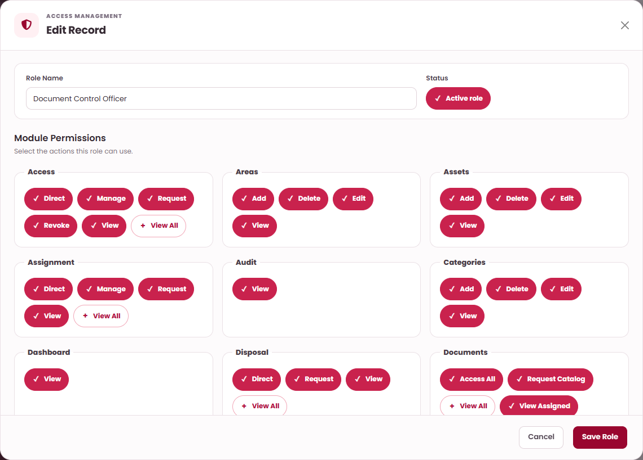
Create or edit a role
MANAGE ROLES AND PERMISSIONS · STEP 1 OF 2
1
2
DO THIS
1
Enter Role Name and keep Active role on.
1
2
Under Module Permissions select each action this role can use (next slide explains them).
2
3
Select Save Role › Confirm.
KEEP IN MIND
The Administrator role is protected. A role name alone receives no approval tasks — a Workflow step must name the role.
3
WHAT HAPPENS NEXT
Check users’ Primary role / Assigned roles in User Management. Unused roles can be Deactivated or Removed.
WHO: Administrator (or a role given these permissions) (Roles: Add / Edit)

Slide 153
What the main permissions allow
MANAGE ROLES AND PERMISSIONS · STEP 2 OF 2
1
2
Module | Actions you can tick | What they unlock
Hardcopy / Softcopy / External Documents | View, Request, Direct | See the register · make requests · Add / Edit / Approve Directly
Documents | Access All, View Assigned, View Granted, View All, Request Catalog, Hard Delete | Which documents are visible · permanent deletion of disposed documents
Files | View, View All, Upload, Approve, Generate, File History, Print, Download, Download Locked Files | Preview, upload, history and download, including locked files
Requests | View, Add, Edit, Submit, Cancel, Manage, View All | My Requests: New Request, Edit, Submit, Cancel / Delete
Transfer / Access / Assignment / Disposal | View, View All, Request, Manage, Direct (+ Revoke for Access) | Request types and direct actions (e.g. Assignment: Direct = Document Assignments page)
Workflows | View, Edit, Reassign | Workflow Builder
Areas, Specifics, Assets, Locations, Categories, External Categories, Subsidiaries | View, Add, Edit, Delete | Master Data tabs (Delete = Deactivate)
Users, Roles, Permissions | View, Add, Edit, Delete | User Management and Roles & Permissions
Audit · Settings · Notifications · Dashboard | View (Edit) | Internal Audit Trail, Backup & Restore, notifications, Overview
WHO: Administrator (or a role given these permissions) (Roles: Add / Edit)

Slide 154
Change an approval route
SYSTEM ADMINISTRATION · TASK OVERVIEW
Each request type has a published route. You edit a draft copy and publish it; only new submissions use it.
WHO CAN DO THIS
STEP BY STEP
Administrator (or a role given these permissions) (Workflows: Edit)
1
Open the workflow and create a draft
slide 155
2
Add or edit an approval step
slide 156
BEFORE YOU START
The steps and approvers you want, in order.
3
Set the special steps and publish
slide 157
WHERE TO START
✓
Result: New requests of that type follow the published route.
Left menu › Workflow Builder › Step Actions on the workflow.
WHO: Administrator (or a role given these permissions) (Workflows: Edit)

Slide 155
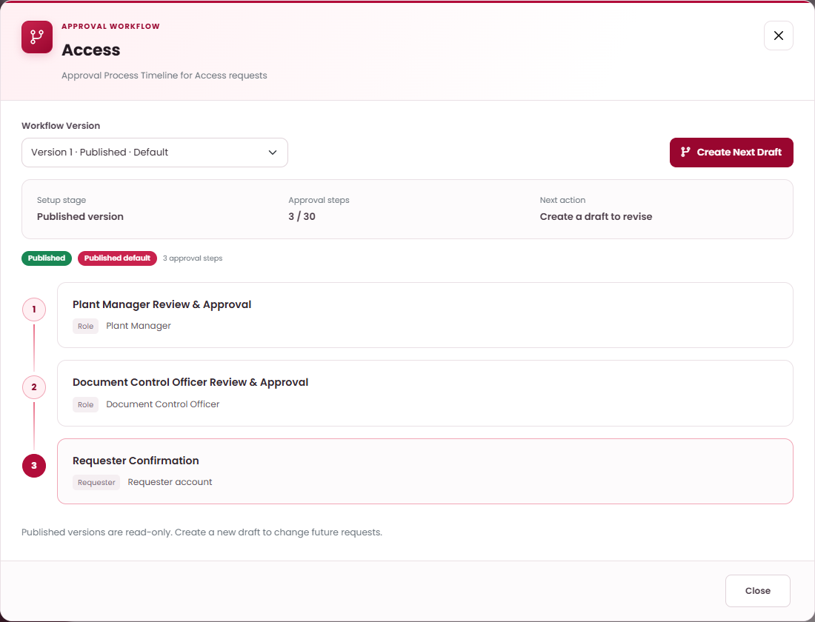
Open the workflow and create a draft
CHANGE AN APPROVAL ROUTE · STEP 1 OF 3
1
2
3
DO THIS
1
In the list (Workflow, Request Type, Current Version, Publication, Steps) select Step Actions.
2
2
Check the Workflow Version list.
3
Select Create Next Draft (or Start First Draft if none exists). Published versions are read-only.
WHAT HAPPENS NEXT
The draft opens with a copy of the steps. Edit them (next step).
WHO: Administrator (or a role given these permissions) (Workflows: Edit)

Slide 156
Add or edit an approval step
CHANGE AN APPROVAL ROUTE · STEP 2 OF 3
1
2
3
Approval Step
×
Select Add Approval Step, or Edit on a step.
1
# | Field / button | What to enter or check | Rule
1 | Approval Step Name | Name shown in timelines, e.g. “Plant Manager Approval”. | Required
2 | Approver Type | Any active member of role, Specific user, Requester’s leader or Requester account. | Required
3 | Approver Role / Specific Approver | Shown for role or user types: choose who decides. | If shown
4 | Save Step | Adds or updates the step in the draft. | Button
Approval Step Name
e.g. Supervisor Review
2
Approver Type
Any active member of role
▾
3
Approver Role
Select role
▾
Requester and requester’s leader are resolved when the request is submitted.
Cancel
4
Save Step
WHAT HAPPENS NEXT
Use the arrows to move steps up or down and the remove button to delete a step.
WHO: Administrator (or a role given these permissions) (Workflows: Edit)

Slide 157
Set the special steps and publish
CHANGE AN APPROVAL ROUTE · STEP 3 OF 3
1
2
3
Draft
›
Save Approver
›
Validate & Publish
DO THIS
1
Softcopy / External: choose the Document-locking approver › Save Approver. Only that step’s approval locks Excel, PDF or Word attachments.
Softcopy Request — Draft version
×
2
Softcopy create / revise: choose the Final-file approver (uploads the final controlled file). It must come after the locking step.
1
Document-locking approver
Plant Manager Review & Approval — Plant Manager
▾
Only this step’s approval locks eligible Excel, PDF, or Word attachments. Later workflow steps continue normally.
3
Check the order (1 to 30 steps, active approvers) and select Validate & Publish › Confirm.
2
Final-file approver (uploads the final controlled file)
Document Control Officer Review & Approval — Document Control Officer
▾
Save Approver
KEEP IN MIND
3
Validate & Publish
Submitted and Returned requests keep the route they started with.
WHAT HAPPENS NEXT
The new version becomes the default for new submissions.
WHO: Administrator (or a role given these permissions) (Workflows: Edit)

Slide 158
Review the Internal Audit Trail
SYSTEM ADMINISTRATION
Activity Record
×
Open Internal Audit Trail. Columns: Recorded At, User, What Happened, Result.
3
What Happened
# | Field / button | What to enter or check | Rule
1 | Search & filters | Search, then All Results / Done / Not completed and the date filter. | Optional
2 | View | Opens the Activity Record window for one event. | Button
3 | What Happened | Plain description, who did it, when and the result. | Shown
4 | Technical Details | Raw data for IT support. | Shown
What happened
Approved softcopy request DEMO-2026-002
Who
Plant Manager name
When
2026-11-12 10:41:10
Result
Done
4
Technical Details (for IT only)
Close
KEEP IN MIND
The audit trail is read-only. Correct records on their own pages.
WHO: Administrator, Internal Auditor, Document Control Officer (Audit: View)

Slide 159
Back up and restore
SYSTEM ADMINISTRATION · TASK OVERVIEW
Backups protect all records and private files. Restore replaces everything — use it only for recovery.
WHO CAN DO THIS
STEP BY STEP
Administrator (or a role given these permissions) (Settings: View / Edit)
1
Create, import, clean up and download backups
slide 160
2
Restore system data
slide 161
BEFORE YOU START
For restore: your password and agreement on the timing with affected users.
Result: A fresh backup exists, or the system is restored from a chosen backup.
✓
WHERE TO START
Left menu › Backup & Restore.
WHO: Administrator (or a role given these permissions) (Settings: View / Edit)

Slide 160
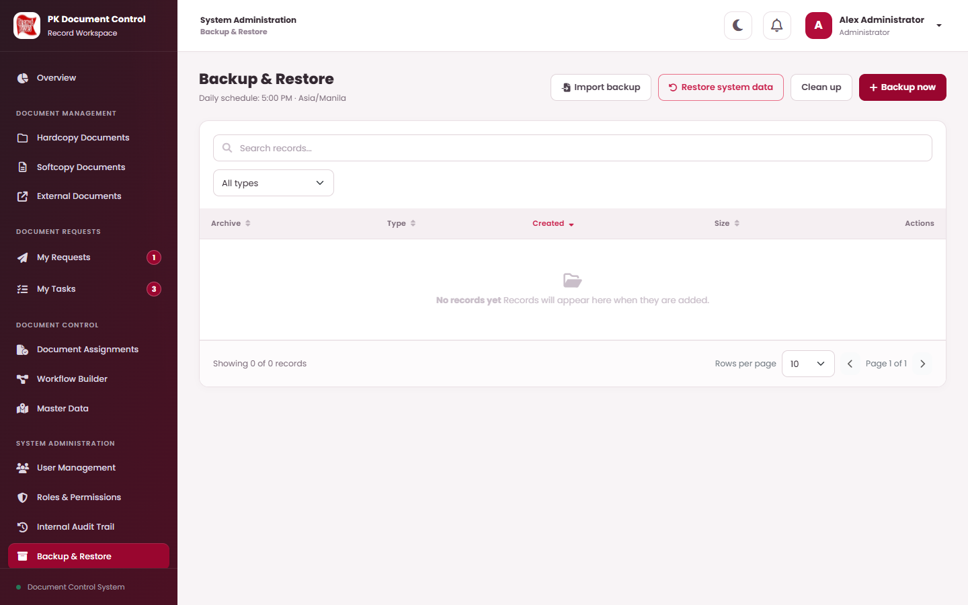
Create, import, clean up and download backups
BACK UP AND RESTORE · STEP 1 OF 2
1
2
DO THIS
2
3
1
1
Backup now › Confirm. Wait for the result; the archive appears in the list.
2
Import backup › choose a Backup ZIP › Import backup › Confirm. It is checked before being stored.
3
Clean up › Confirm removes eligible backups, audit and log archives older than three months.
4
In the list (Archive, Type, Created, Size) filter Manual / Automatic / Recovery and select Download to save a copy.
KEEP IN MIND
The daily schedule is 5:00 PM Asia/Manila. Check Last automatic backup. “Backup setup is incomplete” means automatic backups are not running.
WHO: Administrator (or a role given these permissions) (Settings: View / Edit)

Slide 161
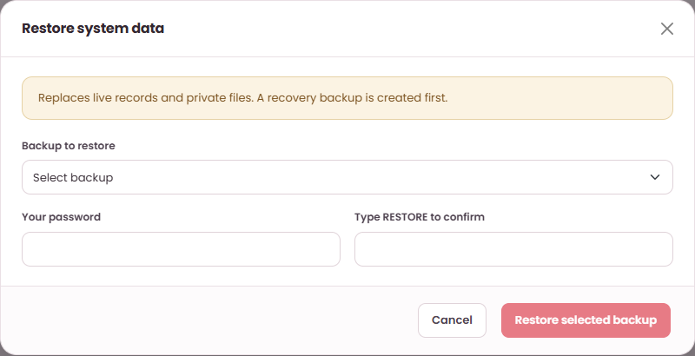
Restore system data
BACK UP AND RESTORE · STEP 2 OF 2
1
2
Select Restore system data. “Replaces live records and private files. A recovery backup is created first.”
# | Field / button | What to enter or check | Rule
1 | Backup to restore | Choose the archive. Check its name and date carefully. | Required
2 | Your password | Your own sign-in password. | Required
3 | Type RESTORE to confirm | Type RESTORE in capitals. | Required
4 | Restore selected backup | Then read the warning and Confirm. | Button
1
2
3
IMPORTANT
Restore affects every user. Follow your recovery procedure and agree the timing first.
WHAT HAPPENS NEXT
A recovery backup is made, then the chosen backup replaces the data. You are signed out — sign in again and check the records and files.
WHO: Administrator (or a role given these permissions) (Settings: View / Edit)

Slide 162
Help and reference
11
IN THIS SECTION
Solve common problems
163
Statuses and terms
164
Quick answers to common problems, and the words PK DTS uses.

Slide 163
If something does not work
HELP AND REFERENCE
What you see | Check this first | Then
A menu or button is missing | The record’s status (only Active records can be edited) and whether a file is locked. | Ask the Administrator to check your roles and permissions.
A document seems missing | Select Clear, set All Statuses, try Table view and search by number. | Request access with a Document Access Request.
Upload failed | File type (PDF, TXT, PNG, JPG/JPEG, DOCX, XLSX; external: PDF or image) and the 15 MB limit. | Attach the corrected file again.
Submit failed | Required fields and the attachment. An unfinished request for the same document may block it. | Ask the Administrator to check the route has active approvers.
“Action could not be completed” | Read the full message. If the record changed elsewhere, refresh and check it. | Repeat only the changes still needed.
Number preview blank | The category is a Document Number Pattern and has a code pattern. | Ask a controller to check the category or series setup.
Preview does not load | Close View Details and open it again. Word/Excel need a few seconds the first time. | Ask document control to check the file.
Access expired | The approved expiry date has passed. | Submit a new Document Access Request.
GOOD TO KNOW
When asking for help give: the document or request reference, what you did, the time, and the exact message. Never share your password.
WHO: Everyone

Slide 164
Request and document statuses
HELP AND REFERENCE
Status | Where | Meaning | What you can do
Draft | Request | Saved, not submitted. Nothing has changed yet. | Edit, Submit, Cancel
In progress / Awaiting … | Request | Submitted; waiting for the named approver. | View and follow the timeline
Pending your approval: … | Task | It is your turn to decide. | Approve, Return, Reject
Returned | Request | Sent back to you for correction. | Edit and Submit again
Approved | Request | Transfer approved; waiting for Dispatch and Accept. | Dispatch (requester), Accept (receiver)
Completed | Request | All steps done; the change is applied. | View
Rejected | Request | Closed by an approver; nothing changed. | Create a new request if needed
Cancelled | Request / Document | Draft cancelled, or document cancelled. | Delete (own never-submitted draft)
Active | Document | In use and current. | View, request, edit (with permission)
Disposed | Document | Disposal recorded; normal file downloads stop. | View; Hard Delete (permission)
For Transfer / In Transit / Accepted | Handoff | Approved transfer › dispatched › received. | Dispatch › Accept
WHO: Everyone

Slide 165
Words used in PK DTS
HELP AND REFERENCE
Term | Meaning
Hardcopy | A paper document, tracked by its storage place and Current Holder. No file is attached.
Softcopy | A controlled electronic document with a number, revision level and approved file.
External document | A scanned document received from outside, kept as a backup copy with its own categories.
Register | The list where you find and manage one type of document.
Direct action | A change applied at once by an authorized controller (Approve Directly, Save Directly, Save Document, Dispose).
Request | A proposed change that takes effect only after its approval route is complete.
Approval route / workflow | The ordered steps and approvers a request must pass.
Requester’s leader | The Leader set on the requester’s user account.
Locked file | A read-only attachment after the locking approver’s approval.
Final file | The controlled file uploaded by the Document Control Officer at the final-file step.
Retention | The keep-until period of a hardcopy, used for reminders only.
Sequence | A number that belongs to each hardcopy document (not to its Location).
WHO: Everyone

