Slide 1
PK DTS / REQUEST WORKFLOW
REQUEST WORKFLOW SERIES
PK DOCUMENT TRACKING SYSTEM
THREE PARTS
01
Meet the sample users and their roles
Request Workflow
02
Follow one softcopy request from start to finish
One request, from sign-in to final approval
Follow a softcopy request through every step with sample users and roles, then see the approval route of every request type.
03
See every request type and its approval route
WHAT YOU WILL SEE
Sign in
Follow the route
Check the result
Start as the requester.
Each approver acts in turn.
See the status and outcome.
PK DTS / REQUEST WORKFLOW / 11 NOVEMBER 2026
1 / 20
Notes:
Introduce the deck: it follows one softcopy request and then shows every request route.

Slide 2


PK DTS / REQUEST WORKFLOW
PART 1 / SAMPLE USERS
Meet the sample users
Five sample accounts play the roles used in every route. Your own people and routes come from Workflow Builder.
REQUESTER
REQUESTER'S LEADER
PLANT MANAGER
DOCUMENT CONTROL
READS ONLY
Sam Staff
Alex Administrator
Morgan Manager
Casey Controller
Avery Auditor
Staff
Administrator / Sam's leader
Plant Manager
Document Control Officer
Internal Auditor
Signs in, creates the request, saves the draft and submits it.
First reviewer ("Noted By"). Also confirms assignment requests as Sam's leader.
Second reviewer. In document requests, this approval locks the attached file.
Final reviewer. Approval creates or updates the document.
Reads documents, history and the audit trail. Does not approve requests.
HOW TO READ THIS PRESENTATION
Every person signs in with their own account and sees only what their role allows.
Only the person or role assigned to the current approval step can decide it. Administrator status gives no bypass.
The default document route is: Requester, Requester's leader, Plant Manager, Document Control Officer.
Other request types use Plant Manager, Document Control Officer, then a final confirmation by the requester or the requester's leader.
PK DTS / REQUEST WORKFLOW / 11 NOVEMBER 2026
2 / 20
Notes:
Sample users come from the documentation demonstration site. They are synthetic.

Slide 3
PK DTS / REQUEST WORKFLOW
PART 2 / ONE REQUEST START TO FINISH
The journey at a glance
A softcopy creation request: eight stations in order. The status shows where the request stands after each one.
1
2
3
4
Sign in
Start a request
Save a draft
Submit
Sam Staff
Sam Staff
Sam Staff
Sam Staff
Sam signs in with their own account.
My Requests, Softcopy Request, New Request.
Complete the form, attach the file, Save Draft.
Check View Details, then Submit and Confirm.
REQUEST STATUS
REQUEST STATUS
REQUEST STATUS
REQUEST STATUS
No request yet
No request yet
Draft
Submitted
5
6
7
8
Noted By
Plant Manager review
Final review
Result
Alex Administrator
Morgan Manager
Casey Controller
Sam Staff
Alex reviews and approves.
Morgan approves. The file is locked.
Casey approves.
Active document and file at revision 00.
REQUEST STATUS
REQUEST STATUS
REQUEST STATUS
REQUEST STATUS
Submitted
Submitted / file locked
Completed
Completed
If an approver returns the request it goes back one step (or to Sam at the first step). A rejection ends the route.
PK DTS / REQUEST WORKFLOW / 11 NOVEMBER 2026
3 / 20
Notes:
Walk the eight stations left to right, then continue on the second row.

Slide 4
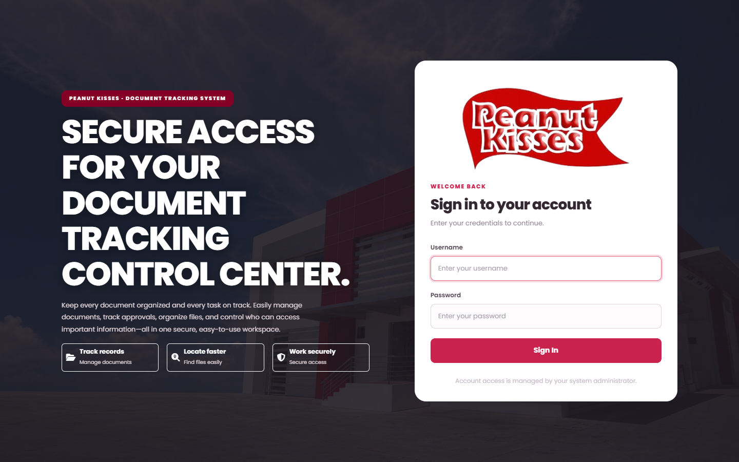
PK DTS / REQUEST WORKFLOW
PART 2 / ONE REQUEST START TO FINISH
Station 1: sign in as the requester
Sam Staff starts with their own account.
Sam Staff / Staff
REQUEST STATUS
No request yet
Acts in this station
Sign in using your own account.
FOLLOW THESE STEPS
1
Open PK DTS in the browser.
2
Enter Sam's Username and Password.
A
B
C
3
Select Sign In. Replace a temporary password first if asked.
A Username
B Password
C Sign In
The Overview page opens with totals and recent activity.
4
AFTER THIS
KEEP IN MIND
Sam is signed in as a Staff requester. The menus show only what the Staff role may use.
Each person uses their own account. If a menu or action is missing, the role does not have that permission.
PK DTS / REQUEST WORKFLOW / 11 NOVEMBER 2026
4 / 20
Notes:
Station 1: sign in as the requester: Open PK DTS in the browser. Enter Sam's Username and Password. Select Sign In. Replace a temporary password first if asked. The Overview page opens with totals and recent activity.

Slide 5
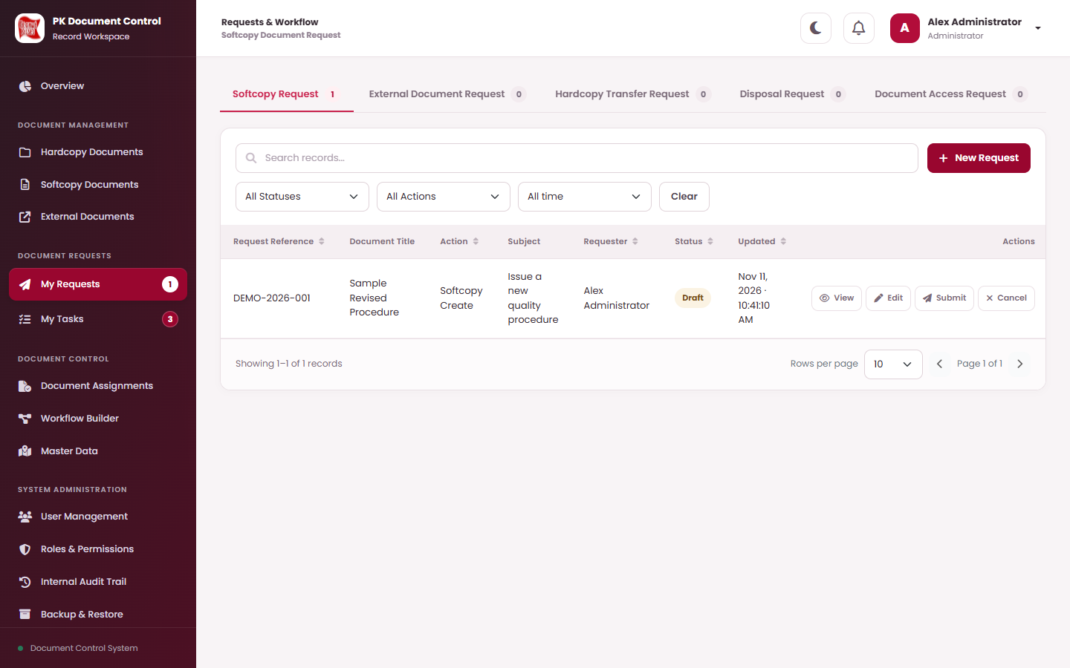
PK DTS / REQUEST WORKFLOW
PART 2 / ONE REQUEST START TO FINISH
Station 2: start a new request
Sam opens My Requests and chooses the Softcopy Request tab.
Sam Staff / Staff
REQUEST STATUS
No request yet
Acts in this station
My Requests lists your requests. Select New Request to start another.
FOLLOW THESE STEPS
1
Under Document Requests, open My Requests.
A
2
Choose the Softcopy Request tab.
3
Select New Request.
A New Request
The request form opens.
4
AFTER THIS
KEEP IN MIND
A blank New Request form is ready. Nothing is saved until Sam selects Save Draft.
Saving a draft does not change any document, holder, access or status. Only Submit sends it for approval.
PK DTS / REQUEST WORKFLOW / 11 NOVEMBER 2026
5 / 20
Notes:
Station 2: start a new request: Under Document Requests, open My Requests. Choose the Softcopy Request tab. Select New Request. The request form opens.

Slide 6
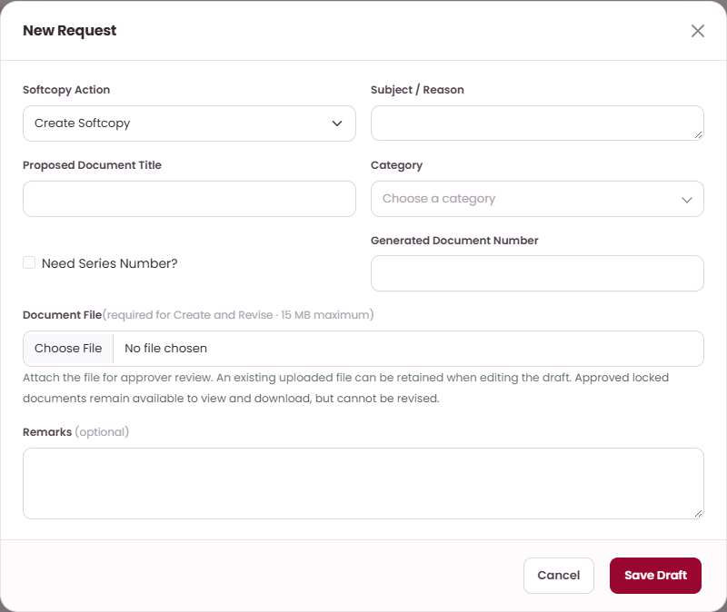
PK DTS / REQUEST WORKFLOW
PART 2 / ONE REQUEST START TO FINISH
Station 3: complete the form and save a draft
Sam describes the document and attaches the file.
Sam Staff / Staff
REQUEST STATUS
Draft
Acts in this station
Prepare a softcopy create request.
FOLLOW THESE STEPS
1
Choose Create Softcopy as the action.
A
B
2
Enter Subject / Reason and Proposed Document Title, then choose Category.
3
Check Generated Document Number. Attach the Document File (up to 15 MB).
C
A Action
B Document title
C Save
Add optional Remarks. Select Save Draft and Confirm.
4
AFTER THIS
KEEP IN MIND
The request is saved as a Draft with its own reference. Only Sam can edit it.
The final document number is assigned at final approval and may differ from the preview.
PK DTS / REQUEST WORKFLOW / 11 NOVEMBER 2026
6 / 20
Notes:
Station 3: complete the form and save a draft: Choose Create Softcopy as the action. Enter Subject / Reason and Proposed Document Title, then choose Category. Check Generated Document Number. Attach the Document File (up to 15 MB). Add optional Remarks. Select Save Draft and Confirm.

Slide 7
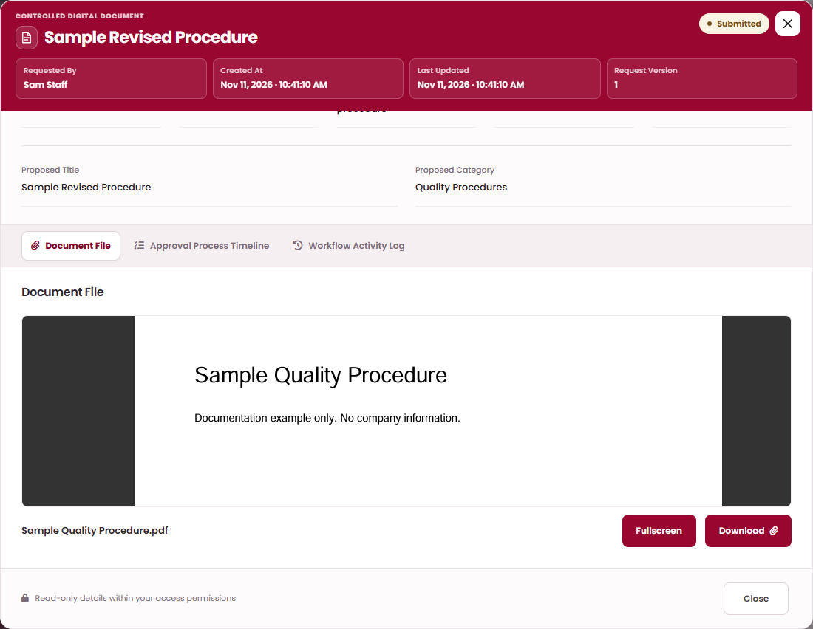
PK DTS / REQUEST WORKFLOW
PART 2 / ONE REQUEST START TO FINISH
Station 4: check the draft and submit
Sam previews the proposal and sends it into the approval route.
Sam Staff / Staff
REQUEST STATUS
Draft > Submitted
Acts in this station
View Details shows the proposal. The Document File tab previews the attachment.
FOLLOW THESE STEPS
1
In My Requests, select View on the draft.
A
2
Open the Document File tab and check the preview. Use Fullscreen to enlarge it.
B
C
3
Close View Details. Select Submit, then Continue and Confirm.
A Document File
B Fullscreen
C Download
The status changes to Submitted and the first approver is notified.
4
AFTER THIS
KEEP IN MIND
The request is Submitted. Sam can no longer edit or cancel it, but can follow it in My Requests.
The route is fixed at submission. If the request is returned and resubmitted, it keeps the original route.
PK DTS / REQUEST WORKFLOW / 11 NOVEMBER 2026
7 / 20
Notes:
Station 4: check the draft and submit: In My Requests, select View on the draft. Open the Document File tab and check the preview. Use Fullscreen to enlarge it. Close View Details. Select Submit, then Continue and Confirm. The status changes to Submitted and the first approver is notified.

Slide 8
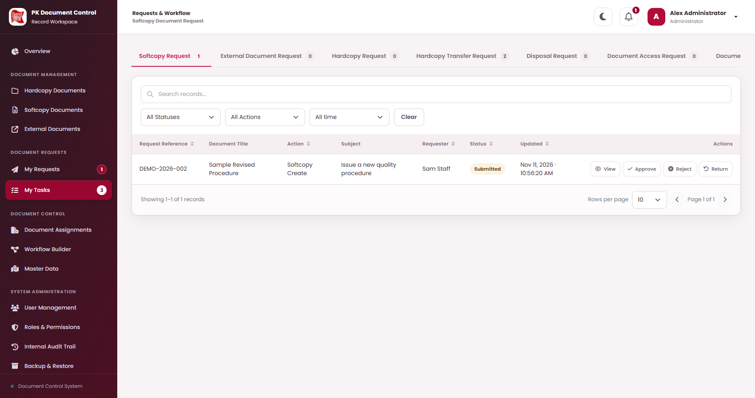
PK DTS / REQUEST WORKFLOW
PART 2 / ONE REQUEST START TO FINISH
Station 5: the requester's leader reviews (Noted By)
Alex sees the task in My Tasks and decides.
Alex Administrator / Administrator, Sam's leader
REQUEST STATUS
Submitted
Acts in this station
My Tasks shows the request assigned to Alex. Each row offers View, Approve, Reject and Return.
FOLLOW THESE STEPS
1
Open My Tasks and the Softcopy Request tab. A badge counts waiting tasks.
A
B
C
Select View. Check the proposal, the file preview and the timeline.
2
3
Choose Approve, Return or Reject. Add an optional remark.
A Approve
B Reject
C Return
Select Continue and Confirm.
4
AFTER THIS
KEEP IN MIND
Alex's approval moves the request to the Plant Manager. The status stays Submitted.
Only the assigned user or role can decide. A Return sends the request back to Sam to correct and resubmit.
PK DTS / REQUEST WORKFLOW / 11 NOVEMBER 2026
8 / 20
Notes:
Station 5: the requester's leader reviews (Noted By): Open My Tasks and the Softcopy Request tab. A badge counts waiting tasks. Select View. Check the proposal, the file preview and the timeline. Choose Approve, Return or Reject. Add an optional remark. Select Continue and Confirm.

Slide 9
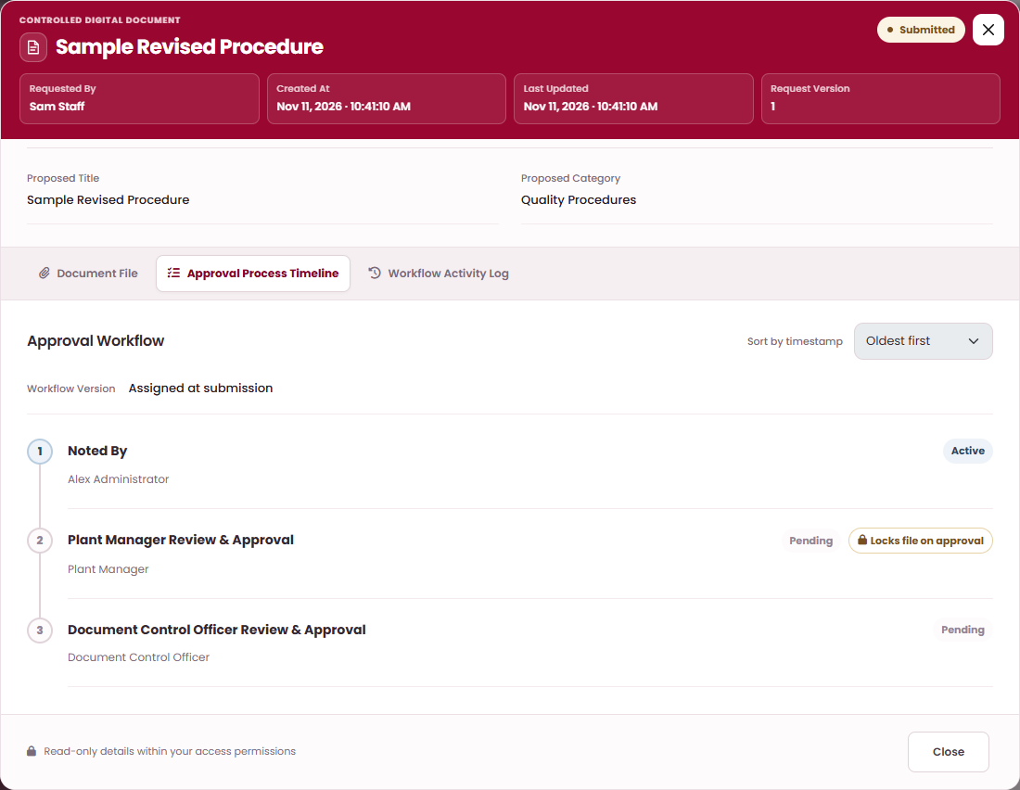
PK DTS / REQUEST WORKFLOW
PART 2 / ONE REQUEST START TO FINISH
Station 6: the Plant Manager approves and the file locks
Morgan reviews next. In this route, this approval locks the attachment.
Morgan Manager / Plant Manager
REQUEST STATUS
Submitted, file locked
Acts in this station
The Approval Process Timeline shows each step. A badge marks the step that locks the file.
FOLLOW THESE STEPS
1
Morgan opens My Tasks, then View on the request.
A
2
Open Approval Process Timeline. The step shows Locks file on approval.
B
3
Choose Approve, add a remark and Confirm.
A Approval Process Timeline
B Locks file on approval badge
The step shows Locked. The next reviewer is notified.
4
AFTER THIS
KEEP IN MIND
The attached file is locked as read-only. It can still be previewed; downloads are limited to roles with lock access.
A Return here goes back to Alex, the requester's leader. The status stays Submitted.
PK DTS / REQUEST WORKFLOW / 11 NOVEMBER 2026
9 / 20
Notes:
Station 6: the Plant Manager approves and the file locks: Morgan opens My Tasks, then View on the request. Open Approval Process Timeline. The step shows Locks file on approval. Choose Approve, add a remark and Confirm. The step shows Locked. The next reviewer is notified.

Slide 10
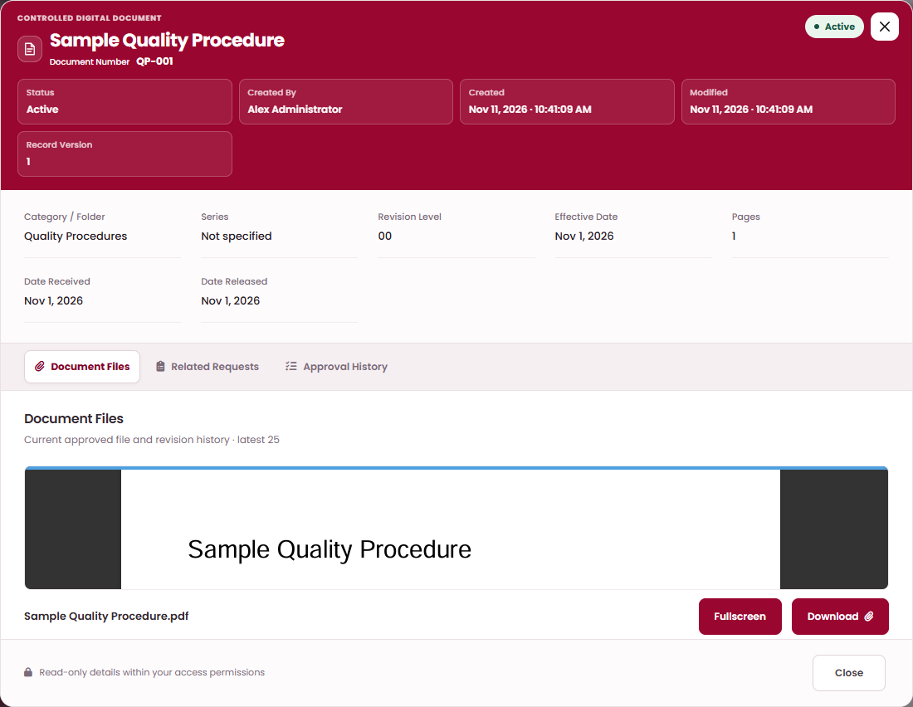
PK DTS / REQUEST WORKFLOW
PART 2 / ONE REQUEST START TO FINISH
Station 7: Document Control gives the final approval
Casey approves. The system applies the change.
Casey Controller / Document Control Officer
REQUEST STATUS
Completed
Acts in this station
The new Active document opens with its approved file on the Document Files tab.
FOLLOW THESE STEPS
1
Casey opens My Tasks, then View on the request.
2
Check the proposal, approval history and file preview.
3
Choose Approve and Confirm.
A
B
A Fullscreen
B Download
The Active record and file are created at revision 00.
4
AFTER THIS
KEEP IN MIND
The request is Completed. The document appears in Softcopy Documents with its number and file.
Sam can check the Workflow Activity Log for every decision, remark and time. A rejection would have closed the request.
PK DTS / REQUEST WORKFLOW / 11 NOVEMBER 2026
10 / 20
Notes:
Station 7: Document Control gives the final approval: Casey opens My Tasks, then View on the request. Check the proposal, approval history and file preview. Choose Approve and Confirm. The Active record and file are created at revision 00.

Slide 11
PK DTS / REQUEST WORKFLOW
PART 3 / EVERY REQUEST TYPE
Every request on one page
Default routes with the sample users. All eight request types pass three approvals before the result is applied.
Request
Requester
Approval 1
Approval 2
Approval 3
When the last approver approves
Softcopy creation
Sam Staff
Alex Administrator
Morgan Manager
Casey Controller
Create the Active record and file at revision 00. Status: Completed.
Requester
Requester's leader
Plant Manager
Document Control Officer
Softcopy revision
Sam Staff
Alex Administrator
Morgan Manager
Casey Controller
Publish the next revision and replacement file. Status: Completed.
Requester
Requester's leader
Plant Manager
Document Control Officer
External document creation
Sam Staff
Alex Administrator
Morgan Manager
Casey Controller
Create the Active record and file at revision 00. Status: Completed.
Requester
Requester's leader
Plant Manager
Document Control Officer
External document revision
Sam Staff
Alex Administrator
Morgan Manager
Casey Controller
Publish the next revision and replacement file. Status: Completed.
Requester
Requester's leader
Plant Manager
Document Control Officer
Hardcopy transfer
Sam Staff
Morgan Manager
Casey Controller
Sam Staff
Status: Approved; handoff: For Transfer. Then Dispatch and Accept.
Requester
Plant Manager
Document Control Officer
Requester account
Document access
Sam Staff
Morgan Manager
Casey Controller
Sam Staff
Grant access through the approved expiry. Status: Completed.
Requester
Plant Manager
Document Control Officer
Requester account
Document assignment
Sam Staff
Morgan Manager
Casey Controller
Alex Administrator
Assign the softcopy or hardcopy to the requester. Status: Completed.
Requester
Plant Manager
Document Control Officer
Requester's leader
Disposal
Sam Staff
Morgan Manager
Casey Controller
Sam Staff
Mark the document Disposed and record it. Request status: Completed.
Requester
Plant Manager
Document Control Officer
Requester account
PK DTS / REQUEST WORKFLOW / 11 NOVEMBER 2026
11 / 20
Notes:
Each row is one request type; the names are the sample users.

Slide 12
PK DTS / REQUEST WORKFLOW
PART 3 / REQUEST 1 OF 8
Softcopy creation request
Sam asks for a new controlled document. Three reviewers approve it in turn.
Sam Staff
1
Alex Administrator
2
Morgan Manager
3
Casey Controller
4
Staff
Administrator, Sam's leader
Plant Manager
Document Control Officer
Prepare the proposal and Submit.
Noted By
Plant Manager Review & Approval
Document Control Officer Review & Approval
Draft, then Submitted
Submitted
Submitted, file locked
Completed
WHEN THE LAST APPROVER APPROVES
Create the Active record and file at revision 00. Status: Completed.
Approve
Return
Reject
Alex (Requester's leader) approves
Alex (Requester's leader) returns
Any assigned operator rejects
Plant Manager reviews next.
Requester corrects and resubmits. Status: Returned until resubmission.
Status: Rejected. The approval route ends.
Morgan (Plant Manager) approves
Morgan (Plant Manager) returns
Proposed change
Document Control Officer reviews next.
Requester's leader reviews again. Status stays Submitted.
Not applied. No new document is created.
Casey (Document Control Officer) approves
Casey (Document Control Officer) returns
Requester checks the result
Create the Active record and file at revision 00. Status: Completed.
Plant Manager reviews again. Status stays Submitted.
Read the decision and remarks. This request cannot be resubmitted.
This sample uses the supplied default. Check your Approval Process Timeline. Resubmission keeps the original route. Only the assigned user or role can decide; Administrator status gives no bypass.
PK DTS / REQUEST WORKFLOW / 11 NOVEMBER 2026
12 / 20
Notes:
Softcopy creation: Sam asks for a new controlled document. Three reviewers approve it in turn.

Slide 13
PK DTS / REQUEST WORKFLOW
PART 3 / REQUEST 2 OF 8
Softcopy revision request
Sam proposes a replacement file for an Active document. The document number is kept.
Sam Staff
1
Alex Administrator
2
Morgan Manager
3
Casey Controller
4
Staff
Administrator, Sam's leader
Plant Manager
Document Control Officer
Prepare the revision request and Submit.
Noted By
Plant Manager Review & Approval
Document Control Officer Review & Approval
Draft, then Submitted
Submitted
Submitted, file locked
Completed
WHEN THE LAST APPROVER APPROVES
Publish the next revision and replacement file. Status: Completed.
Approve
Return
Reject
Alex (Requester's leader) approves
Alex (Requester's leader) returns
Any assigned operator rejects
Plant Manager reviews next.
Requester corrects and resubmits. Status: Returned until resubmission.
Status: Rejected. The approval route ends.
Morgan (Plant Manager) approves
Morgan (Plant Manager) returns
Proposed change
Document Control Officer reviews next.
Requester's leader reviews again. Status stays Submitted.
Not applied. The current approved file and revision stay unchanged.
Casey (Document Control Officer) approves
Casey (Document Control Officer) returns
Requester checks the result
Publish the next revision and replacement file. Status: Completed.
Plant Manager reviews again. Status stays Submitted.
Read the decision and remarks. This request cannot be resubmitted.
This sample uses the supplied default. Check your Approval Process Timeline. Resubmission keeps the original route. Revision keeps the document number, category and series. The approved replacement becomes the current file.
PK DTS / REQUEST WORKFLOW / 11 NOVEMBER 2026
13 / 20
Notes:
Softcopy revision: Sam proposes a replacement file for an Active document. The document number is kept.

Slide 14
PK DTS / REQUEST WORKFLOW
PART 3 / REQUEST 3 OF 8
External document creation request
Sam registers a document received from outside the organization.
Sam Staff
1
Alex Administrator
2
Morgan Manager
3
Casey Controller
4
Staff
Administrator, Sam's leader
Plant Manager
Document Control Officer
Prepare the external creation request and Submit.
Noted By
Plant Manager Review & Approval
Document Control Officer Review & Approval
Draft, then Submitted
Submitted
Submitted, file locked
Completed
WHEN THE LAST APPROVER APPROVES
Create the Active record and file at revision 00. Status: Completed.
Approve
Return
Reject
Alex (Requester's leader) approves
Alex (Requester's leader) returns
Any assigned operator rejects
Plant Manager reviews next.
Requester corrects and resubmits. Status: Returned until resubmission.
Status: Rejected. The approval route ends.
Morgan (Plant Manager) approves
Morgan (Plant Manager) returns
Proposed change
Document Control Officer reviews next.
Requester's leader reviews again. Status stays Submitted.
Not applied. No new external document is created.
Casey (Document Control Officer) approves
Casey (Document Control Officer) returns
Requester checks the result
Create the Active record and file at revision 00. Status: Completed.
Plant Manager reviews again. Status stays Submitted.
Read the decision and remarks. This request cannot be resubmitted.
This sample uses the supplied default. Check your Approval Process Timeline. Resubmission keeps the original route. External Documents uses its own categories. The attached file becomes the current file after final approval.
PK DTS / REQUEST WORKFLOW / 11 NOVEMBER 2026
14 / 20
Notes:
External document creation: Sam registers a document received from outside the organization.

Slide 15
PK DTS / REQUEST WORKFLOW
PART 3 / REQUEST 4 OF 8
External document revision request
Sam proposes replacement attachments for an Active external document.
Sam Staff
1
Alex Administrator
2
Morgan Manager
3
Casey Controller
4
Staff
Administrator, Sam's leader
Plant Manager
Document Control Officer
Prepare the external revision request and Submit.
Noted By
Plant Manager Approval
Document Control Officer
Draft, then Submitted
Submitted
Submitted, file locked
Completed
WHEN THE LAST APPROVER APPROVES
Publish the next revision and replacement file. Status: Completed.
Approve
Return
Reject
Alex (Requester's leader) approves
Alex (Requester's leader) returns
Any assigned operator rejects
Plant Manager reviews next.
Requester corrects and resubmits. Status: Returned until resubmission.
Status: Rejected. The approval route ends.
Morgan (Plant Manager) approves
Morgan (Plant Manager) returns
Proposed change
Document Control Officer reviews next.
Requester's leader reviews again. Status stays Submitted.
Not applied. The current external file and revision stay unchanged.
Casey (Document Control Officer) approves
Casey (Document Control Officer) returns
Requester checks the result
Publish the next revision and replacement file. Status: Completed.
Plant Manager reviews again. Status stays Submitted.
Read the decision and remarks. This request cannot be resubmitted.
This sample uses the supplied default. Check your Approval Process Timeline. Resubmission keeps the original route. The approved replacement becomes the current Download file. External Documents has no separate File History action.
PK DTS / REQUEST WORKFLOW / 11 NOVEMBER 2026
15 / 20
Notes:
External document revision: Sam proposes replacement attachments for an Active external document.

Slide 16
PK DTS / REQUEST WORKFLOW
PART 3 / REQUEST 5 OF 8
Hardcopy transfer request
Sam asks to move a paper document. Approval prepares the handoff; Dispatch and Accept finish it.
Sam Staff
1
Morgan Manager
2
Casey Controller
3
Sam Staff
4
Handoff
5
Staff
Plant Manager
Document Control Officer
Staff (Requester account)
Sam Staff and the named receiver
Prepare the transfer request and Submit.
Plant Manager Approval
Document Control Officer Approval
Requester Confirmation
Sam dispatches the document. The named receiver accepts it. Holder and location change after Accept.
Draft, then Submitted
Submitted
Submitted
Approved, For Transfer
In Transit, then Accepted
WHEN THE LAST APPROVER APPROVES
Status: Approved; handoff: For Transfer. Then Dispatch and Accept.
Approve
Return
Reject
Morgan (Plant Manager) approves
Morgan (Plant Manager) returns
Any assigned operator rejects
Document Control Officer reviews next.
Requester corrects and resubmits. Status: Returned until resubmission.
Status: Rejected. The approval route ends.
Casey (Document Control Officer) approves
Casey (Document Control Officer) returns
Proposed change
Requester reviews next.
Plant Manager reviews again. Status stays Submitted.
No handoff is created. The current holder and location stay unchanged.
Sam (Requester) approves
Sam (Requester) returns
Requester checks the result
Status: Approved; handoff: For Transfer. Then Dispatch and Accept.
Document Control Officer reviews again. Status stays Submitted.
Read the decision and remarks. This request cannot be resubmitted.
This sample uses the supplied default. Check your Approval Process Timeline. Resubmission keeps the original route. Only the requester can Dispatch; only the named receiver can Accept. Holder and location change after Accept.
PK DTS / REQUEST WORKFLOW / 11 NOVEMBER 2026
16 / 20
Notes:
Hardcopy transfer: Sam asks to move a paper document. Approval prepares the handoff; Dispatch and Accept finish it.

Slide 17
PK DTS / REQUEST WORKFLOW
PART 3 / REQUEST 6 OF 8
Document access request
Sam asks for temporary access to a document. Sam gives the final confirmation.
Sam Staff
1
Morgan Manager
2
Casey Controller
3
Sam Staff
4
Staff
Plant Manager
Document Control Officer
Staff (Requester account)
Prepare the access request and Submit.
Plant Manager Approval
Document Control Officer
Requester Confirmation
Draft, then Submitted
Submitted
Submitted
Completed
WHEN THE LAST APPROVER APPROVES
Grant access through the approved expiry. Status: Completed.
Approve
Return
Reject
Morgan (Plant Manager) approves
Morgan (Plant Manager) returns
Any assigned operator rejects
Document Control Officer reviews next.
Requester corrects and resubmits. Status: Returned until resubmission.
Status: Rejected. The approval route ends.
Casey (Document Control Officer) approves
Casey (Document Control Officer) returns
Proposed change
Requester reviews next.
Plant Manager reviews again. Status stays Submitted.
No new access is granted. Existing permissions stay unchanged.
Sam (Requester) approves
Sam (Requester) returns
Requester checks the result
Grant access through the approved expiry. Status: Completed.
Document Control Officer reviews again. Status stays Submitted.
Read the decision and remarks. This request cannot be resubmitted.
This sample uses the supplied default. Check your Approval Process Timeline. Resubmission keeps the original route. Access is for the requester. The expiry must still be valid at final approval; document holder and location stay unchanged.
PK DTS / REQUEST WORKFLOW / 11 NOVEMBER 2026
17 / 20
Notes:
Document access: Sam asks for temporary access to a document. Sam gives the final confirmation.

Slide 18
PK DTS / REQUEST WORKFLOW
PART 3 / REQUEST 7 OF 8
Document assignment request
Sam asks to be assigned a document. Sam's leader gives the final approval.
Sam Staff
1
Morgan Manager
2
Casey Controller
3
Alex Administrator
4
Staff
Plant Manager
Document Control Officer
Administrator, Sam's leader
Prepare the assignment request and Submit.
Plant Manager Approval
Document Control Officer
Requester Approval
Draft, then Submitted
Submitted
Submitted
Completed
WHEN THE LAST APPROVER APPROVES
Assign the softcopy or hardcopy to the requester. Status: Completed.
Approve
Return
Reject
Morgan (Plant Manager) approves
Morgan (Plant Manager) returns
Any assigned operator rejects
Document Control Officer reviews next.
Requester corrects and resubmits. Status: Returned until resubmission.
Status: Rejected. The approval route ends.
Casey (Document Control Officer) approves
Casey (Document Control Officer) returns
Proposed change
Requester's leader reviews next.
Plant Manager reviews again. Status stays Submitted.
No new assignment or hardcopy holder change is applied.
Alex (Requester's leader) approves
Alex (Requester's leader) returns
Requester checks the result
Assign the softcopy or hardcopy to the requester. Status: Completed.
Document Control Officer reviews again. Status stays Submitted.
Read the decision and remarks. This request cannot be resubmitted.
This sample uses the supplied default. Check your Approval Process Timeline. Resubmission keeps the original route. Softcopy assignment adds the requester as assignee. Hardcopy assignment changes the holder, keeps Location and records no physical handoff.
PK DTS / REQUEST WORKFLOW / 11 NOVEMBER 2026
18 / 20
Notes:
Document assignment: Sam asks to be assigned a document. Sam's leader gives the final approval.

Slide 19
PK DTS / REQUEST WORKFLOW
PART 3 / REQUEST 8 OF 8
Disposal request
Sam asks to dispose of a document. Sam gives the final confirmation.
Sam Staff
1
Morgan Manager
2
Casey Controller
3
Sam Staff
4
Staff
Plant Manager
Document Control Officer
Staff (Requester account)
Prepare the disposal request and Submit.
Plant Manager Approval
Document Control Officer
Requester Confirmation
Draft, then Submitted
Submitted
Submitted
Completed
WHEN THE LAST APPROVER APPROVES
Mark the document Disposed and record it. Request status: Completed.
Approve
Return
Reject
Morgan (Plant Manager) approves
Morgan (Plant Manager) returns
Any assigned operator rejects
Document Control Officer reviews next.
Requester corrects and resubmits. Status: Returned until resubmission.
Status: Rejected. The approval route ends.
Casey (Document Control Officer) approves
Casey (Document Control Officer) returns
Proposed change
Requester reviews next.
Plant Manager reviews again. Status stays Submitted.
No disposal is applied. The document stays unchanged.
Sam (Requester) approves
Sam (Requester) returns
Requester checks the result
Mark the document Disposed and record it. Request status: Completed.
Document Control Officer reviews again. Status stays Submitted.
Read the decision and remarks. This request cannot be resubmitted.
This sample uses the supplied default. Check your Approval Process Timeline. Resubmission keeps the original route. Disposal requests cover Hardcopy and External Documents. Hardcopy disposal clears Location; active document grants are revoked.
PK DTS / REQUEST WORKFLOW / 11 NOVEMBER 2026
19 / 20
Notes:
Disposal: Sam asks to dispose of a document. Sam gives the final confirmation.

Slide 20
PK DTS / REQUEST WORKFLOW
SUMMARY
Keep these four rules in mind
They apply to every request type and every sample user.
Status shows the stage
Only the assigned approver decides
Draft: only the requester can edit.
Submitted: in the approval route.
Returned: back to the requester.
Completed or Approved: applied.
Rejected: closed, cannot be resubmitted.
The current step names one person or role. Each reviewer chooses Approve, Return or Reject and may add a remark. Administrator status gives no bypass.
A return goes back one step
Approval can lock the file
At the first step it goes to the requester. At a later step it goes to the previous approver and the status stays Submitted. The original route is kept.
In softcopy and external requests, the approval at the document-locking step locks the attachment. A Locked badge marks that step in the timeline.
Check View Details at any time: Document File, Approval Process Timeline and Workflow Activity Log.
PK DTS / REQUEST WORKFLOW / 11 NOVEMBER 2026
20 / 20
Notes:
Close with the four rules.

