Slide 1
Analysis of Boston Housing Dataset
Chenyang Shi
2021/03/15

Slide 2
Tools used
Data manipulation
Pandas, Numpy
Data Visualization
Matplotlib, Seaborn
Machine learning
Sklearn, statsmodels

Slide 3
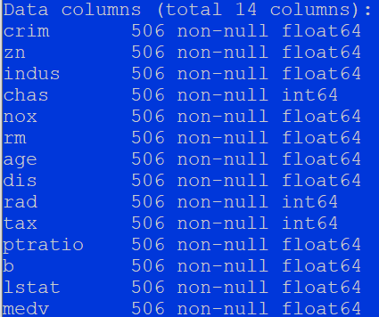
Basic Data Description
Tabular Data (506 rows × 14 columns)
Column 1 to column 13 are numerical features
Column 14 is the continuous target
No column has missing values.
Goal: regression problem, using numerical features to predict median housing prices in $1000.

Slide 4
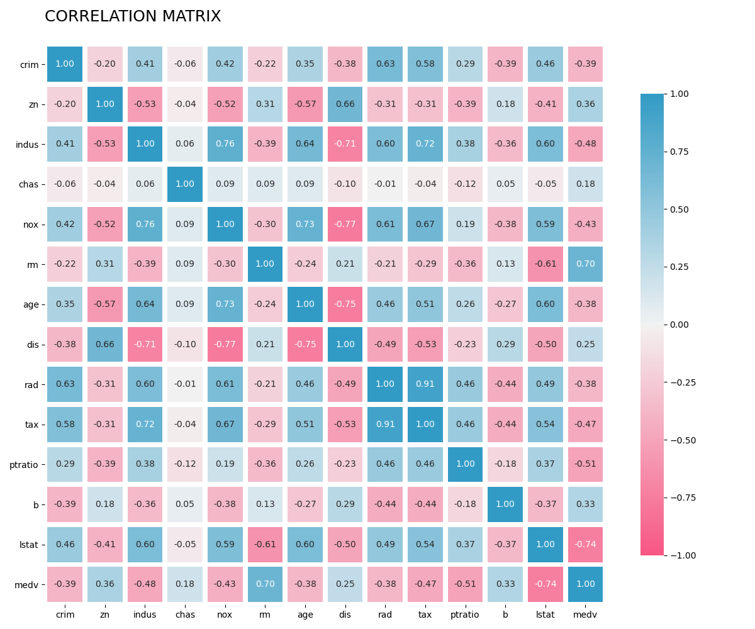
Correlation heat map

Slide 5
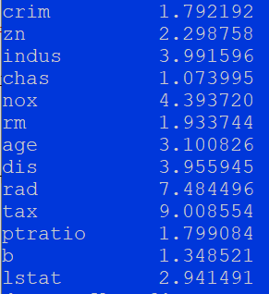
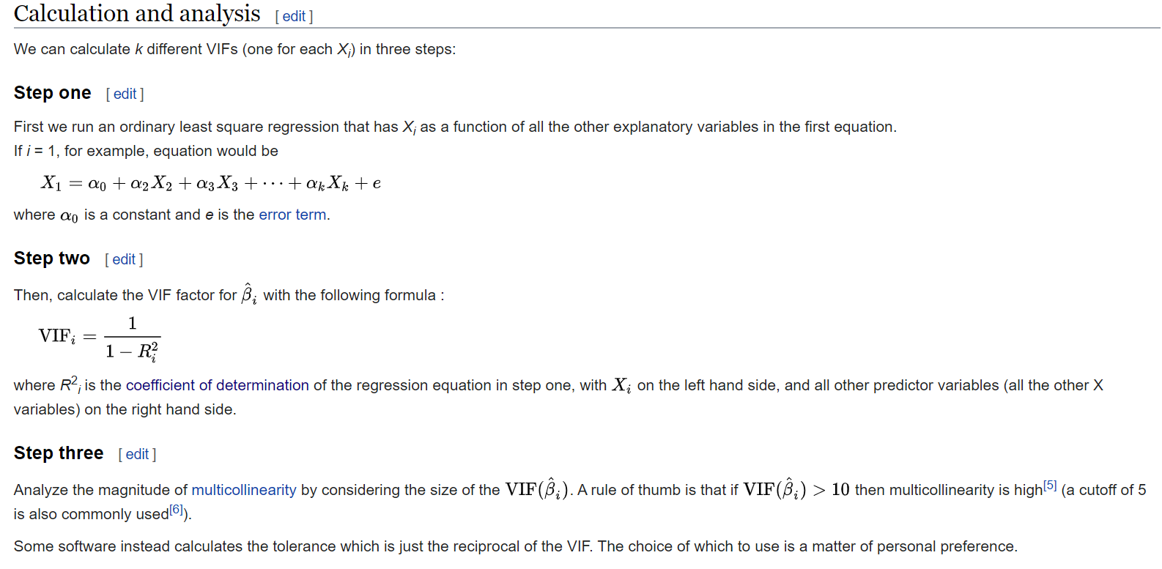
Detect multicollinearity using Variance Inflation Factor
Multicollinearity is a problem because it undermines the statistical
significance of an independent variable.

Slide 6
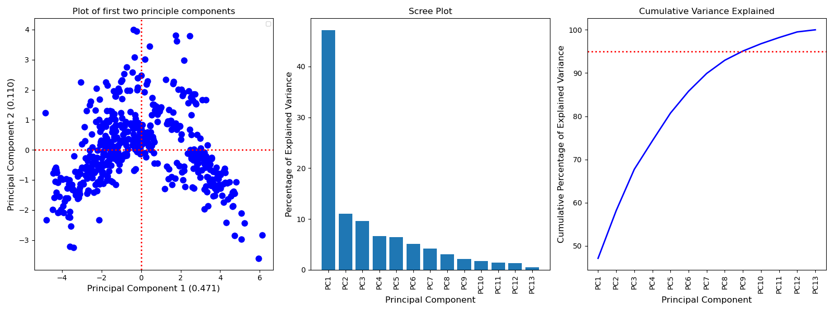
Principle component Analysis

Slide 7
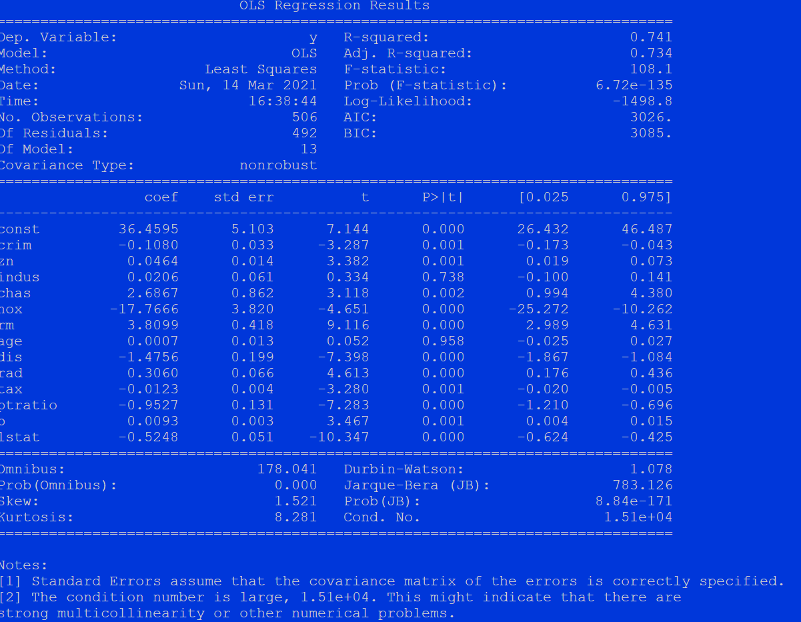

Slide 8
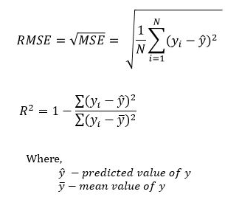

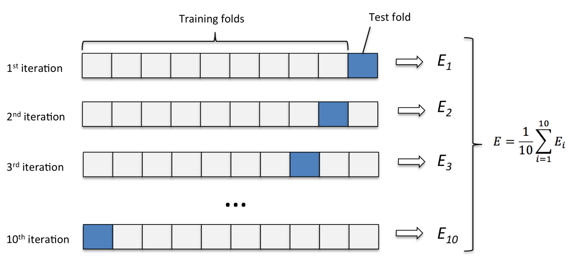
Build a machine learning pipeline
Pipeline
Standard Scaler
Principle Component Analysis (n = 10)
Try various classifiers:
Linear Regression
Support Vector Machine
Random Forest
K Nearest Neighbors
Ten-fold cross validation on Training data

Slide 9
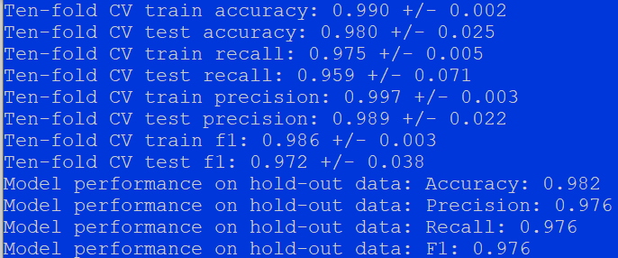
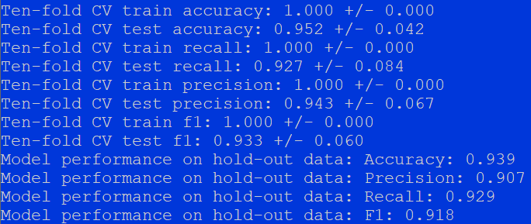
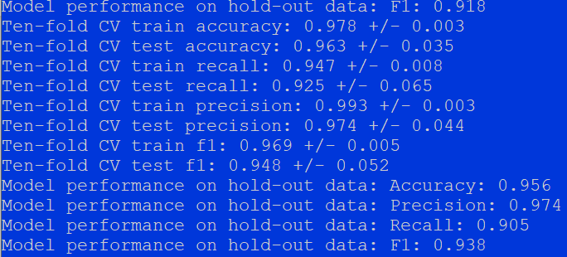
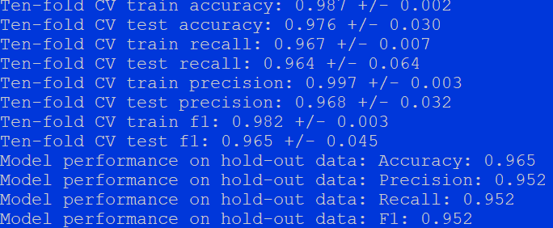
Model performance comparison (using default parameters)
Logistic regression
Random forest
K nearest neighbor
Support vector machine

Slide 10
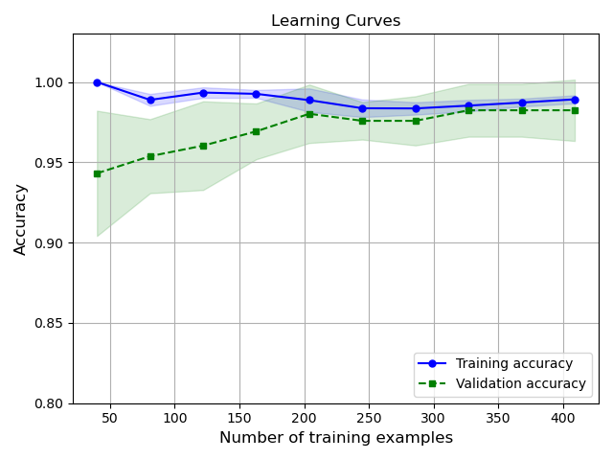
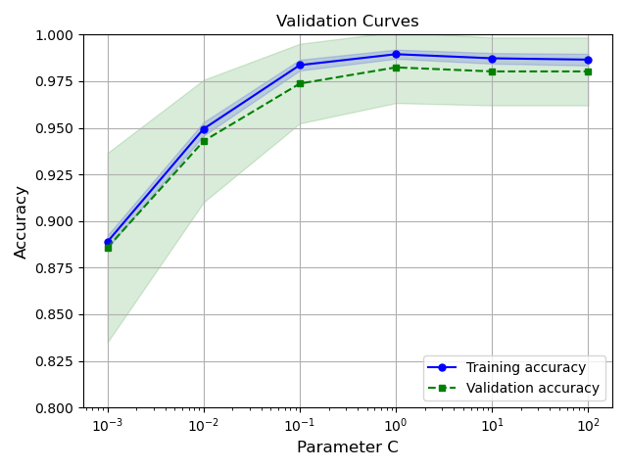
Learning and validation curves

Slide 11
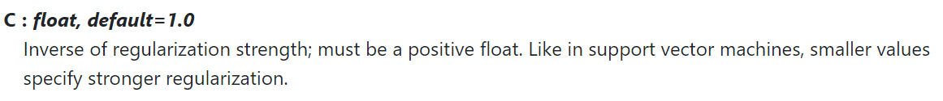

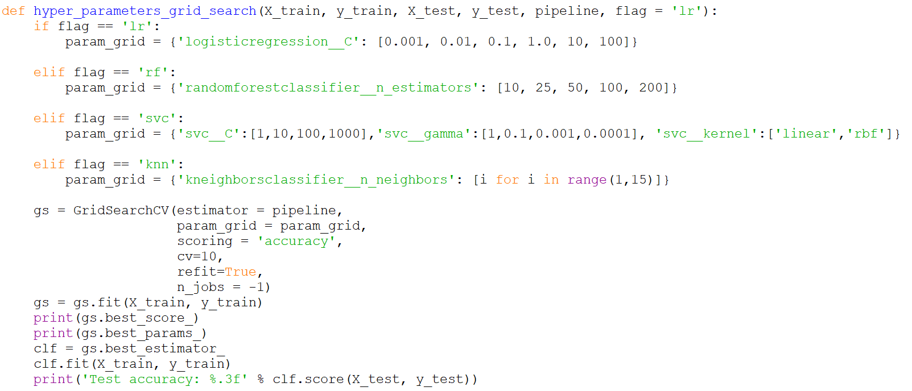
Hyperparameter tuning via grid search
Pipeline
Standard Scaler
Principle Component Analysis (n = 10)
Logistic Regression (find optimal C value)
Ten-fold cross validation on Training data

Slide 12
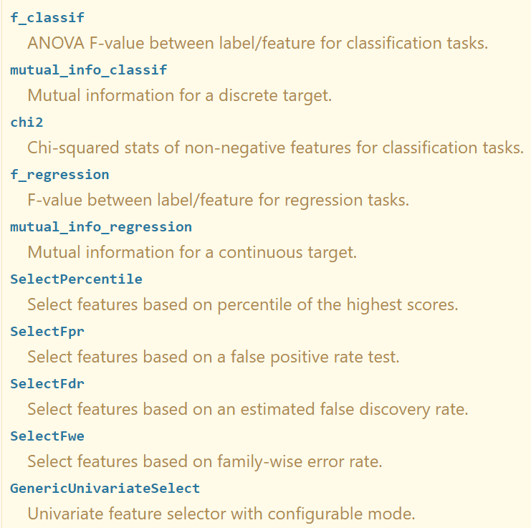
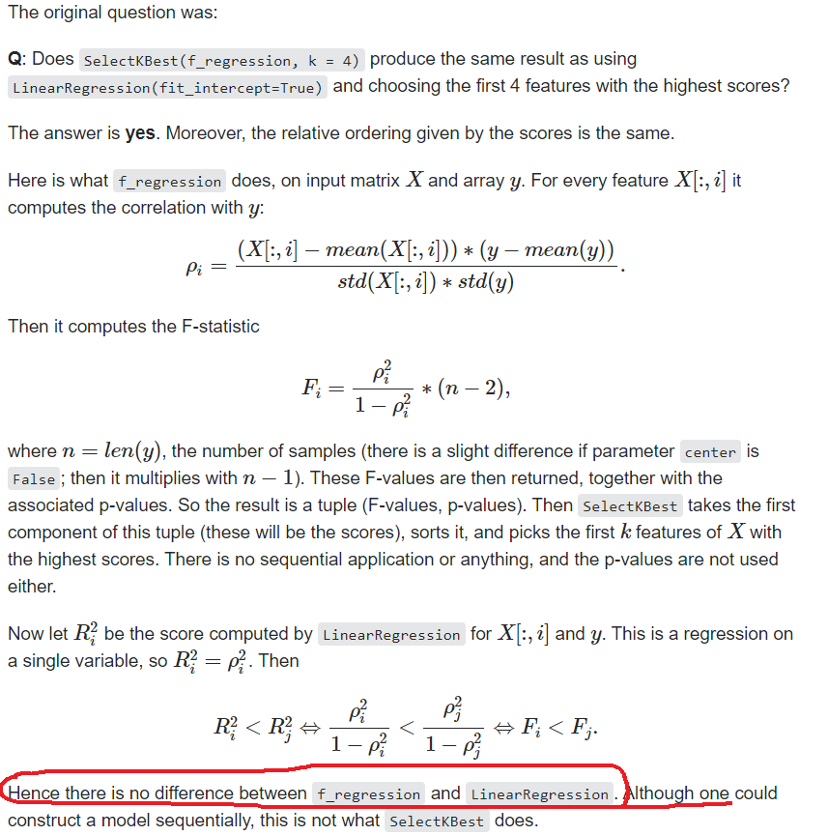
Select K-best features
Automatic Feature Selection
Univariate Statistics (e.g. ANOVA, chi squared)
Model based feature selection (e.g. tree based model, LASSO)
Iterative feature selection (e.g. recursive feature elimination)

Slide 13
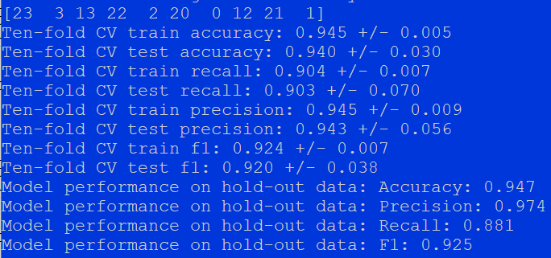
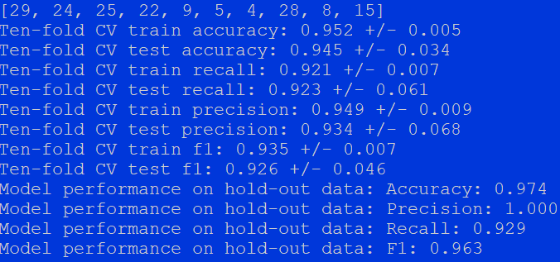
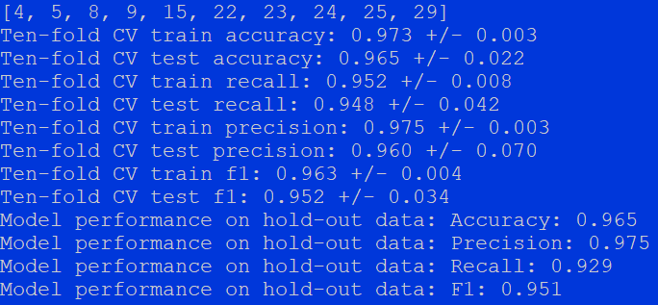
F-regression
Tree
RFE

Slide 14
To do lists
Do a hyperparameter tuning on other machine learning algorithms
To achieve a better prediction, try combining different regression and predict using averaging.

