Slide 1
Analysis of Wisconsin Breast Cancer Dataset
Chenyang Shi
2021/03/15

Slide 2
Tools used
Data manipulation
Pandas, Numpy
Data Visualization
Matplotlib, Seaborn
Machine learning
Sklearn, statsmodels

Slide 3
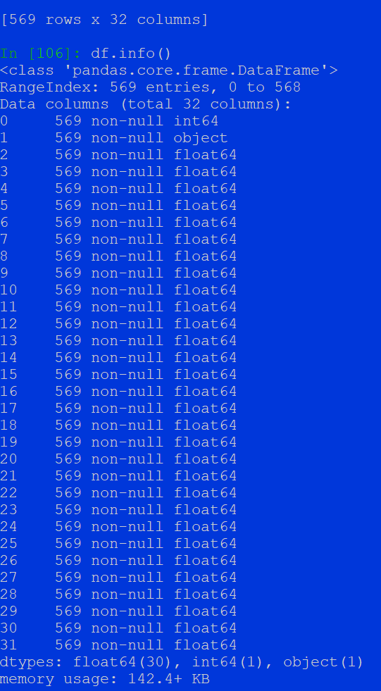
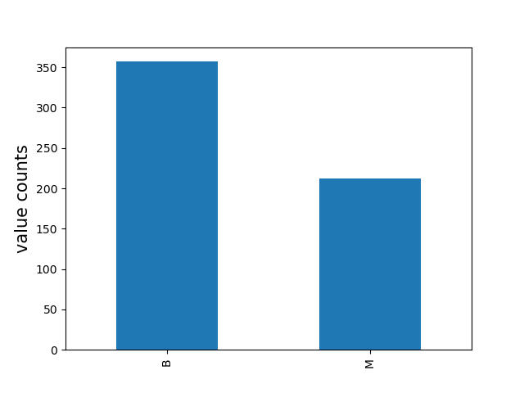
Basic Data Description
Tabular Data (569 rows × 32 columns)
Has no column names
Column 1 is non-informative
Column 2 is the label (M: malignant; B: benign)
Column 3 to column 32 are numerical features (float 64)
No column has missing values.
Goal: binary classification -- predict M or B using 30 columns of float numbers

Slide 4
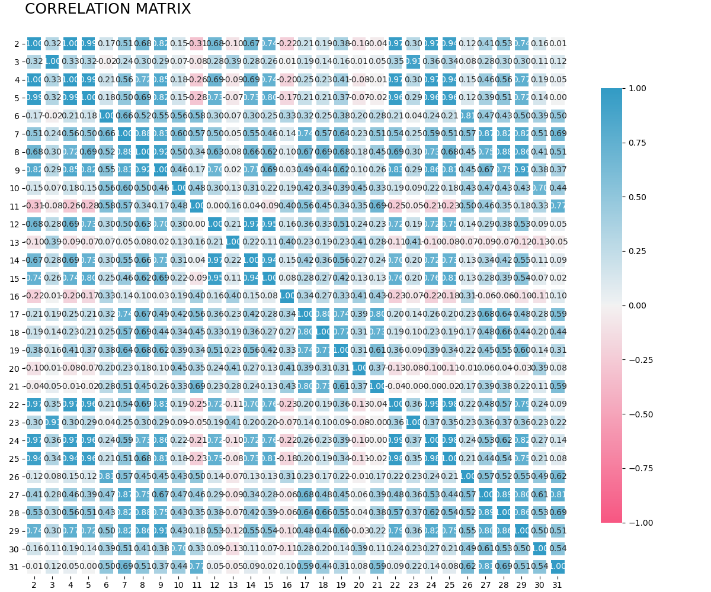
Correlation heat map

Slide 5
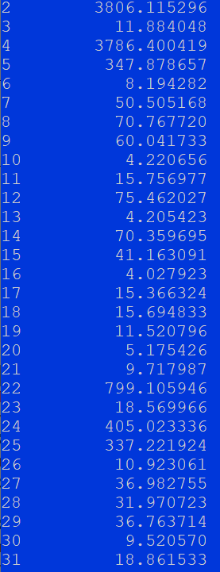
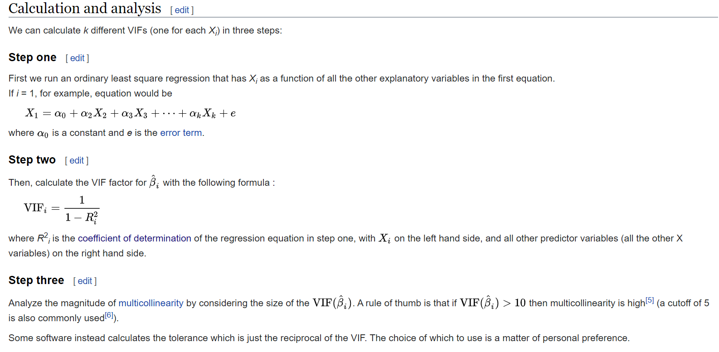
Detect multicollinearity using Variance Inflation Factor
Multicollinearity is a problem because it undermines the statistical
significance of an independent variable.

Slide 6
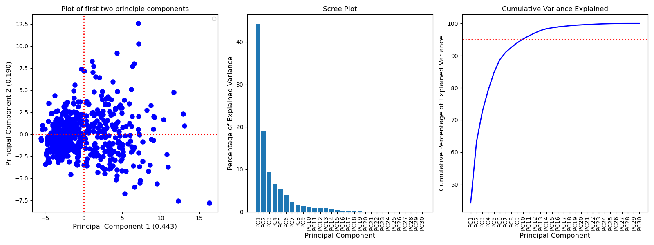
Principle component Analysis

Slide 7
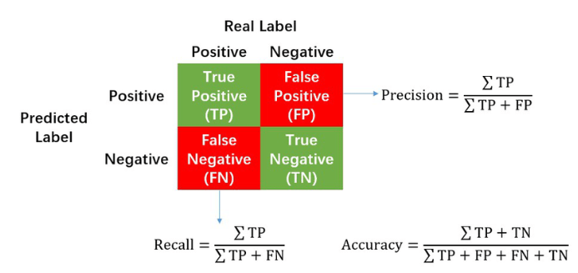

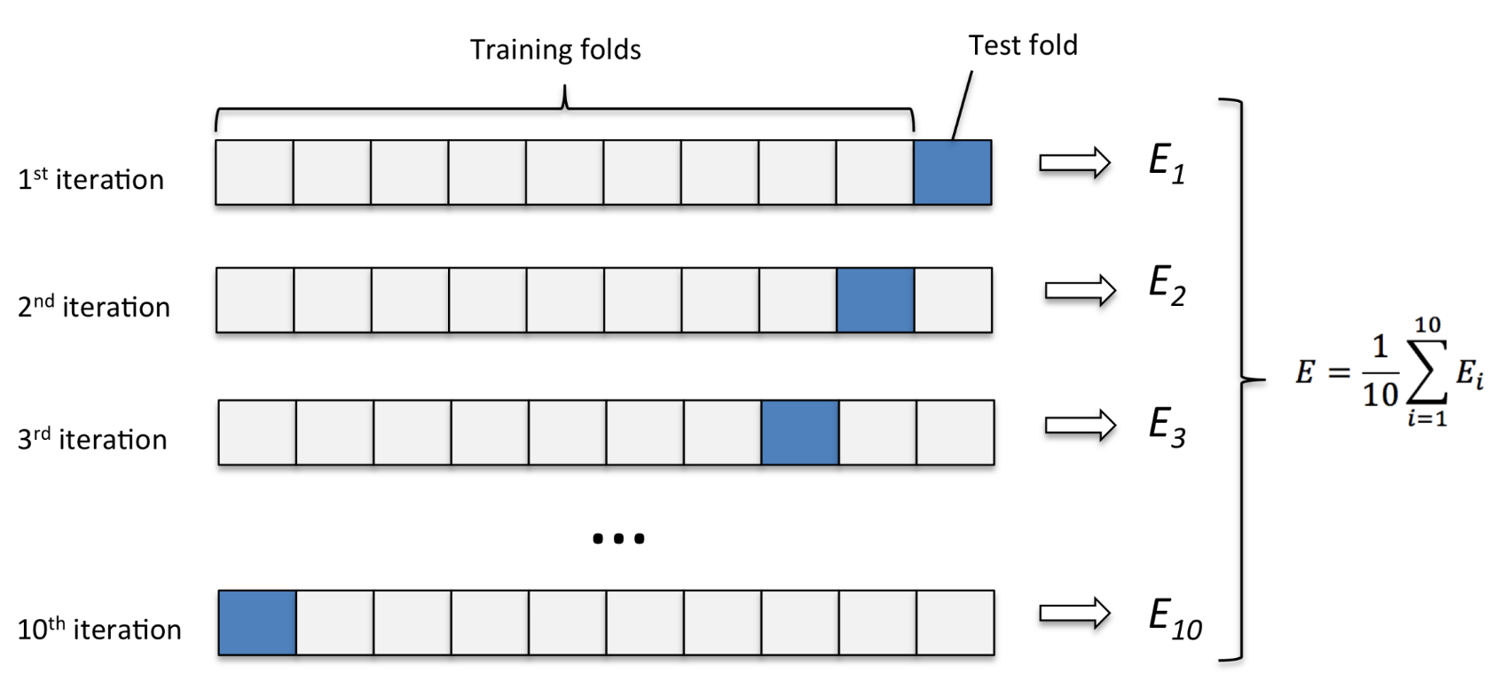
Build a machine learning pipeline
Pipeline
Standard Scaler
Principle Component Analysis (n = 10)
Try various classifiers:
Logistic Regression
Support Vector Machine
Random Forest
K Nearest Neighbors
Ten-fold cross validation on Training data

Slide 8
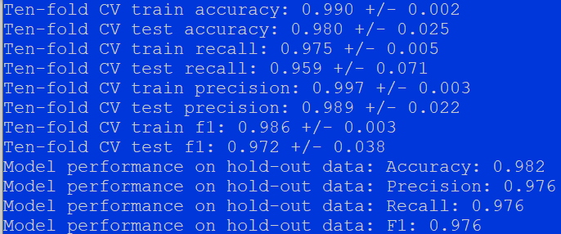
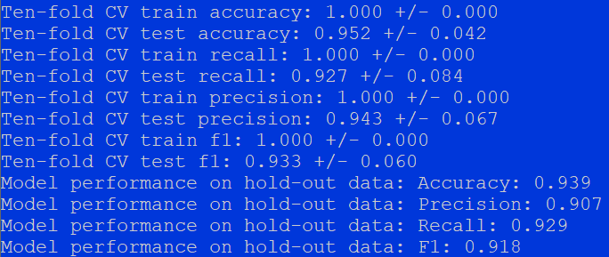
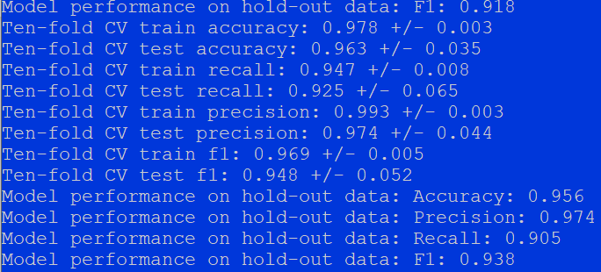
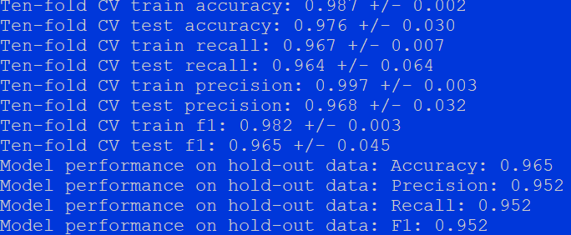
Model performance comparison (using default parameters)
Logistic regression
Random forest
K nearest neighbor
Support vector machine

Slide 9
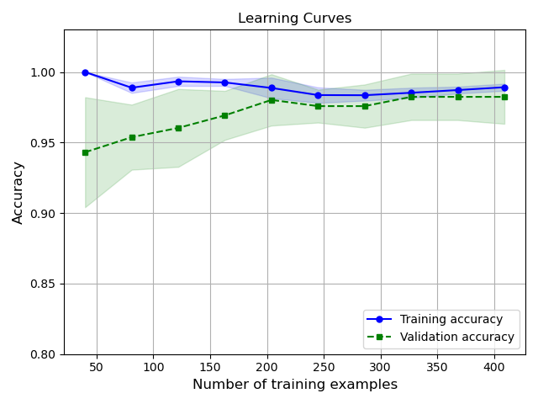
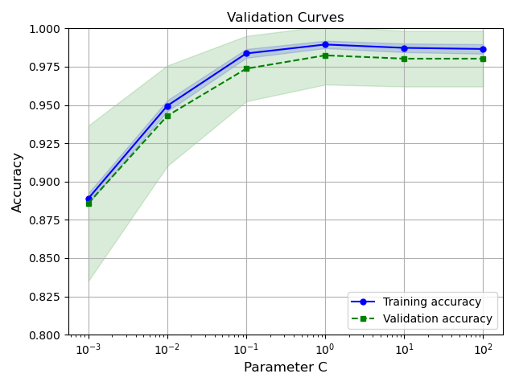
Learning and validation curves

Slide 10
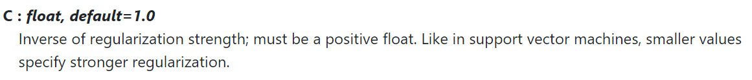

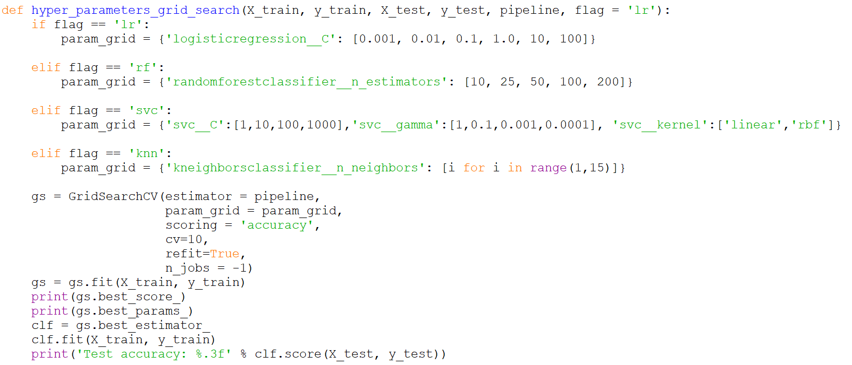
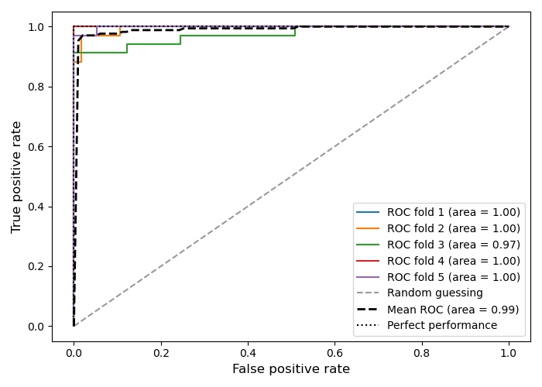
Hyperparameter tuning via grid search
Pipeline
Standard Scaler
Principle Component Analysis (n = 10)
Logistic Regression (find optimal C value)
Ten-fold cross validation on Training data

Slide 11
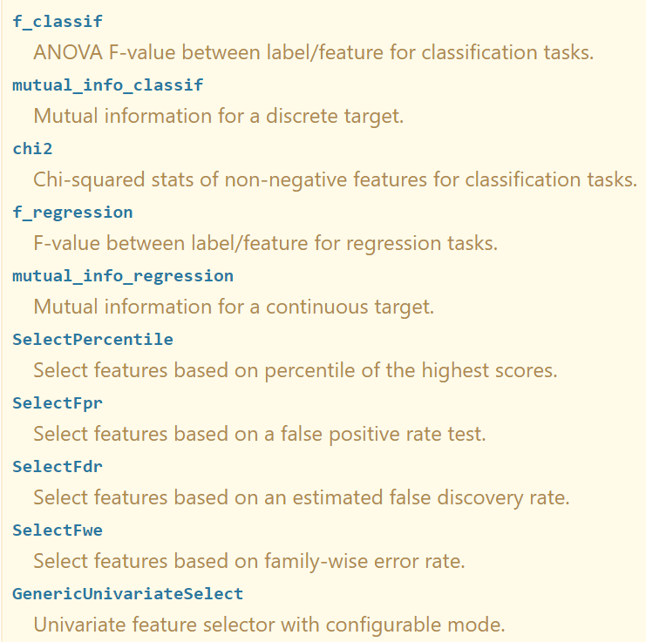
Select K-best features
Automatic Feature Selection
Univariate Statistics (e.g. ANOVA, chi squared)
Model based feature selection (e.g. tree based model, LASSO)
Iterative feature selection (e.g. recursive feature elimination)
Higher F-score is, better the feature discriminates between classes.
Recall that the chi-square test measures dependence between stochastic variables, so using this function “weeds out” the features that are the most likely to be independent of class and therefore irrelevant for classification.

Slide 12
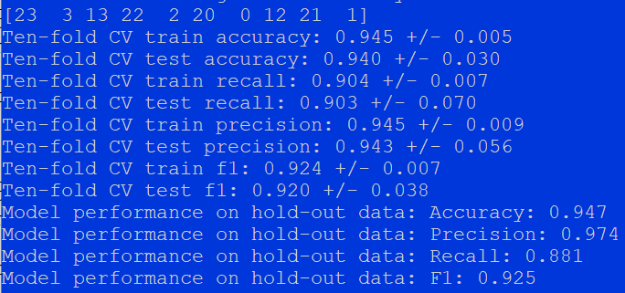
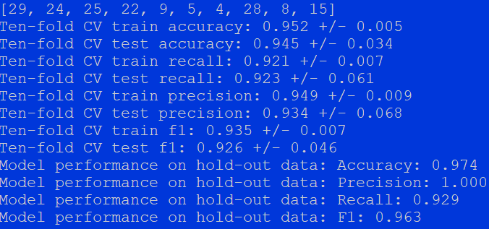
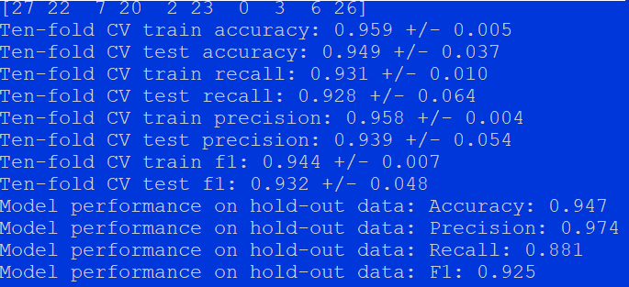
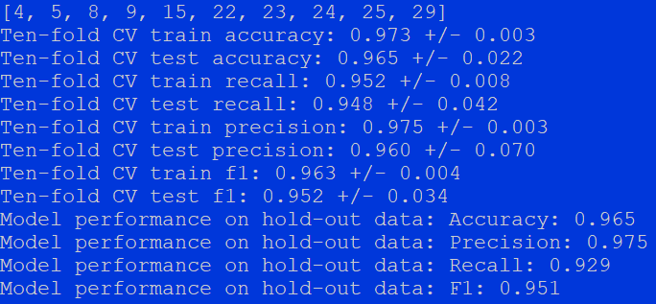
ANOVA F-value
Tree
Chi2 test
RFE

Slide 13
To do lists
Do a hyperparameter tuning on other machine learning algorithms
To achieve a better prediction, try combining different classifiers and predict using majority voting.
Experiment with precision-recall tradeoff.
Others

