Slide 1
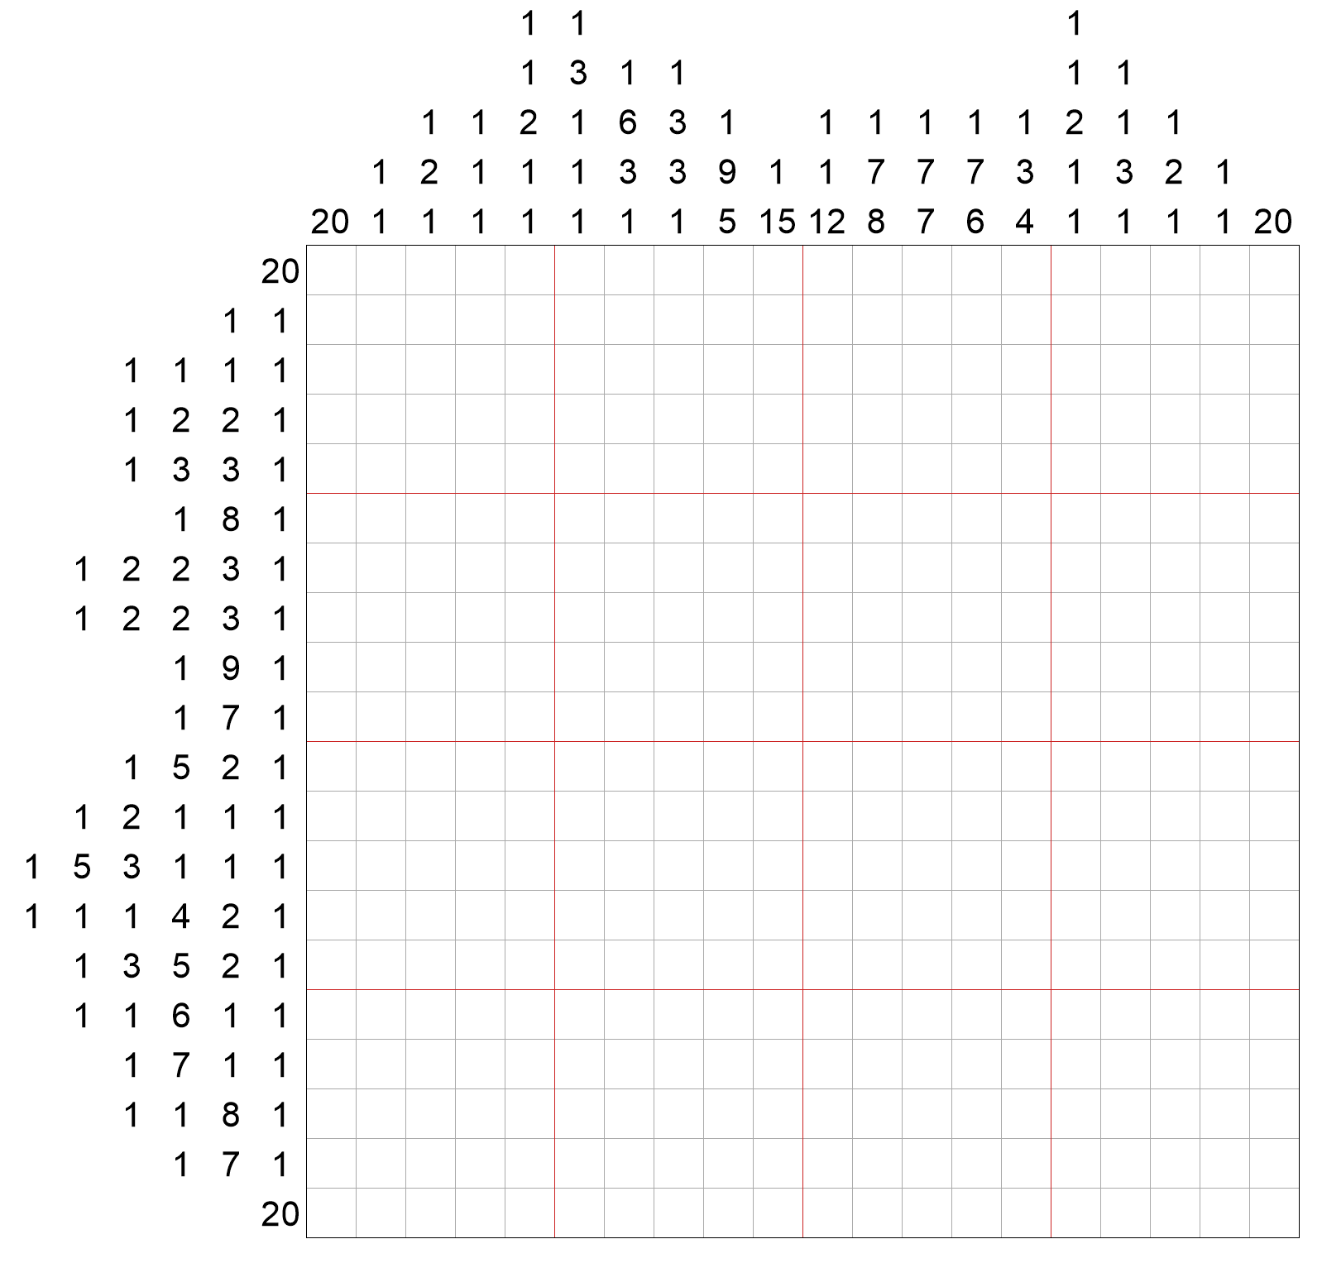
Week 2
Q Picross
Hint
 |  |  |  | 1 | 1 |  | 4
 |  | 4 | 6 | 1 | 2 | 7 | 1
 | 4
2 | 2
2 | 2
2 | 2
2 | 2
 | 4
 | 3
Quantum Challenge 2020

