Slide 1

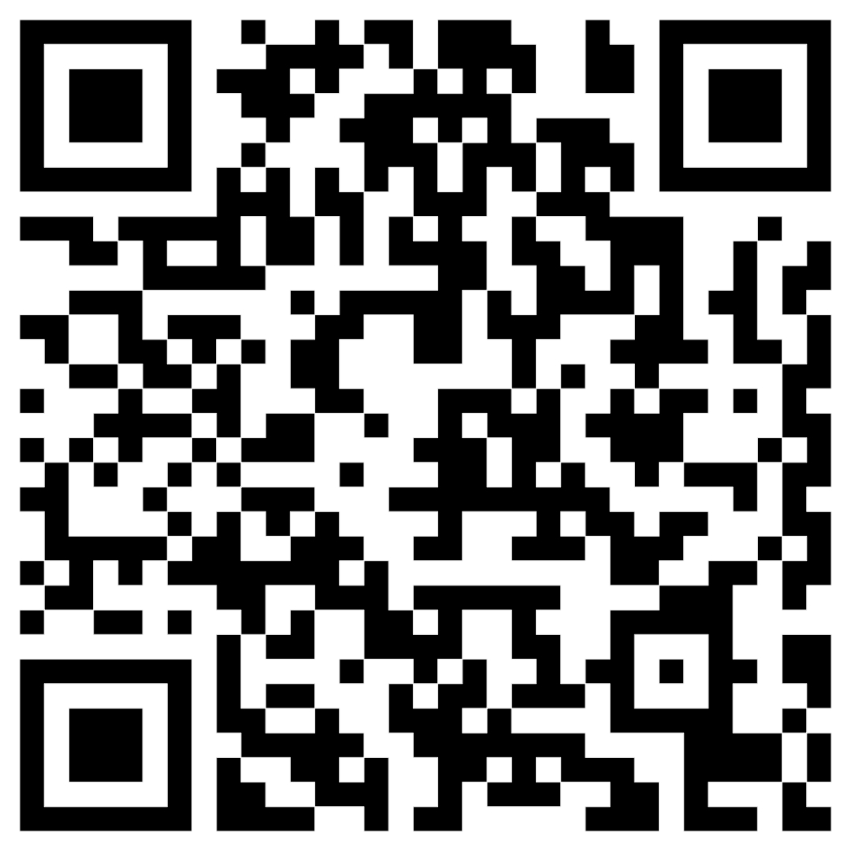

The When Before the How
Ethical and Practical Boundaries of AI in Academic Research Writing
AECT 2025 Panel Session
Moderator: G. Curt Fulwider, Florida State University
Panelists: Zhichun Liu, Bret Staudt Willet, Jewoong Moon, Chaewon Kim, Stephanie Gilstrap

Slide 2

Opening Remarks
Focus: academic research writing (not creative or coursework).
Guiding question: When does AI-assisted writing cross from helpful to ethically problematic?
We explore the 'when before the how'—ethics before technique.

Slide 3
Why This Matters
AI tools like ChatGPT streamline research but blur ethical boundaries.
Raises issues of authorship, accountability, and fairness.
Particularly impacts non-native English-speaking scholars.
Publishing norms and ethical standards are still evolving.

Slide 4
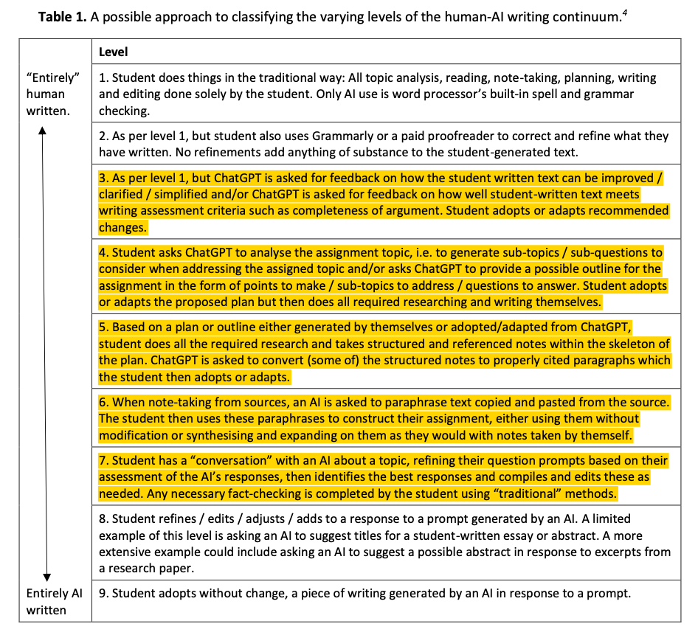

Rowland’s Human–AI Writing Continuum

Slide 5

Focus Range for generation: Levels 3–7
3: AI gives feedback on clarity or argument strength.
4: AI helps outline structure; human writes content.
5: AI drafts paragraphs from structured notes.
6: AI paraphrases or summarizes sources.
7: AI co-creates content through conversation and refinement.

Slide 6
Session Format
Scenario introduced by moderator.
Audience votes via Poll Everywhere.
Panelists discuss.

Slide 7
Scenario 1: Abstract Co-writing
A researcher pastes sections of their completed paper into ChatGPT and iteratively refines a 250-word abstract through multiple prompt-and-revise cycles (“make it more concise,” “emphasize novelty”). The final abstract is heavily shaped by AI phrasing, though all information originates from the author’s study.

Slide 8

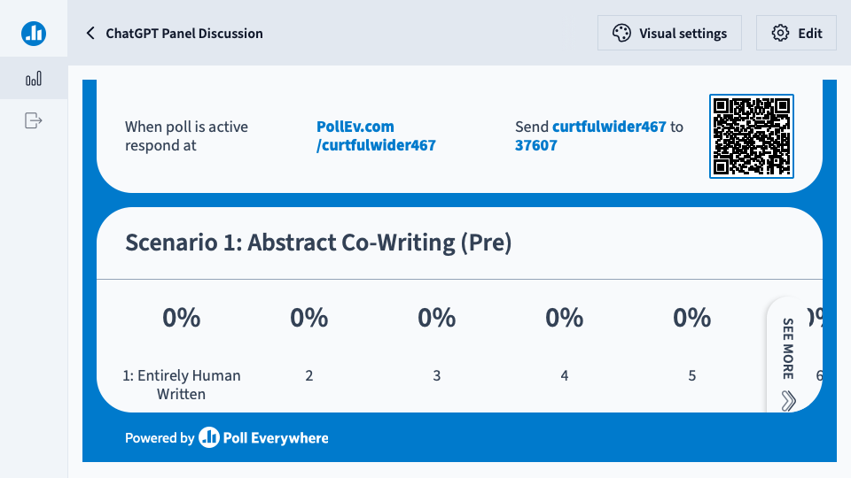
Poll Everywhere Presenter

Slide 9
Scenario 1: Abstract Co-writing
A researcher pastes sections of their completed paper into ChatGPT and iteratively refines a 250-word abstract through multiple prompt-and-revise cycles (“make it more concise,” “emphasize novelty”). The final abstract is heavily shaped by AI phrasing, though all information originates from the author’s study.

Slide 10
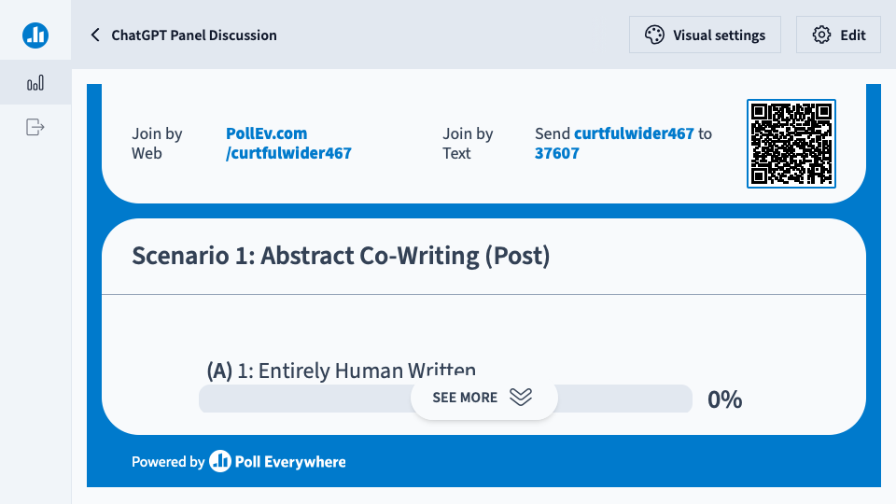
Poll Everywhere Presenter

Slide 11
Scenario 2: Journal Revision
A research team receives “major revision” feedback. Before rewriting, they paste the entire results section into ChatGPT and ask for suggestions on how to reorganize the argument for clarity and logical flow. They use some structural suggestions and rephrase transitions but do not insert AI-generated sentences.

Slide 12
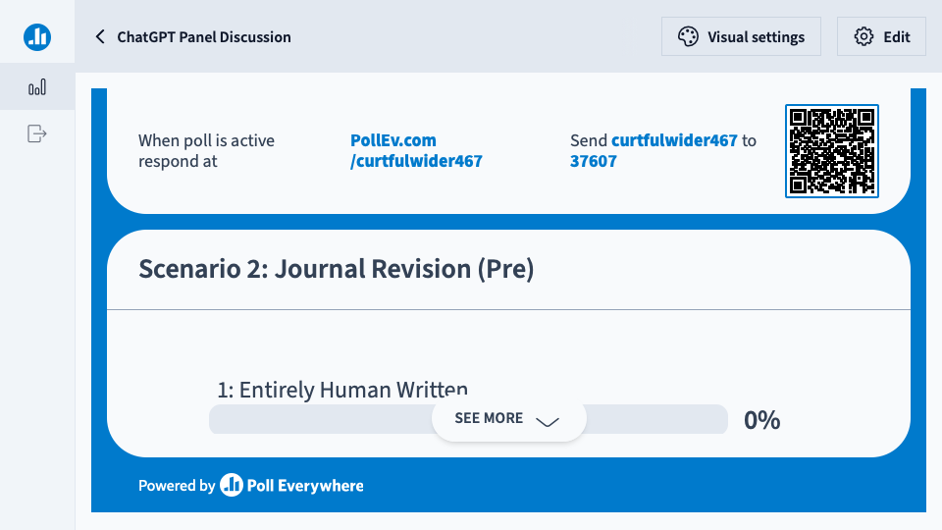
Poll Everywhere Presenter

Slide 13
Scenario 2: Journal Revision
A research team receives “major revision” feedback. Before rewriting, they paste the entire results section into ChatGPT and ask for suggestions on how to reorganize the argument for clarity and logical flow. They use some structural suggestions and rephrase transitions but do not insert AI-generated sentences.

Slide 14
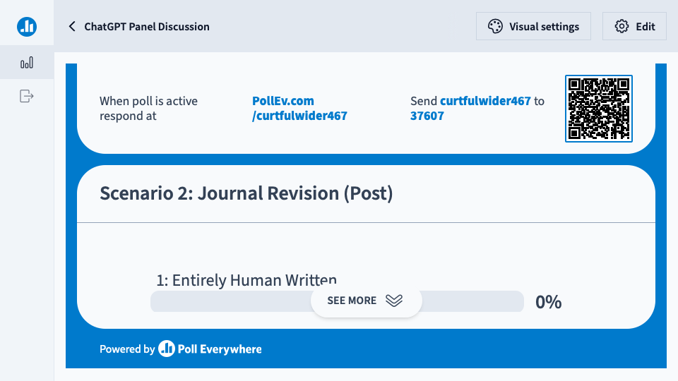
Poll Everywhere Presenter

Slide 15
Scenario 3: Lit. Review Drafting
A doctoral student compiles annotated notes summarizing 30 studies. They paste the notes into ChatGPT with the prompt, “Turn these into a coherent literature review section (APA style).” The AI produces a rough draft that the student revises for flow and accuracy before submission.

Slide 16

Poll Everywhere Presenter

Slide 17
Scenario 3: Lit. Review Drafting
A doctoral student compiles annotated notes summarizing 30 studies. They paste the notes into ChatGPT with the prompt, “Turn these into a coherent literature review section (APA style).” The AI produces a rough draft that the student revises for flow and accuracy before submission.

Slide 18
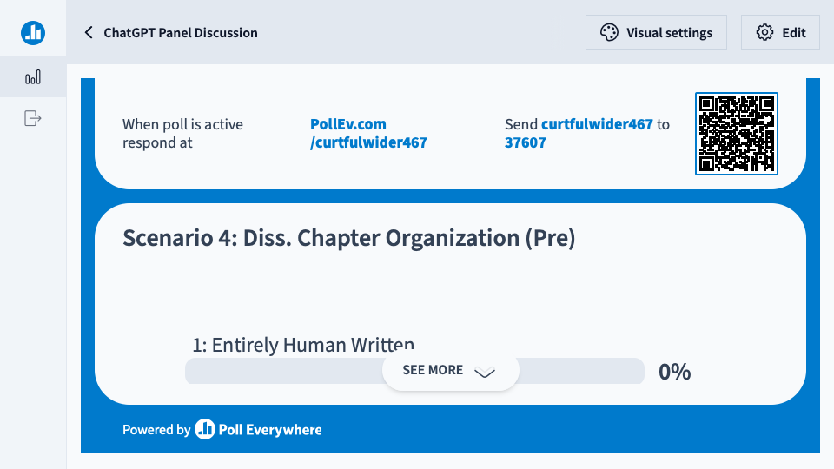
Poll Everywhere Presenter

Slide 19
Scenario 4: Diss. Chapter Organization
A PhD candidate uses ChatGPT to generate possible subheadings for their discussion chapter, based on a brief summary of findings. The AI provides a list of themes, which the student adapts into an outline before writing all text independently.

Slide 20

Poll Everywhere Presenter

Slide 21
Scenario 4: Diss. Chapter Organization
A PhD candidate uses ChatGPT to generate possible subheadings for their discussion chapter, based on a brief summary of findings. The AI provides a list of themes, which the student adapts into an outline before writing all text independently.

Slide 22

Poll Everywhere Presenter

Slide 23
Scenario 5: Conceptual Framework Dev.
Two scholars developing a theoretical framework feed ChatGPT a long exchange about their ideas and ask it to summarize and refine their emerging argument. They copy portions of the AI’s phrasing directly into the manuscript draft.

Slide 24

Poll Everywhere Presenter

Slide 25
Scenario 5: Conceptual Framework Dev.
Two scholars developing a theoretical framework feed ChatGPT a long exchange about their ideas and ask it to summarize and refine their emerging argument. They copy portions of the AI’s phrasing directly into the manuscript draft.

Slide 26
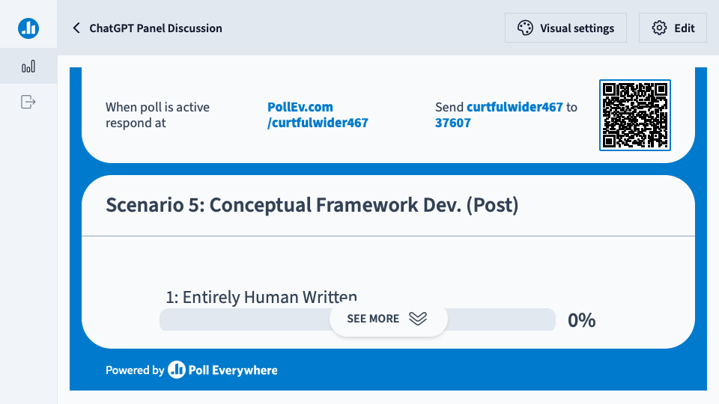
Poll Everywhere Presenter

Slide 27
Scenario 6: Methods Paraphrasing
A non-native English-speaking researcher copies sentences from prior publications describing standard procedures and asks ChatGPT to paraphrase them to avoid plagiarism. They integrate those paraphrased sentences into their paper, citing the original methods appropriately.

Slide 28

Poll Everywhere Presenter

Slide 29
Scenario 6: Methods Paraphrasing
A non-native English-speaking researcher copies sentences from prior publications describing standard procedures and asks ChatGPT to paraphrase them to avoid plagiarism. They integrate those paraphrased sentences into their paper, citing the original methods appropriately.

Slide 30

Poll Everywhere Presenter

Slide 31
Q&A

