Slide 1

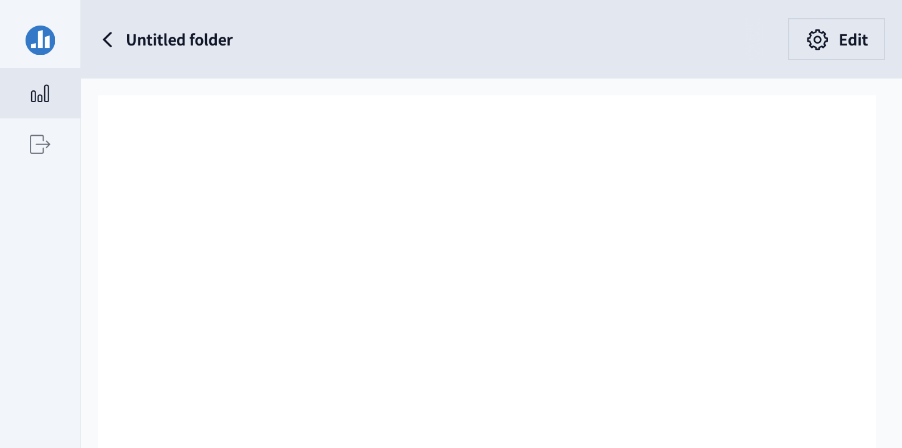
Poll Everywhere Presenter

