Slide 1


Text Analytics in Sustainable Development Goals (SDGs)

Slide 2



Our team
Lianos Alexandros
Data Scientist
Marinos Efstratios
Machine Learning
Engineer
Papanikou Lydia
Business Analyst

Slide 3

Our Mission
The main idea is to create a tool, which could be a part of the UN website, where the user can navigate in a user-friendly platform and analyse large quantities of publications according to a desired criterion.
Train a Neural Network with pre-classified data and create an algorithmic model so that, by entering new data, we can achieve the greatest predictability in new and future publications.

Slide 4
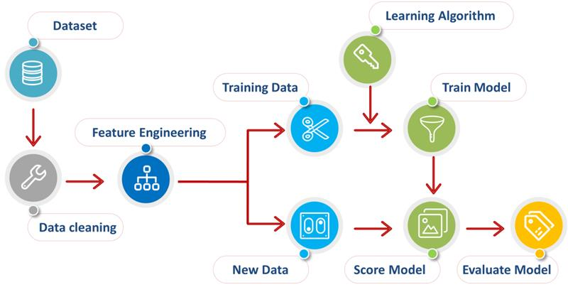
How would we accomplish that?
Data Collection Annotation process
EDA & Pre-processing
Train a Neural Network Hyperparameter Tuning

Slide 5
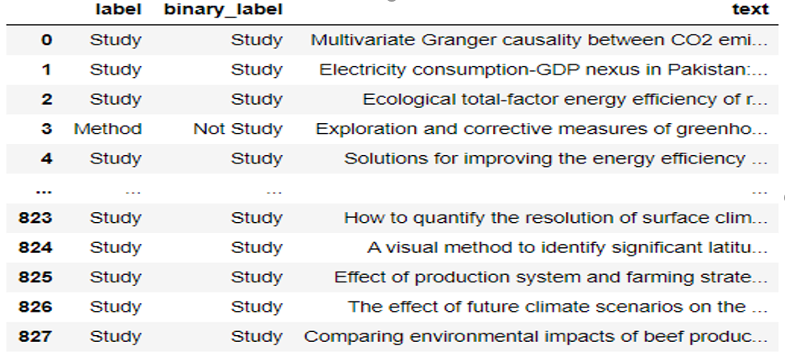
DATASET (Initial Form)
After running the parser, the dataset consists of:
828 rows
3 columns

Slide 6
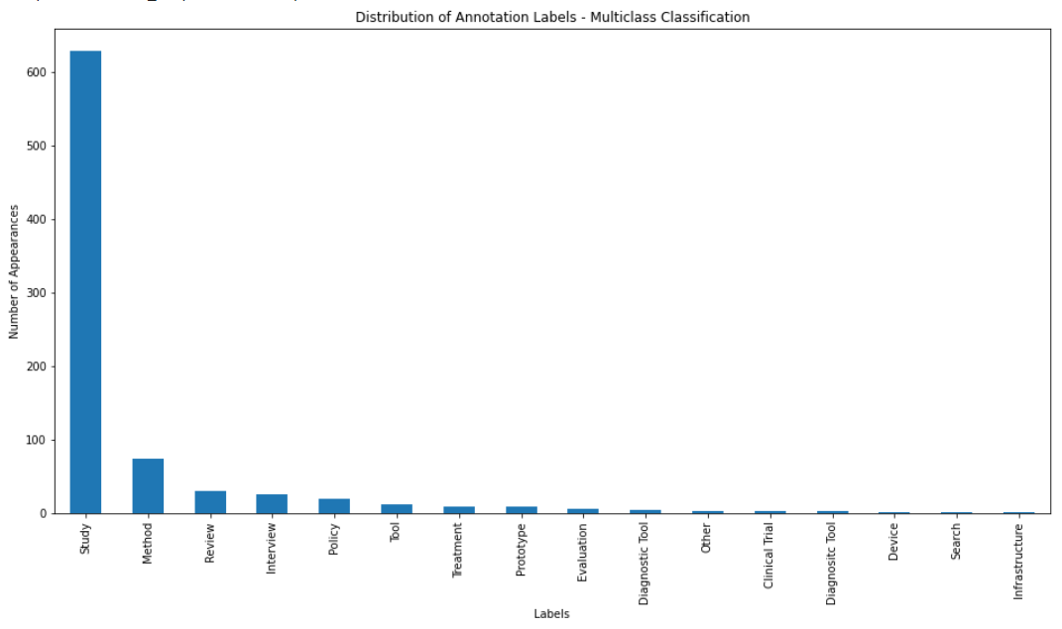
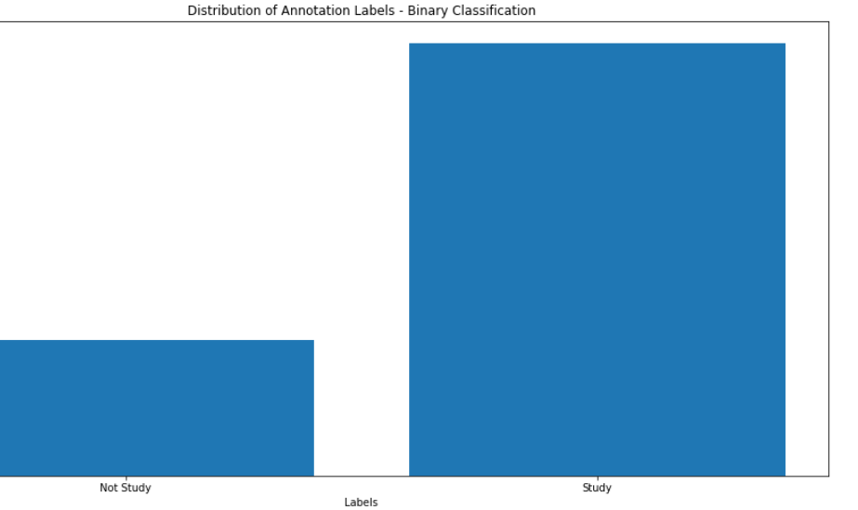
DATASET (Visualization)
BINARY CLASSIFICATION
Data divided into 2 categories: Study, No Study
MULTICLASS CLASSIFICATION
15 categories → 9 of them were selected as statistically significant
In both approaches, we encountered the problem of imbalanced classes.
Besides classification accuracy, we added more evaluation metrics such as precision, recall, f1.
Split the dataset in a stratified manner to prevent the distribution of the training data to create bias towards our model.

Slide 7
DATASET (Pre-processing)
Remove duplicates
3 papers removed
Cleaning of text data
preprocess methods to better modify our data
Label Encoding
convert categorical output data into model-understandable numerical data
Splitting/Shuffling Dataset
stratified sampling classes are proportionally splitted between training and test set
Tokenizing text data
splitting text into tokens, padding, truncating Keras Tokenizer

Slide 8

Methodology (Architectures)
Proceed to classification using two different architectures. To find the most efficient model, various hyperparameters and combinations were tested for each network.
Multilayer Perceptron (MLP)
Convolutional Neural Networks (CNN)
Data is fed to the input layer, there may be one or more hidden layers providing levels of abstraction, and predictions are made on the output layer.
The input is traditionally two-dimensional but can also be changed to be one-dimensional. This allows the CNN to be used more generally on other types of data (except images) that has a spatial relationship, such as words in a document of text.

Slide 9
Methodology (Variations - Hyperparameter Tuning)
Activation Functions
Word Embeddings
Learning an Embedding
Using Pre-Trained GloVe Embedding
Dropout Regularization
range from 0.2 to 0.5
Batch Normalization
range from 0.90 (highest low value) to 0.99
relu
softmax
sigmoid
Configuration of the Model
Metrics
Accuracy
Recall
Precision
F1
Keras Callbacks
embedding_dim, max_words, max_len
Training Parameters (batch size, epochs)
Neurons and Layers (width, depth)
Optimizers
Nadam
Adam
SGD
↓
decay rate
Loss functions
Model Checkpoint
Early Stopping
ReduceLROnPlateau
Binary Crossentropy
Categorical Crossentropy

Slide 10
RESULTS (Evaluation Metrics)
The 11 binary NN models are compared based on accuracy and their ability to predict the research theme of new papers.
Predictability: The probability that a text has a research theme classified as “Study”
Accuracy: Number of correct predictions / Total Number of predictions
Model 1 has the highest loss amongst the 11 models. Model 1 is our baseline model. It does not have an Embedding layer, or a Batch Normalization layer and it has the lowest number of neurons per layer.
Model 10 has the 2nd lowest loss while Model 11 has the 2nd highest loss.
Model 10 has the 2nd highest accuracy. Considering that Model 11 has the highest accuracy, this shows that our CNN models performed overall better on this regard.

Slide 11
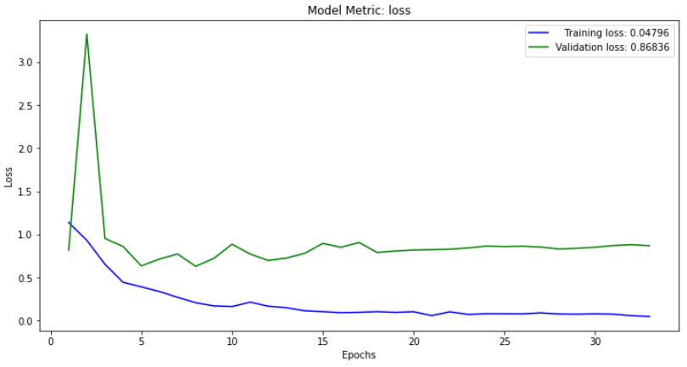
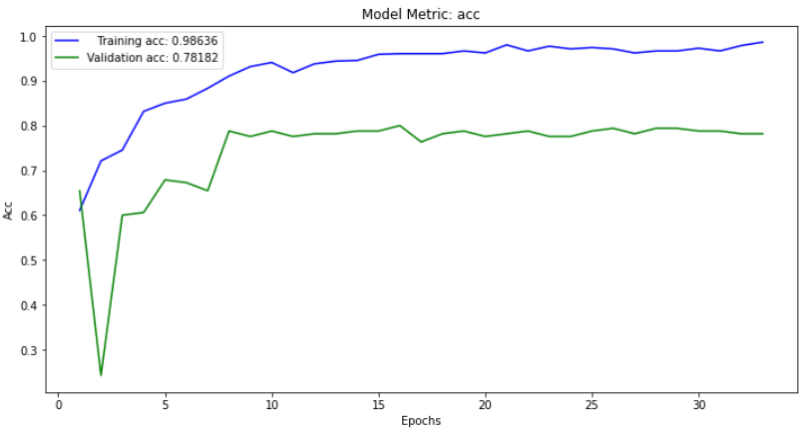
RESULTS (Model Selection)
Summary of model 11
(best accuracy)
For model 11, the training loss decreases with every epoch, and the training accuracy increases with every epoch.
On the other hand, the validation loss and accuracy “spike” early on and then proceed to show reverse behavior - validation loss steadily increases, and validation accuracy steadily decreases.

Slide 12
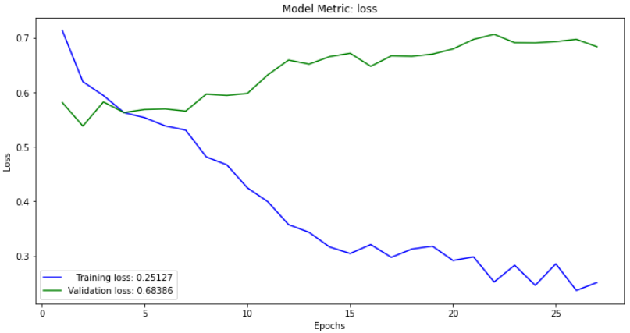
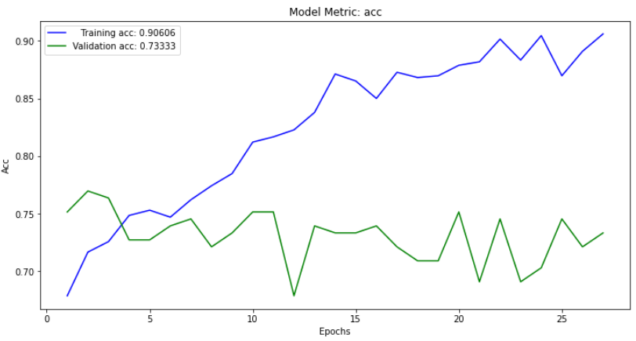
RESULTS (Model Selection)
Summary of model 10
(best predictability)
Expectations do not change for model 10 since the pairs of validation and training show similar behavior minus the “big spike“ we observed in Model 11.
Unlike Model 11, in Model 10 before epoch 5 validation values for accuracy and loss change dramatically.

Slide 13

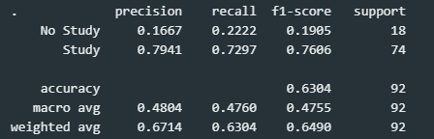
RESULTS Predictions on new data
Confusion Matrix
Predicted labels are on the x-axis and the True labels are on the y-axis.
Observing the confusion matrix, there are 92 total samples in the held-out dataset.
We can see that Model 10 accurately predicted 58 out of 92 total samples. The model incorrectly predicted 34 out of the 92. Based on the classification report below, the accuracy is at 63%. Is it expected?
Classification Report

Slide 14
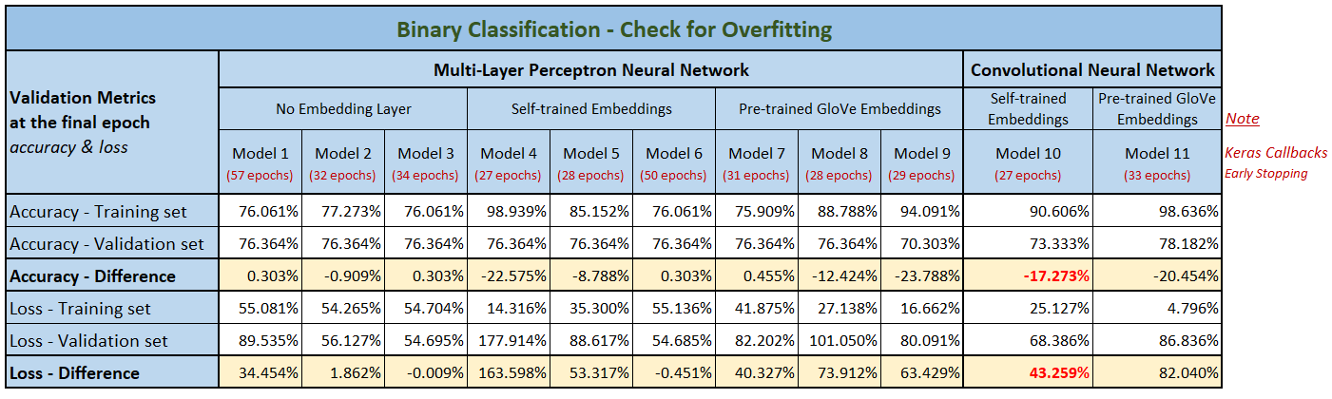
RESULTS (Check for Overfitting)
Both models are an example of models that perform better on the training data but do not necessarily perform better on data they have never seen before. In precise terms, what we’re seeing is overfitting: especially for Model 10, after the 5th epoch, we’re overoptimizing on the training data, and we end up learning representations that are specific to the training data and don’t generalize to data outside of the training set.
The problem with overfitting, is that the more specialized the model becomes to training data, the less well it is able to generalize to new data, resulting in an increase in generalization error. This increase in generalization error can be measured by the performance of the model on the validation dataset.
A plot of learning curves shows overfitting if:
The plot of training loss continues to decrease with experience.
The plot of validation loss decreases to a point and begins increasing again.

Slide 15


Problems / SOLUTIONS
Small Dataset
Collect more data (or data augmentation) to prevent overfitting
Manual approach and testing of numerous parameters to see which provide the best model performance
Type of Neural Network
Different Performance Metrics. Resampling the dataset, either with over-sampling or under-sampling.
Imbalanced Data

Slide 16


Thank you

