Slide 1


Text Analytics in Sustainable Development Goals (SDGs)

Slide 2



Our team
Lianos Alexandros
Marinos Efstratios
Papanikou Lydia

Slide 3

Project description
The challenge of this project is to create a support tool for the academic researcher/scientist
Resolve grouping problems related to text data.
Such tools are widely used (i.e In biomedical science) where you can get notified of knowledge you need to augment your research.
There is a growing interest among governmental researchers and academic institutions in tracking the performance of Sustainable Development Goals (SDGs).
To help this scientific research, machine learning algorithms analyze and connect millions of papers, in order to measure how SDGs are connected to different research themes.
This tool could be part of the United Nations website.

Slide 4

Our Mission
Quick and objective way to analyze large quantities of United Nations publications according to a desired criteria.
More specific, provide a solution by introducing a proof-of-concept classification system that measures the alignment of publications with each of the pre-defined research themes.
Using machine learning algorithms to analyze digital texts.
To build such an algorithm the main issue that must be tackled is the proper annotation of the papers.

Slide 5

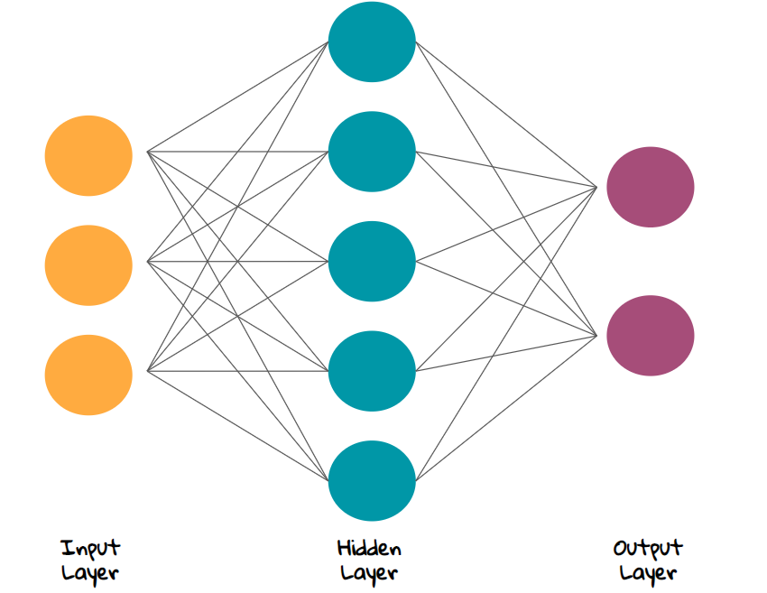

How would we accomplish that?
1
2
3
Collect Data
Analyze
Train
Collect Data from the various papers with annotation method
Analyze the data to detect patterns, discrepancies and other potentially useful descriptive statistics
Use the data to train a Neural Network from the already known activities to use as a prediction model

Slide 6
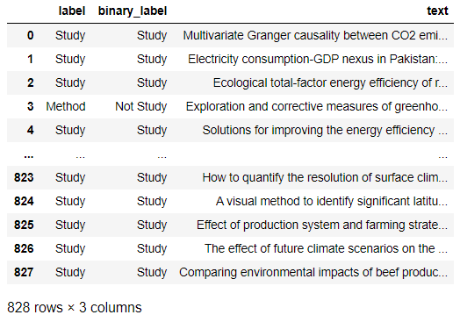
dataset preprocessing
Running a parser and extract a dataframe consisting 828 rows and 3 columns
Remove duplicate papers
1
2

Slide 7
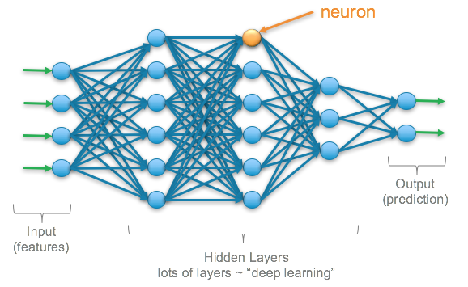
dataset preprocessing
Label Encoder → Convert the categorical text output data into model-understandable numerical data
Basic Preprocessing of text data → Remove special characters, tags
Tokenizing text data using Word Embeddings→ Words are called tokens and the process of splitting text to tokens is called tokenization.
Two methods of word embeddings → GloVe (Using Pre-Trained GloVe Embedding) and Self-learned as part of a deep learning model (Learning an Embedding).
Keras Tokenizer → Two Keras preprocessing tools: the Tokenizer class, and the pad_sequences module
Splitting/Shuffling Dataset Procedure → Split the dataset in a stratified manner.

Slide 8
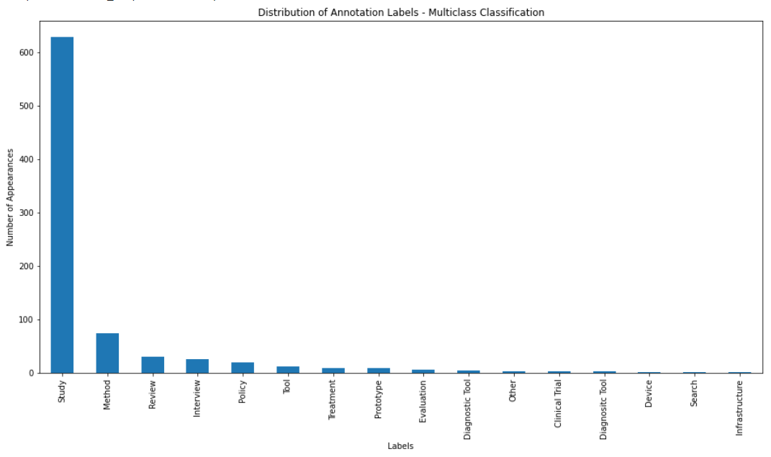
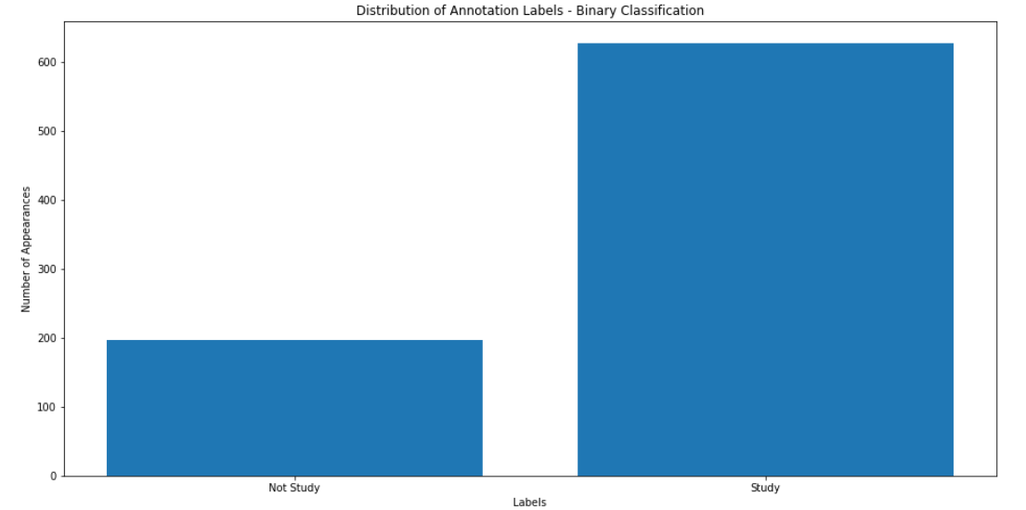
Data
BINARY CLASSIFICATION
Data divided into 2 categories: Study, No Study
MULTICLASS CLASSIFICATION
15 categories → 9 of them were selected as statistically significant

Slide 9

methodology
The architecture models we have used are the following:
Multilayer Perceptrons (MLP):Classical type of neural network. MLP comprised of one or more layers of neurons.
Convolutional Neural Networks (CNN): Designed to map image data to an output variable.
Recurrent Neural Networks (RNN): Designed to work with sequence prediction problems.

Slide 10
methodology
Variations - Hyperparameter Tuning
Keras Embedding Layer: Keras offers an Embedding layer that can be used for neural networks on text data
Dropout Regularization: Dropout Regularization is a computationally cheap way to regularize a deep neural network
Batch NormalizationRecurrent: Create desired network architecture It is a technique designed to automatically standardize the inputs to a layer in a deep learning neural network.
Activation Functions:
Relu: neural network activation function. Used for hidden layers
Sigmoid: Classic neural network activation. Often used on output layer of a binary classifier

Slide 11

methodology
Loss Functions
BinaryCrossentropy: Computes the cross-entropy loss between true labels and predicted labels.
Keras Callbacks
Model Checkpoint: Save the current weights of the model at different points during training
Early Stopping: Interrupt training once a target metric being monitored has stopped improving for a fixed number of epochs
ReduceLROnPlateau: Reduce learning rate when a metric has stopped improving

Slide 12

Configuration of the model
The model that we will create is a sequential model meaning that each layer that we add per line will use as input the output of the former layer added to the model.
We have to specify:
embedding_dim
max_words
Maxlen
Training Parameter: Regarding batch size and epochs
Neurons and Layers: Small layers may act as information bottlenecks, permanently dropping relevant information. No use of less neurons on intermediate layers.

Slide 13
results

Slide 14
Problems faced
Team
Team
A small sample initially used and needed to re-upload a greater sample to train the model
Small Dataset
Imbalanced Data
Type of Neural Network

Slide 15


Thank you

