Slide 1
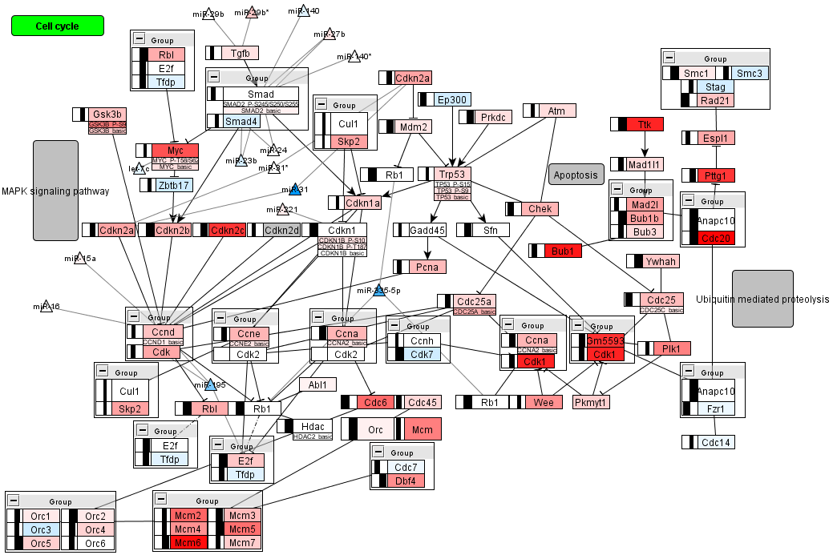

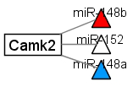

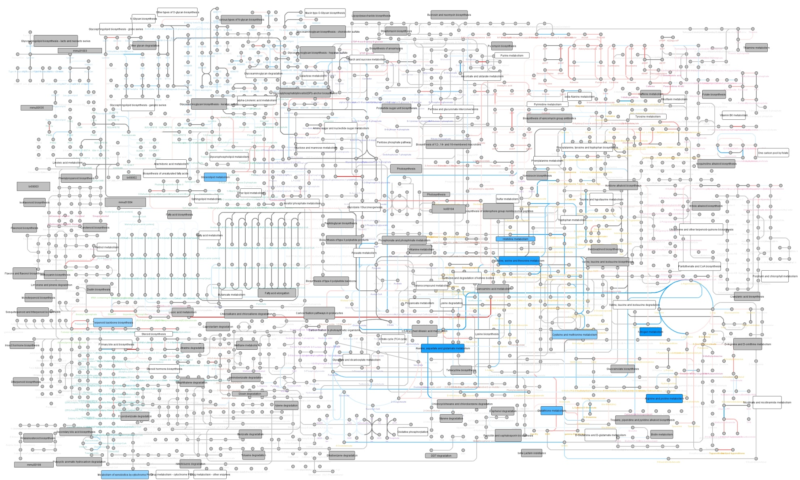

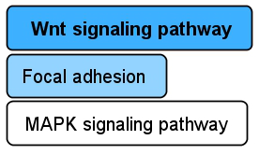
A
Data types
mRNA
miRNA
Protein modification
Metabolite
DNAm
Pathway
Color keys
upregulated
no difference
downregulated
no data
mRNA target
same colors as mRNA
same colors as mRNA
B
hypermethylated
no difference
hypomethylated
log₂ fold change (e.g. mRNA)
-1.5
0
1.5
p-value (e.g. Pathways)
0
0.05

