Slide 1
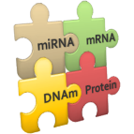
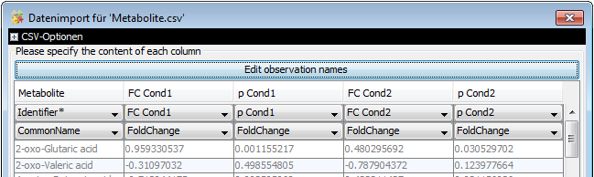
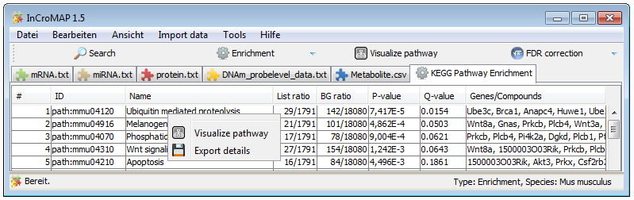
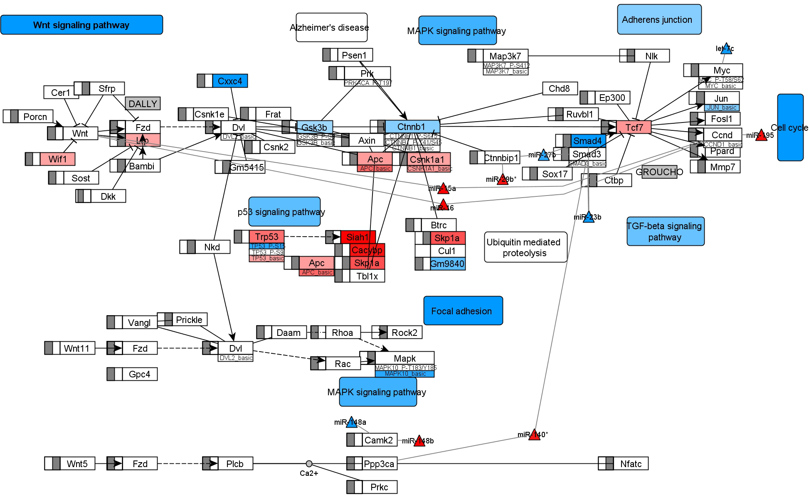
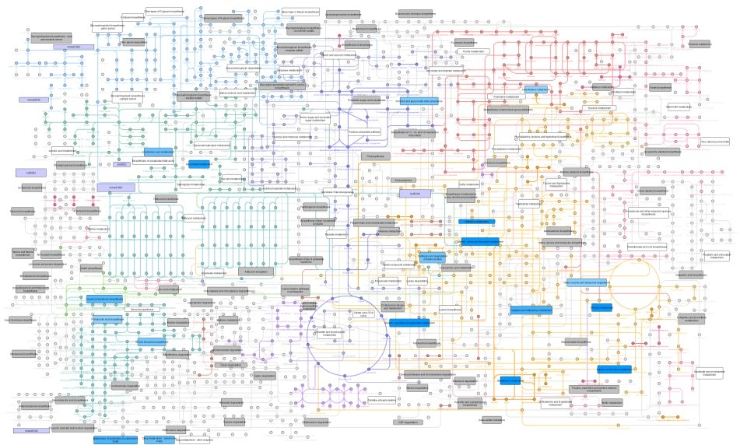
mRNA
miRNA
DNAm
Protein
Metabolite
Preprocessing ?
e.g. with ….
Preprocessing
e.g. OpenMS
Normalization and statistical analysis with appropriate software
e.g. MayDay, R, IBM SPSS, SAS JMP
Annotation with gene and metabolite identifiers
InCroMAP
Import data from heterogeneous sources
Single platform enrichment
Integrated multi-omics enrichment
Select pathway of interest for integrated visualization
Integrated visualization of enrichment in metabolic overview

