Slide 1
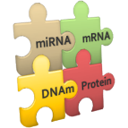
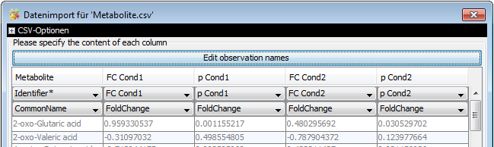
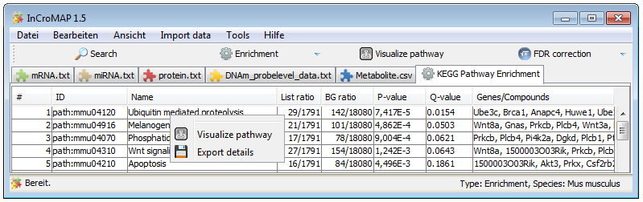
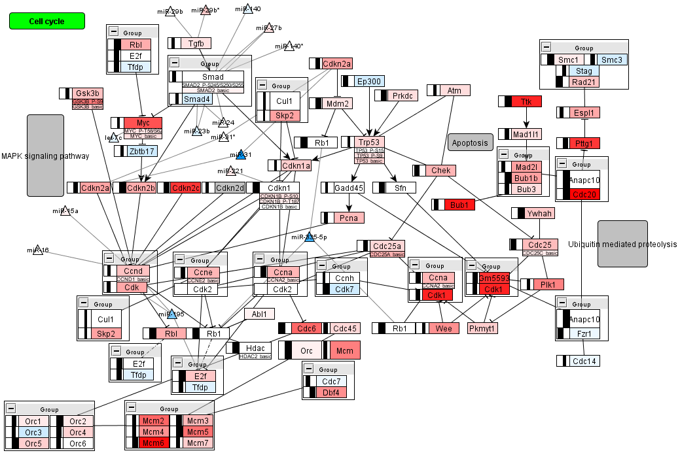
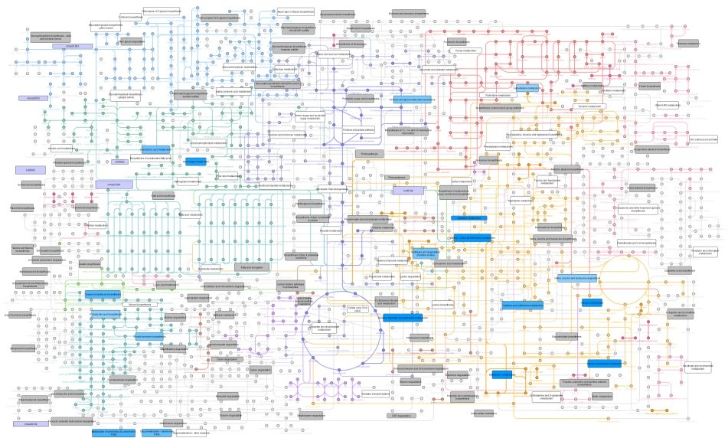
mRNA
miRNA
DNAm
Protein
Metabolite
Preprocessing ?
e.g. with ….
Pre-processing
e.g. OpenMS
Normalization and statistical analysis with appropriate software
e.g. R (BioConductor and other packages), SPSS, SAS
InCroMAP
Import data from heterogeneous sources
Single platform enrichment
Integrated multi-omics enrichment
Select pathway of interest for integrated visualization
Integrated visualization of enrichment in metabolic overview

