Slide 1
Microservices NodeConfEU 2015
@pelger
@mcollina

Slide 2
Micro-services
NOT a new concept
See ‘unix’ and all that…
SOA done right
Mixing point to point / Bus
Very much in vogue
But we feel for good reason

Slide 3
Monolithic
Faster to begin with
Doesn’t scale
Deployment is easy
Testing is HARD
Example R on R
Big bang deployment is SCARY

Slide 4
Microservices
Micro-services accelerate development
Small components – easily grokked
Independently deployable
Easily replaceable
Scales better
Distributed by nature
Optimized for delete
Greg Young - https://vimeo.com/108441214

Slide 5
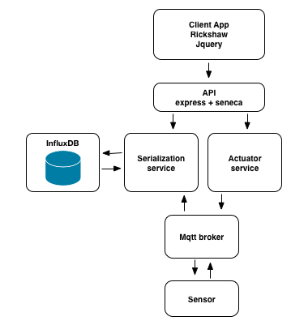
Lets build a system…

Slide 6
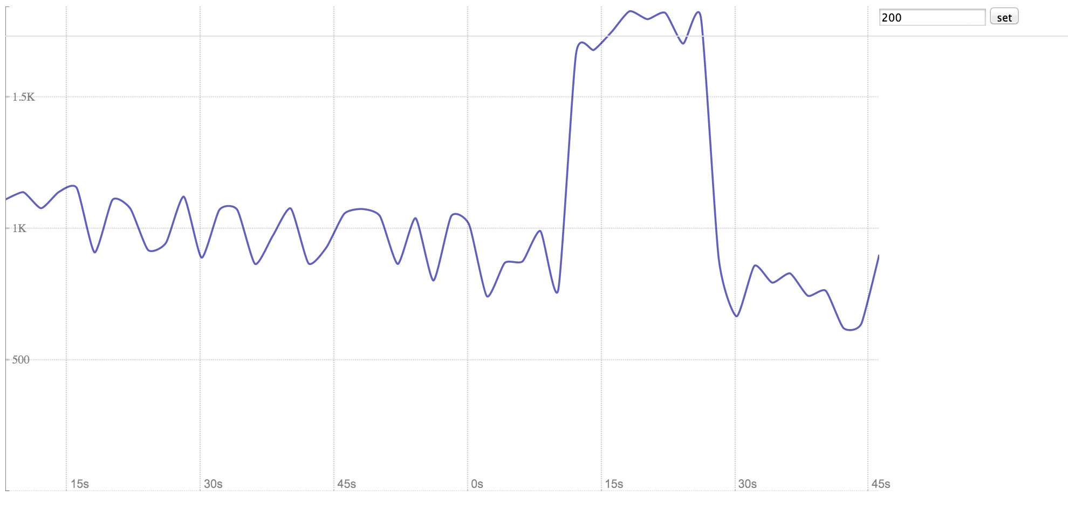
Lets build a system…

Slide 7
We will be using…
Rickshaw charts + socket.io
Node.js + express
Seneca (Microservices framework)
Mosca (MQTT broker)
InfluxDB (Time series database)
Docker

Slide 8
Buzzword Bingo!
Microservices + IoT + Docker
In one workshop!
You’re being spoilt
I drink G&T’s
Matteo prefers beer
Microservices in action
Cocktail robot!!

Slide 9
Prerequisites
TODO – prereqs page on server with download links
Install docker / docker-machine
Provide download link
Setup npm
Details here
Install bower
cacahe bower
Grab the code (tarball or gitub)
Tarball on server or git repo
Setup to point to our docker registry
Details here

Slide 10
Step 0 – Build the frontend
Step0/README.md
Build and run the front end as a container

Slide 11
Step 1 – Add websockets
Clone the step1 repository
Grab the socket.io module
Move the random value generation code to the api layer
Emit data events to the client
Rebuild the container
Should work as before

Slide 12
Step2 – Data writer service
Cone the step2 repository
Pull the influxDB container
Docker pull …
Start influx
docker run -d -p 8083:8083 -p 8086:8086 --expose 8090 --expose 8099 tutum/influxdb
Connect to the container and create a database
docker exec -ti fee /opt/influxdb/influx
Create database temperature
Write the handler to push data into influxDB
Hint: see influxUtil

Slide 13
Step 2 – Data writer service
Make the test case work
mocha test.js
Check that there is data in influx
Select * from temperature;
Build the container
Run the container
docker run -p 3001:3001 -e SERVICE_HOST=0.0.0.0 -e SERVICE_PORT=3001 -e INFLUX_HOST=$DOCKER_IP serializer

Slide 14
Step 2 – Data writer service
Make the test case work
mocha test.js
Check that there is data in influx
Select * from temperature;
Build the container
Run the container
docker run -p 3001:3001 -e SERVICE_HOST=0.0.0.0 -e SERVICE_PORT=3001 -e INFLUX_HOST=$DOCKER_IP serializer

Slide 15
Step 2 – Data writer service
Test the container
See commands.txt
Point is to run as a process first before putting in a container

Slide 16
Step 3 – Docker compose
Clone the step 3 repo
Stop all running containers
Docker kill $(docker ps –a –q)
Now start the system using docker compose
docker-compose up -d

Slide 17
Step 4 – Mqtt Broker
Clone the step 4 repo
Add the broker container to docker-compose.yml
Start the system
docker-compose up –d

Slide 18
Step 5 – reader service
Clone the step 5 repo
Add a seneca handler to read data from influx db
Add the reader service to docker-compose.yml
Restart the system
Test the reader service

Slide 19
Step 6 – Hook up to the front end
Clone the step 6 repo
Replace the random value generator with a call to the data reader service
The solution should send each data point once only
Re-build the front end container
Re-start the system
View the chart

Slide 20
Step 7 – add an actuator service
Clone the step 7 repo
Build the actuator service
Test with Curl

Slide 21
Step 8 – Hook up the actuator
Clone the step 8 repo
Add a button and input value to the front end
Add a route to the API
Call the actuator
Rebuild the system and run it
View the charts and call the actuator

Slide 22
Step 42 – Beer O’Clock
Close your laptop
Make your way to the bar
Order beer
Repeat…
Thank you!
@pelger @mcollina

Slide 23
Taverymuch

