Slide 1
Microservices NodeConfEU 2015
@pelger
@mcollina

Slide 2
Microservices
NOT a new concept
See ‘unix’ ☺
Small, focused, decoupled components
Independently deployable
Architectural style particularly suited to node.js

Slide 3
Benefits
Accelerated development
Small components – easily grokked
Independently deployable
Easily replaceable
Inherently scale-able
Distributed by nature
Optimized for delete
Greg Young - https://vimeo.com/108441214

Slide 4
We will be using…
Rickshaw charts + socket.io
Node.js + express
Seneca (Microservices framework)
Mosca (MQTT broker)
InfluxDB (Time series database)
Docker

Slide 5
Buzzword Bingo!
Microservices + IoT + Docker
In one workshop!
Practical example of microservices in action
Cocktail robot!!

Slide 6
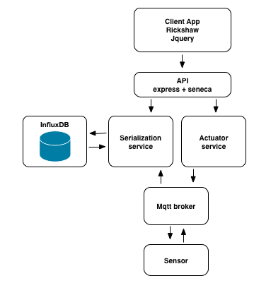
Let’s build a system…

Slide 7
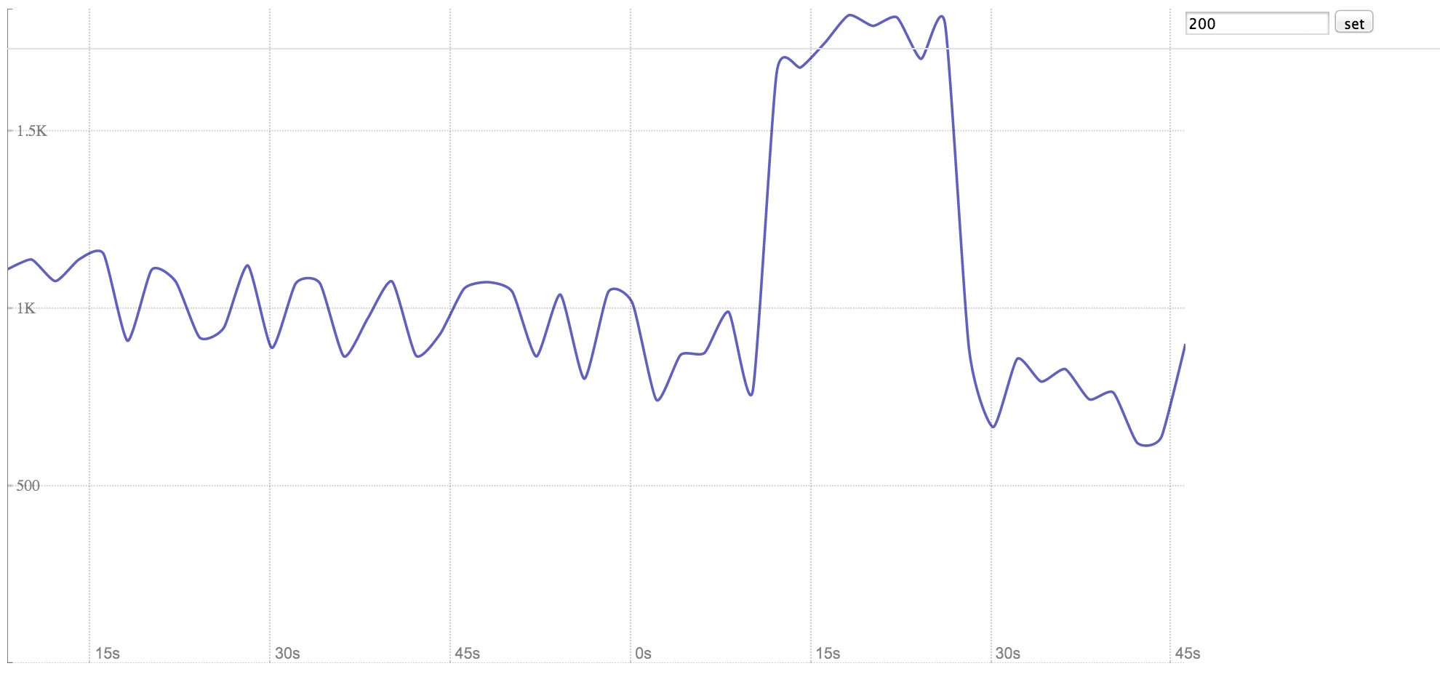
Let’s build a system…

Slide 8
Prerequisites
Go to: http://192.168.3.12/
Follow the setup instructions!

Slide 9
You should have
Run ‘docker ps’
Should execute and show no processes
Run ‘docker images’
Should show two images loaded
node
tutum/influxdb

Slide 10
Get the workshop
Clone:
git@github.com:nearform/msworkshop.git
Or grab the tarball from a key drive

Slide 11
Step 0 – Build the frontend
Step0/README.md
Build and run the front end as a container
Hint
Docker build –t frontend .

Slide 12
Step 1 – Add websockets
Step1/README.mc
Move the data generation function to the back end

Slide 13
Step2 – Data writer service
Step2/README.md
The `step2` folder has a skeleton for the serializer service, your challenge is to write a [Seneca](http://senecajs.org) handler to write points to influxdb.

Slide 14
Step 3 – Docker compose
Step3/README.md
Running multiple containers individually is error prone, your challenge is to use docker-compose. In this step you will create a docker compose yml file to launch all our containers with a single command.

Slide 15
Step 4 – Mqtt
Step4/README.md
You are provided with a dummy sensor and a MQTT broker service, your challenge is to wire these into the docker compose yml.

Slide 16
Step 5 – read handler
Step5/README.md
Your challenge is to add a read action handler to select data from influx the handler should take a start and end time and also a sensor id as input parameters and return time series data.

Slide 17
Step 6 – Connect read handler
Step6/README.md
Your challenge is to wire the data reader up to the front end. To do this you will need to replace the radom value generator in the frontend/api/index.js with a call to read data from the serializer service.

Slide 18
Step 7 –
Step7/README.md
Your challenge is to wire up the actuator micro-service. The actuator service is provided for you in services/actuator. The actuator service will send a new offset message to the sensor via the mqtt broker.

Slide 19
Step 8 – Beer O’Clock
Close your laptop
Make your way to the bar
Order beer
Repeat…
Thank you!
@pelger @mcollina

