Slide 1


Managing data availability and integrity
in federated cloud storage
Krzysztof Styrc
Department of Computer Science AGH
Supervisor:
Marian Bubak
Consultancy:
Piotr Nowakowski, ACC Cyfronet AGH
Reviewer:
Dawid Kurzyniec, Google Kraków

Slide 2
Agenda
Introduction
Motivation
VPH-Share project background
Objectives of the thesis
State of the art
Overview of methods for data integrity
Proof of Retrievability (POR)
Data integrity proof (DIP)
Design and implementation
Data validation algorithm
Design of Data Reliability and Integrity (DRI) service
Example of DRI service operation
Summary and future work

Slide 3
Motivation
Cloud storage problems
data stored on external resources of (untrusted) cloud provider
best-effort SLAs definition, return of costs otherwise
cloud vendor lock-in effect
numerous cloud storage failures and security flaws [1]
deleted emails, millions of blocked accounts in Gmail service
multiple Amazon S3 downtimes reports
unauthorized access to files in GoogleDocs
Cloud storage data integrity challenges
network latency and bandwidth limits
fine-grained access pattern overhead
WAN networks (Internet) bandwidth outages
costs of [2]
data storage (per volume)
data transfer (per # of requests, per volume)
simplified API, no computation available without retrieval
[1] C. Cerin et al: Downtime statistics of current cloud solutions, IWGCR, June 2013
[2] Amazon S3, Google Cloud Storage, Rackspace storage official pages

Slide 4
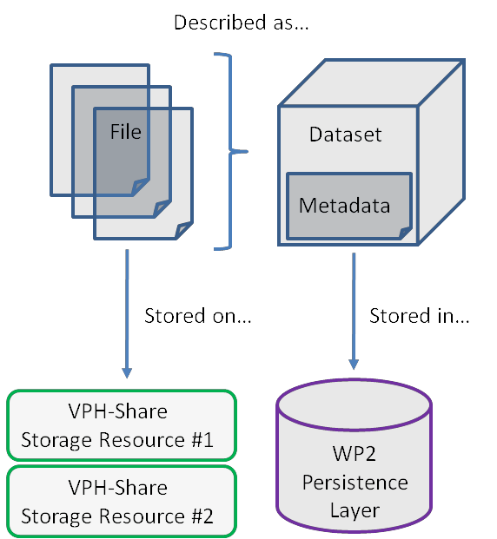
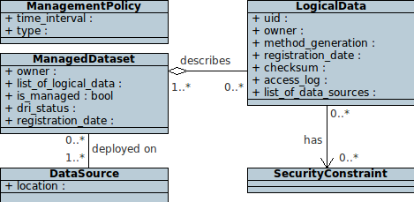
VPH-Share project background [1]
Data in VPH-Share
mostly static and sensitive, biomedical data
stored in federation of cloud storage providers to
avoid vendor lock-in effect
provide fault tolerance against provider failures
storage entity defined as dataset (simply, a set of files)
Data integrity requirements
Periodical monitoring of data availability and integrity
Network-efficient data validation
reduce whole-file retrieval overhead
reduce costs
Replication of datasets in cloud federation
[1] P. Nowakowski et al: VPH-Share WP2: Data and Compute Cloud Platform, Deliverable 2.2, VPH-Share 2011

Slide 5
Objectives
The aim of this thesis is to develop a method to efficiently monitor the availability and integrity of data stored in federation of cloud storages.
Detailed objectives of this work
literature research on efficient cloud storage validation algorithm
design of network-efficient data validation algorithm
design and implementation of validation web service prototype
integration with VPH-Share platform

Slide 6
Overview of methods for data integrity
Data integrity building blocks
Hash functions (MD5, SHA-1, SHA-256)
Message authentication code (MAC) – integrity and authenticity assurance
Error correcting code (ECC) – corruption detection and correction
Popular approaches
MD5/SHA-1 software package checksumming
integrity checksums of messages in networking
Widespread use of ECCs in hardware solutions
Existing methods fail in cloud storage model due to
huge amount of data
stored on external resources

Slide 7
Proof of Retrievability
Prepare for data validation
divide a file F into b blocks and apply ECCs
encrypt the file with appended ECCs
select m blocks out of M, compute their MACs and append to the file
Perform data validation
choose k out of m blocks and download their content
compute MACs and compare with the originals
When retrieving whole file, apply ECCs
Drawbacks of the approach
modification of file F
ECCs storage overhead
for network-efficient validation, requires computing capabilities on the prover side
A. Juels and B. Kaliski: PORs: Proofs of Retrievability for Large Files, ACM CCS, 2007

Slide 8
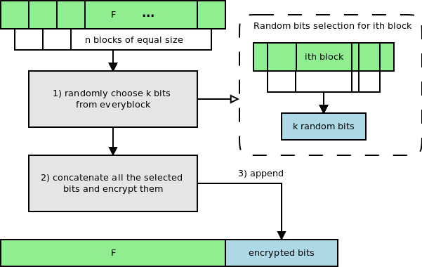
Data integrity proof
Drawbacks of the approach
Inefficient with regard to current cloud REST APIs, where every non-contiguous bit range requires separate HTTP request
Prepare for data validation
divide a file F into n blocks and select randomly k bits from every block using key generator
concatenate all selected bits and encrypt them
append encrypted bits to the end of file
Perform data validation
select the same bits and concatenate
compare with the originals
S. Kumar and A. Saxena: Data integrity proofs in cloud storage, COMNETS, 2011

Slide 9
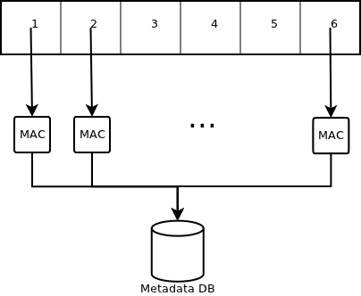
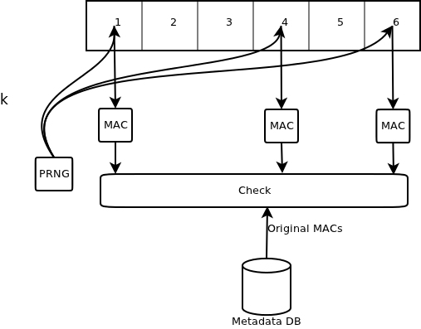
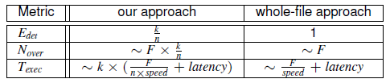
Data validation algorithm
Prepare for data validation
divide file F into n equal chunks
compute MAC checksum for every chunk and store
Perform data validation
randomly select k out of n chunks
compute MAC checksum of selected chunks and compare with the originals

Slide 10
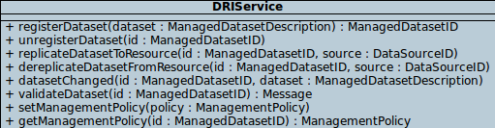
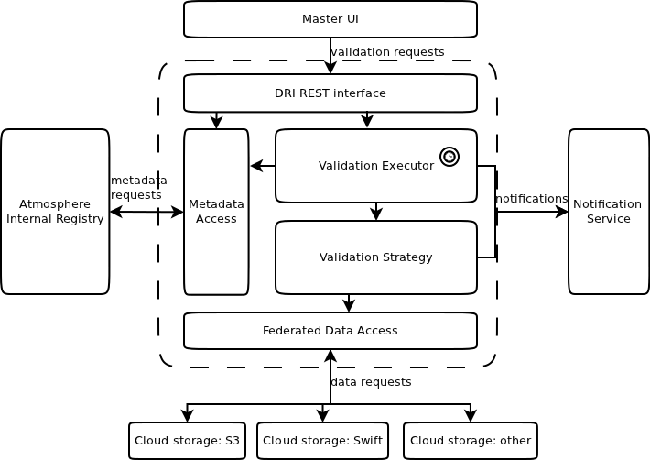
Design of Data Reliability and Integrity (DRI)
DRI service
stateless REST web service in VPH-Share cloud environment
periodical and on-request probabilistic data validation of data in federation of cloud storages
datasets and validation metadata stored in AIR registry
notifying scientific users via Notification service
asynchronous calls and batch execution
Implementation technologies
JClouds library – generic cloud storage abstraction
Quartz – task scheduling
JAX-RS – REST web service
Java, Guice, Guava, Tomcat

Slide 11
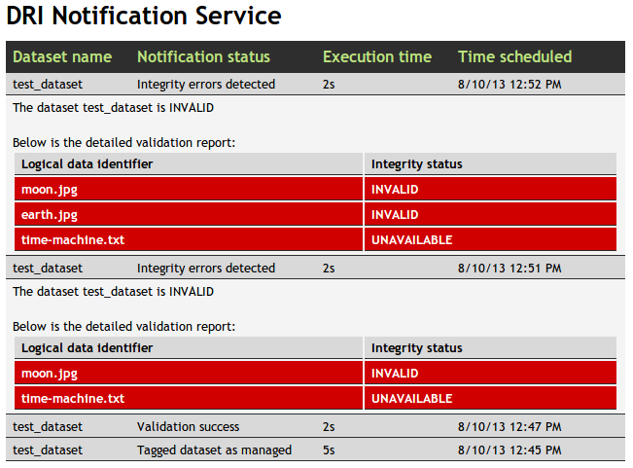

Slide 12
Summary and future work
Results
proposed a network-efficient algorithm for data validation in the cloud
proposed methodology how to address the problem of providing data reliability and integrity in the cloud
enabled VPH-Share project users to monitor data integrity and notify in case offailures
Future work
investigate how to combine DRI monitoring service with federated cloud storage data access layer
extract DRI functionality and provide it as a reusable component outside of the VPH-Share project
investigate further improvements of data validation algorithm

Slide 13
Acknowledgement
More at http://dice.cyfronet.pl/VPH-Share
This thesis was realized partially in the framework of the following projects:
Virtual Physiological Human: Sharing for Healthcare (VPH-Share) – partially funded by the European Commission under the Information Communication Technologies Programme (contract number 269978)

