Slide 1





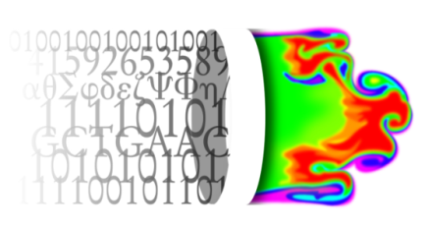



VPH-Share
2nd March 2011
Kraków, Poland
WP2 T2.5: Data Reliability and Integrity (DRI)
Krzysztof Styrc, ACC CYFRONET
VPH-Share (No 269978)

Slide 2
DRI: overview
Long-term persistence of medical data sets requires reliability and integrity mechanisms to be built on top of Cloud storage. DRI is designed to fullfill these requirements by performing the following tasks:
periodic and request-driven integrity checks on data sets,
facilitating storage of multiple copies of data on various Cloud platforms,
tracking the history and origin of binary data sets.
Datasets validation:
availability of each dataset at its (multiple) locations,
the integrity of each dataset’s file (checksum-based).

Slide 3
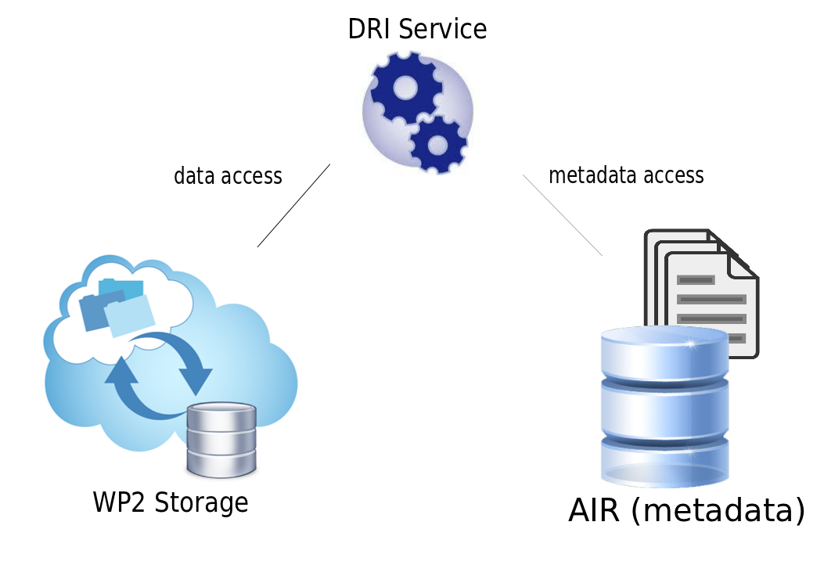
DRI: service idea
DRI Service characteristics:
stateless REST WebService,
built on top of AIR registry and WP2 Storage
self-working (periodic checks) and API access.

Slide 4
DRI: current implementation
Current functionalities:
supported requests: dataset validation and adding dataset under management (computing its checksums),
integrity checks based on SHA-256 hash of the file,
asynchronous operations added to queue of a simple scheduler,
report notifications (validation success/failure or finished adding dataset under management) as emails,
Current REST API:
compute_dataset_checksums/{datasetID} – asynchronously
computing dataset’s files checksums and notify by email,
validate_dataset/{datasetID} – asynchronously validate dataset and notify by email.

Slide 5
DRI: future work
On-going work:
further integration with AIR registry,
support for S3 storage besides Swift,
efficient validation algorithm research,
periodic validation based on scheduler,
Datasets validation concerns:
the number and size of stored datasets can be vast,
existing Cloud storage API’s (Swift, S3) flexibility is limited,
serving data – primary service , validation – secondary service,
need for efficient and effective validation algorithm.

Slide 6
DRI: demo description
Subsequence demo steps:
create new dataset,
crawl dataset using AIR,
mark dataset as managed (default),
compute dataset checksums → receive email,
validate dataset → receive success email,
modify dataset,
validate dataset again → receive failure email.

