Slide 1


Developing a MEDIA Fragment NODE.JS SERVER
Master degree thesis
Pasquale Lisena

Slide 2

What is a “media fragment”?
“[...] to make media a “first class citizen” on the Web, it needs to be as easily linkable as HTML pages. Only when we can link into media resources, will we really be able to share the important parts of a media resource.”
D. Van Deursen, R. Troncy, et al. Implementing the Media Fragments URI Specification.
MEDIA FRAGMENTS URI 1.0 RECOMENDATION

Slide 3
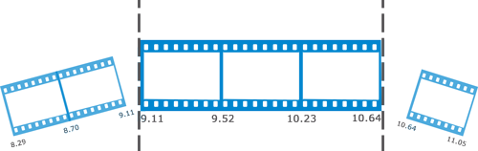

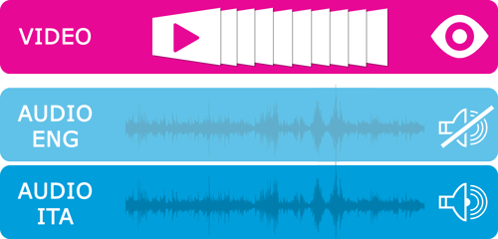

What is a “media fragment”?
Temporal Dimension
Track Dimension
Spatial dimension (xywh)
Named dimension (id)

Slide 4
What is a “media fragment”?
Query format
http://www.example.com/example.ogv?t=10,20
Server generates the fragment resource
Hash format
http://www.example.com/example.ogv#t=10,20
HTTP Range request (time)
User Agent is in charge of display it correctly

Slide 5
WHY media fragments?
BOOK- MARK
SHARE
PIN
SAVE BAND

Slide 6










Clients VIDEO PLATFORMS
State of the art
TEMPORAL
NPT (hh:mm:ss)
SMPTE - Clock
SPATIAL
Only start
Not standard syntax

Slide 7
State of the art
Mediafragment.js
https://github.com/tomayac/Media-Fragments-URI/
MediaFragments.parse( "http://www.example.com/video.ogv
?t=1:00:00#t=npt:10,20
&xywh=percent:25,25,50,50" );
{
"query":{
"t":[
{
"value":"1:00:00",
"unit":"npt",
"start":"1:00:00",
"end":"",
"startNormalized":3600,
"endNormalized":""
}
]
},
"hash":{
"t":[
{
"value":"npt:10,20",
"unit":"npt",
OUR
CONTRIBUTION
Alignment to specification
Controls for percent spatial frags
Node.JS module

Slide 8
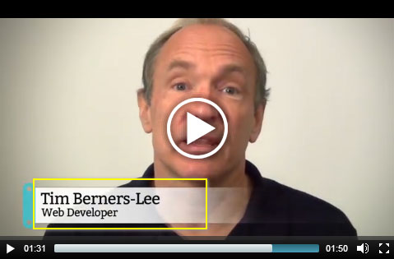
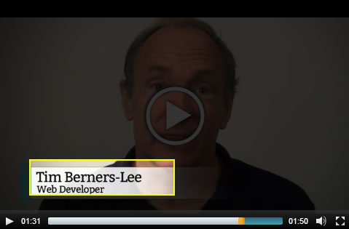
State of the art
CLIENT IMPLEMENTATIONS
Synote media fragment player
https://github.com/pasqLisena/Media-Fragment-Player
Cross-browser (Flash fallback)
HTML5, YouTube, Daylimotion, Vimeo support
HTML5-like interface
OUR
CONTRIBUTION

Slide 9
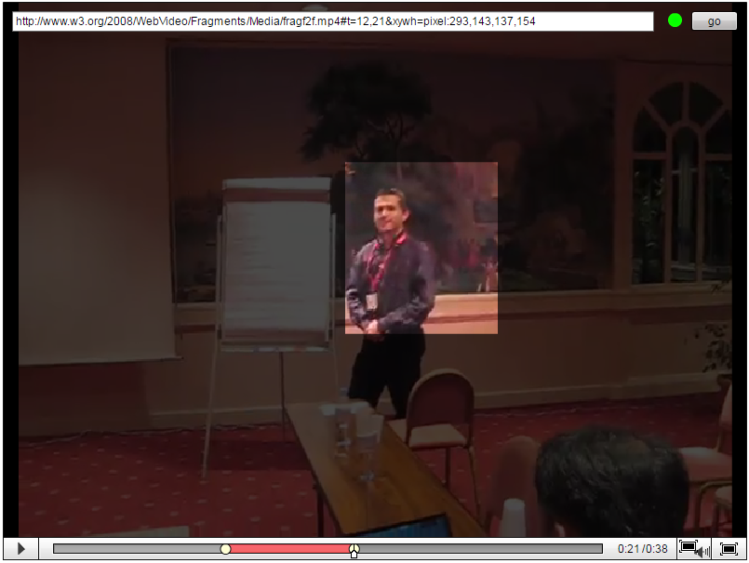
State of the art
CLIENT IMPLEMENTATIONS
NINSUNA media fragment player
http://ninsuna.elis.ugent.be/MediaFragmentsPlayer

Slide 10
State of the art
SERVER IMPLEMENTATIONS
NINSUNA MEDIA FRAGMENT
SERVER
RAFAEl
http://ninsuna.elis.ugent.be/MediaFragmentsServer
https://github.com/Noterik/Rafael
Preliminary process of media resources
Structural metadata stored in a RDF triplestore
Annotation system
Media adaptation and binarization
Support for Time range request
Fragment extraction on the fly
Java lib mp4parser
Fragment stored on filesystem
Support only for query fragments

Slide 11




THE GOAL
Query Fragment
Time (npt)
Track (video/audio)
Xywh (?)
Hash fragment
Range request (npt)

Slide 12
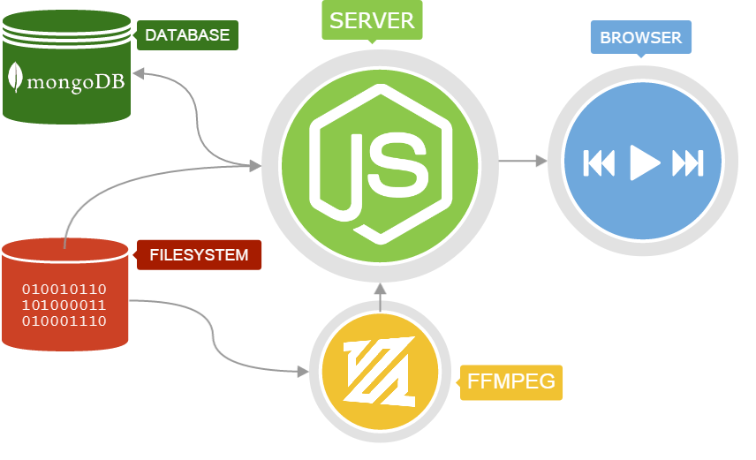
MAFFIN ARCHITECTURE

Slide 13
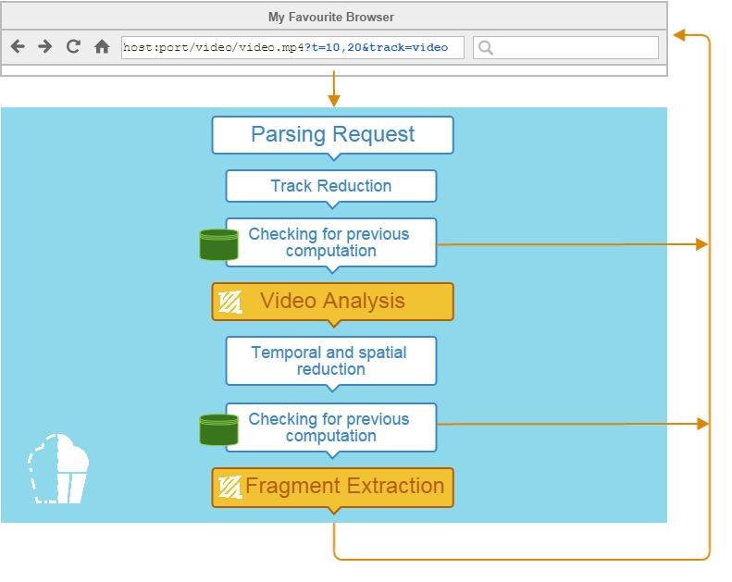
Implementation of the Server
QUERY FRAGMENT FLOW

Slide 14
PARSING THE REQUESTS
Media Fragment URI
media-
fragment.js
t = 00:00:10, 00:00:20
JSON
Start=10
End=20
Parsing
URI Error Detection
xywh = percent: 200,10,20,20

Slide 15
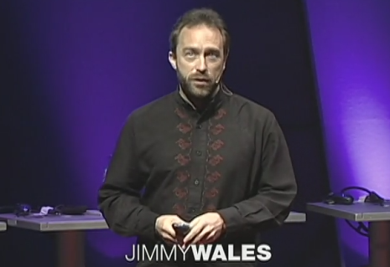
REDUCTION
video.mp4
? t= 00:00:10, 00:00:20
& xywh=0,0,400,220
& track=video & track=audio
00:21:43
220px
t=10,20
Spatial reduction
Track reduction
Time reduction
400px
video_10-20.mp4
originalFileName[_START[-END]][_TRACKNAME][_[PERCENT]X-Y-W-H].origFmt

Slide 16
VIDEO ANALYSIS
ffprobe
analysis tool of ffmpeg
GENERAL PROPERTIES
about the entire video
Duration
Height and Width
FRAME PROPERTIES
about each frame
Type (I, P or B)
Time
Duration
Byte position
Byte length

Slide 17
Checking for previous computations
We use the database as smart cache
avoiding re-doing the ffmpeg process of a previous fragment
alias detection
GridFS

Slide 18
Checking for previous computations
We can “cut” only in correspondence to Intra-coded frames
video_10-20 and video_11-20 are byte identical → ALIASES
GridFS
ALIASES Collection
video_10-20
video_10.45-19.41
video_11-20

Slide 19
Checking for previous computations
video_10_20.mp4
Check in aliases table
Video analysis
Check in GridFS
Extract the fragment

Slide 20
FRAGMENT EXTRACTION
FRAGMENT QUERY | FFMPEG OPTION | NOTE
t=10 | -ss 10
t=,20 | -to 20
t=10,20 | -ss 10 -to 20
track=video | -an | no audio
track=audio | -vn | no video
xywh=10,10,50,60 | -filter:v "crop=50:60:10:10" | require transcoding
xywh=percent:10,10,50,60 | -filter:v "crop=in_w*50/100:in_h*60/100:in_w*10/100:in_h*10/100" | require transcoding
ffmpeg -i C:/video/video.mp4 -ss 10 -to 20 C:/video/out/video_10-20_.mp4

Slide 21

FRAGMENT EXTRACTION

Slide 22
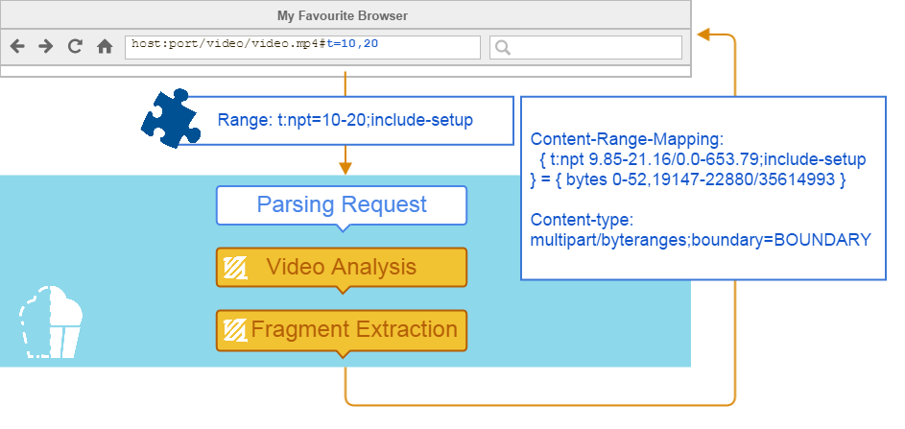
TIME Range requests

Slide 23
TIME Range requests
REQUEST | RESPONSE
GET /video.ogv HTTP/1.1 Host: www.example.com Accept: video/* Range: t:npt=10-20 | HTTP/1.1 206 Partial Content Accept-Ranges: bytes, t, id Content-Length: 3743 Content-Type: video/ogg Content-Range: bytes 19147-22880/35614993 Content-Range-Mapping: { t:npt 9.85-21.16/0.0-653.79 } = { bytes 19147-22880/35614993 } Etag: "b7a60-21f7111-46f3219476580" {binary data}

Slide 24
TIME Range requests
REQUEST | RESPONSE
GET /video.ogv HTTP/1.1 Host: www.example.com Accept: video/* Range: t:npt=10-20; include-setup | HTTP/1.1 206 Partial Content Accept-Ranges: bytes, t, id Content-Length: 3795 Content-Type: video/ogg Content-Range-Mapping: { t:npt 9.85-21.16/0.0-653.79;include-setup } = { bytes 0-52,19147-22880/35614993 } Content-type: multipart/byteranges; boundary=BOUNDARY Etag: "b7a60-21f7111-46f3219476580" --BOUNDARY Content-type: video/ogg Content-Range: bytes 0-52/35614993 {binary data} --BOUNDARY Content-type: video/ogg Content-Range: bytes 19147-22880/35614993 {binary data} ---BOUNDARY--
METADATA:
Bytes until first frame
DATA:
Byte range built with ffprobe

Slide 25
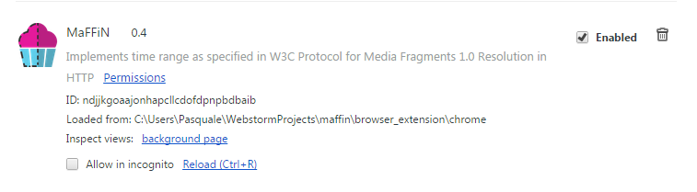
A chrome extension
#t=10,20
Range: t:npt=10-20;
include-setup
mediafragment.js

Slide 26
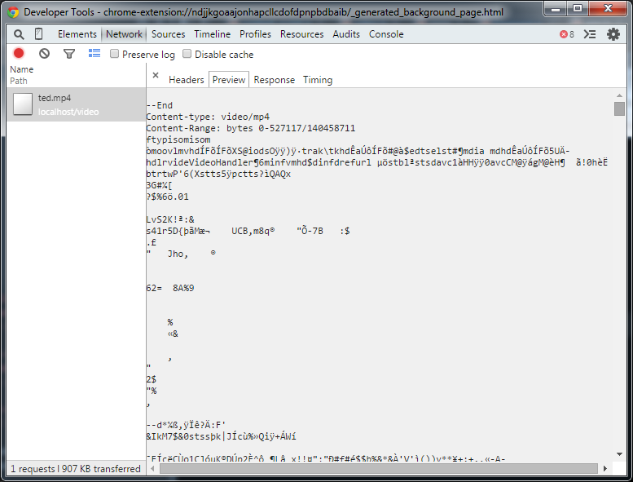
A CHROME EXTENSION

Slide 27
Conclusion and future works
We contribute to the generic "media-fragment.js" polyfill and prepare a node.js version (open source)
We contribute to the Synote Media Player to build a more generic media fragment player (open source)
We discover bugs in the W3C specification and proposed amendments (revised text) to be endorsed by W3C
We implement a media fragment server in node.js (using ffmeg) + a smart cache (based on MongoDB)
Future work: finalize the Chrome extension so that the browser understand the response from the server and test MaFFiN on a more large scale environment.

Slide 28
THANK YOU
FOR THE ATTENTION

