Slide 1
Q-Learning
심현아
5
off

Slide 2


Q-Learning
hyuna
5
$$π^{∗}\left(s\right)=\underset{a}{argmax}{Q(s,a)}$$
$$Q\left(S_{t},a_{t}\right)←r_{t+1}+ γ\underset{a}{argmax}{Q\left(S_{t+1},a_{t+1}\right)}$$
off
Q-Value를 최대화하는 action을 취하도록 학습

Slide 3
Q-Learning gridworld example
hyuna
5
9 States
4 Actions (up, down, left, right)
= 시작
= 도착
= 시작
= 도착
off
 |  | R = 1
 |  | R = 1
0
0
0
1

Slide 4
Q-Learning gridworld example
hyuna
5
9 States
4 Actions (up, down, left, right)
= 시작
= 도착
= 시작
= 도착
off
 |  | R = 1
0
 |  | R = 1
0
0
1
0
0
0
0
0
0
1
1

Slide 5
Return vs Value
hyuna
5
[Retrun]
현재 정책을 따랐을 때 얻을 수 있는 보상의 합
평가가 포함되어 있지 않음
[Value]
대수의 법칙을 따라 예상되는 모든 return의 평균
몬테카를로 방식을 이용
( 반복 무작위 샘플링으로 함수의 값을 수리적으로 근사)
off

Slide 6
State Value Function
hyuna
5
= 시작
= 도착
= 시작
= 도착
off
어떤게 더 가치 있다고 할 수 있을까?

Slide 7


State Value Function
hyuna
5
= 시작
= 도착
= 시작
= 도착
1.0
1.0
off
1.0
0.1
1.0
1.0
0.9
1.0
$$V= γ^{3}R$$
$$V=0.9γR+0.1γ^{2}R$$

Slide 8
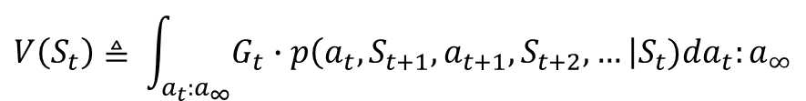
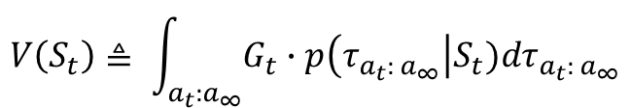
State Value Function
hyuna
5
$$G_{t}= R_{t+1}+ γR_{t+2}+γ^{2}R_{t+3}+ …$$
$$V\left(S_{t}\right)=E\left[G_{t} | S_{t}\right]=E[R_{t+1}+ γ{V(S}_{t+1})|S_{t}]$$
off
해당 상태에서의 반환값의 기댓값
지금부터 기대되는 Return
$$V\left(S_{t}\right)≜ \int_{a_{t}:a_{∞}}{G_{t}∙p\left(τ_{a_{t}: a_{∞}}\right|S_{t})dτ_{a_{t}: a_{∞}}}$$
$$V\left(S_{t}\right)≜ \int_{a_{t}:a_{∞}}{G_{t}∙p\left(a_{t}, S_{t+1}, a_{t+1}, S_{t+2}, …\right|S_{t})da_{t}:a_{∞}}$$

Slide 9


Action Value Function Q-function
hyuna
5
= 시작
= 도착
= 시작
= 도착
off
0.1
0.1
1.0
0.9
1.0
0.9
1.0
1.0
$$Q(S_{t}, a_{t})=Q(S_{t},a=′navy′)=R$$
$$Q(S_{t}, a_{t})=Q(S_{t},a=′green′)=γ^{2}R$$

Slide 10
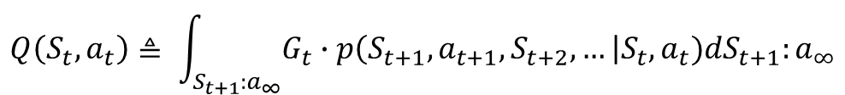
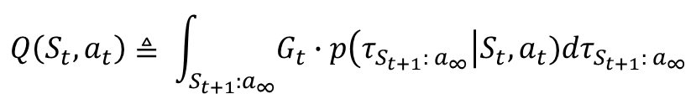
Action Value Function Q-function
hyuna
5
$$G_{t}= R_{t+1}+ γR_{t+2}+γ^{2}R_{t+3}+ …$$
Q-function
그 행동을 했을 때 얻는 반환값의 기댓값
지금 행동으로부터 기대되는 Return
$Q\left(S_{t}, a_{t}\right)=E[G_{t}|S_{t}, a_{t}]$ = $E[R_{t+1}+ γ{Q(S}_{t+1},a_{t+1})|S_{t},a_{t}]$
off
$$Q\left(S_{t}, a_{t}\right)≜ \int_{S_{t+1}:a_{∞}}{G_{t}∙p\left(τ_{S_{t+1}: a_{∞}}\right|S_{t}, a_{t})dτ_{S_{t+1}: a_{∞}}}$$
$$Q\left(S_{t}, a_{t}\right)≜ \int_{S_{t+1}:a_{∞}}{G_{t}∙p\left(S_{t+1}, a_{t+1}, S_{t+2}, …\right|S_{t},a_{t})dS_{t+1}:a_{∞}}$$

Slide 11
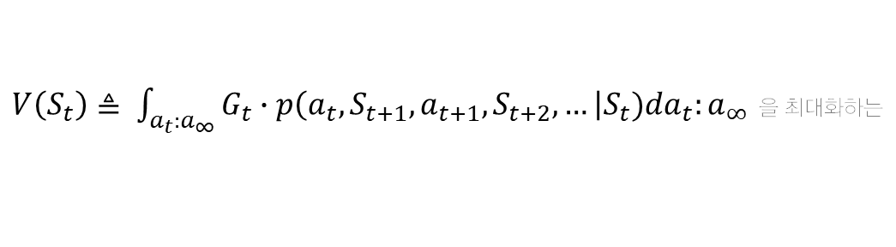
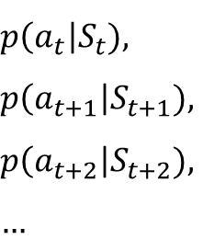
Optimal Policy
hyuna
5
State Value Function을 최대화하는 Policy
$$p\left(a_{t}\right|S_{t}),$$
$$p\left(a_{t+1}\right|S_{t+1}),$$
$$p\left(a_{t+2}\right|S_{t+2}),$$
$$…$$
off
$V\left(S_{t}\right)≜ \int_{a_{t}:a_{∞}}{G_{t}∙p\left(a_{t}, S_{t+1}, a_{t+1}, S_{t+2}, …\right|S_{t})da_{t}:a_{∞}}$ 을 최대화하는

Slide 12

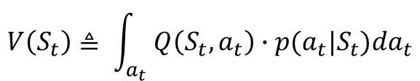
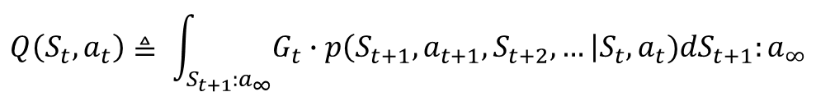
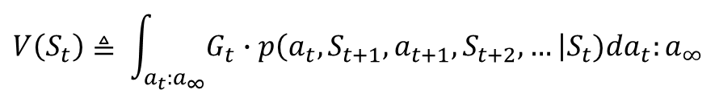
Bellman Equation
hyuna
5
$$V\left(S_{t}\right)≜ \int_{a_{t}:a_{∞}}{G_{t}∙p\left(a_{t}, S_{t+1}, a_{t+1}, S_{t+2}, …\right|S_{t})da_{t}:a_{∞}}$$
$$Q\left(S_{t}, a_{t}\right)≜ \int_{S_{t+1}:a_{∞}}{G_{t}∙p\left(S_{t+1}, a_{t+1}, S_{t+2}, …\right|S_{t},a_{t})dS_{t+1}:a_{∞}}$$
off
$$V\left(S_{t}\right)≜ \int_{a_{t}}{\int_{S_{t+1}:a_{∞}}{G_{t}∙p\left(S_{t+1}, a_{t+1}, S_{t+2}, …\right|S_{t},a_{t})dS_{t+1}:a_{∞}∙p(a_{t}|S_{t})da_{t}}}$$
$$V\left(S_{t}\right)≜ \int_{a_{t}}{Q\left(S_{t}, a_{t}\right)∙p(a_{t}|S_{t})da_{t}}$$
Beysian Rule
$$p\left(x,y\right)=p\left(x | y\right) ∙p\left(y\right)$$
$$p\left(x,y | z\right)=p\left(x | y,z\right)∙p(y|z)$$

Slide 13
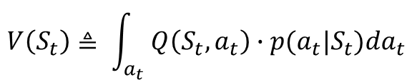
Bellman Equation
hyuna
5
= 시작
= 도착
$$V\left(S_{t}\right)≜ \int_{a_{t}}{Q\left(S_{t}, a_{t}\right)∙p(a_{t}|S_{t})da_{t}}$$
off
0.1
현재 상태에서 각각의 액션을 취했을 때 얻을 수 있는 Q값들의 평균
1.0
0.9
$$0.9 Q\left(S_{t},a=^{′}navy^{′}\right)+0.1 Q(S_{t},a=^{′}green′)$$
1.0

Slide 14

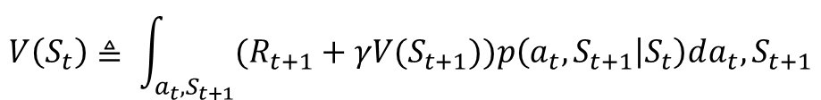
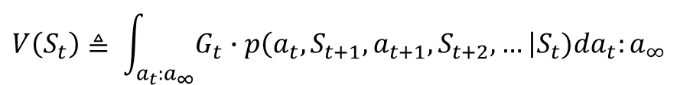
Bellman Equation
hyuna
5
$$G_{t}= R_{t+1}+ γR_{t+2}+γ^{2}R_{t+3}+ …= R_{t+1}+ γG_{t+1}$$
$$V\left(S_{t}\right)≜ \int_{a_{t}:a_{∞}}{G_{t}∙p\left(a_{t}, S_{t+1}, a_{t+1}, S_{t+2}, …\right|S_{t})da_{t}:a_{∞}}$$
$$V\left(S_{t}\right)≜ \int_{a_{t},S_{t+1}}{\int_{a_{t+1}:a_{∞}}{G_{t}∙p\left(a_{t+1}, S_{t+2}, …\right|S_{t},a_{t}, S_{t+1})da_{t+1}:a_{∞}∙p(a_{t},S_{t+1}|S_{t})da_{t}},S_{t+1}}$$
off
$$V\left(S_{t}\right)≜ \int_{a_{t},S_{t+1}}{\int_{a_{t+1}:a_{∞}}{{(R_{t+1}+γG}_{t+1})∙p\left(a_{t+1}, S_{t+2}, …\right| S_{t+1})da_{t+1}:a_{∞}∙p(a_{t},S_{t+1}|S_{t})da_{t}},S_{t+1}}$$
$$V\left(S_{t}\right)≜ \int_{a_{t},S_{t+1}}{{(R_{t+1}+γV(S}_{t+1}))p\left(a_{t},S_{t+1} | S_{t}\right)da_{t},S_{t+1}}$$
두 개의 변수에 대해서만 적분하면 되는 장점
$$p\left(S_{t+1} | S_{t},a_{t}\right)p\left(a_{t} | S_{t} \right)$$
Transition Probability
상태천이확률
Policy
정책
$$V\left(S_{t}\right)=E\left[G_{t} | S_{t}\right]=E[R_{t+1}+ γ{V(S}_{t+1})|S_{t}]$$

Slide 15
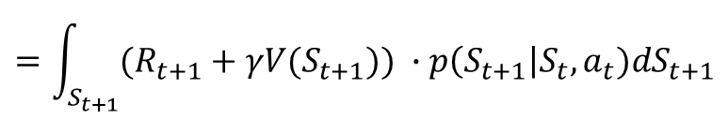
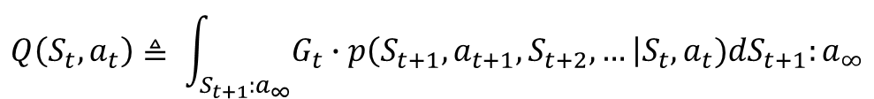
Bellman Equation
hyuna
5
$$Q\left(S_{t}, a_{t}\right)≜ \int_{S_{t+1}:a_{∞}}{G_{t}∙p\left(S_{t+1}, a_{t+1}, S_{t+2}, …\right|S_{t},a_{t})dS_{t+1}:a_{∞}}$$
$$=\int_{S_{t+1}}{\int_{a_{t+1}:a_{∞}}{({R_{t+1}+γG}_{t+1})p\left(a_{t+1}, S_{t+2}, …\right|S_{t},a_{t},S_{t+1})da_{t+1}:a_{∞}∙p\left(S_{t+1}\right|S_{t},a_{t})}dS_{t+1}}$$
off
$$=\int_{S_{t+1}}{({R_{t+1}+γV(S}_{t+1})) ∙p\left(S_{t+1}\right|S_{t},a_{t})dS_{t+1}}$$
Beysian Rule
$$p\left(x,y\right)=p\left(x | y\right) ∙p\left(y\right)$$
$$p\left(x,y | z\right)=p\left(x | y,z\right)∙p(y|z)$$

Slide 16
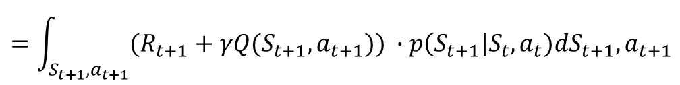
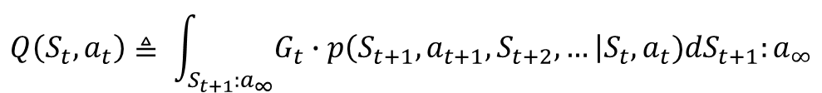
Bellman Equation
hyuna
5
$$Q\left(S_{t}, a_{t}\right)≜ \int_{S_{t+1}:a_{∞}}{G_{t}∙p\left(S_{t+1}, a_{t+1}, S_{t+2}, …\right|S_{t},a_{t})dS_{t+1}:a_{∞}}$$
$$=\int_{S_{t+1},a_{t+1}}{\int_{S_{t+2}:a_{∞}}{\left({R_{t+1}+γG}_{t+1}\right)p\left(S_{t+2},a_{t+2},…\right| S_{t+1},a_{t+1})dS_{t+2}:a_{∞}∙p\left(S_{t+1},a_{t+1}\right|S_{t},a_{t})}dS_{t+1},a_{t+1}}$$
off
$$=\int_{S_{t+1},a_{t+1}}{({R_{t+1}+γQ(S}_{t+1},a_{t+1})) ∙p\left(S_{t+1}\right|S_{t},a_{t})dS_{t+1},a_{t+1}}$$
$Q\left(S_{t}, a_{t}\right)=E[G_{t}|S_{t}, a_{t}]$ = $E[R_{t+1}+ γ{Q(S}_{t+1},a_{t+1})|S_{t},a_{t}]$
Beysian Rule
$$p\left(x,y\right)=p\left(x | y\right) ∙p\left(y\right)$$
$$p\left(x,y | z\right)=p\left(x | y,z\right)∙p(y|z)$$

Slide 17
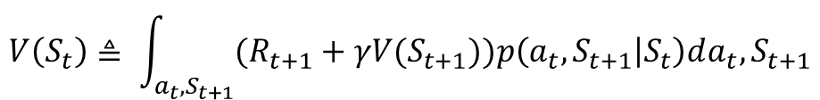
Why We Use Bellman Equation?
hyuna
5
$$V\left(S_{t}\right)≜ \int_{a_{t}:a_{∞}}{G_{t}∙p\left(a_{t}, S_{t+1}, a_{t+1}, S_{t+2}, …\right|S_{t})da_{t}:a_{∞}}$$
모든 변수에 대해 계산해야함
끝까지 도달해야만 계산 가능
$$V\left(S_{t}\right)≜ \int_{a_{t},S_{t+1}}{{(R_{t+1}+γV(S}_{t+1}))p\left(a_{t},S_{t+1} | S_{t}\right)da_{t},S_{t+1}}$$
off
변수의 개수가 확 줄음
$$V\left(S_{t}\right)=E\left[G_{t} | S_{t}\right]=E[R_{t+1}+ γ{V(S}_{t+1})|S_{t}]$$
인접한 바로 다음 상태의 가치만으로 현재의 가치 판단 가능
$Q\left(S_{t}, a_{t}\right)=E[G_{t}|S_{t}, a_{t}]$ = $E[R_{t+1}+ γ{Q(S}_{t+1},a_{t+1})|S_{t},a_{t}]$
인접한 바로 다음 Q값으로 현재의 Q값 판단 가능

Slide 18
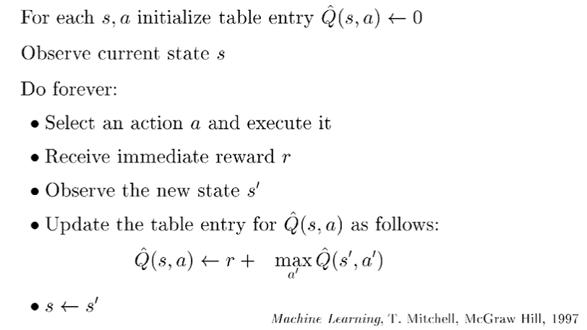
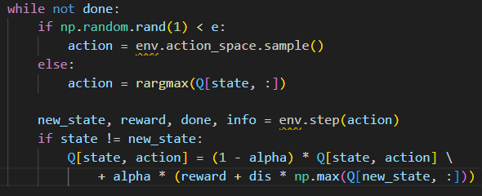
Q-Learning
hyuna
5
Q-Value를 최대화하는 action을 취하도록 학습
$$Q\left(S_{t},a_{t}\right)←r_{t+1}+ γ\underset{a}{argmax}{Q\left(S_{t+1},a_{t+1}\right)}$$
코드로 보기
off

Slide 19
Summary
hyuna
5
Q-Learning
반복을 통해 계속 Q값을 업데이트 하며 최적 방법을 학습하는 알고리즘
off

