Slide 1
Big operators in Agda
Leonhard Markert
Supervised by Timothy Griffin
and Dominic Mulligan

Slide 2
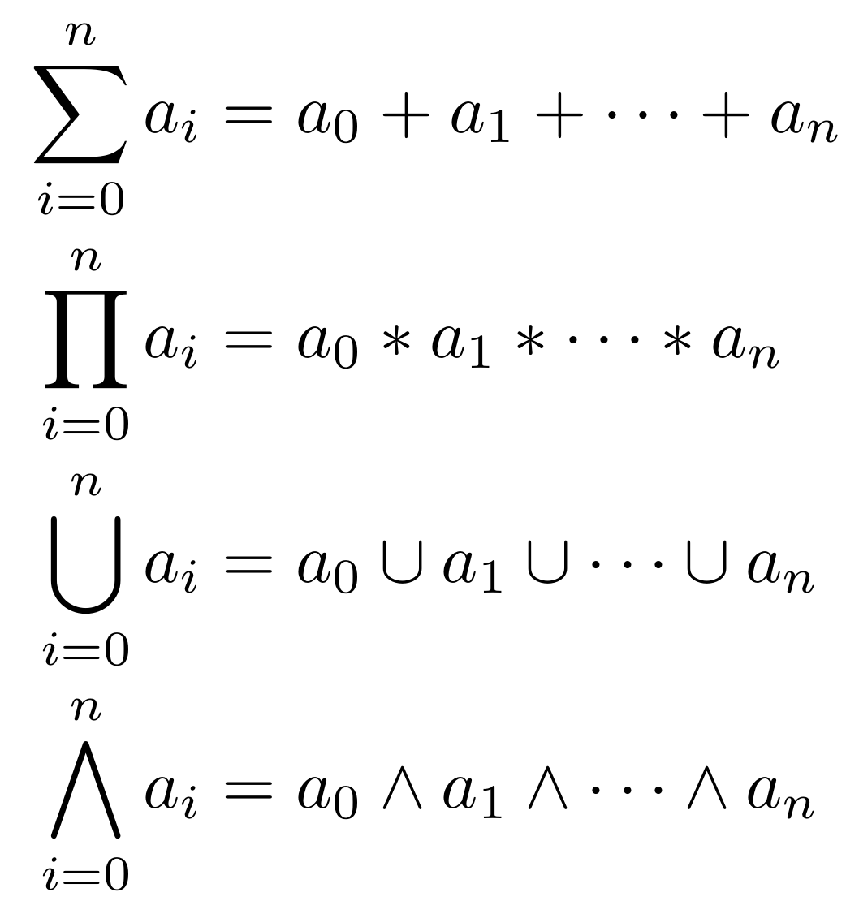
A pattern?
<number>/12
Notes:
Most will be familiar with summation
May also have seen capital Pi for products
Similar notation exists for set union and logical AND

Slide 3
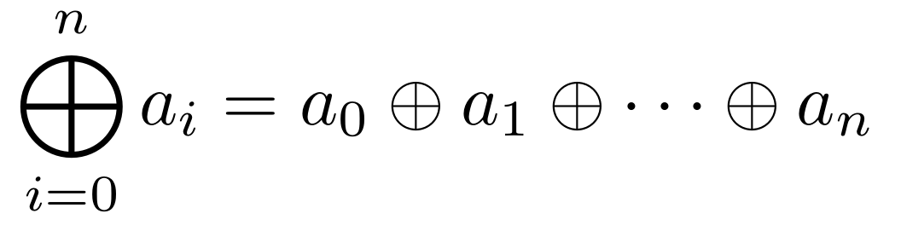
Big operator!
<number>/12
Notes:
Abstract away concrete underlying operator, consider sum, product, big union, big conjunction as instances of a
general concept of “big operator”: index collection + expression with index variable bound + operator used to combine values
“circled plus”: stands for any operator
Operator: at least associative and have identity (monoid) – may explain why at the end if there's time

Slide 4
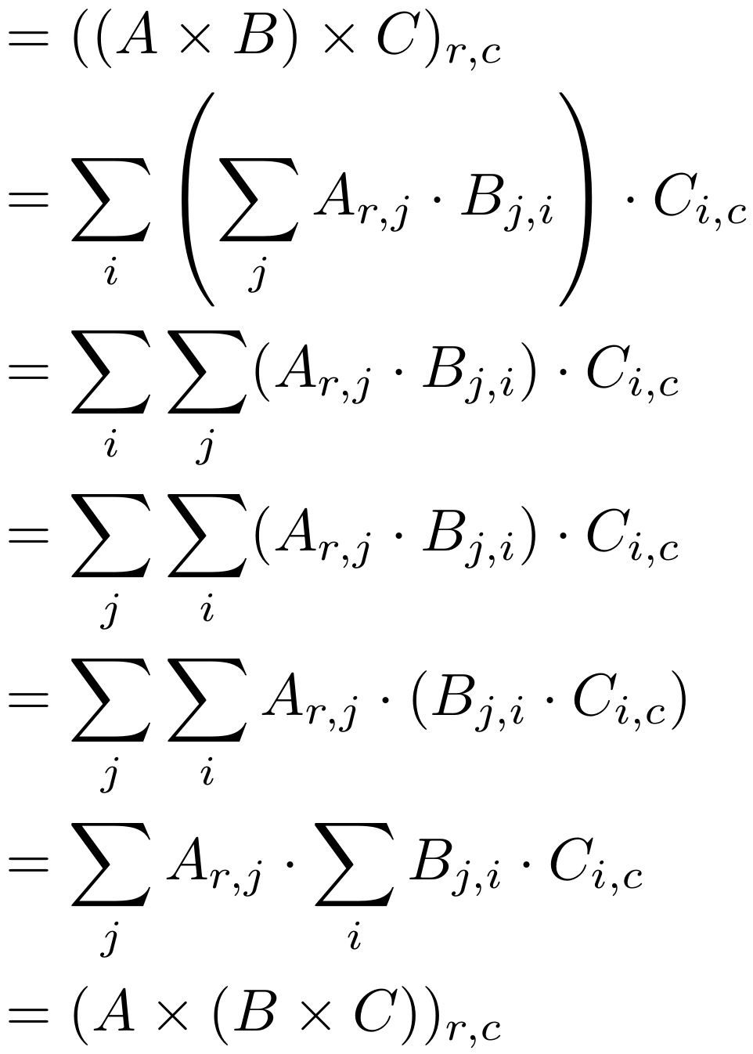
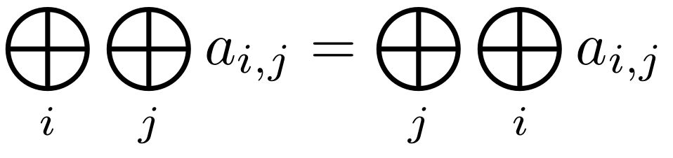
Bigop rules
<number>/12
Notes:
Can then express “reasoning principles”/rules that often “come for free” with big Sigma notation and others
Example: matrix multiplication associative proof
Highlighted step: swap sums
Question: when can we do this? What's required of the underlying operator?

Slide 5
Big operators in Agda
Agda: no bigops but equational reasoning
Isabelle and Coq: have bigop libraries
Maths in a proof assistant:
  increased confidence and understanding
  more effort to write, often hard to read
<number>/12
Notes:
Know what big operators are
Let's talk about the “in Agda” bit
Agda: proof assistant – language and environment to write formal proofs in
(no bigops but equational reasoning – will talk about this later)
Isabelle and Coq: popular proof assistants, but have bigop libraries. Coq library in particular: inspiration
If we can provide notation and rules that mathematicians are used to from pen-and-paper maths, they may consider doing more of it in a formal setting (?)

Slide 6
Aims
Prove and package big operator rules
Provide readable syntax
Use the above to prove “square matrices over a semiring form a semiring”
… all in Agda
<number>/12

Slide 7
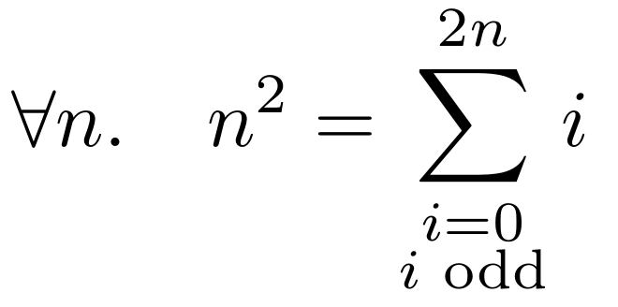
Contributions
Syntax – Rules – Proofs
Ffoldr 0 _+_ (map id (filter odd (upFrom 0 (n + n))))
<number>/12
Notes:
First of all: want to write conjectures in a way that resembles mathematical notation
Just a functional programming language at heart, so looks like OCaml or Haskell usually
Has a mechanism for defining new syntax which was used here
Syntax is “compositional” – ask me about it

Slide 8
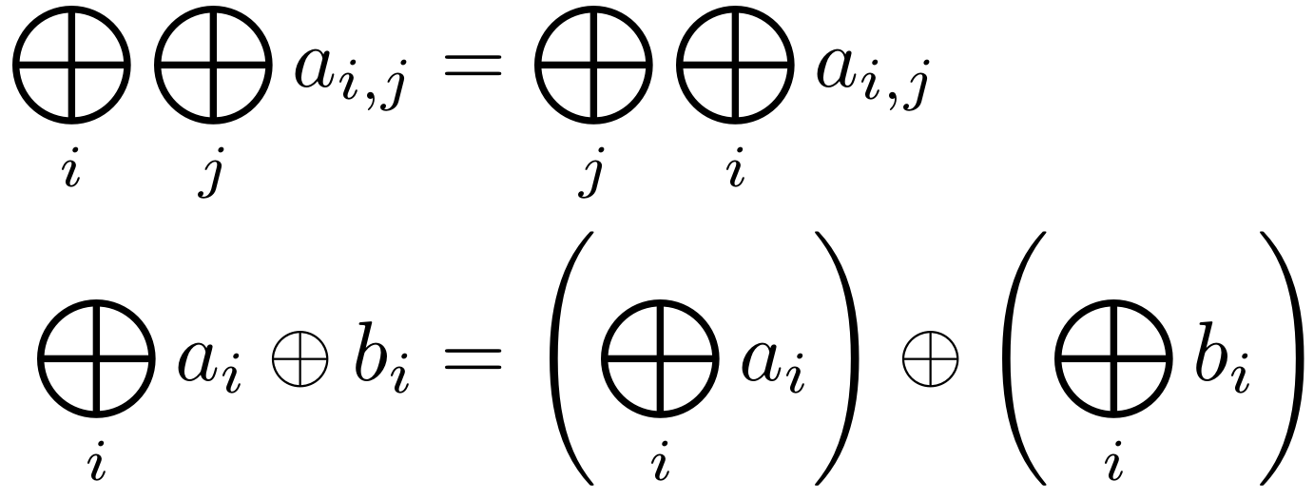
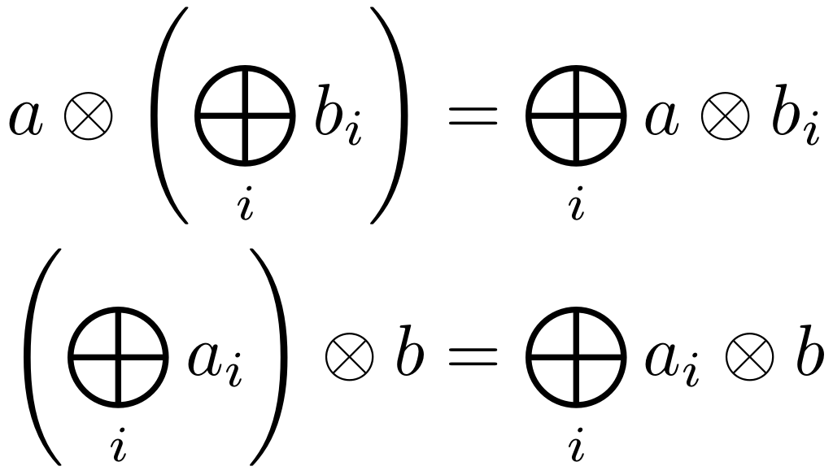
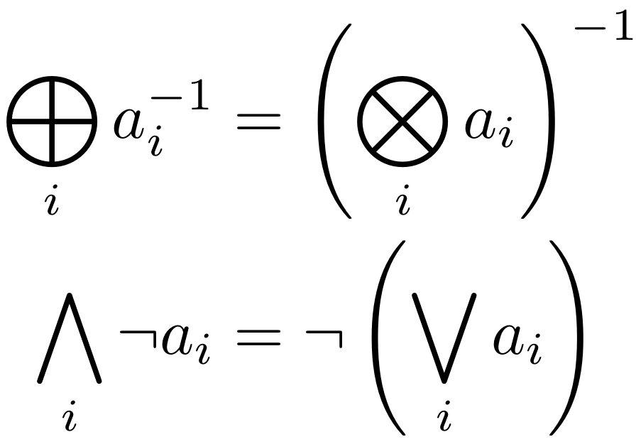
Contributions
Syntax – Rules – Proofs
<number>/12
Notes:
Based on what properties the underlying operator has we can prove different big operator rules
Commutative monoid, Semiring, Boolean Algebra (different notation for the same rule)
Framework is very general
Always assume operators are associative and have an identity – monoid (ask me about it)

Slide 9
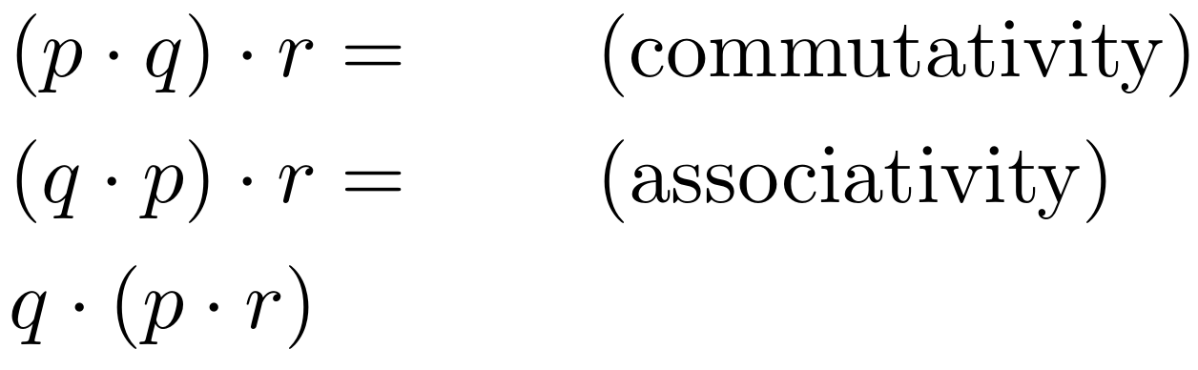
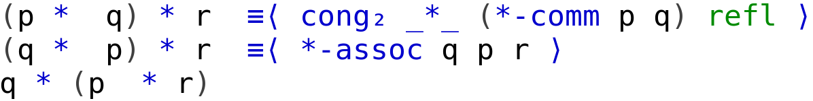
Interlude
<number>/12
Notes:
Equational reasoning
“cong2” combines

Slide 10
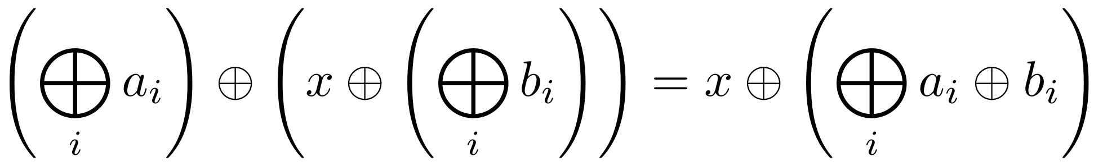
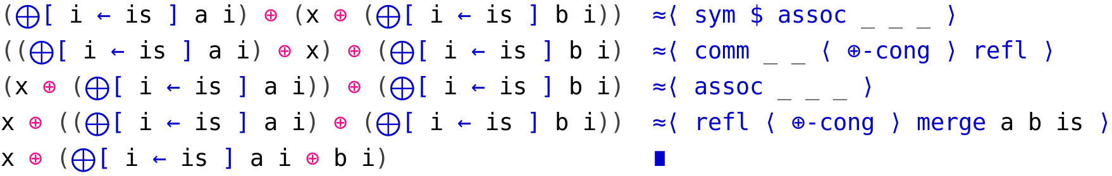
Contributions
Syntax – Rules – Proofs
<number>/12
Notes:
Part of a proof of the induction step of the “merge” rule
Underscores: values determined by Agda
We use associativity, commutativity, congruence
Symmetry, reflexivity: properties of the underlying equivalence relation

Slide 11
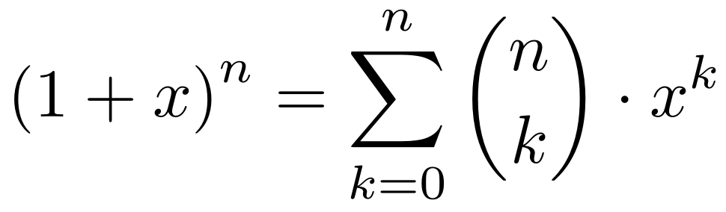
Contributions
Syntax – Rules – Proofs
“Gauss theorems”
Binomial theorem
“Square matrices over a semiring form a semiring”
<number>/12
Notes:
“Square matrices” proof – motivation: path problems course, interested in properties of multiplication and requirements on underlying operators
Part of the semiring proof is the associativity proof we saw before
Agda standard library does not define exponentiation, binomials, matrices – had to define them myself

Slide 12
Conclusion
Big operator notation and rules for Agda users
Proved “square matrices over a semiring form a semiring”, Gauss formula, Binomial theorem
Next steps: clean up, add rules, publish!
Tim intends to inflict this on L11 (Algebraic Path Problems) students in October
<number>/12

Slide 13
Extra slides
Notes:
Extra slides

Slide 14
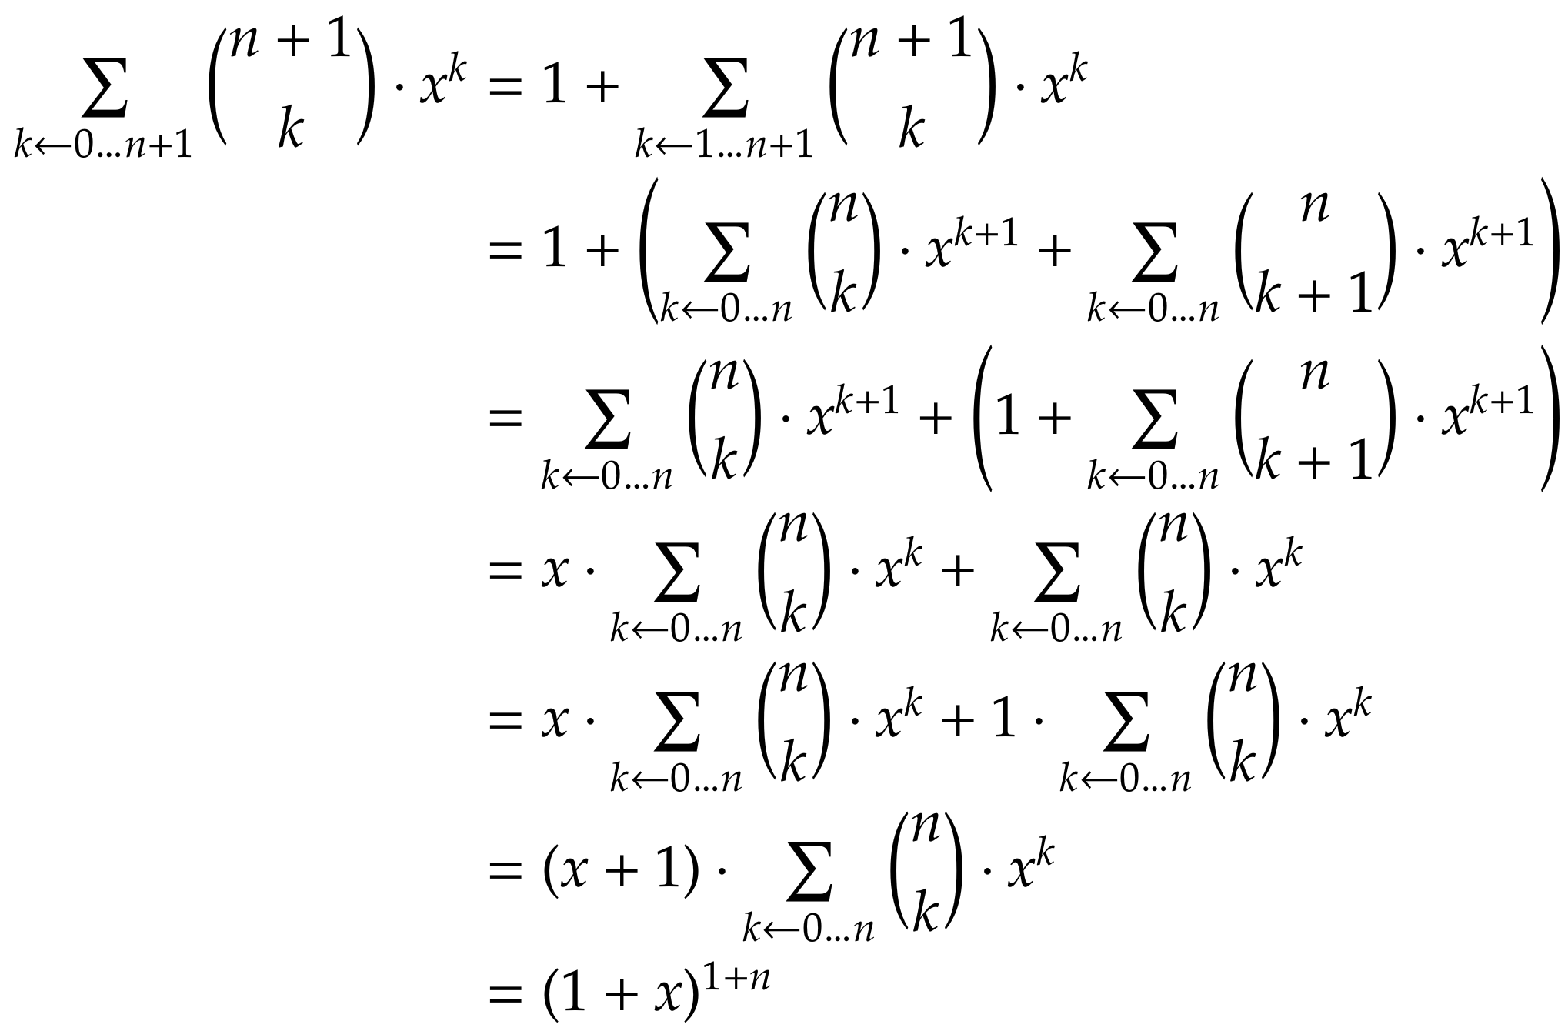
Binomial theorem: induction step
Notes:
Example: managed to do non-trivial proofs!

Slide 15
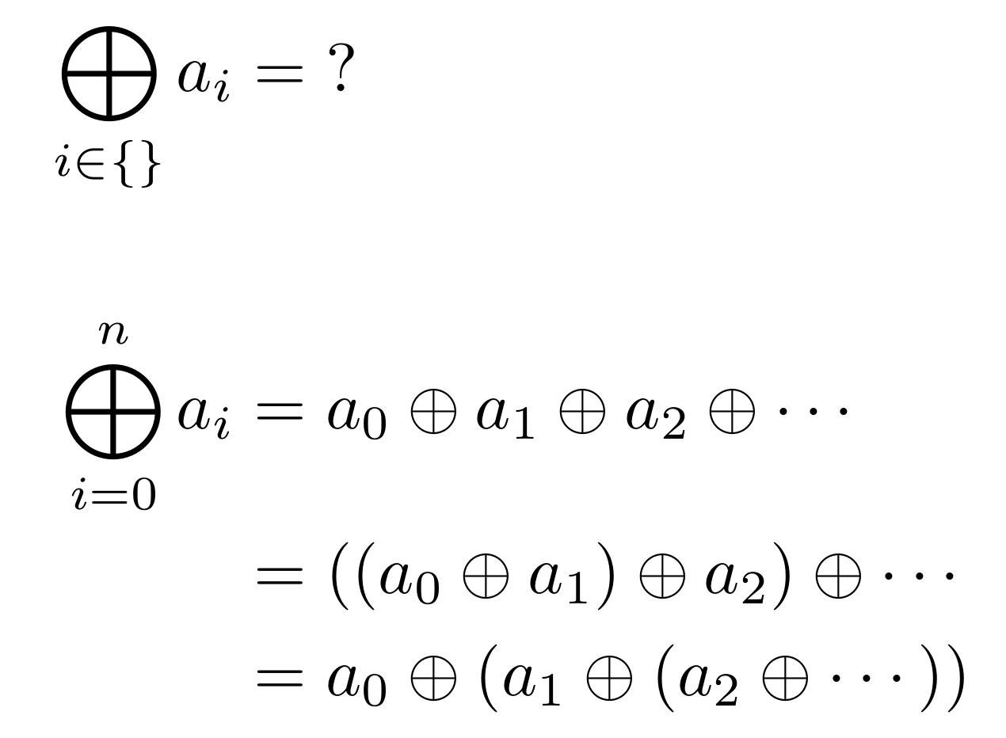
Computing it
Notes:
What to do if the collection of indices is empty?
Rephrase: how should this value behave (thinking abstractly)?
Like an identity!

Slide 16
Computing it
Notes:
Big operators defined as in first line. Implicit assumption: associativity (otherwise we can't leave out the parentheses, and the definition would be useless.)

Slide 17
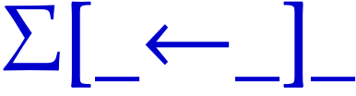

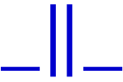
Syntax
Notes:
Compositional syntax

