Slide 1
Barclays Case Study Competition
Nishith Choudhary
CAMPUS – Mukesh Patel School of Technology Management and Engineering
Roll No. – J206
SAP ID - 70431116006

Slide 2
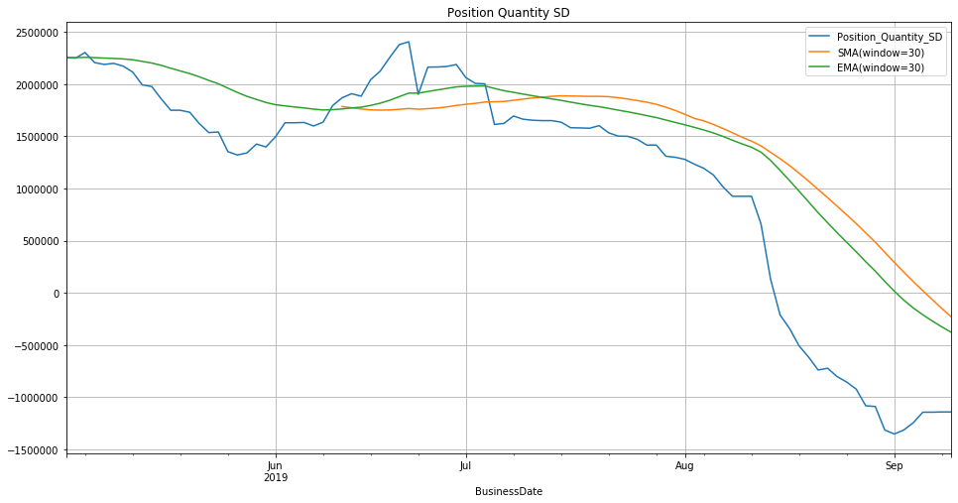
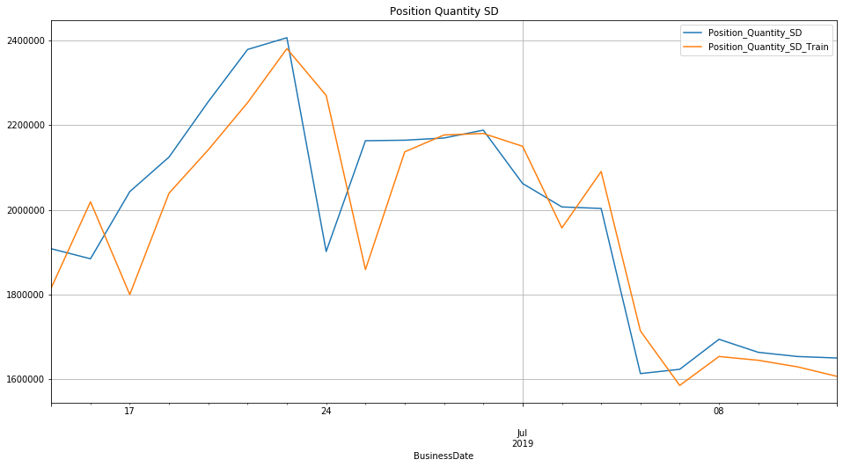
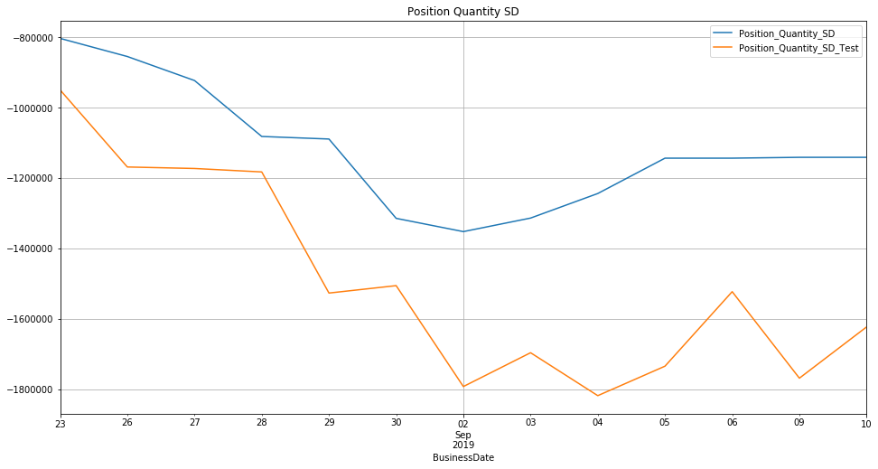
SEDOL 1 - '5BDN21B'
The graphs represents the data of different SEDOLs
The graphs on the right side represents the SMA
and EMA with window size of 30
The bottom two graphs represents the application
of regression on the Training and Testing data
respectively

Slide 3
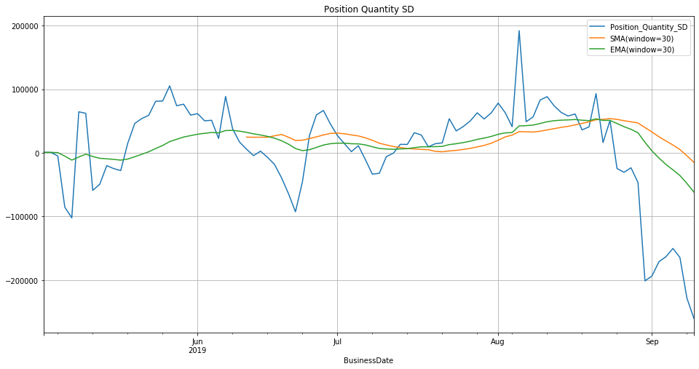
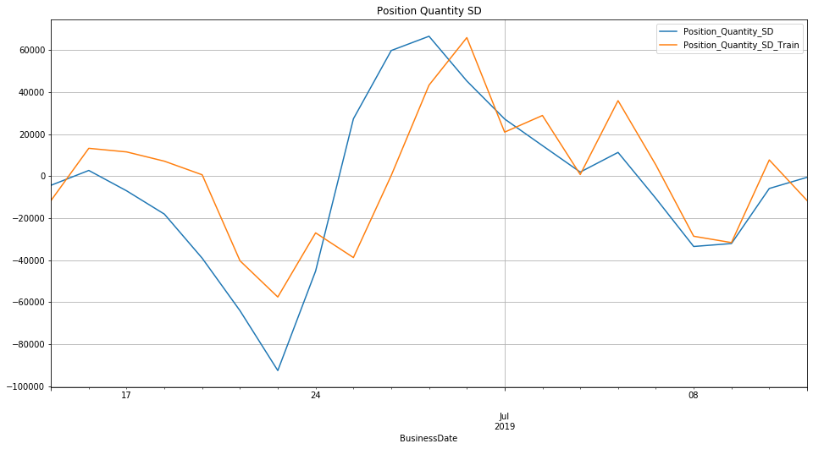
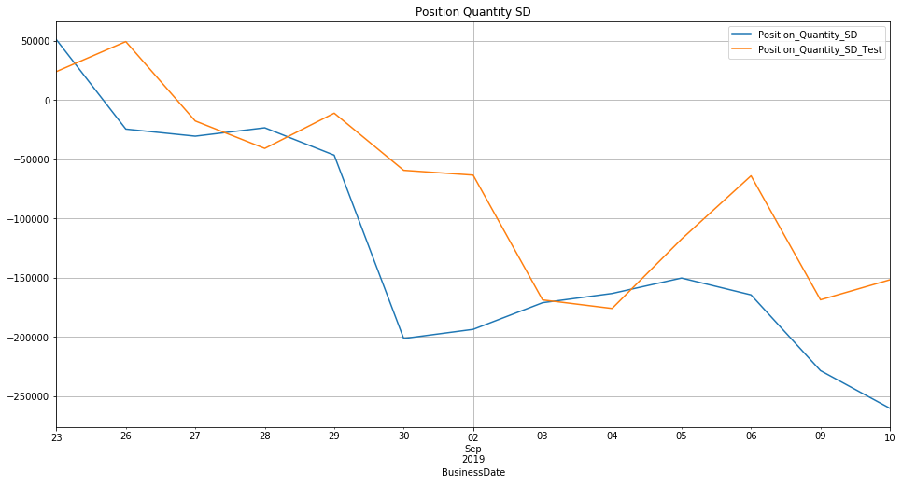
SEDOL 2 - '5MJ2C1B'
Platform used - Python
Libraries – Numpy, Matplotlib, Pandas, Datetime,
Scikit-Learn

Slide 4
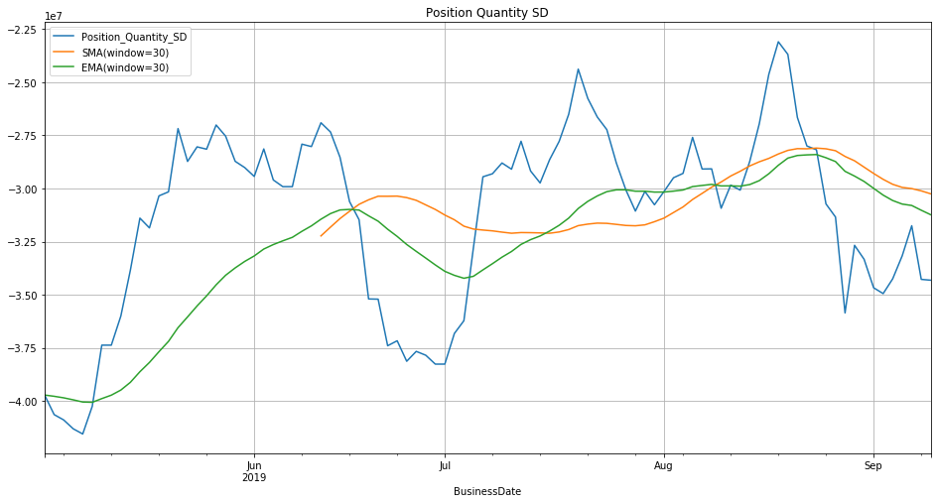
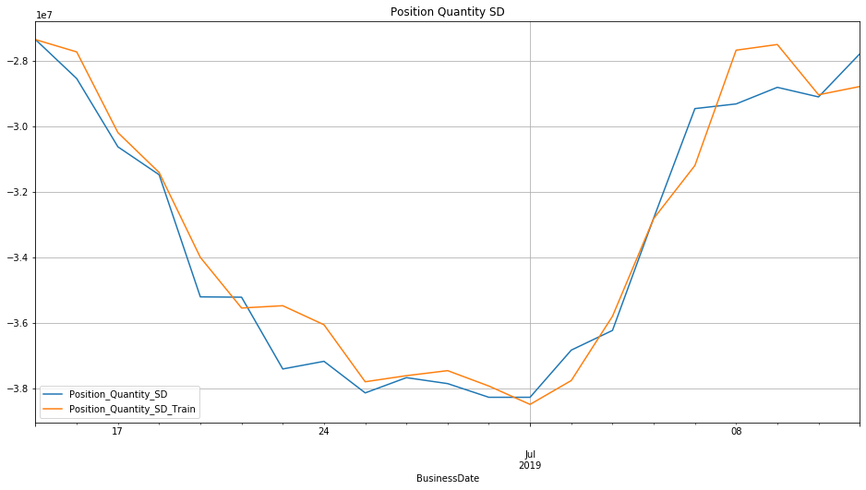
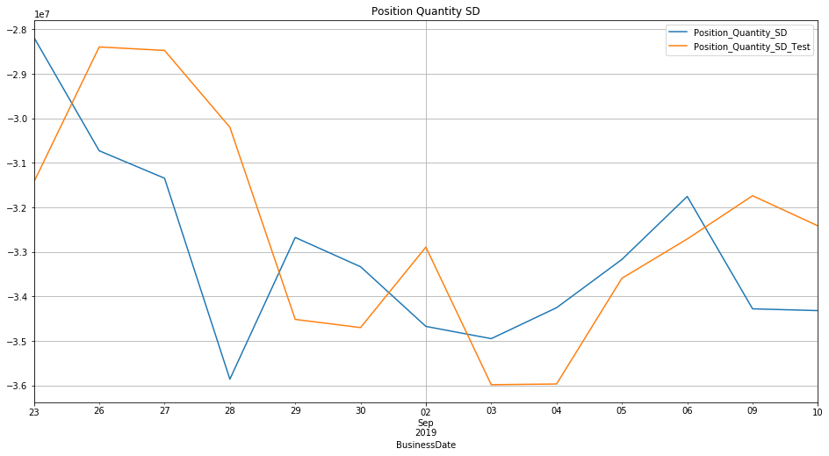
SEDOL 3 - '6NY9V1B'
Uploading the data using Pandas
Grouping the data according to SEDOL and
BusinessDate and creating 5 different DataFrames

Slide 5
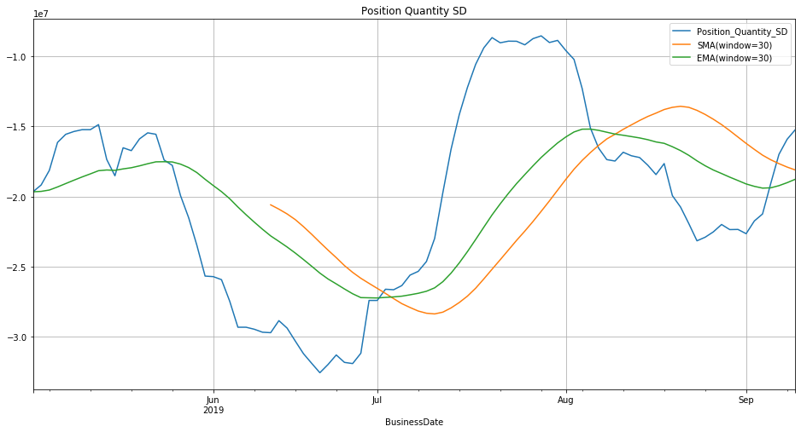
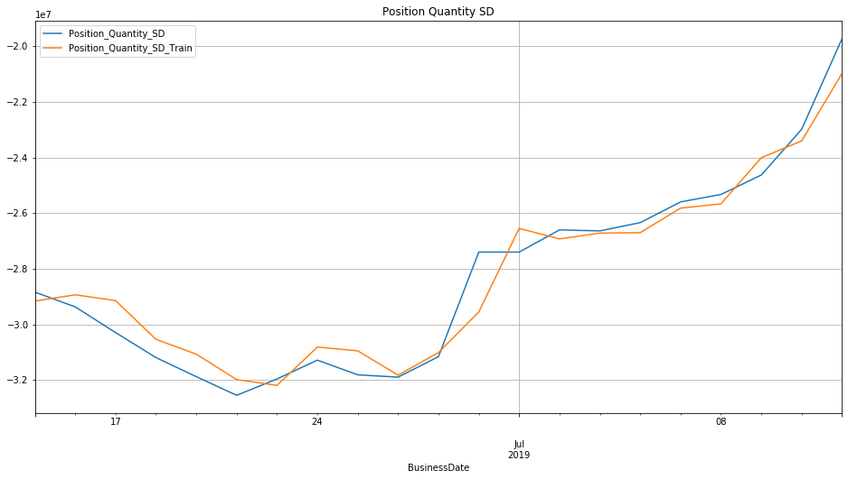
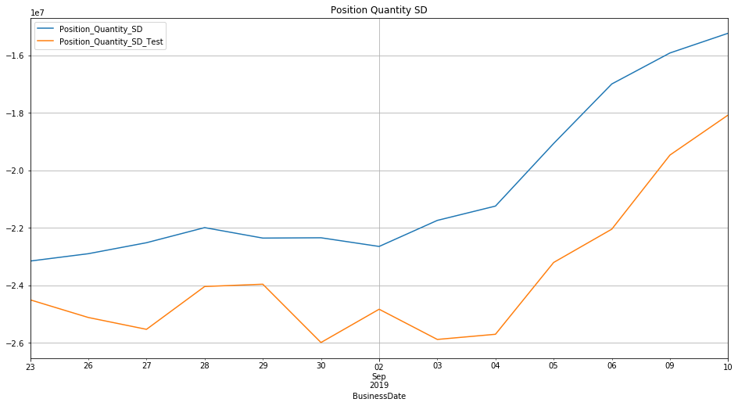
SEDOL 4 - '6Y3RH2B'
Linear Regression – 80% of the dataset for training
and 20% for testing
Window size = 30, for training the data on 30 days
and predicting the label for the 31st day

Slide 6
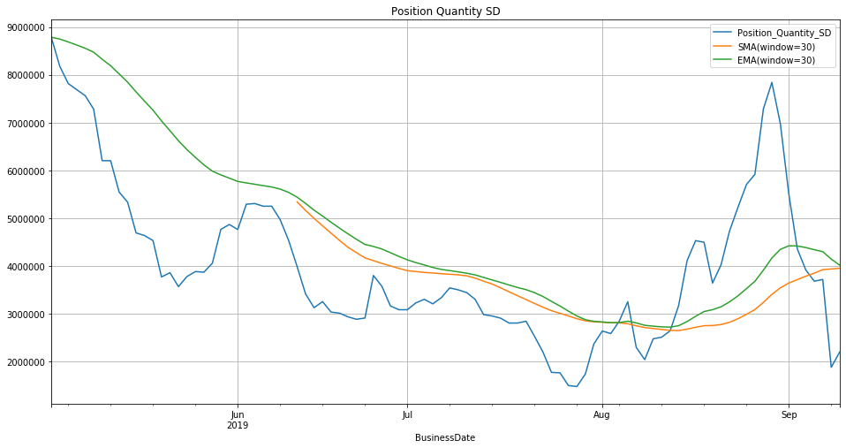
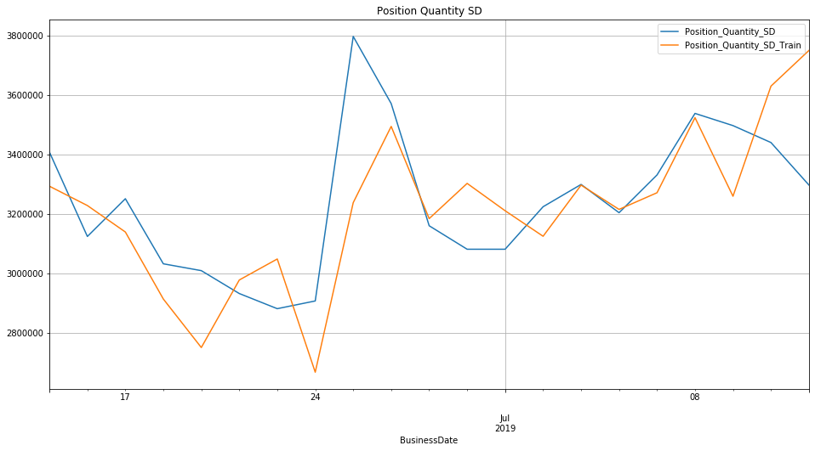
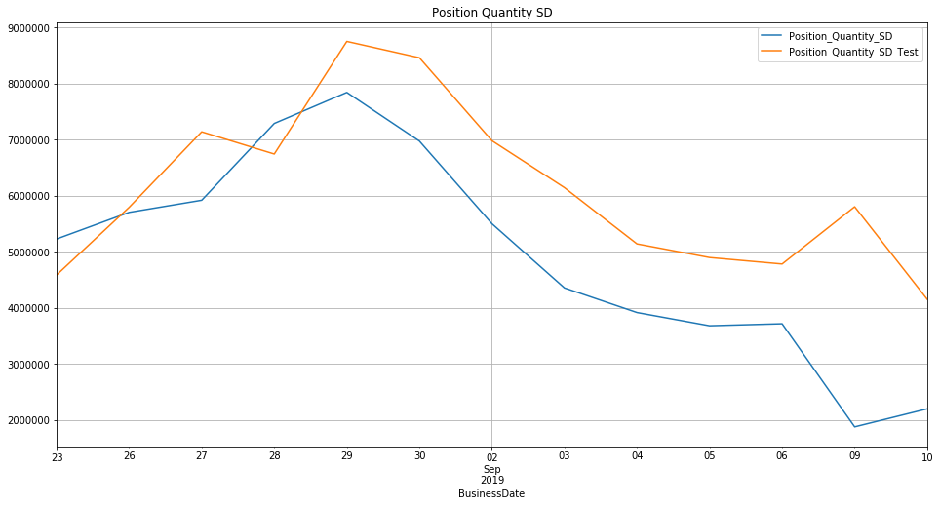
SEDOL 5 - '74ZI41B'
Simple Moving Average (SMA) – using the
rolling() function of the Pandas library with
window size = 30
Exponential Moving Average (EMA) – using the
ewm() function of the Pandas library with
window size = 30

Slide 7
Thank You

