Slide 1
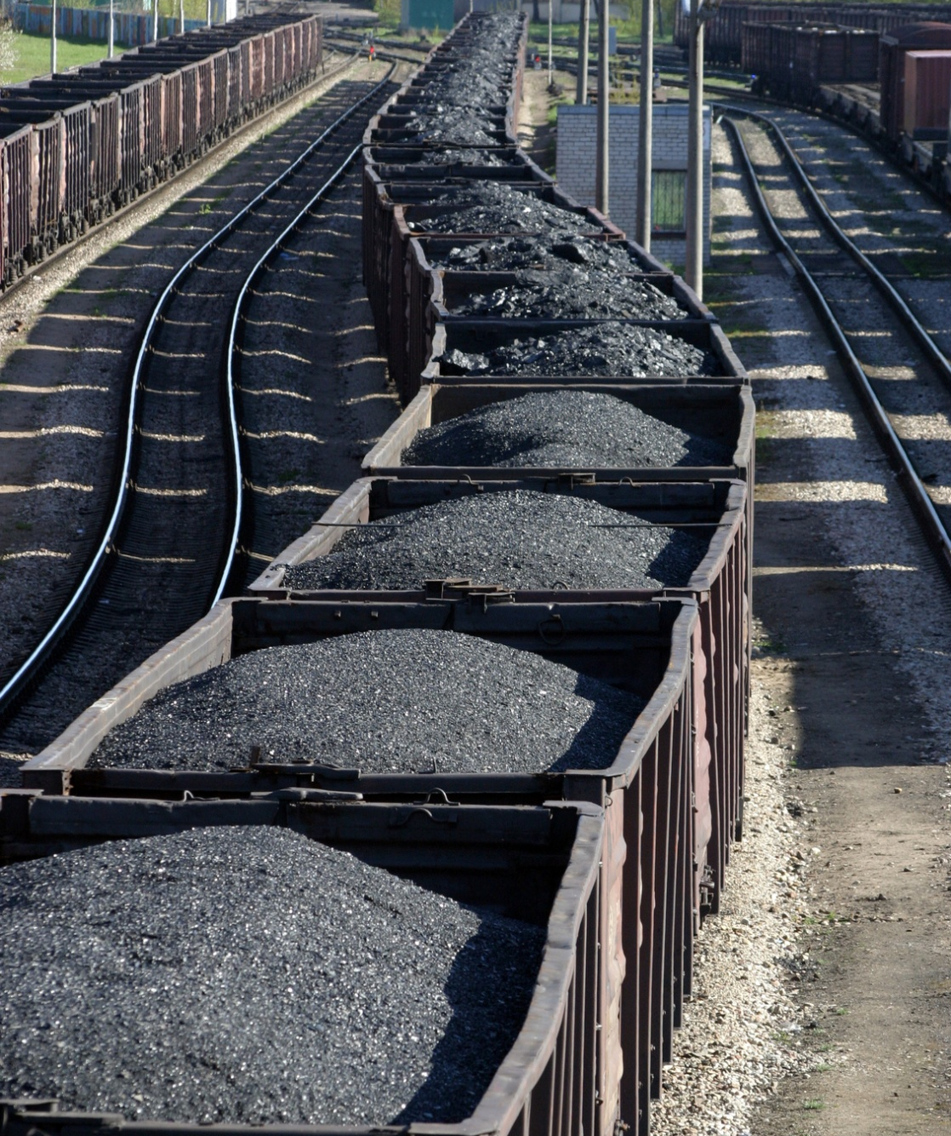
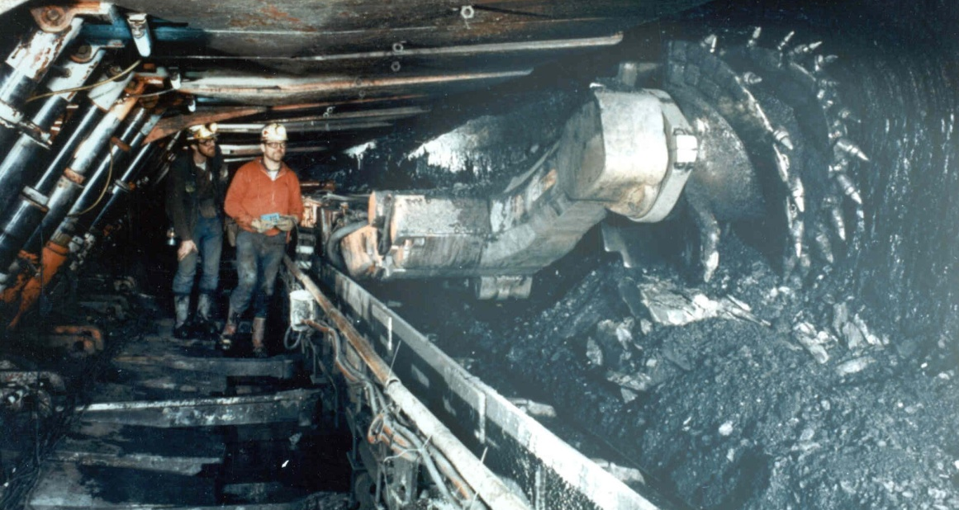
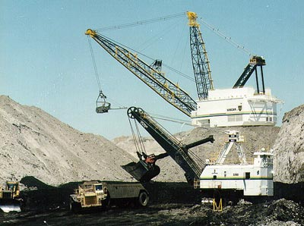
Coal
EG5066 Energy Technologies: current issues & future directions

Slide 2
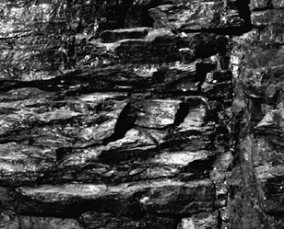
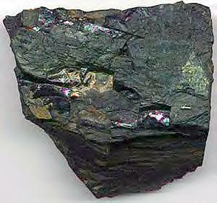
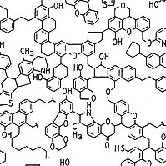
Coal
A readily combustable black or brownish-black sedimentary rock normally occurring in rock strata in layers of veins know as coal beds.
Formed from annual plant remains protected from biodegradation by acidic waters then later mud deposits mainly during the carboniferous period
Coal seam
Vein bituminous coal
EG5066 Energy Technologies: current issues & future directions

Slide 3
Types of coal
Coal
Peat – a precursor of coal used in Ireland, Finland, Russia
Lignite (brown coal) – lowest rank of coal used for electric power generation
Sub-bituminous coal – properties range from lignite to bituminous coal used for
Electric power generation
Source of light aromatic hydrocarbons for the chemical synthesis industry
Bituminous coal – dense and black used
Primarily electric power generation
Heat and power in manufacturing
Making coke
Steam coal – used for steam locomotives & domestic heating
Anthracite – highest rank used for residential and commercial space heating
Graphite – highest rank but not used for fuel but pencils and, when powdered as a lubricant
EG5066 Energy Technologies: current issues & future directions

Slide 4
Coal Classification
Coal
Brown Coals
Lignite
Sub-bituminous coal
Calorific value increases
Carbon content increases
Volatile matter increases
Hard coals or black coals
High volatile bituminous coal
Medium volatile bituminous coal
Low volatile bituminous coal
Semi-anthracite
Anthracite
EG5066 Energy Technologies: current issues & future directions

Slide 5
Ranks of Coal
Anthracite
Coking
Increasing Carbon
Bituminous
Sub-Bituminous
Lignite
EG5066 Energy Technologies: current issues & future directions

Slide 6
Characteristics
Coal
Type | Volatiles (%) | C % | H% | O% | S% | Energy Content (GJ/t)
Lignite | 45-65 | 60-75 | 6.0-5.8 | 34-17 | 0.5-3 | 28.47
Anthracite | 7 - 12 | >91.5 | <3.75 | <2.5 | ~1 | 35.3
EG5066 Energy Technologies: current issues & future directions

Slide 7
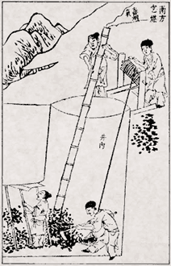
History
Coal
Outcrop coal used in Britain during Bronze Age (2000-3000 years BC)
Carved in Neolithic times in China (4000 C)
Used as fuel in Han Dynasty 206-220 AD
Romans exploiting coal from all major coalfields in E&W by 2nd Century
Not developed on large scale until industrial revolution
EG5066 Energy Technologies: current issues & future directions

Slide 8
Coal Combustion
Coal
300 BC Greeks record use of coal combustion
1700s First steam engines
1820s Stoker boiler
1881 First steam electric plant
1920s Pulverised coal boiler
1920-present Atmospheric fluidized bed combustor
Pulverised coal boiler to 38% efficiency
Supercritical boilers
Cyclone combustors (1950s)
Pressurised fluidised bed combustor (1980s)
Environmental controls for No_{x} and SO₂
EG5066 Energy Technologies: current issues & future directions

Slide 9
Coal uses, by coal type
Coal
Brown Coals
Lignite
Sub-bituminous coal
Power generation
Power generation & industrial uses
Hard coals or black coals
High volatile bituminous coal
Medium volatile bituminous coal
Low volatile bituminous coal
Semi-anthracite
Anthracite
Steam coal
Coking coal
Steel industry
Domestic & industrial
EG5066 Energy Technologies: current issues & future directions

Slide 10
Uses
Coal
Two major uses for coal:
Electricity generation (7100 Mtce in 2010)
Steel production (721 Mtce in 2010)
Coal provided in 2010:
23% of total global primary energy demand
40% of the world’s electricity production
70% of the world steel production
Five largest users: China, USA, India, Russia, Japan account for 77% of global consumption
EG5066 Energy Technologies: current issues & future directions

Slide 11
Coal
Importance of Coal in Electricity Generation
Country | % | Country | % | Country | %
S Africa | 93 | Poland | 92 | China | 79
Australia | 77 | Kazakstan | 70 | India | 69
Israel | 63 | Czech Republic | 60 | Morocco | 55
Greece | 52 | USA | 49 | Germany | 46
EG5066 Energy Technologies: current issues & future directions

Slide 12
Reserves - Production
Coal
 | World coal reserves (745,000 mtce in 2000) | World coal production (3210 mtce in 2000)
North America | 25% | 29%
Europe | 11% | 11%
Former Soviet Union | 22% | 9%
Australasia | 9% | 7%
Africa | 8% | 6%
S & Central America | 2% | 2%
Asia | 23% | 36%
EG5066 Energy Technologies: current issues & future directions

Slide 13
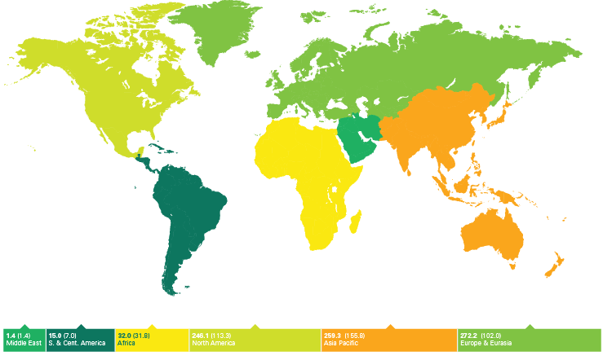
Proved coal reserves 2008
Source: BP Statistical Review of World Energy June 2009
246.1 (113.3)
259.3 (155.8)
272.2 (102.0)
15.0 (7.0)
32.0 (31.8)
1.4 (1.4)
Thousand million tonnes (anthracite & bituminous coal in brackets)

Slide 14
Coal
Coal Reserves
Mtonnes
Region | Anthracite and Bituminous | Sub-Bituminous & Lignite | Total | Share (%) | R/P (y)
N America | 112835 | 132253 | 245088 | 28.5 | 228
S&C America | 6890 | 5618 | 12508 | 1.5 | 124
Europe & Eurasia | 92990 | 211614 | 304604 | 35.4 | 242
Middle East & Asia | 159326 | 106517 | 265843 | 30.9 | 53
World | 404762 | 456176 | 860938 |  | 112
Source: BP 2012

Slide 15
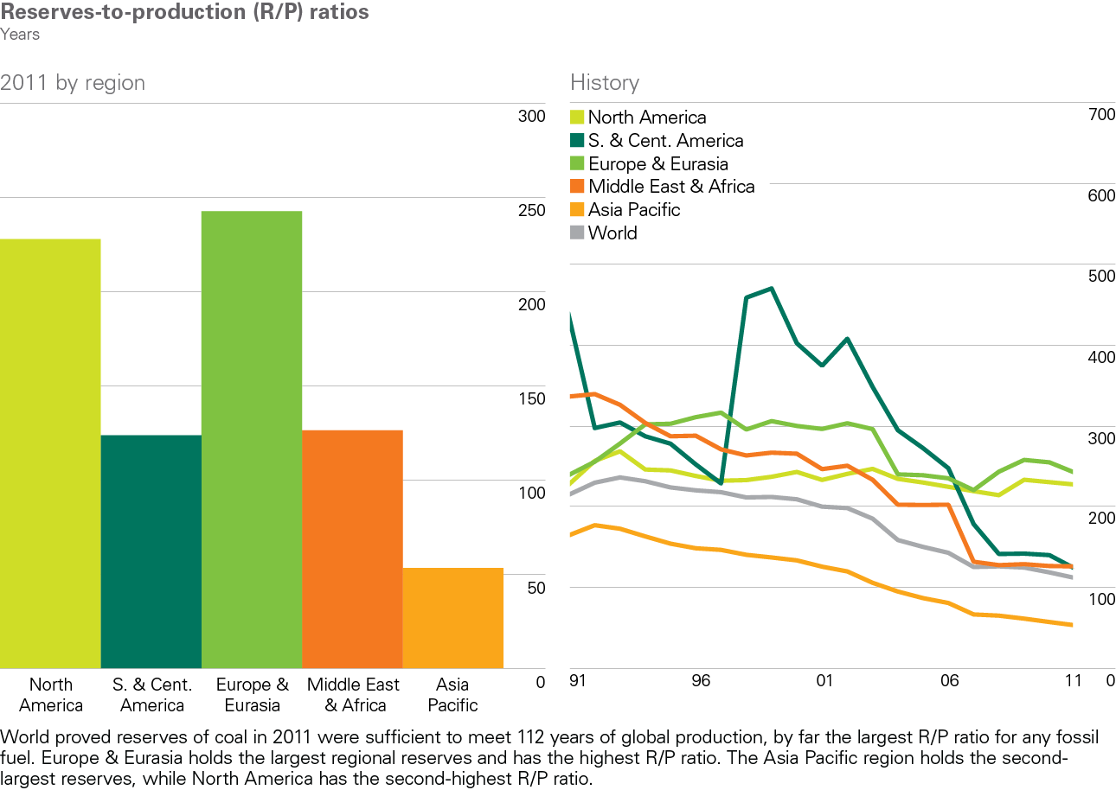
Coal reserves-to-production ratios 2011
BP Statistical Review of World Energy 2012
© BP 2012

Slide 16
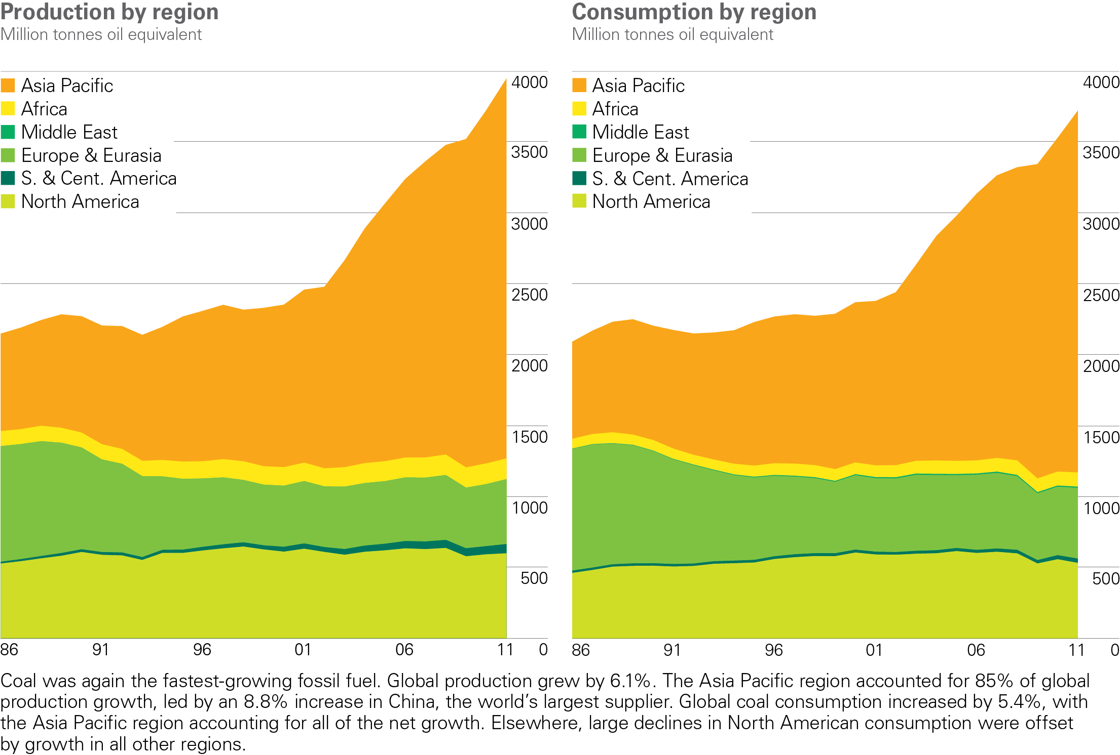
Coal production/consumption by region
BP Statistical Review of World Energy 2012
© BP 2012

Slide 17
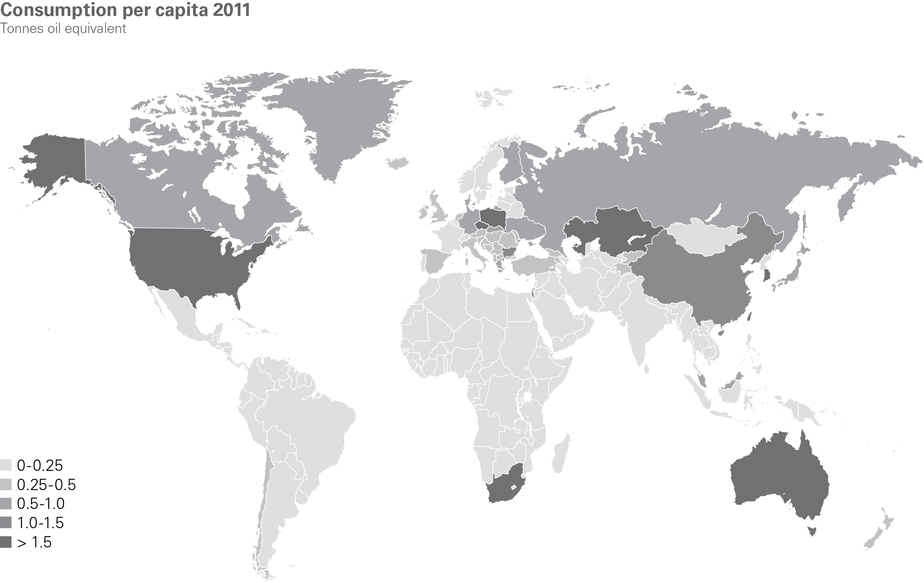
Coal consumption per capita 2011
BP Statistical Review of World Energy 2012
© BP 2012

Slide 18
Coal
Coal Reserves at End 2008 (Million Tonnes)
 | Bituminous & Anthracite | Sub-Bituminous & lignite | Lignite | Total | Share (%)
USA | 108,501 | 98,618 | 30,176 | 237,295 | 22.6
Russia | 49,088 | 97,472 | 10,450 | 157,010 | 14.4
China | 62,200 | 33,700 | 18,600 | 114,500 | 12.6
India | 56,100 | 0 | 4,500 | 60,600 | 7.0
Australia | 37,100 | 2,100 | 37,200 | 76,500 | 8.9
Germany | 99 | 0 | 40,600 | 40,699 | 4.7
Ukraine | 15,351 | 16,577 | 1,945 | 33,873 | 3.9
Kazakhstan | 21,500 | 0 | 12,100 | 33,600 | 3.9
S Africa | 30,156 | 0 | 0 | 30,156 | 3.5
World | 404,762 | 260,789 | 195,387 | 860,938
EG5066 Energy Technologies: current issues & future directions

Slide 19
Coal
Coal Production (Million Tonnes)
 | 2003 | 2005 | 2007 | 2009 | 2011 | Share | Reserve Life (y)
China | 1834.9 | 2349.5 | 2691.6 | 2973.0 | 3520 | 49.5% | 35
USA | 972.3 | 1026.5 | 1040.2 | 975.2 | 992.8 | 14.1% | 239
India | 375.4 | 428.4 | 478.4 | 556.0 | 588.5 | 5.6% | 103
EU | 637.2 | 607.4 | 592.3 | 538.4 | 576.1 | 4.2% | 97
Australia | 350.4 | 375.4 | 392.7 | 413.2 | 415.5 | 5.8% | 184
Russia | 276.7 | 298.3 | 313.5 | 301.3 | 333.5 | 4.0% | 471
S Africa | 237.9 | 244.4 | 247.7 | 250.6 | 255.1 | 3.6% | 118
World | 5301.3 | 6035.3 | 6573.3 | 6880.8 | 7695.34 |  | 112
EG5066 Energy Technologies: current issues & future directions

Slide 20
Coal
Coal Consumption (Mtoe)
 | 1970 | 1980 | 1990 | 2000 | 2010
China | 162.9 | 304.9 | 507.1 | 709.6 | 1676.2
USA | 309.1 | 388.6 | 483.1 | 569.0 | 526.1
India | 37.6 | 56.7 | 95.5 | 144.2 | 207.1
Russia |  |  | 180.6 | 105.2 | 90.2
Japan | 60.2 | 57.6 | 76.0 | 98.9 | 123.7
S Africa | 27.4 | 42.7 | 66.4 | 74.6 | 91.3
Germany | 151.7 | 139.5 | 129.6 | 84.9 | 76.7
UK | 96.0 | 71.1 | 64.9 | 36.7 | 31.0
World | 1499.3 | 1804.0 | 2207.0 | 2372.2 | 3532.0
Source: BP Annual Energy Statistics 2010
EG5066 Energy Technologies: current issues & future directions

Slide 21
Coal
Major Coal Exporters
(Million Short Tonnes)
Country | 2006 | 2008 | 2010 | Share
Australia | 255 | 278 | 328.1 | 27%
Indonesia | 192 | 228 | 316 | 26.1%
Russia | 103.4 | 115.4 | 122.1 | 10.1%
USA | 51.2 | 83.5 | 83.2 | 6.9%
Columbia | 68.3 | 74.7 | 76.4 | 6.3%
South Africa | 75.8 | 68.2 | 76.7 | 6.3
Canada | 31.2 | 36.5 | 36.9 | 3.0%
Kazakhstan | 30.5 | 47.6 | 36.3 | 3.0%
EG5066 Energy Technologies: current issues & future directions

Slide 22
Coal
Major Coal Importers
(Million Short Tonnes)
Country | 2006 | 2008 | 2010 | Share
Japan | 200 | 206 | 207 | 17.5%
China | 42 | 44.5 | 195 | 16.6%
S. Korea | 84 | 107 | 126 | 10.7%
India | 53 | 71 | 102 | 8.6%
Taiwan | 69 | 71 | 71 | 6.0%
Germany | 51 | 56 | 55 | 4.7%
UK | 57 | 49 | 29 | 2.5%
EG5066 Energy Technologies: current issues & future directions

Slide 23
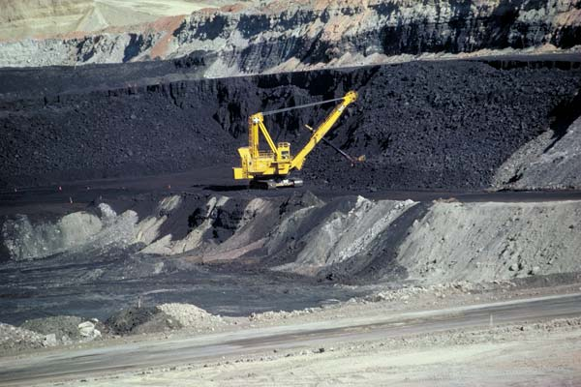
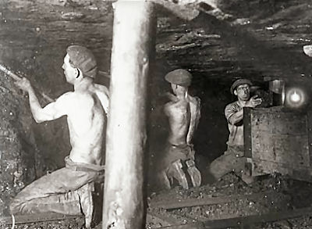
Coal Mining
Coal
Coal is mined by two methods:
Surface or “opencast” mining
Underground or “deep” mining
Method largely determined by geology of the coal deposit
Underground mining accounts for ~60% world coal production
Surface mining accounts for 80% in Australia and 67% in USA
EG5066 Energy Technologies: current issues & future directions

Slide 24
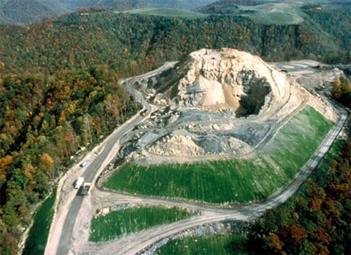
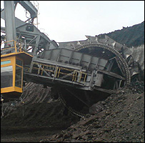
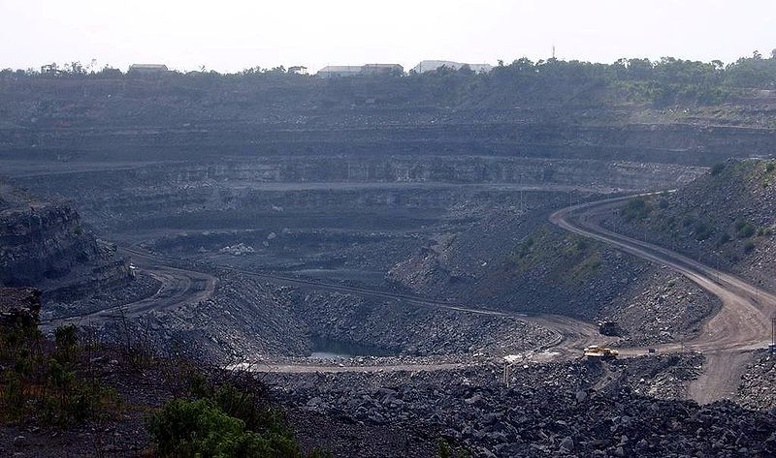
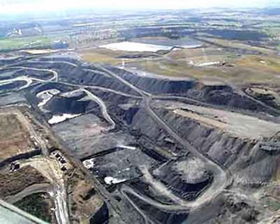
Surface Mining
Coal
Only economic when coal seam near surface
Recovers higher proportion of coal deposit than underground mining ~90%
Large opencast mines can cover an area of several square kilometres & use large equipment
Draglines to remove the overburden
Power shovel
Large trucks to transport the coal
Bucket wheel excavators
Conveyors
Overburden of soil and rock broken up with explosives & removed
Exposed coal seam is drilled, fractured and systematically mined in strips
EG5066 Energy Technologies: current issues & future directions

Slide 25
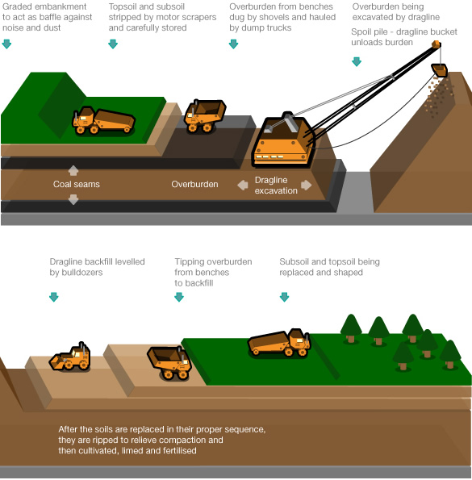
Surface Mining
Coal
EG5066 Energy Technologies: current issues & future directions

Slide 26
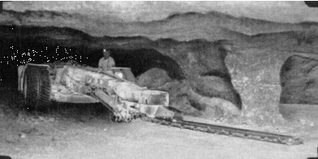
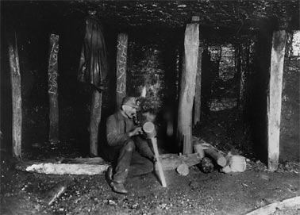
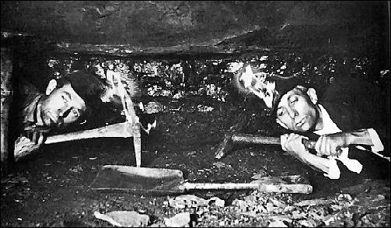
Underground Mining
Coal
Two main methods:
Room-and-pillar
Longwall – 50% of underground mining
Room & Pillar
Coal deposits are mined by cutting a network of “rooms” into the coal seam and leaving behind “pillars” of coal to support the roof of the mine
Pillars account for ~40% of the coal seam
EG5066 Energy Technologies: current issues & future directions

Slide 27
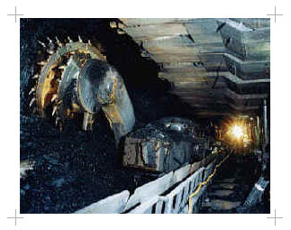
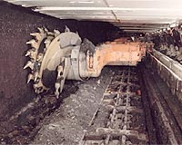
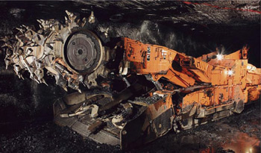
Underground Mining
Coal
Longwall mining
Involves full extraction of coal from a section of seam or face using mechanical shears
Coal face 100 – 350 m
Self-advancing hydraulically-powered supports temporarily hold up the roof while coal is extracted
When coal extracted roof allowed to collapse
>75% of coal in seam can be extracted
EG5066 Energy Technologies: current issues & future directions

Slide 28
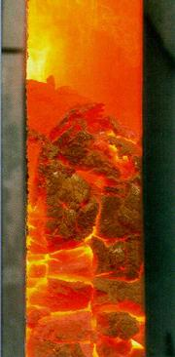
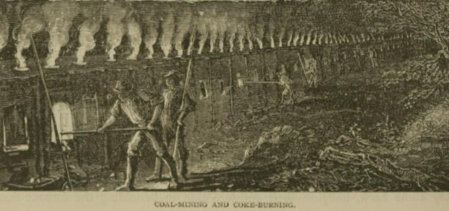
Coking and use of coke
Coal
Coke – a solid carboniferous residue derived from low-ash, low-sulphur bituminous coal from which volatile constituents driven off by baking in an oven without oxygen at 1,000ºC so that fixed carbon and residual ash fused together
Coke from coal is grey, hard, porous and 29.6 GJ/t
By-products include coal tar, ammonia, light oils and coal gas
Metallurgical coke is used as a fuel and as a reducing agent in smelting iron ore in a blast furnace
EG5066 Energy Technologies: current issues & future directions

Slide 29
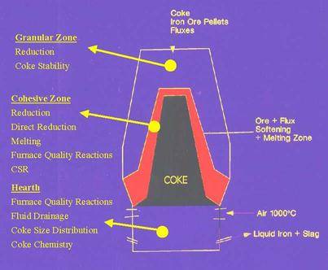
Coking and use of coke
Coal
Coal to coke transformation
Heat is transferred from heated brick walls into coal charge
375-475ºC coal decomposes to form plastic layers near each wall
475-600ºC marked evolution of tar and aromatic hydrocarbons and resolidification of the plastic mass into semi-coke
600-1100ºC coke stabilization phase begins – contraction of coke mass, structural development of coke and hydrogen evolution
Once the plastic layers have met at the centre of the oven the entire mass has been carbonised
Incandescent coke mass pushed from oven and quenched prior to shipment to blast furnace
Blast Furnace Operating Zones and Coke Behaviour

Slide 30
Underground coal gasification (UCG)
Coal
An industrial process that enables coal to be converted into product gas in situ
Carried out in non-mined coal seams using injection of oxidants and bringing the product gas to the surface through production wells drilled from the surface
Product gas used as feedstock or fuel
Used on otherwise not economic coal reserves
Less environmental impact than coal mining and gasification
EG5066 Energy Technologies: current issues & future directions

Slide 31
Underground coal gasification
Coal
First suggested in 1868 by Sir William Siemens
Idea developed by Dmitri Mendeleyev
First experimental work in Durham in 1912
No further development until after WWII
Significant development in Russia in 1960s with 14 plants in operation but discontinued with discovery of natural gas in Uzbekistan
Picked up again in Europe in 1980s
Successful demonstration in Queensland (1999-2003) has resulted in surge of interest
EG5066 Energy Technologies: current issues & future directions

Slide 32
Underground coal gasification
Coal
Criteria
Seam lies underground at depth of 100 – 600 metres
Seam thickness no more that 5 metres
Ash content of coal <60%
Seam has minimal discontinuities
No nearby aquifers (to avoid polluting drinking water)
EG5066 Energy Technologies: current issues & future directions

Slide 33
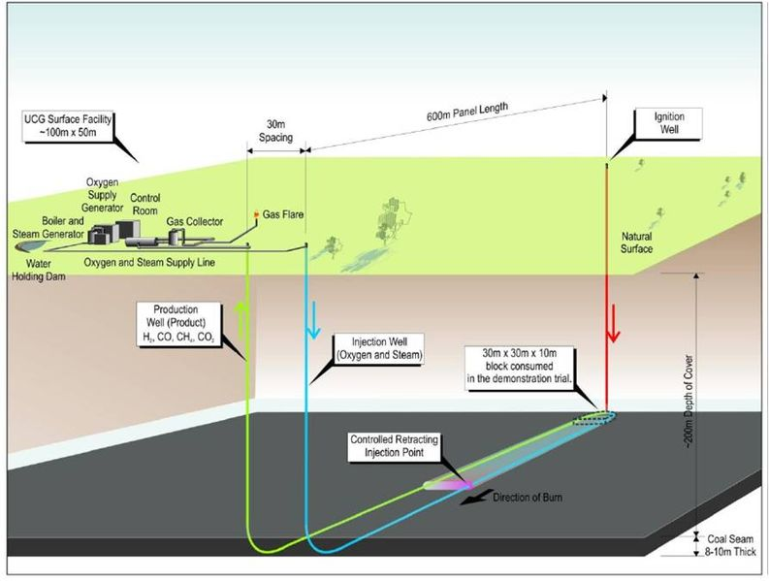
Underground coal gasification (UCG)
Coal
Technology
One production well drilled into the un-mined coal-seam for injection of oxidants
2nd production well drilled to bring product gas to the surface
Coal seam ignited and burns at 700 - 1500ºC
Generates:
CO₂
Hydrogen
CO
CH₄
H₂S
EG5066 Energy Technologies: current issues & future directions

Slide 34
Gasification
Coal
Coal gasification used to produce syngas (CO & H₂)
Syngas converted through Fischer-Tropsch process to gasoline & diesel
Used by Sasol in South Africa to make gasoline from coal & natural gas
Coal + O₂ +H₂O
H₂ + CO
Can also use water shift reaction to produce more hydrogen
CO + H₂O
CO₂ + H₂
EG5066 Energy Technologies: current issues & future directions

Slide 35
Coalbed Methane
Coal
Coalbed Methane (CBM) – a form of natural gas extracted from coal beds
Important source of energy in USA & Canada
Refers to methane adsorbed into the solid matrix of coal
Known as a “sweet gas” because there is no H₂S
Methane is in a near-liquid state, lining the inside of pores within the coal
Open fractures in coal (cleats) can also contain free gas
Gas mainly methane with trace quantities of ethane, nitrogen and CO₂
Factors affecting production
Permeability of the reservoir
Porosity
Adsorption capacity
Thickness of formation & initial reservoir pressure
EG5066 Energy Technologies: current issues & future directions

Slide 36
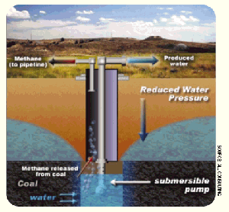
Coalbed Methane - Extraction
Coal
Steel-encased hole drilled into coal seam (100-1500m below ground)
Gas escapes to surface
Gas compressed and sent to pipeline
CBM wells produce at lower rates than conventional reservoirs (8,500m³/day)
Methane desorption follows a curve (gas content vs reservoir pressure – a Langmuir isotherm)
Varies with coal type
Potential a function of:
Cleat density/intensity
High cleat density required for profitable operation
Maceral composition important
High vitrinite composition is ideal
EG5066 Energy Technologies: current issues & future directions

Slide 37
Coal Mine Methane
Coal
After an underground coal mine has been abandoned methane released from the remaining coal accumulates in the voids and is diluted by air to methane concentrations of 25 – 75%
Can be recovered commercially as coal mine methane (CMM) from operating mines or abandoned mine methane from abandoned mines (AMM)
Number of operations in UK
Production in 2005 was 69 Mm³
Methane used in gas engines to generate electricity
EG5066 Energy Technologies: current issues & future directions

Slide 38
Environmental effects
Coal
Release of carbon dioxide – a GHG
Generation of waste products including fly ash, bottom ash, flue gas desulphurisation sludge containing mercury, uranium, thorium, arsenic, and other heavy metals
Acid rain from high sulphur coal
Interference with groundwater and water table levels
Contamination of land and waterways with fly ash
Subsidence above tunnels
Coal-fired power plants without effective fly ash capture are one of the largest sources of human-caused background radiation exposure
Coal-fired power plant releases emission including mercury, selenium and arsenic
EG5066 Energy Technologies: current issues & future directions

Slide 39
Clean Coal
Coal
Umbrella term describing technologies being developed that aim to reduce the environmental impact of coal electricity generation. They include:
Chemical washing minerals and impurities from the coal
Gasification (IGCC)
Treating flue gases with steam to remove SO₂
Carbon capture and storage technologies to capture the CO₂ from flue gas
Dewatering brown coals to improve calorific value
But what about the mercury (5000 t global) and radio-nuclides
Some say that “clean coal” is an oxymoron! And not achievable
EG5066 Energy Technologies: current issues & future directions

Slide 40
Integrated Gasification Combined Cycle
Coal
A power plant using synthesis gas produced from coal
Gas used to power a gas turbine whose waste heat is passed to a steam turbine (Combined Cycle Gas Turbine)
Removes impurities from the coal before it is combusted
Gives lower emissions of SO₂, particulates & mercury
Gives greater efficiency of power generation
But very expensive and reliability issues
EG5066 Energy Technologies: current issues & future directions

Slide 41
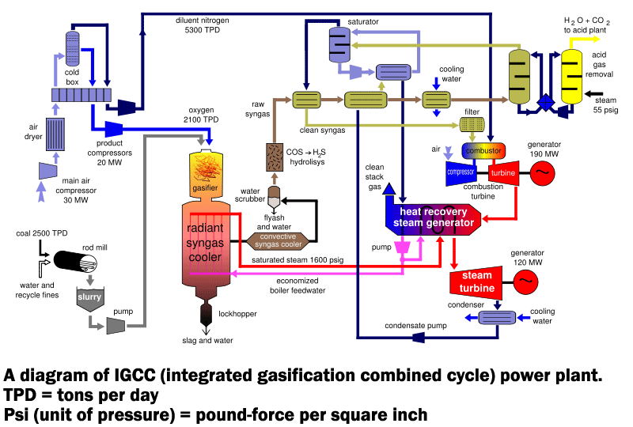
Integrated Gasification Combined Cycle
Coal
EG5066 Energy Technologies: current issues & future directions

Slide 42
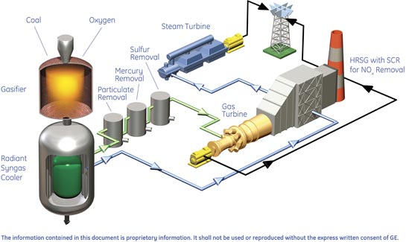
Integrated Gasification Combined Cycle
Coal
EG5066 Energy Technologies: current issues & future directions

Slide 43
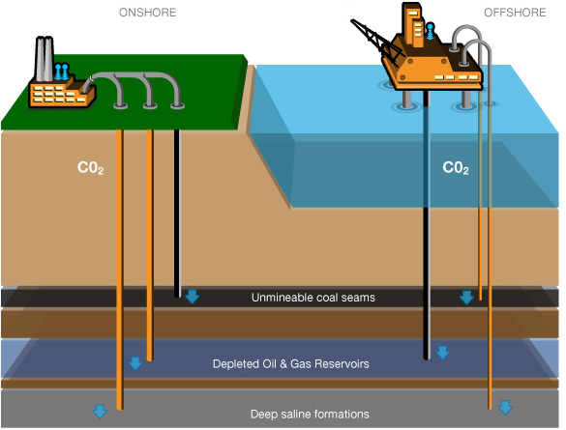
Carbon Capture & Storage
Coal
EG5066 Energy Technologies: current issues & future directions

