Slide 1
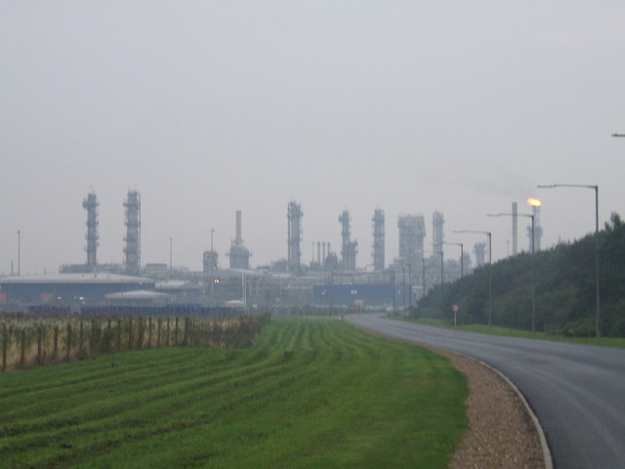
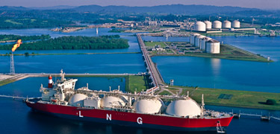
Natural Gas
EG5066 Energy Technologies: current issues & future directions

Slide 2
Natural Gas
Consists primarily of methane (CH₄) but sometimes contains significant quantities of:
Ethane
Propane
Butane
Pentane
And CO₂, nitrogen, helium and H₂S
Found associated with crude oil
Isolated natural gas reservoirs
In coal beds – coal bed methane
As methane clathrates
Created by methanogenic organisms in marshes, bogs and landfills
EG5066 Energy Technologies: current issues & future directions

Slide 3
Natural Gas
Produced commercially from oil fields & natural gas fields
Sour gas, tight gas, shale gas and coal bed methane
An important fuel source
Major feedstock for fertilisers
A potent greenhouse gas
EG5066 Energy Technologies: current issues & future directions

Slide 4
Components of Natural Gas
Methane (CH₄)
Ethane (C₂H₆)
Propane (C₃H₈)
Normal butane (n-C₄H₁₀)
Isobutane (i-C₄H₁₀)
Pentanes
Acid gases – CO₂, H₂S, mercaptans – methanethiol (CH₃SH) and ethanethiol (C₂H₅SH)
Other gases – Nitrogen (N₂) and Helium (He)
Water – water vapour and liquid water
Some natural gas condensate (aka casinghead gasoline or natural gasoline)
Crude oil
Mercury
EG5066 Energy Technologies: current issues & future directions

Slide 5
Types of Raw Natural Gas Wells
Crude oil wells – known as associated gas either:
Separate
Dissolved in crude oil
Natural gas from gas wells & from condensate wells with little or no oil – known as non-associated gas
Condensate wells produce raw natural gas & very low density liquid hydrocarbon – natural gas condensate
EG5066 Energy Technologies: current issues & future directions

Slide 6
Natural Gas Condensates
A low density mixture or hydrocarbon liquids present as gaseous components in raw natural gas
Condense out if temperature reduced below hydrocarbon dewpoint temperature of raw gas
Each wet gas field has its own unique gas condensate composition:
H₂S
Mercaptans
CO₂
Straight chain alkanes (C₂ – C₁₂)
Cyclohexanes
Aromatics (benzene, toluene, xylenes, ethylbenzene)
EG5066 Energy Technologies: current issues & future directions

Slide 7
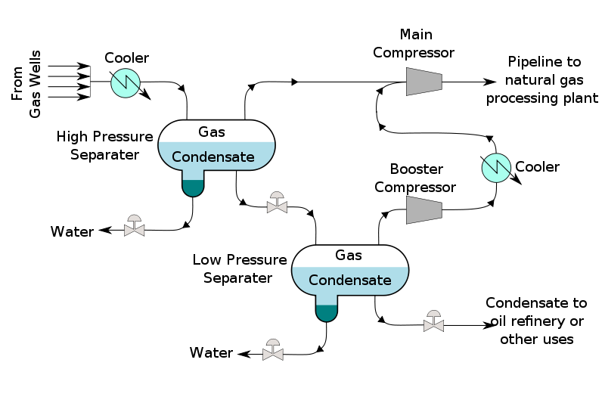
Natural Gas Condensates
Separation technique
Raw gas cooled below hydrocarbon dewpoint
Gas condensates condense out
The condensates passed through high pressure separator where water and raw natural gas separated
Condensates passed to lower pressure vessel and flash vaporised
EG5066 Energy Technologies: current issues & future directions

Slide 8
Flow Diagram - Natural Gas Processing Plant
Raw Gas
Tail Gas Treating
Scot process
Clauspol process
Others
Condensate to oil refinery
Tail Gas
Incinerator
Condensate and water removal
Waste water
Nitrogen-rich Gas
Acid Gas
Sulphur Unit
Claus process
Elemental Sulphur
Raw Gas
Acid gas removal
Amine treating
Benfield process
PSA Unit
Sulphinol process
Nitrogen Rejection
Cryogenic process
Absorption processes
Adsorption processes
Dehydration
Glycol unit
PSA unit
Mercury Removal
Mol Sieves
Activated carbon
Removes H₂S & CO₂
Gas Pipeline
Ethane
Propane
Butanes
Pentanes
Sweetening units
Merox process
Sulphrex process
Mol sieves
Fractionation Train
De-ethanizer
De-propanizer
De-butanizer
NGL Recovery
Turbo-expander
De-methanizer
Removes mercaptans
EG5066 Energy Technologies: current issues & future directions

Slide 9
Natural Gas - reserves
World’s largest reserves located in Russia
4.757 x 10¹³ m3 (1.6 x 10¹⁵ cu ft)
World’s largest natural gas producer - Gazprom
World’s largest gas field
North Field – offshore Qatar
25 trillion cubic metres (9.0 x 10¹⁴ cu ft) gas in place
2nd largest
South Pars Gas Field, Iran
8 – 14 trillion cubic metre (2.8 – 5.0 x 10¹⁴ cu ft)
EG5066 Energy Technologies: current issues & future directions

Slide 10
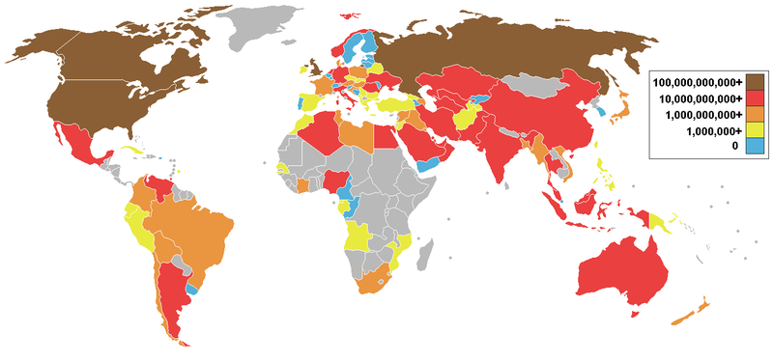
Natural Gas – producing countries
EG5066 Energy Technologies: current issues & future directions

Slide 11
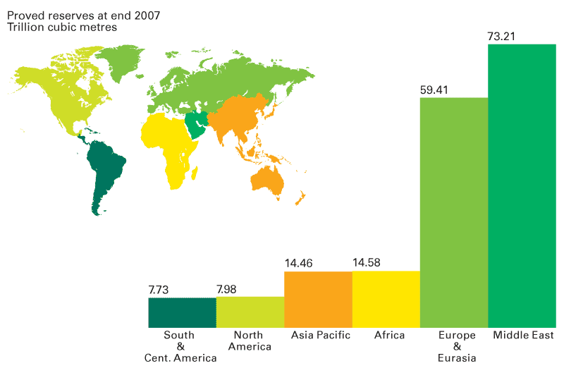
Proved natural gas reserves at end 2007
Source: BP
EG5066 Energy Technologies: current issues & future directions

Slide 12
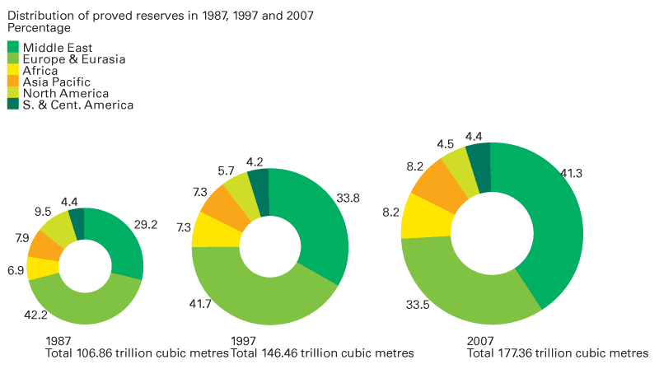
Distribution of proved natural gas reserves
Source: BP
EG5066 Energy Technologies: current issues & future directions

Slide 13
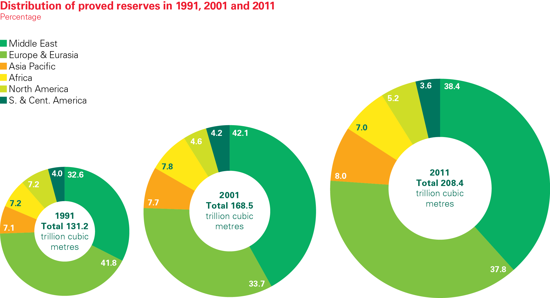
Distribution of proved gas reserves
EG5066 Energy Technologies: current issues & future directions

Slide 14
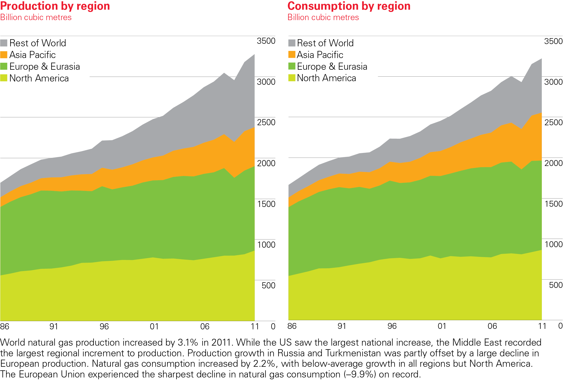
Gas production/consumption by region
EG5066 Energy Technologies: current issues & future directions

Slide 15
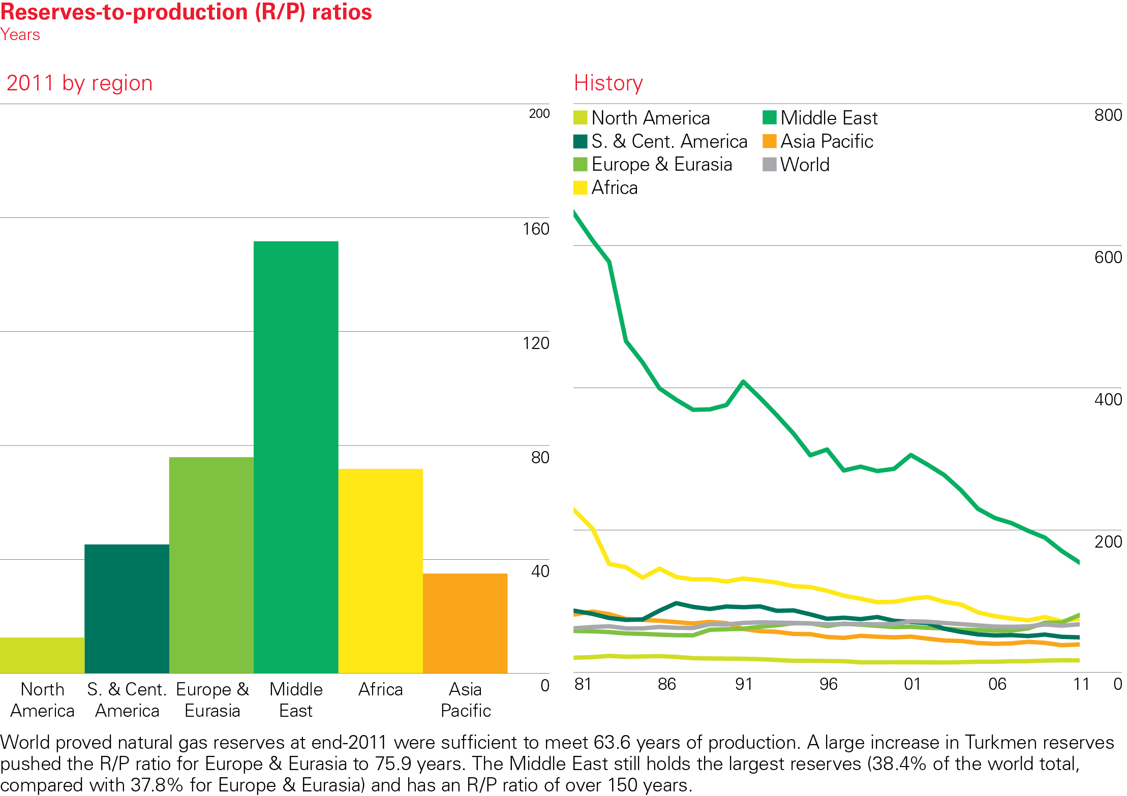
Gas reserves-to-production (R/P) ratios
EG5066 Energy Technologies: current issues & future directions

Slide 16
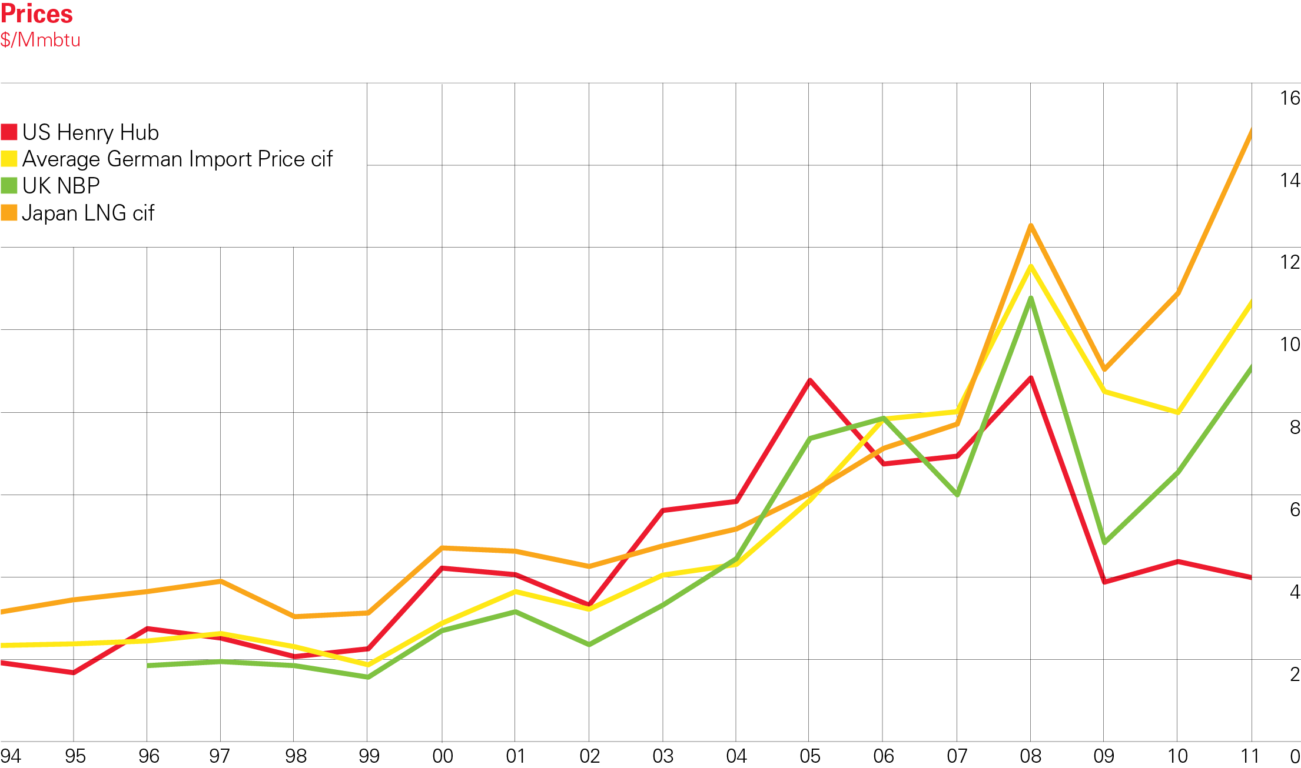
Chart of gas prices
EG5066 Energy Technologies: current issues & future directions

Slide 17
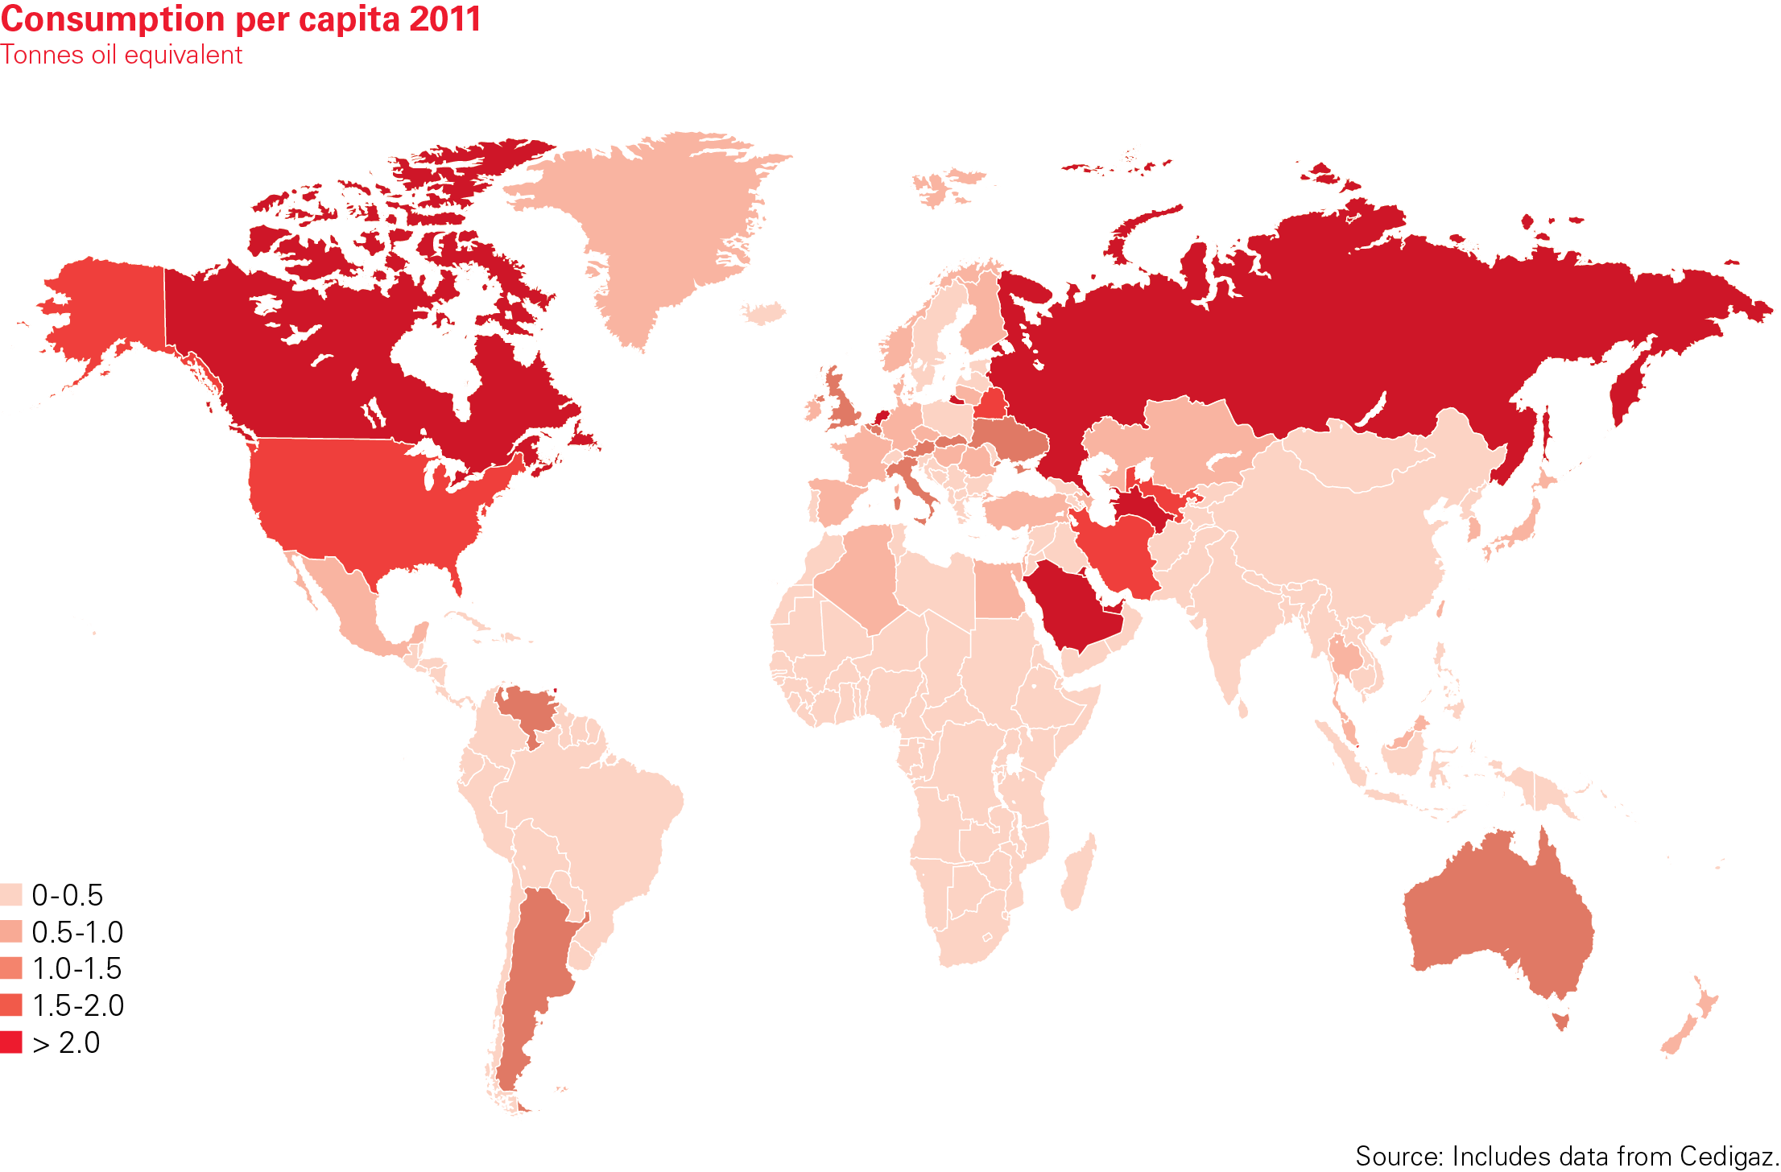
Gas consumption per capita
EG5066 Energy Technologies: current issues & future directions

Slide 18
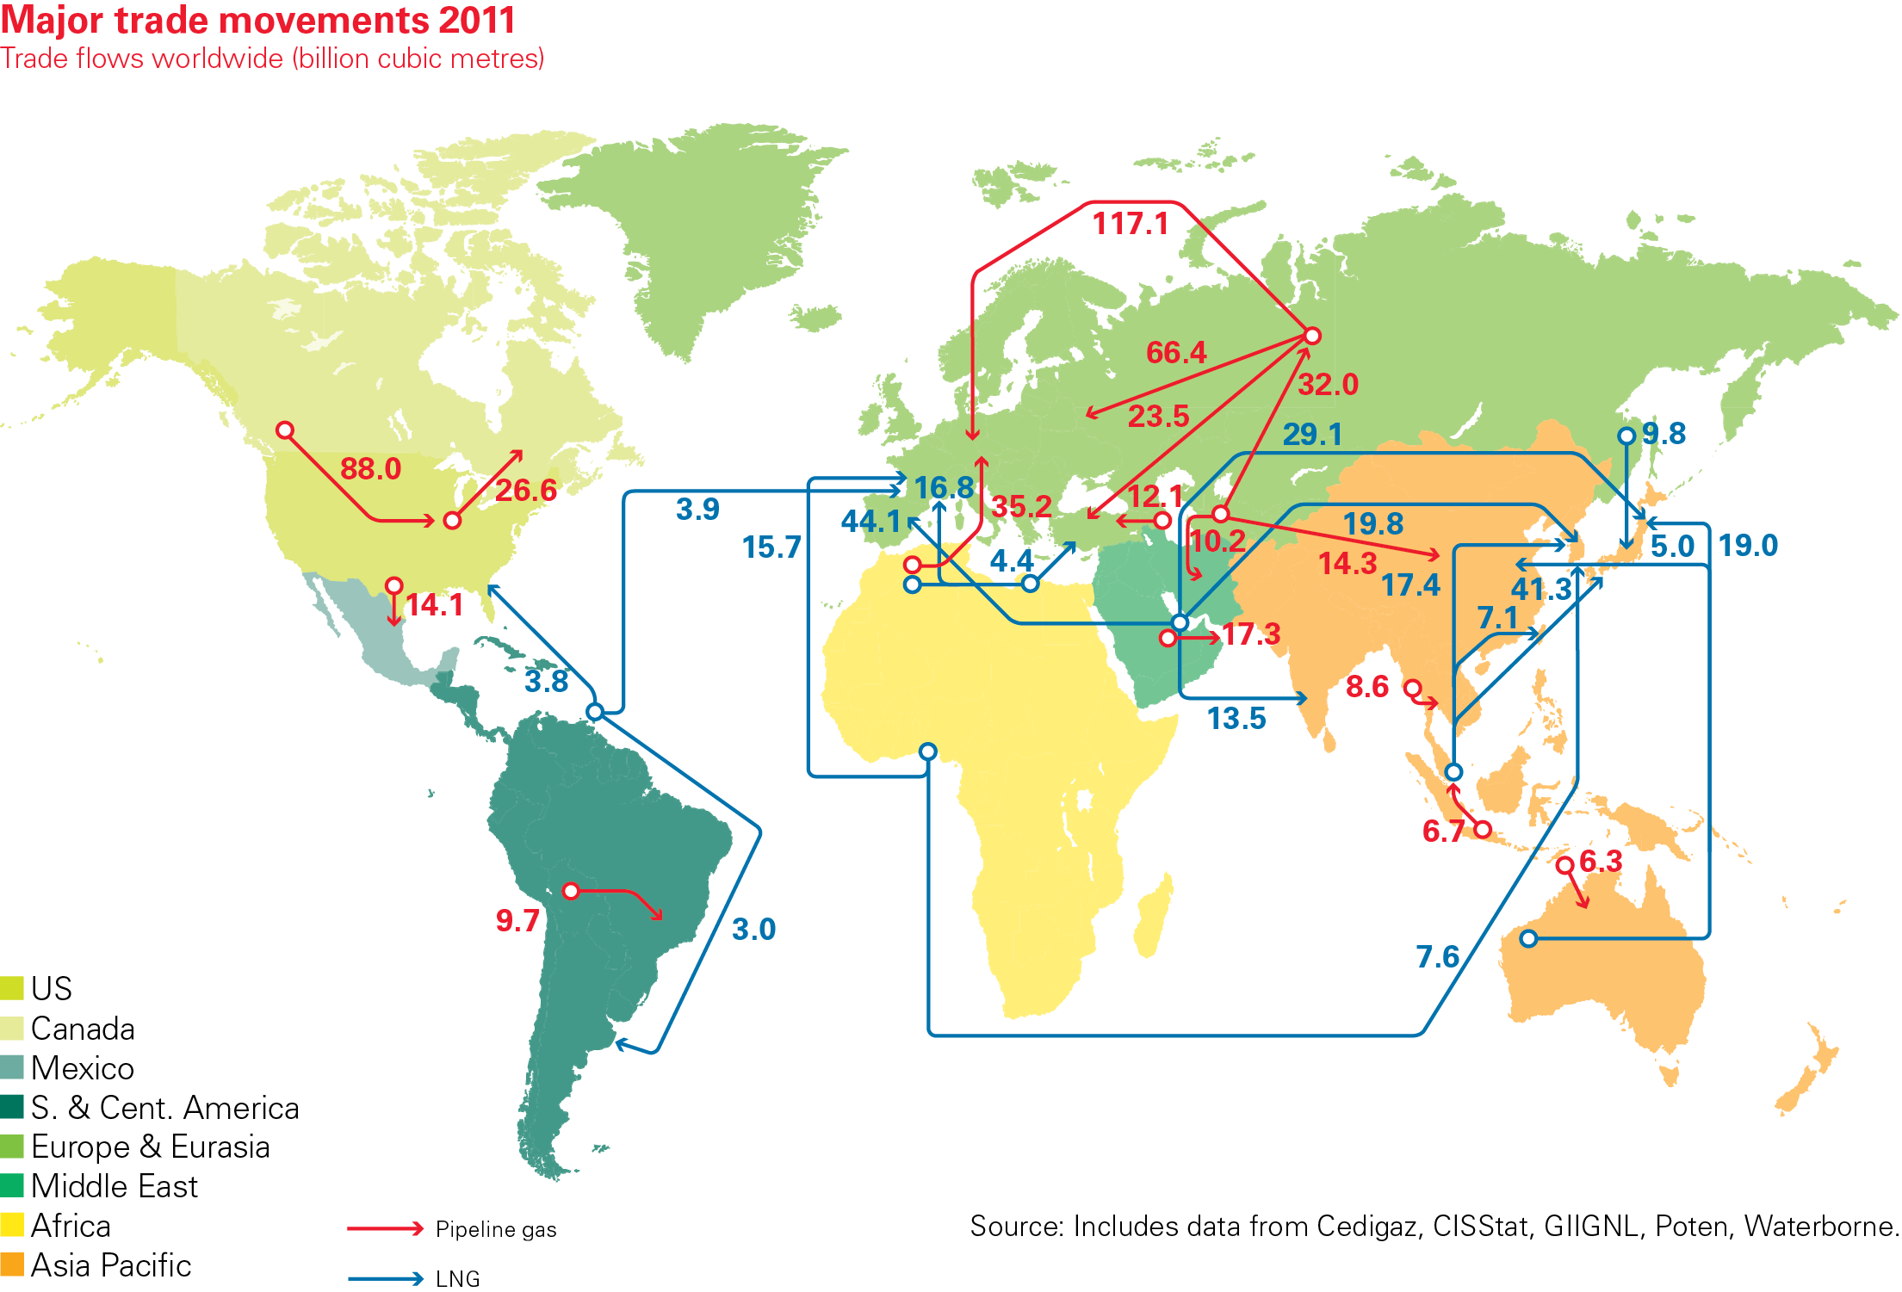
Major gas trade movements

