Slide 1
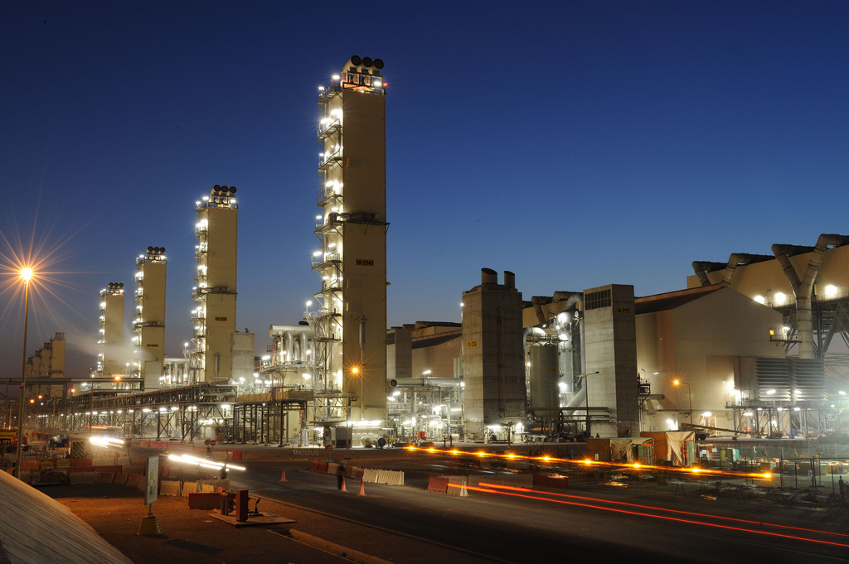
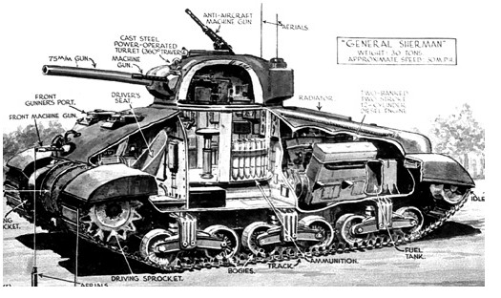
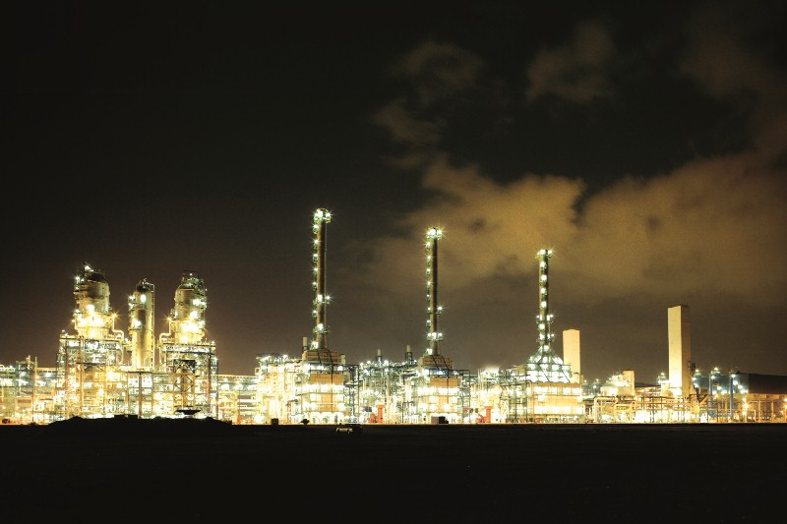

Synthetic Fuels
EG5066 Energy Technologies: current issues & future directions

Slide 2
Synthetic Fuels
Synthetic fuels - liquid fuel obtained from:
Coal
Natural gas
Biomass
Worldwide production capacity July 2009 240,000 bpd (38,000 m³/day)
Direct conversion of coal to synthetic fuel originally developed in Germany
Bergius process patented in 1913 – production began in 1919
Indirect coal conversion (gasified then converted) developed in Germany by Fischer & Tropsch 1923
Number of processes – three broad categories
Indirect
Direct
Biofuel
EG5066 Energy Technologies: current issues & future directions

Slide 3
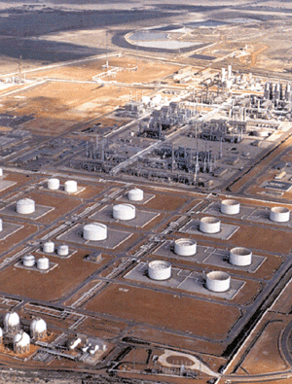
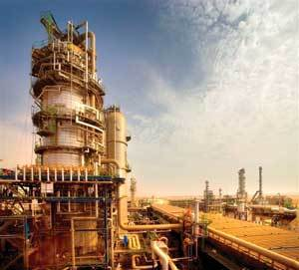
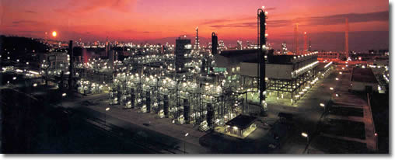
Synthetic Fuels
Commercialisation
Sasol – leading company based in South Africa
Indirect Fischer Tropsch plants:
Mossgas and Secunda CTL (160,000 bpd) in South Africa
Oryx GTL in Qatar – 35,000 bpd
Shell Bintulu in Malaysia GTL – 14,500 bpd
Mobil process plant in New Zealand
Mossgas
Shell Bintulu GTL plant
Oryx GTL
EG5066 Energy Technologies: current issues & future directions

Slide 4
Synthetic Fuels
Indirect conversion
Most widely deployed technology
Worldwide production 260,000 bpd (41,000 m³/d) – 2009 figures
Process in which biomass, coal or natural gas converted into syngas (H₂ + CO) through gasification or steam methane reforming and syngas processed to appropriate transport fuel
Known as:
Coal to Liquids (CTL)
Gas to Liquids (GTL)
Biomass to Liquids (BTL)
Primary technologies:
Fischer-Tropsch synthesis
Mobil process (or Methanol to Gasoline – MTG)
Can also be used to produce hydrogen for fuel cells
EG5066 Energy Technologies: current issues & future directions

Slide 5
Indirect Conversion to Synthetic Fuels
Fischer Tropsch Conversion
Diesel Fuel
Coal
Syngas (H₂ & CO)
Jet Fuel
Gasification
Wax Hydrocracking
Biomass
Syngas Cleanup
Syngas (H₂ & CO)
Steam Methane Reformation
Methanol Synthesis
Gasoline
Natural Gas
Methanol to Gasoline conversion (Mobil Process)
EG5066 Energy Technologies: current issues & future directions

Slide 6
Gas to Liquids
Gas to liquids
A refinery process to convert natural gas or other gaseous hydrocarbons into longer chain hydrocarbons such as gasoline or diesel fuel
Methane-rich gases are converted into liquid fuels either via direct conversions or via syngas as an intermediate
Fischer Tropsch process
Mobil process
EG5066 Energy Technologies: current issues & future directions

Slide 7
GTL Fischer-Tropsch Process
Air
Natural Gas
Partial oxidation of methane to CO₂, CO, H₂, H₂O
CO to H₂ ratio adjusted with Water Gas Shift Reaction
Excess CO₂ removed by aqueous solution of alkanolamine
Water removed
Produces syngas (CO + H₂)
Syngas reacted over iron or cobalt catalyst to give liquid hydrocarbons
Liquid Gas
Air separation
Gas Processing
Oxygen
Methane
Gas Synthesis
CO
H₂
Fischer-Tropsch Process
Liquid Hydrocarbons
Cracking
Diesel
Naphtha
Paraffin
EG5066 Energy Technologies: current issues & future directions

Slide 8
GTL Process
NGL Fractionation
& Impurity Removal
Oxygen
Steam
Heat Recovery
Hydrogen
Natural
Gas
Methane
Syngas
Wax
Liquid
fuels
Natural Gas
Processing
Syngas
Generation
Hydrocarbon
Synthesis
Fuel Upgrading
& Distillation
Treatment to remove impurities
Reforming of natural gas to give syngas
Fischer-Tropsch conversion to produce hydrocarbon waxes
Upgrading to clean diesel fuel
Typical yield – 70% diesel fuel, 25% naptha
10mcf natural gas gives 1 barrel of output
EG5066 Energy Technologies: current issues & future directions

Slide 9
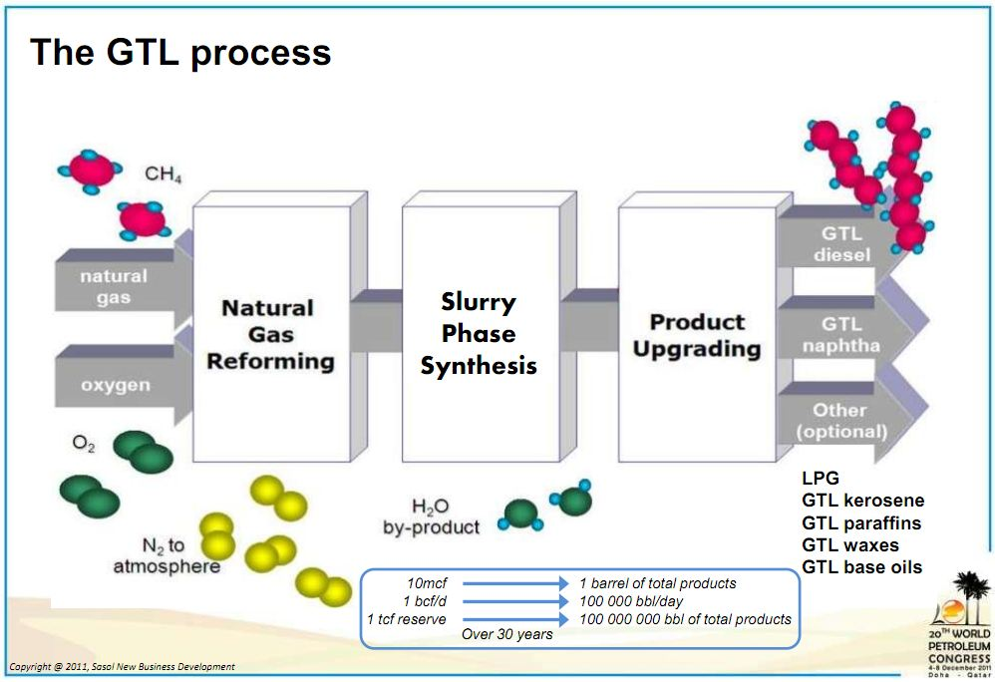
Sasol Slurry Phase Distillate Process^{tm}
Source: www.sasol.com
EG5066 Energy Technologies: current issues & future directions

Slide 10
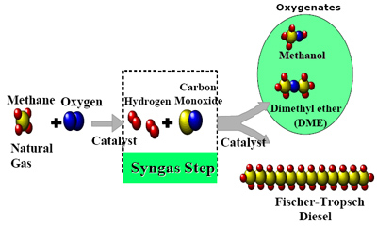
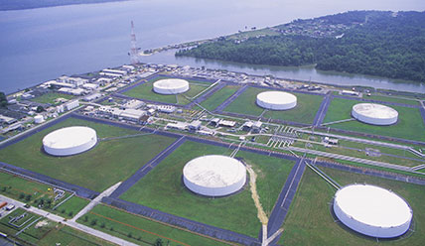
Chevron & Nigerian National Petroleum Corporation
GTL plant at Escravos – start up 2013
325 mcf pd of natural gas converted to 33,000 bpd of low sulphur diesel fuel
EG5066 Energy Technologies: current issues & future directions

Slide 11
Mobil Process
Developed by Mobil in early 1970s
Conversion of natural gas to syngas
Conversion of syngas to methanol
Methanol polymerised into alkanes over a zeolite catalyst to give gasoline
Methanol from methane (natural gas)
Steam reforming: CH₄ + H₂0
CO + 3H₂
Water shift reaction: CO + H₂O
CO₂ + H₂
Synthesis: 2H₂ + CO
CH₃OH
Methanol converted to gasoline by Mobil process
Methanol dehydrated to dimethyl ether
2CH₃OH
CH₃OCH₃ + H₂O
Dehydrated over a zeolite catalyst to give gasoline
EG5066 Energy Technologies: current issues & future directions

Slide 12
Synthetic Fuels
Direct conversion
Two processes:
Pyrolysis & Carbonisation
Hydrogenation
Pyrolysis & Carbonisation Processes
Carbonisation through pyrolysis or destructive distillation
Gives ; condensable coal tar, oil and water vapour, non-condensable synthetic gas and char
Condensable coal tar and oil processed by hydrogenation to remove sulphur and nitrogen
Processed to fuels
EG5066 Energy Technologies: current issues & future directions

Slide 13
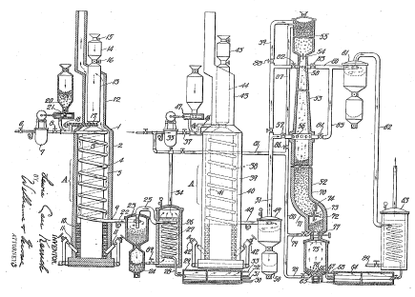
Synthetic Fuels
Karrick Process
Invented by Lewis Karrick in late 1920s
Retort based on Nevada-Texas-Utah retort used for shale oil extraction
Coal heated with superheated steam in absence of air to 360º – 750ºC.
Coal mainly used but can use oil shale or lignite
Optimizes production of lighter hydrocarbons
Generates no CO₂
Unlikely to yield economically viable volumes of liquid fuel
1 tonne coal yields:
0.175 m3 oils
95m3 gas
750kg semi-coke
EG5066 Energy Technologies: current issues & future directions

Slide 14
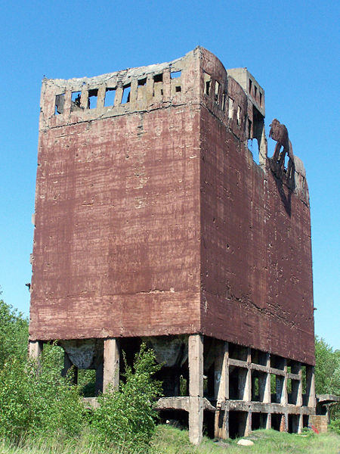
Coal to Liquids
Hydrogenation processes
Bergius process
Developed by Friedrich Bergius in 1913 – Nobel Prize for Chemistry 1931
Synthetic fuel by hydrogenation of high volatile bituminous coal
Developed before the Fischer-Tropsch method
One of main methods for Coal-to-Liquids
Coal liquefied by mixing it with hydrogen gas and heating
Dry high-volatile bituminous coal is mixed with heavy oil recycled from the process with a catalyst (tungsten or molybdenum)
Reaction at 400ºC to 500ºC and 20-70MPa hydrogen pressure
97% conversion rate
Used in Germany WWII, now 4000 tpd plant in China
Basis for a number of different developments
nC + (n + 1)H₂
CnH_{2n+2}
EG5066 Energy Technologies: current issues & future directions

Slide 15
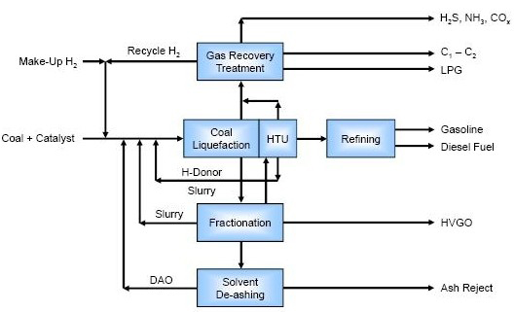
Coal to Liquids
Hydrogenation processes
Number of different developments:
Nedol Process
Developed 1970 – 1980 by group of Japanese companies
Coal mixed with solvent and iron-based catalyst
Reactor operates at 430 – 465ºC, 15 – 200 bar
Produces low quality oil
Needs upgrading
Other process include:
Gulf Oil’s Solvent refined coal
Exxon Donor solvent process
Imhausen High Pressure Process
Conoco Zinc Chloride Process
Chevron Coal Liquefaction Process
EG5066 Energy Technologies: current issues & future directions

Slide 16
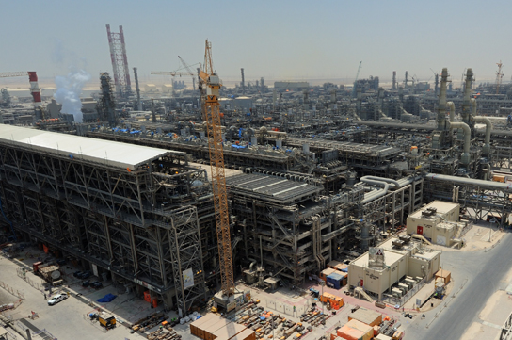
Gas to Liquids
GTL Jet Fuel
Shell developed and produced 50-50 blend of synthetic GTL kerosene and conventional oil-based kerosene fuel
Gives lower SO₂ and particulates emissions than conventional oil-based kerosene
Shell’s Pearl GTL plant in Qatar
1.6 bcf pd of gas from the North Field converted to 140 kbo/d liquid fuels
Uses Shell Middle Distillate Synthesis (SMDS)
EG5066 Energy Technologies: current issues & future directions

Slide 17
Aviation Biofuels
Flightpaths for Aviation Biofuels
USDA – Farm to Fly programme
One million gallons of biofuel per year by 2018
EU programme
2 million tonnes of aviation biofuels by 2020:
Mainly based on Neste hydrogenated vegetable oil technology
Potential 400,000 t/a F-T SPK by 2020
Potential 100,000 t/a HPO
Potential 160,000 t/a from algal oil
Gives 1% replacement of global aviation kerosene by 2020
HRJ/HEFA – Hydroprocessed esters & fatty acids
FT-SPK – Fischer Tropsch synthetic paraffinic kerosene
ATJ – Alcohol to Jet
PTJ/HPO – Pyrolysis oil to jet/Hydrogenated pyrolysis oil
FRJ – Fermented renewable jet
EG5066 Energy Technologies: current issues & future directions

Slide 18
Routes to SPK
F-T process*
Synthesis gas
Olefins, naphtha, long chain paraffins
CO + 2H₂
Ligno-
Cellulose
Gasification
Fischer-Tropsch synthesis
Hydrocracking & separation
Jet fuel
O₂
Cleaning & Conditioning
HRJ*
Long chain paraffins
Bio-derived oil
Hydrotreating
Hydrocracking & separation
Jet fuel
*ASTM Approved as 50:50 mix with Jet-A
EG5066 Energy Technologies: current issues & future directions

Slide 19
Aviation Biofuels
Alcohol to Jet
Utilises Oligomerization – process of “building C chains”
Ethanol Dehydration
Oligomerization
Distillation
Hydrogenation
Alcohol
Jet Fuel
EG5066 Energy Technologies: current issues & future directions

Slide 20

Aviation Biofuels
Emerging Processes – Alcohol to Jet (ATJ)
Cobalt Technology with Albemarle Corp & NAWCWD
Bio n-Butanol to JP-8
Tested 50:50 in A-10 Thunderbolt II Engine
Woody biomass
Oligomerization
Fermentation
Distillation
N-butanol
Hydrogenation
1-butene
Jet Fuel
EG5066 Energy Technologies: current issues & future directions

Slide 21
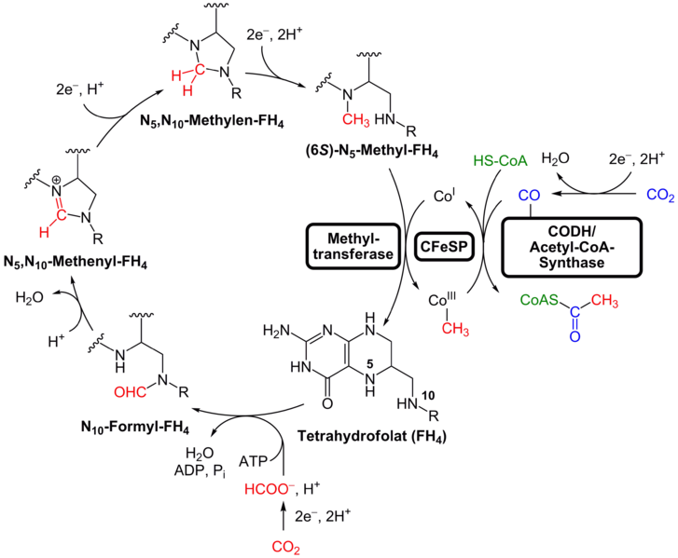
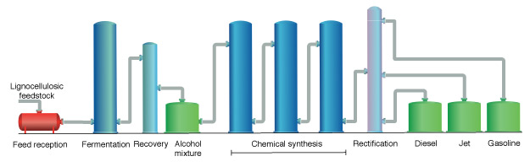

Aviation Biofuels
Emerging Processes – Alcohol to Jet (ATJ)
Thermo-biological processes
Wood Ljungdahl Pathway
LanzaTech with Swedish Biofuels
Lanza Tech
CO from SynGas (CO & H2) or offgas from steel works
Fermentation (Clostridia sp) to alcohols (ethanol, butanol, propanol)
Source: Yikrazuul, 2010
Reductive acetyl-CoA pathway
Swedish Biofuels technology
Alcohols to Jet Fuel
Methanogens or acetogenic organisms
H₂ as electron donor (Energy Source)
CO₂ as electron acceptor (Carbon Source)
CO₂ reduced to CO
CO converted to acetyl coenzyme A
C2-C5 sugars
C4-C20 Hydrocarbons
Source: Swedish Biofuels AB
EG5066 Energy Technologies: current issues & future directions

Slide 22
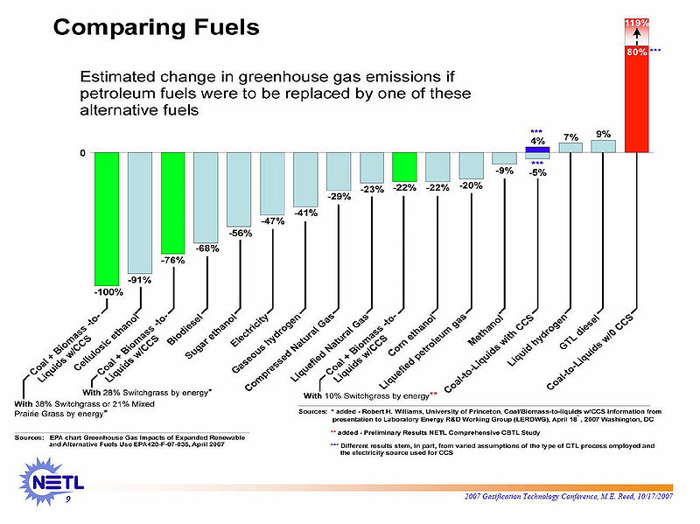
Life cycle analysis of different fuels

Slide 23
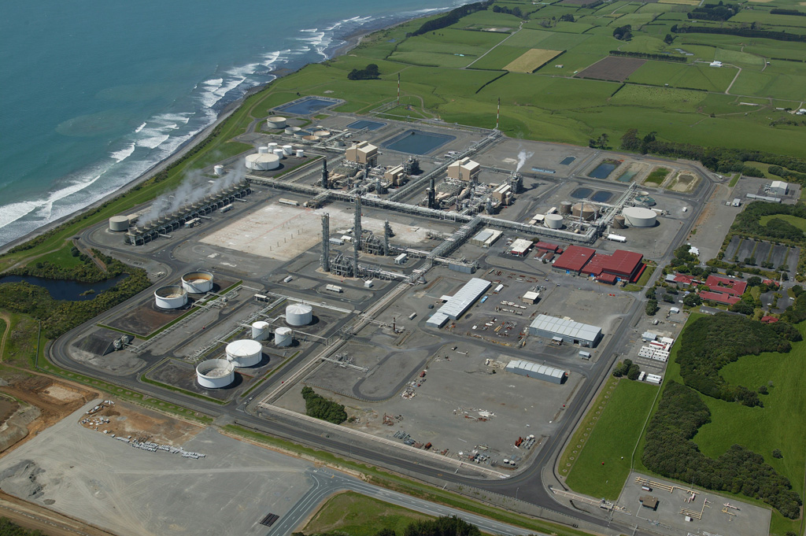
Synthetic Fuels
Methanex, New Zealand. A Mobil process plant producing 5,200 t methanol a day
EG5066 Energy Technologies: current issues & future directions

