Slide 1
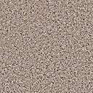
P + Δx
P
Porous Media
(K)
Q
Δx

