Slide 1
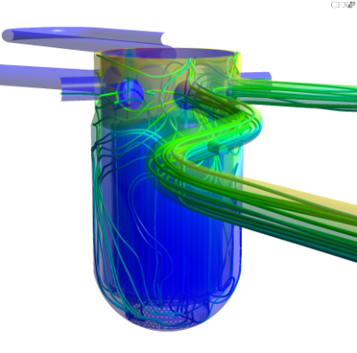
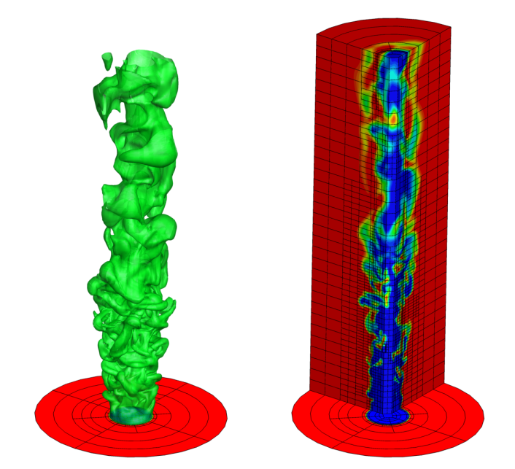
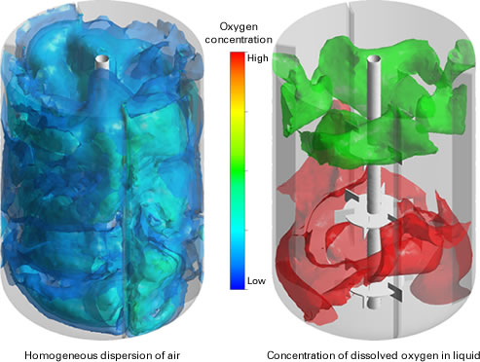
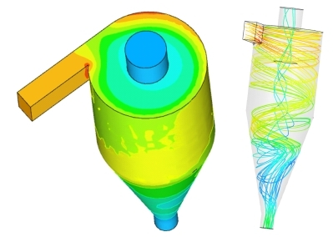
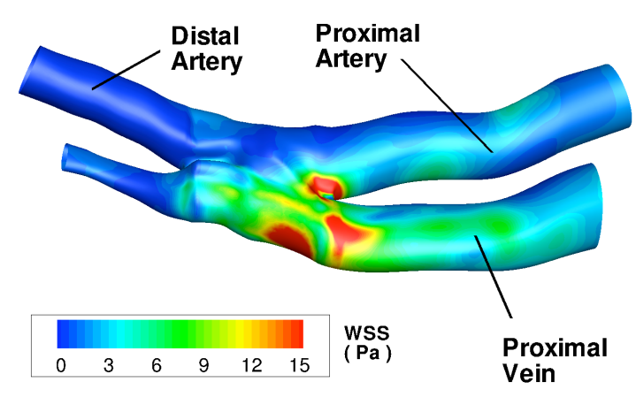
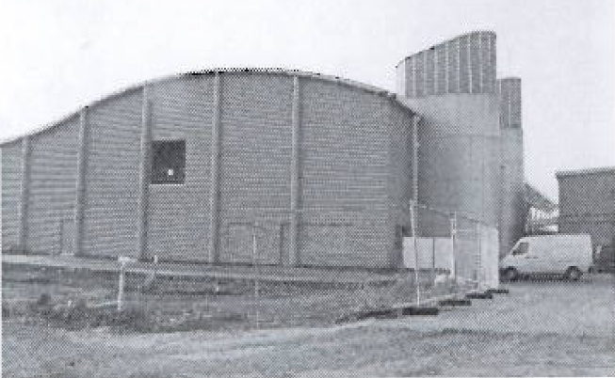
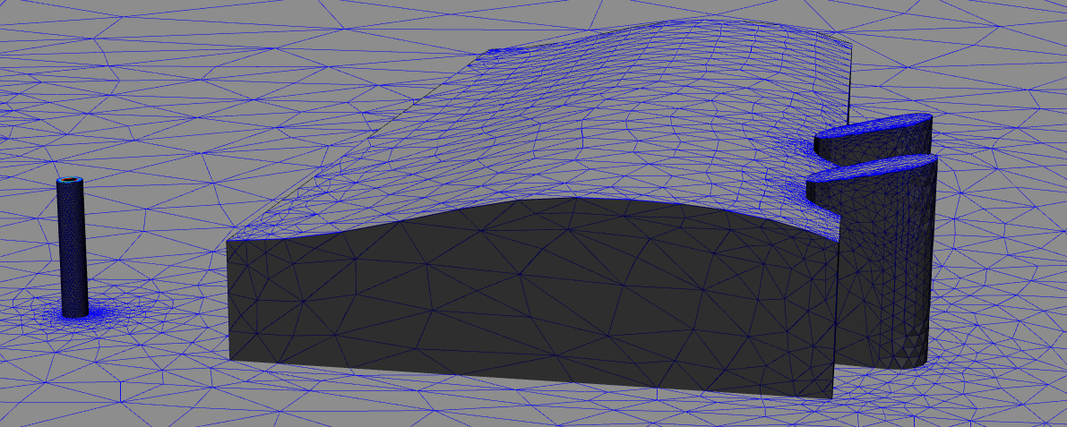
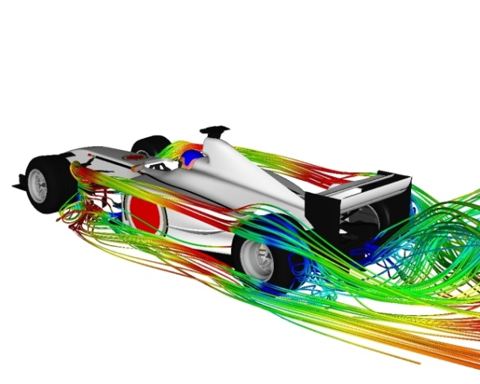
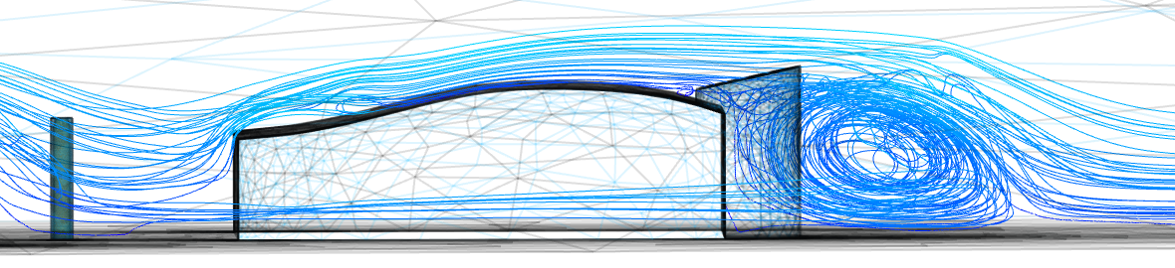
Mixing nuclear test facility ROCOM (HZDR)
Simulation of laminar/turbulent flames
http://arrow.utias.utoronto.ca/~groth/Research.html
Mixing vessels http://www.jgc.co.jp/en/04tech/08lfsnc/cfd.html
Study of arteries (blood http://depts.washington.edu/fluidlab/circulation.shtml)
Cyclone (Chembridge Technologies Ltd)
Virtual wind-tunnel for F1 car design
http://www.symscape.com/blog/new-f1-team-uses-cfd-only
Study of pollutant release in industrial siteshttp://www3.imperial.ac.uk/earthscienceandengineering/research/amcg/software

