Slide 1
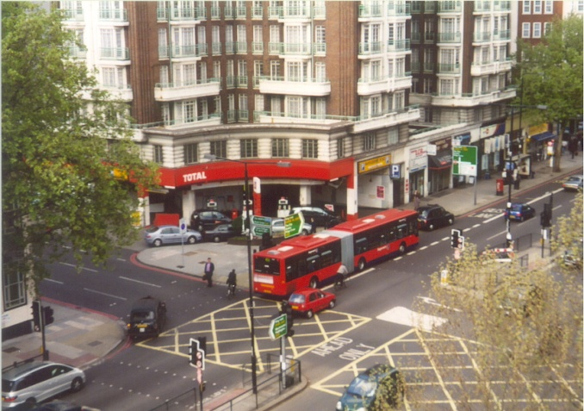
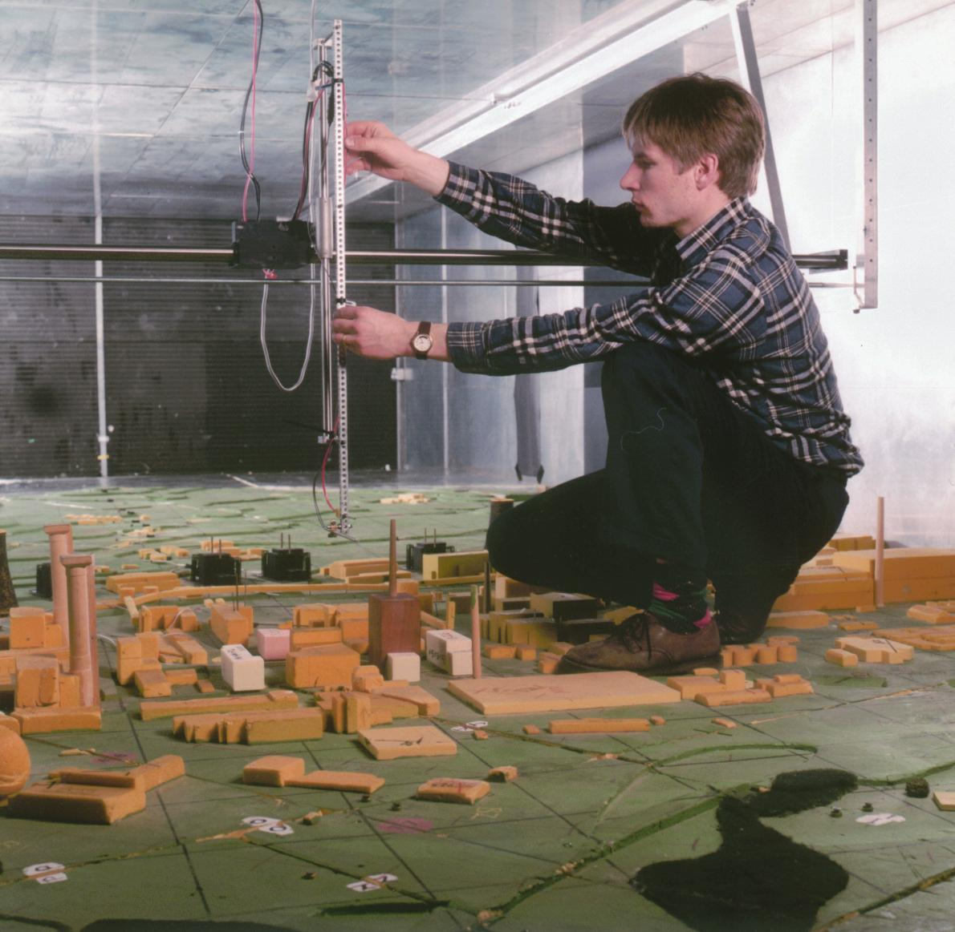
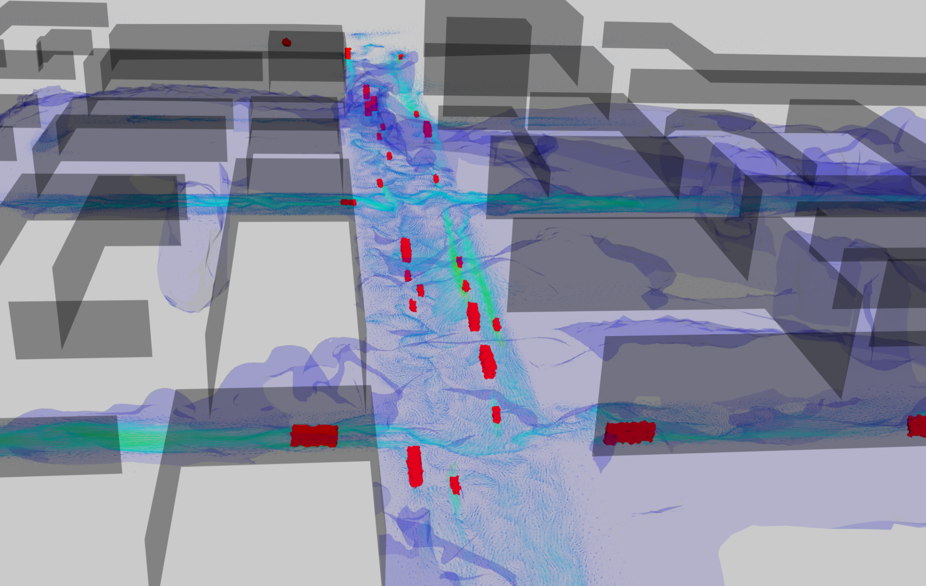
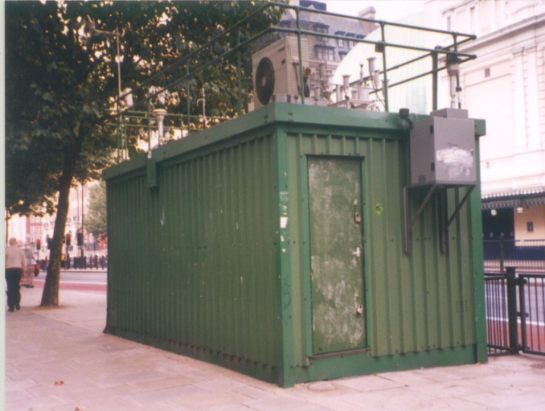
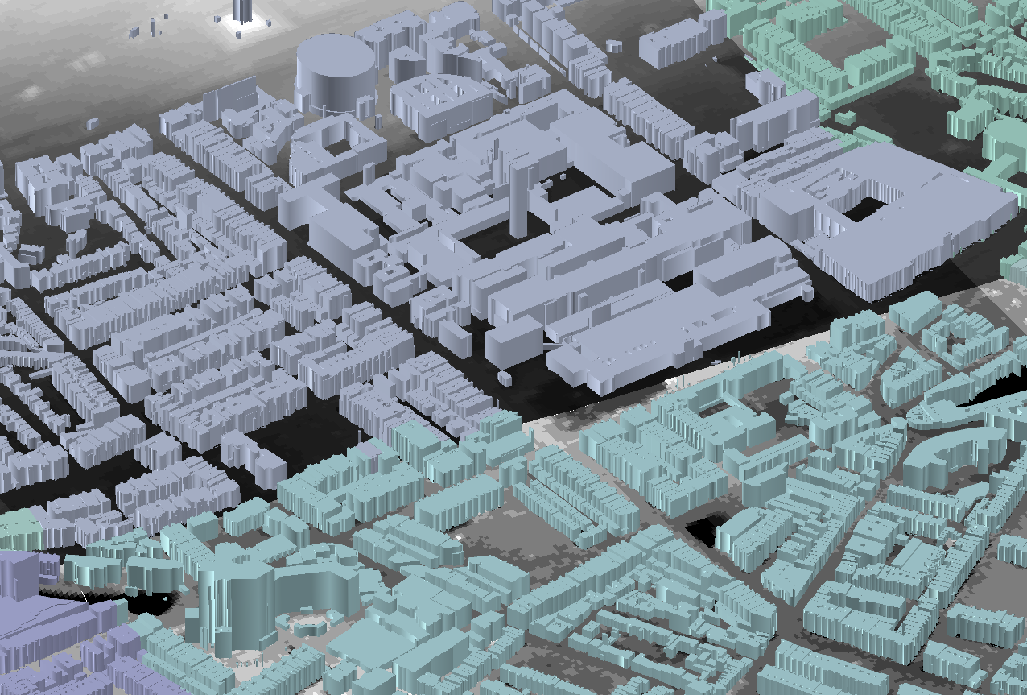
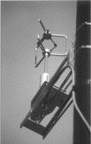
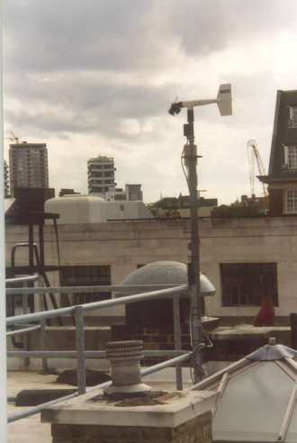
Collecting Field Data in Central London (Marylebone Rd intersection)
Setting up meteorological wind tunnel in Univ. Surrey for flow measurements of the same intersection
Numerical simulation of pollution dispersion in Central London. Coupled CFD and traffic model – Comparison between simulations, experiments (wind tunnel) and field observation)
Virtual-City: simulations will help ensure sustainability
Dapple Consortium: http://ercoftac.mech.surrey.ac.uk/news.html

