Slide 1
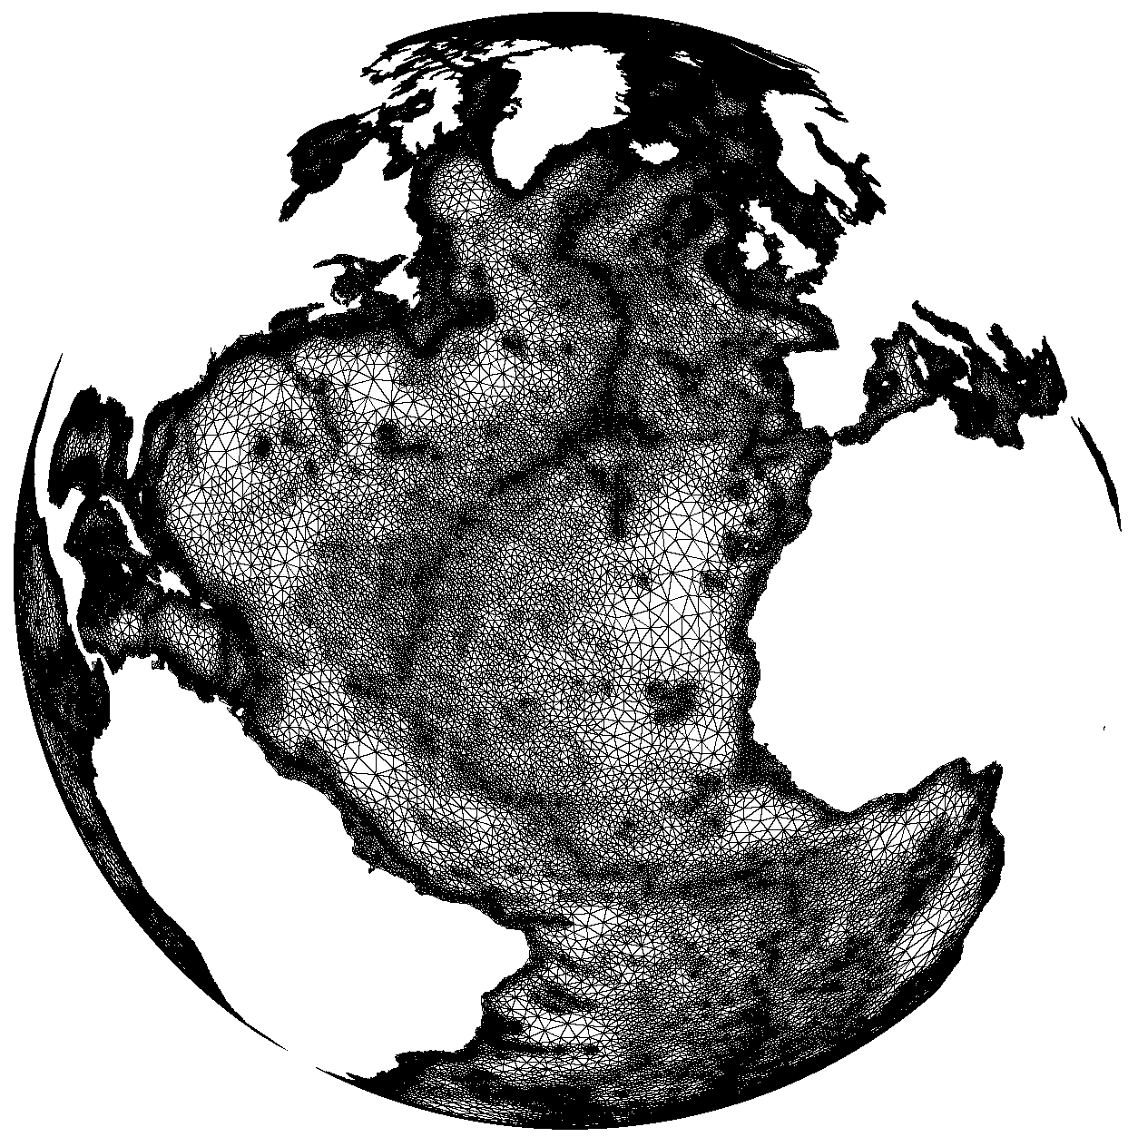
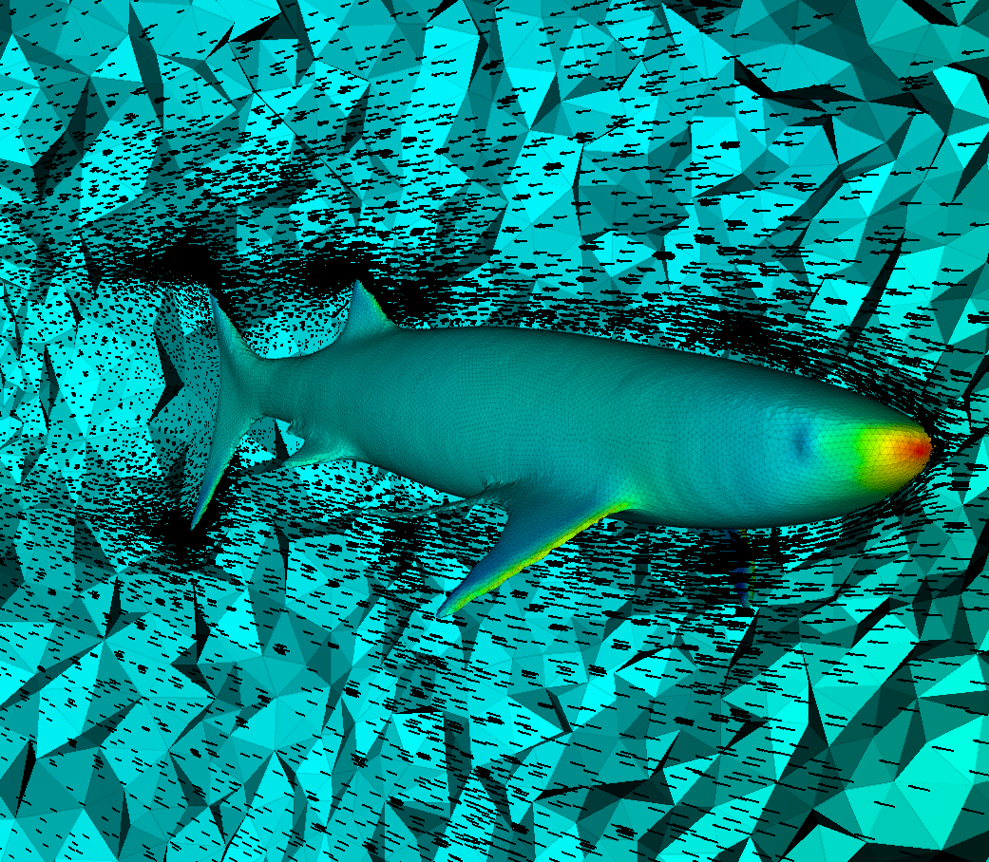
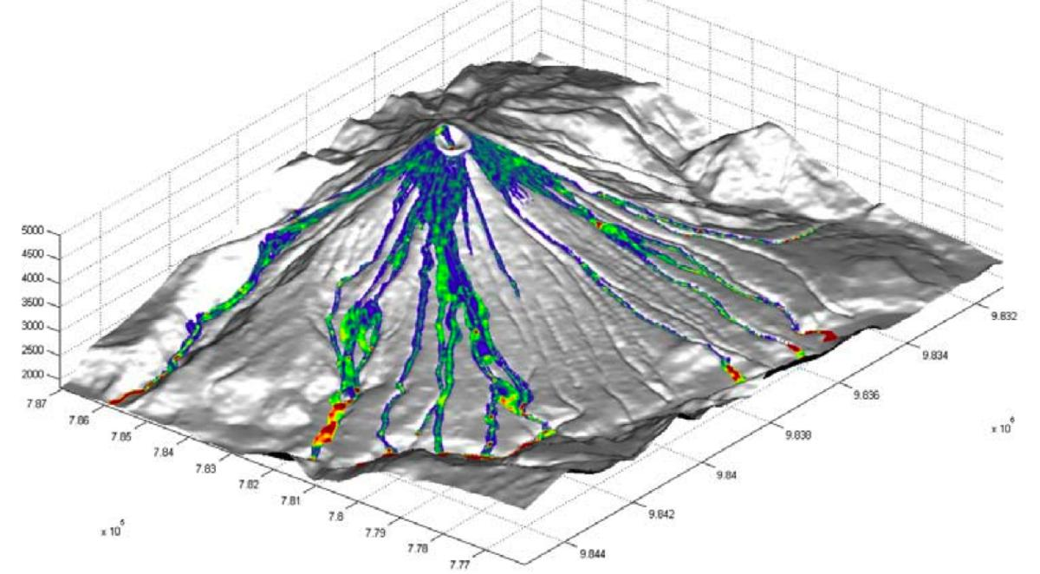
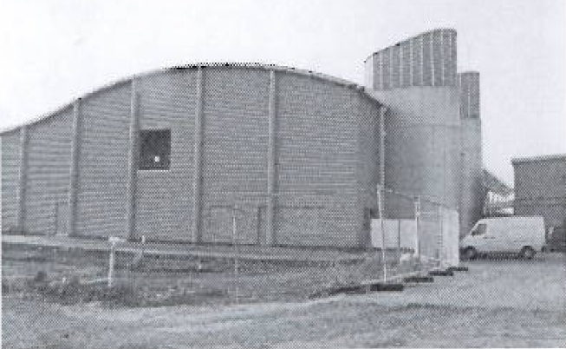
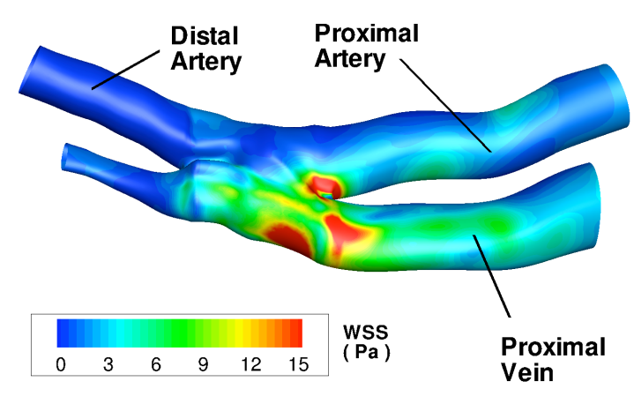
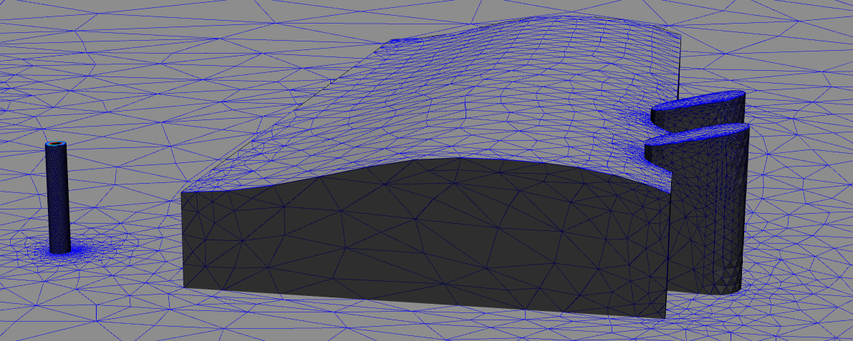
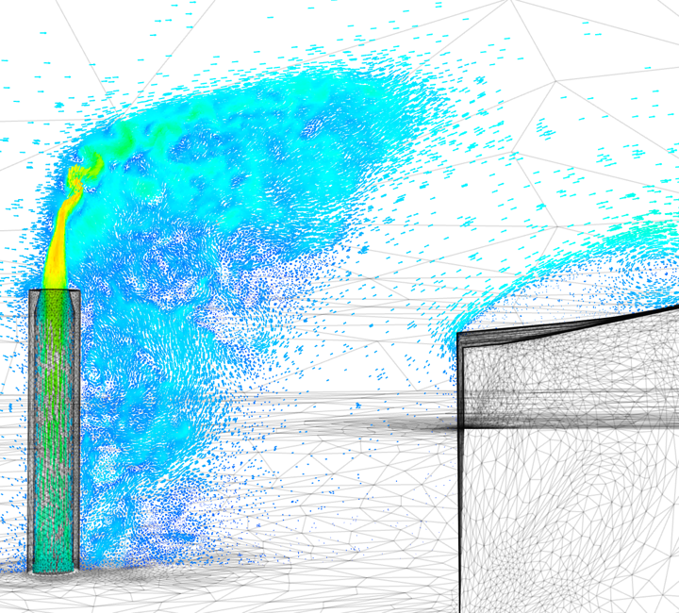
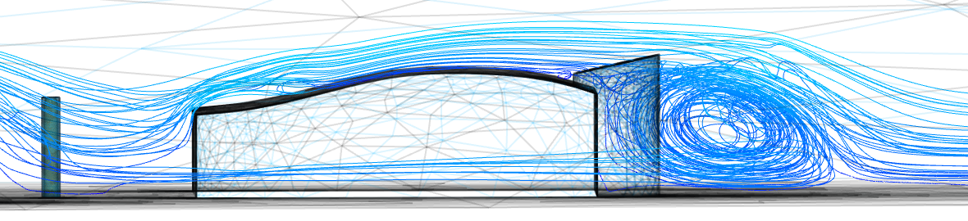
Pyroclastic flows (volcano eruption, http://www.disasterscharter.org/web/charter/home)
Study of shark evolution - Palaeo-hydrodynamics - http://www3.imperial.ac.uk/earthscienceandengineering/research/amcg/software)
Ocean recirculation (top: Mediterranean sea, http://www3.imperial.ac.uk/earthscienceandengineering/research/amcg/software)
Study of pollutant release in industrial sites (http://www3.imperial.ac.uk/earthscienceandengineering/research/amcg/software)
Study of arteries (blood http://depts.washington.edu/fluidlab/circulation.shtml)

