Slide 1
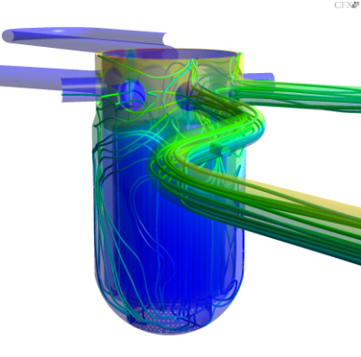
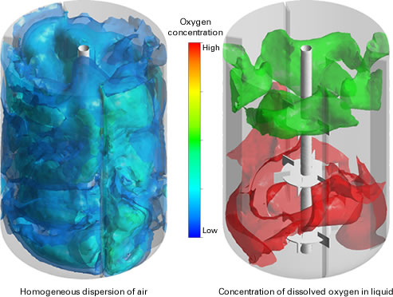
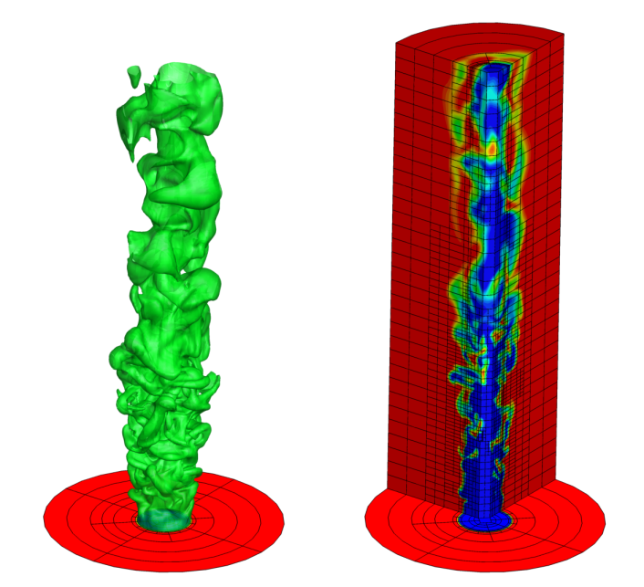
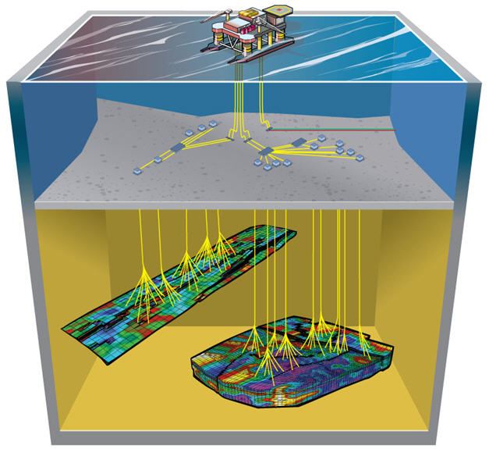
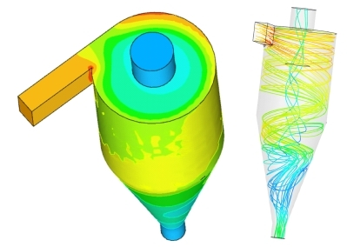
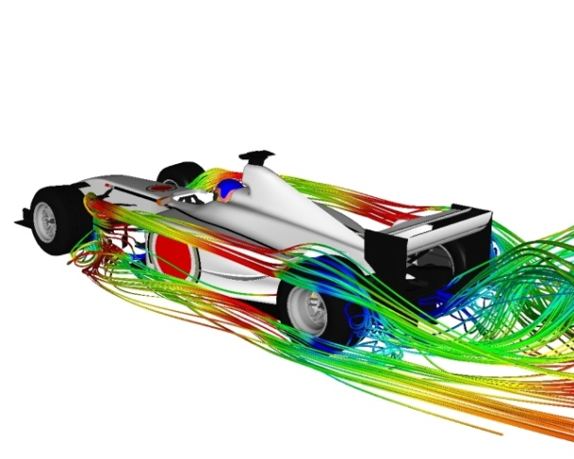
Mixing vessels (http://www.jgc.co.jp/en/04tech/08lfsnc/cfd.html)
Mixing nuclear test facility ROCOM (HZDR)
Simulation of laminar/turbulent flames
(http://arrow.utias.utoronto.ca/~groth/Research.html)
Virtual wind-tunnel for F1 car design
http://www.symscape.com/blog/new-f1-team-uses-cfd-only
Reservoir simulation
(http://epts-eg.com/studies.php)
Cyclone (Chembridge Technologies Ltd)

