Slide 1
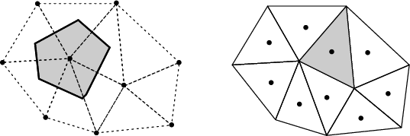
Δx
w
e
W
P
E
δx_{w}
δx_{e}

