Slide 1
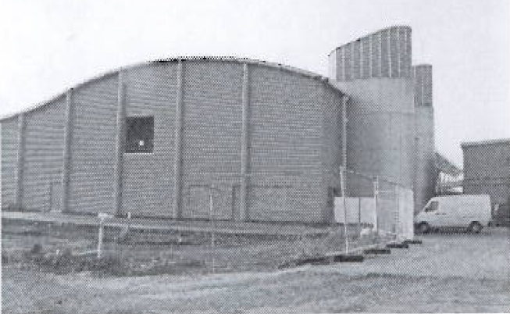
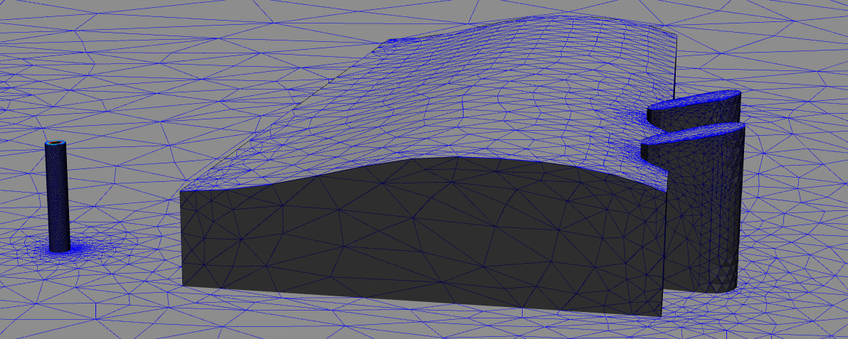
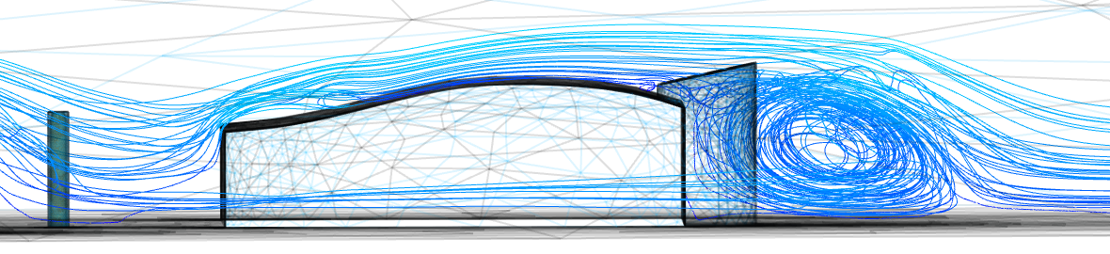
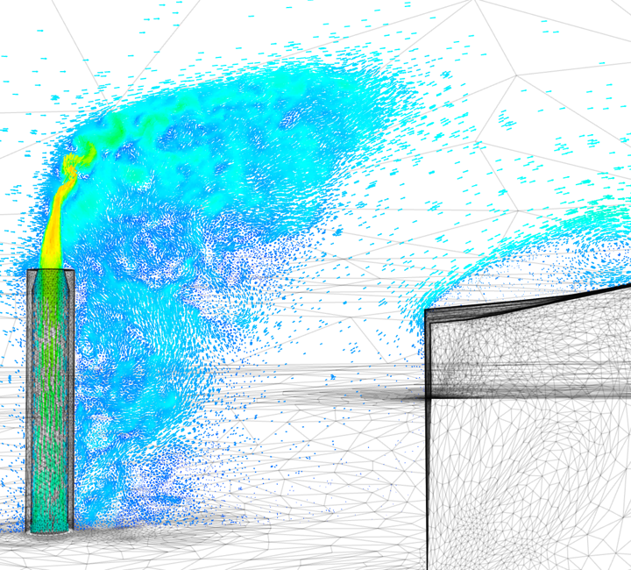
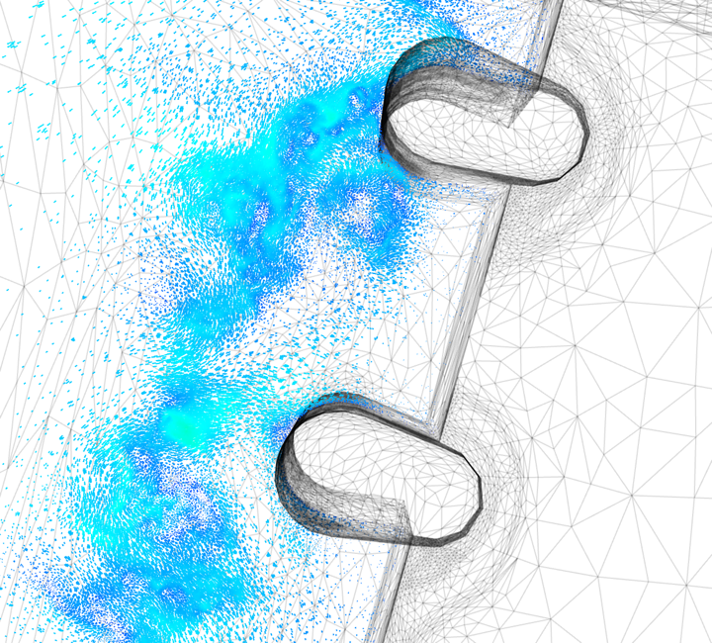
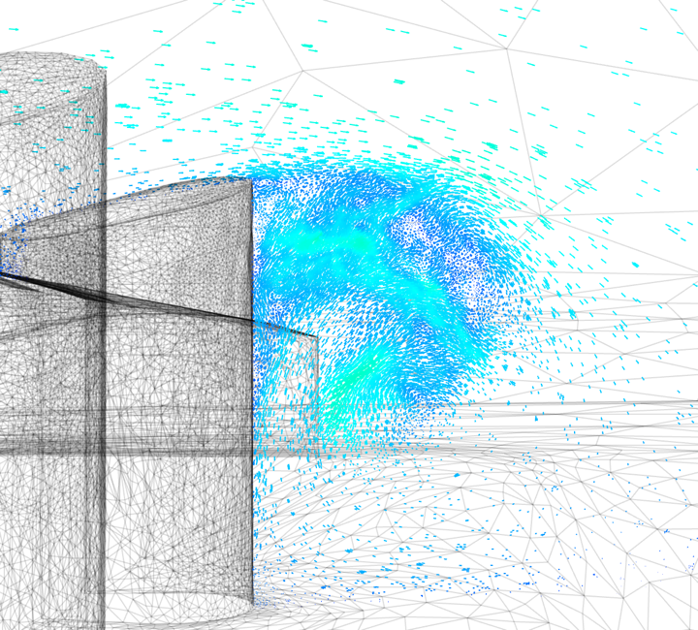
Physical problem →Mathematical Modelling
Navier-Stokes equations with boundary and initial conditions
(turbulence problem)
Discretised problem → Geometry and Equations
Parameterisation and/or closure models (e.g., turbulence)
Solving equations
Analyzing the solution (critical thinking)
Courtesy: Applied Modelling and Computation Group (Imperial College London)

