Slide 1
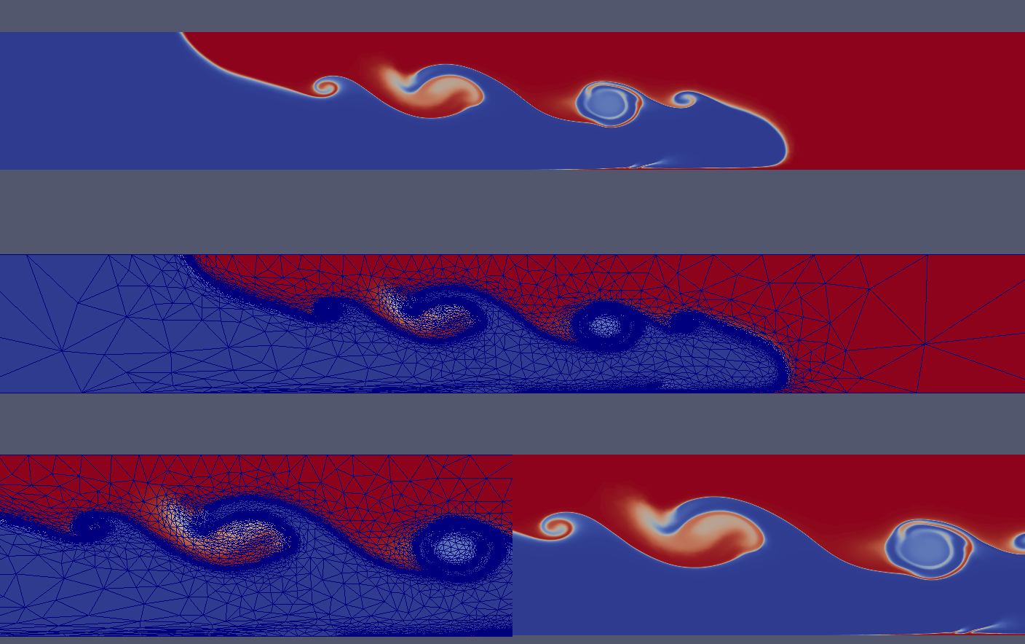
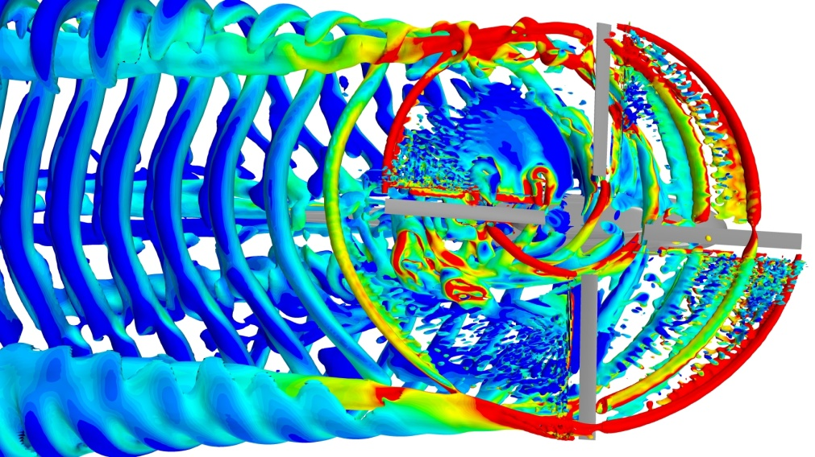
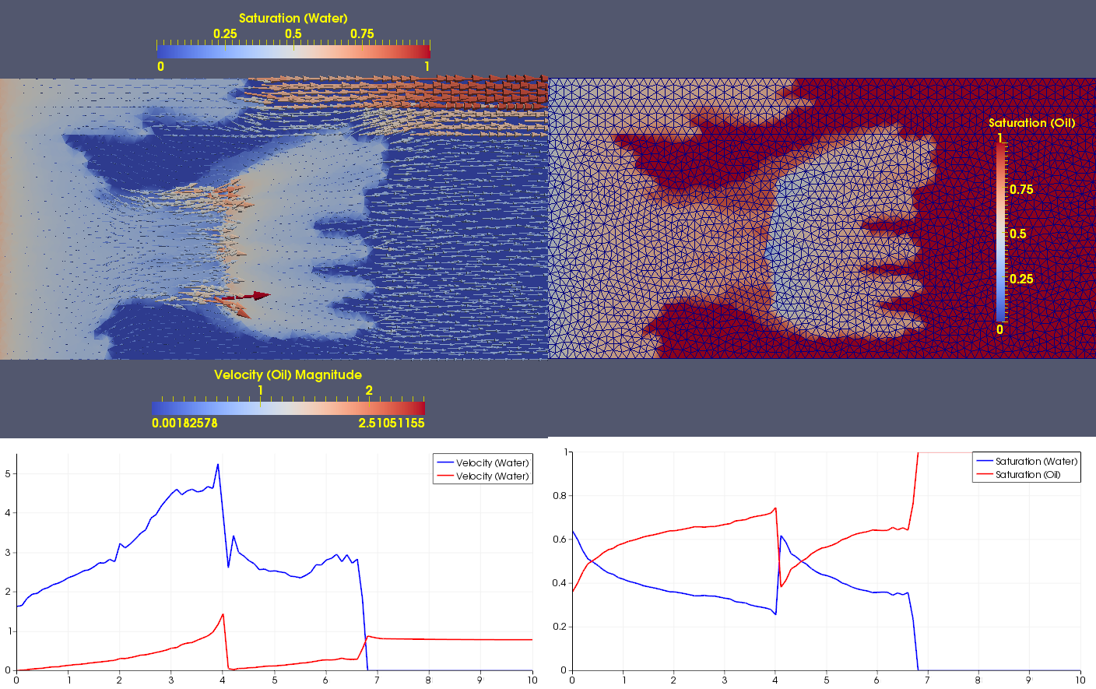
Lock exchange problem: mixing of 2 fluids of different densities (Navier-Stokes + thermal advection-diffusion equations under Boussinesq approximation). The simulation was performed using unstructured triangular mesh.
Isosurfaces in a mixing tank. (http://www.cd-adapco.com/products/star-ccm%C2%AE)
Reservoir simulation: oil displacement by water inflow in heterogeneous geological formation (Darcy + global saturation conservation equation). The simulation was performed using unstructured triangular mesh.

